Slide 1




Privacy-Preserving Federated Active Learning for Data Completion in Sparse Crowdsensing
Zhifei Wang, Wenbin Liu, En Wang, and Jie Wu
College of Computer Science and Technology, Jilin University
China Telecom Cloud Computing Research Institute
Department of Computer and Information Sciences, Temple University
Notes:
Good morning everyone.
I am honored to present this work on behalf of the authors.
The title of this paper is Privacy-Preserving Federated Active Learning for Data Completion in Sparse Crowdsensing.
This work was conducted by Zhifei Wang, Wenbin Liu, En Wang, and Jie Wu from Jilin University and Temple University.
Today, I will briefly introduce the motivation, framework, method, experimental results, and conclusion of this work.

Slide 2
Outline
Background and Motivation
Problem and Framework
Method
Performance Evaluation
Conclusion
May 2026
Notes:
This presentation has five parts: background and motivation, problem and framework, method, performance evaluation, and conclusion.

Slide 3
Outline
Background and Motivation
Problem and Framework
Method
Performance Evaluation
Conclusion
May 2026
Notes:
Let me start with the background and motivation.
This part explains why sparse crowdsensing is important, why centralized data completion may cause privacy risks, and why more efficient sampling is needed under limited sensing budgets.

Slide 4
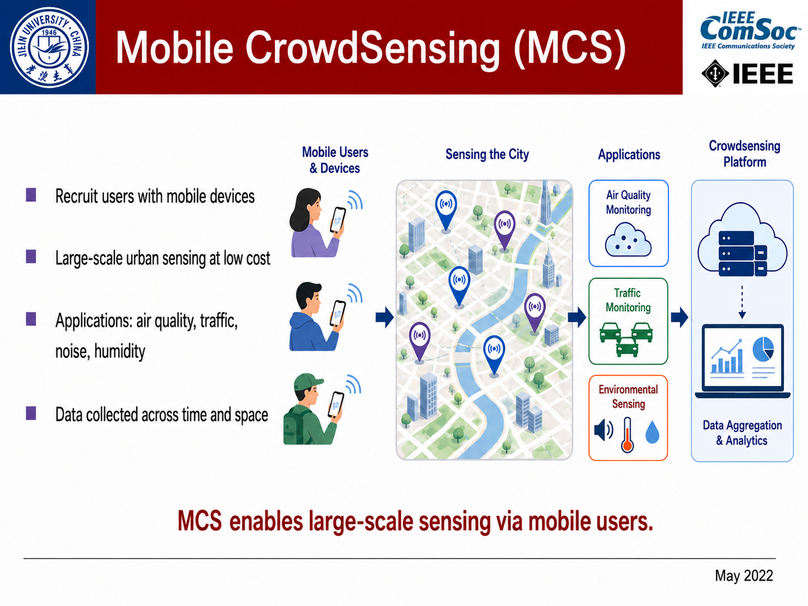
Mobile CrowdSensing (MCS)
Recruit users with mobile devices
Large-scale urban sensing at low cost
Applications: air quality, traffic, noise, humidity
Data collected across time and space
MCS enables large-scale sensing via mobile users.
May 2026
Notes:
Mobile CrowdSensing, or MCS, is a large-scale sensing paradigm.
It recruits users with mobile devices, vehicles, or other sensors to collect urban data.
Typical applications include air-quality sensing, traffic monitoring, and crowdsourced parking.
The advantage of MCS is that it can achieve large-scale data collection with relatively low deployment cost.

Slide 5
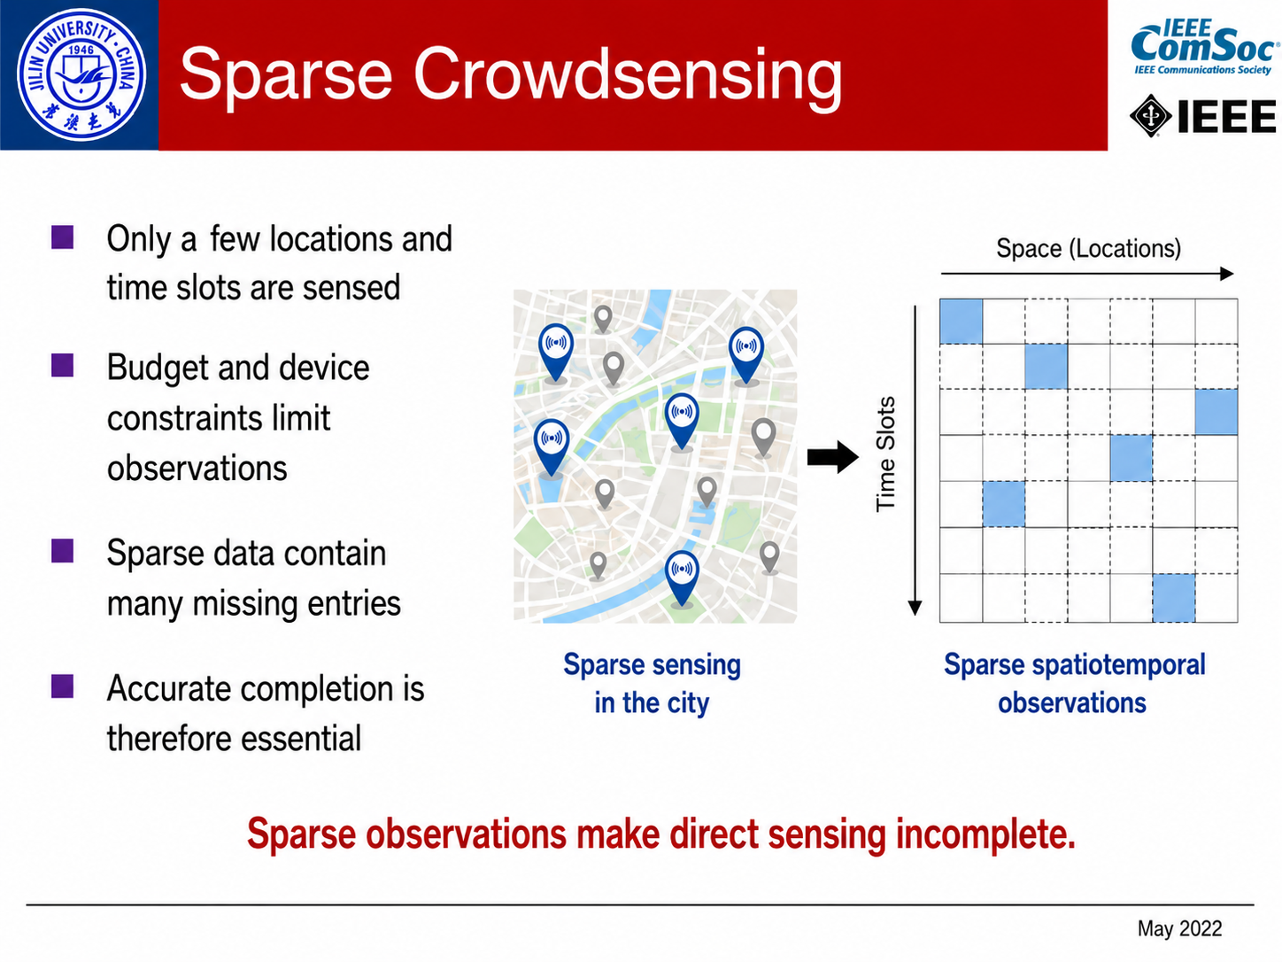
Sparse Crowdsensing
Only a few locations and time slots are sensed
Budget and device constraints limit observations
Sparse data contain many missing entries
Accurate completion is therefore essential
Sparse sensing in the city
Sparse spatiotemporal observations
Sparse observations make direct sensing incomplete.
May 2026
Notes:
However, in real-world crowdsensing systems, the collected data are often sparse.
We cannot observe every location at every time because of limited sensing budgets, limited users, device constraints, or communication costs.
Therefore, sparse crowdsensing usually observes only part of the data and then infers the missing values.
So data completion becomes a core problem.

Slide 6
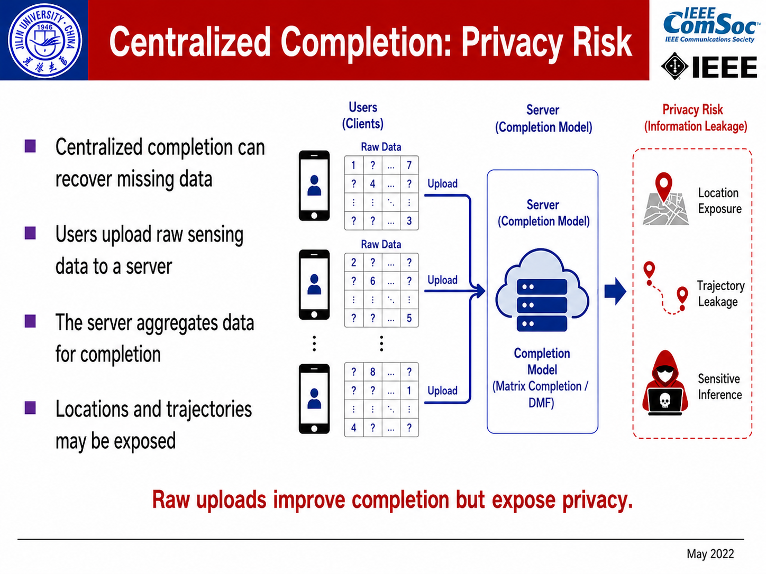
Centralized Completion: Privacy Risk
Centralized completion can recover missing data
Users upload raw sensing data to a server
The server aggregates data for completion
Locations and trajectories may be exposed
Raw uploads improve completion but expose privacy.
May 2026
Notes:
A straightforward solution is centralized data completion.
In this setting, clients upload raw sensing data to a central server, and the server performs matrix completion or deep matrix factorization.
However, raw sensing data may contain sensitive information, such as locations and mobility traces.
Centralized storage increases the risk of privacy leakage.
Therefore, we need a privacy-preserving completion method without raw data aggregation.

Slide 7
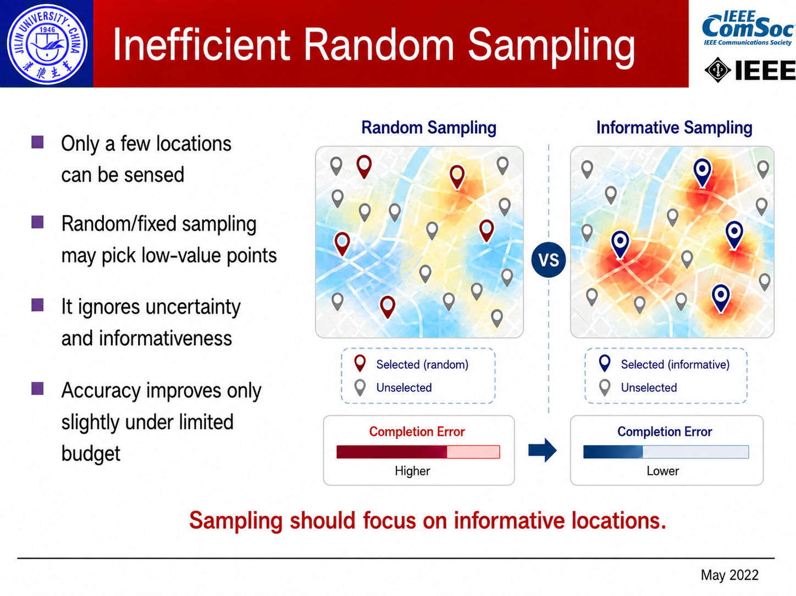
Inefficient Random Sampling
Only a few locations can be sensed
Random/fixed sampling may pick low-value points
It ignores uncertainty and informativeness
Accuracy improves only slightly under limited budget
Sampling should focus on imformative locations.
May 2026
Notes:
Another issue is sampling efficiency.
Under limited budgets, not every sample contributes equally to completion accuracy.
Random or fixed sampling may select redundant points and ignore model uncertainty.
As a result, some collected data may bring only limited improvement.
This motivates us to actively select more informative samples.

Slide 8
Challenge
Privacy-preserving completion
  How to train completion models without uploading raw sensing data?
Local sparse modeling
  How to capture useful spatiotemporal dependencies from client-local sparse data?
Budget-efficient sampling
  How to select high-value observations under a limited sensing budget?
May 2026
Notes:
Based on the above motivation, this work focuses on three challenges.
First, how to train completion models without uploading raw sensing data.
Second, how to model spatiotemporal dependencies from sparse local data.
Third, how to select high-value observations under a limited sensing budget.
The proposed framework is designed to address these three challenges.

Slide 9
Outline
Background and Motivation
Problem and Framework
Method
Performance Evaluation
Conclusion
May 2026
Notes:
Next, I will introduce the problem formulation and the overall framework.
This part shows how federated learning, differential privacy, and active learning are integrated for sparse crowdsensing data completion.

Slide 10
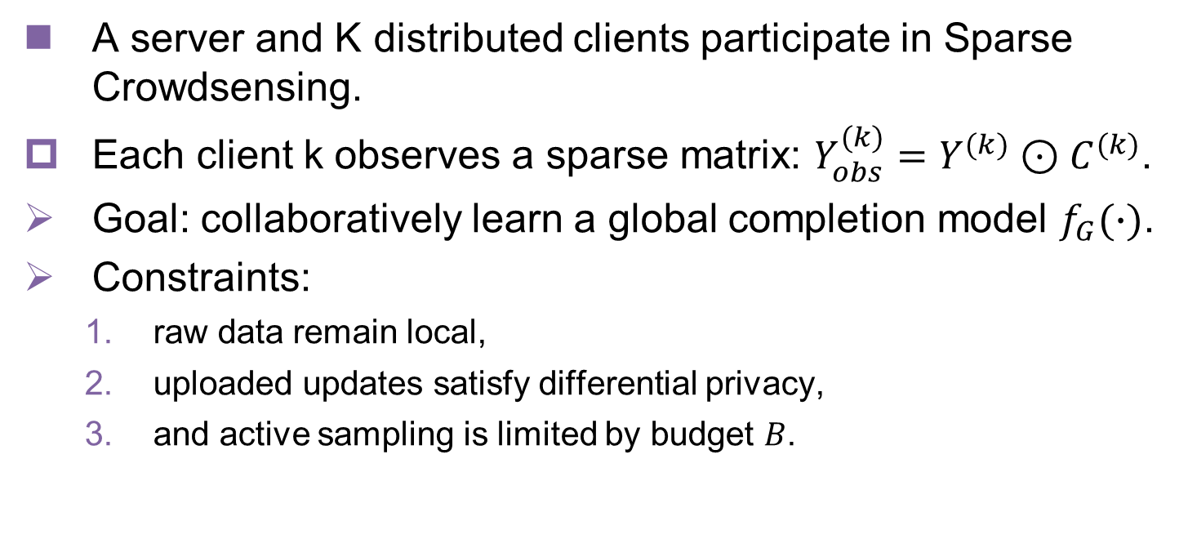
Problem Formulation
A server and K distributed clients participate in Sparse Crowdsensing.
Each client k observes a sparse matrix: $Y_{obs}^{(k)}=Y^{(k)}⊙C^{(k)}$.
Goal: collaboratively learn a global completion model $f_{G}(∙)$.
Constraints:
  raw data remain local,
  uploaded updates satisfy differential privacy,
  and active sampling is limited by budget $B$.
Distributed objective
minimize completion error
+
privacy regularization
under active learning budget
1. accurate completion
2. privacy preservation
3. sampling efficiency
→
May 2026
Notes:
We consider a system with one server and multiple distributed clients.
Each client observes a sparse local matrix.
The goal is to collaboratively learn a global completion model for missing-value inference.
There are three constraints: raw data remain local, uploaded updates should satisfy differential privacy, and active sampling is limited by budget.
So the objective is to improve completion accuracy while preserving privacy and improving sampling efficiency.

Slide 11
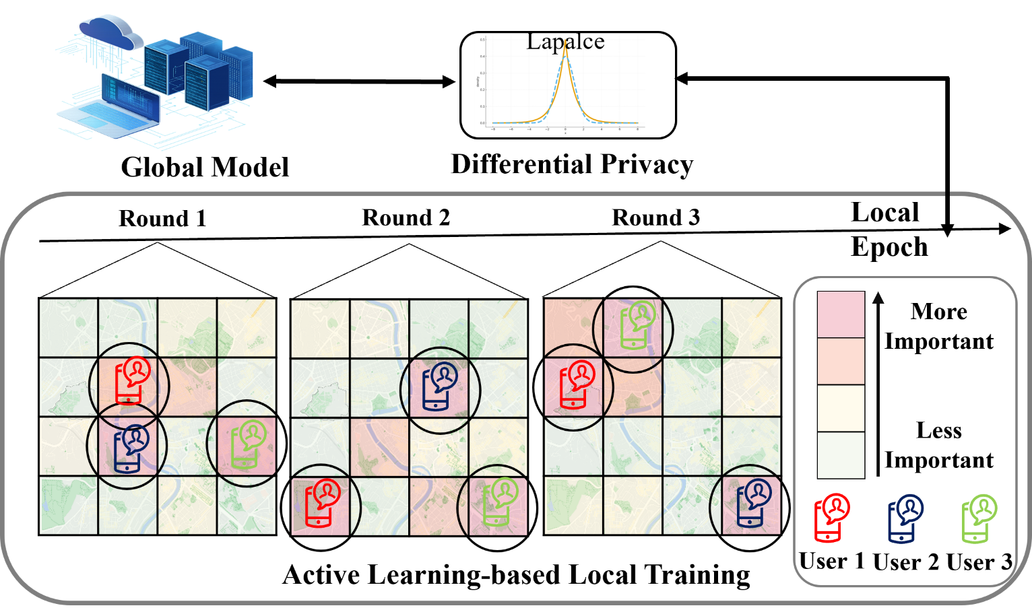
Framework Overview
Federated training + Differential privacy + Active learning-based local sampling
May 2026
Notes:
This slide shows the overall framework.
Each client downloads the global model and trains locally using its own sparse observations.
Before uploading updates, the client applies privacy protection, such as gradient clipping and noise injection.
The server aggregates protected updates and redistributes the global model.
Meanwhile, active learning helps each client select informative samples locally.
In this way, the framework combines federated training, differential privacy, and active sample selection.

Slide 12
Outline
Background and Motivation
Problem and Framework
Method
Performance Evaluation
Conclusion
May 2026
Notes:
Now I will introduce the method.
The method is built progressively: from deep matrix factorization, to federated learning, then temporal modeling, differential privacy, and finally active learning-based sample selection.

Slide 13
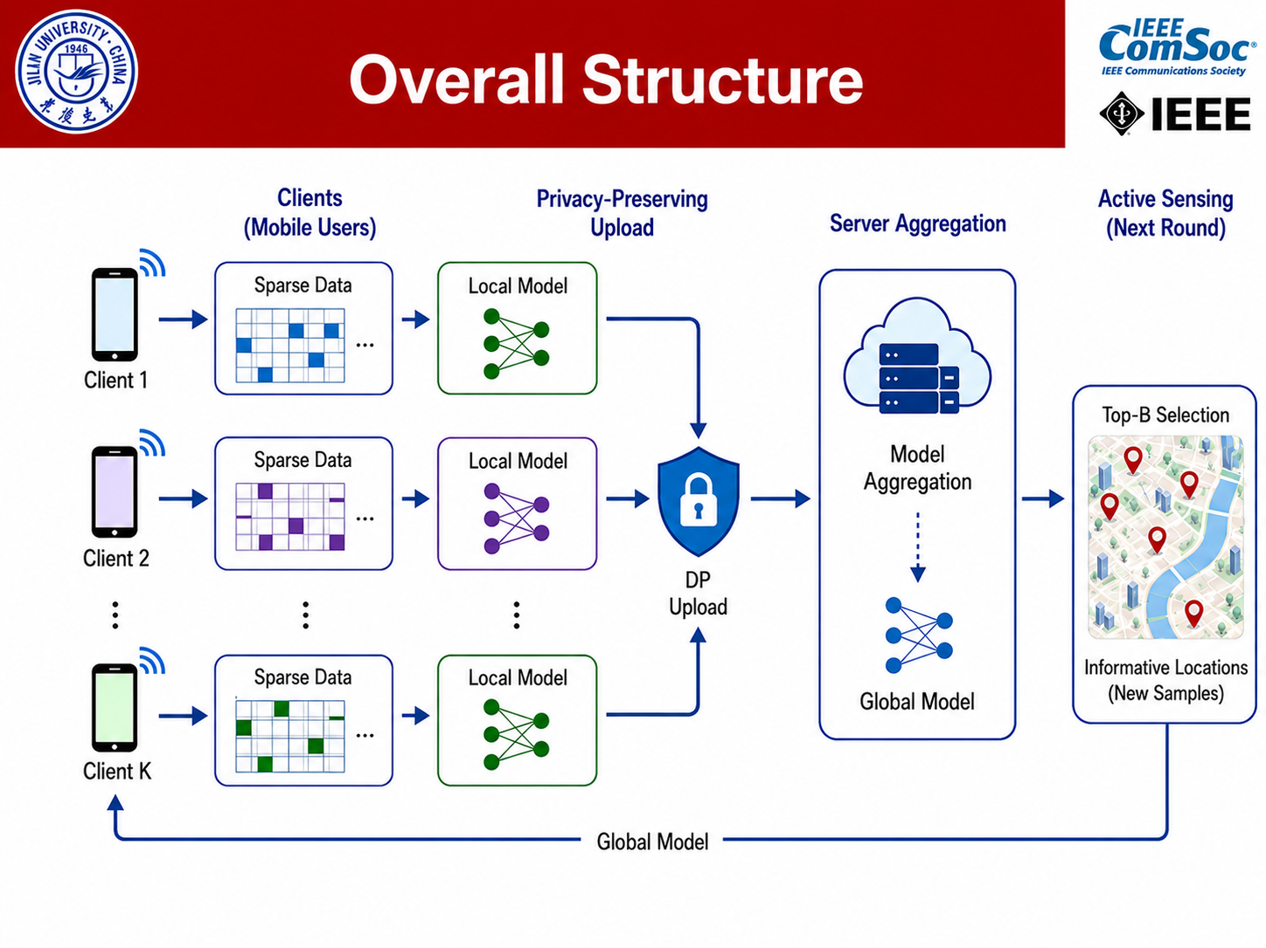
Overall Structure
May 2026
Notes:
This slide gives the overall structure of the method.
The framework is progressively built to address different challenges in sparse crowdsensing.
Federated deep matrix factorization is used to avoid raw data sharing.
RNN-enhanced modeling is introduced to better capture temporal dependencies from local sparse data.
Differential privacy is used to protect uploaded gradients.
Finally, active learning is added to improve sampling efficiency under a limited budget.
So each module is not added randomly. Each one is designed to solve a specific limitation of the previous version.

Slide 14
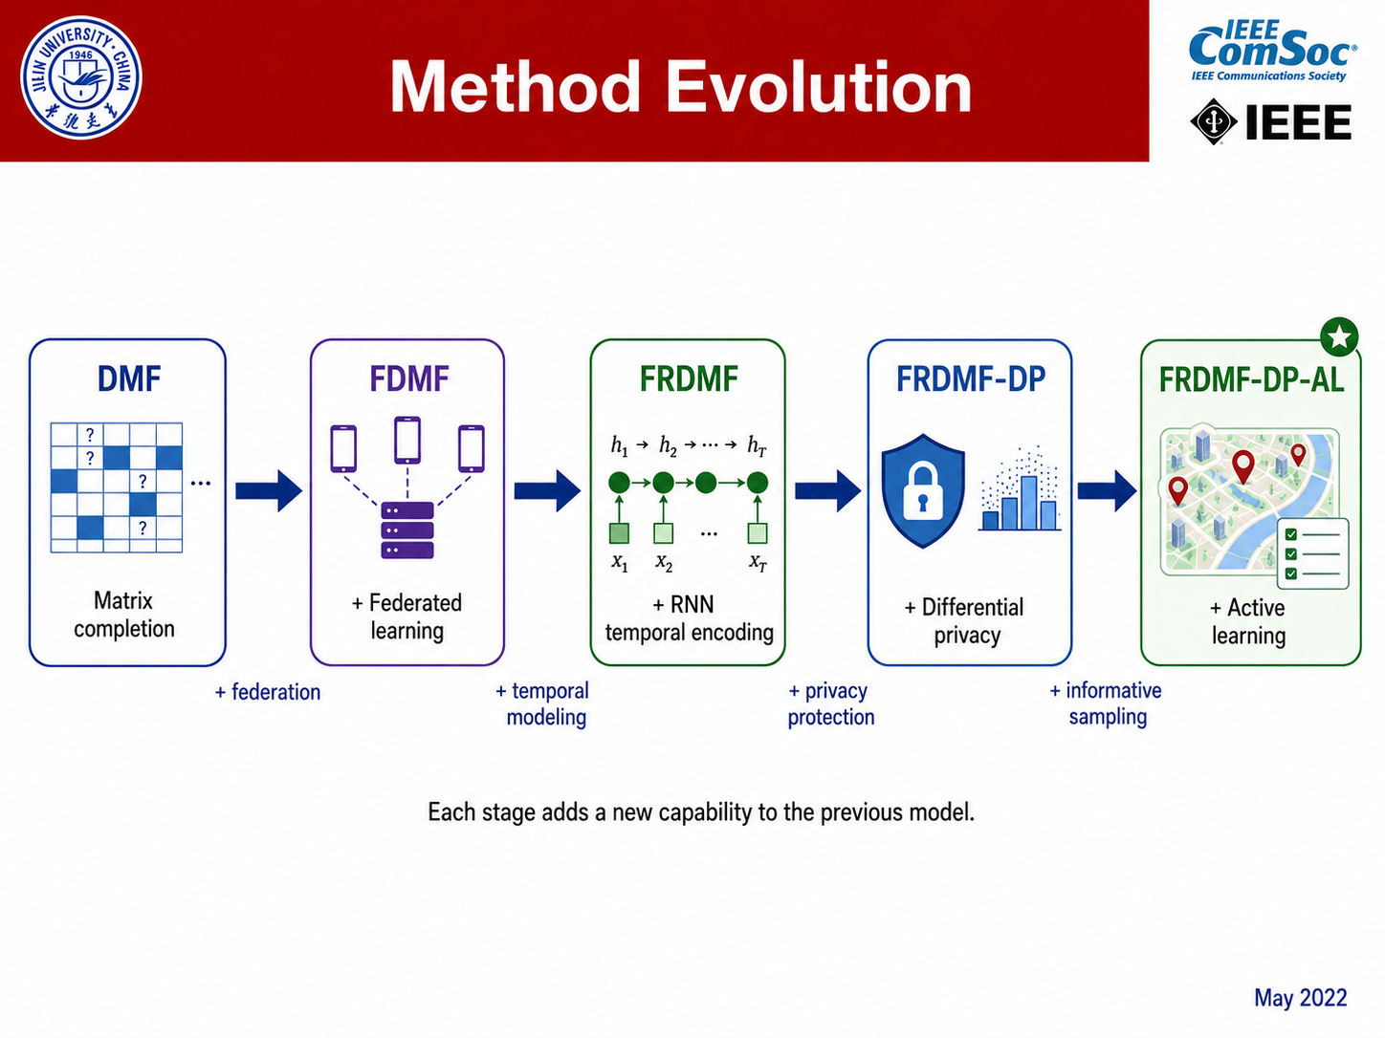
Method Evolution
+temporal modeling
+privacy protection
+informative sampling
+federation
Each stage adds a new capability to the previous model
May 2026
Notes:
This slide shows the evolution of the proposed method.
The starting point is Deep Matrix Factorization, or DMF, which is used for data completion.
Then, by adding federation, we obtain Federated Deep Matrix Factorization, or FDMF, so that clients can train collaboratively without sharing raw data.
Next, temporal modeling is introduced, leading to Federated RNN-enhanced DMF, or FRDMF.
After that, differential privacy is added to protect uploaded updates, resulting in FRDMF-DP.
Finally, active learning-based informative sampling is introduced, producing the final model, FRDMF-DP-AL.
This evolution reflects the main logic of the paper: from completion accuracy, to privacy protection, and then to sampling efficiency.

Slide 15
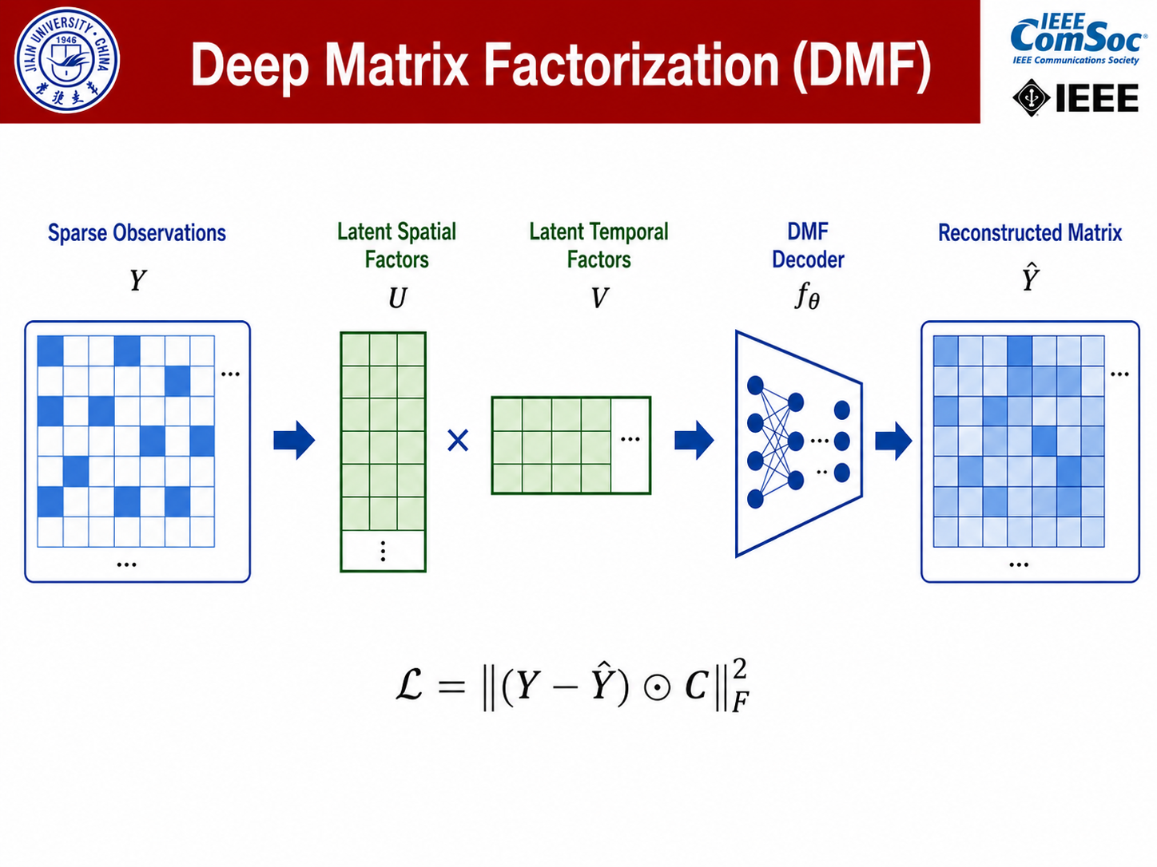
Deep Matrix Factorization (DMF)
May 2026
Notes:
First, Deep Matrix Factorization, or DMF, is used to recover missing values from sparse observations.
It learns latent representations of the data matrix and reconstructs the complete matrix.
Compared with traditional matrix factorization, DMF can model more complex nonlinear patterns.
However, DMF is usually trained in a centralized way, which requires raw data aggregation.
This motivates the next step: federated deep matrix factorization.

Slide 16
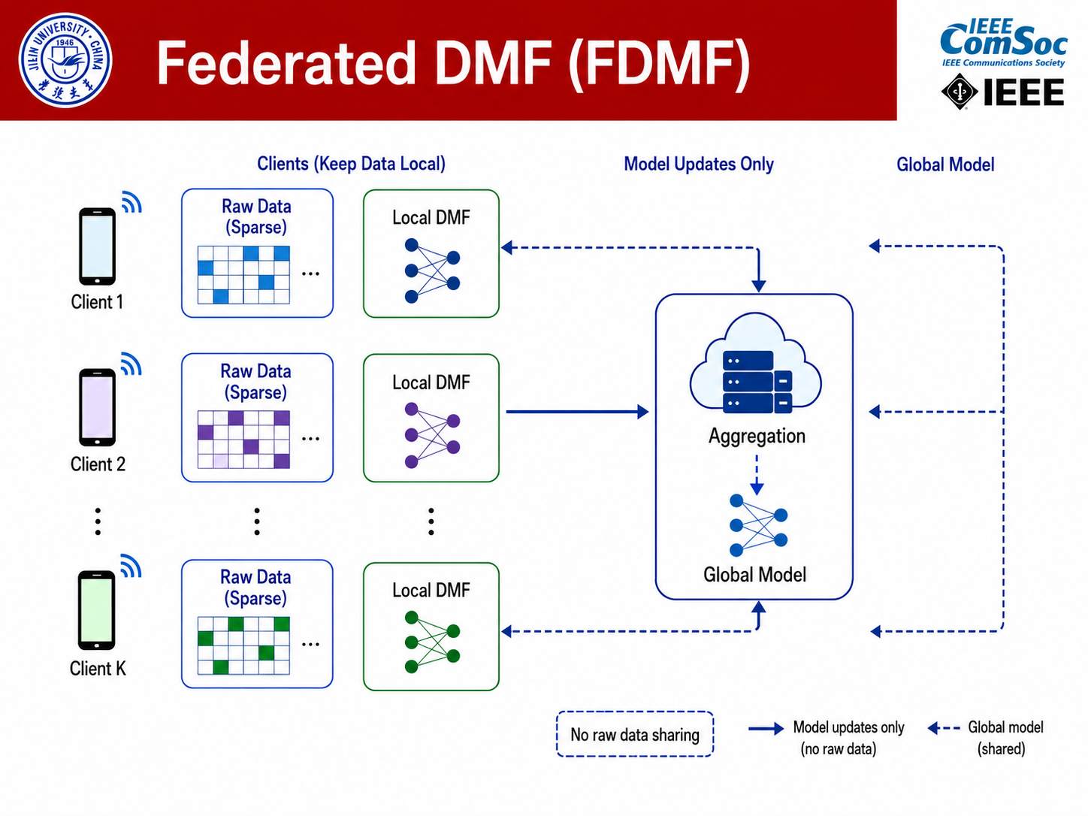
Federated Deep Matrix Factorization (FDMF)
May 2026
Notes:
Federated Deep Matrix Factorization, or FDMF, extends DMF to the federated learning setting.
Instead of uploading raw sensing data, each client keeps its local observations private and trains a local model.
Only model updates are uploaded to the server for aggregation.
The server aggregates updates from multiple clients and sends the updated global model back.
In this way, FDMF can use distributed data to improve completion performance while avoiding direct raw-data sharing.
However, FDMF still has a limitation.
Since local observations are sparse and time-dependent, a pure matrix factorization model may not fully capture temporal dynamics.
Therefore, the next module introduces RNN-based temporal modeling.

Slide 17
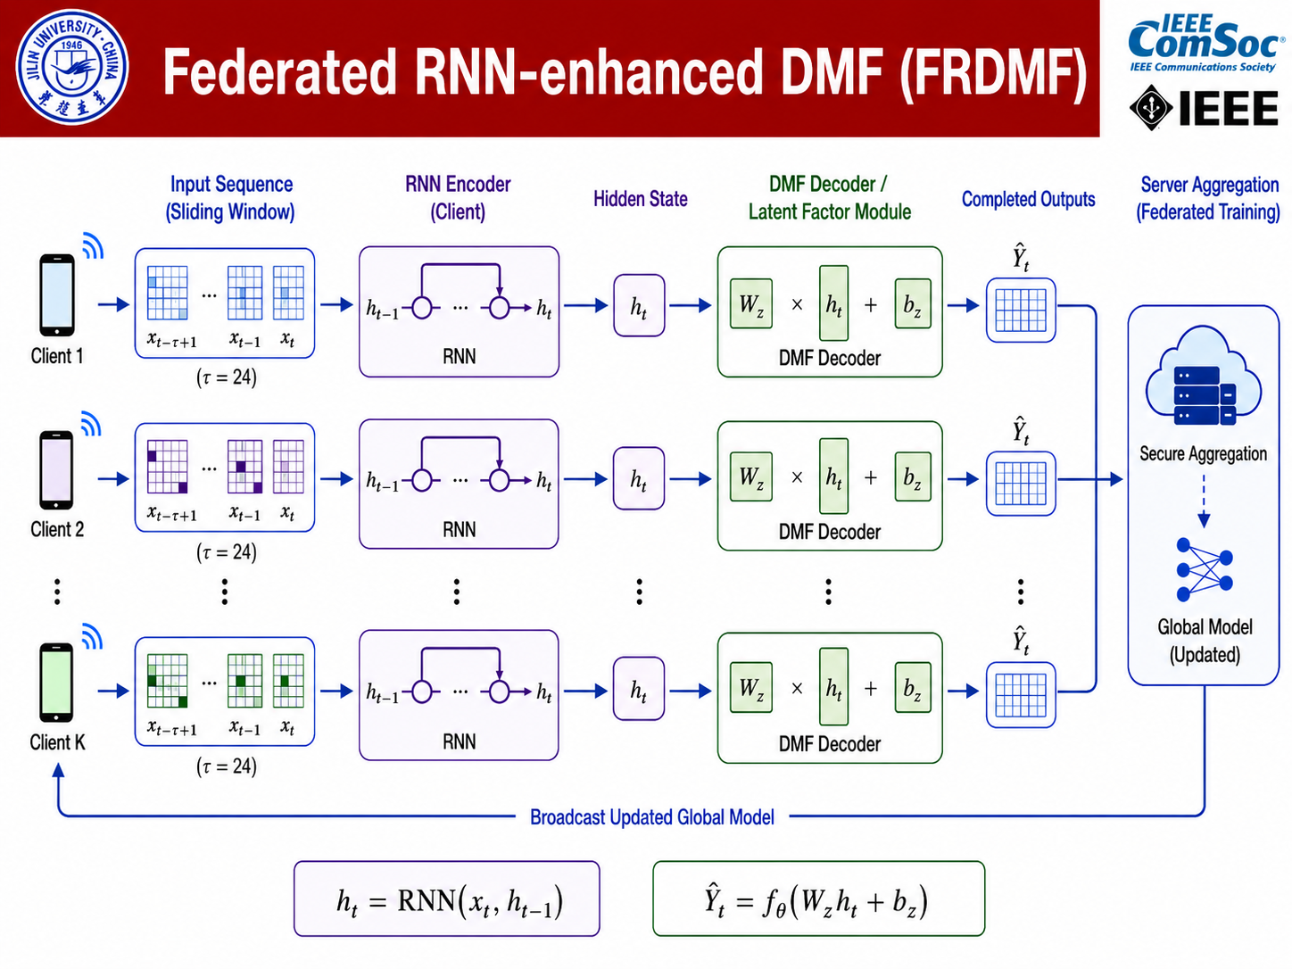
Federated RNN-enhanced DMF (FRDMF)
May 2026
Notes:
Federated RNN-enhanced DMF, or FRDMF, further improves the model by adding a local temporal encoder.
Each client takes sparse local observations as input.
The RNN encoder captures temporal dependencies from historical sensing data, while the DMF decoder reconstructs the completed matrix.
This design has two advantages.
First, the RNN module helps model temporal dynamics, which are very important in spatiotemporal sensing data.
Second, the DMF decoder helps complete missing spatial values.
Through federated aggregation, the server integrates knowledge from different clients without directly collecting their raw data.

Slide 18
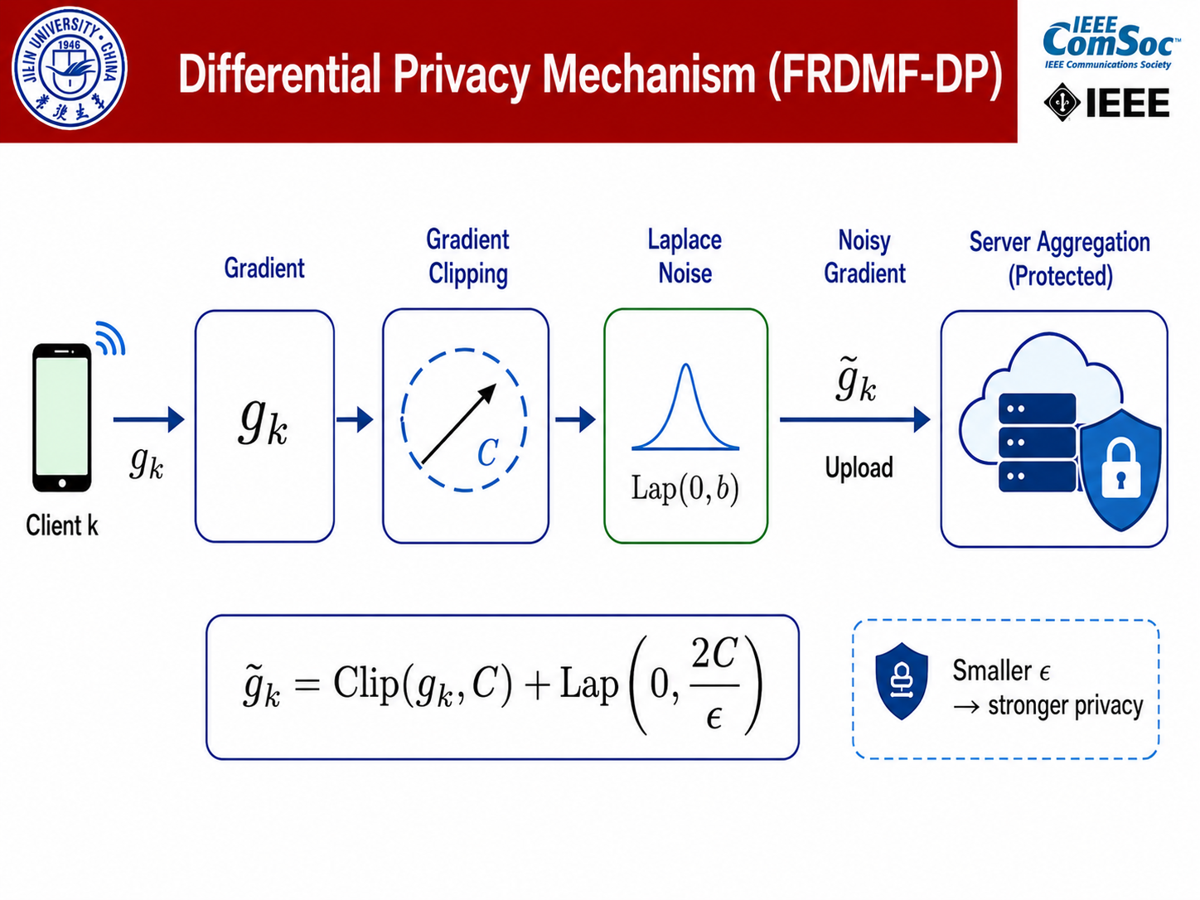
Differential Privacy Mechanism (FRDMF-DP)
May 2026
Notes:
Next, differential privacy is introduced to further protect the uploaded updates.
Although federated learning avoids raw-data sharing, uploaded gradients may still leak private information.
For example, gradient inversion attacks may reconstruct sensitive data from model updates.
To reduce this risk, the framework applies two steps.
The first step is gradient clipping, which bounds the sensitivity of each client update.
The second step is Laplace noise injection, which perturbs the uploaded gradients to satisfy epsilon-differential privacy.
Here, epsilon controls the privacy level.
A smaller epsilon means stronger privacy protection, but it also introduces larger noise and may reduce completion accuracy.
Therefore, there is a trade-off between privacy and utility.

Slide 19
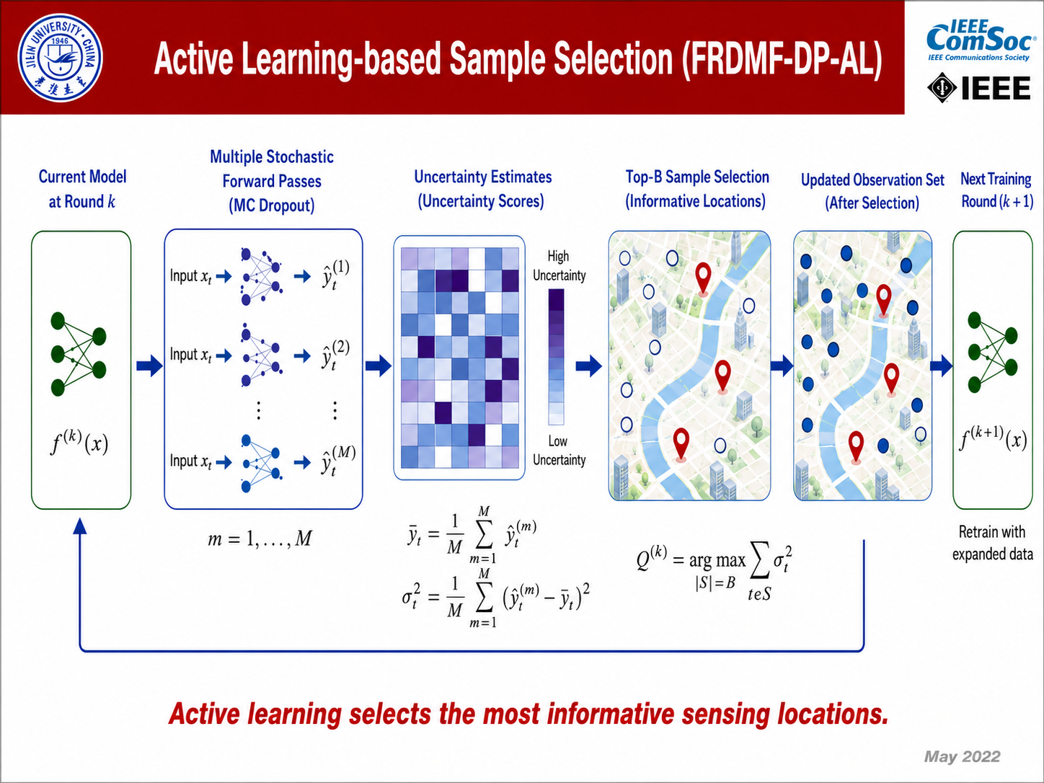
Active Learning-based Sample Selection (FRDMF-DP-AL)
May 2026
Notes:
Finally, active learning-based sample selection is added to improve sampling efficiency.
The key idea is to identify which unobserved points are most informative for the model.
To estimate uncertainty, the method uses MC Dropout. During inference, dropout remains activated, and the model performs multiple stochastic forward passes.
For each unobserved point, the prediction variance is computed.
A larger variance means the model is less confident about that point.
Then, the client selects the top-B unobserved points with the largest uncertainty as new sensing targets.
These selected points are added as new observations in the next training round.
This active sensing loop improves completion accuracy without changing the communication protocol or the differential privacy mechanism.

Slide 20
Outline
Background and Motivation
Problem and Framework
Method
Performance Evaluation
Conclusion
May 2026
Notes:
Next, I will present the experimental evaluation.
The experiments are designed to answer three main questions.
First, whether the proposed method can improve completion accuracy.
Second, whether differential privacy can reduce privacy leakage.
Third, whether active learning can improve sampling efficiency under sparse observations.

Slide 21
Datasets and Compared Models
Datasets
PM25
Othree
Humidity
MyTraffic
Beijing PM2.5
36 stations
Beijing ozone
36 stations
EPFL campus
0.5-hour interval
Taxi speed data
50 roads
Compared Models
Centralized
Federated
Privacy-preserving
DMF
RNN-DMF
FDMF
FRDMF
FRDMF-DP
FRDMF-DP-AL
May 2026
Notes:
The experiments are conducted on four real-world spatiotemporal datasets.
PM25 and Othree are air-quality datasets from Beijing.
Humidity is an environmental sensing dataset from the EPFL campus.
MyTraffic contains taxi speed data from fifty roads.
We compare the proposed model with centralized, federated, and privacy-preserving baselines, including DMF, RNN-DMF, FDMF, FRDMF, and FRDMF-DP.

Slide 22
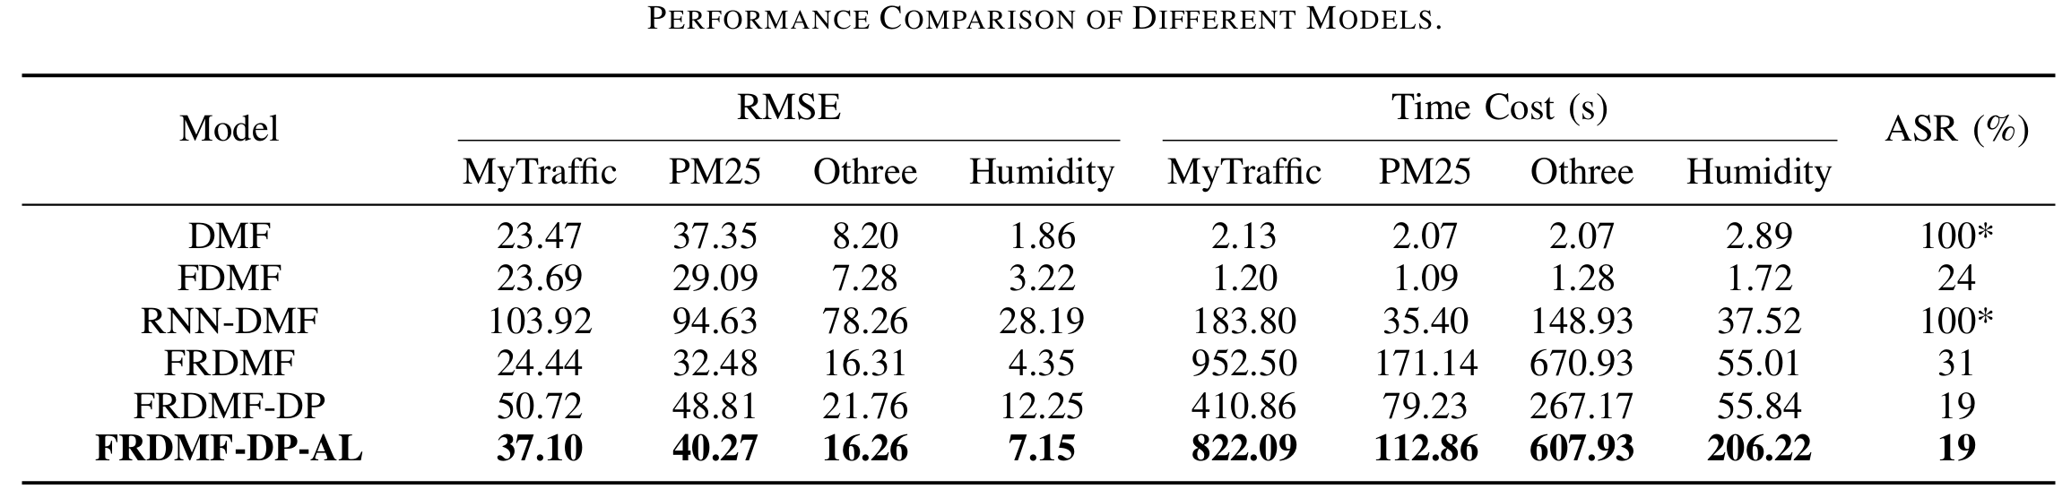
Main results
Key observations
Federated models avoid centralized raw data storage.
Differential privacy reduces attack strength but introduces utility loss.
Active learning recovers accuracy under the same privacy mechanism.
Othree: FRDMF-DP → FRDMF-DP-AL
RMSE 21.76 → 16.26 (−25.3%)
May 2026
Notes:
This slide summarizes the main results.
Federated models avoid centralized raw-data storage, which reduces privacy exposure.
Differential privacy further reduces the strength of gradient-based attacks, but it may also introduce utility loss because of the added noise.
Active learning helps recover part of this accuracy loss under the same privacy mechanism.
For example, on the Othree dataset, the RMSE decreases from 21.76 with FRDMF-DP to 16.26 with FRDMF-DP-AL.
This corresponds to a 25.3 percent reduction in RMSE.
The result shows that active learning can effectively improve completion accuracy under a fixed privacy setting.

Slide 23
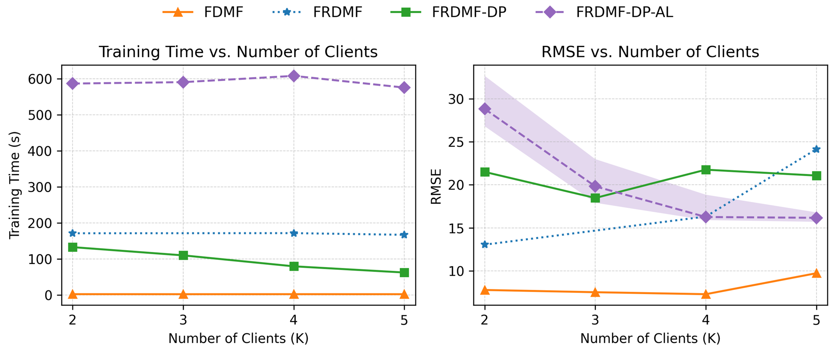
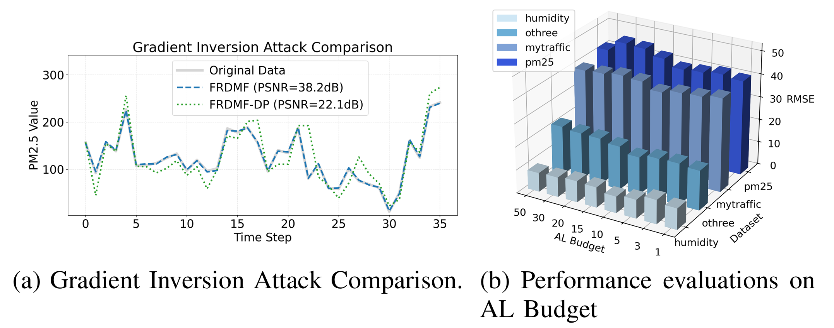
Privacy Robustness & AL Efficiency
Gradient inversion attack
Scalability with different clients
Differential privacy lowers PSNR from 38.2 dB to 22.1 dB, reducing gradient leakage risk.
Active learning improves accuracy without increasing privacy risk or communication cost.
The federated framework scales to more clients with stable RMSE.
May 2026
Notes:
This slide evaluates privacy robustness and active learning efficiency.
Differential privacy lowers PSNR from 38.2 dB to 22.1 dB in the gradient inversion attack experiment, which indicates reduced gradient leakage risk.
Active learning improves accuracy without increasing privacy risk or communication cost.
The framework also remains stable when the number of clients changes.

Slide 24
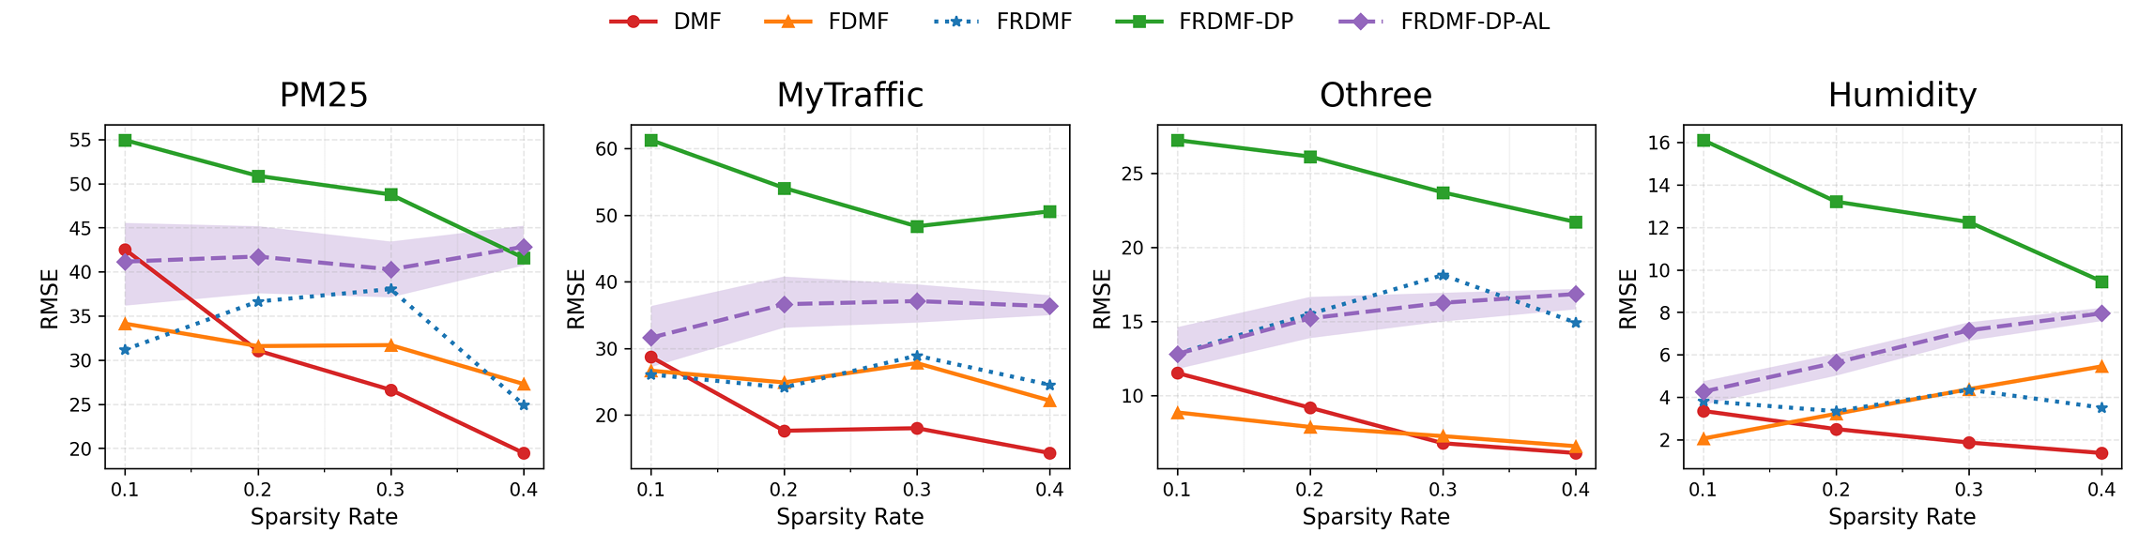
Robustness under Sparsity
Sparse adaptability
Federated models capture localized spatiotemporal features through client-side modeling.
On PM25, FRDMF-DP-AL fluctuates only 4.08% when sparsity changes from 0.1 to 0.4.
RNN-based temporal modeling is important for sparse scenarios.
May 2026
Notes:
This slide shows robustness under different sparsity rates.
Since sparse crowdsensing has limited observations, stability under sparsity is important.
On the PM25 dataset, when sparsity changes from 0.1 to 0.4, FRDMF-DP-AL fluctuates only 4.08 percent.
This shows that the proposed method remains stable under sparse sensing conditions.

Slide 25
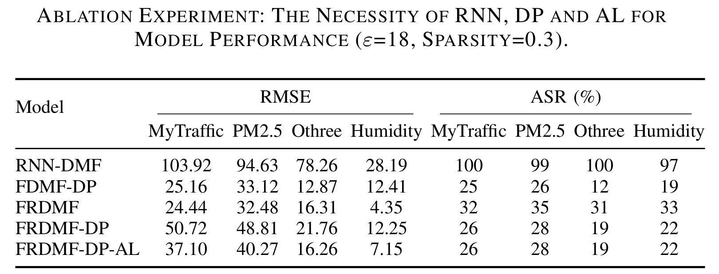
Ablation Study
Necessity of RNN, DP and AL
RNN is crucial for temporal dependencies and sparse adaptability.
DP reduces privacy leakage by perturbing uploaded updates.
AL compensates for the utility loss caused by privacy noise.
May 2026
Notes:
The ablation study validates the necessity of each component.
The RNN module captures temporal dependencies.
Differential privacy reduces gradient leakage.
Active learning compensates for part of the accuracy loss caused by privacy noise.
Therefore, each component contributes to privacy protection, completion accuracy, or sampling efficiency.

Slide 26
Outline
Background and Motivation
Problem and Framework
Method
Performance Evaluation
Conclusion
May 2026
Notes:
Finally, I will conclude the presentation.

Slide 27
Conclusion
Problem: Privacy-preserving Data Completion in Sparse Crowdsensing
Framework: Federated learning with localized temporal modeling and global matrix factorization.
Privacy: ε-differential privacy suppresses gradient inversion attacks.
Sampling: Active learning selects high-value observations under budget.
Evaluation: Four datasets show a strong privacy–utility–efficiency trade-off.
May 2026
Notes:
In conclusion, this work studies privacy-preserving data completion in sparse crowdsensing.
The proposed framework combines federated learning, localized temporal modeling, differential privacy, and uncertainty-driven active learning.
Federated learning keeps raw sensing data on local clients.
RNN-enhanced modeling captures temporal dependencies from sparse local observations.
Differential privacy suppresses gradient inversion attacks by perturbing uploaded updates.
Active learning selects high-value observations under a limited sensing budget.
Experiments on four real-world datasets show that the framework provides a strong trade-off among privacy protection, completion accuracy, and sampling efficiency.

Slide 28

Q&A
Thank you!
Q&A
zfwang22@mails.jlu.edu.cn
Notes:
Thank you very much for your attention. I would be happy to take any questions.
Since I am presenting this work on behalf of the authors, I may not be able to explain every technical detail perfectly. If there is anything that I cannot answer clearly today, please feel free to contact the authors by email for further discussion.
Thank you again.

