Slide 1
Transaction control and isolation levels in Oracle

Slide 2
Contents
Transaction control
Data Concurrency and Consistency in a Multiuser Environment
Locking

Slide 3
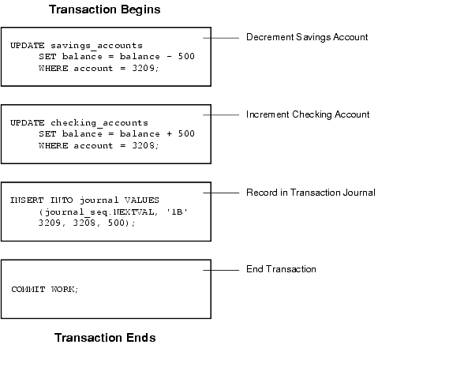
A Banking Transaction

Slide 4
Transactions - Rationale
Consider two clients booking airline tickets
There are 2 seats left on a flight
Client A wants 2 seats:
time 12:02 makes initial request
12:06 confirms purchase through booking form
12:08 authorises credit card payment
Client B wants 2 seats:
time 12:03 makes initial request
12:05 confirms purchase through booking form
12:09 authorises credit card payment
Situation needs careful control
Notes:
See Connolly & Begg Section 20.2 pp.577-580

Slide 5
Some Possibilities
Clients A and B are both told 2 seats are free in initial enquiries
B confirms purchase before A
But A may still proceed
A attempts credit card debit first
If successful A secures tickets at 12:08
B then attempts credit card debit
If successful B secures tickets at 12:09
potentially over-writing A’s tickets
A has paid for tickets no longer his/hers

Slide 6
Requirements 1
When client A beats B in the initial enquiry:
they should form a queue (serialisability)
B must wait for A to finish
Different kinds of finish for A:
successful
completes booking form
makes credit card debit
store results (commit)
number of seats available is now zero
write transaction log and finish
B cannot proceed with purchase as no tickets left

Slide 7
Requirements 2
unsuccessful
may not complete booking form
may not have funds on credit card
undo any database changes (rollback) and finish
number of seats available is still 2
B can now proceed to attempt to purchase the 2 tickets left
Techniques required to emulate business practice

Slide 8
Structure of a DBMS
Query Optimization
and Execution
Relational Operators
Files and Access Methods
These layers must consider concurrency
control and recovery
(Transaction, Lock, Recovery Managers)
Buffer Management
Disk Space Management

Slide 9
Transactions and Concurrent Execution
Transaction - DBMS’s abstract view of a user program (or activity):
A sequence of reads and writes of database objects.
Unit of work that must commit or abort as an atomic unit
Transaction Manager controls the execution of transactions.
User’s program logic is invisible to DBMS!
Arbitrary computation possible on data fetched from the DB
The DBMS only sees data read/written from/to the DB.
Challenge: provide atomic transactions to concurrent users!
Given only the read/write interface.
Notes:
While one transaction is waiting for a page to be read in from disk, CPU can process another transaction. Overlapping I/O and CPU activity reduces the amount of time disk and processors are idle and increases system throughput (useful work completed per unit time)
In serial execution, a short transaction can get stuck behind a long transaction. Interleaving the execution of a short transaction with a long transaction allows the short transaction to complete quickly.
Transaction is defined as any one execution of a user program in a DBMS and differs from an execution outside the DBMS.

Slide 10
Concurrency: Why bother?
The latency argument
The throughput argument
Both are critical!

Slide 11
Example of a Fund Transfer
Isolation requirement — if between steps 3 and 6, another transaction T2 is allowed to access the partially updated database, it will see an inconsistent database (the sum A + B will be less than it should be). T1 T2
1. read(A)
2. A := A – 50
3. write(A) read(A), read(B), print(A+B)
4. read(B)
5. B := B + 50
6. write(B
Isolation can be ensured trivially by running transactions serially
that is, one after the other.
However, executing multiple transactions concurrently has significant benefits, as we will see later.

Slide 12
ACID Properties
A transaction is a unit of program execution that accesses and possibly updates various data items.To preserve the integrity of data the database system must ensure:
Atomicity. Either all operations of the transaction are properly reflected in the database or none are.
Consistency. Execution of a transaction in isolation preserves the consistency of the database.
Isolation. Although multiple transactions may execute concurrently, each transaction must be unaware of other concurrently executing transactions. Intermediate transaction results must be hidden from other concurrently executed transactions.
That is, for every pair of transactions T_{i} and T_{j}, it appears to T_{i} that either T_{j}, finished execution before T_{i} started, or T_{j} started execution after T_{i} finished.
Durability. After a transaction completes successfully, the changes it has made to the database persist, even if there are system failures.

Slide 13
Transaction State
Active – the initial state; the transaction stays in this state while it is executing
Partially committed – after the final statement has been executed.
Failed -- after the discovery that normal execution can no longer proceed.
Aborted – after the transaction has been rolled back and the database restored to its state prior to the start of the transaction. Two options after it has been aborted:
restart the transaction
can be done only if no internal logical error
kill the transaction
Committed – after successful completion.

Slide 14
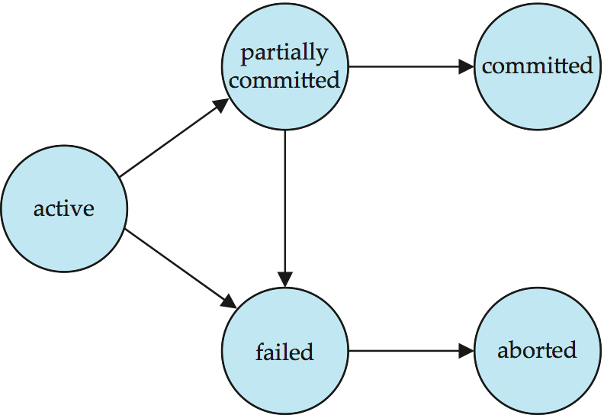
Transaction State (Cont.)

Slide 15
Atomicity and Durability
A.C.I.D.
A transaction ends in one of two ways:
commit after completing all its actions
“commit” is a contract with the caller of the DB
abort (or be aborted by the DBMS) after executing some actions.
Or system crash while the xact is in progress; treat as abort.
Two important properties for a transaction:
Atomicity : Either execute all its actions, or none of them
Durability : The effects of a committed xact must survive failures.
DBMS ensures the above by logging all actions:
Undo the actions of aborted/failed transactions.
Redo actions of committed transactions not yet propagated to disk when system crashes.
Notes:
1) Users should not have to worry about the effect of incomplete transactions (say when a system crash occurs)

Slide 16
SQL Transaction commands
DBMS does not have an inbuilt way of knowing which commands are grouped to form a single logical transaction.
Some commands, e.g. COMMIT and ROLLBACK can provide boundaries of transaction.
Commit;
saves current database state
releases resources, locks & savepoints held
equivalent to Save and Exit in MS Word
Rollback;
returns database state to that at start of transaction
releases resources, locks & savepoints held
equivalent to dismiss/ do not save changes in MS Word
By default, every SQL statement also commits implicitly if it executes successfully
Implicit commit can be turned off by a database directive
E.g. in JDBC, connection.setAutoCommit(false);

Slide 17
Transactions in SQL
A transaction is a logical unit of work on a database.
A group of related operations that
typically comprises a collection of individual actions
e.g. in SQL INSERT, UPDATE, DELETE, SELECT
must be performed successfully
before any changes to the database are finalised.
Variable size:
entire run on SQL*Plus
e.g. spend 2 hours inserting data
single command in SQL*Plus
e.g. one insert command
one execution of a procedure
e.g. one run of add_patient
Notes:
See Connolly & Begg Section 23.7.1 p.774

Slide 18
Database Transaction
A database transaction consists of one of the following:
DML statements which constitute one consistent change to the data
One DDL statement
One DCL statement

Slide 19
Oracle Transaction Types
Type | Description
Data manipulation language (DML) | Consists of any number of DML statements that the Oracle server treats as a single entity or a logical unit of work
Data definition language (DDL) | Consists of only one DDL statement
Data control language (DCL) | Consists of only one DCL statement

Slide 20
Transaction boundaries
A transaction begins with the first executable SQL statement.
A transaction ends with one of the following events:
A COMMIT or ROLLBACK statement is issued
A DDL or DCL statement executes (automatic commit)
The user exits iSQL*Plus
The system crashes

Slide 21
Advantages of COMMIT and ROLLBACK
With COMMIT and ROLLBACK statements, you can:
Ensure data consistency
Preview data changes before making changes
permanent
Group logically related operations

Slide 22
Concurrent Executions
Multiple transactions are allowed to run concurrently in the system. Advantages are:
increased processor and disk utilization, leading to better transaction throughput
E.g. one transaction can be using the CPU while another is reading from or writing to the disk
reduced average response time for transactions: short transactions need not wait behind long ones.
Concurrency control schemes – mechanisms to achieve isolation
Control the interaction among the concurrent transactions in order to prevent them from destroying the consistency of the database

Slide 23
Schedules
Schedule – a sequences of instructions that specify the chronological order in which instructions of concurrent transactions are executed
a schedule for a set of transactions must consist of all instructions of those transactions
must preserve the order in which the instructions appear in each individual transaction.
A transaction that successfully completes its execution will have a commit instructions as the last statement
by default transaction assumed to execute commit instruction as its last step
A transaction that fails to successfully complete its execution will have an abort instruction as the last statement

Slide 24
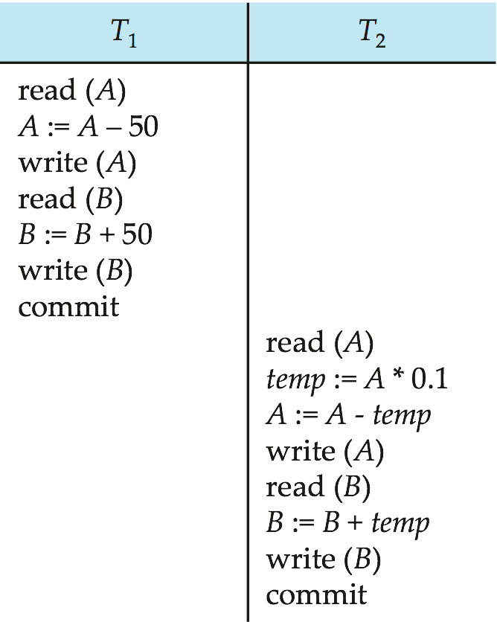
Schedule 1
Let T₁ transfer $50 from A to B, and T₂ transfer 10% of the balance from A to B.
Goal: A + B is “preserved”.
A serial schedule in which T₁ is followed by T₂ :

Slide 25
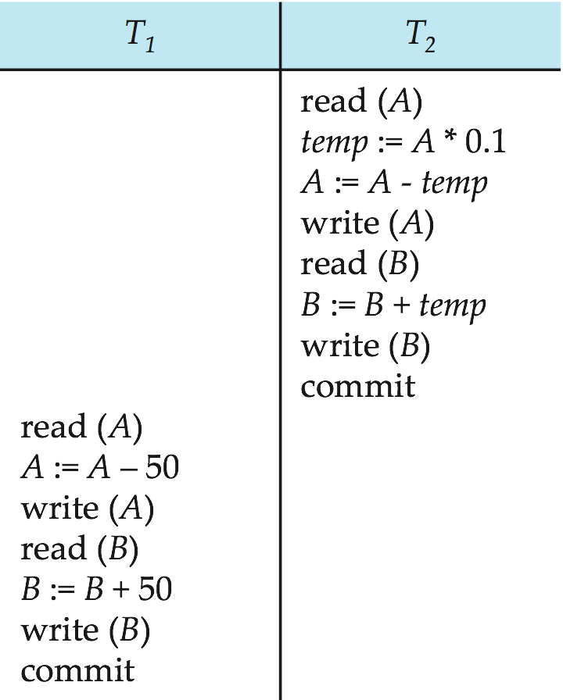
Schedule 2
A serial schedule where T₂ is followed by T₁

Slide 26
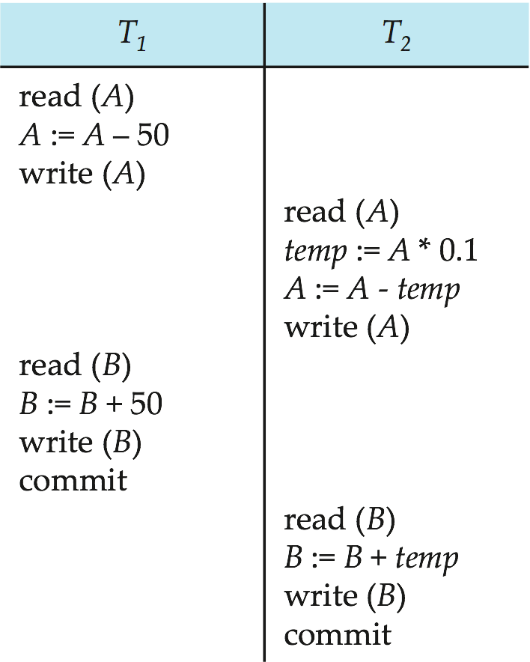
Schedule 3
Let T₁ and T₂ be the transactions defined previously. The following schedule is not a serial schedule, but it is equivalent to Schedule 1.
A = 100
A = 50
Write A = 50
A = 50
temp = 5
A = 45
Write A = 45
B = 10
B = 60
Write B = 60
B = 60
B = 65
Write B = 65
A + B = 110
In Schedules 1, 2 and 3, the sum A + B is preserved.

Slide 27
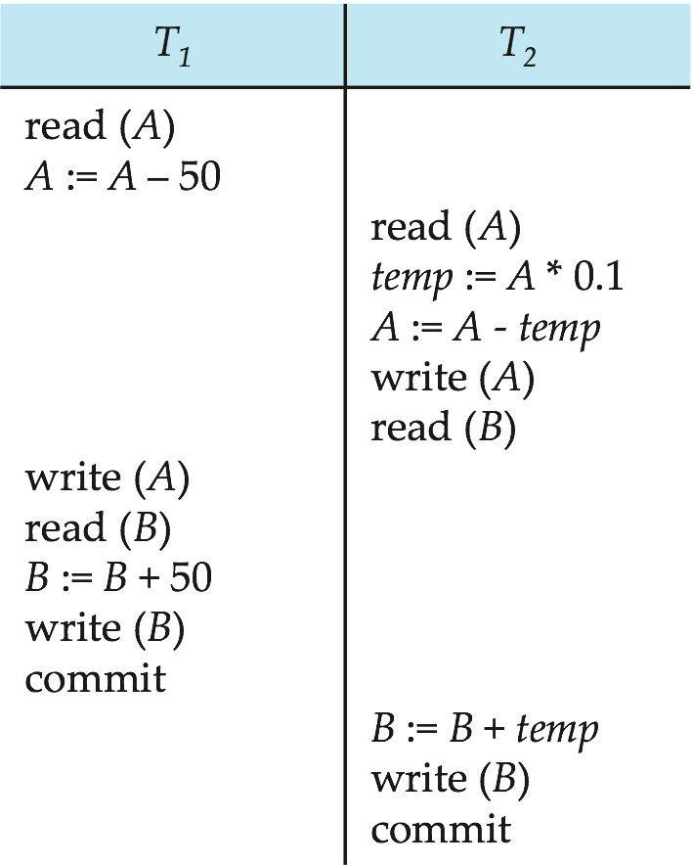
Schedule 4
The following concurrent schedule does not preserve the value of (A + B ).
A = 100
A = 50
A = 100
temp = 10
A = 90
Write A = 90
B = 10
Write A = 50
B = 10
B = 60
Write B = 60
B = 10 + 10 = 20
Write B = 20
A + B = 70

Slide 28
Serializability
Basic Assumption – Each transaction preserves database consistency.
Thus serial execution of a set of transactions preserves database consistency.
A (possibly concurrent) schedule is serializable if it is equivalent to a serial schedule. Different forms of schedule equivalence give rise to the notions of:
1. conflict serializability
2. view serializability

Slide 29
Simplified view of transactions
We ignore operations other than read and write instructions
We assume that transactions may perform arbitrary computations on data in local buffers in between reads and writes.
Our simplified schedules consist of only read and write instructions.

Slide 30
Conflicting Instructions
Instructions l_{i} and l_{j} of transactions T_{i} and T_{j} respectively, conflict if and only if there exists some item Q accessed by both l_{i} and l_{j}, and at least one of these instructions wrote Q.
1. l_{i} = read(Q), l_{j} = read(Q). l_{i} and l_{j} don’t conflict. 2. l_{i} = read(Q), l_{j} = write(Q). They conflict. 3. l_{i} = write(Q), l_{j} = read(Q). They conflict 4. l_{i} = write(Q), l_{j} = write(Q). They conflict
Intuitively, a conflict between l_{i} and l_{j} forces a (logical) temporal order between them.
If l_{i} and l_{j} are consecutive in a schedule and they do not conflict, their results would remain the same even if they had been interchanged in the schedule.

Slide 31
Conflict Serializability
If a schedule S can be transformed into a schedule S´ by a series of swaps of non-conflicting instructions, we say that S and S´ are conflict equivalent.
We say that a schedule S is conflict serializable if it is conflict equivalent to a serial schedule

Slide 32
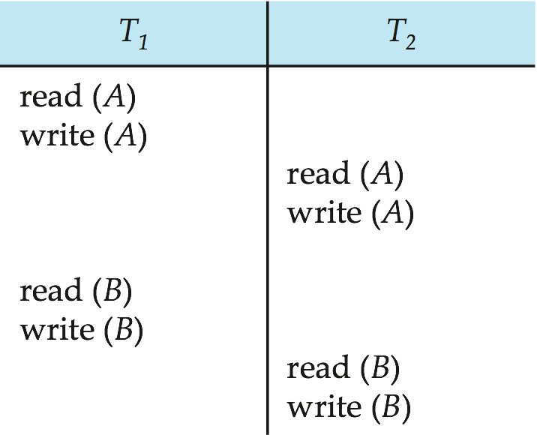
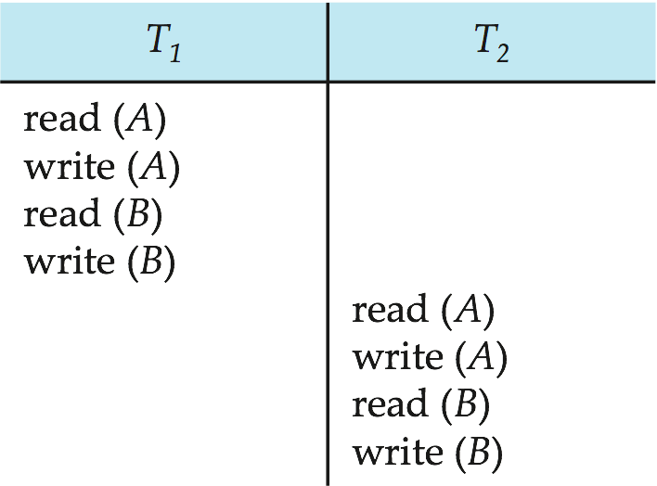
Conflict Serializability (Cont.)
Schedule 3 can be transformed into Schedule 6, a serial schedule where T₂ follows T₁, by series of swaps of non-conflicting instructions. Therefore Schedule 3 is conflict serializable.
Schedule 3
Schedule 6

Slide 33
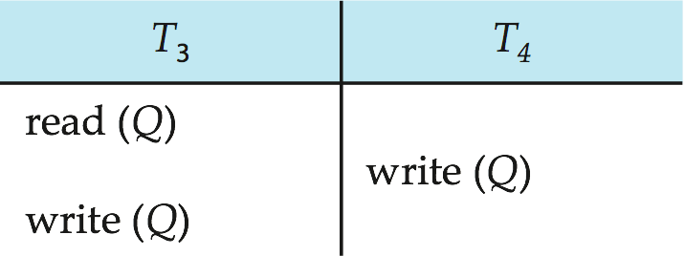
Conflict Serializability (Cont.)
Example of a schedule that is not conflict serializable:
We are unable to swap instructions in the above schedule to obtain either the serial schedule < T₃, T₄ >, or the serial schedule < T₄, T₃ >.

Slide 34
View Serializability
Let S and S´ be two schedules with the same set of transactions. S and S´ are view equivalent if the following three conditions are met, for each data item Q,
If in schedule S, transaction T_{i} reads the initial value of Q, then in schedule S’ also transaction T_{i} must read the initial value of Q.
If in schedule S transaction T_{i} executes read(Q), and that value was produced by transaction T_{j} (if any), then in schedule S’ also transaction T_{i} must read the value of Q that was produced by the same write(Q) operation of transaction T_{j} .
The transaction (if any) that performs the final write(Q) operation in schedule S must also perform the final write(Q) operation in schedule S’.
As can be seen, view equivalence is also based purely on reads and writes alone.

Slide 35
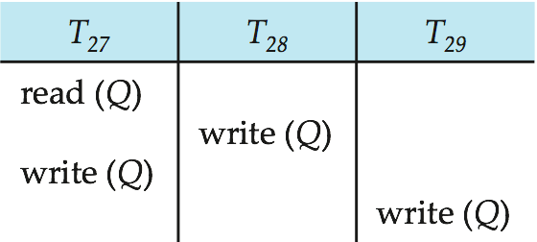
View Serializability (Cont.)
A schedule S is view serializable if it is view equivalent to a serial schedule.
Every conflict serializable schedule is also view serializable.
But, a view serializable schedule may not be conflict serializable.
Below is a schedule which is view-serializable but not conflict serializable.
What serial schedule is above equivalent to?
Every view serializable schedule that is not conflict serializable has blind writes.

Slide 36
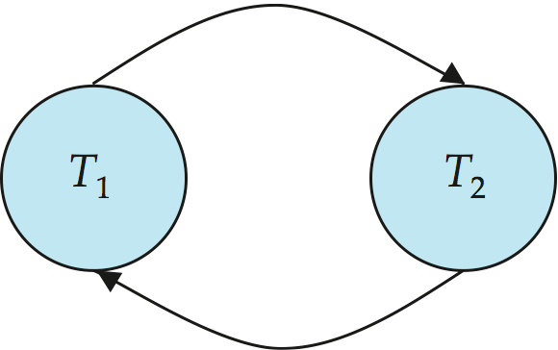
Testing for Serializability
Consider some schedule of a set of transactions T₁, T₂, ..., T_{n}
Precedence graph — a directed graph where the vertices are the transactions (names).
We draw an arc from T_{i} to T_{j} if the two transaction conflict, and T_{i} accessed the data item on which the conflict arose earlier.
We may label the arc by the item that was accessed.
Example 1

Slide 37
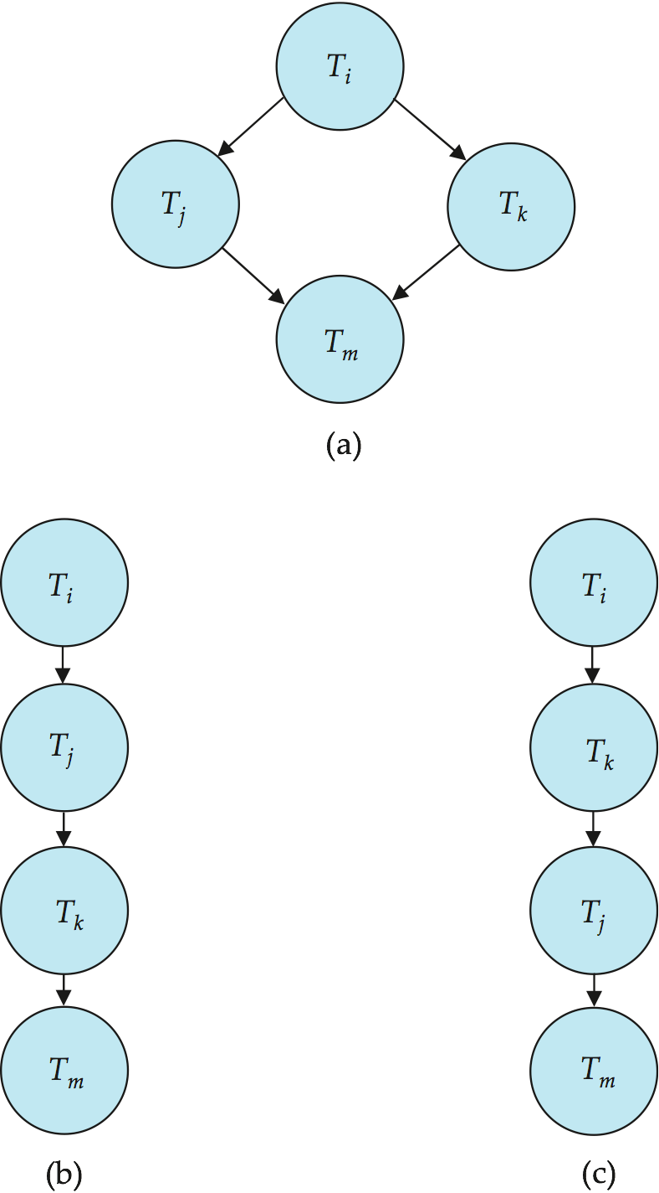
Test for Conflict Serializability
A schedule is conflict serializable if and only if its precedence graph is acyclic.
Cycle-detection algorithms exist which take order n² time, where n is the number of vertices in the graph.
If precedence graph is acyclic, the serializability order can be obtained by a topological sorting of the graph.
This is a linear order consistent with the partial order of the graph.
For example, a serializability order for Schedule A would be T₅ → T₁ → T₃ → T₂ → T₄
Are there others?

Slide 38
Examples
Schedule 1:
T2:R(A),T1:R(B), T2:W(A), T3:R(A), T1:W(B), T3:W(A), T2:R(B), T2:W(B)
Schedule 2:
T2:R(A),T1:R(B), T2:W(A), T2:R(B), T3:R(A), T1:W(B), T3:W(A), T2:W(B)
T1
B
T2
A
T3
B
T1
B
T2
A
T3

Slide 39
Test for View Serializability
The precedence graph test for conflict serializability cannot be used directly to test for view serializability.
Extension to test for view serializability has cost exponential in the size of the precedence graph.
The problem of checking if a schedule is view serializable falls in the class of NP-complete problems.
Thus existence of an efficient algorithm is extremely unlikely.
However practical algorithms that just check some sufficient conditions for view serializability can still be used.

Slide 40
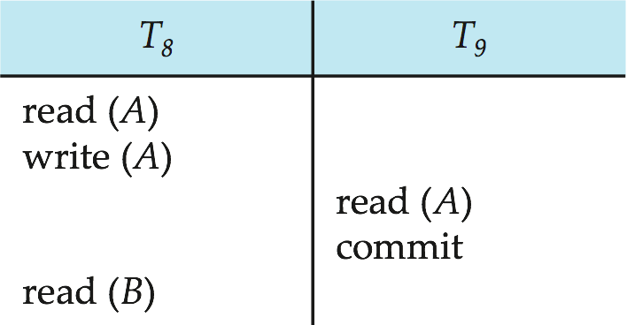
Recoverable Schedules
Need to address the effect of transaction failures on concurrently running transactions.
Recoverable schedule — if a transaction T_{j} reads a data item previously written by a transaction T_{i} , then the commit operation of T_{i} appears before the commit operation of T_{j}.
The following schedule (Schedule 11) is not recoverable if T₉ commits immediately after the read
If T₈ should abort, T₉ would have read (and possibly shown to the user) an inconsistent database state. Hence, database must ensure that schedules are recoverable.

Slide 41
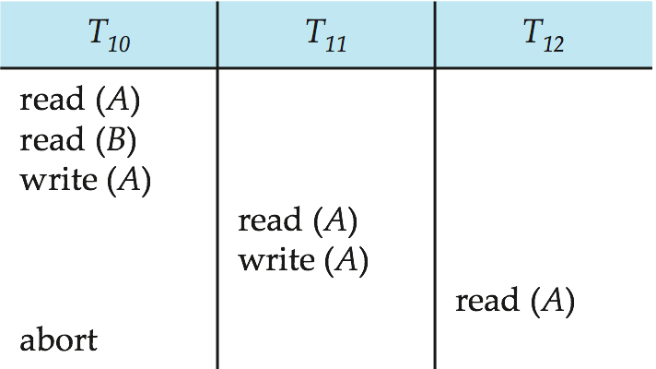
Cascading Rollbacks
Cascading rollback – a single transaction failure leads to a series of transaction rollbacks. Consider the following schedule where none of the transactions has yet committed (so the schedule is recoverable) If T₁₀ fails, T₁₁ and T₁₂ must also be rolled back.
Can lead to the undoing of a significant amount of work

Slide 42
Cascadeless Schedules
Cascadeless schedules — cascading rollbacks cannot occur;
for each pair of transactions T_{i} and T_{j} such that T_{j} reads a data item previously written by T_{i}, the commit operation of T_{i} appears before the read operation of T_{j}.
Every cascadeless schedule is also recoverable
It is desirable to restrict the schedules to those that are cascadeless

Slide 43
Concurrency Control
A database must provide a mechanism that will ensure that all possible schedules are
either conflict or view serializable,
are recoverable and
preferably cascadeless
A policy in which only one transaction can execute at a time generates serial schedules, but provides a poor degree of concurrency
Q: Are serial schedules recoverable/cascadeless?
Testing a schedule for serializability after it has executed is a little too late!
Goal – develop concurrency control protocols that will assure serializability.

Slide 44
Concurrency Control (Cont.)
Concurrency-control schemes tradeoff between the amount of concurrency they allow
and
the amount of overhead that they incur.
Some schemes allow only conflict-serializable schedules to be generated, while others allow view-serializable schedules that are not conflict-serializable.

Slide 45
Concurrency Control vs. Serializability Tests
Concurrency-control protocols allow concurrent schedules, but ensure that the schedules are conflict/view serializable, and are recoverable and cascadeless .
Concurrency control protocols generally do not examine the precedence graph as it is being created
Instead a protocol imposes a discipline that avoids nonseralizable schedules.
Different concurrency control protocols provide different tradeoffs between the amount of concurrency they allow and the amount of overhead that they incur.
Tests for serializability help us understand why a concurrency control protocol is correct.

Slide 46
Weak Levels of Consistency
Some applications are willing to live with weak levels of consistency, allowing schedules that are not serializable
E.g. a read-only transaction that wants to get an approximate total balance of all accounts
E.g. database statistics computed for query optimization can be approximate (why?)
Such transactions need not be serializable with respect to other transactions
Tradeoff accuracy for performance

Slide 47
Levels of Consistency in SQL-92
Serializable — default
Repeatable read — only committed records to be read, repeated reads of same record must return same value. However, a transaction may not be serializable – it may find some records inserted by a transaction but not find others.
Read committed — only committed records can be read, but successive reads of record may return different (but committed) values.
Read uncommitted — even uncommitted records may be read.
Lower degrees of consistency useful for gathering approximate information about the database
Warning: some DBMSes do not ensure serializable schedules by default
E.g. Oracle and PostgreSQL by default support a level of consistency called snapshot isolation (not part of the SQL standard)

Slide 48
A Briefer on Oracle Internals

Slide 49
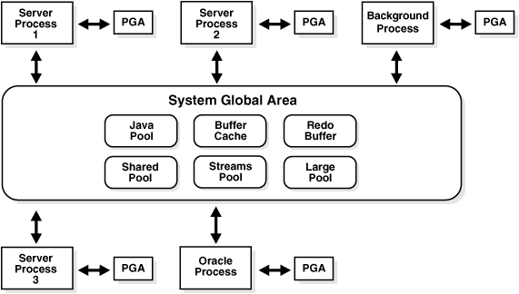
Oracle Memory Structures

Slide 50
Overview of the System Global Area
A system global area (SGA) is a group of shared memory structures that contain data and control information for one Oracle database instance.
If multiple users are concurrently connected to the same instance, then the data in the instance's SGA is shared among the users.
the SGA is sometimes called the shared global area.
An SGA and Oracle processes constitute an Oracle instance.
Oracle automatically allocates memory for an SGA when you start an instance,
the OS reclaims the memory when you shut down the instance.
Each instance has its own SGA.
The SGA is read/write.

Slide 51
Log Writer Process (LGWR)
Log writer process (LGWR) is responsible for redo log buffer management
writing the redo log buffer to a redo log file on disk.
LGWR writes all redo entries that have been copied into the buffer since the last time it wrote
A commit record when a user process commits a transaction
Redo log buffers
When a user commits a transaction, the transaction is assigned a system change number (SCN)
Oracle records it along with the transaction's redo entries in the redo log.
SCNs are recorded in the redo log so that recovery operations can be synchronized in Real Application Clusters and distributed databases.

Slide 52
COMMIT transaction
Before COMMIT
generated rollback segment records in buffers in the SGA
generated redo log entries in the redo log buffer of the SGA.
The changes have been made to the database buffers of the SGA.
After COMMIT
The internal transaction table for the associated rollback segment records updated with SCN
LGWR writes SGA redo log entries to the online redo log file
Oracle releases locks
Oracle marks the transaction complete.

Slide 53
ROLLBACK transaction
ROLLBACK
Oracle undoes all transaction changes using the undo tablespace or rollback segments
Oracle releases all the transaction’s locks of data
The transaction ends
ROLLBACK to SAVEPOINT
Oracle rolls back only the statements run after the savepoint.
Oracle preserves the specified savepoint, but all savepoints that were established after the specified one are lost
Oracle releases all table and row locks acquired since that savepoint

Slide 54
State of the Data Before COMMIT or ROLLBACK
The previous state of the data can be recovered.
The current user can review the results of the DML operations by using the SELECT statement.
Other users cannot view the results of the DML statements by the current user.
The affected rows are locked
Other users cannot change the data within the affected rows.

Slide 55
State of the Data after COMMIT
Data changes are made permanent in the database.
The previous state of the data is permanently lost.
All users can view the results.
Locks on the affected rows are released; those rows are available for other users to manipulate.
All savepoints are erased.

Slide 56
Data Concurrency and Consistency
Data concurrency means that many users can access data at the same time.
Data consistency means that each user sees a consistent view of the data, including visible changes made by the user’s own transactions and transactions of other users.

Slide 57
The isolation models prevents
Dirty reads
Nonrepeatable (fuzzy) reads
Phantom reads

Slide 58
Isolation levels (SQL92) controls
Isolation Level | Dirty Read | Nonrepeatable Read | Phantom Read
Read uncommitted | Y | Y | Y
Read committed | N | Y | Y
Repeatable read | N | N | Y
Serializable | N | N | N

Slide 59
Oracle isolation levels
Read committed | Each query executed by a transaction sees only data that was committed before the query began (Oracle default isolation level)
Serializable | Serializable transactions see only those changes that were committed at the time the transaction began, plus its own changes
Read-only | The transaction sees only those changes that were committed at the time the transaction began and do not allow any DML statement

Slide 60
Multiversion Concurrency Control
Statement-level read consistency
The data returned by a single query comes from a single point in time — the time that the query began
Transaction-level read consistency
When a transaction executes in serializable mode, all data accesses reflect the state of the database as of the time the transaction began

Slide 61
Common recommendations
Keep transactions as fast as possible
Increase the size/number of rollback segments
Avoid executing long-running queries when transactions which update the table are also executing.

Slide 62
Set the Isolation Level
You can set the isolation level of a transaction by using one of these statements at the beginning of a transaction:
SET TRANSACTION ISOLATION LEVEL READ COMMITTED;
SET TRANSACTION ISOLATION LEVEL SERIALIZABLE;
SET TRANSACTION ISOLATION LEVEL READ ONLY;

Slide 63
Serializable Transaction Failure

Slide 64
Modes of Locking
Exclusive lock
The mode prevents the associates resource from being shared
Share lock
The mode allows the associated resource to be shared, depending on the operations involved

Slide 65
Deadlock

Slide 66
Types of Locks
Lock | Description
DML locks (data locks) | DML locks protect data For example, table locks lock entire tables, rowlocks lock selected rows.
DDL locks (dictionary locks) | DDL locks protect the structure of schema objects
Internal locks and latches | Internal locks and latches protect internal database structures such as datafiles

