Slide 1
Recursion
Chapter 5

Slide 2
Chapter Objectives
To understand how to think recursively
To learn how to trace a recursive method
To learn how to write recursive algorithms and methods for searching arrays
To learn about recursive data structures and recursive methods for a LinkedList class
To understand how to use recursion to solve the Towers of Hanoi problem
To understand how to use recursion to process two-dimensional images
To learn how to apply backtracking to solve search problems such as finding a path through a maze

Slide 3
Recursion
Recursion can solve many programming problems that are difficult to conceptualize and solve linearly
In the field of artificial intelligence, recursion often is used to write programs that exhibit intelligent behavior:
playing games of chess
proving mathematical theorems
recognizing patterns, and so on
Recursive algorithms can
compute factorials
compute a greatest common divisor
process data structures (strings, arrays, linked lists, etc.)
search efficiently using a binary search
find a path through a maze, and more

Slide 4
Recursive Thinking

Slide 5
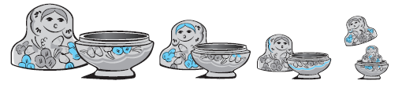
Recursive Thinking
Recursion is a problem-solving approach that can be used to generate simple solutions to certain kinds of problems that are difficult to solve by other means
Recursion reduces a problem into one or more simpler versions of itself

Slide 6
Recursive Thinking (cont.)
Recursive Algorithm to Process Nested Figures
if there is one figure
do whatever is required to the figure
else
do whatever is required to the outer figure
process the figures nested inside the outer figure in the same way

Slide 7
Recursive Thinking (cont.)
Consider searching for a target value in an array
Assume the array elements are sorted in increasing order
We compare the target to the middle element and, if the middle element does not match the target, search either the elements before the middle element or the elements after the middle element
Instead of searching n elements, we search n/2 elements

Slide 8
Recursive Thinking (cont.)
Recursive Algorithm to Search an Array
if the array is empty
return -1 as the search result
else if the middle element matches the target
return the subscript of the middle element as the result
else if the target is less than the middle element
recursively search the array elements preceding the middle element and return the result
else
recursively search the array elements following the middle element and return the result

Slide 9
Steps to Design a Recursive Algorithm
There must be at least one case (the base case), for a small value of n, that can be solved directly
A problem of a given size n can be reduced to one or more smaller versions of the same problem (recursive case(s))
Identify the base case(s) and solve it/them directly
Devise a strategy to reduce the problem to smaller versions of itself while making progress toward the base case
Combine the solutions to the smaller problems to solve the larger problem

Slide 10
Google interview questions
How will you implement three stacks with one array.
Create a Java program to find middle node of linked list in Java in one pass?

Slide 11
Recursive Algorithm for Finding the Length of a String
if the string is empty (has no characters)
the length is 0
else
the length is 1 plus the length of the string that excludes the first character

Slide 12
Recursive Algorithm for Finding the Length of a String (cont.)
/** Recursive method length
@param str The string
@return The length of the string
*/
public static int length(String str) {
if (str == null || str.equals(""))
return 0;
else
return 1 + length(str.substring(1));
}
Base case
Reduce Step

Slide 13
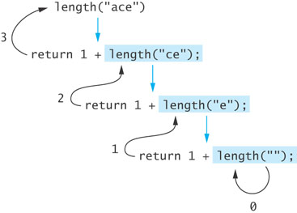
Tracing a Recursive Method
The process of returning from recursive calls and computing the partial results is called unwinding the recursion

Slide 14
Recursive Algorithm for Printing String Characters
/** Recursive method printChars
post: The argument string is displayed, one character per line
@param str The string
*/
public static void printChars(String str) {
if (str == null || str.equals(""))
return;
else {
System.out.println(str.charAt(0));
printChars(str.substring(1));
}
}

Slide 15
Recursive Algorithm for Printing String Characters in Reverse
/** Recursive method printCharsReverse
post: The argument string is displayed in reverse, one character per line
@param str The string
*/
public static void printCharsReverse(String str) {
if (str == null || str.equals(""))
return;
else {
printCharsReverse(str.substring(1));
System.out.println(str.charAt(0));
}
}
Interview Question:
Write Java program to reverse String in Java without using API functions ?

Slide 16
Proving that a Recursive Method is Correct
Proof by induction
Prove the theorem is true for the base case
Show that if the theorem is assumed true for n, then it must be true for n+1
Recursive proof is similar to induction
Verify the base case is recognized and solved correctly
Verify that each recursive case makes progress towards the base case
Verify that if all smaller problems are solved correctly, then the original problem also is solved correctly

Slide 17
Run-Time Stack and Activation Frames
Java maintains a run-time stack on which it saves new information in the form of an activation frame
The activation frame contains storage for
method arguments
local variables (if any)
the return address of the instruction that called the method
Whenever a new method is called (recursive or not), Java pushes a new activation frame onto the run-time stack

Slide 18
Run-Time Stack and Activation Frames (cont.)

Slide 19
Stacks and Recursion in Action
length(“”)
length(e)
length(e)
length(ce)
length(ce)
length(ce)
length(ace)
length(ace)
length(ace)
length(ace)
main()
main()
main()
main()
main()
Time: 0
Empty Stack
Time 1:
Push: main()
Time 2:
Push: length(ace)
Time 3:
Push: length(ce)
Time 3:
Push: length(e)
Time 4:
Push: length(“”)
length(“”)
length(e)
length(e)
length(ce)
length(ce)
length(ce)
length(ace)
length(ace)
length(ace)
length(ace)
main()
main()
main()
main()
Time 5:
Pop: length(“”)
Return: 0
Time 6:
Pop: length(e)
Return: 0+1
Time 7:
Pop: length(ce)
Return: 1+1
Time 7:
Pop: length(ace)
Return: 2+1

Slide 20
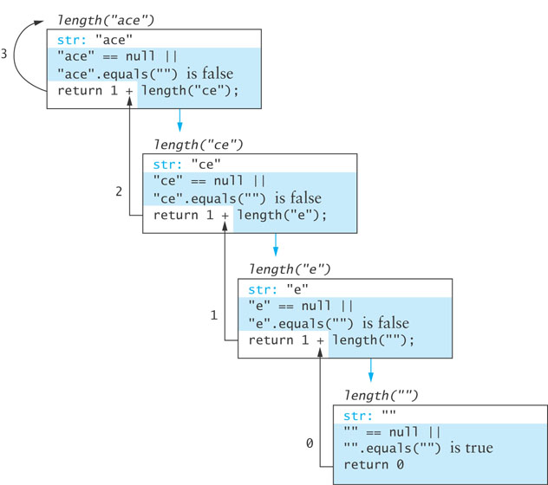
Run-Time Stack and Activation Frames

Slide 21
Recursive Definitions of Mathematical Formulas

Slide 22
Recursive Definitions of Mathematical Formulas
Mathematicians often use recursive definitions of formulas that lead naturally to recursive algorithms
Examples include:
factorials
powers
greatest common divisors (gcd)

Slide 23
Google Interview Question
You are climbing a stair case. Each time you can either make 1 step or 2 steps. The staircase has n steps. In how many distinct ways can you climb the staircase ?

Slide 24
Factorial of n: n!
The factorial of n, or n! is defined as follows:
0! = 1
n! = n x (n -1)! (n > 0)
The base case: n is equal to 0
The second formula is a recursive definition

Slide 25
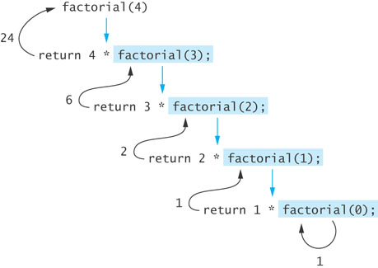
Factorial of n: n! (cont.)
The recursive definition can be expressed by the following algorithm:
if n equals 0
n! is 1
else
n! = n x (n – 1)!
The last step can be implemented as:
return n * factorial(n – 1);

Slide 26
Factorial of n: n! (cont.)
public static int factorial(int n)
{
if (n == 0)
return 1;
else
return n * factorial(n – 1);
}

Slide 27
Infinite Recursion and Stack Overflow
If you call method factorial with a negative argument, the recursion will not terminate because n will never equal 0
If a program does not terminate, it will eventually throw the StackOverflowError exception
Make sure your recursive methods are constructed so that a stopping case is always reached
In the factorial method, you could throw an IllegalArgumentException if n is negative

Slide 28
Recursive Algorithm for Calculating x^{n}
Recursive Algorithm for Calculating x^{n} (n ≥ 0)
if n is 0
The result is 1
else
The result is x × x^{n–1}
/** Recursive power method (in RecursiveMethods.java).
pre: n >= 0
@param x The number being raised to a power
@param n The exponent
@return x raised to the power n
*/
public static double power(double x, int n) {
if (n == 0)
return 1;
else
return x * power(x, n – 1);
}

Slide 29
Recursive Algorithm for Calculating gcd
The greatest common divisor (gcd) of two numbers is the largest integer that divides both numbers
The gcd of 20 and 15 is 5
The gcd of 36 and 24 is 12
The gcd of 38 and 18 is 2
The gcd of 17 and 97 is 1

Slide 30
Recursive Algorithm for Calculating gcd (cont.)
Given 2 positive integers m and n (m > n)
if n is a divisor of m
gcd(m, n) = n
else
gcd (m, n) = gcd (n, m % n)

Slide 31
Recursive Algorithm for Calculating gcd (cont.)
/** Recursive gcd method (in RecursiveMethods.java).
pre: m > 0 and n > 0
@param m The larger number
@param n The smaller number
@return Greatest common divisor of m and n
*/
public static double gcd(int m, int n) {
if (m % n == 0)
return n;
else if (m < n)
return gcd(n, m); // Transpose arguments.
else
return gcd(n, m % n);
}

Slide 32
Recursion Versus Iteration
There are similarities between recursion and iteration
In iteration, a loop repetition condition determines whether to repeat the loop body or exit from the loop
In recursion, the condition usually tests for a base case
You can always write an iterative solution to a problem that is solvable by recursion
A recursive algorithm may be simpler than an iterative algorithm and thus easier to write, code, debug, and read

Slide 33
Iterative factorial Method
/** Iterative factorial method.
pre: n >= 0
@param n The integer whose factorial is being computed
@return n!
*/
public static int factorialIter(int n) {
int result = 1;
for (int k = 1; k <= n; k++)
result = result * k;
return result;
}

Slide 34
Efficiency of Recursion
Recursive methods often have slower execution times relative to their iterative counterparts
The overhead for loop repetition is smaller than the overhead for a method call and return
If it is easier to conceptualize an algorithm using recursion, then you should code it as a recursive method
The reduction in efficiency usually does not outweigh the advantage of readable code that is easy to debug

Slide 35
Recursive Array Search

Slide 36
Recursive Array Search
Searching an array can be accomplished using recursion
Simplest way to search is a linear search
Examine one element at a time starting with the first element and ending with the last
On average, (n + 1)/2 elements are examined to find the target in a linear search
If the target is not in the list, n elements are examined
A linear search is O(n)

Slide 37
Recursive Array Search (cont.)
Base cases for recursive search:
Empty array, target can not be found; result is -1
First element of the array being searched = target; result is the subscript of first element
The recursive step searches the rest of the array, excluding the first element

Slide 38
Algorithm for Recursive Linear Array Search
Algorithm for Recursive Linear Array Search
if the array is empty
the result is –1
else if the first element matches the target
the result is the subscript of the first element
else
search the array excluding the first element and return the result

Slide 39
Implementation of Recursive Linear Search

Slide 40
Implementation of Recursive Linear Search (cont.)
A non-recursive wrapper method:
/** Wrapper for recursive linear search method
@param items The array being searched
@param target The object being searched for
@return The subscript of target if found;
otherwise -1
*/
public static int linearSearch(Object[] items, Object target) {
return linearSearch(items, target, 0);
}

Slide 41
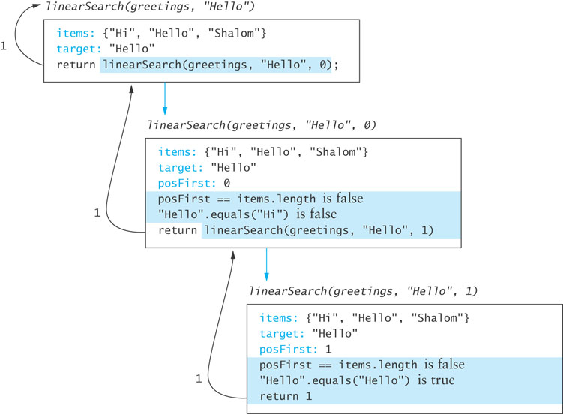
Implementation of Recursive Linear Search (cont.)

Slide 42
Design of a Binary Search Algorithm
A binary search can be performed only on an array that has been sorted
Base cases
The array is empty
Element being examined matches the target
Rather than looking at the first element, a binary search compares the middle element for a match with the target
If the middle element does not match the target, a binary search excludes the half of the array within which the target cannot lie

Slide 43
Design of a Binary Search Algorithm (cont.)
Binary Search Algorithm
if the array is empty
return –1 as the search result
else if the middle element matches the target
return the subscript of the middle element as the result
else if the target is less than the middle element
recursively search the array elements before the middle element
and return the result
else
recursively search the array elements after the middle element and
return the result

Slide 44
Binary Search Algorithm
target
First call
Dustin
Caryn
Debbie
Dustin
Elliot
Jacquie
Jonathon
Rich
first = 0
middle = 3
last = 6

Slide 45
Binary Search Algorithm (cont.)
target
Second call
Dustin
Caryn
Debbie
Dustin
Elliot
Jacquie
Jonathon
Rich
first = 0
last = 2
middle = 1

Slide 46
Binary Search Algorithm (cont.)
target
Third call
Dustin
Caryn
Debbie
Dustin
Elliot
Jacquie
Jonathon
Rich
first= middle = last = 2

Slide 47
Efficiency of Binary Search
At each recursive call we eliminate half the array elements from consideration, making a binary search O(log n)
An array of 16 would search arrays of length 16, 8, 4, 2, and 1: 5 probes in the worst case
16 = 2⁴
5 = log₂16 + 1
A doubled array size would require only 6 probes in the worst case
32 = 2⁵
6 = log₂32 + 1
An array with 32,768 elements requires only 16 probes! (log₂32768 = 15)

Slide 48
Comparable Interface
Classes that implement the Comparable interface must define a compareTo method
Method call obj1.compareTo(obj2) returns an integer with the following values
negative if obj1 < obj2
zero if obj1 == obj2
positive if obj1 > obj2
Implementing the Comparable interface is an efficient way to compare objects during a search

Slide 49
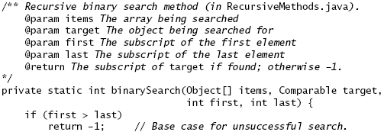
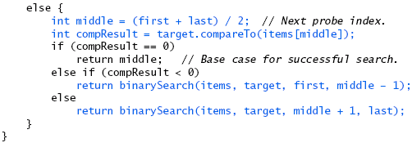
Implementation of a Binary Search Algorithm

Slide 50
Implementation of a Binary Search Algorithm (cont.)

Slide 51
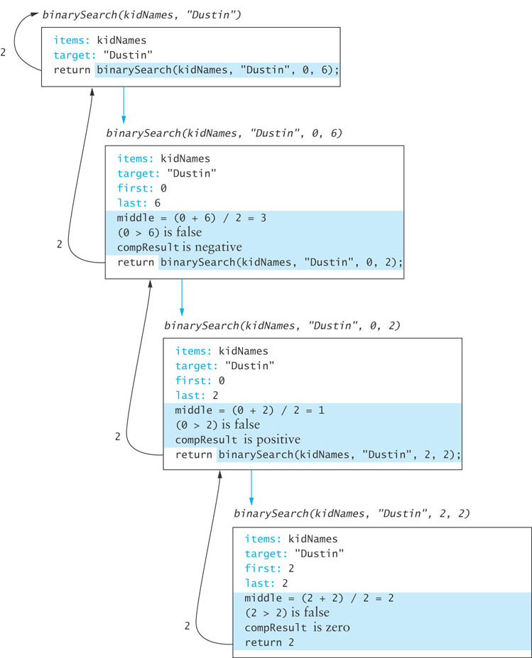
Trace of Binary Search

Slide 52
Testing Binary Search
You should test arrays with
an even number of elements
an odd number of elements
duplicate elements
Test each array for the following cases:
the target is the element at each position of the array, starting with the first position and ending with the last position
the target is less than the smallest array element
the target is greater than the largest array element
the target is a value between each pair of items in the array

Slide 53
Method Arrays.binarySearch
Java API class Arrays contains a binarySearch method
Called with sorted arrays of primitive types or with sorted arrays of objects
If the objects in the array are not mutually comparable or if the array is not sorted, the results are undefined
If there are multiple copies of the target value in the array, there is no guarantee which one will be found
Throws ClassCastException if the target is not comparable to the array elements

Slide 54
Recursive Data Structures
Section 5.4

Slide 55
Recursive Data Structures
Computer scientists often encounter data structures that are defined recursively – each with another version of itself as a component
Linked lists and trees (Chapter 6) can be defined as recursive data structures
Recursive methods provide a natural mechanism for processing recursive data structures
The first language developed for artificial intelligence research was a recursive language called LISP

Slide 56
Recursive Definition of a Linked List
A linked list is a collection of nodes such that each node references another linked list consisting of the nodes that follow it in the list
The last node references an empty list
A linked list is empty, or it contains a node, called the list head, that stores data and a reference to a linked list

Slide 57
Class LinkedListRec
We define a class LinkedListRec<E> that implements several list operations using recursive methods
public class LinkedListRec<E> {
private Node<E> head;
// inner class Node<E> here
// (from chapter 2)
}

Slide 58
Recursive size Method

Slide 59
Recursive toString Method

Slide 60
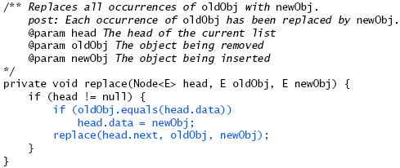
Recursive replace Method

Slide 61
Recursive add Method

Slide 62
Recursive remove Method

Slide 63
Recursive remove Method (cont.)

Slide 64
Problem Solving with Recursion
Section 5.5

Slide 65
Fibonacci Numbers
Fibonacci numbers were used to model the growth of a rabbit colony
fib₁ = 1
fib₂ = 1
fib_{n} = fib_{n-1} + fib_{n-2}
1, 1, 2, 3, 5, 8, 13, 21, 34, 55, 89, 144, …

Slide 66
An Exponential Recursive fibonacci Method

Slide 67
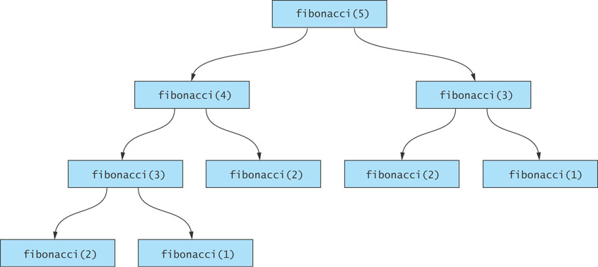
Efficiency of Recursion: Exponential fibonacci
Inefficient
redundant

Slide 68
Fibonacci Sequence
1+1=2
1+2=3
2+3=5
3+5=8
5+8=13
8+13=21

Slide 69
Google Interview Question
You are climbing a stair case. Each time you can either make 1 step or 2 steps. The staircase has n steps. In how many distinct ways can you climb the staircase ?
Solution:
Let f(i) be the number of ways that can be taken to reach step i.
If we assume that we are about to take the last step for reaching i, either we are at step i-1 or at step i-2.
Coming to step (i-1) we could have taken f(i-1) ways
Coming to step i-2, we could have taken f(i-2) different ways.
Hence, f(i) = f(i-1) + f(i).

Slide 70
Backtracking
Backtracking is an approach to implementing a systematic trial and error search for a solution
Example
Finding a path through a maze
If you are attempting to walk through a maze, you will probably walk down a path as far as you can go
Eventually, you will reach your destination or you won’t be able to go any farther
If you can’t go any farther, you will need to consider alternative paths
Backtracking is a systematic, nonrepetitive approach to trying alternative paths and eliminating them if they don’t work

Slide 71
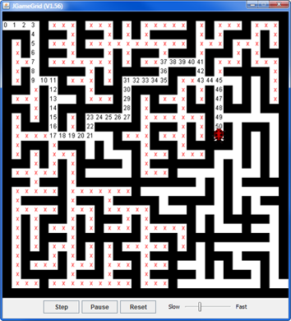
Finding a Path through a Maze
Problem
Use backtracking to find the path through a maze
From each point in a maze you can move to the next cell in a horizontal or vertical direction if the cell is not blocked
http://www.gamegrid.ch/gamegridEnglish/index.php?inhalt_mitte=backtracking/labyrinth.inc.php

Slide 72
Finding a Path through a Maze (cont.)
Analysis
The maze will consist of a grid of colored cells
The starting point is at the top left corner (0,0)
The exit point is at the bottom right corner
All cells on the path will be BACKGROUND color
All cells that represent barriers will be ABNORMAL color
Cells that we have visited will be TEMPORARY color
If we find a path, all cells on the path will be set to PATH color

Slide 73
Finding a Path through a Maze

Slide 74
Backtracking (cont.)
Does it ever terminate?
If you never try the same path more than once, you will eventually find a solution path if one exists
Problems that are solved by backtracking can be described as a set of choices made by some method
Recursion allows you to implement backtracking in a relatively straightforward manner
Each activation frame is used to remember the choice that was made at that particular decision point

Slide 75
Backtracking (animation)
dead end
?
dead end
dead end
?
start
?
?
dead end
dead end
?
success!

Slide 76
Implementation
Listing 5.4 (Maze.java, pages 286-287)
Test for a variety of test cases:
Mazes that can be solved
Mazes that can't be solved
A maze with no barrier cells
A maze with a single barrier cell at the exit point

