Slide 1
Text Processing
Information Retrieval in Practice
All slides ©Addison Wesley, 2008
TexPoint fonts used in EMF.
Read the TexPoint manual before you delete this box.: AA

Slide 2
Processing Text
Converting documents to index terms
Why?
  Matching the exact string of characters typed by the user is too restrictive
    It doesn’t work very well in terms of effectiveness
  Not all words are of equal value in a search
  Sometimes not clear where words begin and end
    Not even clear what a word is in some languages
      e.g., Chinese, Korean

Slide 3

Text Statistics
Huge variety of words used in text but
Many statistical characteristics of word occurrences are predictable
  e.g., distribution of word counts
Retrieval models and ranking algorithms depend heavily on statistical properties of words
  e.g., important words occur often in documents, but are not high frequency in collection

Slide 4
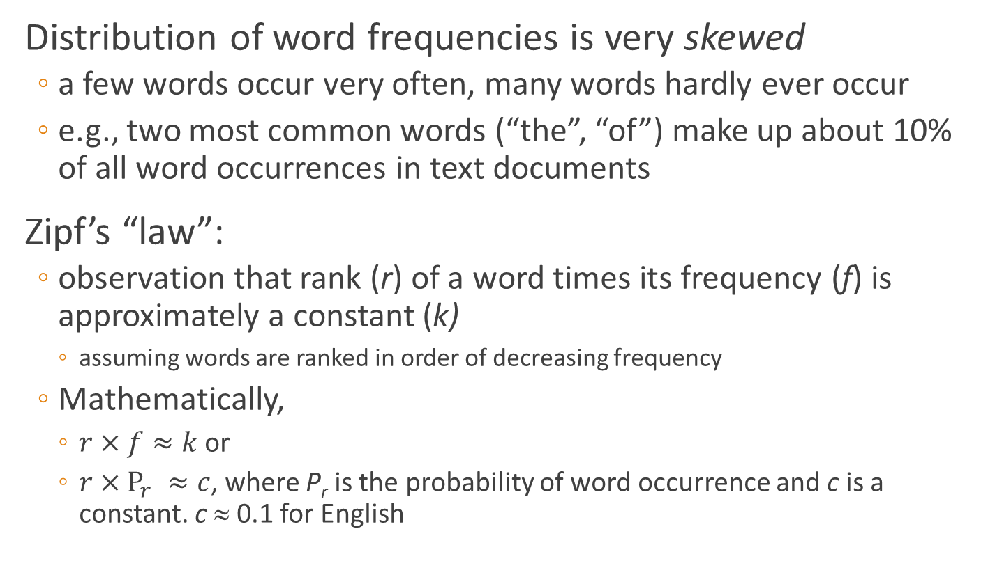
Zipf’s Law
Distribution of word frequencies is very skewed
  a few words occur very often, many words hardly ever occur
  e.g., two most common words (“the”, “of”) make up about 10% of all word occurrences in text documents
Zipf’s “law”:
  observation that rank (r) of a word times its frequency (f) is approximately a constant (k)
    assuming words are ranked in order of decreasing frequency
  Mathematically,
    $r×f≈k$ or
    $r×P_{r} ≈c$, where P_{r} is the probability of word occurrence and c is a constant. c ≈ 0.1 for English

Slide 5

Zipf’s Law
frequency decreases very rapidly with rank

Slide 6

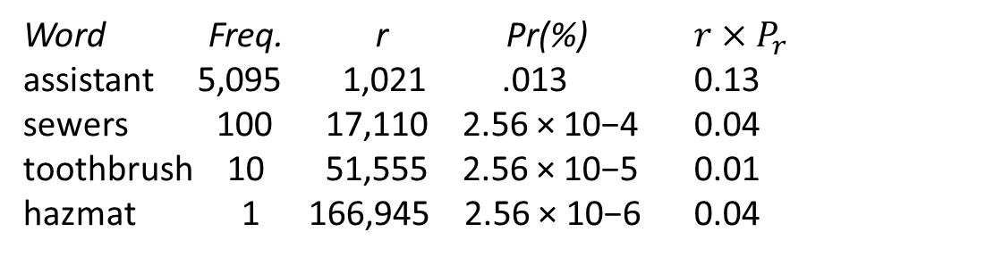
News Collection (AP89) Statistics
Total documents 84,678
Total word occurrences 39,749,179
Vocabulary size 198,763
Words occurring > 1000 times 4,169
Words occurring once 70,064
Word Freq. r Pr(%) $r×P_{r}$
assistant 5,095 1,021 .013 0.13
sewers 100 17,110 2.56 × 10−4 0.04
toothbrush 10 51,555 2.56 × 10−5 0.01
hazmat 1 166,945 2.56 × 10−6 0.04

Slide 7
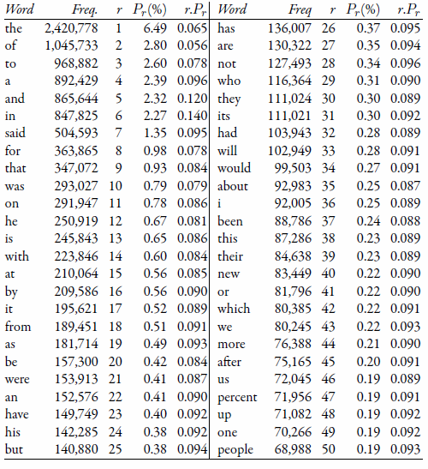
Top 50 Words from AP89

Slide 8
Zipf’s Law for AP89 (log-log plot)
Note problems at high and low frequencies

Slide 9
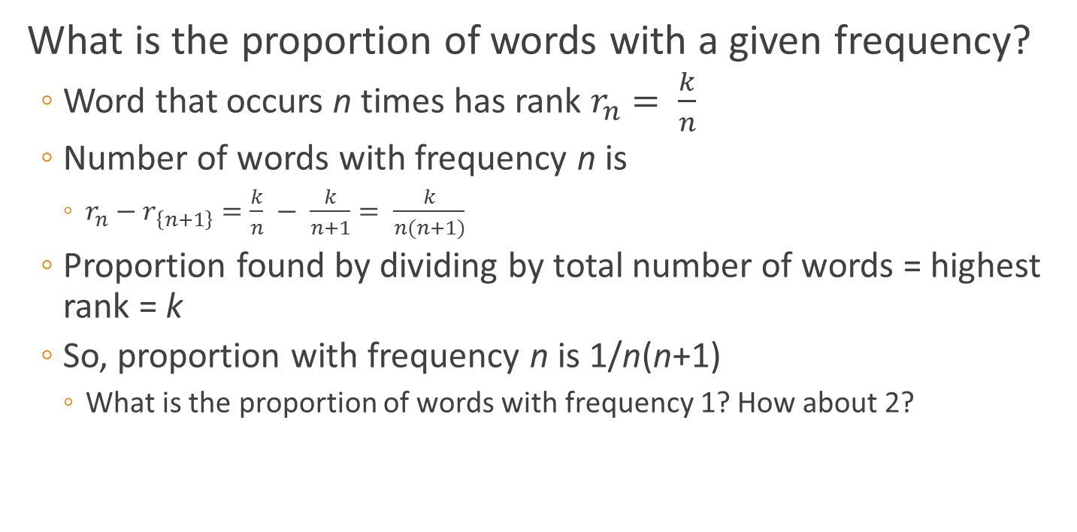
Zipf’s Law
What is the proportion of words with a given frequency?
  Word that occurs n times has rank $r_{n}= \frac{k}{n}$
  Number of words with frequency n is
    $r_{n}−r_{\left\{n+1\right\}}=\frac{k}{n} − \frac{k}{n+1}= \frac{k}{n(n+1)}$
  Proportion found by dividing by total number of words = highest rank = k
  So, proportion with frequency n is 1/n(n+1)
    What is the proportion of words with frequency 1? How about 2?

Slide 10
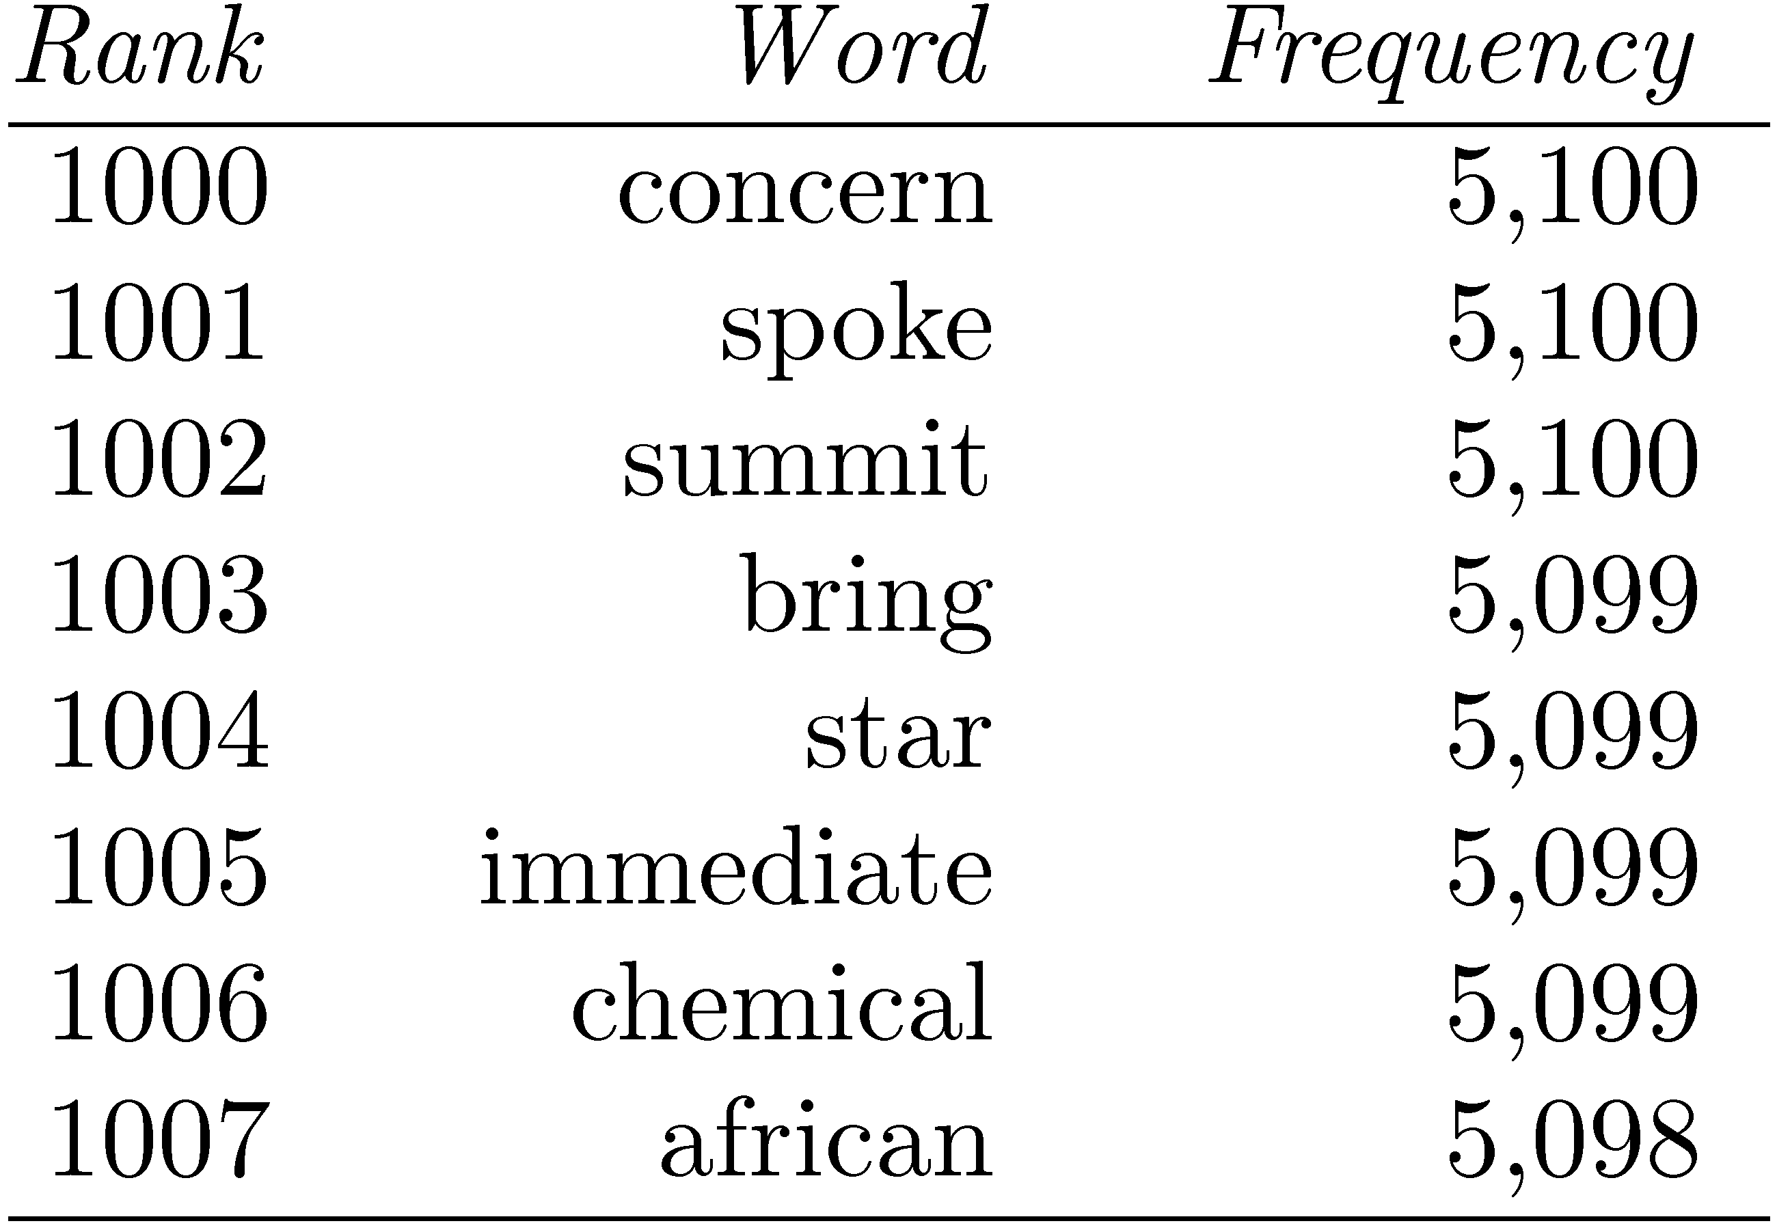
Zipf’s Law
Example word
frequency ranking
To compute number of words with frequency 5,099
  rank of “chemical” minus the rank of “summit”
  1006 − 1002 = 4

Slide 11
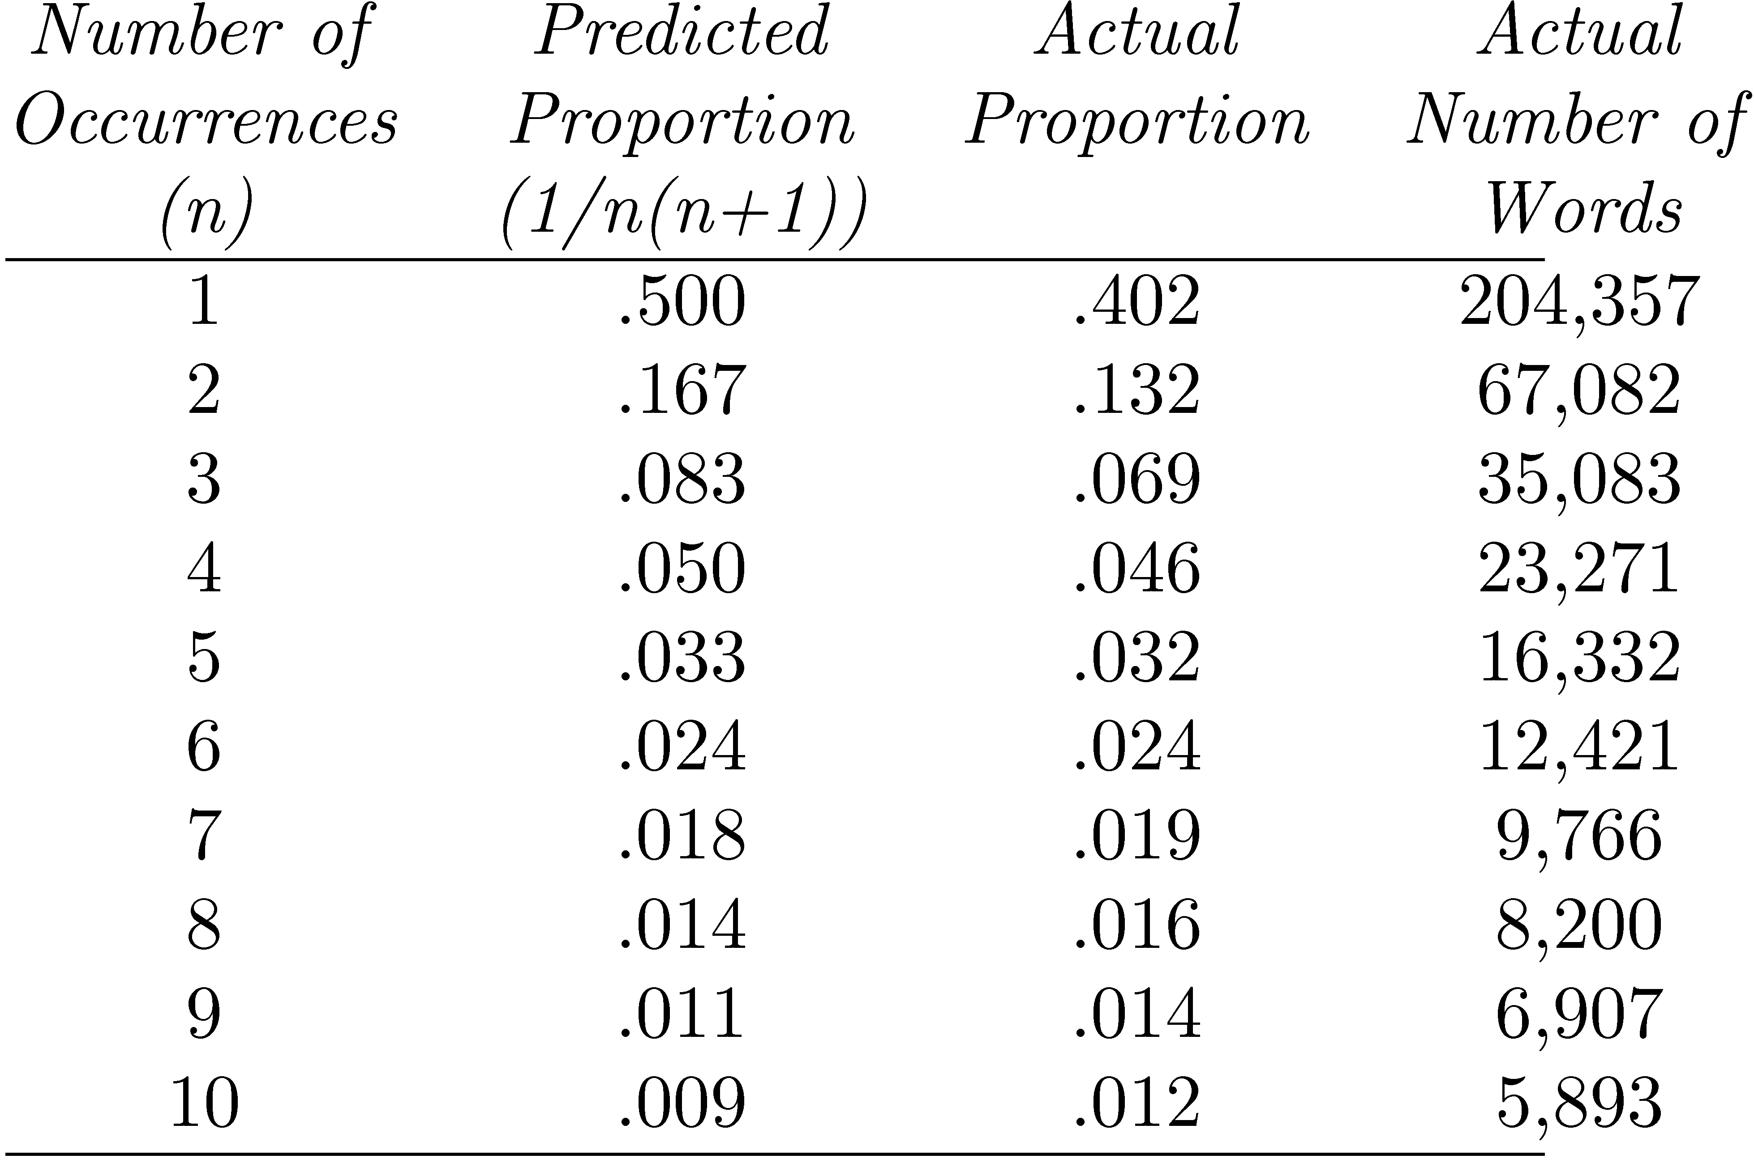
Example
Proportions of words occurring n times in 336,310 TREC documents
Vocabulary size is 508,209

Slide 12
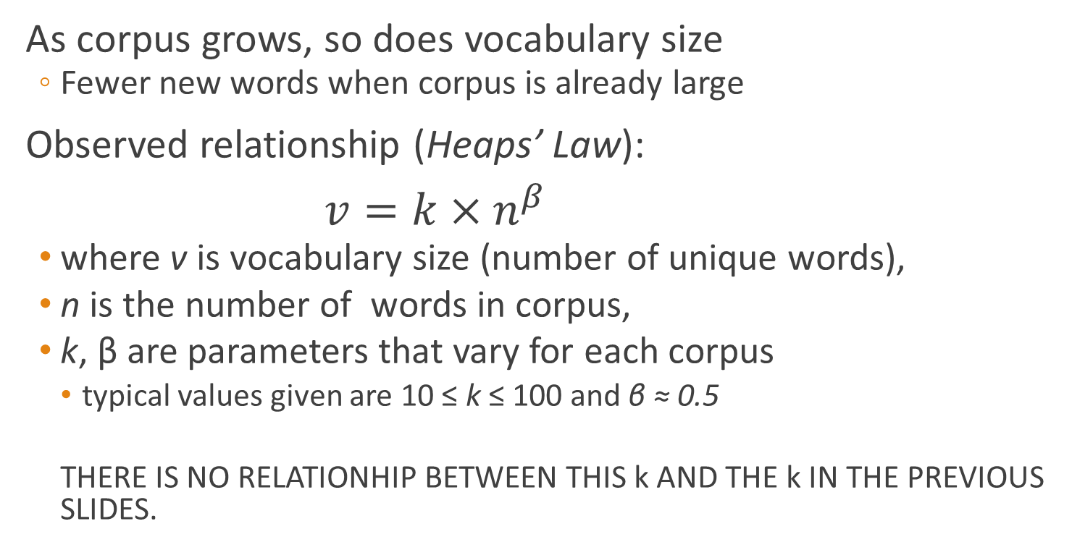
Vocabulary Growth
As corpus grows, so does vocabulary size
  Fewer new words when corpus is already large
Observed relationship (Heaps’ Law):
$v=k×n^{β}$
  where v is vocabulary size (number of unique words),
  n is the number of words in corpus,
  k, β are parameters that vary for each corpus
    typical values given are 10 ≤ k ≤ 100 and β ≈ 0.5
    THERE IS NO RELATIONHIP BETWEEN THIS k AND THE k IN THE PREVIOUS SLIDES.

Slide 13
AP89 Example

Slide 14
Heaps’ Law Predictions
Predictions for TREC collections are accurate for large numbers of words
  e.g., first 10,879,522 words of the AP89 collection scanned
  prediction is 100,151 unique words
  actual number is 100,024
Predictions for small numbers of words (i.e. < 1000) are much worse

Slide 15
Web Example
New words come from a variety of sources
    spelling errors, invented words (e.g. product, company names), code, other languages, email addresses, etc.
Search engines must deal with these large and growing vocabularies

Slide 16

Estimating Result Set Size
How many pages contain all of the query terms?
For the query “a b c”:
  f_{abc} = N · f_{a}/N · f_{b}/N · f_{c}/N = (f_{a} · f_{b} · f_{c})/N²
    Assuming that terms occur independently
    f_{abc} is the estimated size of the result set
    f_{a}, f_{b}, f_{c} are the number of documents that terms a, b, and c occur in
    N is the number of documents in the collection

Slide 17
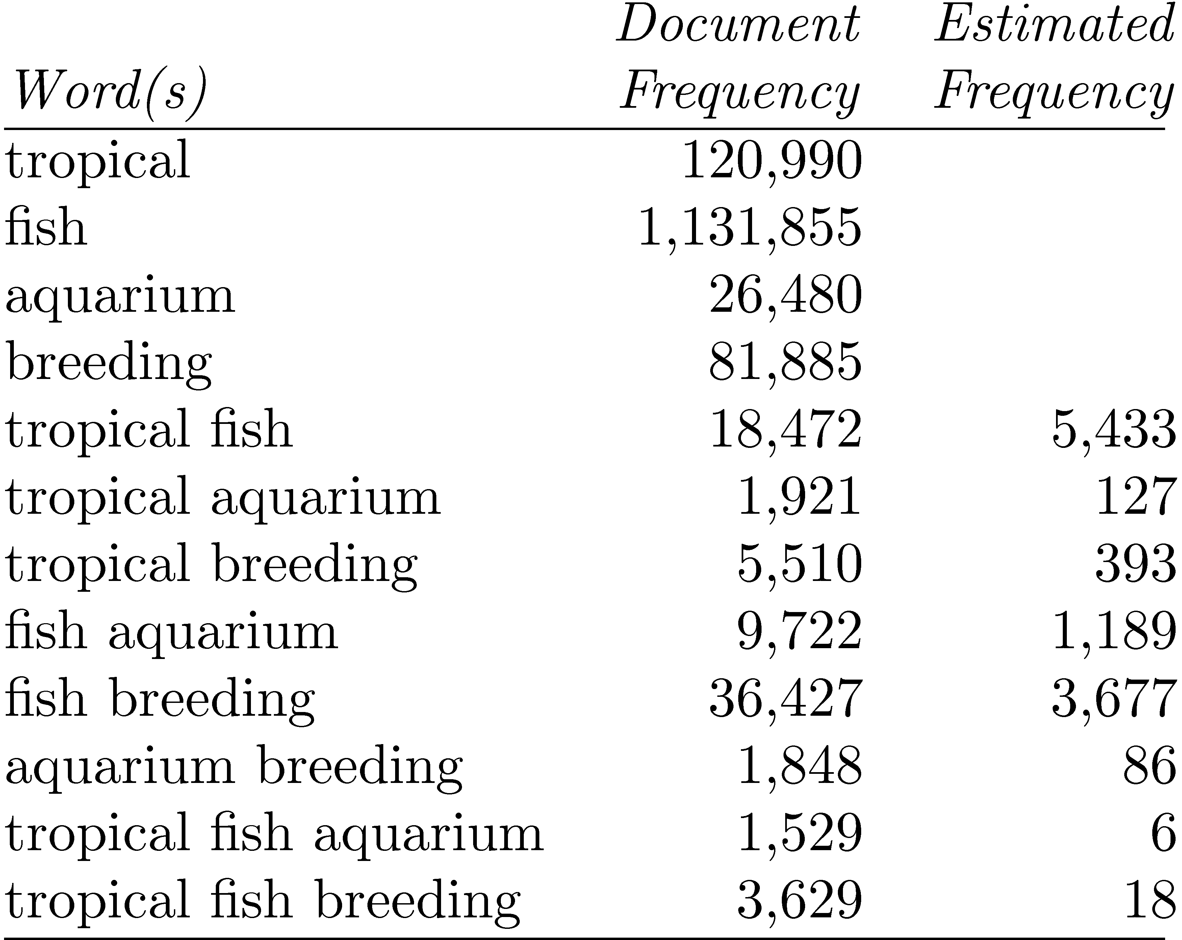
GOV2 Example
Collection size (N) is 25,205,179

Slide 18
Result Set Size Estimation
Poor estimates because words are not independent
Better estimates possible if co-occurrence information available
  P(a ∩ b ∩ c) = P(a ∩ b) · P(c|(a ∩ b))
  approximate P(c|(a ∩ b)) by max{P(c|a), P(c|b)}
  Example:
  f_{tropical∩fish∩aquarium} = f_{tropical∩aquarium} · f_{fish∩aquarium}/f_{aquarium}
  = 1921 · 9722/26480 = 705
  f_{tropical∩fish∩breeding} = f_{tropical∩breeding} · f_{fish∩breeeding}/f_{breeding}
  = 5510 · 36427/81885 = 2451

Slide 19
Result Set Estimation
Even better estimates using initial result set
  Estimate is simply C/s
    where s is the proportion of the total documents that have been ranked, and
    C is the number of documents found that contain all the query words
  E.g., “tropical fish aquarium” in GOV2
    after processing 3,000 out of the 26,480 documents that contain “aquarium”, C = 258
    f_{tropical∩fish∩aquarium} = 258/(3000÷26480) = 2,277
    After processing 20% of the documents,
    f_{tropical∩fish∩aquarium} = 1,778 (1,529 is real value)

Slide 20
Estimating Collection Size
Important issue for Web search engines
Simple technique: use independence model
  Given two words a and b that are independent
  f_{ab}/N = f_{a}/N · f_{b}/N
  N = (f_{a} · f_{b})/f_{ab}
  e.g., for GOV2
    f_{lincoln} = 771,326 f_{tropical} = 120,990 f_{lincoln ∩ tropical} = 3,018
    N = (120990 · 771326)/3018 = 30,922,045
    (actual number is 25,205,179)

Slide 21
Tokenization

Slide 22

Recall the Basic Indexing Pipeline
Documents to
be indexed
Friends, Romans, countrymen.
Tokenizer
Token stream
Friends
Romans
Countrymen
Linguistic modules
Modified tokens
friend
roman
countryman
Indexer
friend
2
4
roman
1
2
Inverted index
countryman
13
16
Notes:
Circle documents

Slide 23
Tokenizing
Forming words from sequence of characters
Surprisingly complex in English, can be harder in other languages
Early IR systems:
  any sequence of alphanumeric characters of length 3 or more
  terminated by a space or other special character
  upper-case changed to lower-case

Slide 24
Tokenizing
Example:
  “Bigcorp's 2007 bi-annual report showed profits rose 10%.” becomes
  “bigcorp 2007 annual report showed profits rose”
Too simple for search applications or even large-scale experiments
Why? Too much information lost
  Small decisions in tokenizing can have major impact on effectiveness of some queries

Slide 25
Tokenizing Problems
Small words can be important in some queries, usually in combinations
    xp, ma, pm, ben e king, el paso, master p, gm, j lo, world war II
Both hyphenated and non-hyphenated forms of many words are common
  Sometimes hyphen is not needed
    e-bay, wal-mart, active-x, cd-rom, t-shirts
  At other times, hyphens should be considered either as part of the word or a word separator
    winston-salem, mazda rx-7, e-cards, pre-diabetes, t-mobile, spanish-speaking

Slide 26
Tokenizing Problems
Special characters are an important part of tags, URLs, code in documents
Capitalized words can have different meaning from lower case words
  Bush, Apple
Apostrophes can be a part of a word, a part of a possessive, or just a mistake
  rosie o'donnell, can't, don't, 80's, 1890's, men's straw hats, master's degree, england's ten largest cities, shriner's

Slide 27
Tokenizing Problems
Numbers can be important, including decimals
  nokia 3250, top 10 courses, united 93, quicktime 6.5 pro, 92.3 the beat, 288358
Periods can occur in numbers, abbreviations, URLs, ends of sentences, and other situations
  I.B.M., Ph.D., cis.temple.edu, F.E.A.R.
Note: tokenizing steps for queries must be identical to steps for documents

Slide 28
Tokenizing Process
First step is to use parser to identify appropriate parts of document to tokenize
Defer complex decisions to other components
  word is any sequence of alphanumeric characters, terminated by a space or special character, with everything converted to lower-case
  everything indexed
  example: 92.3 → 92 3 but search finds documents with 92 and 3 adjacent
  incorporate some rules to reduce dependence on query transformation components

Slide 29
Tokenizing Process
Not that different than simple tokenizing process used in past
Examples of rules used with TREC
  Apostrophes in words ignored
    o’connor → oconnor bob’s → bobs
  Periods in abbreviations ignored
    I.B.M. → ibm Ph.D. → ph d

Slide 30
Case folding
Sec. 2.2.3
Reduce all letters to lower case
  exception: upper case in mid-sentence?
    e.g., General Motors
    Fed vs. fed
    SAIL vs. sail
  Often best to lower case everything, since users will use lowercase regardless of ‘correct’ capitalization…
Longstanding Google example: [fixed in 2011…]
  Query C.A.T.
  #1 result is for “cats” (well, Lolcats) not Caterpillar Inc.

Slide 31
Normalization to terms
Sec. 2.2.3
An alternative to equivalence classing is to do asymmetric expansion
An example of where this may be useful
  Enter: window Search: window, windows
  Enter: windows Search: Windows, windows, window
  Enter: Windows Search: Windows
Potentially more powerful, but less efficient
Notes:
Why not the reverse?

Slide 32
Thesauri and soundex
Do we handle synonyms and homonyms?
  E.g., by hand-constructed equivalence classes
    car = automobile color = colour
  We can rewrite to form equivalence-class terms
    When the document contains automobile, index it under car-automobile (and vice-versa)
  Or we can expand a query
    When the query contains automobile, look under car as well
What about spelling mistakes?
  One approach is Soundex, which forms equivalence classes of words based on phonetic heuristics

Slide 33
Stopping
Function words (determiners, prepositions) have little meaning on their own
High occurrence frequencies
Treated as stopwords (i.e. removed)
  reduce index space, improve response time, improve effectiveness
Can be important in combinations
  e.g., “to be or not to be”

Slide 34
Stopping
Stopword list can be created from high-frequency words or based on a standard list
Lists are customized for applications, domains, and even parts of documents
  e.g., “click” is a good stopword for anchor text

Slide 35
Stopping Nowadays
But the trend is away from doing this:
  Good compression techniques means the space for including stop words in a system is very small
  Good query optimization techniques mean you pay little at query time for including stop words.
  You need them for:
    Phrase queries: “King of Denmark”
    Various song titles, etc.: “Let it be”, “To be or not to be”
    “Relational” queries: “flights to London”

Slide 36
Lemmatization
Sec. 2.2.4
Reduce inflectional/variant forms to base form
E.g.,
  am, are, is → be
  car, cars, car's, cars' → car
the boy's cars are different colors → the boy car be different color
Lemmatization implies doing “proper” reduction to dictionary headword form

Slide 37
Stemming
Many morphological variations of words
  inflectional (plurals, tenses)
  derivational (making verbs nouns etc.)
In most cases, these have the same or very similar meanings
Stemmers attempt to reduce morphological variations of words to a common stem
  usually involves removing suffixes
Can be done at indexing time or as part of query processing (like stopwords)

Slide 38
Stemming
Sec. 2.2.4
Reduce terms to their “roots” before indexing
“Stemming” suggests crude affix chopping
  language dependent
  e.g., automate(s), automatic, automation all reduced to automat.
for example compressed
and compression are both
accepted as equivalent to
compress.
for exampl compress and
compress ar both accept
as equival to compress

Slide 39
Porter’s algorithm
Sec. 2.2.4
Commonest algorithm for stemming English
  Results suggest it’s at least as good as other stemming options
Conventions + 5 phases of reductions
  phases applied sequentially
  each phase consists of a set of commands
  sample convention: Of the rules in a compound command, select the one that applies to the longest suffix.

Slide 40
Typical rules in Porter
Sec. 2.2.4
sses → ss : stresses
ies → i : cries → cri
ational → ate : relational → relate
tional → tion : conditional → condition
Weight of word sensitive rules
(m>1) EMENT →
    replacement → replac
    cement → cement
Notes:
careses
parties
separational -> separate
factional -> faction

Slide 41
Other stemmers
Sec. 2.2.4
Other stemmers exist:
  Lovins stemmer
    http://www.comp.lancs.ac.uk/computing/research/stemming/general/lovins.htm
    Single-pass, longest suffix removal (about 250 rules)
  Paice/Husk stemmer
  Snowball
Full morphological analysis (lemmatization)
  At most modest benefits for retrieval

Slide 42
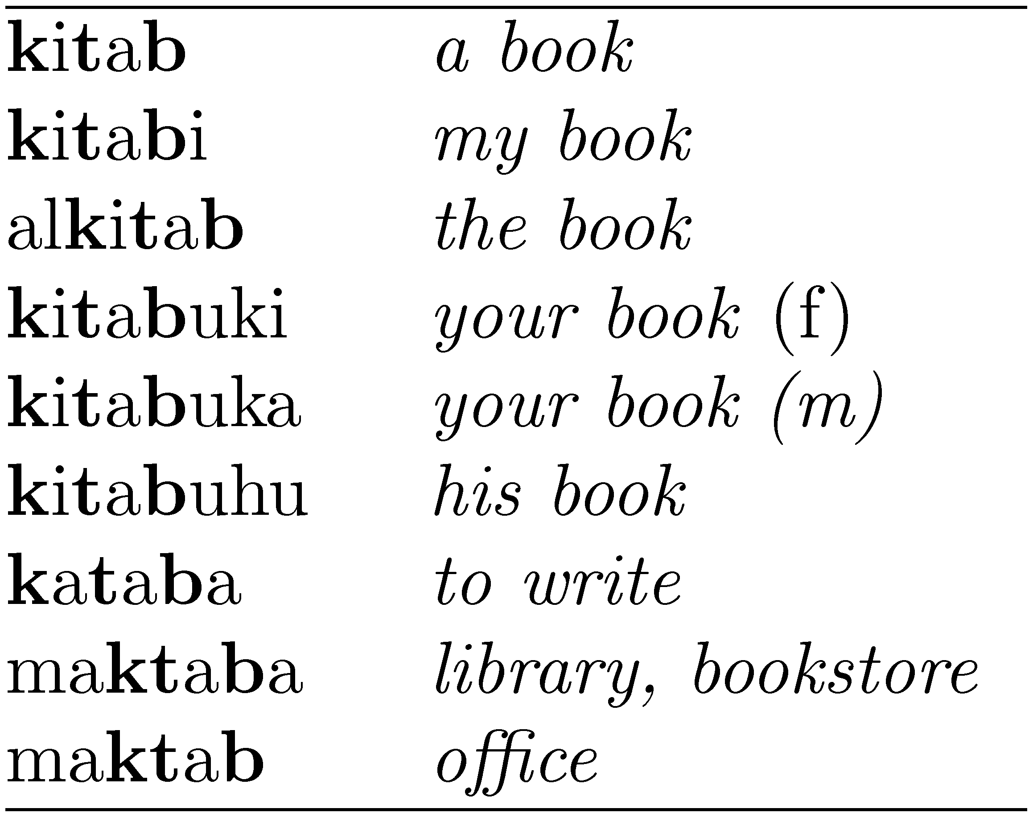
Stemming: Does it help?
Generally a small but significant effectiveness improvement
  can be crucial for some languages
  e.g., 5-10% improvement for English, up to 30% for Finnish and up to 50% in Arabic
Words with the Arabic root ktb

Slide 43
Language-specificity
Sec. 2.2.4
The above methods embody transformations that are
  Language-specific, and often
  Application-specific
These are “plug-in” addenda to the indexing process
Both open source and commercial plug-ins are available for handling these

Slide 44
Word N-Grams
POS tagging too slow for large collections
Simpler definition – phrase is any sequence of n words – known as n-grams
  bigram: 2 word sequence, trigram: 3 word sequence, unigram: single words
  N-grams also used at character level for applications such as OCR
N-grams typically formed from overlapping sequences of words
  i.e. move n-word “window” one word at a time in document

Slide 45
N-Grams
Frequent n-grams are more likely to be meaningful phrases
N-grams form a Zipf distribution
  Better fit than words alone
Could index all n-grams up to specified length
  Much faster than POS tagging
  Uses a lot of storage
    e.g., document containing 1,000 words would contain 3,990 instances of word n-grams of length 2 ≤ n ≤ 5

Slide 46
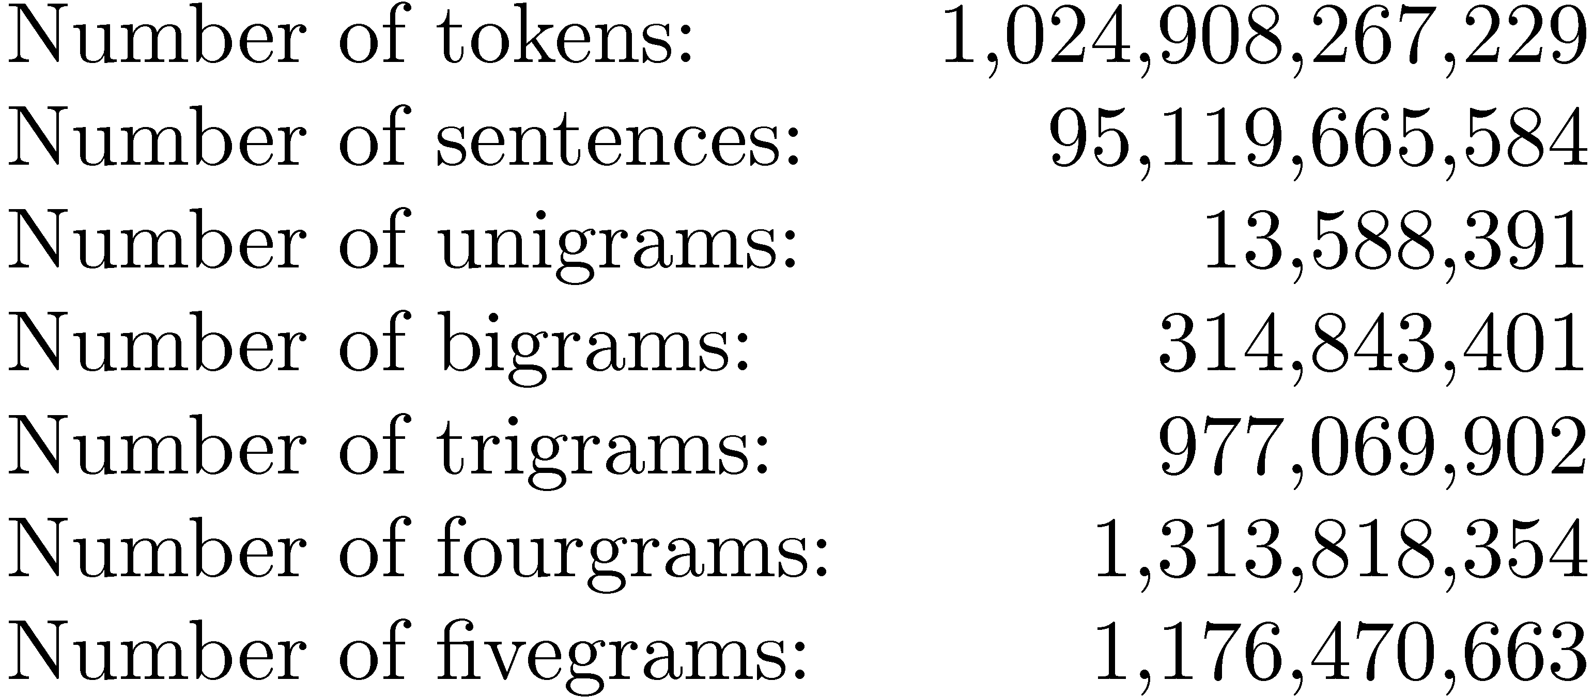
Google N-Grams
Web search engines index n-grams
Google sample:
Most frequent trigram in English is “all rights reserved”
  In Chinese, “limited liability corporation”

Slide 47
Document Structure and Markup
Some parts of documents are more important than others
Document parser recognizes structure using markup, such as HTML tags
  Headers, anchor text, bolded text all likely to be important
  Metadata can also be important
  Links used for link analysis

Slide 48
Example Web Page

Slide 49
Example Web Page

Slide 50
Information Extraction
Automatically extract structure from text
  annotate document using tags to identify extracted structure
Named entity recognition
  identify words that refer to something of interest in a particular application
  e.g., people, companies, locations, dates, product names, prices, etc.

Slide 51
Named Entity Recognition
Rule-based
  Uses lexicons (lists of words and phrases) that categorize names
    e.g., locations, peoples’ names, organizations, etc.
  Rules also used to verify or find new entity names
    e.g., “<number> <word> street” for addresses
    “<street address>, <city>” or “in <city>” to verify city names
    “<street address>, <city>, <state>” to find new cities
    “<title> <name>” to find new names

Slide 52
Named Entity Recognition
Rules either developed manually by trial and error or using machine learning techniques
Statistical
  uses a probabilistic model of the words in and around an entity
  probabilities estimated using training data (manually annotated text)
  Hidden Markov Model (HMM) is one approach

Slide 53
Internationalization
2/3 of the Web is in English
About 50% of Web users do not use English as their primary language
Many (maybe most) search applications have to deal with multiple languages
  monolingual search: search in one language, but with many possible languages
  cross-language search: search in multiple languages at the same time

Slide 54
Internationalization
Many aspects of search engines are language-neutral
Major differences:
  Text encoding (converting to Unicode)
  Tokenizing (many languages have no word separators)
  Stemming
Cultural differences may also impact interface design and features provided

Slide 55
Chinese “Tokenizing”

Slide 56
Normalization: other languages
Sec. 2.2.3
Accents: e.g., French résumé vs. resume.
Umlauts: e.g., German: Tuebingen vs. Tübingen
  Should be equivalent
Most important criterion:
  How are your users like to write their queries for these words?
Even in languages that standardly have accents, users often may not type them
  Often best to normalize to a de-accented term
    Tuebingen, Tübingen, Tubingen ⎝ Tubingen

Slide 57
Normalization: other languages
Sec. 2.2.3
Normalization of things like date forms
  7月30日 vs. 7/30
  Japanese use of kana vs. Chinese characters
Tokenization and normalization may depend on the language and so is intertwined with language detection
Crucial: Need to “normalize” indexed text as well as query terms identically
Is this
German “mit”?
Morgen will ich in MIT …

