Slide 1
Hinrich Schütze and Christina Lioma
Lecture 9: Relevance Feedback & Query Expansion

Slide 2
Take-away today
  Interactive relevance feedback: improve initial retrieval results by telling the IR system which docs are relevant / nonrelevant
  Best known relevance feedback method: Rocchio feedback
  Query expansion: improve retrieval results by adding synonyms / related terms to the query
    Sources for related terms: Manual thesauri, automatic thesauri, query logs
2

Slide 3
Overview
Motivation
Relevance feedback: Basics
Relevance feedback: Details
Query expansion

Slide 4
Outline
Motivation
Relevance feedback: Basics
Relevance feedback: Details
Query expansion

Slide 5
How can we improve recall in search?
  Main topic today: two ways of improving recall:
    relevance feedback and
    query expansion
  As an example consider query q: [aircraft] . . .
  . . . and document d containing “plane”, but not containing “aircraft”
  A simple IR system will not return d for q.
  Even if d is the most relevant document for q!
  We want to change this:
  Return relevant documents even if there is no term match with the (original) query
5

Slide 6
Recall
  Loose definition of recall in this lecture: “increasing the number of relevant documents returned to user”
  This may actually decrease recall on some measures, e.g., when expanding “jaguar” with “panthera”
    . . .which eliminates some relevant documents, but increases relevant documents returned on top pages
6

Slide 7
Options for improving recall
  Local: Do a “local”, on-demand analysis for a user query
    Main local method: relevance feedback
    Part 1
  Global: Do a global analysis once (e.g., of collection) to produce thesaurus
    Use thesaurus for query expansion
    Part 2
7

Slide 8
Google examples for query expansion
  One that works well
    ˜flights -flight
  One that doesn’t work so well
    ˜hospitals -hospital
8

Slide 9
Outline
Motivation
Relevance feedback: Basics
Relevance feedback: Details
Query expansion

Slide 10
Relevance feedback: Basic idea
  The user issues a (short, simple) query.
  The search engine returns a set of documents.
  User marks some docs as relevant, some as nonrelevant.
  Search engine computes a new representation of the information need. Hope: better than the initial query.
  Search engine runs new query and returns new results.
  New results have (hopefully) better recall.
10

Slide 11
Relevance feedback
  We can iterate this: several rounds of relevance feedback.
  We will use the term ad hoc retrieval to refer to regular retrieval without relevance feedback.
  We will now look at three different examples of relevance feedback that highlight different aspects of the process.
11

Slide 12
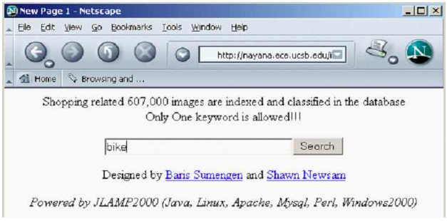
Relevance feedback: Example 1
12

Slide 13
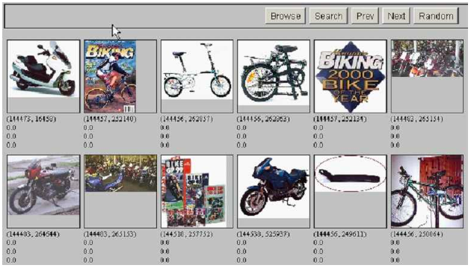
Results for initial query
13

Slide 14
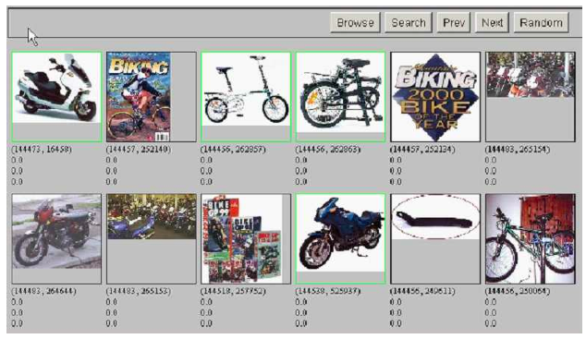
User feedback: Select what is relevant
14

Slide 15
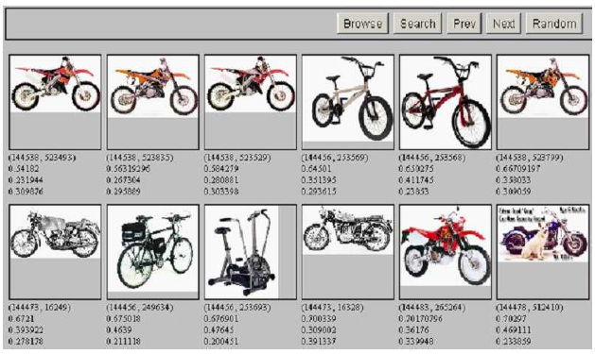
Results after relevance feedback
15

Slide 16
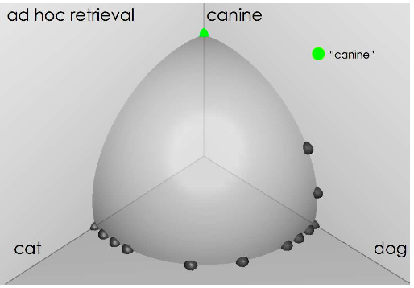
Vector space example: query “canine” (1)
  Source:
  Fernando Díaz
16

Slide 17
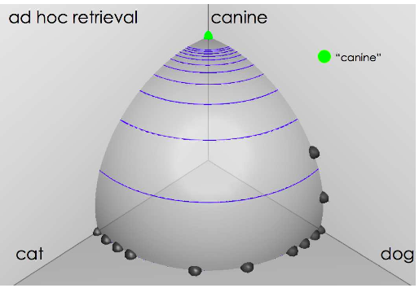
Similarity of docs to query “canine”
  Source:
  Fernando Díaz
17

Slide 18
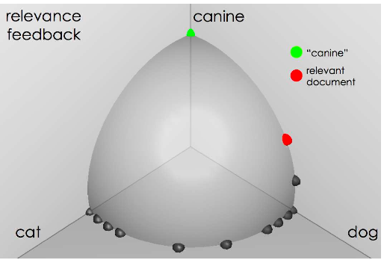
User feedback: Select relevant documents
  Source:
  Fernando Díaz
18

Slide 19
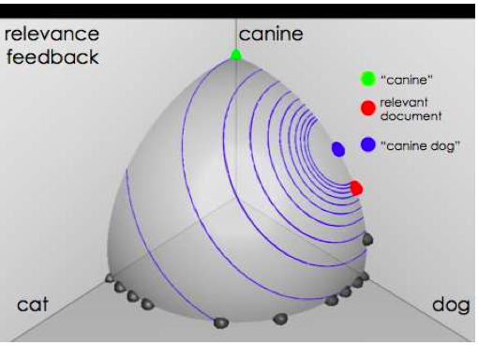
Results after relevance feedback
  Source:
  Fernando Díaz
19

Slide 20
Example 3: A real (non-image) example
Initial query:
[new space satellite applications] Results for initial query: (r = rank)
r
+ 1 0.539 NASA Hasn’t Scrapped Imaging Spectrometer
+ 2 0.533 NASA Scratches Environment Gear From Satellite Plan
3 0.528 Science Panel Backs NASA Satellite Plan, But Urges Launches of Smaller Probes
4 0.526 A NASA Satellite Project Accomplishes Incredible Feat: Staying
Within Budget
5 0.525 Scientist Who Exposed Global Warming Proposes Satellites for
Climate Research
6 0.524 Report Provides Support for the Critics Of Using Big Satellites
to Study Climate
7 0.516 Arianespace Receives Satellite Launch Pact From Telesat
Canada
+ 8 0.509 Telecommunications Tale of Two Companies
User then marks relevant documents with “+”.

Slide 21
Expanded query after relevance feedback
2.074 | new | 15.106 | space
30.816 | satellite | 5.660 | application
5.991 | nasa | 5.196 | eos
4.196 | launch | 3.972 | aster
3.516 | instrument | 3.446 | arianespace
3.004 | bundespost | 2.806 | ss
2.790 | rocket | 2.053 | scientist
2.003 | broadcast | 1.172 | earth
0.836 | oil | 0.646 | measure
Compare to original
query: [new space satellite applications]
21

Slide 22
Results for expanded query
r
* 1 0.513 NASA Scratches Environment Gear From Satellite Plan
* 2 0.500 NASA Hasn’t Scrapped Imaging Spectrometer
3 0.493 When the Pentagon Launches a Secret Satellite, Space Sleuths Do Some Spy Work of Their Own
4 0.493 NASA Uses ‘Warm’ Superconductors For Fast Circuit
* 5 0.492 Telecommunications Tale of Two Companies
6 0.491 Soviets May Adapt Parts of SS-20 Missile For Commercial Use
7 0.490 Gaping Gap: Pentagon Lags in Race To Match the Soviets In Rocket Launchers
8 0.490 Rescue of Satellite By Space Agency To Cost $90 Million

Slide 23
Outline
Motivation
Relevance feedback: Basics
Relevance feedback: Details
Query expansion

Slide 24


Key concept for relevance feedback: Centroid
  The centroid is the center of mass of a set of points.
  Recall that we represent documents as points in a high-dimensional space.
  Thus: we can compute centroids of documents.
  Definition:
where D is a set of documents and is the vector we use to represent document d.
24

Slide 25
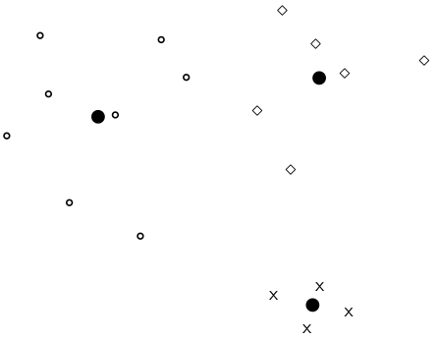
Centroid: Example
25

Slide 26

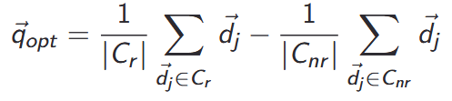
Rocchio’ algorithm
  The Rocchio’ algorithm implements relevance feedback in the vector space model.
  Rocchio’ chooses the query that maximizes
  D_{r} : set of relevant docs; D_{nr} : set of nonrelevant docs
  Intent: ~q_{opt} is the vector that separates relevant and nonrelevant docs maximally.
  Making some additional assumptions, we can rewrite as:
26

Slide 27
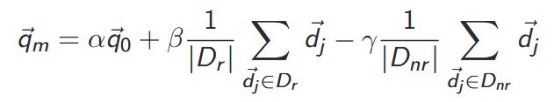
Rocchio’ algorithm
  The optimal query vector is:
  We move the centroid of the relevant documents by the difference between the two centroids.
  Where:
  α: Tunable weight for initial query.
  β: Tunable weight for relevant documents.
  γ: Tunable weight for irrelevant documents.
α: T
27

Slide 28
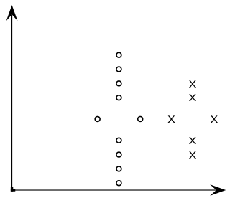
Exercise: Compute Rocchio’ vector
circles: relevant documents, Xs: nonrelevant documents
28

Slide 29
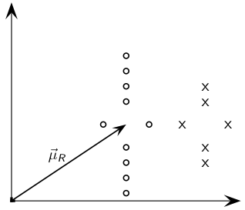
Rocchio’ illustrated
: centroid of relevant documents
29

Slide 30
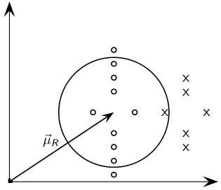
Rocchio’ illustrated
does not separate relevant / nonrelevant.
30

Slide 31
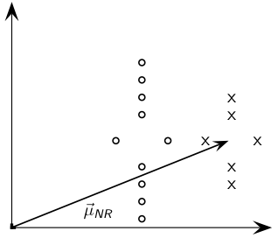
Rocchio’ illustrated
centroid of nonrelevant documents.
31

Slide 32
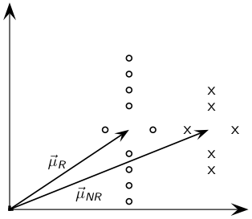
Rocchio’ illustrated
32

Slide 33
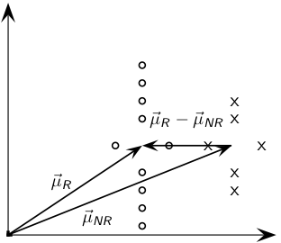
Rocchio’ illustrated
- difference vector
33

Slide 34
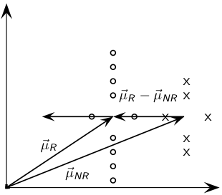
Rocchio’ illustrated
Add difference vector to …
34

Slide 35
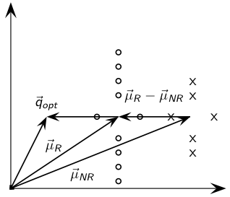
Rocchio’ illustrated
… to get
35

Slide 36
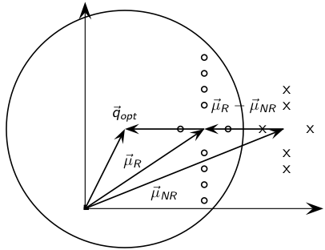
Rocchio’ illustrated
separates relevant / nonrelevant perfectly.
36

Slide 37
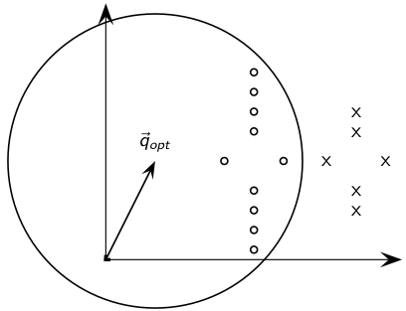
Rocchio’ illustrated
separates relevant / nonrelevant perfectly.
37

Slide 38
Terminology
  We use the name Rocchio’ for the theoretically better motivated original version of Rocchio.
  The implementation that is actually used in most cases is the SMART implementation – we use the name Rocchio (without prime) for that.
38

Slide 39
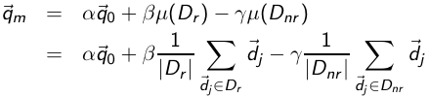
Rocchio 1971 algorithm (SMART)
  Used in practice:
  q_{m}: modified query vector; q₀: original query vector; D_{r} and D_{nr} : sets of known relevant and nonrelevant documents respectively; α, β, and γ: weights
  New query moves towards relevant documents and away from nonrelevant documents.
  Tradeoff α vs. β/γ: If we have a lot of judged documents, we want a higher β/γ.
  Set negative term weights to 0.
  “Negative weight” for a term doesn’t make sense in the vector space model.
39

Slide 40
Positive vs. negative relevance feedback
  Positive feedback is more valuable than negative feedback.
  For example, set β = 0.75, γ = 0.25 to give higher weight to positive feedback.
  Many systems only allow positive feedback.
40

Slide 41
Relevance feedback: Assumptions
  When can relevance feedback enhance recall?
  Assumption A1: The user knows the terms in the collection well enough for an initial query.
  Assumption A2: Relevant documents contain similar terms (so I can “hop” from one relevant document to a different one when giving relevance feedback).
41

Slide 42
Violation of A1
  Assumption A1: The user knows the terms in the collection well enough for an initial query.
  Violation: Mismatch of searcher’s vocabulary and collection vocabulary
  Example: cosmonaut / astronaut
42

Slide 43
Violation of A2
  Assumption A2: Relevant documents are similar.
  Example for violation: [contradictory government policies]
  Several unrelated “prototypes”
    Subsidies for tobacco farmers vs. anti-smoking campaigns
    Aid for developing countries vs. high tariffs on imports from developing countries
  Relevance feedback on tobacco docs will not help with finding docs on developing countries.
43

Slide 44
Relevance feedback: Evaluation
  Pick one of the evaluation measures from last lecture, e.g., precision in top 10: P@10
  Compute P@10 for original query q₀
  Compute P@10 for modified relevance feedback query q1
  In most cases: q₁ is spectacularly better than q₀!
  Is this a fair evaluation?
44

Slide 45
Relevance feedback: Evaluation
  Fair evaluation must be on “residual” collection: docs not yet judged by user.
  Studies have shown that relevance feedback is successful when evaluated this way.
  Empirically, one round of relevance feedback is often very useful. Two rounds are marginally useful.
45

Slide 46
Evaluation: Caveat
  True evaluation of usefulness must compare to other methods taking the same amount of time.
  Alternative to relevance feedback: User revises and resubmits query.
  Users may prefer revision/resubmission to having to judge relevance of documents.
  There is no clear evidence that relevance feedback is the “best use” of the user’s time.
46

Slide 47
Exercise
  Do search engines use relevance feedback?
  Why?
47

Slide 48
Relevance feedback: Problems
  Relevance feedback is expensive.
    Relevance feedback creates long modified queries.
    Long queries are expensive to process.
  Users are reluctant to provide explicit feedback.
  It’s often hard to understand why a particular document was retrieved after applying relevance feedback.
  The search engine Excite had full relevance feedback at one point, but abandoned it later.
48

Slide 49
Pseudo-relevance feedback
  Pseudo-relevance feedback automates the “manual” part of true relevance feedback.
  Pseudo-relevance algorithm:
    Retrieve a ranked list of hits for the user’s query
    Assume that the top k documents are relevant.
    Do relevance feedback (e.g., Rocchio)
  Works very well on average
  But can go horribly wrong for some queries.
  Several iterations can cause query drift.
49

Slide 50
Pseudo-relevance feedback at TREC4
  Cornell SMART system
  Results show number of relevant documents out of top 100 for 50 queries (so total number of documents is 5000):
method | number of relevant documents
lnc.ltc | 3210
lnc.ltc-PsRF | 3634
Lnu.ltu | 3709
Lnu.ltu-PsRF | 4350
  Results contrast two length normalization schemes (L vs. l) and pseudo-relevance feedback (PsRF).
  The pseudo-relevance feedback method used added only 20 terms to the query. (Rocchio will add many more.)
  This demonstrates that pseudo-relevance feedback is effective on average.
50

Slide 51
Outline
Motivation
Relevance feedback: Basics
Relevance feedback: Details
Query expansion

Slide 52
Query expansion
  Query expansion is another method for increasing recall.
  We use “global query expansion” to refer to “global methods for query reformulation”.
  In global query expansion, the query is modified based on some global resource, i.e. a resource that is not query-dependent.
  Main information we use: (near-)synonymy
  A publication or database that collects (near-)synonyms is called a thesaurus.
  We will look at two types of thesauri: manually created and automatically created.
52

Slide 53
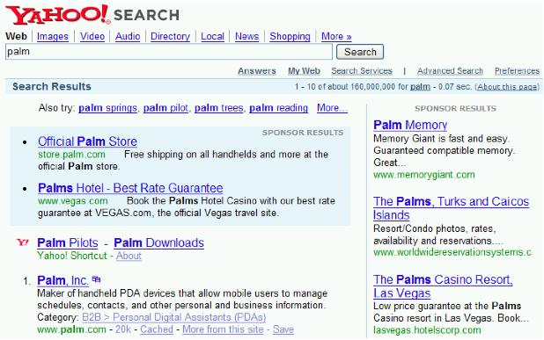
Query expansion: Example
53

Slide 54
Types of user feedback
  User gives feedback on documents.
    More common in relevance feedback
  User gives feedback on words or phrases.
    More common in query expansion
54

Slide 55
Types of query expansion
  Manual thesaurus (maintained by editors, e.g., PubMed)
  Automatically derived thesaurus (e.g., based on co-occurrence statistics)
  Query-equivalence based on query log mining (common on the web as in the “palm” example)
55

Slide 56
Thesaurus-based query expansion
  For each term t in the query, expand the query with words the thesaurus lists as semantically related with t.
  Example from earlier: HOSPITAL → MEDICAL
  Generally increases recall
  May significantly decrease precision, particularly with ambiguous terms
    INTEREST RATE → INTEREST RATE FASCINATE
  Widely used in specialized search engines for science and engineering
  It’s very expensive to create a manual thesaurus and to maintain it over time.
  A manual thesaurus has an effect roughly equivalent to annotation with a controlled vocabulary.
56

Slide 57
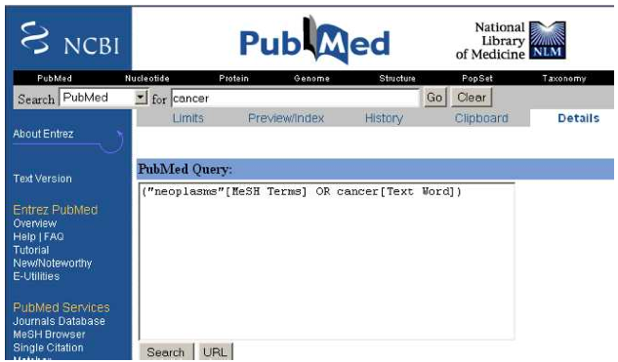
Example for manual thesaurus: PubMed
57

Slide 58
Automatic thesaurus generation
  Attempt to generate a thesaurus automatically by analyzing the distribution of words in documents
  Fundamental notion: similarity between two words
  Definition 1: Two words are similar if they co-occur with similar words.
    “car” ≈ “motorcycle” because both occur with “road”, “gas” and “license”, so they must be similar.
  Definition 2: Two words are similar if they occur in a given grammatical relation with the same words.
    You can harvest, peel, eat, prepare, etc. apples and pears, so apples and pears must be similar.
  Co-occurrence is more robust, grammatical relations are more accurate.
58

Slide 59
Co-occurence-based thesaurus: Examples
Word | Nearest neighbors
absolutely bottomed captivating doghouse makeup mediating keeping lithographs pathogens senses | absurd whatsoever totally exactly nothing dip copper drops topped slide trimmed shimmer stunningly superbly plucky witty dog porch crawling beside downstairs repellent lotion glossy sunscreen skin gel reconciliation negotiate case conciliation hoping bring wiping could some would drawings Picasso Dali sculptures Gauguin toxins bacteria organisms bacterial parasite grasp psyche truly clumsy naive innate
WordSpace demo on web
59

Slide 60
Query expansion at search engines
  Main source of query expansion at search engines: query logs
  Example 1: After issuing the query [herbs], users frequently search for [herbal remedies].
    → “herbal remedies” is potential expansion of “herb”.
  Example 2: Users searching for [flower pix] frequently click on the URL photobucket.com/flower. Users searching for [flower clipart] frequently click on the same URL.
    → “flower clipart” and “flower pix” are potential expansions of each other.
60

Slide 61
Take-away today
  Interactive relevance feedback: improve initial retrieval results by telling the IR system which docs are relevant / nonrelevant
  Best known relevance feedback method: Rocchio feedback
  Query expansion: improve retrieval results by adding synonyms / related terms to the query
    Sources for related terms: Manual thesauri, automatic thesauri, query logs
61

Slide 62
Resources
  Chapter 9 of IIR
  Resources at http://ifnlp.org/ir
    Salton and Buckley 1990 (original relevance feedback paper)
    Spink, Jansen, Ozmultu 2000: Relevance feedback at Excite
    Schütze 1998: Automatic word sense discrimination (describes a simple method for automatic thesuarus generation)
62

