Slide 1
Information Retrieval (in Practice)
All slides ©Addison Wesley, 2008

Slide 2
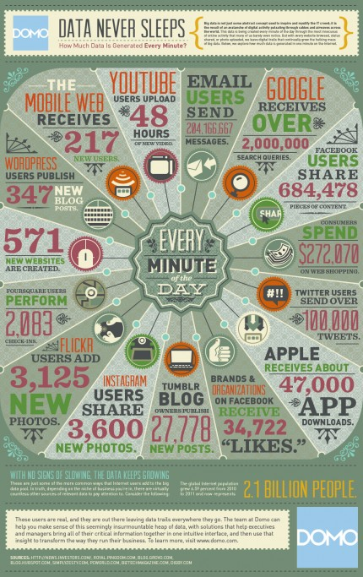
How Much Data is Created Every Minute?
2012
Source:
https://www.domo.com/blog/2012/06/how-much-data-is-created-every-minute/

Slide 3
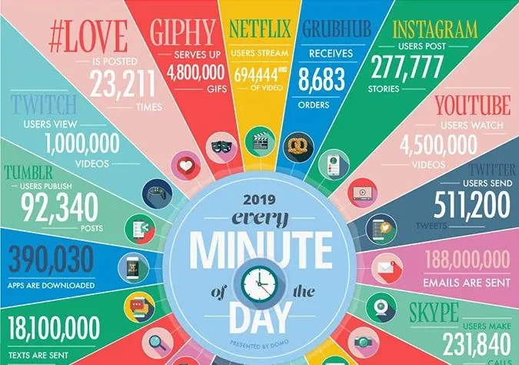
How Much Data is Created Every Minute?
2019

Slide 4
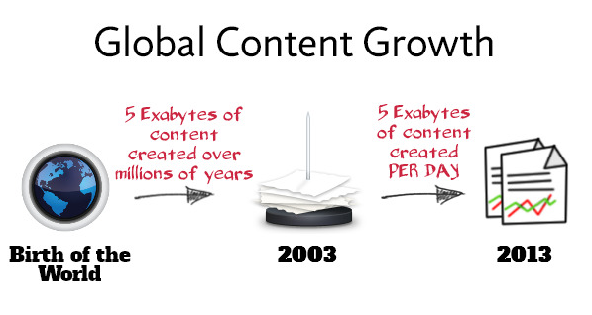

Slide 5
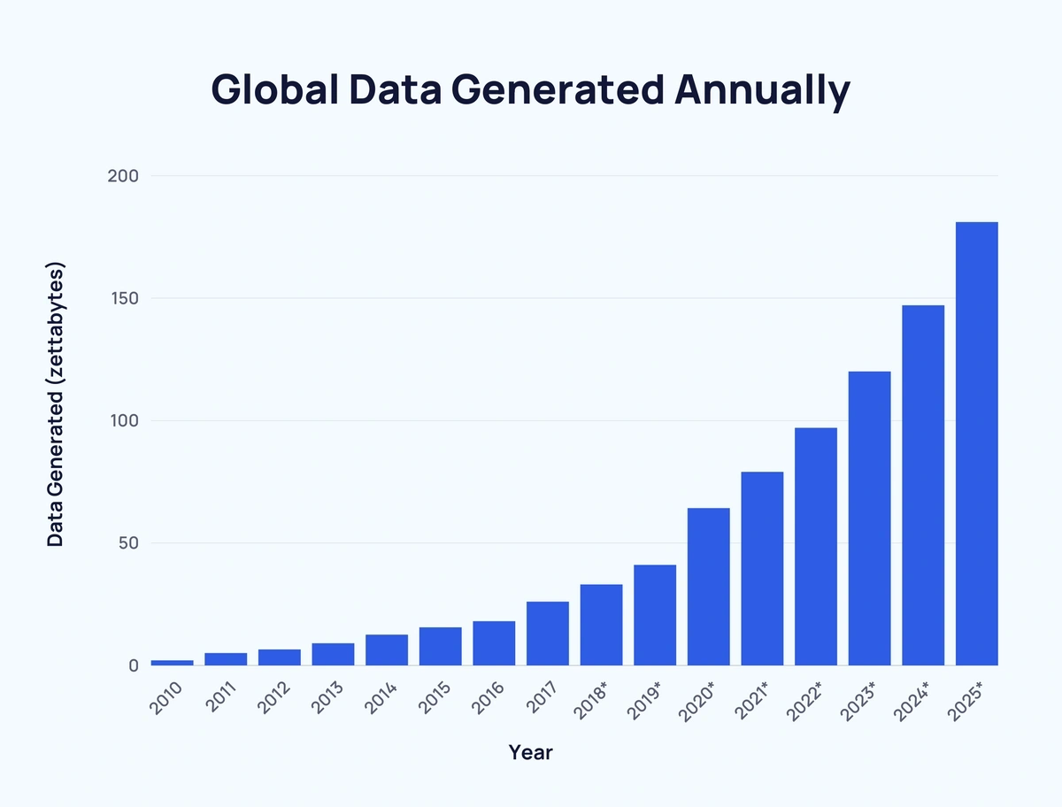
https://explodingtopics.com/blog/data-generated-per-day

Slide 6
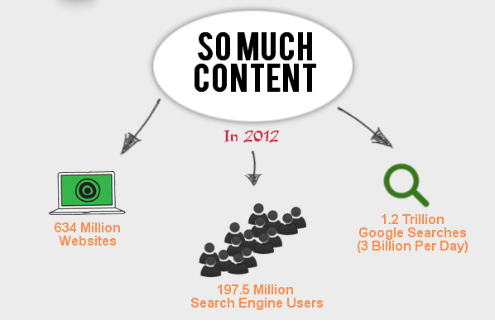
The Search Problem

Slide 7
Search and Information Retrieval
Search (on the Web) is a daily activity for many people throughout the world
Search and communication are most popular uses of the computer
Applications involving search are everywhere
The field of computer science that is most involved with R&D for search is information retrieval (IR)

Slide 8
Information Retrieval
“Information retrieval is a field concerned with the structure, analysis, organization, storage, searching, and retrieval of information.” (Salton, 1968)
Information Retrieval (IR) is finding material (usually documents) of an unstructured nature (usually text) that satisfies an information need from within large collections (usually stored on computers).
Manning, 2010.

Slide 9


Academic Genealogy
Gerard Salton
Clement Yu
Eduard Dragut
the father of information retrieval

Slide 10
Typical IR Task
Input:
A corpus of textual natural-language documents.
A user query in the form of a textual string.
Output:
A ranked set of documents that are relevant to the query.

Slide 11
IR System
Document
corpus
IR
System
Query String
1. Doc1
2. Doc2
3. Doc3
.
.
Ranked
Documents

Slide 12
What is a Document?
Examples:
web pages, email, books, news stories, scholarly papers, text messages, Word™, Powerpoint™, PDF, forum postings, patents, IM sessions, etc.
Common properties
Significant text content
Some structure (e.g., title, author, date for papers; subject, sender, destination for email)

Slide 13
Documents vs. Database Records
Database records (or tuples in relational databases) are typically made up of well-defined fields (or attributes)
e.g., bank records with account numbers, balances, names, addresses, social security numbers, dates of birth, etc.
Easy to compare fields with well-defined semantics to queries in order to find matches
Text is more difficult

Slide 14
IR versus DBMS
Relational Database Management Systems (RDBMS):
Semantics of each object are well defined
Complex query languages (e.g., SQL)
Exact retrieval for what you ask
Emphasis on efficiency
Information Retrieval (IR):
Semantics of object are subjective, not well defined
Usually simple query languages (e.g., natural language query)
You should get what you want, even the query is bad
Effectiveness is primary issue, although efficiency is important

Slide 15
(Un)Structured Queries
Example bank database query
Find records with balance > $50,000 in branches located in Philadelphia.
This can be represented in a SQL query.
Matches easily found by comparison with field values of records
Example search engine query
Concerts in Philadelphia
This text must be compared to the text of entire news stories

Slide 16
Comparing Text
Comparing the query text to the document text and determining what is a good match is the core issue of information retrieval
Exact matching of words is not enough
Many different ways to write the same thing in a “natural language” like English
E.g., Philadelphia vs. Philly
e.g., does a news story containing the text “bank director in Philly steals funds” match the query?
Some stories will be better matches than others

Slide 17
Dimensions of IR
IR is more than just text, and more than just web search
although these are central
People doing IR work with different media, different types of search applications, and different tasks

Slide 18
Web search
These days we frequently think first of web search, but there are many other cases:
E-mail search
Searching your laptop
Corporate knowledge bases
Legal information retrieval
Social media search
Video and image search

Slide 19
Dimensions of IR
Content | Applications | Tasks
Text | Web search | Ad hoc search
Images | Vertical search | Filtering
Video | Enterprise search | Classification
Scanned docs | Desktop search | Question answering
Audio | Forum search
Music | P2P search
 | Literature search

Slide 20
IR Tasks
Ad-hoc search
Find relevant documents for an arbitrary text query
Filtering
Identify relevant user profiles for a new document
Classification
Identify relevant labels for documents
Question answering
Give a specific answer to a question

Slide 21
Big Issues in IR
Relevance
What is it?
Simple (and simplistic) definition:
A relevant document contains the information that a person was looking for when they submitted a query to the search engine
Many factors influence a person’s decision about what is relevant: e.g., task, context, novelty, style
Topical relevance (same topic) vs. user relevance (everything else)

Slide 22
Big Issues in IR
Relevance
Retrieval models define a view of relevance
Ranking algorithms used in search engines are based on retrieval models
Most models describe statistical properties of text rather than linguistic
i.e. counting simple text features such as words instead of parsing and analyzing the sentences
Statistical approach to text processing started with Luhn in the 50s
Linguistic features can be part of a statistical model

Slide 23
Big Issues in IR
Evaluation
Experimental procedures and measures for comparing system output with user expectations
Originated in Cranfield experiments in the 60s
IR evaluation methods now used in many fields
Typically use test collection of documents, queries, and relevance judgments
Most commonly used are TREC collections
Recall and precision are two examples of effectiveness measures

Slide 24
How good are the retrieved docs?
Sec. 1.1
Precision : Fraction of retrieved docs that are relevant to the user’s information need
Recall : Fraction of relevant docs in collection that are retrieved

Slide 25
Big Issues in IR
Users and Information Needs
Search evaluation is user-centered
Keyword queries are often poor descriptions of actual information needs
Interaction and context are important for understanding user intent
Query refinement techniques such as
query expansion,
query suggestion,
relevance feedback improve ranking

Slide 26
IR and Search Engines
A search engine is the practical application of information retrieval techniques to large scale text collections
Web search engines are best-known examples, but many others
Open source search engines are important for research and development
e.g., Lucene, Lemur/Indri, Galago
Big issues include main IR issues but also some others

Slide 27
IR and Search Engines
Information Retrieval
Search Engines
Performance
-Efficient search and indexing
Incorporating new data
-Coverage and freshness
Scalability
-Growing with data and users
Adaptability
-Tuning for applications
Specific problems
-e.g. Spam
Relevance
-Effective ranking
Evaluation
-Testing and measuring
Information needs
-User interaction

Slide 28
Search Engine Issues
Performance
Measuring and improving the efficiency of search
e.g., reducing response time, increasing query throughput, increasing indexing speed
Indexes are data structures designed to improve search efficiency
designing and implementing them are major issues for search engines

Slide 29
Search Engine Issues
Dynamic data
The “collection” for most real applications is constantly changing in terms of updates, additions, deletions
e.g., web pages
Acquiring or “crawling” the documents is a major task
Typical measures are coverage (how much has been indexed) and freshness (how recently was it indexed)
Updating the indexes while processing queries is also a design issue

Slide 30
Search Engine Issues
Scalability
Making everything work with millions of users every day, and many terabytes of documents
Distributed processing is essential
Adaptability
Changing and tuning search engine components such as ranking algorithm, indexing strategy, interface for different applications

Slide 31
Spam
For Web search, spam in all its forms is one of the major issues
Affects the efficiency of search engines and, more seriously, the effectiveness of the results
Many types of spam
e.g. spamdexing or term spam, link spam, “optimization”
New subfield called adversarial IR, since spammers are “adversaries” with different goals

Slide 32
Course Goals
To help you to understand search engines, evaluate and compare them, and modify them for specific applications
Provide broad coverage of the important issues in information retrieval and search engines
includes underlying models and current research directions

