Slide 1
Search Engine Architecture
Information Retrieval (in Practice)

Slide 2
Search Engine Architecture
A software architecture consists of software components, the interfaces provided by those components, and the relationships between them
  describes a system at a particular level of abstraction
Architecture of a search engine determined by 2 requirements
  effectiveness (quality of results) and
  efficiency (response time and throughput)

Slide 3
Indexing Process

Slide 4
Indexing Process
Text acquisition
  identifies and stores documents for indexing
Text transformation
  transforms documents into index terms or features
Index creation
  takes index terms and creates data structures (indexes) to support fast searching

Slide 5
Query Process

Slide 6
Query Process
User interaction
  supports creation and refinement of query, display of results
Ranking
  uses query and indexes to generate ranked list of documents
Evaluation
  monitors and measures effectiveness and efficiency (primarily offline)

Slide 7
Details: Text Acquisition
Crawler
  Identifies and acquires documents for search engine
  Many types – web, enterprise, desktop
  Web crawlers follow links to find documents
    Must efficiently find huge numbers of web pages (coverage) and keep them up-to-date (freshness)
    Single site crawlers for site search
    Topical or focused crawlers for vertical search
  Document crawlers for enterprise and desktop search
    Follow links and scan directories

Slide 8
Text Acquisition: Feeds & Conversion
Feeds
  Real-time streams of documents
    e.g., web feeds for news, blogs, video, radio, tv
  RSS is common standard
    RSS “reader” can provide new XML documents to search engine
Conversion
  Convert variety of documents into a consistent text plus metadata format
    e.g. HTML, XML, Word, PDF, etc. → XML
  Convert text encoding for different languages
    Using a Unicode standard like UTF-8

Slide 9
Text Acquisition: Document Storage
  Stores text, metadata, and other related content for documents
    Metadata is information about document such as type and creation date
    Other content includes links, anchor text
  Provides fast access to document contents for search engine components
    e.g. result list generation
  Could use relational database system
    More typically, a simpler, more efficient storage system is used due to huge numbers of documents

Slide 10
Text Transformation: Parser
  Processing the sequence of text tokens in the document to recognize structural elements
    e.g., titles, links, headings, etc.
  Tokenizer recognizes “words” in the text
    must consider issues like capitalization, hyphens, apostrophes, non-alpha characters, separators
  Markup languages such as HTML, XML often used to specify structure
    Tags used to specify document elements
      E.g., <h2> Overview </h2>
    Document parser uses syntax of markup language (or other formatting) to identify structure

Slide 11
Text Transformation: Stop Words
Stopping
  Remove common words
    e.g., “and”, “or”, “the”, “in”
  Some impact on efficiency and effectiveness
  Can be a problem for some queries
Stemming
  Group words derived from a common stem
    e.g., “computer”, “computers”, “computing”, “compute”
  Usually effective, but not for all queries
  Benefits vary for different languages

Slide 12

Text Transformation: Link Analysis
  Makes use of links and anchor text in web pages
<a href="https://cis.temple.edu">Computer and Information Sciences Department </a>

Slide 13
Text Transformation: Link Analysis
  Link analysis identifies popularity and community information
    e.g., PageRank
  Anchor text can significantly enhance the representation of pages pointed to by links
  Significant impact on web search
    Less importance in other applications

Slide 14
Text Transformation: Information Extraction
Information Extraction
  Identify classes of index terms that are important for some applications
  e.g., named entity recognizers identify classes such as people, locations, companies, dates.
Classifier
  Identifies class-related metadata for documents
    i.e., assigns labels to documents
    e.g., topics, reading levels, sentiment, genre
  Use depends on application

Slide 15
Index Creation
Document Statistics
  Gathers counts and positions of words and other features
  Used in ranking algorithm
Weighting
  Computes weights for index terms
  Used in ranking algorithm
  e.g., tf.idf weight
    Combination of term frequency in document and inverse document frequency in the collection

Slide 16
Index Creation: Inversion
  Core of indexing process
  Converts document-term information to term-document for indexing
    Difficult for very large numbers of documents
  Format of inverted file is designed for fast query processing
    Must also handle updates
    Compression used for efficiency

Slide 17
Index Creation: The Problem
Very large document collections
  Question: How does Google search 30 trillion web pages, 100 billion times a month?
  One index on one computer?
    Slow response
Solution: parallel and distributed computing
  Google: thousands of computers

Slide 18
Index Creation: Distribution
Index Distribution
  Distributes indexes across multiple computers and/or multiple sites
  Essential for fast query processing with large numbers of documents
  Many variations
    Document distribution, term distribution, replication
  P2P and distributed IR involve search across multiple sites

Slide 19
User Interaction
Query input
  Provides interface and parser for query language
  Most web queries are very simple, other applications may use forms
  Query language used to describe more complex queries and results of query transformation
    e.g., Boolean queries, Indri and Galago query languages
    similar to SQL language used in database applications
    IR query languages also allow content and structure specifications, but focus on content

Slide 20
User Interaction: Query Transformation
Query transformation
  Improves initial query, both before and after initial search
  Includes text transformation techniques used for documents
  Spell checking and query suggestion provide alternatives to original query
  Query expansion and relevance feedback modify the original query with additional terms

Slide 21
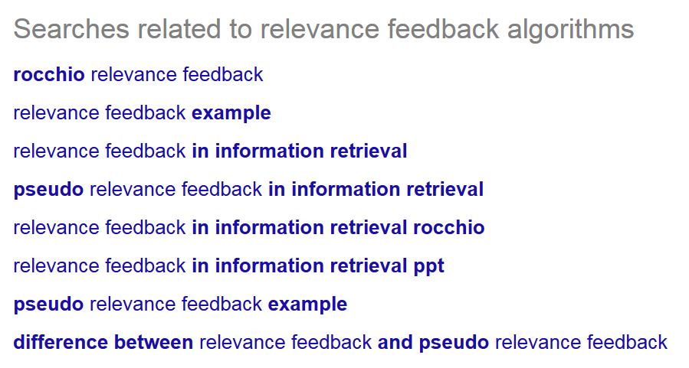
Query Suggestions for “relevance feedback algorithms”

Slide 22
User Interaction: Query Expansion
  Example Methods
    Finding synonyms of words
    Finding all the various morphological forms of words
  Searching for the synonyms and morphological forms as well

Slide 23
User Interaction: Relevance Feedback
  Explicit Feedback – a user indicates the relevance of a document retrieved for a query
  Implicit Feedback - inferred from user behavior
  Selected documents
  Duration of time spent viewing a document, or
  Page browsing or scrolling actions
  Blind Feedback – automates the manual part of relevance feedback.

Slide 24
User Interaction: Output
  Constructs the display of ranked documents for a query
  Generates snippets to show how queries match documents
  Highlights important words and passages
  Retrieves appropriate advertising in many applications
  May provide clustering and other visualization tools

Slide 25
Ranking
Scoring
  Calculates scores for documents using a ranking algorithm
  Core component of search engine
  Basic form of score is ∑ q_{i} d_{i}
    q_{i} and d_{i} are query and document term weights for term i
  Many variations of ranking algorithms and retrieval models
    The core research area in IR.

Slide 26
Ranking
Performance optimization
  Designing ranking algorithms for efficient processing
    Term-at-a time vs. document-at-a-time processing
    Safe vs. unsafe optimizations
Distribution
  Processing queries in a distributed environment
  Query broker distributes queries and assembles results
  Caching is a form of distributed searching

Slide 27
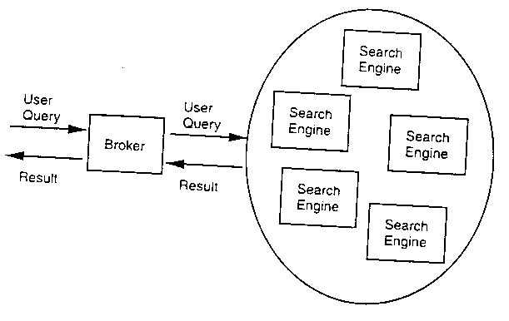
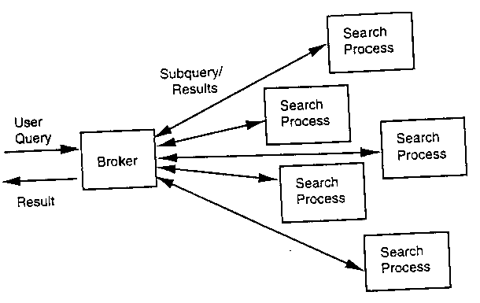
Ranking: Distribution

Slide 28
Evaluation
Logging
  Logging user queries and interaction is crucial for improving search effectiveness and efficiency
  Query logs and clickthrough data used for query suggestion, spell checking, query caching, ranking, advertising search, and other components
Ranking analysis
  Measuring and tuning ranking effectiveness
Performance analysis
  Measuring and tuning system efficiency

Slide 29
How Does It Really Work?
This course explains these components of a search engine in more detail
Often many possible approaches and techniques for a given component
  Focus is on the most important alternatives
    explain a small number of approaches in detail rather than many approaches
  Alternatives described in references

