Slide 1
Retrieval Models
Information Retrieval in Practice
All slides ©Addison Wesley, 2008

Slide 2
Retrieval Models
Provide a mathematical framework for defining the search process
includes explanation of assumptions
basis of many ranking algorithms
can be implicit
Progress in retrieval models has corresponded with improvements in effectiveness
Theories about relevance

Slide 3
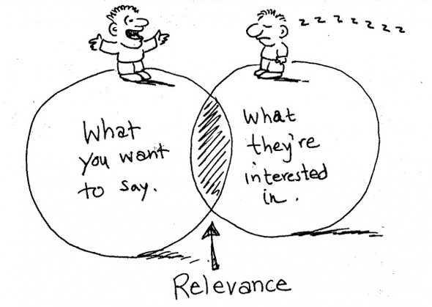
What is Relevance?

Slide 4
Relevance
Complex concept that has been studied for some time
Many factors to consider
People often disagree when making relevance judgments
Retrieval models make various assumptions about relevance to simplify problem
e.g., topical vs. user relevance
e.g., binary vs. multi-valued relevance

Slide 5
Retrieval Model Overview
Early models
Boolean retrieval
Vector Space model
Probabilistic Models
BM25
Language models
Combining evidence
Inference networks
Learning to Rank

Slide 6
Boolean Retrieval
Two possible outcomes for query processing
TRUE and FALSE
“exact-match” retrieval
simplest form of ranking
Query usually specified using Boolean operators
AND, OR, NOT
proximity operators also used

Slide 7
Boolean Retrieval
Advantages
Results are predictable, relatively easy to explain
Many different features can be incorporated
Efficient processing since many documents can be eliminated from search
Disadvantages
Effectiveness depends entirely on user
Simple queries usually don’t work well
Complex queries are difficult

Slide 8
Searching by Numbers
Sequence of queries driven by number of retrieved documents
Example query: “lincoln”
president AND lincoln
president AND lincoln AND NOT (automobile OR car)
president AND lincoln AND biography AND life AND birthplace AND gettysburg AND NOT (automobile OR car)
president AND lincoln AND (biography OR life OR birthplace OR gettysburg) AND NOT (automobile OR car)

Slide 9
Ranked retrieval
Ch. 6
Thus far, our queries have all been Boolean.
Documents either match or don’t.
Good for expert users with precise understanding of their needs and the collection.
Also good for applications: Applications can easily consume 1000s of results.
Not good for the majority of users.
Most users incapable of writing Boolean queries (or they are, but they think it’s too much work).
Most users don’t want to wade through 1000s of results.
This is particularly true of web search.

Slide 10
Ranked retrieval models
Rather than a set of documents satisfying a query expression, in ranked retrieval, the system returns an ordering over the (top) documents in the collection for a query
Free text queries: Rather than a query language of operators and expressions, the user’s query is just one or more words in a human language
In principle, there are two separate choices here, but in practice, ranked retrieval has normally been associated with free text queries and vice versa

Slide 11
Feast or famine: not a problem in ranked retrieval
Ch. 6
When a system produces a ranked result set, large result sets are not an issue
Indeed, the size of the result set is not an issue
We just show the top k ( ≈ 10) results
We don’t overwhelm the user
Premise: the ranking algorithm works

Slide 12
Scoring as the basis of ranked retrieval
Ch. 6
We wish to return in order the documents most likely to be useful to the searcher
How can we rank-order the documents in the collection with respect to a query?
Assign a score – say in [0, 1] – to each document
This score measures how well document and query “match”.

Slide 13
Query-document matching scores
Ch. 6
We need a way of assigning a score to a query/document pair
Let’s start with a one-term query
If the query term does not occur in the document: score should be 0
The more frequent the query term in the document, the higher the score (should be)
We will look at a number of alternatives for this.

Slide 14
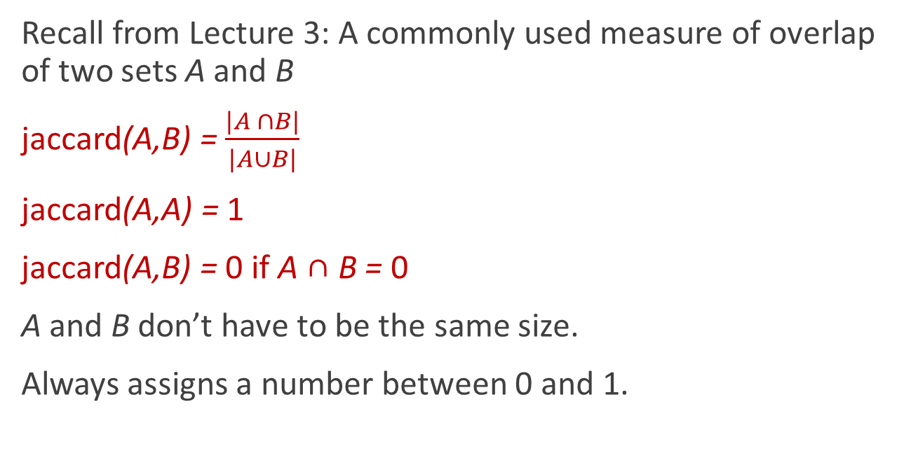
Take 1: Jaccard coefficient
Ch. 6
Recall from Lecture 3: A commonly used measure of overlap of two sets A and B
jaccard(A,B) = $\frac{|A ∩B|}{|A∪B|}$
jaccard(A,A) = 1
jaccard(A,B) = 0 if A ∩ B = 0
A and B don’t have to be the same size.
Always assigns a number between 0 and 1.

Slide 15
Jaccard coefficient: Scoring example
Ch. 6
What is the query-document match score that the Jaccard coefficient computes for each of the two documents below?
Query: ides of march
Document 1: caesar died in march
Document 2: the long march

Slide 16
Issues with Jaccard for scoring
Ch. 6
It doesn’t consider term frequency (how many times a term occurs in a document)
Rare terms in a collection are more informative than frequent terms. Jaccard doesn’t consider this information
We need a more sophisticated way of normalizing for length
Later in this lecture, we’ll use
. . . instead of |A ∩ B|/|A ∪ B| (Jaccard) for length normalization.

Slide 17
Binary term-document incidence matrix
Sec. 6.2
Each document is represented by a binary vector ∈ {0,1}^{|V|}

Slide 18
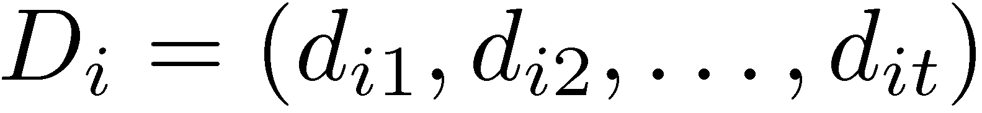
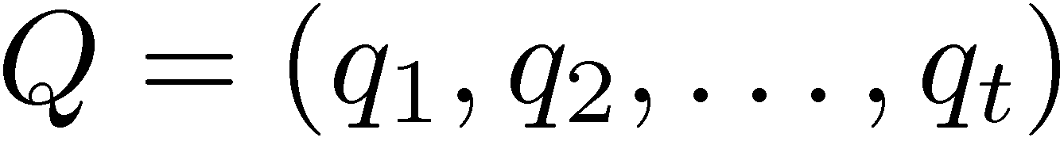
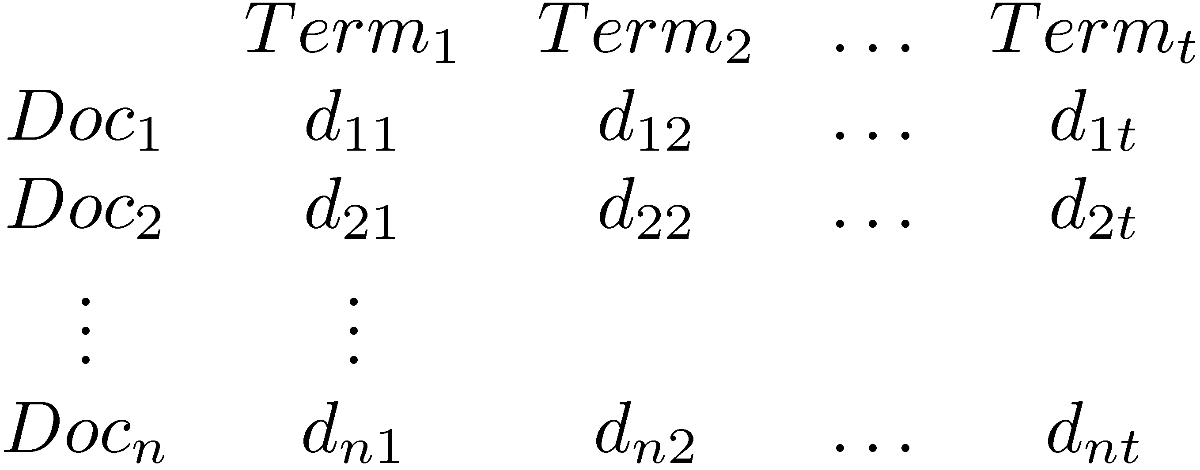
Vector Space Model
Documents and query represented by a vector of term weights
Collection represented by a matrix of term weights

Slide 19
Term-document count matrices
Sec. 6.2
Consider the number of occurrences of a term in a document:
Each document is a count vector in ℕ^{v}: a column below

Slide 20

Bag of words model
Vector representation doesn’t consider the ordering of words in a document
John is quicker than Mary and Mary is quicker than John have the same vectors
This is called the bag of words model.
In a sense, this is a step back: The positional index was able to distinguish these two documents.
We will look at “recovering” positional information later.
For now: bag of words model

Slide 21
Term frequency or tf
The term frequency tf_{t,d} of term t in document d is defined as the number of times that t occurs in d.
We want to use tf when computing query-document match scores. But how?
Raw term frequency is not what we want:
A document with 10 occurrences of the term is more relevant than a document with 1 occurrence of the term.
But not 10 times more relevant.
Relevance does not increase proportionally with term frequency.
NB: frequency = count in IR

Slide 22
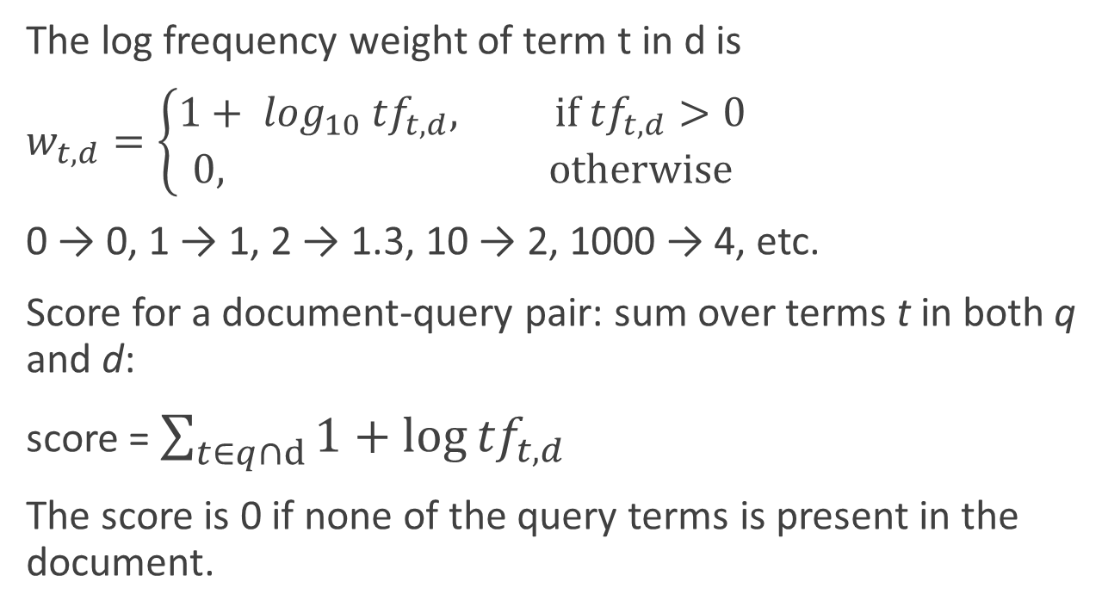
Log-frequency weighting
Sec. 6.2
The log frequency weight of term t in d is
$w_{t,d}=\left\{\begin{aligned}1+ \log_{10} {tf}_{t,d}, if {tf}_{t,d}>0 \\ 0, otherwise\end{aligned}\right.$
0 → 0, 1 → 1, 2 → 1.3, 10 → 2, 1000 → 4, etc.
Score for a document-query pair: sum over terms t in both q and d:
score = $\sum_{t∈q∩d}{1+\log{{tf}_{t,d}}}$
The score is 0 if none of the query terms is present in the document.

Slide 23
Document frequency
Sec. 6.2.1
Rare terms are more informative than frequent terms in a collection of documents
Recall stop words
Consider a term in the query that is rare in the collection (e.g., arachnocentric)
A document containing this term is very likely to be relevant to the query arachnocentric
→ We want a high weight for rare terms like arachnocentric.

Slide 24
Document frequency, continued
Sec. 6.2.1
Frequent terms are less informative than rare terms
Consider a query term that is frequent in the collection (e.g., high, increase, line)
A document containing such a term is more likely to be relevant than a document that doesn’t
But it’s not a sure indicator of relevance.
→ For frequent terms, we want high positive weights for words like high, increase, and line
But lower weights than for rare terms.
We will use document frequency (df) to capture this.

Slide 25
idf weight
Sec. 6.2.1
df_{t} is the document frequency of t: the number of documents that contain t
df_{t} is an inverse measure of the informativeness of t
df_{t} ≤ N
We define the idf (inverse document frequency) of t by
We use log (N/df_{t}) instead of N/df_{t} to “dampen” the effect of idf.
Will turn out the base of the log is immaterial.

Slide 26
idf example, suppose N = 1 million
Sec. 6.2.1
term | df_{t} | idf_{t}
calpurnia | 1
animal | 100
sunday | 1,000
fly | 10,000
under | 100,000
the | 1,000,000
There is one idf value for each term t in a collection.
Notes:
6 4 3 2 1 0

Slide 27
Effect of idf on ranking
Does idf have an effect on ranking for one-term queries, like
iPhone
idf has no effect on ranking one term queries
idf affects the ranking of documents for queries with at least two terms
For the query capricious person, idf weighting makes occurrences of capricious count for much more in the final document ranking than occurrences of person.

Slide 28
Collection vs. Document frequency
Sec. 6.2.1
The collection frequency of t is the number of occurrences of t in the collection, counting multiple occurrences.
Example:
Which word is a better search term (and should get a higher weight)?
Word | Collection frequency | Document frequency
insurance | 10440 | 3997
try | 10422 | 8760
Notes:
Why do you get these numbers?
Suggests df is better.

Slide 29
tf-idf weighting
Sec. 6.2.2
The tf-idf weight of a term is the product of its tf weight and its idf weight.
Best known weighting scheme in information retrieval
Note: the “-” in tf-idf is a hyphen, not a minus sign!
Alternative names: tf.idf, tf x idf

Slide 30
When does tf-idf increase?
Increases with the number of occurrences within a document
Increases with the rarity of the term in the collection.

Slide 31
Score for a document given a query
Sec. 6.2.2
There are many variants
How “tf” is computed (with/without logs)
Whether the terms in the query are also weighted
…

Slide 32
Binary → count → weight matrix
Sec. 6.3
Each document is now represented by a real-valued vector of tf-idf weights ∈ R^{|V|}

Slide 33
Documents as vectors
Sec. 6.3
So we have a |V|-dimensional vector space
Terms are axes of the space
Documents are points or vectors in this space
Very high-dimensional: tens of millions of dimensions when you apply this to a web search engine
These are very sparse vectors - most entries are zero.

Slide 34
Queries as vectors
Sec. 6.3
Key idea 1: Do the same for queries: represent them as vectors in the space
Key idea 2: Rank documents according to their proximity to the query in this space
proximity = similarity of vectors
proximity ≈ inverse of distance
Recall: We do this because we want to get away from the you’re-either-in-or-out Boolean model.
Instead: rank more relevant documents higher than less relevant documents

Slide 35
Formalizing vector space proximity
Sec. 6.3
First cut: distance between two points
( = distance between the end points of the two vectors)
Euclidean distance?
Euclidean distance is a bad idea . . .
. . . because Euclidean distance is large for vectors of different lengths.

Slide 36
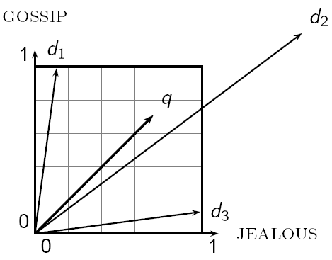
Why distance is a bad idea
Sec. 6.3
The Euclidean distance between q
and d₂ is large even though the
distribution of terms in the query q and the distribution of
terms in the document d₂ are
very similar.

Slide 37
Use angle instead of distance
Sec. 6.3
Thought experiment: take a document d and append it to itself. Call this document d′.
“Semantically” d and d′ have the same content
The Euclidean distance between the two documents can be quite large
The angle between the two documents is 0, corresponding to maximal similarity.
Key idea: Rank documents according to angle with query.

Slide 38
From angles to cosines
Sec. 6.3
The following two notions are equivalent.
Rank documents in decreasing order of the angle between query and document
Rank documents in increasing order of cosine(query,document)
Cosine is a monotonically decreasing function for the interval [0º, 180º]

Slide 39
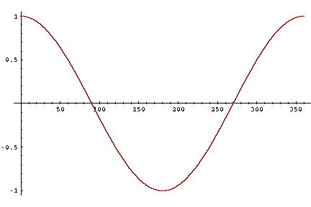
From angles to cosines
Sec. 6.3
But how – and why – should we be computing cosines?

Slide 40
Length normalization
Sec. 6.3
A vector can be (length-) normalized by dividing each of its components by its length – for this we use the L₂ norm:
Dividing a vector by its L₂ norm makes it a unit (length) vector (on surface of unit hypersphere)
Effect on the two documents d and d′ (d appended to itself) from earlier slide: they have identical vectors after length-normalization.
Long and short documents now have comparable weights

Slide 41
cosine(query,document)
Sec. 6.3
Dot product
Unit vectors
q_{i} is the tf-idf weight of term i in the query
d_{i} is the tf-idf weight of term i in the document
cos(q,d) is the cosine similarity of q and d … or,
equivalently, the cosine of the angle between q and d.
Notes:
See Law of Cosines (Cosine Rule) wikipedia page

Slide 42
Cosine for length-normalized vectors
For length-normalized vectors, cosine similarity is simply the dot product (or scalar product):
for q, d length-normalized.

Slide 43
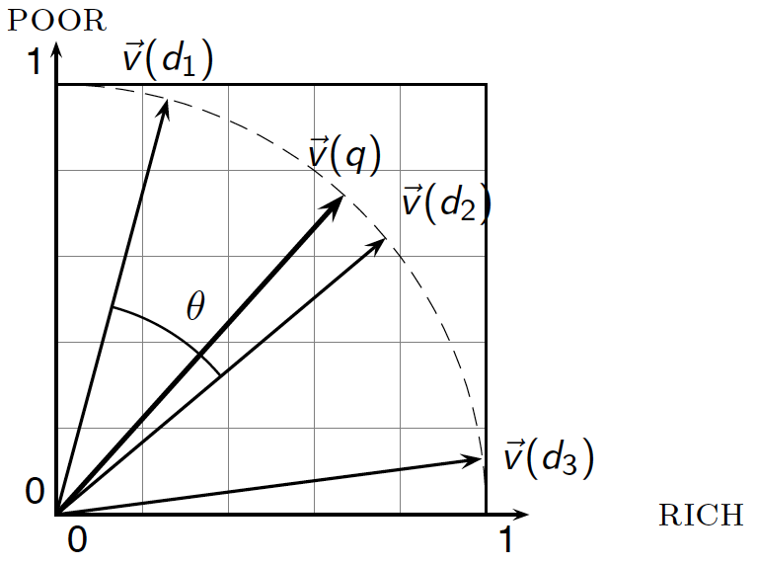
Cosine similarity illustrated

Slide 44
Cosine similarity amongst 3 documents
Sec. 6.3
How similar are
the novels
SaS: Sense and
Sensibility
PaP: Pride and
Prejudice, and
WH: Wuthering
Heights?
term | SaS | PaP | WH
affection | 115 | 58 | 20
jealous | 10 | 7 | 11
gossip | 2 | 0 | 6
wuthering | 0 | 0 | 38
Term frequencies (counts)
Note: To simplify this example, we don’t do idf weighting.

Slide 45
3 documents example contd.
Sec. 6.3
Log frequency weighting
After length normalization
term | SaS | PaP | WH
affection | 3.06 | 2.76 | 2.30
jealous | 2.00 | 1.85 | 2.04
gossip | 1.30 | 0 | 1.78
wuthering | 0 | 0 | 2.58
term | SaS | PaP | WH
affection | 0.789 | 0.832 | 0.524
jealous | 0.515 | 0.555 | 0.465
gossip | 0.335 | 0 | 0.405
wuthering | 0 | 0 | 0.588
cos(SaS,PaP) ≈
0.789 × 0.832 + 0.515 × 0.555 + 0.335 × 0.0 + 0.0 × 0.0
≈ 0.94
cos(SaS,WH) ≈ 0.79
cos(PaP,WH) ≈ 0.69
Why do we have cos(SaS,PaP) > cos(SaS,WH)?

Slide 46
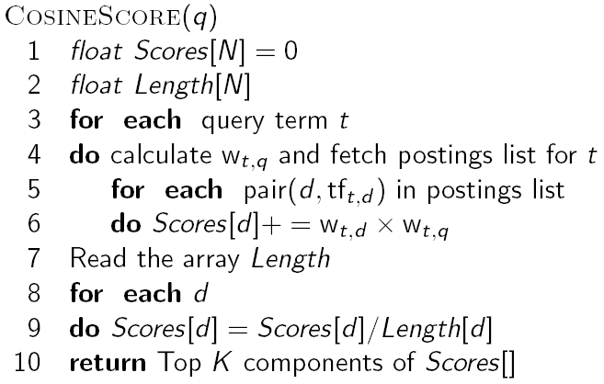
Computing cosine scores
Sec. 6.3

Slide 47
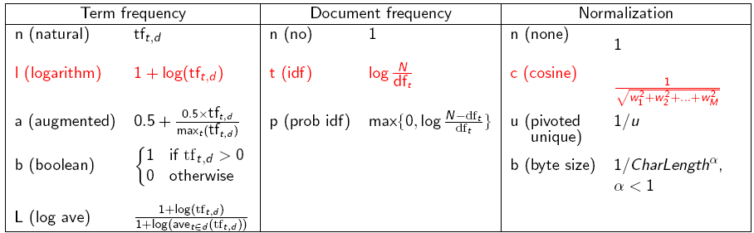
tf-idf weighting has many variants
Sec. 6.4
Columns headed ‘n’ are acronyms for weight schemes.
Why is the base of the log in idf immaterial?
Notes:
n default is just term frequency
ltc is best known form of weighting

Slide 48
Weighting may differ in queries vs documents
Sec. 6.4
Many search engines allow for different weightings for queries vs. documents
SMART Notation: denotes the combination in use in an engine, with the notation ddd.qqq, using the acronyms from the previous table
A very standard weighting scheme is: lnc.ltc
Document: logarithmic tf (l as first character), no idf and cosine normalization
Query: logarithmic tf (l in leftmost column), idf (t in second column), no normalization …
A bad idea?
Notes:
Leaving off idf weighting on documents is good for both efficiency and system effectiveness reasons.

Slide 49

tf-idf example: lnc.ltc
Sec. 6.4
N = 1,000,000 documents; the document frequencies of auto, best, car and insurance are respectively 5000, 50000, 10000 and 1000.
Document: car insurance auto insurance
Query: best car insurance
Term | Query |  |  |  |  | Document |  |  |  | Prod
 | tf-raw | df | idf | wt | n’lize | tf-raw | tf-wt | wt | n’lize
auto | 0 | 5000 | 2.3 | 0 | 0 | 1 | 1 | 1 | 0.52 | 0
best | 1 | 50000 | 1.3 | 1.3 | 0.34 | 0 | 0 | 0 | 0 | 0
car | 1 | 10000 | 2.0 | 2.0 | 0.52 | 1 | 1 | 1 | 0.52 | 0.27
insurance | 1 | 1000 | 3.0 | 3.0 | 0.78 | 2 | 1.3 | 1.3 | 0.68 | 0.53
Exercise: what is N, the number of docs?
Doc length =
Score = 0+0+0.27+0.53 = 0.8

Slide 50
Summary – vector space ranking
Represent the query as a weighted tf-idf vector
Represent each document as a weighted tf-idf vector
Compute the cosine similarity score for the query vector and each document vector
Rank documents with respect to the query by score
Return the top K (e.g., K = 10) to the user

Slide 51
Resources on Cosine
Ch. 6
http://www.miislita.com/information-retrieval-tutorial/cosine-similarity-tutorial.html
Term weighting and cosine similarity tutorial for SEO folk!

