Slide 1
Query Processing
Information Retrieval in Practice

Slide 2
Query Processing
Document-at-a-time
Calculates complete scores for documents by processing all term lists, one document at a time
Term-at-a-time
Accumulates scores for documents by processing term lists one at a time
Both approaches have optimization techniques that significantly reduce time required to generate scores

Slide 3
Document-At-A-Time

Slide 4
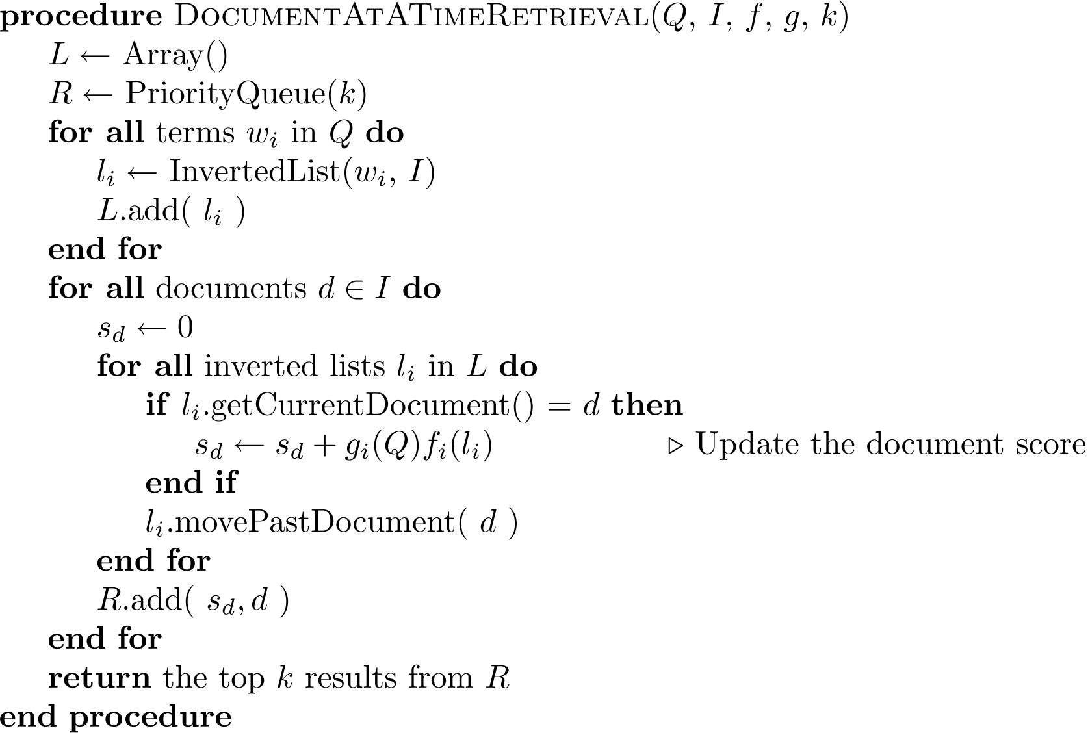
Document-At-A-Time

Slide 5
Pseudocode Function Descriptions
getCurrentDocument()
Returns the document number of the current posting of the inverted list.
skipForwardToDocument(d)
Moves forward in the inverted list until getCurrentDocument() <= d. This function may read to the end of the list.
movePastDocument(d)
Moves forward in the inverted list until getCurrentDocument() < d.
moveToNextDocument()
Moves to the next document in the list. Equivalent to movePastDocument(getCurrentDocument()).
getNextAccumulator(d)
returns the first document number d' >= d that has already has an accumulator.
removeAccumulatorsBetween(a, b)
Removes all accumulators for documents numbers between a and b. A_{d} will be removed iff a < d < b.

Slide 6
Term-At-A-Time

Slide 7
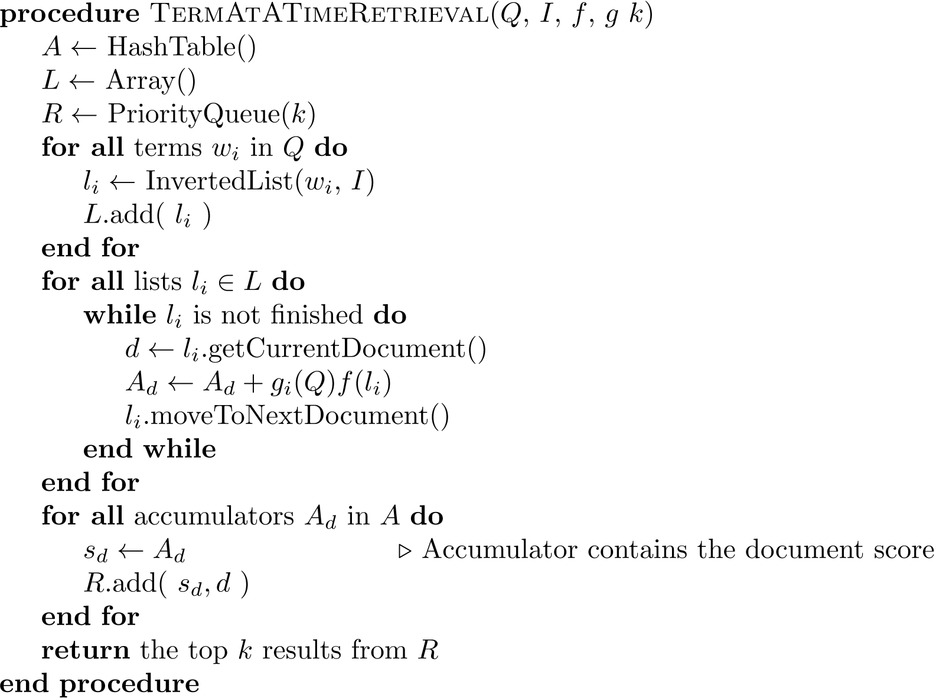
Term-At-A-Time

Slide 8
Optimization Techniques
Term-at-a-time uses more memory for accumulators, but accesses disk more efficiently
Two classes of optimization
Read less data from inverted lists
e.g., skip lists
better for simple feature functions
Calculate scores for fewer documents
e.g., conjunctive processing
better for complex feature functions

Slide 9
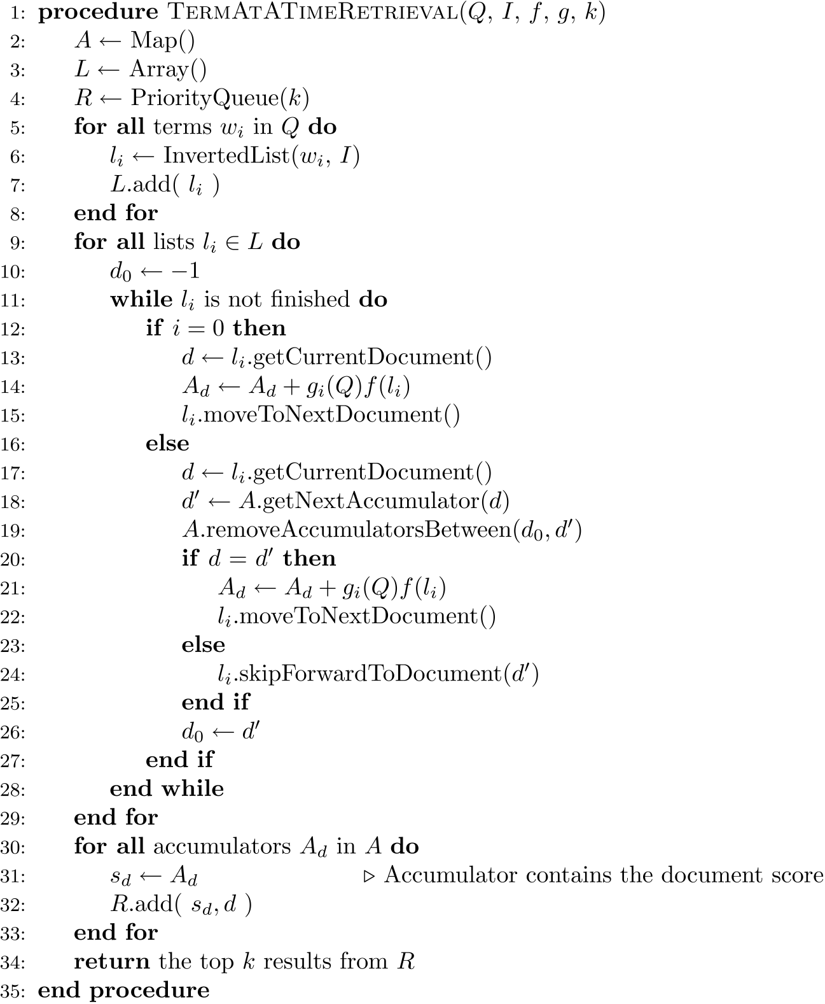
Conjunctive
Term-at-a-Time

Slide 10
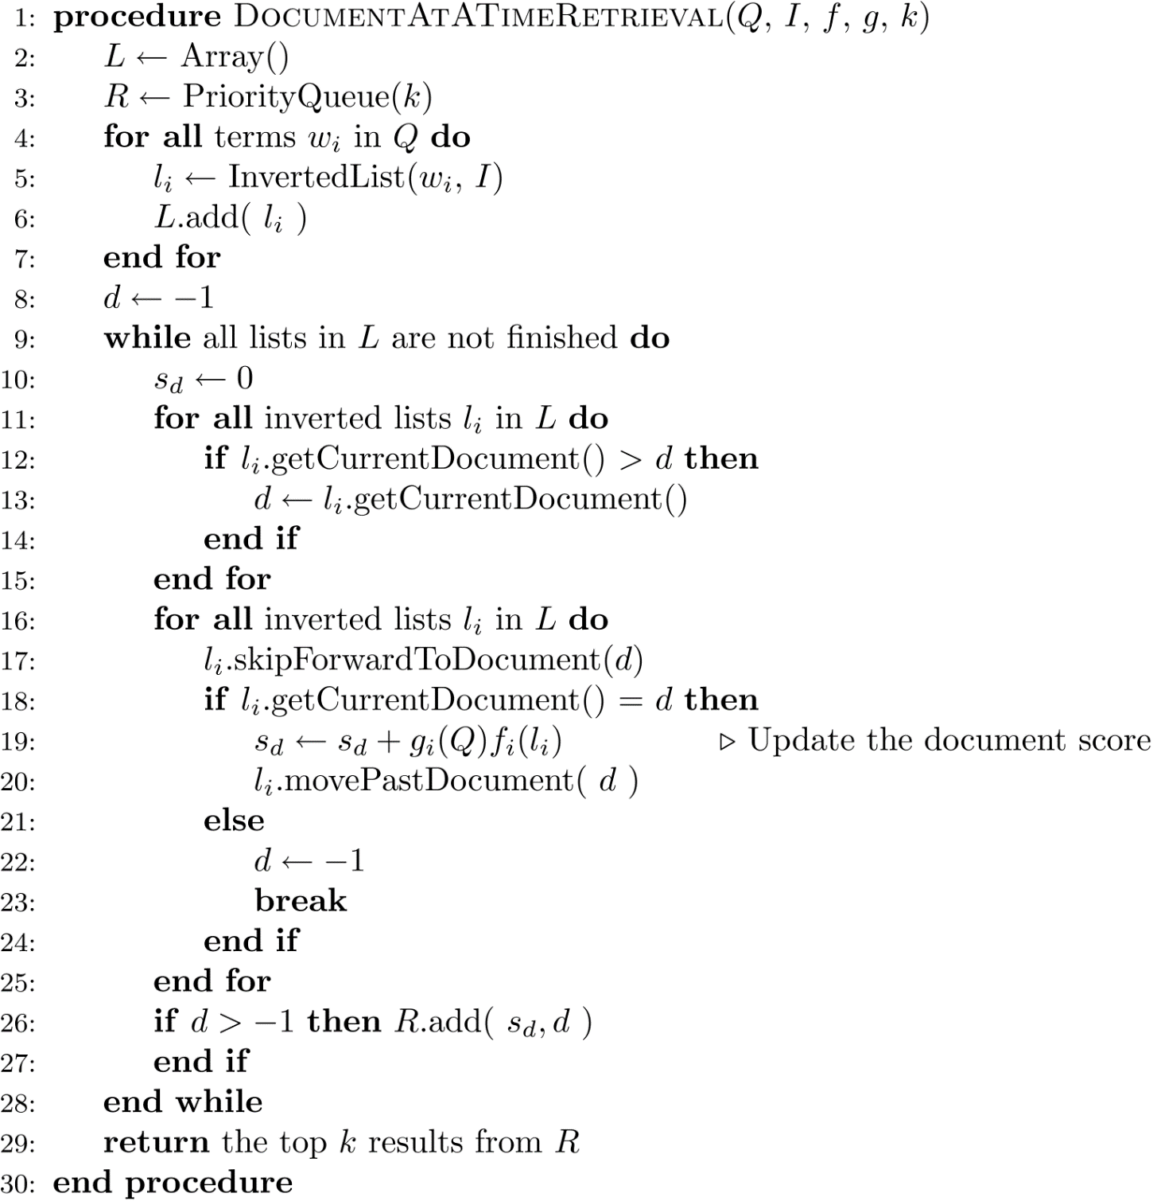
Conjunctive
Document-at-a-Time

Slide 11
Threshold Methods
Threshold methods use number of top-ranked documents needed (k) to optimize query processing
for most applications, k is small
For any query, there is a minimum score that each document needs to reach before it can be shown to the user
score of the kth-highest scoring document
gives threshold τ
optimization methods estimate τ′ to ignore documents

Slide 12
Threshold Methods
For document-at-a-time processing, use score of lowest-ranked document so far for τ′
for term-at-a-time, have to use kth-largest score in the accumulator table
MaxScore method compares the maximum score that remaining documents could have to τ′
safe optimization in that ranking will be the same without optimization

Slide 13
MaxScore Example
Indexer computes μ_{tree}
maximum score for any document containing just “tree”
Assume k =3, τ′ is lowest score after first three docs
Likely that τ ′ > μ_{tree}
τ ′ is the score of a document that contains both query terms
Can safely skip over all gray postings

Slide 14
Other Approaches
Early termination of query processing
ignore high-frequency word lists in term-at-a-time
ignore documents at end of lists in doc-at-a-time
unsafe optimization
List ordering
order inverted lists by quality metric (e.g., PageRank) or by partial score
makes unsafe (and fast) optimizations more likely to produce good documents

Slide 15
Distributed Evaluation
Basic process
All queries sent to a director machine
Director then sends messages to many index servers
Each index server does some portion of the query processing
Director organizes the results and returns them to the user
Two main approaches
Document distribution
by far the most popular
Term distribution

Slide 16
Distributed Evaluation
Document distribution
each index server acts as a search engine for a small fraction of the total collection
director sends a copy of the query to each of the index servers, each of which returns the top-k results
results are merged into a single ranked list by the director
Collection statistics should be shared for effective ranking

Slide 17
Distributed Evaluation
Term distribution
Single index is built for the whole cluster of machines
Each inverted list in that index is then assigned to one index server
in most cases the data to process a query is not stored on a single machine
One of the index servers is chosen to process the query
usually the one holding the longest inverted list
Other index servers send information to that server
Final results sent to director

Slide 18
Caching
Query distributions similar to Zipf
About ½ each day are unique, but some are very popular
Caching can significantly improve effectiveness
Cache popular query results
Cache common inverted lists
Inverted list caching can help with unique queries
Cache must be refreshed to prevent stale data

