Slide 1
Random Surfers on the Web
Transition Matrix of the Web
Dead Ends and Spider Traps
Topic-Specific PageRank
PageRank
Information Retrieval in Practice
Slides from Mining Massive Data Sets at
http://web.stanford.edu/class/cs246/handouts.html

Slide 2
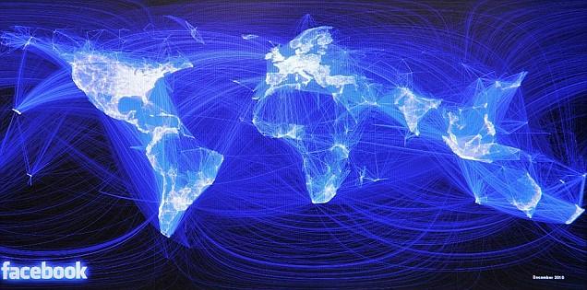
Graph Data: Social Networks
Facebook social graph
4-degrees of separation [Backstrom-Boldi-Rosa-Ugander-Vigna, 2011]

Slide 3
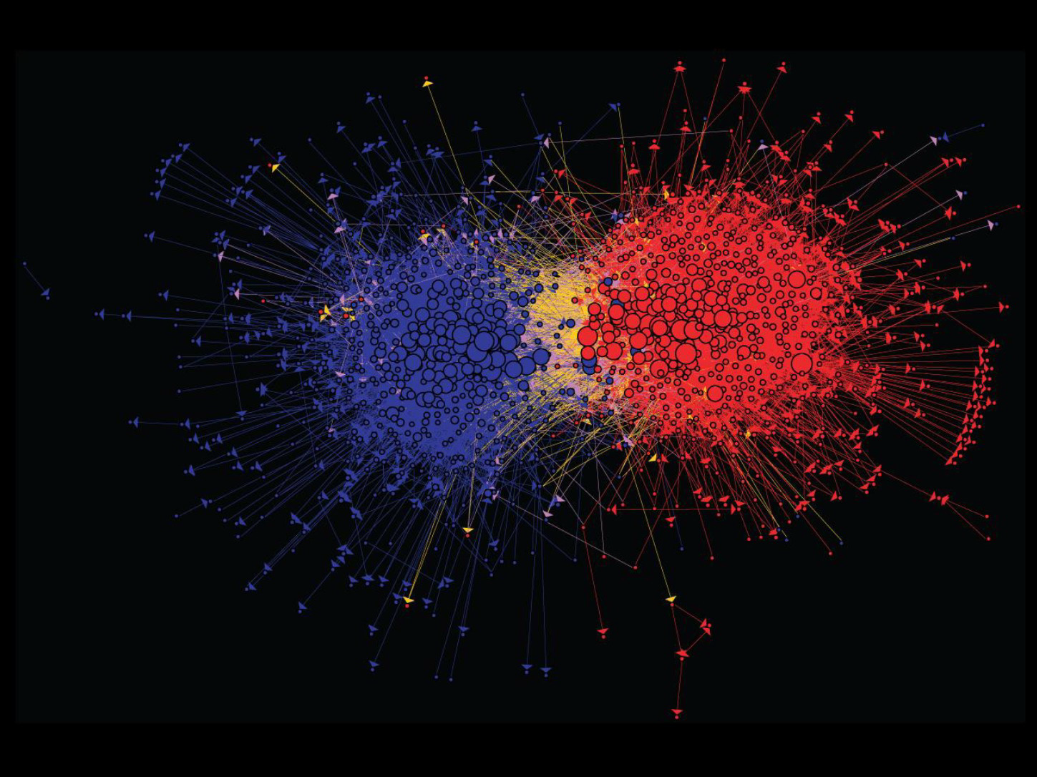
Graph Data: Media Networks
Connections between political blogs
Polarization of the network [Adamic-Glance, 2005]

Slide 4
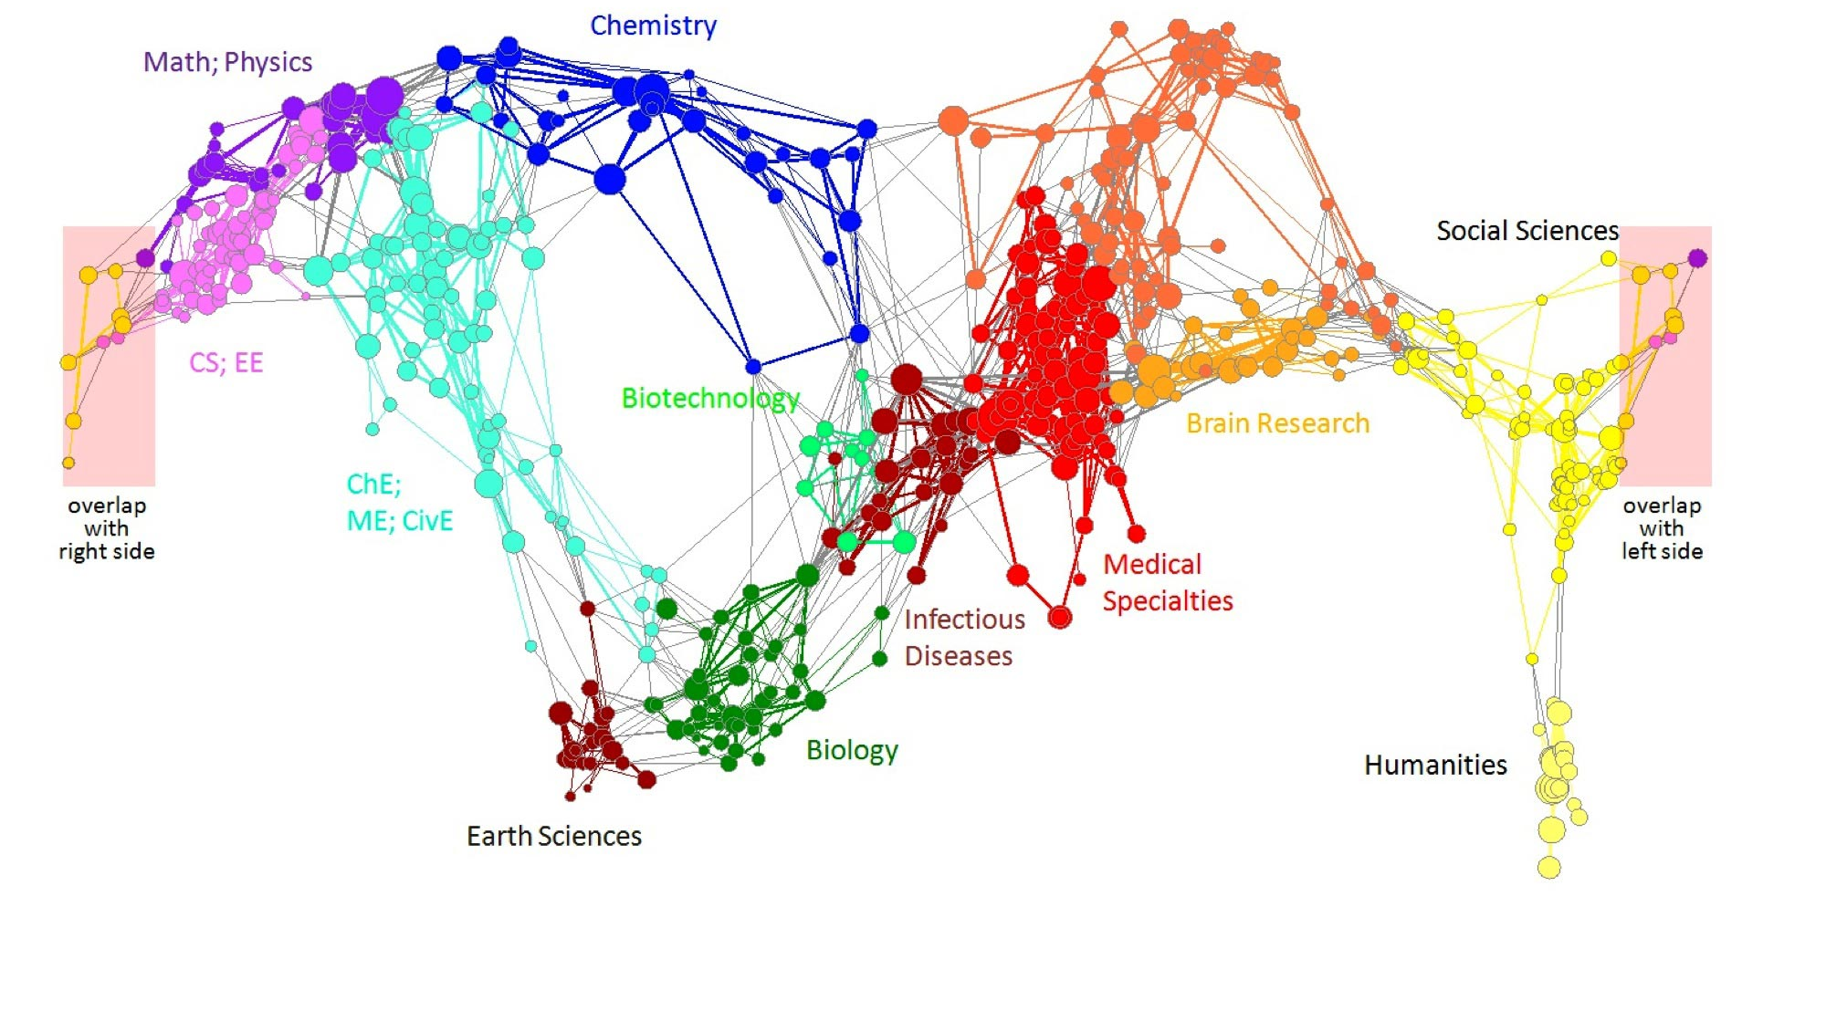
Graph Data: Information Nets
Citation networks and Maps of science
[Börner et al., 2012]

Slide 5
Web as a Graph
Web as a directed graph:
  Nodes: Webpages
  Edges: Hyperlinks
I teach a class on InformationRetrieval.
CS224W: Classes are in the
Tutelman building
Computer Science Department at Temple
Temple University

Slide 6
Web as a Graph
Web as a directed graph:
  Nodes: Webpages
  Edges: Hyperlinks
I teach a class on IR.
CIS5590: Classes are in the
Tutelman building
Computer Science Department at Temple
Temple University

Slide 7

Broad Question
How to organize the Web?
First try: Human curated
Web directories
  Yahoo, DMOZ, LookSmart
Second try: Web Search
  Information Retrieval investigates:
  Find relevant docs in a small
  and trusted set
    Newspaper articles, Patents, etc.
  But: Web is huge, full of untrusted documents, random things, web spam, etc.

Slide 8
Web Search: 2 Challenges
2 challenges of web search:
(1) Web contains many sources of information
Who to “trust”?
  Trick: Trustworthy pages may point to each other!
(2) What is the “best” answer to query “newspaper”?
  No single right answer
  Trick: Pages that actually know about newspapers might all be pointing to many newspapers

Slide 9
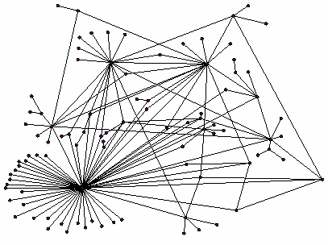
Ranking Nodes on the Graph
All web pages are not equally “important”
  www.joe-schmoe.com vs. www.temple.edu
There is large diversity
in the web-graph
node connectivity.
Let’s rank the pages by
the link structure!

Slide 10
Link Analysis Algorithms
We will cover the following Link Analysis approaches for computing importances
of nodes in a graph:
  Page Rank
  Web Spam Detection Algorithms
    A brief intro next

Slide 11
What Is Web Spam?
Spamming = any deliberate action solely in order to boost a Web page’s position in search-engine results.
Spam = Web pages that are the result of spamming.
SEO industry might disagree!
  SEO = search engine optimization

Slide 12
Web Spam Taxonomy
Boosting techniques.
  Techniques for achieving high relevance/importance for a Web page.
Hiding techniques.
  Techniques to hide the use of boosting from humans and Web crawlers.

Slide 13
Boosting: Term Manipulation
Term spamming.
  Manipulating the text of web pages in order to appear relevant to queries.

Slide 14
Term-Spamming Techniques
Repetition of terms, e.g., “Viagra,” in order to subvert TF.IDF-based rankings.
Dumping = adding large numbers of words to your page.
  Example: run the search query you would like your page to match, and add copies of the top 10 pages.
  Example: add a dictionary, so you match every search query.
  Key hiding technique: words are hidden by giving them the same color as the background.

Slide 15


Slide 16

Need a Different Paradigm
Page Importance

Slide 17
Links as Votes
Idea: Links as votes
  Page is more important if it has more links
    In-coming links? Out-going links?
Think of in-links as votes:
  www.temple.edu has ? in-links
  www.joe-schmoe.com has 1 in-link
Are all in-links are equal?
  Links from important pages count more
  Recursive question!
What did you learn in your assignment?

Slide 18
Simple Recursive Formulation
Each link’s vote is proportional to the importance of its source page
If page j with importance r_{j} has n out-links, each link gets r_{j} / n votes
Page j’s own importance is the sum of the votes on its in-links
i
k
r_{i}/3
r_{k}/4
j
r_{j}/3
r_{j} = r_{i}/3+r_{k}/4
r_{j}/3
r_{j}/3

Slide 19
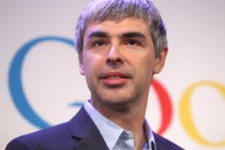

Inventors

Slide 20
Intuition – (1)
Web pages are important if people visit them a lot.
But, can we watch everybody using the Web?
A good surrogate for visiting pages is to assume people follow links randomly.
Leads to random surfer model:
  Start at a random page and follow random out-links repeatedly, from whatever page you are at.
  PageRank = limiting probability of being at a page.

Slide 21
Intuition – (2)
Solve the recursive equation:
a page is important to the extent that important pages link to it
  Equivalent to the random-surfer definition of PageRank.
Technically, importance = the principal eigenvector of the transition matrix of the Web.
  A few fixups needed.

Slide 22

PageRank: The “Flow” Model
A “vote” from an important page is worth more
A page is important if it is pointed to by other important pages
Define a “rank” r_{j} for page j
y/2
y
a/2
y/2
m
a
m
a/2
“Flow” equations:
  r_{y} = r_{y} /2 + r_{a} /2
  r_{a} = r_{y} /2 + r_{m}
  r_{m} = r_{a} /2
$d_{i}$ … out-degree of node $i$

Slide 23
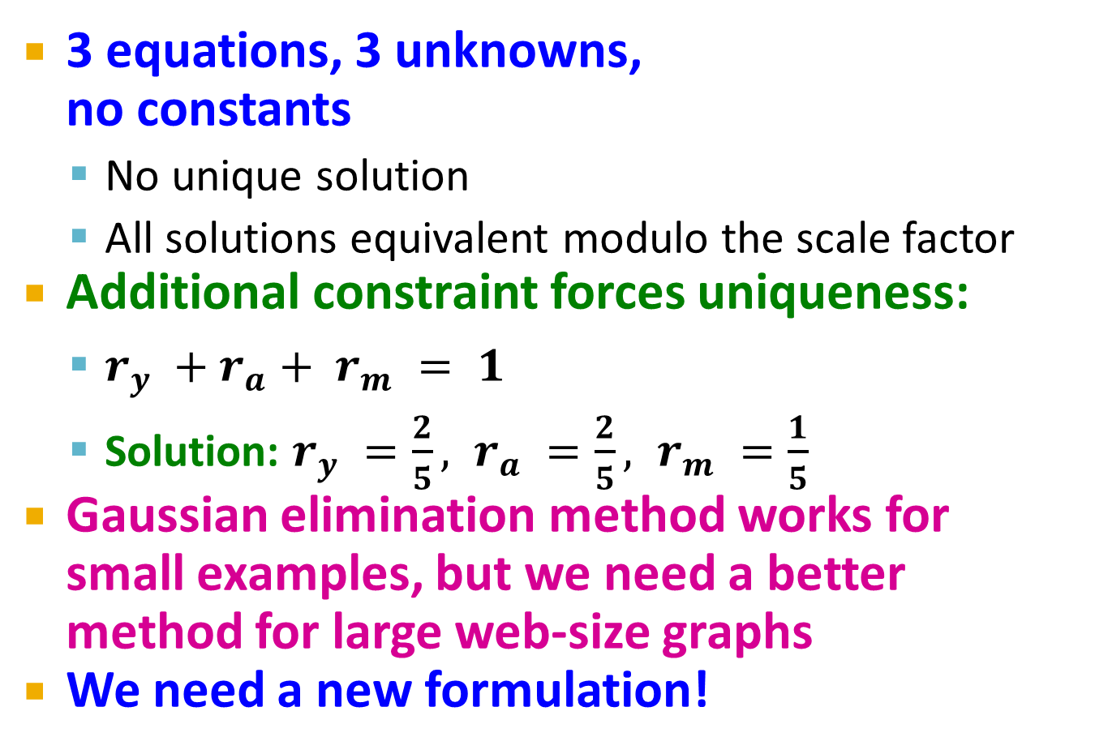
Solving the Flow Equations
Flow equations:
3 equations, 3 unknowns,
no constants
  No unique solution
  All solutions equivalent modulo the scale factor
Additional constraint forces uniqueness:
  $r_{y} +r_{a}+ r_{m} = 1$
  Solution: $r_{y} =\frac{2}{5}, r_{a} =\frac{2}{5}, r_{m} =\frac{1}{5}$
Gaussian elimination method works for
small examples, but we need a better method for large web-size graphs
We need a new formulation!
  r_{y} = r_{y} /2 + r_{a} /2
  r_{a} = r_{y} /2 + r_{m}
  r_{m} = r_{a} /2

Slide 24
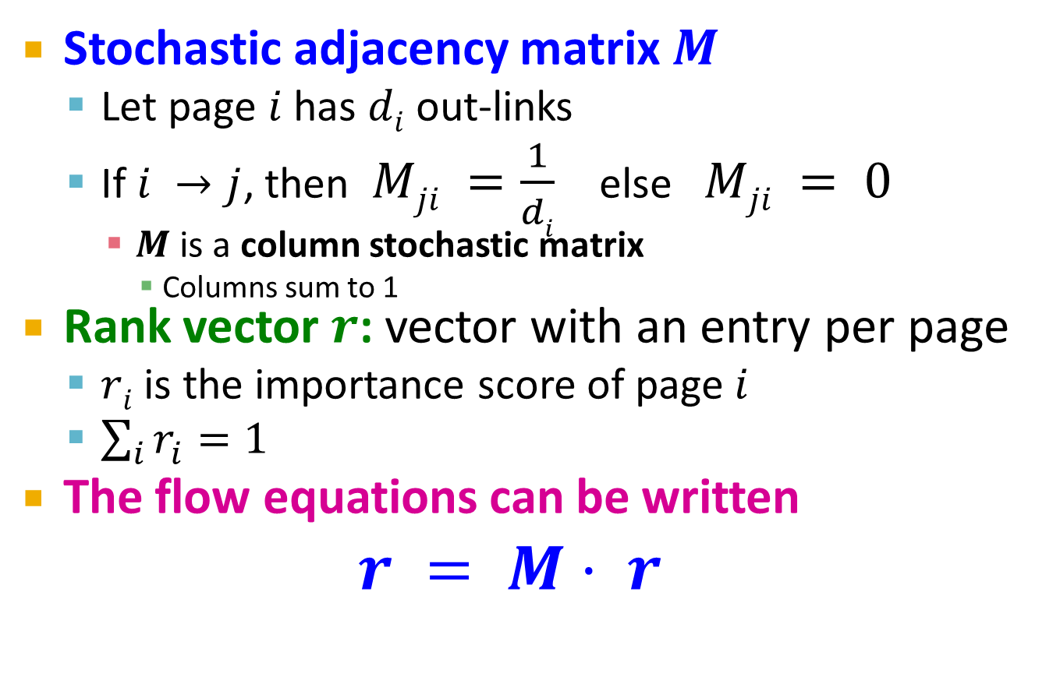
PageRank: Matrix Formulation
Stochastic adjacency matrix $M$
  Let page $i$ has $di$ out-links
  If $i →j$, then $Mji =\frac{1}{di}$ else $Mji = 0$
    $M$ is a column stochastic matrix
      Columns sum to 1
Rank vector $r$: vector with an entry per page
  $ri$ is the importance score of page $i$
  $\sum_{i}{r_{i}^{}=1}$
The flow equations can be written
$r = M⋅ r$

Slide 25
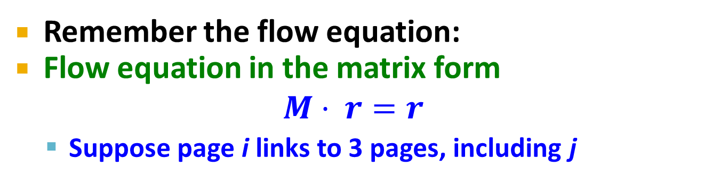
Example
Remember the flow equation:
Flow equation in the matrix form
$$M⋅ r=r$$
  Suppose page i links to 3 pages, including j
i
j
r_{j}
.
=
r_{i}
1/3
M
.
r
=
r

Slide 26
Transition Matrix of the Web
Number the pages 1, 2,… .
  Page i corresponds to row and column i.
M [i, j] = 1/n if page j links to n pages, including page i ; 0 if j does not link to i.
  M [i, j] is the probability we’ll next be at page i if we are now at page j.

Slide 27


Example: Transition Matrix
Suppose page j links to 3 pages, including i but not x.
j
i
  $$y= \frac{1}{2 }+\frac{1}{2 }$$
  $$a= \frac{1}{2 }$$
  $$m= \frac{1}{2 }$$
  $$y= \frac{1}{2 }+\frac{1/2}{2 }$$
  $$a= \frac{1/2}{2 }$$
  $$m= \frac{1/2}{2 }$$
1/3
x
0

Slide 28
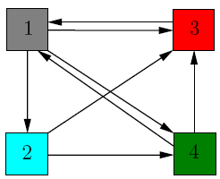
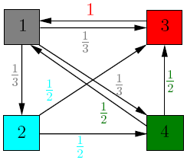
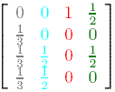
Another Example
Source: http://www.math.cornell.edu/~mec/Winter2009/RalucaRemus/Lecture3/lecture3.html

Slide 29
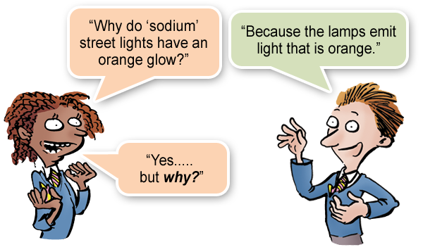
Random Walks on the Web
Suppose v is a vector whose i ^{th} component is the probability that a random walker is at page i at a certain time.
If a walker follows a link from i at random, the probability distribution for walkers is then given by the vector Mv.

Slide 30
Random Walks – (2)
Starting from any vector u, the limit M (M (…M (M u ) …)) is the long-term distribution of walkers.
Intuition: pages are important in proportion to how likely a walker is to be there.
The math: limiting distribution = principal eigenvector of M = PageRank.

Slide 31
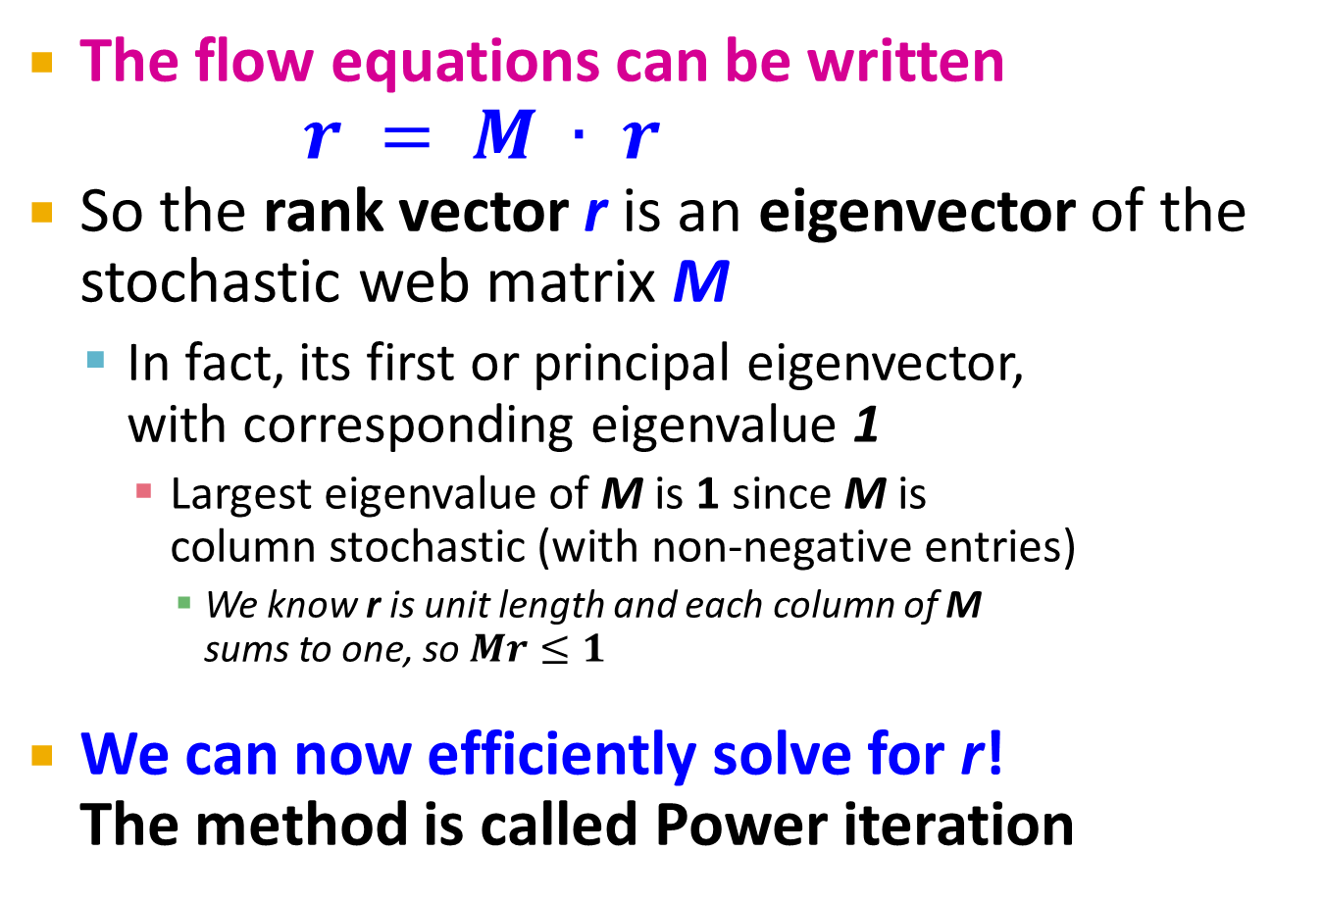

Eigenvector Formulation
The flow equations can be written
$r = M ∙ r$
So the rank vector r is an eigenvector of the stochastic web matrix M
  In fact, its first or principal eigenvector,
  with corresponding eigenvalue 1
    Largest eigenvalue of M is 1 since M is
    column stochastic (with non-negative entries)
      We know r is unit length and each column of M
      sums to one, so $Mr≤1$
We can now efficiently solve for r!
The method is called Power iteration
NOTE: x is an eigenvector with the corresponding eigenvalue λ if:
$$Ax=λx$$

Slide 32
Power Iteration Method
Given a web graph with n nodes, where the nodes are pages and edges are hyperlinks
Power iteration: a simple iterative scheme
  Suppose there are N web pages
  Initialize: r⁽⁰⁾ = [1/N,….,1/N]^{T}
  Iterate: r^{(t+1)} = M ∙ r^{(t)}
  Stop when |r^{(t+1)} – r^{(t)}|₁ < ε
d_{i} …. out-degree of node i
    |x|₁ = ∑_{1≤i≤N}|x_{i}| is the L1 norm
    Can use any other vector norm, e.g., Euclidean
About 50 iterations is sufficient to estimate the limiting solution.

Slide 33
Running Example
Yahoo
 | y | a | m
y | ½ | ½ | 0
a | ½ | 0 | 1
m | 0 | ½ | 0
r = M∙r
Amazon
M’soft
y ½ ½ 0 y
a = ½ 0 1 a
m 0 ½ 0 m
  r_{y} = r_{y} /2 + r_{a} /2
  r_{a} = r_{y} /2 + r_{m}
  r_{m} = r_{a} /2

Slide 34
Solving The Equations
Because there are no constant terms, the equations v = Mv do not have a unique solution.
In Web-sized examples, we cannot solve by Gaussian elimination anyway; we need to use relaxation (= iterative solution).
Works if you start with any nonzero u.

Slide 35
Simulating a Random Walk
Start with the vector u = [1, 1,…, 1] representing the idea that each Web page is given one unit of importance.
  Note: it is more common to start with each vector element = 1/n, where n is the number of Web pages.
Repeatedly apply the matrix M to u, allowing the importance to flow like a random walk.
About 50 iterations is sufficient to estimate the limiting solution.

Slide 36
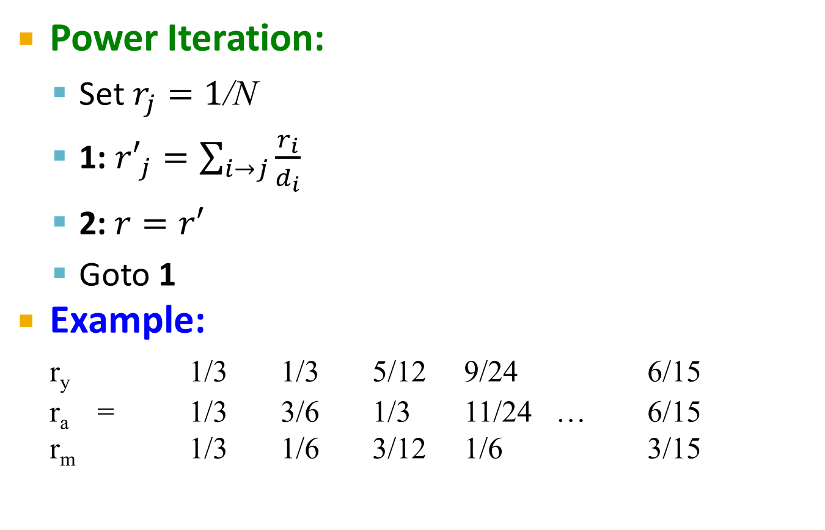
PageRank: How to solve?
Power Iteration:
  Set $r_{j}=1$/N
  1: ${r′}_{j}=\sum_{i→j}{\frac{r_{i}}{d_{i}}}$
  2:$r=r′$
  Goto 1
Example:
r_{y} 1/3 1/3 5/12 9/24 6/15
r_{a} = 1/3 3/6 1/3 11/24 … 6/15
r_{m} 1/3 1/6 3/12 1/6 3/15
y
 | y | a | m
y | ½ | ½ | 0
a | ½ | 0 | 1
m | 0 | ½ | 0
a
m
  r_{y} = r_{y} /2 + r_{a} /2
  r_{a} = r_{y} /2 + r_{m}
  r_{m} = r_{a} /2
Iteration 0, 1, 2, …

Slide 37
PageRank: How to solve?
Power Iteration:
  Set $r_{j}=1$/N
  1: ${r′}_{j}=\sum_{i→j}{\frac{r_{i}}{d_{i}}}$
  2:$r=r′$
  Goto 1
Example:
r_{y} 1/3 1/3 5/12 9/24 6/15
r_{a} = 1/3 3/6 1/3 11/24 … 6/15
r_{m} 1/3 1/6 3/12 1/6 3/15
y
 | y | a | m
y | ½ | ½ | 0
a | ½ | 0 | 1
m | 0 | ½ | 0
a
m
  r_{y} = r_{y} /2 + r_{a} /2
  r_{a} = r_{y} /2 + r_{m}
  r_{m} = r_{a} /2
Iteration 0, 1, 2, …

Slide 38


Example: Iterating Equations
Equations v = Mv:
  y = y /2 + a /2
  a = y /2 + m
  m = a /2
y a m
Note: “=” is
really “assignment.”
y 1/2 1/2 0
a 1/2 0 1
m 0 1/2 0
  $$y= \frac{1}{2 }+\frac{1}{2 }$$
  $$a= \frac{1}{2 }+1$$
  $$m= \frac{1}{2 }$$
  $$y= \frac{1}{2 }+\frac{3/2}{2 }$$
  $$a= \frac{1}{2 }+\frac{1}{2}$$
  $$m= \frac{3/2}{2 }$$
y
a =
m
1
1
1
1
3/2
1/2
5/4
1
3/4
9/8
11/8
1/2
6/5
6/5
3/5
. . .

Slide 39
The Walkers
Yahoo
Amazon
M’soft

Slide 40
The Walkers
Yahoo
Amazon
M’soft

Slide 41
The Walkers
Yahoo
Amazon
M’soft

Slide 42
The Walkers
Yahoo
Amazon
M’soft

Slide 43
In the Limit …
Yahoo
Amazon
M’soft

Slide 44
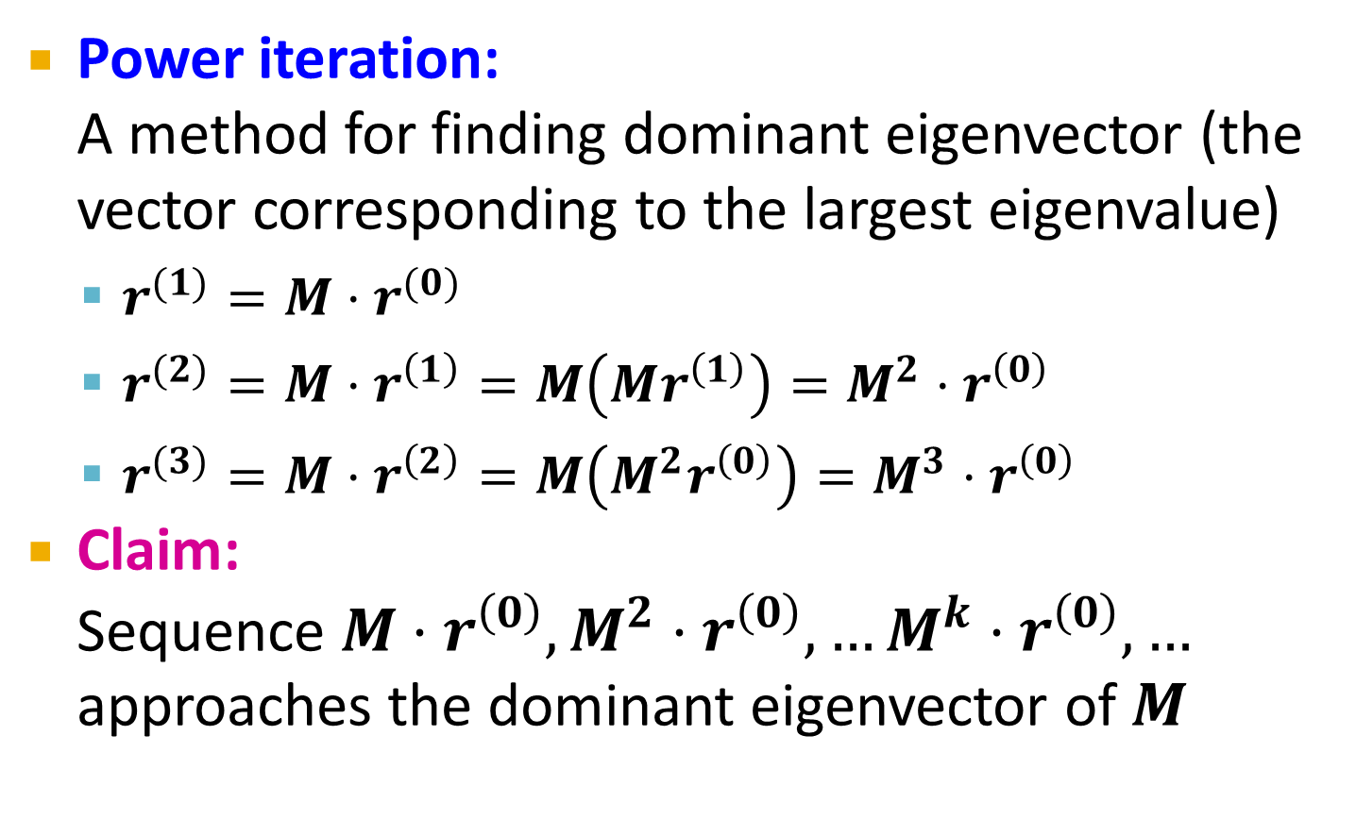
Why Power Iteration works? (1)
Details!
Power iteration:
A method for finding dominant eigenvector (the vector corresponding to the largest eigenvalue)
  $r^{(1)}=M⋅r^{(0)}$
  $r^{(2)}=M⋅r^{\left(1\right)}=M\left(Mr^{\left(1\right)}\right)=M^{2}⋅r^{\left(0\right)}$
  $r^{(3)}=M⋅r^{\left(2\right)}=M\left(M^{2}r^{\left(0\right)}\right)=M^{3}⋅r^{\left(0\right)}$
Claim:
Sequence $M⋅r^{\left(0\right)},M^{2}⋅r^{\left(0\right)},…M^{k}⋅r^{\left(0\right)},…$ approaches the dominant eigenvector of $M$

Slide 45
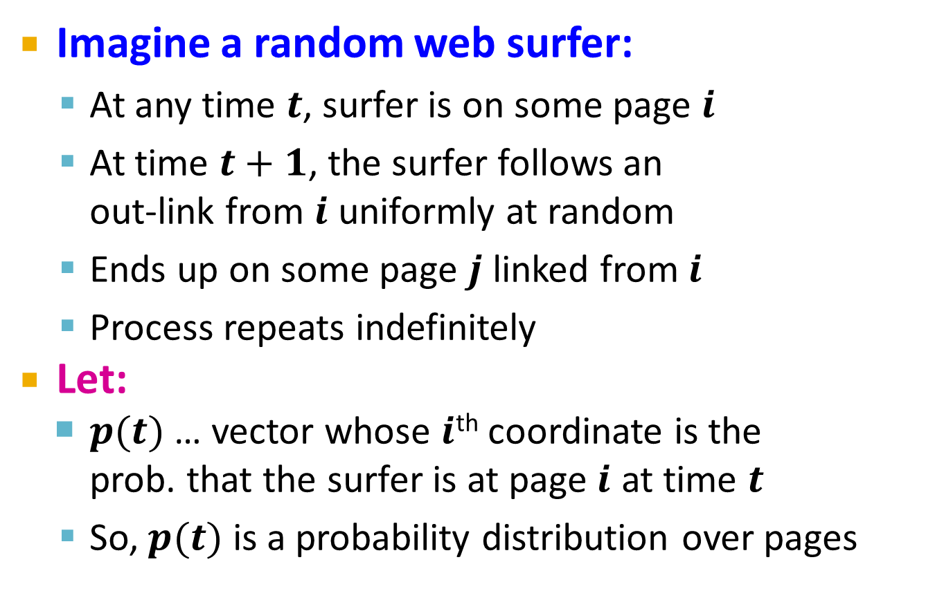
Random Walk Interpretation
Imagine a random web surfer:
  At any time $t$, surfer is on some page $i$
  At time $t+1$, the surfer follows an
  out-link from $i$ uniformly at random
  Ends up on some page $j$ linked from $i$
  Process repeats indefinitely
Let:
  $p(t)$ … vector whose $i$^{th} coordinate is the
  prob. that the surfer is at page $i$ at time $t$
  So, $p(t)$ is a probability distribution over pages
i₁
i₂
i₃
j

Slide 46
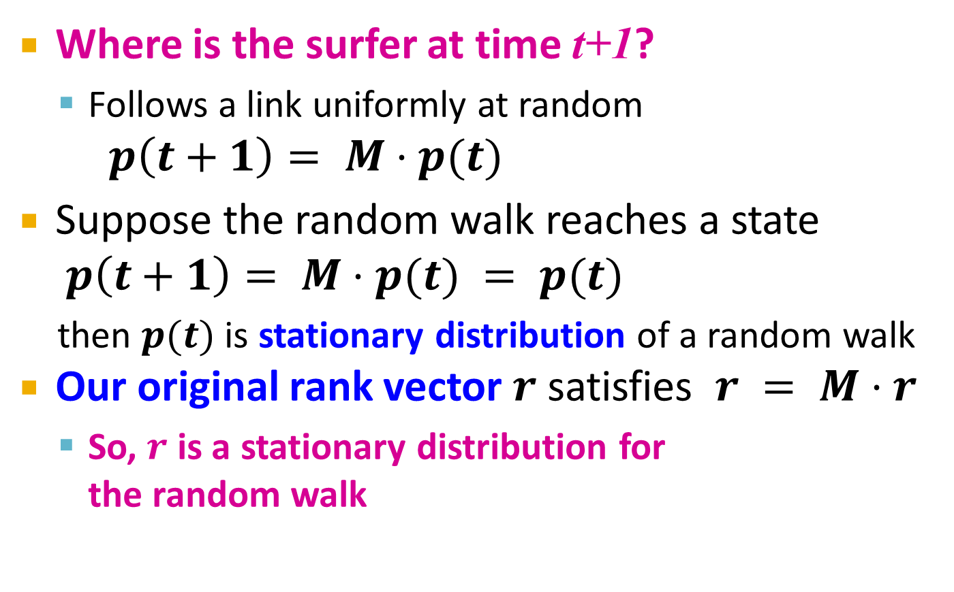
The Stationary Distribution
i₁
i₂
i₃
Where is the surfer at time t+1?
  Follows a link uniformly at random
$p\left(t+1\right)= M⋅p(t)$
Suppose the random walk reaches a state $p\left(t+1\right)= M⋅p(t) = p(t)$
  then $p(t)$ is stationary distribution of a random walk
Our original rank vector $r$ satisfies $r = M⋅r$
  So, $r$ is a stationary distribution for
  the random walk
j

Slide 47
Existence and Uniqueness
A central result from the theory of random walks (a.k.a. Markov processes):
For graphs that satisfy certain conditions,
the stationary distribution is unique and eventually will be reached no matter what the initial probability distribution at time t = 0

Slide 48
Dead Ends
Spider Traps
Taxation Policies
The Web Is More Complex
Than That
Notes:
We’re now going to forget whether the sets we deal with come from shingled documents or any other source, and concentrate on the sets themselves. We’ll learn the formal definition of “similarity” that is commonly used for sets – this notion is called “Jaccard similarity.” We’ll then learn how to construct signatures from sets using the minhashing technique, and we’ll prove the strong relationship between the similarity of the signatures and the sets they represent.

Slide 49
PageRank: Three Questions
Does this converge?
Does it converge to what we want?
Are results reasonable?
or
equivalently

Slide 50
Does this converge?
Example:
r_{a} 1 0 1 0
r_{b} 0 1 0 1
a
b
=
Iteration 0, 1, 2, …

Slide 51
Does it converge to what we want?
Example:
r_{a} 1 0 0 0
r_{b} 0 1 0 0
a
b
=
Iteration 0, 1, 2, …

Slide 52
PageRank: Problems
Dead end
2 problems:
(1) Some pages are
dead ends (have no out-links)
  Random walk has “nowhere” to go to
  Such pages cause importance to “leak out”
(2) Spider traps:
(all out-links are within the group)
  Random walked gets “stuck” in a trap
  And eventually spider traps absorb all importance
Spider trap

Slide 53
Real-World Problems
Some pages are dead ends (have no links out).
  Such a page causes importance to leak out.
Other groups of pages are spider traps (all out-links are within the group).
  Eventually spider traps absorb all importance.

Slide 54
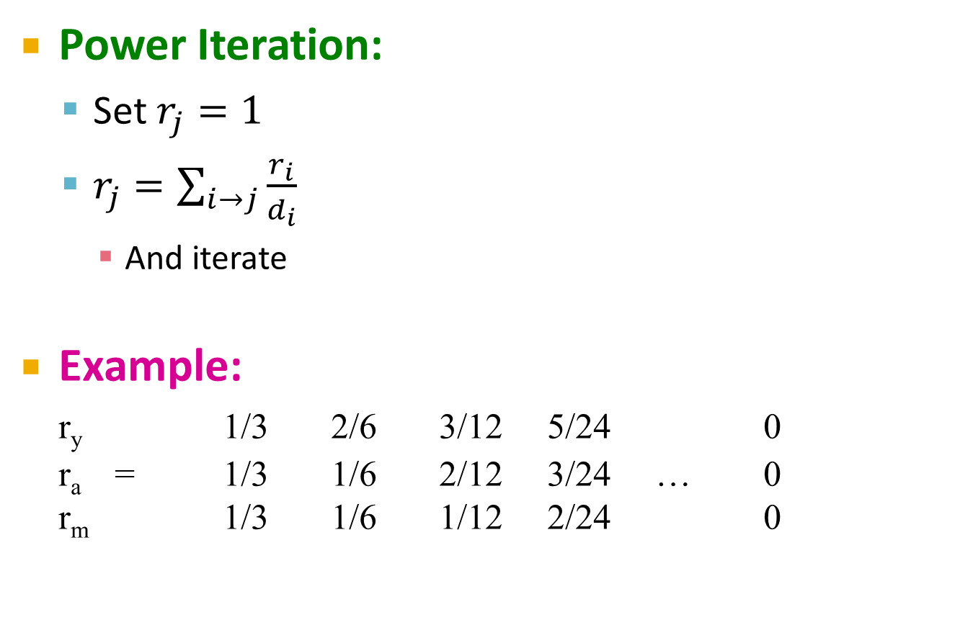
Problem: Dead Ends
Power Iteration:
  Set $r_{j}=1$
  $r_{j}=\sum_{i→j}{\frac{r_{i}}{d_{i}}}$
    And iterate
Example:
r_{y} 1/3 2/6 3/12 5/24 0
r_{a} = 1/3 1/6 2/12 3/24 … 0
r_{m} 1/3 1/6 1/12 2/24 0
y
 | y | a | m
y | ½ | ½ | 0
a | ½ | 0 | 0
m | 0 | ½ | 0
a
m
  r_{y} = r_{y} /2 + r_{a} /2
  r_{a} = r_{y} /2
  r_{m} = r_{a} /2
Iteration 0, 1, 2, …
Here the PageRank “leaks” out since the matrix is not stochastic.

Slide 55
Microsoft Becomes Dead End
y a m
Yahoo
y 1/2 1/2 0
a 1/2 0 0
m 0 1/2 0
Amazon
M’soft

Slide 56

Example: Effect of Dead Ends
Equations v = Mv:
  y = y /2 + a /2
  a = y /2
  m = a /2
  $$y= \frac{1}{2 }+\frac{1/2}{2 }$$
  $$a= \frac{1/2}{2 }$$
  $$m= \frac{1/2}{2 }$$
  $$y= \frac{1}{2 }+\frac{1}{2 }$$
  $$a= \frac{1}{2 }$$
  $$m= \frac{1}{2 }$$
y
a =
m
1
1
1
1
1/2
1/2
3/4
1/2
1/4
5/8
3/8
1/4
0
0
0
. . .

Slide 57
Microsoft Becomes a Dead End
Yahoo
Amazon
M’soft

Slide 58
Microsoft Becomes a Dead End
Yahoo
Amazon
M’soft

Slide 59
Microsoft Becomes a Dead End
Yahoo
Amazon
M’soft

Slide 60
Microsoft Becomes a Dead End
Yahoo
Amazon
M’soft

Slide 61
In the Limit …
Yahoo
Amazon
M’soft

Slide 62
Solution: Always Teleport!
Teleports: Follow random teleport links with probability 1.0 from dead-ends
  Adjust matrix accordingly
y
y
a
m
a
m
 | y | a | m
y | ½ | ½ | 0
a | ½ | 0 | 0
m | 0 | ½ | 0
 | y | a | m
y | ½ | ½ | ⅓
a | ½ | 0 | ⅓
m | 0 | ½ | ⅓

Slide 63

Problem: Spider Traps
Power Iteration:
  Set $r_{j}=1$
  $r_{j}=\sum_{i→j}{\frac{r_{i}}{d_{i}}}$
    And iterate
Example:
r_{y} 1/3 2/6 3/12 5/24 0
r_{a} = 1/3 1/6 2/12 3/24 … 0
r_{m} 1/3 3/6 7/12 16/24 1
y
 | y | a | m
y | ½ | ½ | 0
a | ½ | 0 | 0
m | 0 | ½ | 1
a
m
m is a spider trap
  r_{y} = r_{y} /2 + r_{a} /2
  r_{a} = r_{y} /2
  r_{m} = r_{a} /2 + r_{m}
Iteration 0, 1, 2, …
All the PageRank score gets “trapped” in node m.

Slide 64
M’soft Becomes Spider Trap
y a m
Yahoo
y 1/2 1/2 0
a 1/2 0 0
m 0 1/2 1
Amazon
M’soft

Slide 65
Example: Effect of Spider Trap
Equations v = Mv:
  y = y /2 + a /2
  a = y /2
  m = a /2 + m
y
a =
m
1
1
1
1
1/2
3/2
3/4
1/2
7/4
5/8
3/8
2
0
0
3
. . .

Slide 66
Microsoft Becomes a Spider Trap
Yahoo
Amazon
M’soft

Slide 67
Microsoft Becomes a Spider Trap
Yahoo
Amazon
M’soft

Slide 68
Microsoft Becomes a Spider Trap
Yahoo
Amazon
M’soft

Slide 69
In the Limit …
Yahoo
Amazon
M’soft

Slide 70
PageRank Solution to Traps, Etc.
“Tax” each page a fixed percentage at each iteration.
Add a fixed constant to all pages.
  Optional but useful: add exactly enough to balance the loss (tax + PageRank of dead ends).
Models a random walk with a fixed probability of leaving the system, and a fixed number of new walkers injected into the system at each step.
  Divided equally among all pages.

Slide 71
Solution: Teleports!
The Google solution for spider traps: At each time step, the random surfer has two options
  With prob. β, follow a link at random
  With prob. 1-β, jump to some random page
  Common values for β are in the range 0.8 to 0.9
Surfer will teleport out of spider trap
within a few time steps
y
y
a
m
a
m

Slide 72
Example: Microsoft is a Spider Trap; 20% Tax
Equations v = 0.8(Mv) + 0.2:
  y = 0.8(y/2 + a/2) + 0.2
  a = 0.8(y/2) + 0.2
  m = 0.8(a/2 + m) + 0.2
y
a =
m
1
1
1
1.00
0.60
1.40
0.84
0.60
1.56
0.776
0.536
1.688
7/11
5/11
21/11
. . .

Slide 73
Teleport Sets
Assume each walker has a small probability of “teleporting” at any tick.
Teleport can go to:
  Any page with equal probability.
    As in the “taxation” scheme.
  A set of “relevant” pages (teleport set).
    For topic-specific PageRank.

Slide 74
Picking the Teleport Set
Choose the pages belonging to the topic in Open Directory.
“Learn,” from a training set, the typical words in pages belonging to the topic; use pages heavy in those words as the teleport set.

Slide 75
Why Teleports Solve the Problem?
Why are dead-ends and spider traps a problem
and why do teleports solve the problem?
Spider-traps are not a problem, but with traps PageRank scores are not what we want
  Solution: Never get stuck in a spider trap by
  teleporting out of it in a finite number of steps
Dead-ends are a problem
  The matrix is not column stochastic so our initial assumptions are not met
  Solution: Make matrix column stochastic by always teleporting when there is nowhere else to go

Slide 76
Application: Link Spam
Spam farmers create networks of millions of pages designed to focus PageRank on a few undeserving pages.
To minimize their influence, use a teleport set consisting of trusted pages only.
  Example: home pages of universities.

Slide 77
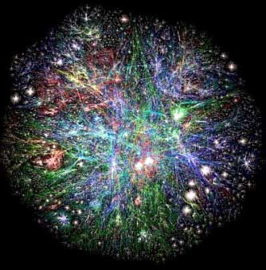
PageRank at Web Scale
Web graph
  How do we compute PageRank for graph of such scale?

Slide 78
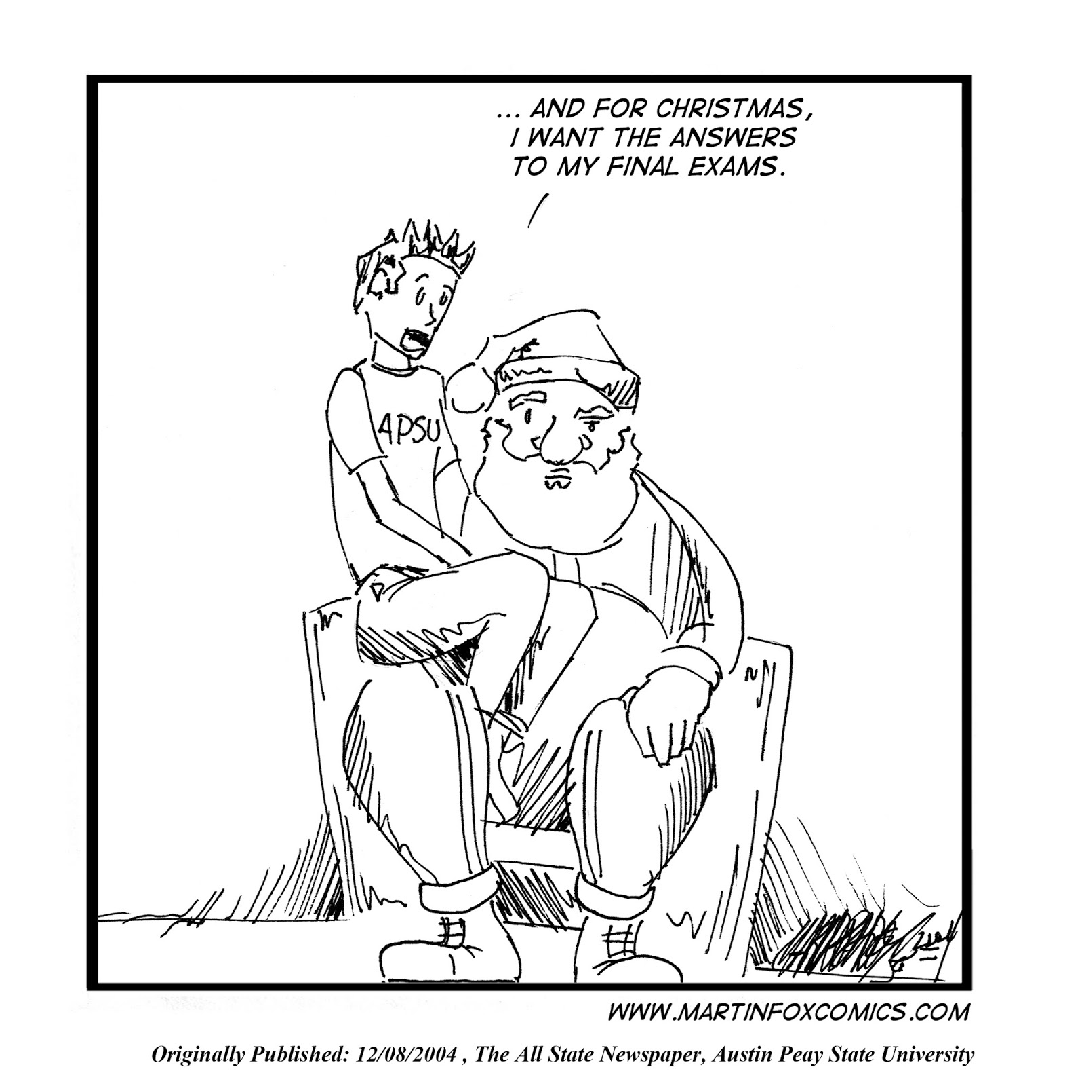
Final Exam Questions

