Slide 1
Indexes
Information Retrieval in Practice
All slides ©Addison Wesley, 2008

Slide 2
Indexes
Indexes are data structures designed to make search faster
Text search has unique requirements, which leads to unique data structures
Most common data structure is inverted index
general name for a class of structures
“inverted” because documents are associated with words, rather than words with documents

Slide 3
Indexes and Ranking
Indexes are designed to support search
faster response time
supports updates
Text search engines use a particular form of search: ranking
documents are retrieved in sorted order according to a score computing using the document representation, the query, and a ranking algorithm
What is a reasonable abstract model for ranking?

Slide 4
Abstract Model of Ranking

Slide 5
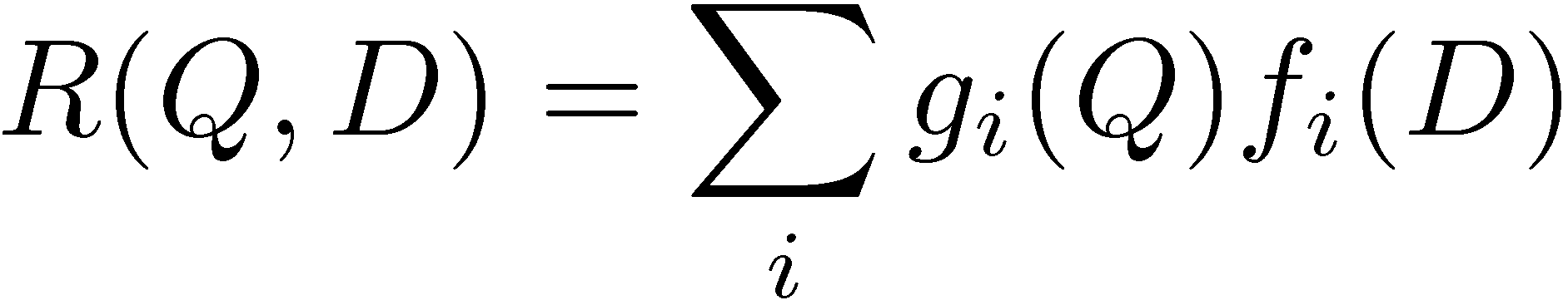
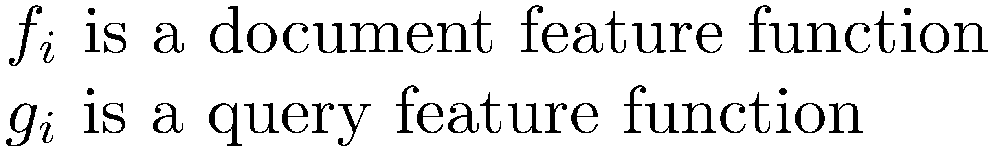
More Concrete Model

Slide 6
Inverted Index
Each index term is associated with an inverted list
Contains lists of documents, or lists of word occurrences in documents, and other information
Each entry is called a posting
The part of the posting that refers to a specific document or location is called a pointer
Each document in the collection is given a unique number
Lists are usually document-ordered (sorted by document number)

Slide 7
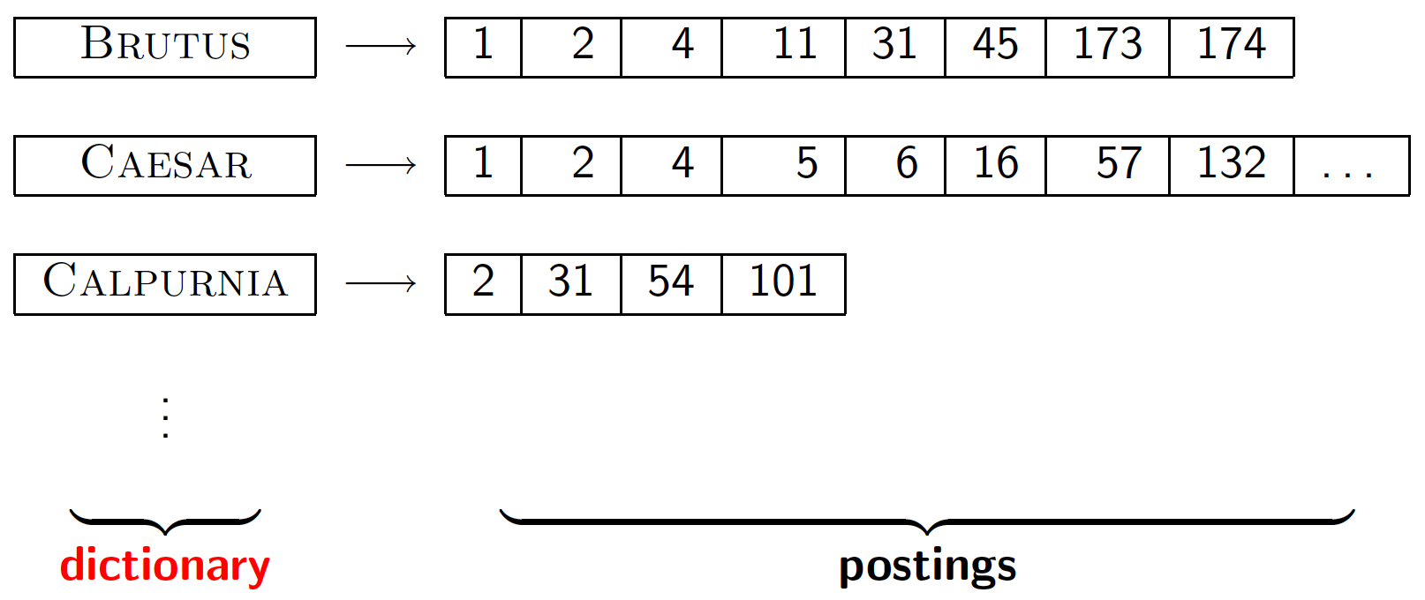
Dictionary data structures for inverted indexes
Sec. 3.1
The dictionary data structure stores the term vocabulary, document frequency, pointers to each postings list … in what data structure?

Slide 8
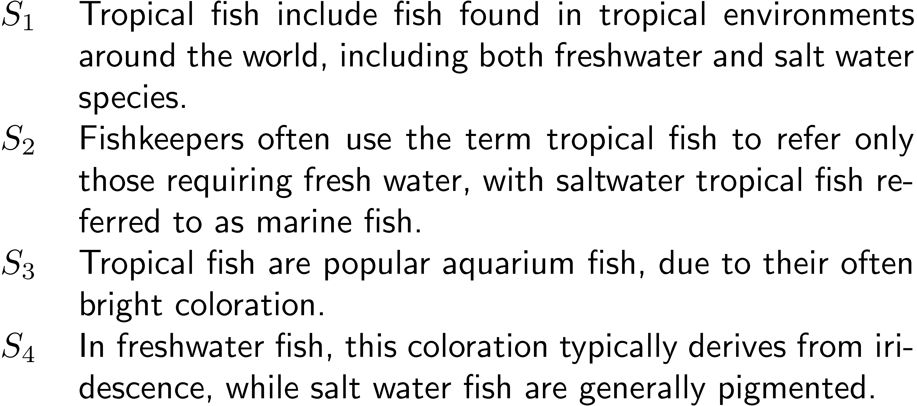
Example “Collection”

Slide 9
Simple Inverted Index

Slide 10
Inverted Index
with counts
supports better ranking algorithms

Slide 11
Inverted Index
with positions
supports
proximity matches

Slide 12
Proximity Matches
Matching phrases or words within a window
e.g., "tropical fish", or
“find tropical within 5 words of fish”
Word positions in inverted lists make these types of query features efficient
e.g.,

Slide 13
Fields and Extents
Document structure is useful in search
field restrictions
e.g., date, from:, etc.
some fields more important
e.g., title
Named Entity
<author>W. Bruce Croft</author>
wrote that book <author>
Donald Metzler</author>
is a co-author of the book.
author: (1:3), (7,8)
Metadata
<author>W. Bruce CroftDonald Metzler</author>

Slide 14
Fields and Extents
Options:
separate inverted lists for each field type
croft_title → ...
croft_author → ...
croft_body → ...
add information about fields to postings
croft → (doc1, position=3, field=author)
use extent lists
author: (1:3), (7:8)
title: (20:25)

Slide 15
Extent Lists
An extent is a contiguous region of a document
represent extents using word positions
inverted list records all extents for a given field type
e.g.,
extent list

Slide 16
Other Issues
Precomputed scores in inverted list
e.g., list for “fish” [(1:3.6), (3:2.2)], where 3.6 is total feature value for document 1
improves speed but reduces flexibility
Score-ordered lists
query processing engine can focus only on the top part of each inverted list, where the highest-scoring documents are recorded
very efficient for single-word queries

Slide 17
COMPRESSION

Slide 18
Hardware basics
Sec. 4.1
Many design decisions in information retrieval are based on the characteristics of hardware
We begin by reviewing hardware basics

Slide 19
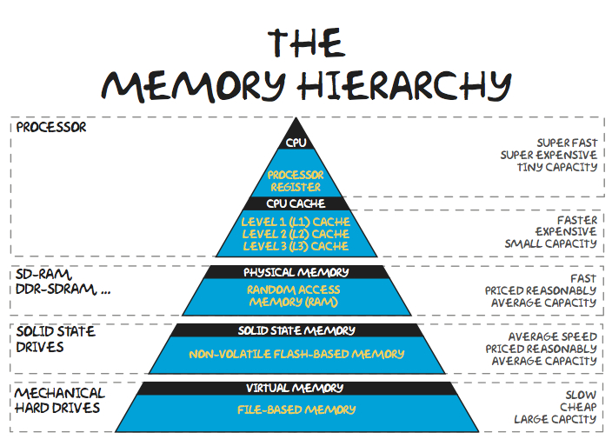

Slide 20
Hardware basics
Sec. 4.1
Access to data in memory is much faster than access to data on disk.
Disk seeks: No data is transferred from disk while the disk head is being positioned.
Therefore: Transferring one large chunk of data from disk to memory is faster than transferring many small chunks.
Disk I/O is block-based: Reading and writing of entire blocks (as opposed to smaller chunks).
Block sizes: 8KB to 256 KB.

Slide 21
Hardware basics
Sec. 4.1
Servers used in IR systems now typically have several GB of main memory, sometimes tens of GB.
Available disk space is several (2–3) orders of magnitude larger.
Fault tolerance is very expensive: It’s much cheaper to use many regular machines rather than one fault tolerant machine.

Slide 22
Compression
Inverted lists are very large
e.g., 25-50% of collection for TREC collections using Indri search engine
Much higher if n-grams are indexed
Compression of indexes saves disk and/or memory space
Typically have to decompress lists to use them
Best compression techniques have good compression ratios and are easy to decompress

Slide 23
Lossless vs. lossy compression
Sec. 5.1
Lossless compression: All information is preserved.
What we mostly do in IR.
Lossy compression: Discard some information
Several of the preprocessing steps can be viewed as lossy compression: case folding, stop words, stemming, number elimination.

Slide 24

Compression
Basic idea: Common data elements use short codes while uncommon data elements use longer codes
Example: coding numbers
number sequence: 0, 1, 0, 3, 0, 2, 0
possible encoding (2-bit): 00 01 00 10 00 11 00
encode 0 using a single 0: 0 01 0 10 0 11 0
only 10 bits < 14 bits!

Slide 25

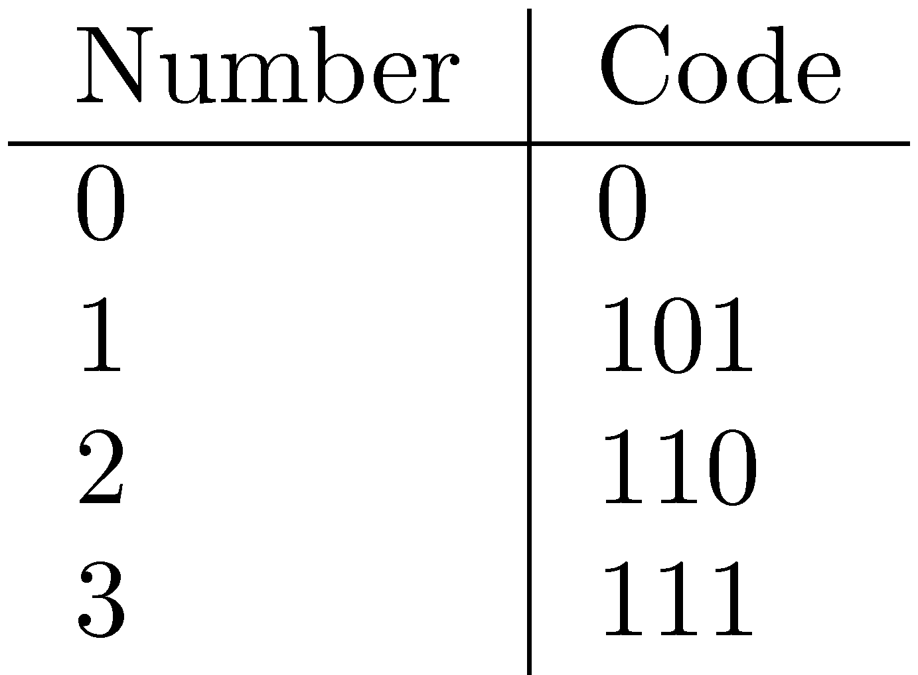

Compression Example
Decoding 0010100110
A possible decoding: 0 01 01 0 0 11 0
which represents: 0, 1, 1, 0, 0, 3, 0
use unambiguous code:
which gives: 0 101 0 111 0 110 0
Wait. What?
Ambiguous encoding – not clear how to decode

Slide 26
POSTINGS COMPRESSION
Sec. 5.3

Slide 27
Postings compression
Sec. 5.3
The postings file is much larger than the dictionary, factor of at least 10.
Key desideratum: store each posting compactly.
A posting for our purposes is a docID - a number.
For 800,000 documents, we would need 32 bits per docID when using 4-byte integers.
Alternatively, we can use log₂ 800,000 ≈ 20 bits per docID.
Our goal: use far fewer than 20 bits per docID.

Slide 28

Postings: two conflicting forces
Sec. 5.3
A term like arachnocentric occurs in maybe one doc out of a million – we would like to store this posting using log₂ 1M ~ 20 bits.
A term like the occurs in virtually every doc, so 20 bits/posting is too expensive.
Prefer 0/1 bitmap vector in this case
Key Goal: Use few bits to encode small, but frequent numbers, and use more bits to encode large but less frequently occurring numbers

Slide 29
Delta Encoding
Word count data is good candidate for compression
many small numbers and few larger numbers
encode small numbers with small codes
Document numbers are less predictable
but differences between numbers in an ordered list are smaller and more predictable
Delta encoding:
encoding differences between document numbers (d-gaps)

Slide 30
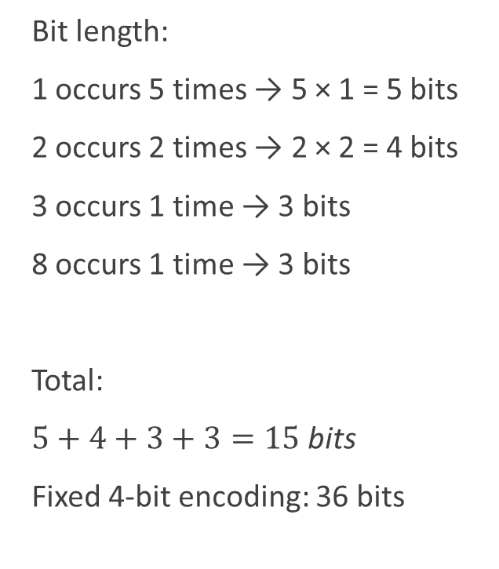
Intuition
Consider the word “Science”
DocID TF
----- ---
1 1
4 2
7 1
10 1
15 3
21 1
30 8
44 1
50 2
Value | Frequency
1 | 5
2 | 2
3 | 1
8 | 1
Bit length:
1 occurs 5 times → 5 × 1 = 5 bits
2 occurs 2 times → 2 × 2 = 4 bits
3 occurs 1 time → 3 bits
8 occurs 1 time → 3 bits
Total:
$5+4+3+3=15 \text{bits}$
Fixed 4-bit encoding: 36 bits
Code assignment
Value | Code
1 | 0
2 | 10
3 | 110
8 | 111

Slide 31
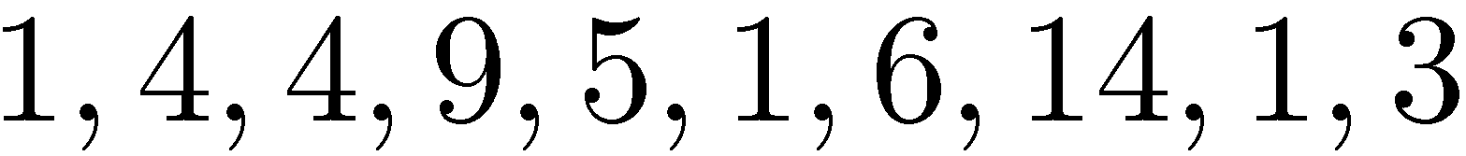
Delta Encoding
Inverted list (without counts)
Differences between adjacent numbers
Differences for a high-frequency word are easier to compress, e.g.,
Differences for a low-frequency word are large, e.g.,

Slide 32
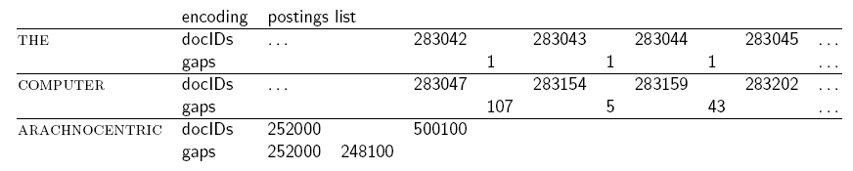
Example of postings entries
Sec. 5.3

Slide 33
Variable length encoding
Sec. 5.3
Aim:
For arachnocentric, we will use ~20 bits/gap entry.
For the, we will use ~1 bit/gap entry.
If the average gap for a term is G, we want to use ~log₂G bits/gap entry.
Key challenge: encode every integer (gap) with about as few bits as needed for that integer.
This requires a variable length encoding
Variable length codes achieve this by using short codes for small numbers

Slide 34
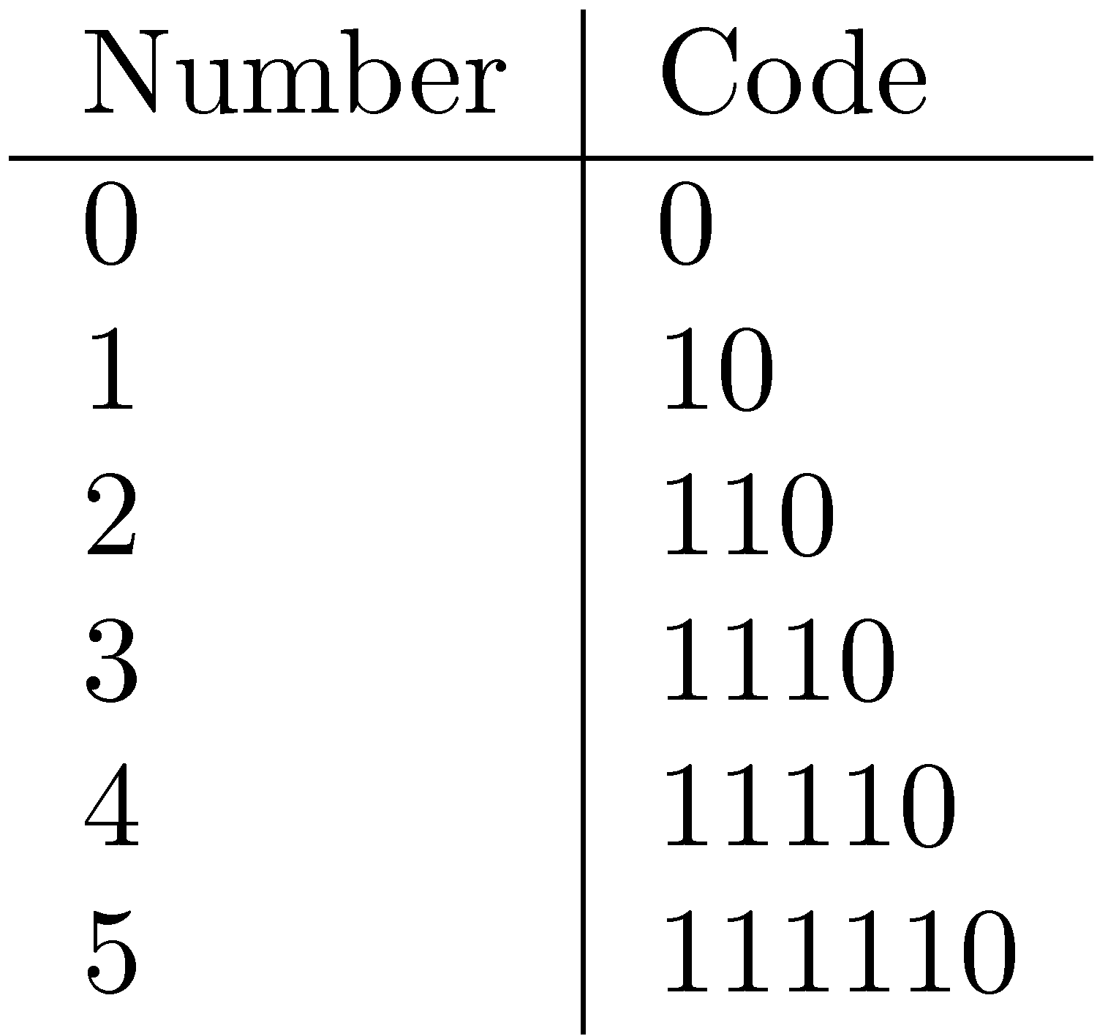
Bit-Aligned Codes
Breaks between encoded numbers can occur after any bit position
Unary code
Encode k by k 1s followed by 0
0 at end makes code unambiguous

Slide 35
Unary and Binary Codes
Unary is very efficient for small numbers such as 0 and 1, but quickly becomes very expensive
1023 can be represented in 10 binary bits, but requires 1024 bits in unary
Binary is more efficient for large numbers, but it may be ambiguous

Slide 36
Gamma codes
Sec. 5.3
We can compress better with bit-level codes
The Gamma code is the best known of these.
Represent a gap G as a pair length and offset
offset is G in binary, with the leading bit cut off
For example 13 → 1101 → 101
length is the length of offset
For 13 (offset 101), this is 3.
We encode length with unary code: 1110.
Gamma code of 13 is the concatenation of length and offset: 1110101

Slide 37
Gamma code examples
Sec. 5.3
number | length | offset | γ-code
0 |  |  | none
1 | 0 |  | 0
2 | 10 | 0 | 10,0
3 | 10 | 1 | 10,1
4 | 110 | 00 | 110,00
9 | 1110 | 001 | 1110,001
13 | 1110 | 101 | 1110,101
24 | 11110 | 1000 | 11110,1000
511 | 111111110 | 11111111 | 111111110,11111111
1025 | 11111111110 | 0000000001 | 11111111110,0000000001
It does not code zero. One way of handling zero is to add 1 before coding and then subtract 1 after decoding. Another way is to prefix each nonzero code with a 1 and then code zero as a single 0.

Slide 38
Decoding Gamma Code:
Bitstream: 101110100
Step 1: Read unary prefix
10 → L = 1 (one '1' before first 0)
Read next 1 bit → 1
Reconstruct: 1 + 1 = 11 (binary) = 3
Remaining stream: 1110100
Step 2: Read unary prefix
1110 → L = 3
Read next 3 bits → 100
Reconstruct: 1 + 100 = 1100 (binary) = 12
Decoded numbers: 3, 12

Slide 39
Compression Example
Encoding 0, 1, 0, 3, 0, 2, 0
Recall previous ambiguous encoding was 0010100110
Exercise: Give the gamma code for this sequence.
Add 1 to all: 1, 2, 1, 4, 1, 3, 1
0 100 0 11000 0 100 101 0
18 bits, but not ambiguous.

Slide 40
Gamma code properties
Sec. 5.3
G is encoded using 2 ⎣log G⎦ + 1 bits
Length of offset is ⎣log G⎦ bits
Length of length is ⎣log G⎦ + 1 bits
All gamma codes have an odd number of bits
Almost within a factor of 2 of best possible, log₂ G
Gamma code is uniquely prefix-decodable
Gamma code can be used for any distribution
Gamma code is parameter-free

Slide 41
Byte-Aligned Codes
Variable-length bit encodings can be a problem on processors that process bytes
v-byte is a popular byte-aligned code
Similar to Unicode UTF-8
Shortest v-byte code is 1 byte
Numbers are 1 to 4 bytes long
For a gap value G, we want to use close to the fewest bytes needed to hold log₂ G bits

Slide 42
Variable Byte Codes
Sec. 5.3
Encoding Procedure
Begin with one byte to store G and dedicate the high bit in it to be a continuation bit c
If G ≤127, binary-encode it in the 7 available bits and set c =1
Else encode G’s lower-order 7 bits and then use additional bytes to encode the higher order bits using the same algorithm
Set the continuation bit of the last byte to 1 (c =1) and for the continuation bit of the other bytes to c = 0.

Slide 43
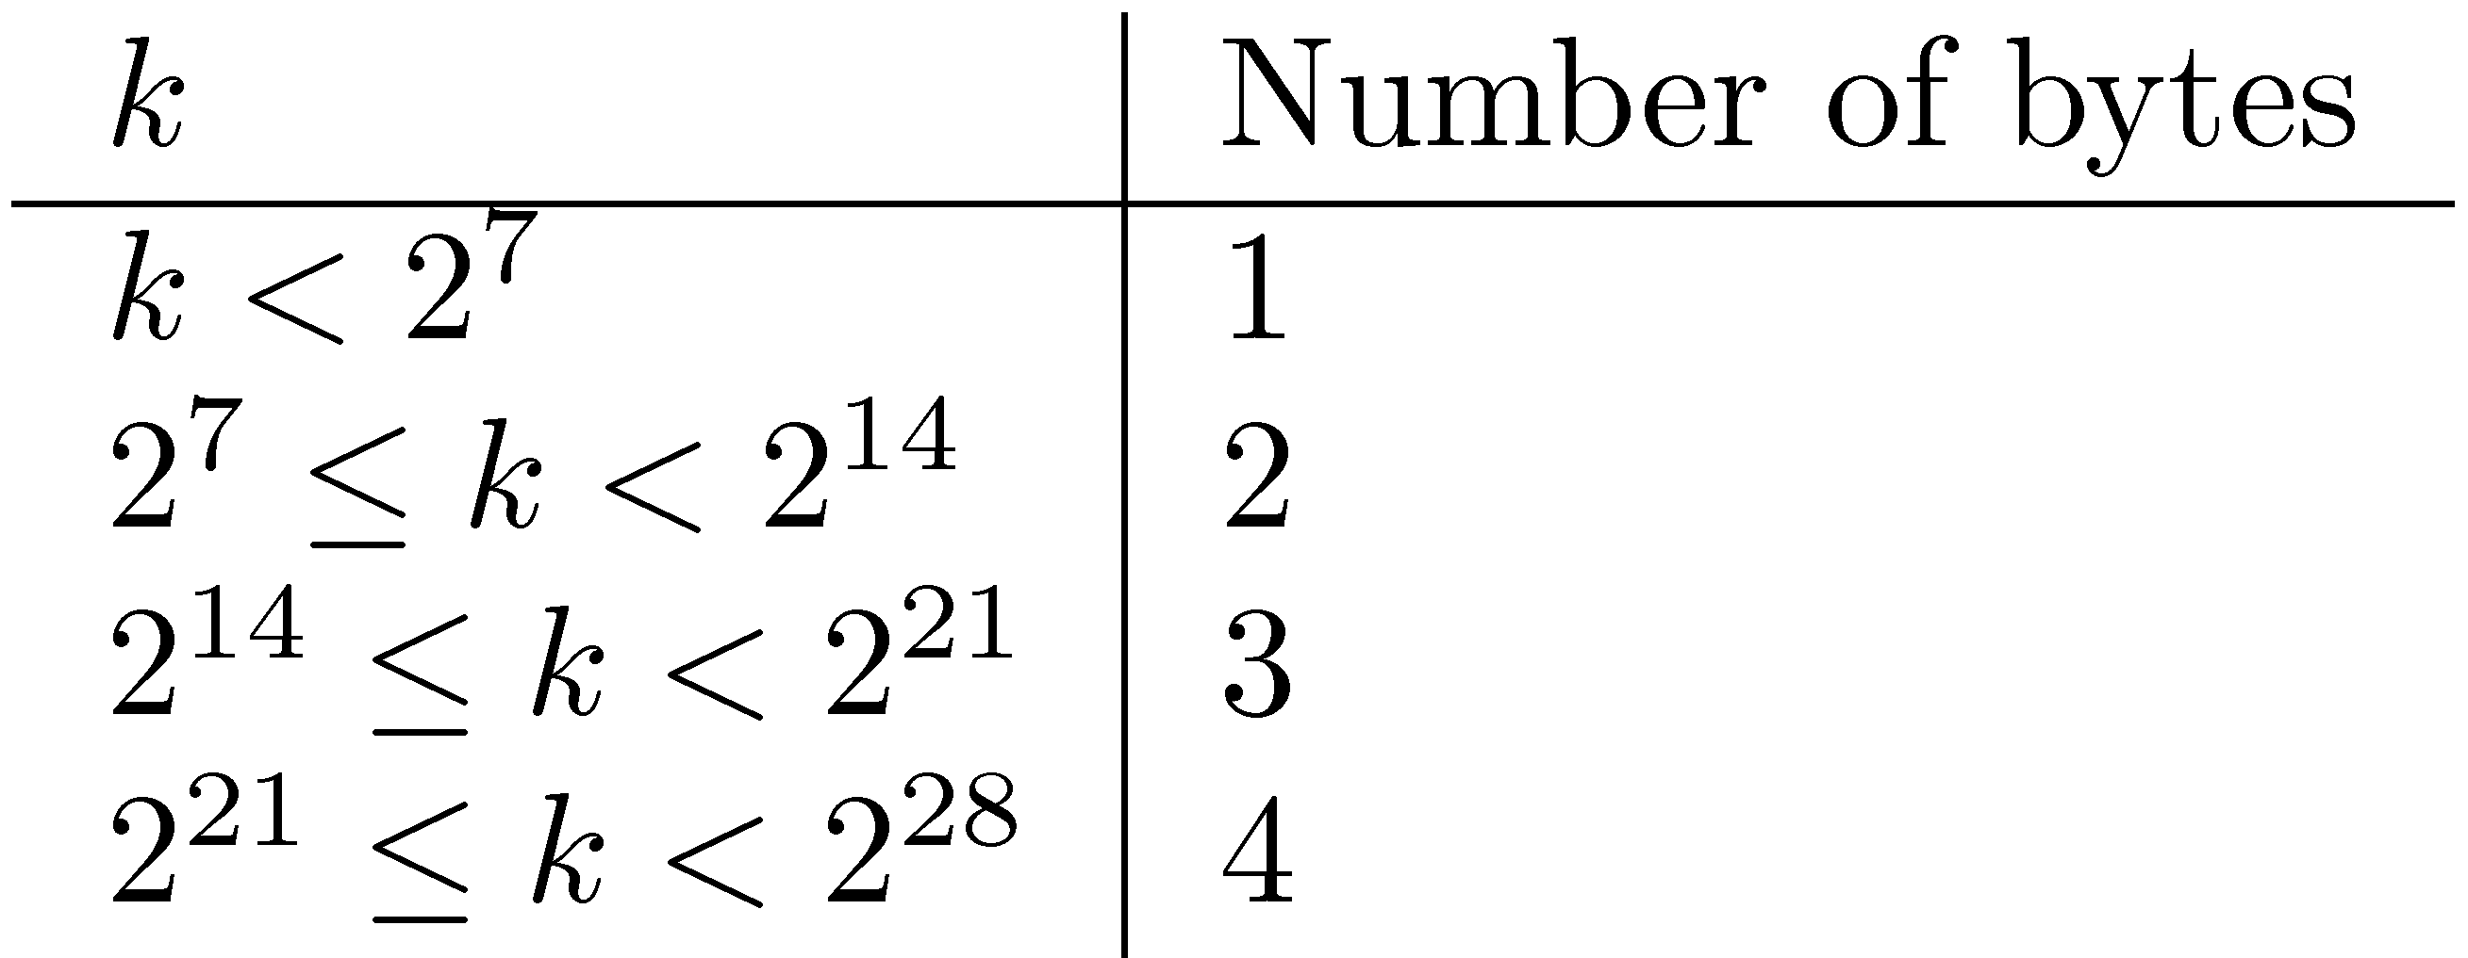
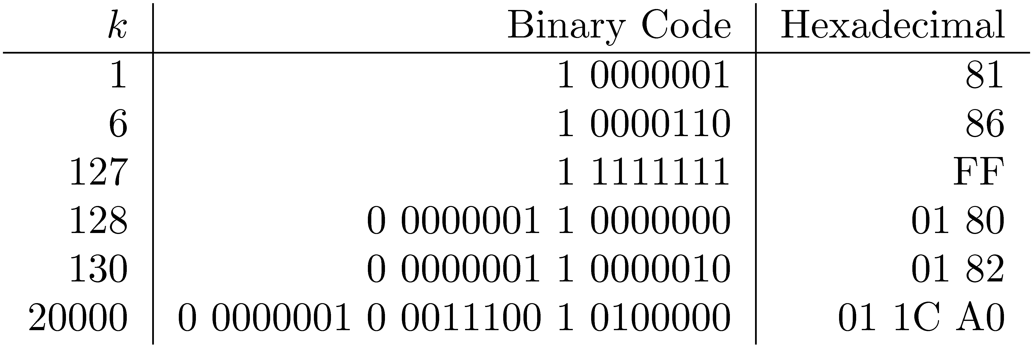
V-Byte Encoding

Slide 44
Example
Sec. 5.3
lower-order 7 bits
 | 1100111000 | 1100111101 | 110100100101101110
docIDs | 824 | 829 | 215406
gaps |  | 5 | 214577
VB code | 00000110 10111000 | 10000101 | 00001101 00001100 10110001
Postings stored as the byte concatenation
000001101011100010000101000011010000110010110001
Key property: VB-encoded postings are
uniquely prefix-decodable.
For a small gap (5), VB
uses a whole byte.

Slide 45
Compression Example with Positions
10001011
10110100
Hexadecimal

Slide 46
Gamma seldom used in practice
Sec. 5.3
Machines have word boundaries – 8, 16, 32, 64 bits
Operations that cross word boundaries are slower
Compressing and manipulating at the granularity of bits can be slow
Variable byte encoding is aligned and thus potentially more efficient
Regardless of efficiency, variable byte is conceptually simpler at little additional space cost

Slide 47

Query Processing Example
Query: galago AND animal
galago
10 | 143 | 301
animal
2 | 5 | 10 | 15 | 100 | 143 | 150 | 200 | 301 | 350
What is the cost?
$$O(N+M)$$
If N = 1M and M = 300M then …
Can we do better?

Slide 48
Skipping
Search involves comparison of inverted lists of different lengths
Can be very inefficient
“Skipping” ahead to check document numbers is much better
Compression makes this difficult
Variable size, only d-gaps stored
Skip pointers are additional data structure to support skipping

Slide 49

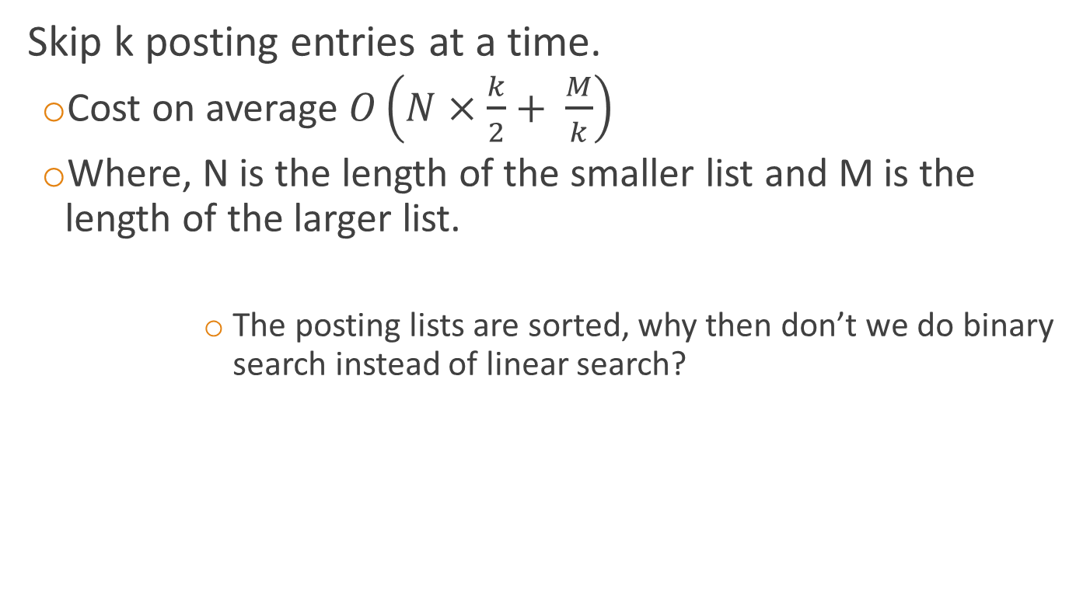
Skipping k Documents
Skip k posting entries at a time.
Cost on average $O\left(N×\frac{k}{2}+ \frac{M}{k}\right)$
Where, N is the length of the smaller list and M is the length of the larger list.
The posting lists are sorted, why then don’t we do binary search instead of linear search?

Slide 50
Better Solution: Skip Pointers
A skip pointer (d, p) contains a document number d and a byte (or bit) position p
Means there is an inverted list posting that starts at position p, and the posting before it was for document d
Inverted list
skip pointers

Slide 51
Skip Pointers
Example
Inverted list
D-gaps
Skip pointers (0-based position)
Examples:
Skip to (34, 6)
Step 1: go to 6th entry in D-gaps; find 2.
Step 2: add 2 to 34 = 36 (docID)

Slide 52
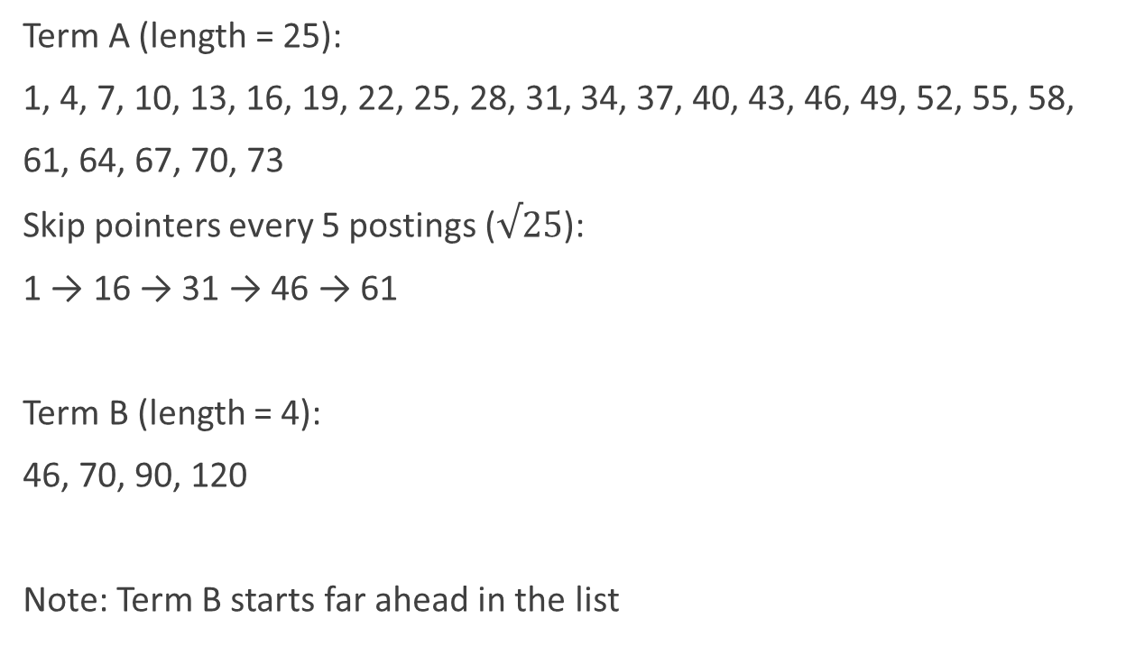
Posting Lists (Sorted DocIDs)
Term A (length = 25):
1, 4, 7, 10, 13, 16, 19, 22, 25, 28, 31, 34, 37, 40, 43, 46, 49, 52, 55, 58,
61, 64, 67, 70, 73
Skip pointers every 5 postings ($√25$):
1 → 16 → 31 → 46 → 61
Term B (length = 4):
46, 70, 90, 120
Note: Term B starts far ahead in the list

Slide 53
Intersection WITHOUT Skip Pointers
We compare sequentially from the start:
1 < 46 → advance
4 < 46 → advance
7 < 46 → advance
...
43 < 46 → advance
46 = 46 → match!
Total comparisons ≈ 16

Slide 54

Intersection WITH Skip Pointers
Start at 1, compare with 46
Check skip: 1 → 16 (≤ 46) → jump
Check skip: 16 → 31 (≤ 46) → jump
Check skip: 31 → 46 (≤ 46) → jump
Now directly at 46 → match!
Comparisons ≈ 4
Why this matters?
Without skips: ~16 comparisons
With skips: ~4 comparisons
Savings grow as posting lists get longer.
Typical heuristic: $√L$ skip pointers

Slide 55
Auxiliary Structures
Inverted lists usually stored together in a single file for efficiency
Inverted file
Vocabulary or lexicon
Contains a lookup table from index terms to the byte offset of the inverted list in the inverted file
Either hash table in memory or B-tree for larger vocabularies
Term statistics stored at start of inverted lists
Collection statistics stored in separate file

Slide 56
Index Construction

Slide 57
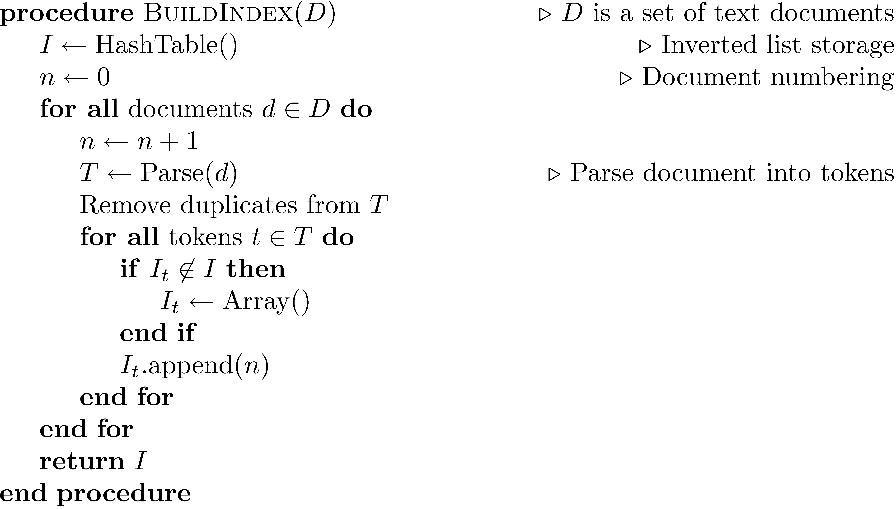
Index Construction
Simple in-memory indexer

Slide 58
Scaling index construction
Sec. 4.2
In-memory index construction does not scale
Can’t stuff entire collection into memory, sort, then write back
How can we construct an index for very large collections?
Taking into account the hardware constraints we just learned about . . .
Memory, disk, speed, etc.

Slide 59
Sort using disk as “memory”?
Sec. 4.2
Can we use the same index construction algorithm for larger collections, but by using disk instead of memory?
No: Sorting T = 100M records on disk is too slow – too many disk seeks.
We need an external sorting algorithm.

Slide 60
Digression: External Sorting

Slide 61
External Sorting
Problem: Sort 100Gb of data with 1Gb of RAM.
When a file doesn’t fit in memory, there are two stages in sorting:
File is divided into several segments, each of which sorted separately
Sorted segments are merged
Each stage involves reading and writing the file at least once!

Slide 62
2-Way Sort: Requires 3 Buffers
Pass 1: Read a page, sort it, write it.
only one buffer page is used
Pass 2, 3, …, etc.:
three buffer pages used.
INPUT 1
OUTPUT
INPUT 2
Main memory buffers
Disk
Disk
Notes:
5

Slide 63
Main Memory 2-Way Merge Sort
2
3
5
6
1
4
8
9
1
2
. . .
3
4
Input page 1
Input page 2
Output page
Disk
Settings:
A frame holds 4 keys.

Slide 64
Two-Way External Merge Sort
3,4
6,2
9,4
8,7
5,6
3,1
2
Input file
Each pass we read + write each page in file.
N pages in the file => the number of passes
So toal cost is:
Idea: Divide and conquer: sort subfiles and merge
PASS 0
3,4
2,6
4,9
7,8
5,6
1,3
2
1-page runs
PASS 1
2,3
4,7
1,3
2-page runs
4,6
8,9
5,6
2
PASS 2
2,3
4,4
1,2
4-page runs
6,7
3,5
8,9
6
PASS 3
1,2
2,3
3,4
8-page runs
4,5
6,6
7,8
9
Notes:
6

Slide 65

General External Merge Sort
More than 3 buffer pages. How can we utilize them?
To sort a file with N pages using B buffer pages:
Pass 0: use B buffer pages. Produce $\left\lceil N/B\right\rceil$ sorted runs of B pages each.
Pass 2, …, etc.: merge B-1 runs.
INPUT 1
. . .
INPUT 2
. . .
. . .
OUTPUT
INPUT B-1
Disk
Disk
B Main memory buffers
Notes:
7

Slide 66
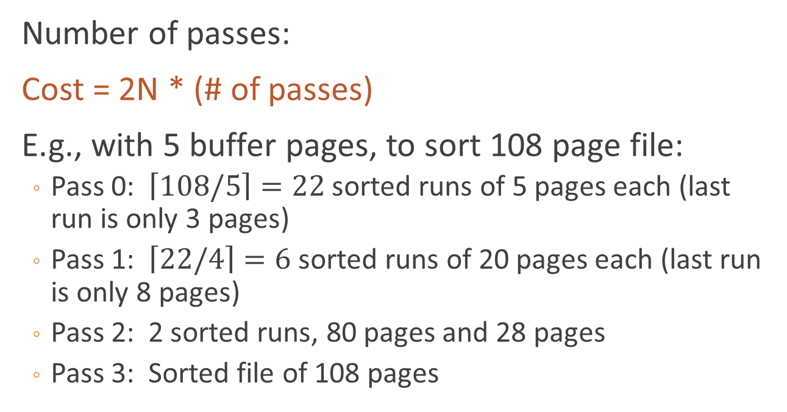
Cost of External Merge Sort
Number of passes:
Cost = 2N * (# of passes)
E.g., with 5 buffer pages, to sort 108 page file:
Pass 0: $\left\lceil 108/5\right\rceil =22$ sorted runs of 5 pages each (last run is only 3 pages)
Pass 1: $\left\lceil 22/4\right\rceil =6$ sorted runs of 20 pages each (last run is only 8 pages)
Pass 2: 2 sorted runs, 80 pages and 28 pages
Pass 3: Sorted file of 108 pages
Notes:
8

Slide 67
Back to Inverted Index Construction

Slide 68
Blocked Sort-Based Indexing (BSB)
Goal: Build an inverted index when data does not fit in memory.
As we parse documents, we generate records: (term, docID, freq)
Each record = 12 bytes (4 + 4 + 4)
Why Not Just Sort Everything?
- Suppose we generate 100 million records; 100M × 12 bytes ≈ 1.2 GB
- Too large to sort entirely in memory (in typical settings).
- We need an external sorting strategy.

Slide 69
Step 1: Divide Into Blocks
Choose block size that fits comfortably in RAM.
Example: 10M records per block
10M × 12 bytes ≈ 120 MB per block
With 100M total records → 10 blocks.

Slide 70
Step 2: Sort Each Block
For each block:
• Load block into memory
• Sort by (term, docID)
• Write sorted block to disk
Now we have 10 sorted runs on disk.

Slide 71
Step 3: Merge Sorted Blocks
Perform multi-way merge of sorted runs.
- Sequential disk reads
- Sequential disk writes
Result: One globally sorted sequence of (term, docID, freq).

Slide 72
Why BSB Reduces Disk Seeks?
Disk is fast for large sequential reads/writes.
Disk is slow for many small random seeks.
BSB performs:
• Large sequential writes (sorted runs)
• Large sequential reads (merge phase)
Minimizes costly disk seeks.

Slide 73
Big Picture
BSB = External sorting of term-document records.
After global sort:
Group identical terms → build postings lists.
Contrast: SPIMI builds postings directly in memory (no global sort).

Slide 74
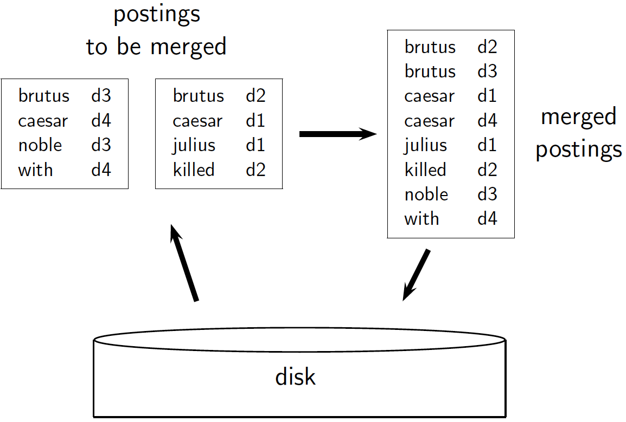
Sec. 4.2

Slide 75
Sorting 10 blocks of 10M records
Sec. 4.2
First, read each block and sort within:
Quicksort takes 2N ln N expected steps
In our case 2 x (10M ln 10M) steps
Exercise: estimate total time to read each block from disk and quicksort it.
10 times this estimate – gives us 10 sorted runs of 10M records each.

Slide 76
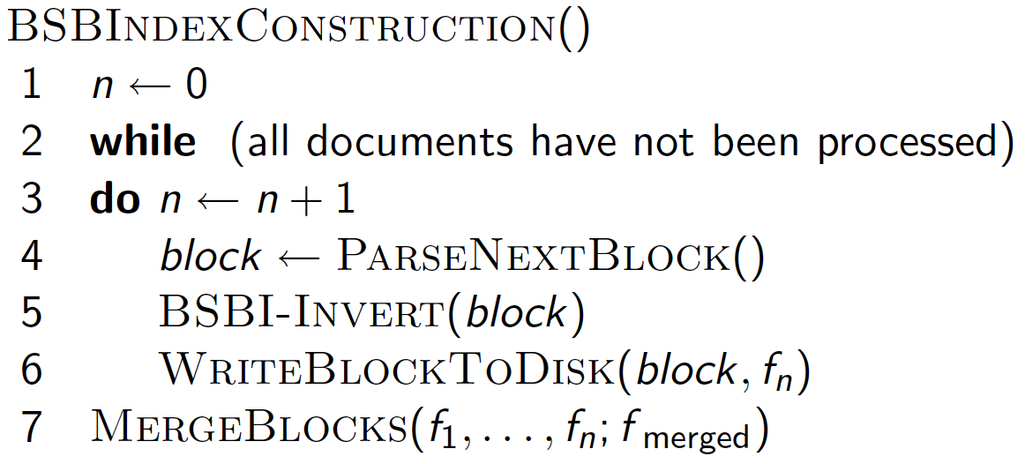
Sec. 4.2

Slide 77
How to merge the sorted runs?
Sec. 4.2
But it is more efficient to do a multi-way merge, where you are reading from all blocks simultaneously
Providing you read decent-sized chunks of each block into memory and then write out a decent-sized output chunk, then you’re not killed by disk seeks
Notes:
What is the overall complexity of

Slide 78
Remaining problem with sort-based algorithm
Sec. 4.3
Our assumption was: we can keep the dictionary in memory.
We need the dictionary (which grows dynamically) in order to implement a term to termID mapping.
Actually, we could work with term, docID postings instead of termID, docID postings .
. . . but then intermediate files become very large. (We would end up with a scalable, but very slow index construction method.)

Slide 79
SPIMI: Single-pass in-memory indexing
Sec. 4.3
Key idea 1: Generate separate dictionaries for each block – no need to maintain term-termID mapping across blocks.
Key idea 2: Don’t sort. Accumulate postings in postings lists as they occur.
With these two ideas we can generate a complete inverted index for each block.
These separate indexes can then be merged into one big index.

Slide 80
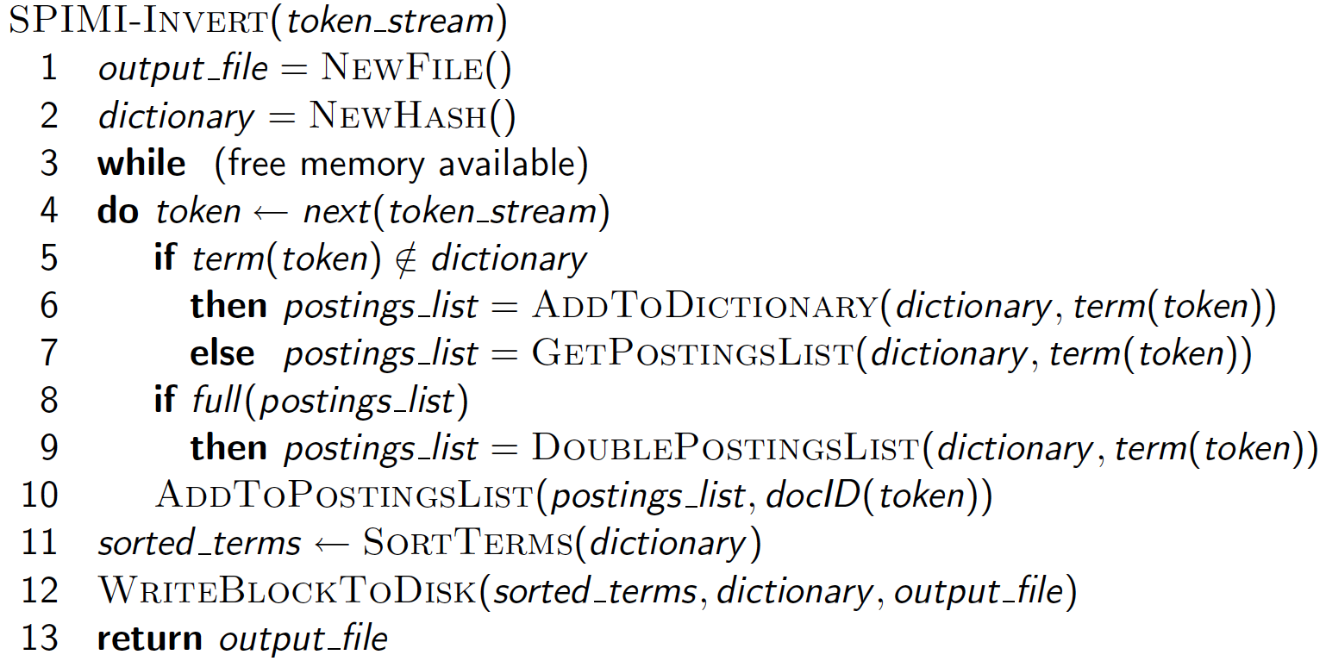
SPIMI-Invert
Sec. 4.3
Merging of blocks is analogous to BSBI.

Slide 81
Distributed Indexing
Distributed processing driven by need to index and analyze huge amounts of data (i.e., the Web)
Large numbers of inexpensive servers used rather than larger, more expensive machines
MapReduce is a distributed programming tool designed for indexing and analysis tasks

Slide 82
Example
Given a large text file that contains data about credit card transactions
Each line of the file contains a credit card number and an amount of money
Determine the number of unique credit card numbers
Could use hash table – memory problems
counting is simple with sorted file
Similar with distributed approach
sorting and placement are crucial

Slide 83
Programming Model: MapReduce
Warm-up task:
We have a huge text document
Count the number of times each distinct word appears in the file
Sample application:
Analyze web server logs to find popular URLs

Slide 84
Task: Word Count
Case 1:
File too large for memory, but all <word, count> pairs fit in memory
Case 2:
Count occurrences of words:
words(doc.txt) | sort | uniq -c
where words takes a file and outputs the words in it, one per a line
Case 2 captures the essence of MapReduce
Great thing is that it is naturally parallelizable

Slide 85
MapReduce: Overview
Sequentially read a lot of data
Map:
Extract something you care about
Group by key: Sort and Shuffle
Reduce:
Aggregate, summarize, filter or transform
Write the result
Outline stays the same, Map and Reduce change to fit the problem

Slide 86
MapReduce: The Map Step
Input
key-value pairs
Intermediate
key-value pairs
k
v
map
k
v
k
v
map
k
v
k
v
…
…
k
v
k
v

Slide 87
MapReduce: The Reduce Step
Output
key-value pairs
Intermediate
key-value pairs
Key-value groups
reduce
k
v
k
v
v
v
k
v
Group
by key
reduce
k
v
k
v
v
k
v
k
v
…
…
…
k
v
k
v
k
v

Slide 88
More Specifically
Input: a set of key-value pairs
Programmer specifies two methods:
Map(k, v) → <k’, v’>*
Takes a key-value pair and outputs a set of key-value pairs
E.g., key is the filename, value is a single line in the file
There is one Map call for every (k,v) pair
Reduce(k’, <v’>*) → <k’, v’’>*
All values v’ with same key k’ are reduced together and processed in v’ order
There is one Reduce function call per unique key k’

Slide 89
MapReduce: Word Counting
Provided by the programmer
Provided by the programmer
MAP:
Read input and produces a set of key-value pairs
Group by key:
Collect all pairs with same key
Reduce:
Collect all values belonging to the key and output
The crew of the space shuttle Endeavor recently returned to Earth as ambassadors, harbingers of a new era of space exploration. Scientists at NASA are saying that the recent assembly of the Dextre bot is the first step in a long-term space-based man/mache partnership. '"The work we're doing now -- the robotics we're doing -- is what we're going to need ……………………..
(The, 1)
(crew, 1)
(of, 1)
(the, 1)
(space, 1)
(shuttle, 1)
(Endeavor, 1)
(recently, 1)
….
(crew, 1)
(crew, 1)
(space, 1)
(the, 1)
(the, 1)
(the, 1)
(shuttle, 1)
(recently, 1)
…
(crew, 2)
(space, 1)
(the, 3)
(shuttle, 1)
(recently, 1)
…
Sequentially read the data
Only sequential reads
Big document
(key, value)
(key, value)
(key, value)

Slide 90
Word Count Using MapReduce
map(key, value):
// key: document name; value: text of the document
for each word w in value:
emit(w, 1)
reduce(key, values):
// key: a word; value: an iterator over counts
result = 0
for each count v in values:
result += v
emit(key, result)

Slide 91
Map-Reduce: Environment
Map-Reduce environment takes care of:
Partitioning the input data
Scheduling the program’s execution across a set of machines
Performing the group by key step
Handling machine failures
Managing required inter-machine communication

Slide 92
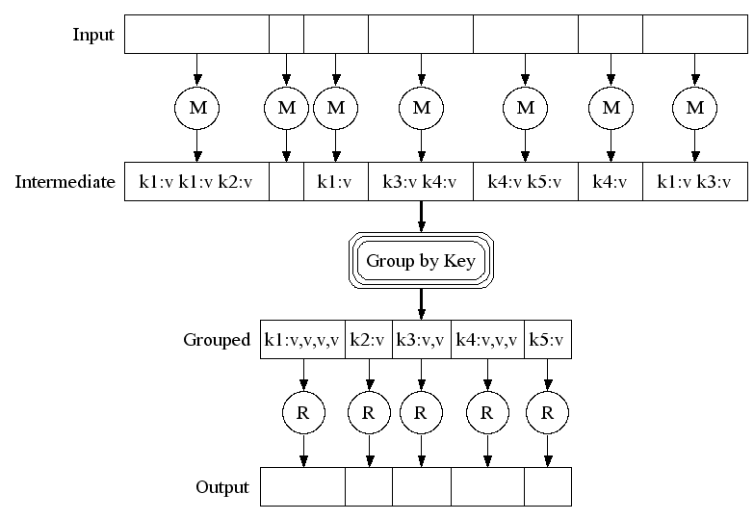
Map-Reduce: A diagram
Big document
MAP:
Read input and produces a set of key-value pairs
Group by key:
Collect all pairs with same key
(Hash merge, Shuffle, Sort, Partition)
Reduce:
Collect all values belonging to the key and output

Slide 93
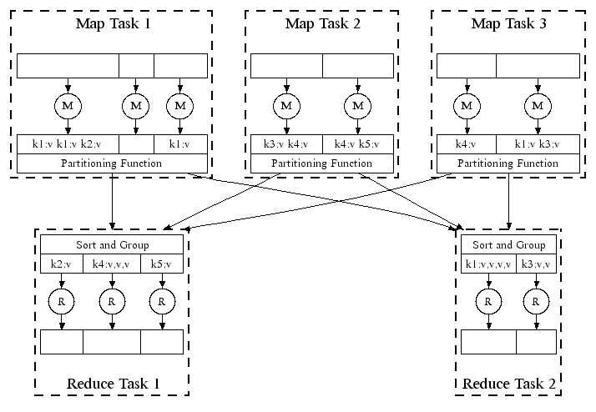
Map-Reduce: In Parallel
All phases are distributed with many tasks doing the work

Slide 94
Map-Reduce
Programmer specifies:
Map and Reduce and input files
Workflow:
Read inputs as a set of key-value-pairs
Map transforms input kv-pairs into a new set of k'v'-pairs
Sorts & Shuffles the k'v'-pairs to output nodes
All k’v’-pairs with a given k’ are sent to the same reduce
Reduce processes all k'v'-pairs grouped by key into new k''v''-pairs
Write the resulting pairs to files
All phases are distributed with many tasks doing the work
Input 0
Input 1
Input 2
Map 0
Map 1
Map 2
Shuffle
Reduce 0
Reduce 1
Out 0
Out 1

Slide 95
Result Merging
Index merging is a good strategy for handling updates when they come in large batches
For small updates this is very inefficient
instead, create separate index for new documents, merge results from both searches
could be in-memory, fast to update and search
Deletions handled using delete list
Modifications done by putting old version on delete list, adding new version to new documents index

