Slide 1
Evaluation of Search Engines
Information Retrieval in Practice
All slides ©Addison Wesley, 2008

Slide 2
Summaries
Two basic kinds: (i) static (ii) dynamic
A static summary of a document is always the same, regardless of the query that was issued by the user.
Dynamic summaries are query-dependent. They attempt to explain why the document was retrieved for the query at hand.
2

Slide 3
Static summaries
In typical systems, the static summary is a subset of the document.
Simplest heuristic: the first 50 or so words of the document
More sophisticated: extract from each document a set of “key” sentences
Simple NLP heuristics to score each sentence
Summary is made up of top-scoring sentences.
Machine learning approach: see IIR 13
Most sophisticated: complex NLP to synthesize/generate a summary
3

Slide 4
Dynamic summaries
Present one or more “windows” or snippets within the document that contain several of the query terms.
Prefer snippets in which query terms occurred as a phrase
Prefer snippets in which query terms occurred jointly in a small window
The summary that is computed this way gives the entire content of the window – all terms, not just the query terms.
4

Slide 5
A dynamic summary
Query: “new guinea economic development”
Snippets (in bold)
that were extracted from a document: . . . In recent years, Papua New Guinea has faced severe economic difficulties and economic growth has slowed, partly as a result of weak governance and civil war, and partly as a result of external factors such as the
Bougainville civil war which led to the closure in 1989 of the Panguna mine (at that time the most important foreign exchange earner and contributor to Government finances), the Asian financial crisis, a decline in the prices of gold and copper, and a fall in the production of oil. PNG’s economic development record over the past few years is evidence that governance issues underly many of the country’s problems. Good governance, which may be defined as the transparent and accountable management of human, natural, economic and financial resources for the purposes
of equitable and sustainable development, flows from proper public sector management, efficient fiscal and accounting mechanisms, and a willingness to make service delivery a priority in practice. . . .
5

Slide 6
Google example for dynamic summaries
6

Slide 7
Generating dynamic summaries
Where do we get these other terms in the snippet from?
We cannot construct a dynamic summary from the positional inverted index – at least not efficiently.
We need to cache documents.
The positional index tells us: query term occurs at position 4378 in the document.
Byte offset or word offset?
Note that the cached copy can be outdated
Don’t cache very long documents – just cache a short prefix
7

Slide 8
Dynamic summaries
Real estate on the search result page is limited ! Snippets must be short . . .
. . . but snippets must be long enough to be meaningful.
Snippets should communicate whether and how the document answers the query.
Ideally: linguistically well-formed snippets
Ideally: the snippet should answer the query, so we don’t have to look at the document.
Dynamic summaries are a big part of user happiness because
. . .we can quickly scan them to find the relevant document we then click on.
. . . in many cases, we don’t have to click at all and save time.
8

Slide 9
Evaluation
Evaluation is key to building effective and efficient search engines
measurement usually carried out in controlled laboratory experiments
online testing can also be done
Effectiveness, efficiency and cost are related
e.g., if we want a particular level of effectiveness and efficiency, this will determine the cost of the system configuration
efficiency and cost targets may impact effectiveness

Slide 10
Overview
Unranked evaluation
Ranked evaluation
Evaluation benchmarks
Result summaries

Slide 11
Outline
Unranked evaluation
Ranked evaluation
Evaluation benchmarks
Result summaries

Slide 12
Measures for a search engine
How fast does it index
e.g., number of bytes per hour
How fast does it search
e.g., latency as a function of queries per second
What is the cost per query?
in dollars
12

Slide 13
Measures for a search engine
All of the preceding criteria are measurable: we can quantify speed / size / money
However, the key measure for a search engine is user happiness.
What is user happiness?
Factors include:
Speed of response
Size of index
Uncluttered UI
Most important: relevance
(actually, maybe even more important: it’s free)
Note that none of these is sufficient: blindingly fast, but useless answers won’t make a user happy.
How can we quantify user happiness?
13

Slide 14
Who is the user?
Who is the user we are trying to make happy?
Web search engine: searcher. Success: Searcher finds what she was looking for. Measure: rate of return to this search engine
Web search engine: advertiser. Success: Searcher clicks on ad. Measure: clickthrough rate
Ecommerce: buyer. Success: Buyer buys something. Measures: time to purchase, fraction of “conversions” of searchers to buyers
Ecommerce: seller. Success: Seller sells something. Measure: profit per item sold
Enterprise: CEO. Success: Employees are more productive (because of effective search). Measure: profit of the company
14

Slide 15
Most common definition of user happiness: Relevance
User happiness is equated with the relevance of search results to the query.
But how do you measure relevance?
Standard methodology in information retrieval consists of three elements.
A benchmark document collection
A benchmark suite of queries
An assessment of the relevance of each query-document pair
15

Slide 16
Relevance: query vs. information need
Relevance to what?
First take: relevance to the query
“Relevance to the query” is very problematic.
Information need i : “I am looking for information on whether drinking red wine is more effective at reducing your risk of heart attacks than white wine.”
This is an information need, not a query.
Query q: [red wine white wine heart attack]
Consider document d′: At heart of his speech was an attack on the wine industry lobby for downplaying the role of red and white wine in drunk driving.
d′ is an excellent match for query q . . .
d′ is not relevant to the information need i .
16

Slide 17
Relevance: query vs. information need
User happiness can only be measured by relevance to an information need, not by relevance to queries.
Our terminology: we talk about query-document relevance judgments even though we mean information-need-document relevance judgments.
17

Slide 18
Test Collection Evaluation

Slide 19
Precision and Recall
Precision (P) is the fraction of retrieved documents that are relevant
Recall (R) is the fraction of relevant documents that are retrieved
19

Slide 20
Precision and recall
P = TP / ( TP + FP )
R = TP / ( TP + FN )
20

Slide 21
Precision/recall tradeoff
You can increase recall by returning more docs.
Recall is a non-decreasing function of the number of docs retrieved.
A system that returns all docs has 100% recall!
The converse is also true (usually): It’s easy to get high precision for very low recall.
Suppose the document with the largest score is relevant. How can we maximize precision?

Slide 22
A combined measure: F
F allows us to trade off precision against recall.
where
α ϵ [0, 1] and thus β ² ϵ [0,∞]
Most frequently used: balanced F with β = 1 or α = 0.5
This is the harmonic mean of P and R:
What value range of β weights recall higher than precision?
22

Slide 23
F: Example
 | relevant | not relevant
retrieved | 20 | 40 | 60
not retrieved | 60 | 1,000,000 | 1,000,060
 | 80 | 1,000,040 | 1,000,120
P = 20/(20 + 40) = 1/3
R = 20/(20 + 60) = 1/4
23

Slide 24
Accuracy
Why do we use complex measures like precision, recall, and F?
Why not something simple like accuracy?
Accuracy is the fraction of decisions (relevant/nonrelevant) that are correct.
In terms of the contingency table above,
accuracy = (TP + TN)/(TP + FP + FN + TN).
Why is accuracy not a useful measure for web information retrieval?
24

Slide 25
Exercise
Compute precision, recall and F₁ for this result set:
The snoogle search engine below always returns 0 results (“0 matching results found”), regardless of the query. Why does snoogle demonstrate that accuracy is not a useful measure in IR?
 | relevant | not relevant
retrieved | 18 | 2
not retrieved | 82 | 1,000,000,000
25

Slide 26
Why accuracy is a useless measure in IR
Simple trick to maximize accuracy in IR: always say no and return nothing
You then get 99.99% accuracy on most queries.
Searchers on the web (and in IR in general) want to find something and have a certain tolerance for junk.
It’s better to return some bad hits as long as you return something.
→We use precision, recall, and F for evaluation, not accuracy.
26

Slide 27
F: Why harmonic mean?
Why don’t we use a different mean of P and R as a measure?
e.g., the arithmetic mean
dominated by large values
27

Slide 28
Difficulties in using Precision, Recall and F
We need relevance judgments for information-need-document pairs – but they are expensive to produce.
Obtaining relevance judgments is an expensive, time-consuming process
who does it?
what are the instructions?
what is the level of agreement?
28

Slide 29
Pooling
Exhaustive judgments for all documents in a collection is not practical
Pooling technique:
top k results (k varied between 50 and 200) from the rankings obtained by different search engines (or retrieval algorithms) are merged into a pool
duplicates are removed
documents are presented in some random order to the relevance judges
Produces a large number of relevance judgments for each query, although still incomplete

Slide 30
Query Logs
Used for both tuning and evaluating search engines
also for various techniques such as query suggestion
Typical contents
User identifier or user session identifier
Query terms - stored exactly as user entered
List of URLs of results, their ranks on the result list, and whether they were clicked on
Timestamp(s) - records the time of user events such as query submission, clicks

Slide 31
Query Logs
Clicks are not relevance judgments
although they are correlated
biased by a number of factors such as rank on result list
Can use clickthough data to predict preferences between pairs of documents
appropriate for tasks with multiple levels of relevance, focused on user relevance
various “policies” used to generate preferences

Slide 32
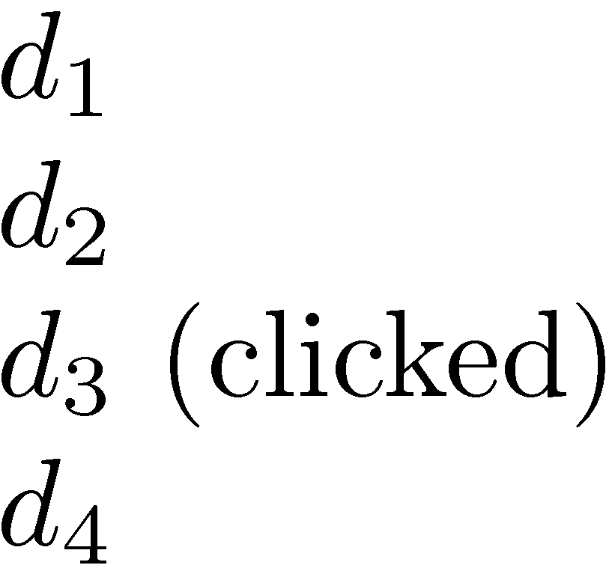
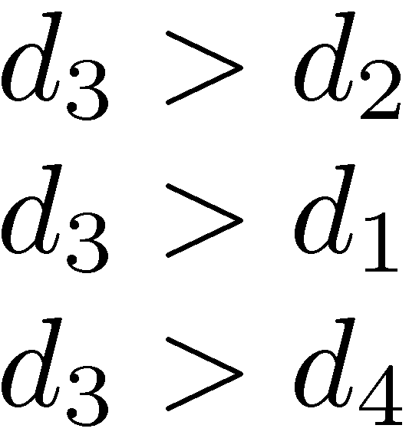
Example Click Policy
Skip Above and Skip Next
click data
generated preferences

Slide 33
Query Logs
Click data can also be aggregated to remove noise
Click distribution information
can be used to identify clicks that have a higher frequency than would be expected
high correlation with relevance
e.g., using click deviation to filter clicks for preference-generation policies

Slide 34
Outline
Recap
Unranked evaluation
Ranked evaluation
Evaluation benchmarks
Result summaries

Slide 35
Ranking Effectiveness
#1 = #2
#1 > #2

Slide 36
Summarizing a Ranking
Calculating recall and precision at fixed rank positions
Calculating precision at standard recall levels, from 0.0 to 1.0
requires interpolation
Averaging the precision values from the rank positions where a relevant document was retrieved

Slide 37
Average Precision

Slide 38
Averaging Across Queries

Slide 39
Averaging
Mean Average Precision (MAP)
summarize rankings from multiple queries by averaging average precision
most commonly used measure in research papers
assumes user is interested in finding many relevant documents for each query
requires many relevance judgments in text collection
Recall-precision graphs are also useful summaries

Slide 40
MAP

Slide 41
Focusing on Top Documents
Users tend to look at only the top part of the ranked result list to find relevant documents
Some search tasks have only one relevant document
e.g., navigational search, question answering
Recall not appropriate
instead need to measure how well the search engine does at retrieving relevant documents at very high ranks

Slide 42
Focusing on Top Documents
Precision at Rank R
R typically 5, 10, 20
easy to compute, average, understand
not sensitive to rank positions less than R
Reciprocal Rank
reciprocal of the rank at which the first relevant document is retrieved
Mean Reciprocal Rank (MRR) is the average of the reciprocal ranks over a set of queries
very sensitive to rank position

Slide 43
Mean Reciprocal Rank
Consider rank position, K, of first relevant doc
Reciprocal Rank score =
MRR is the mean RR across multiple queries
Query | Proposed Results | Correct response | Rank | Reciprocal rank
cat | catten, cati, cats | cats | 3 | 1/3
torus | torii, tori, toruses | tori | 2 | 1/2
virus | viruses, virii, viri | viruses | 1 | 1

Slide 44
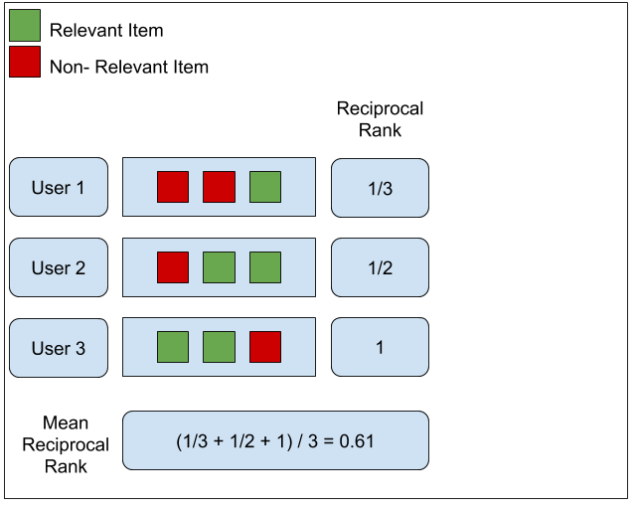
Example
https://medium.com/swlh/rank-aware-recsys-evaluation-metrics-5191bba16832

Slide 45
Discounted Cumulative Gain
Popular measure for evaluating web search and related tasks
Two assumptions:
Highly relevant documents are more useful than marginally relevant document
the lower the ranked position of a relevant document, the less useful it is for the user, since it is less likely to be examined

Slide 46
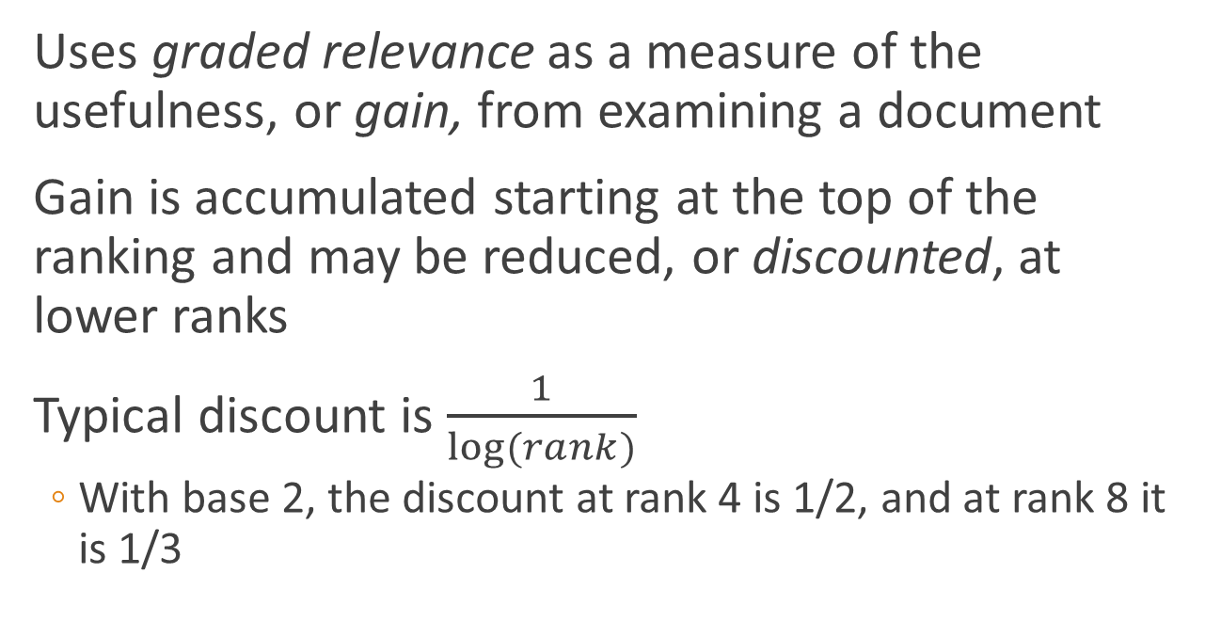
Discounted Cumulative Gain
Uses graded relevance as a measure of the usefulness, or gain, from examining a document
Gain is accumulated starting at the top of the ranking and may be reduced, or discounted, at lower ranks
Typical discount is $\frac{1}{log⁡(rank)}$
With base 2, the discount at rank 4 is 1/2, and at rank 8 it is 1/3

Slide 47
Discounted Cumulative Gain
DCG is the total gain accumulated at a particular rank p:
Alternative formulation:
used by some web search companies
emphasis on retrieving highly relevant documents

Slide 48
DCG Example
10 ranked documents judged on 0-3 relevance scale:
3, 2, 3, 0, 0, 1, 2, 2, 3, 0
discounted gain:
3, 2/1, 3/1.59, 0, 0, 1/2.59, 2/2.81, 2/3, 3/3.17, 0
= 3, 2, 1.89, 0, 0, 0.39, 0.71, 0.67, 0.95, 0
DCG:
3, 5, 6.89, 6.89, 6.89, 7.28, 7.99, 8.66, 9.61, 9.61

Slide 49
Normalized DCG
DCG numbers are averaged across a set of queries at specific rank values
e.g., DCG at rank 5 is 6.89 and at rank 10 is 9.61
DCG values are often normalized by comparing the DCG at each rank with the DCG value for the perfect ranking
makes averaging easier for queries with different numbers of relevant documents

Slide 50
NDCG Example
Perfect ranking:
3, 3, 3, 2, 2, 2, 1, 0, 0, 0
ideal DCG values:
3, 6, 7.89, 8.89, 9.75, 10.52, 10.88, 10.88, 10.88, 10
NDCG values (divide actual by ideal):
1, 0.83, 0.87, 0.76, 0.71, 0.69, 0.73, 0.8, 0.88, 0.88
NDCG ≤ 1 at any rank position

Slide 51
NDCG - Example
4 documents: d₁, d₂, d₃, d₄
i | Ground Truth |  | Ranking Function₁ |  | Ranking Function₂
 | Document Order | r_{i} | Document Order | r_{i} | Document Order | r_{i}
1 | d4 | 2 | d3 | 2 | d3 | 2
2 | d3 | 2 | d4 | 2 | d2 | 1
3 | d2 | 1 | d2 | 1 | d4 | 2
4 | d1 | 0 | d1 | 0 | d1 | 0
 | NDCG_{GT}=1.00 |  | NDCG_{RF1}=1.00 |  | NDCG_{RF2}=0.9203

Slide 52
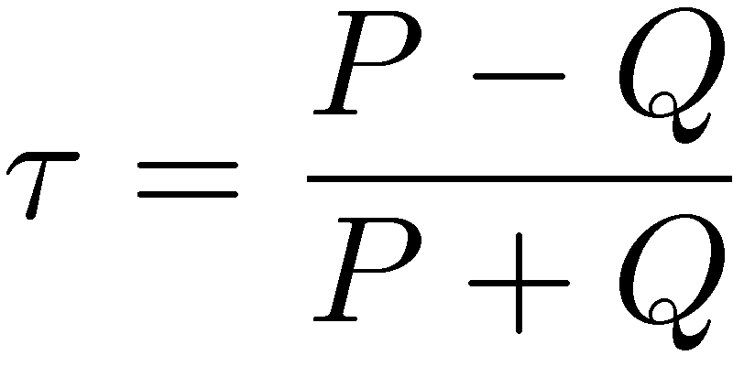
Using Preferences
Two rankings described using preferences can be compared using the Kendall tau coefficient (τ ):
P is the number of preferences that agree and Q is the number that disagree
For preferences derived from binary relevance judgments, can use BPREF

Slide 53
BPREF
For a query with R relevant documents, only the first R non-relevant documents are considered
d_{r} is a relevant document, and N_{dr} gives the number of non-relevant documents (from the set of R non-relevant documents that are considered) that are ranked higher than d_{r}
Alternative definition

Slide 54
Outline
Recap
Unranked evaluation
Ranked evaluation
Evaluation benchmarks
Result summaries

Slide 55
What we need for a benchmark
A collection of documents
Documents must be representative of the documents we expect to see in reality.
A collection of information needs
. . .which we will often incorrectly refer to as queries
Information needs must be representative of the information needs we expect to see in reality.
Human relevance assessments
We need to hire/pay “judges” or assessors to do this.
Expensive, time-consuming
Judges must be representative of the users we expect to see in reality.
55

Slide 56
Validity of relevance assessments
Relevance assessments are only usable if they are consistent.
If they are not consistent, then there is no “truth” and experiments are not repeatable.
How can we measure this consistency or agreement among judges?
→ Kappa measure
56

Slide 57
Kappa measure
Kappa is measure of how much judges agree or disagree.
Designed for categorical judgments
Corrects for chance agreement
P(A) = proportion of time judges agree
P(E) = what agreement would we get by chance
k =? for (i) chance agreement (ii) total agreement
57

Slide 58
Kappa measure (2)
Values of k in the interval [2/3, 1.0] are seen as acceptable.
With smaller values: need to redesign relevance assessment methodology used etc.
58

Slide 59
Calculating the kappa statistic
Judge 1 Relevance | Judge 2 Relevance
 |  | Yes | No | Total
 | Yes | 300 | 20 | 320
 | No | 10 | 70 | 80
 | Total | 310 | 90 | 400
Observed proportion of
the times the judges agreed
P(A) = (300 + 70)/400 = 370/400 = 0.925
Pooled marginals
P(nonrelevant) = (80 + 90)/(400 + 400) = 170/800 = 0.2125
P(relevant) = (320 + 310)/(400 + 400) = 630/800 = 0.7878
Probability that the two judges agreed by chance P(E) =
P(nonrelevant)² + P(relevant)² = 0.2125² + 0.7878² = 0.665
Kappa statistic к = (P(A) − P(E))/(1 − P(E)) =
(0.925 − 0.665)/(1 − 0.665) = 0.776 (still in acceptable range)
59

Slide 60
Impact of interjudge disagreement
Judges disagree a lot. Does that mean that the results of information retrieval experiments are meaningless?
No.
Large impact on absolute performance numbers
Virtually no impact on ranking of systems
Suppose we want to know if algorithm A is better than algorithm B
An information retrieval experiment will give us a reliable answer to this question . . .
. . . even if there is a lot of disagreement between judges.
60

Slide 61
Evaluation at large search engines
Recall is difficult to measure on the web
Search engines often use precision at top k, e.g., k = 10 . . .
. . . or use measures that reward you more for getting rank 1 right than for getting rank 10 right.
Search engines also use non-relevance-based measures.
Example 1: clickthrough on first result
Not very reliable if you look at a single clickthrough (you may realize after clicking that the summary was misleading and the document is nonrelevant) . . .
. . . but pretty reliable in the aggregate.
Example 3: A/B testing
61

Slide 62
A/B testing
Purpose: Test a single innovation
Prerequisite: You have a large search engine up and running.
Have most users use old system
Divert a small proportion of traffic (e.g., 1%) to the new system that includes the innovation
Evaluate with an “automatic” measure like clickthrough on first result
Now we can directly see if the innovation does improve user happiness.
Probably the evaluation methodology that large search engines trust most
62

Slide 63
Critique of pure relevance
We’ve defined relevance for an isolated query-document pair.
Alternative definition: marginal relevance
The marginal relevance of a document at position k in the result list is the additional information it contributes over and above the information that was contained in documents d₁ . . . d_{k−1}.
Exercise
Why is marginal relevance a more realistic measure of user happiness?
Give an example where a non-marginal measure like precision or recall is a misleading measure of user happiness, but marginal relevance is a good measure.
In a practical application, what is the difficulty of using marginal measures instead of non-marginal measures?
63

Slide 64
Outline
Recap
Unranked evaluation
Ranked evaluation
Evaluation benchmarks
Result summaries

Slide 65
Resources
Chapter 8 of IIR
Resources at http://ifnlp.org/ir
The TREC home page – TREC had a huge impact on information retrieval evaluation.
Originator of F-measure: Keith van Rijsbergen
More on A/B testing
Too much A/B testing at Google?
Tombros & Sanderson 1998: one of the first papers on dynamic summaries
Google VP of Engineering on search quality evaluation at Google
65

