Slide 1
Crawls and Feeds
Information Retrieval in Practice
All slides ©Addison Wesley, 2008

Slide 2
Web Crawler
Finds and downloads web pages automatically
  provides the collection for searching
Web is huge and constantly growing
Web is not under the control of search engine providers
Web pages are constantly changing
Crawlers also used for other types of data

Slide 3
Many names
Crawler
Spider
Robot (or bot)
Web agent
Wanderer, worm, …

Slide 4
Retrieving Web Pages
Every page has a unique uniform resource locator (URL)
Web pages are stored on web servers that use HTTP to exchange information with client software
e.g.,

Slide 5
Retrieving Web Pages
Web crawler client program connects to a domain name system (DNS) server
DNS server translates the hostname into an internet protocol (IP) address
Crawler then attempts to connect to server host using specific port
After connection, crawler sends an HTTP request to the web server to request a page
  usually a GET request

Slide 6
Crawling the Web

Slide 7
Web Crawler
Starts with a set of seeds
  A set of URLs given to it as parameters
Seeds are added to a URL request queue
Crawler starts fetching pages from the request queue
Downloaded pages are parsed to find link tags that might contain other useful URLs to fetch
New URLs added to the crawler’s request queue, or frontier
Continue until no more new URLs or disk full

Slide 8
Crawling picture
Sec. 20.2
URLs crawled
and parsed
Unseen Web
Seed
pages
URLs frontier
Web

Slide 9
Web Crawling
Web crawlers spend a lot of time waiting for responses to requests
To reduce this inefficiency, web crawlers use threads and fetch hundreds of pages at once
Crawlers could potentially flood sites with requests for pages
To avoid this problem, web crawlers use politeness policies
  e.g., delay between requests to same web server

Slide 10
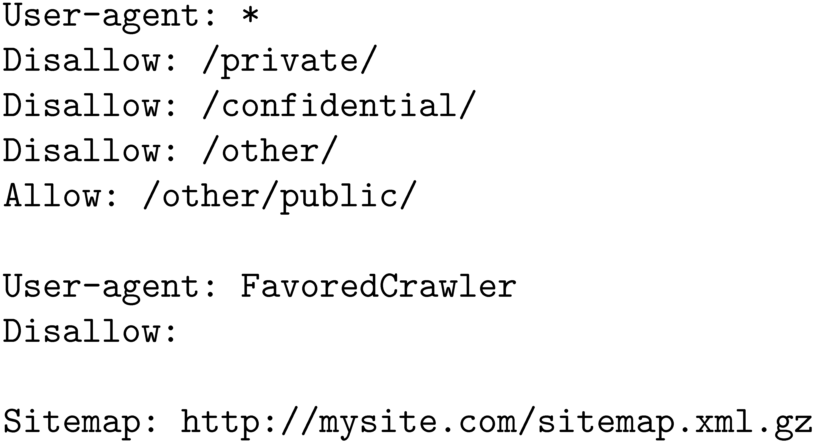
Controlling Crawling
Even crawling a site slowly will anger some web server administrators, who object to any copying of their data
Robots.txt file can be used to control crawlers

Slide 11
Robots.txt
Sec. 20.2.1
Protocol for giving spiders (“robots”) limited access to a website, originally from 1994
  www.robotstxt.org/wc/norobots.html
Website announces its request on what can(not) be crawled
  For a server, create a file /robots.txt
  This file specifies access restrictions

Slide 12
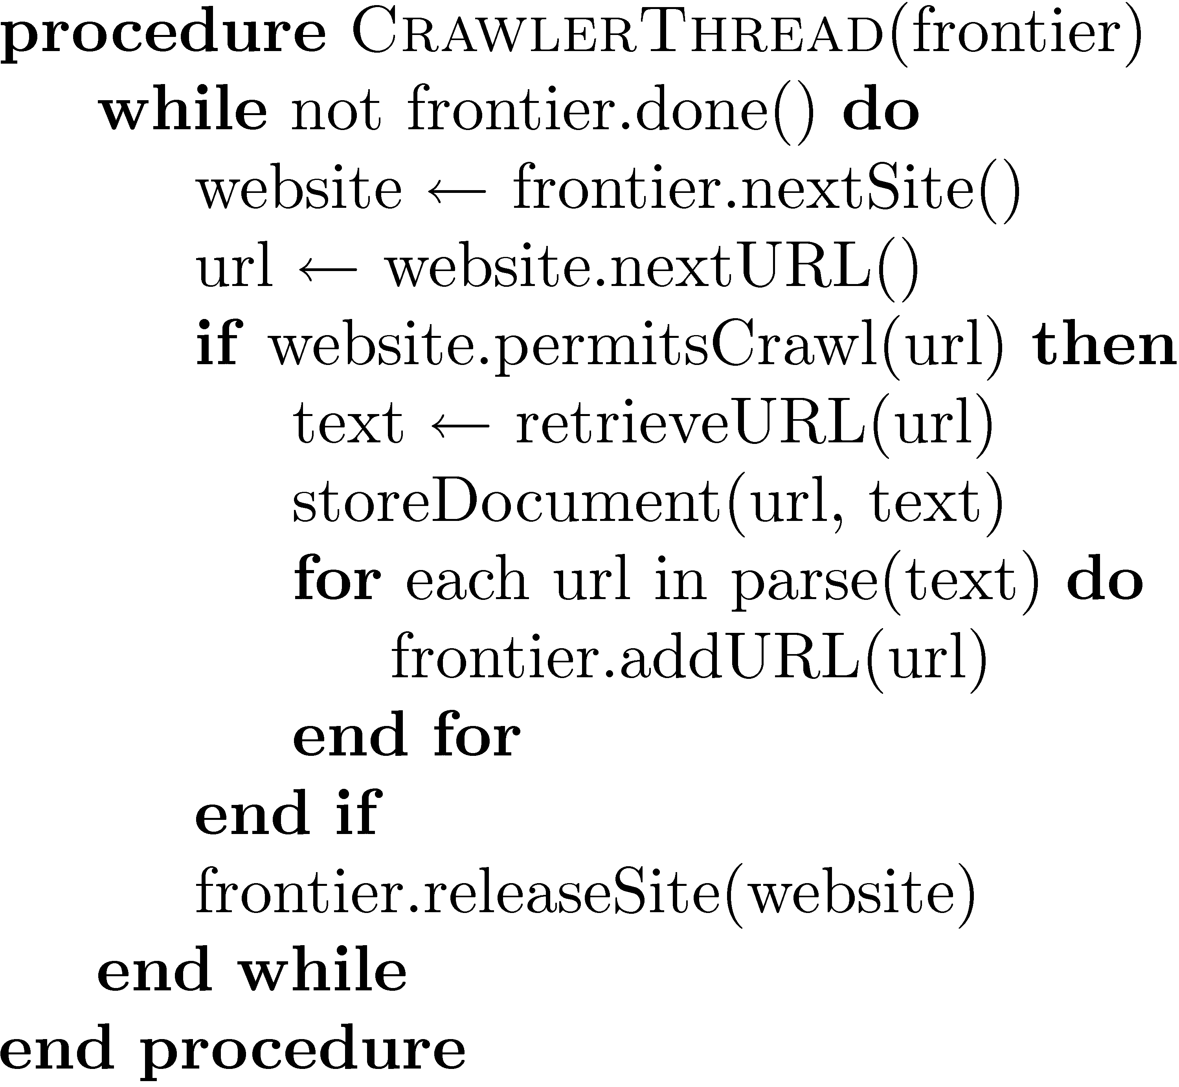
Simple Crawler Thread

Slide 13
Freshness
Web pages are constantly being added, deleted, and modified
Web crawler must continually revisit pages it has already crawled to see if they have changed in order to maintain the freshness of the document collection
  stale copies no longer reflect the real contents of the web pages

Slide 14
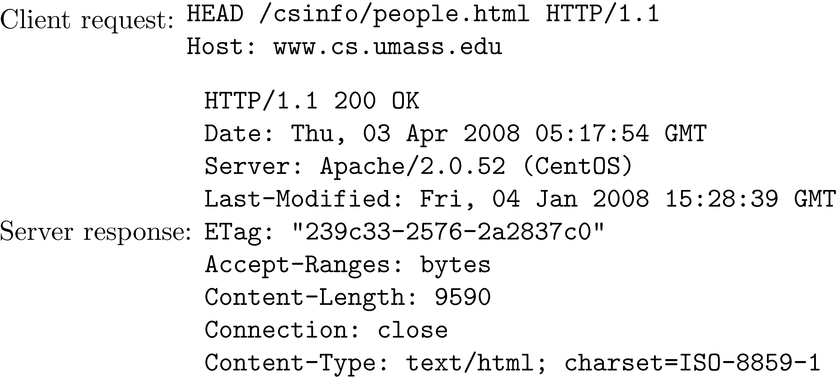
Freshness
HTTP protocol has a special request type called HEAD that makes it easy to check for page changes
  returns information about page, not page itself

Slide 15
Freshness
Not possible to constantly check all pages
  must check important pages and pages that change frequently
Freshness is the proportion of pages that are fresh
Optimizing for this metric can lead to bad decisions, such as not crawling popular sites
Age is a better metric

Slide 16
Freshness vs. Age

Slide 17
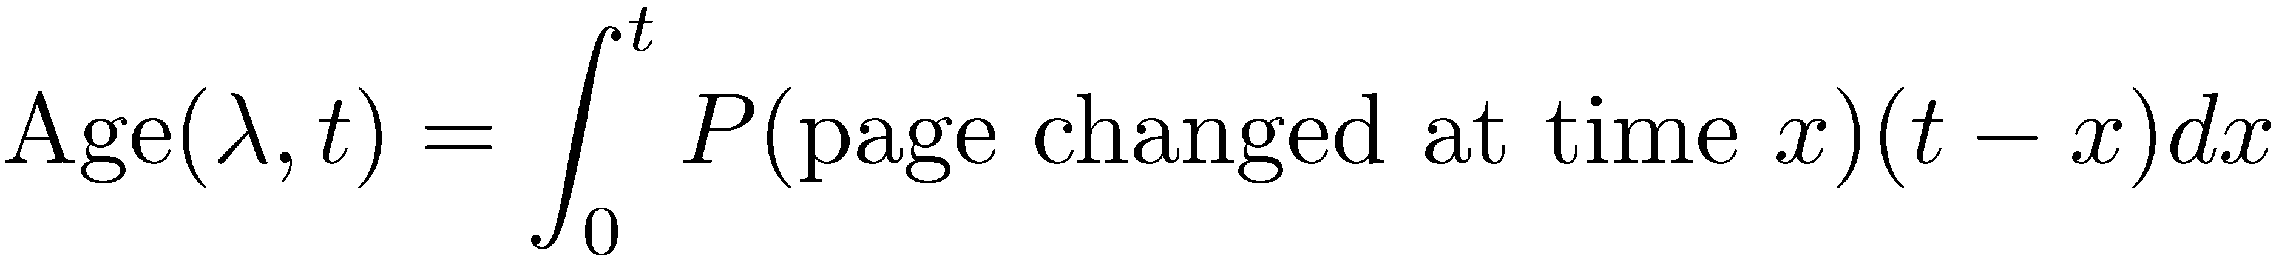
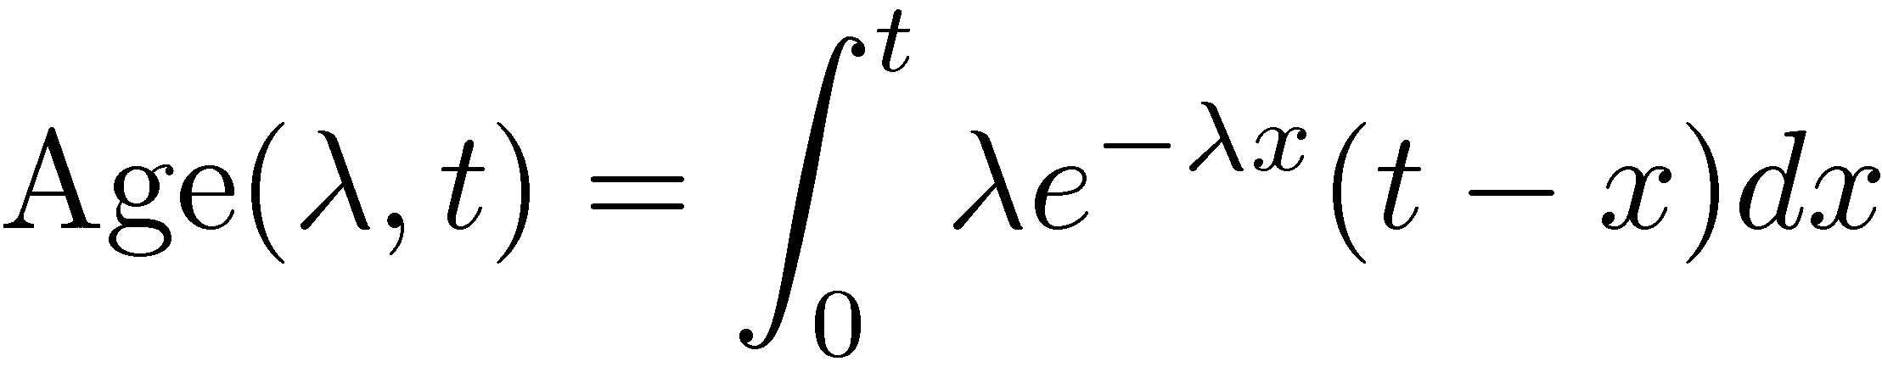
Age
Assume that a page changes λ times a day.
Expected age of a page t days after it was last crawled:
  x is the time of crawl
Web page updates follow the Poisson distribution on average
  time until the next update is governed by an exponential distribution

Slide 18
Age
Older a page gets, the more it costs not to crawl it
  e.g., expected age with mean change frequency λ = 1/7 (one change per week)
Age (in days)
Crawl time (in days)

Slide 19
Focused Crawling
Attempts to download only those pages that are about a particular topic
  used by vertical search applications
Rely on the fact that pages about a topic tend to have links to other pages on the same topic
  popular pages for a topic are typically used as seeds
Crawler uses text classifier to decide whether a page is on topic

Slide 20

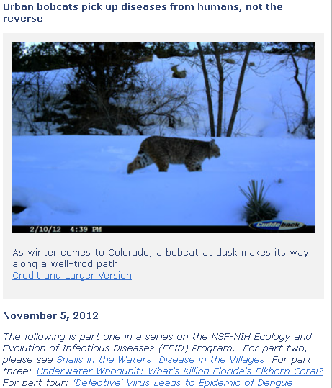
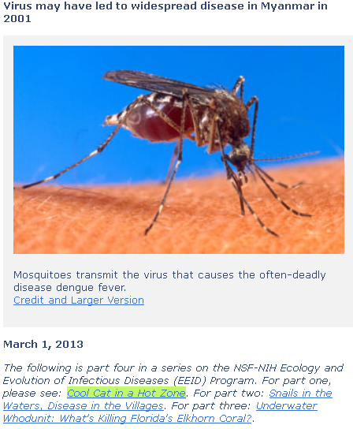
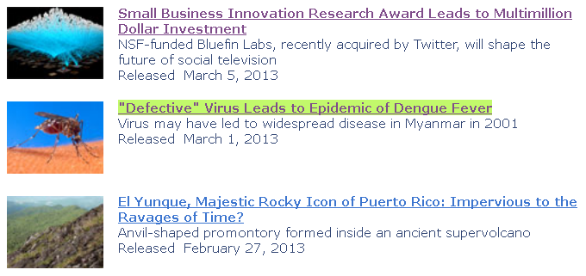
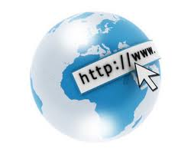



(Surface) Web Exploration
www.nsf.gov

Slide 21
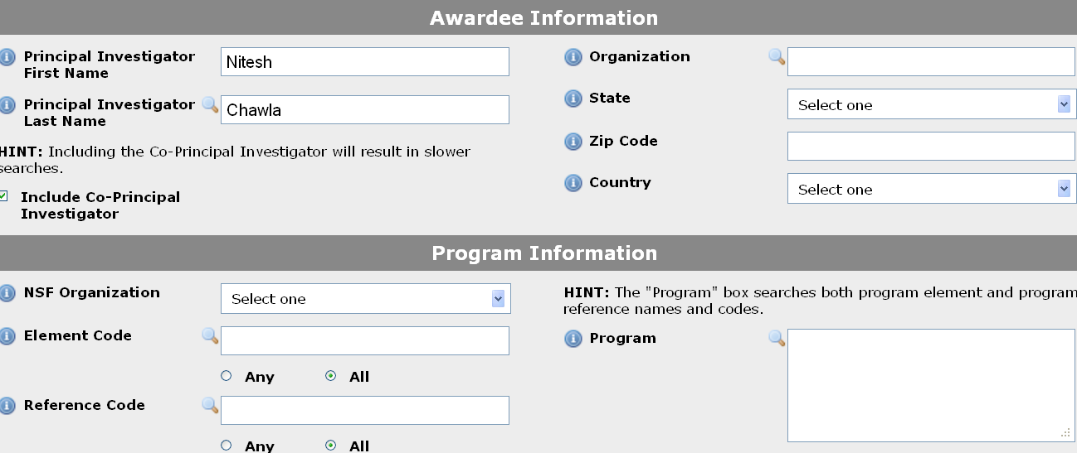
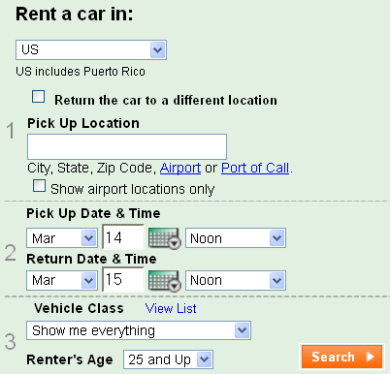
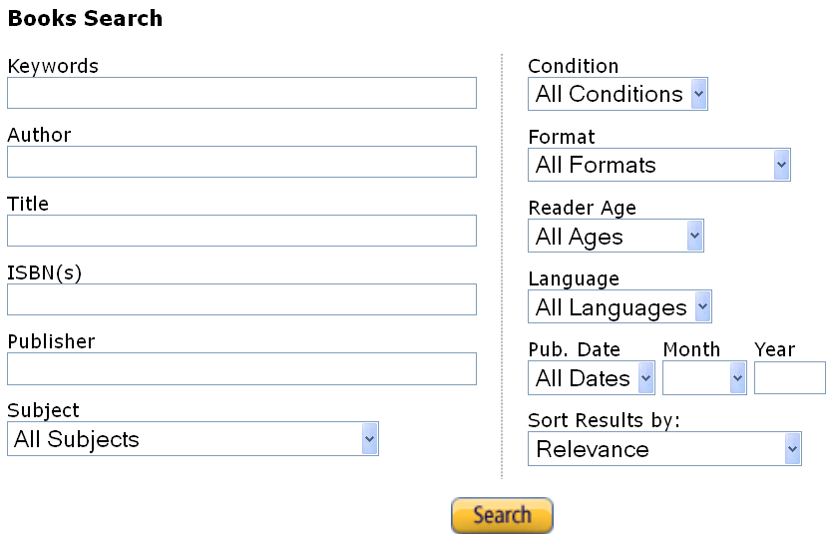
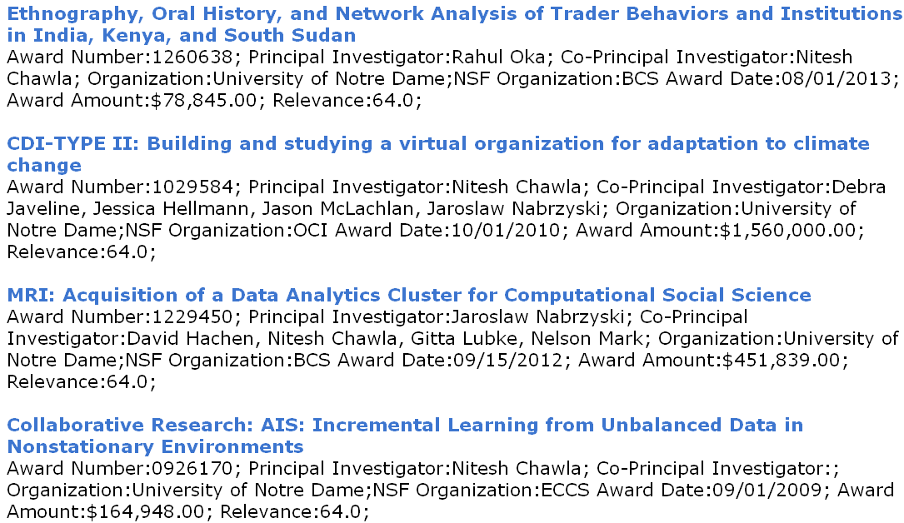

Deep Web Exploration

Slide 22
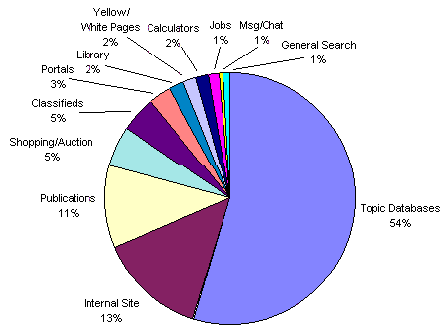
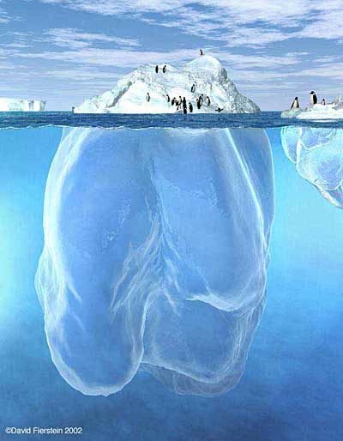
The Deep Web
Deep Web vs. Surface Web
  Dynamic contents, unlinked pages, contextual Web, etc.
  1,000 to 5,000 times larger than Surface Web, as of 2010.
Distribution of Deep Web Sites by Content www.brightplanet.com

Slide 23
Deep Web
Sites that are difficult for a crawler to find are collectively referred to as the deep (or hidden) Web
  much larger than conventional Web
Three broad categories:
  private sites
    no incoming links, or may require log in with a valid account
  form results
    sites that can be reached only after entering some data into a form
  scripted pages
    pages that use JavaScript, Flash, or another client-side language to generate links

Slide 24
Sitemaps
Sitemaps contain lists of URLs and data about those URLs, such as modification time and modification frequency
Generated by web server administrators
Tells crawler about pages it might not otherwise find
Gives crawler a hint about when to check a page for changes

Slide 25
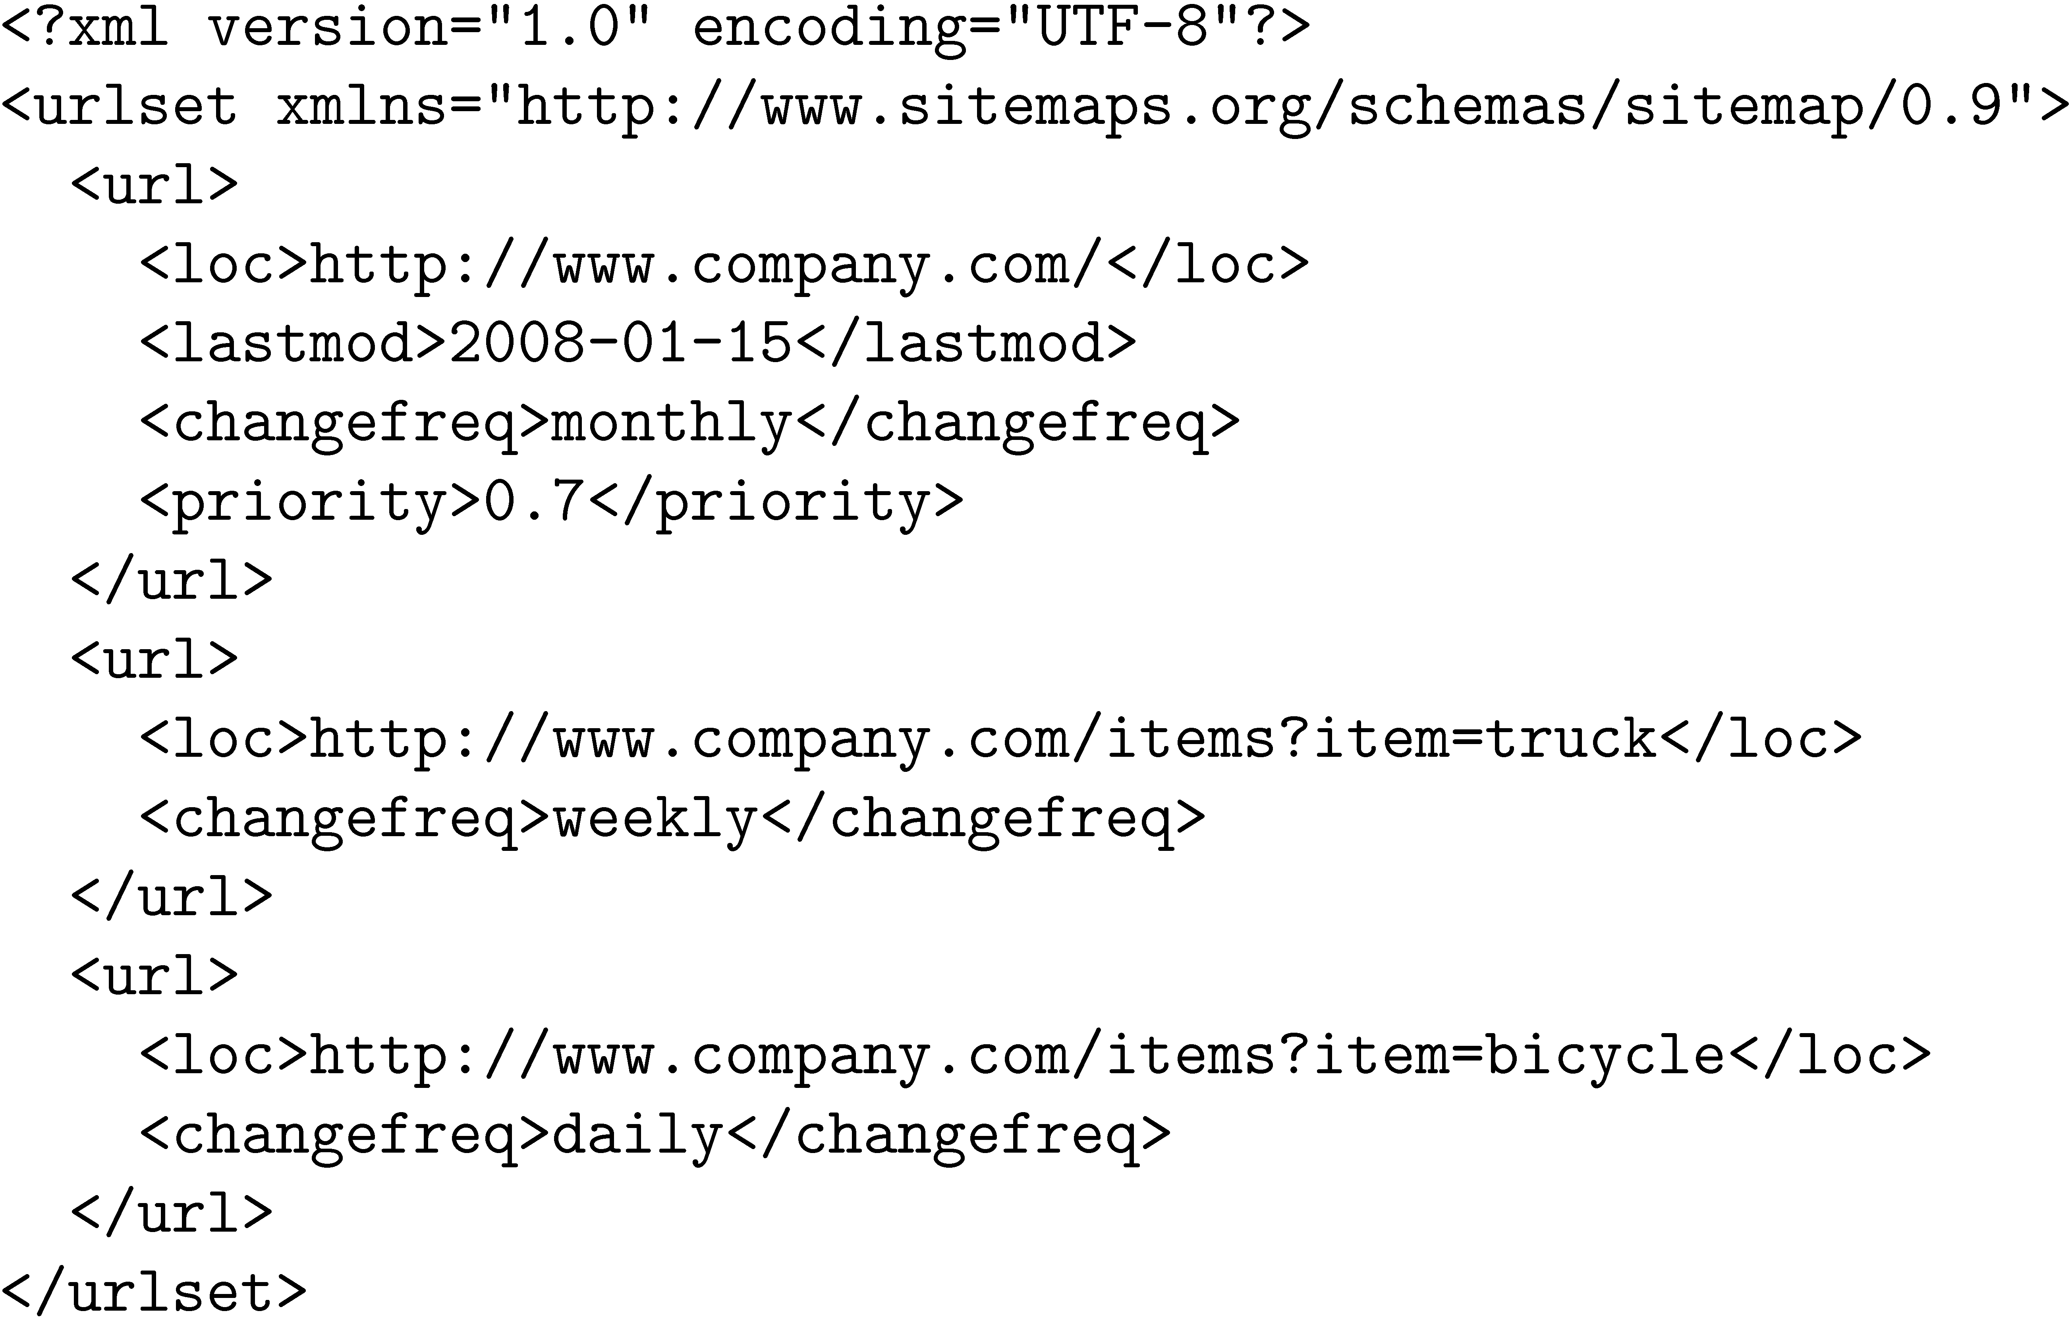
Sitemap Example
Dynamically generated pages

Slide 26
Distributed Crawling
Three reasons to use multiple computers for crawling
  Helps to put the crawler closer to the sites it crawls
  Reduces the number of sites the crawler has to remember
  Reduces computing resources required
Distributed crawler uses a hash function to assign URLs to crawling computers
  hash function should be computed on the host part of each URL

Slide 27
Desktop Crawls
Used for desktop search and enterprise search
Differences to web crawling:
  Much easier to find the data
  Responding quickly to updates is more important
  Must be conservative in terms of disk and CPU usage
  Many different document formats
  Data privacy very important

Slide 28
Document Feeds
Many documents are published
  created at a fixed time and rarely updated again
  e.g., news articles, blog posts, press releases, email
Published documents from a single source can be ordered in a sequence called a document feed
  new documents found by examining the end of the feed

Slide 29
Document Feeds
Two types:
  A push feed alerts the subscriber to new documents
  A pull feed requires the subscriber to check periodically for new documents
Most common format for pull feeds is called RSS
  Really Simple Syndication, RDF Site Summary, Rich Site Summary, or ...

Slide 30
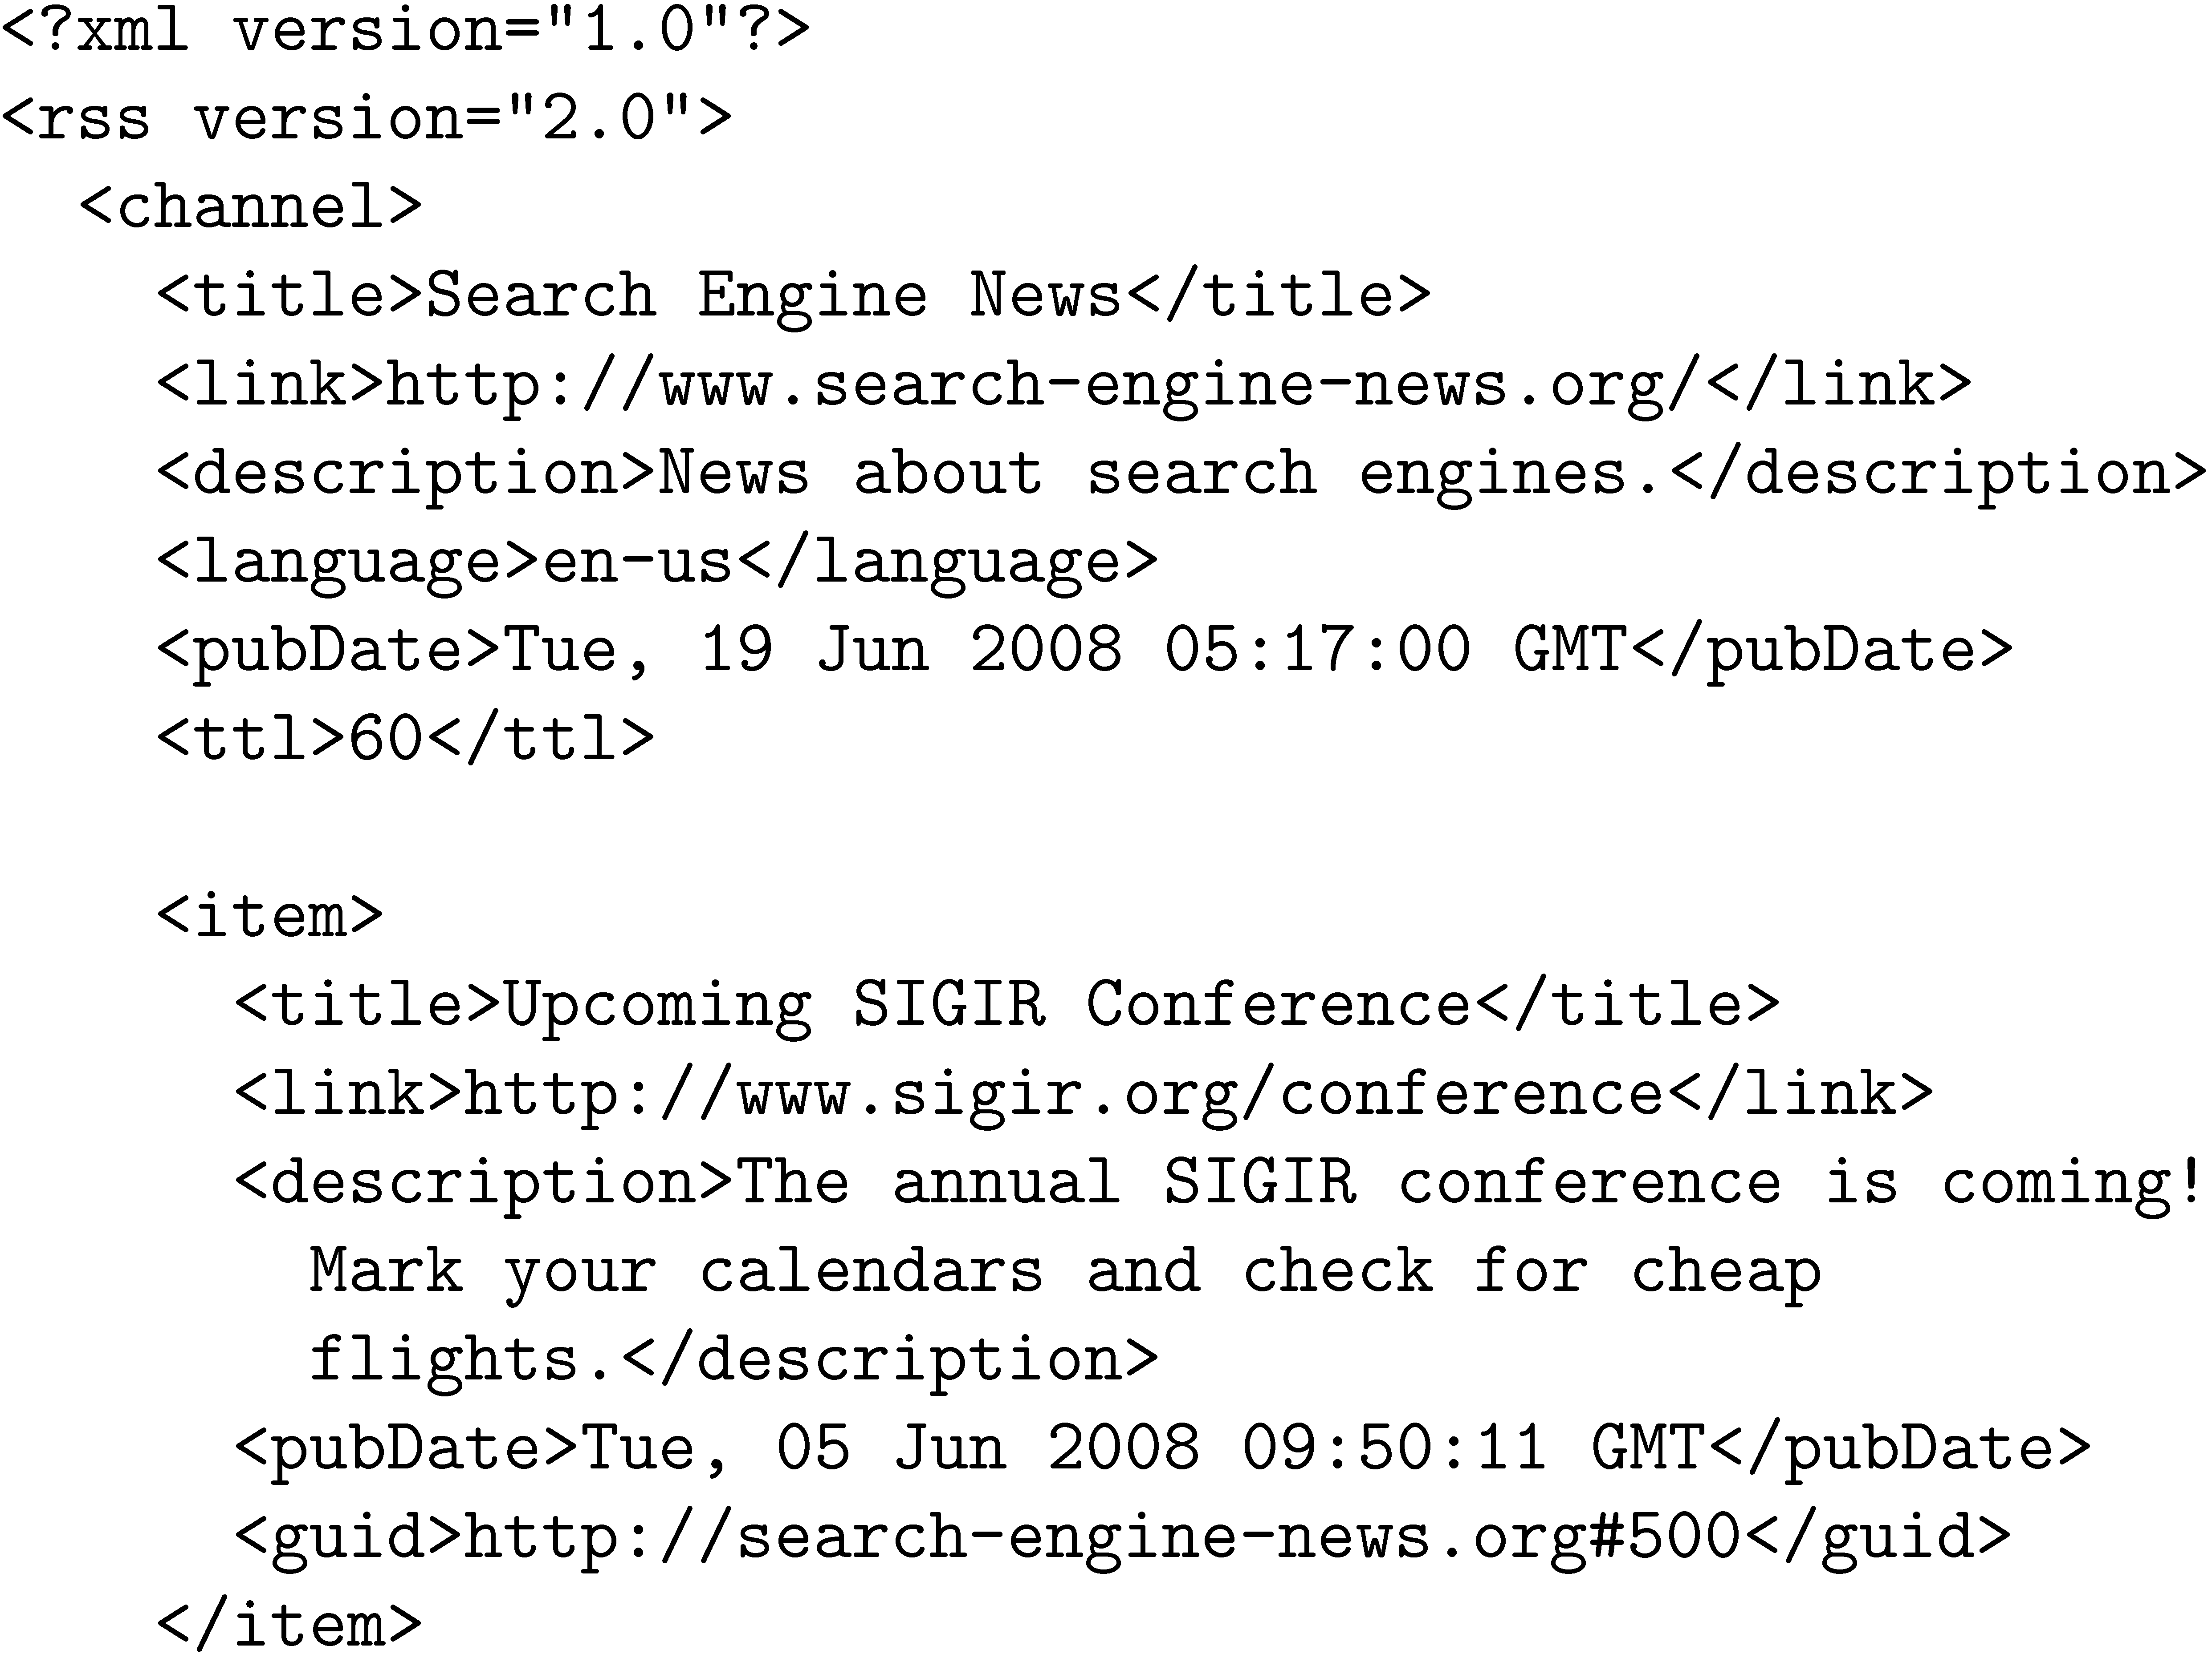
RSS Example

Slide 31
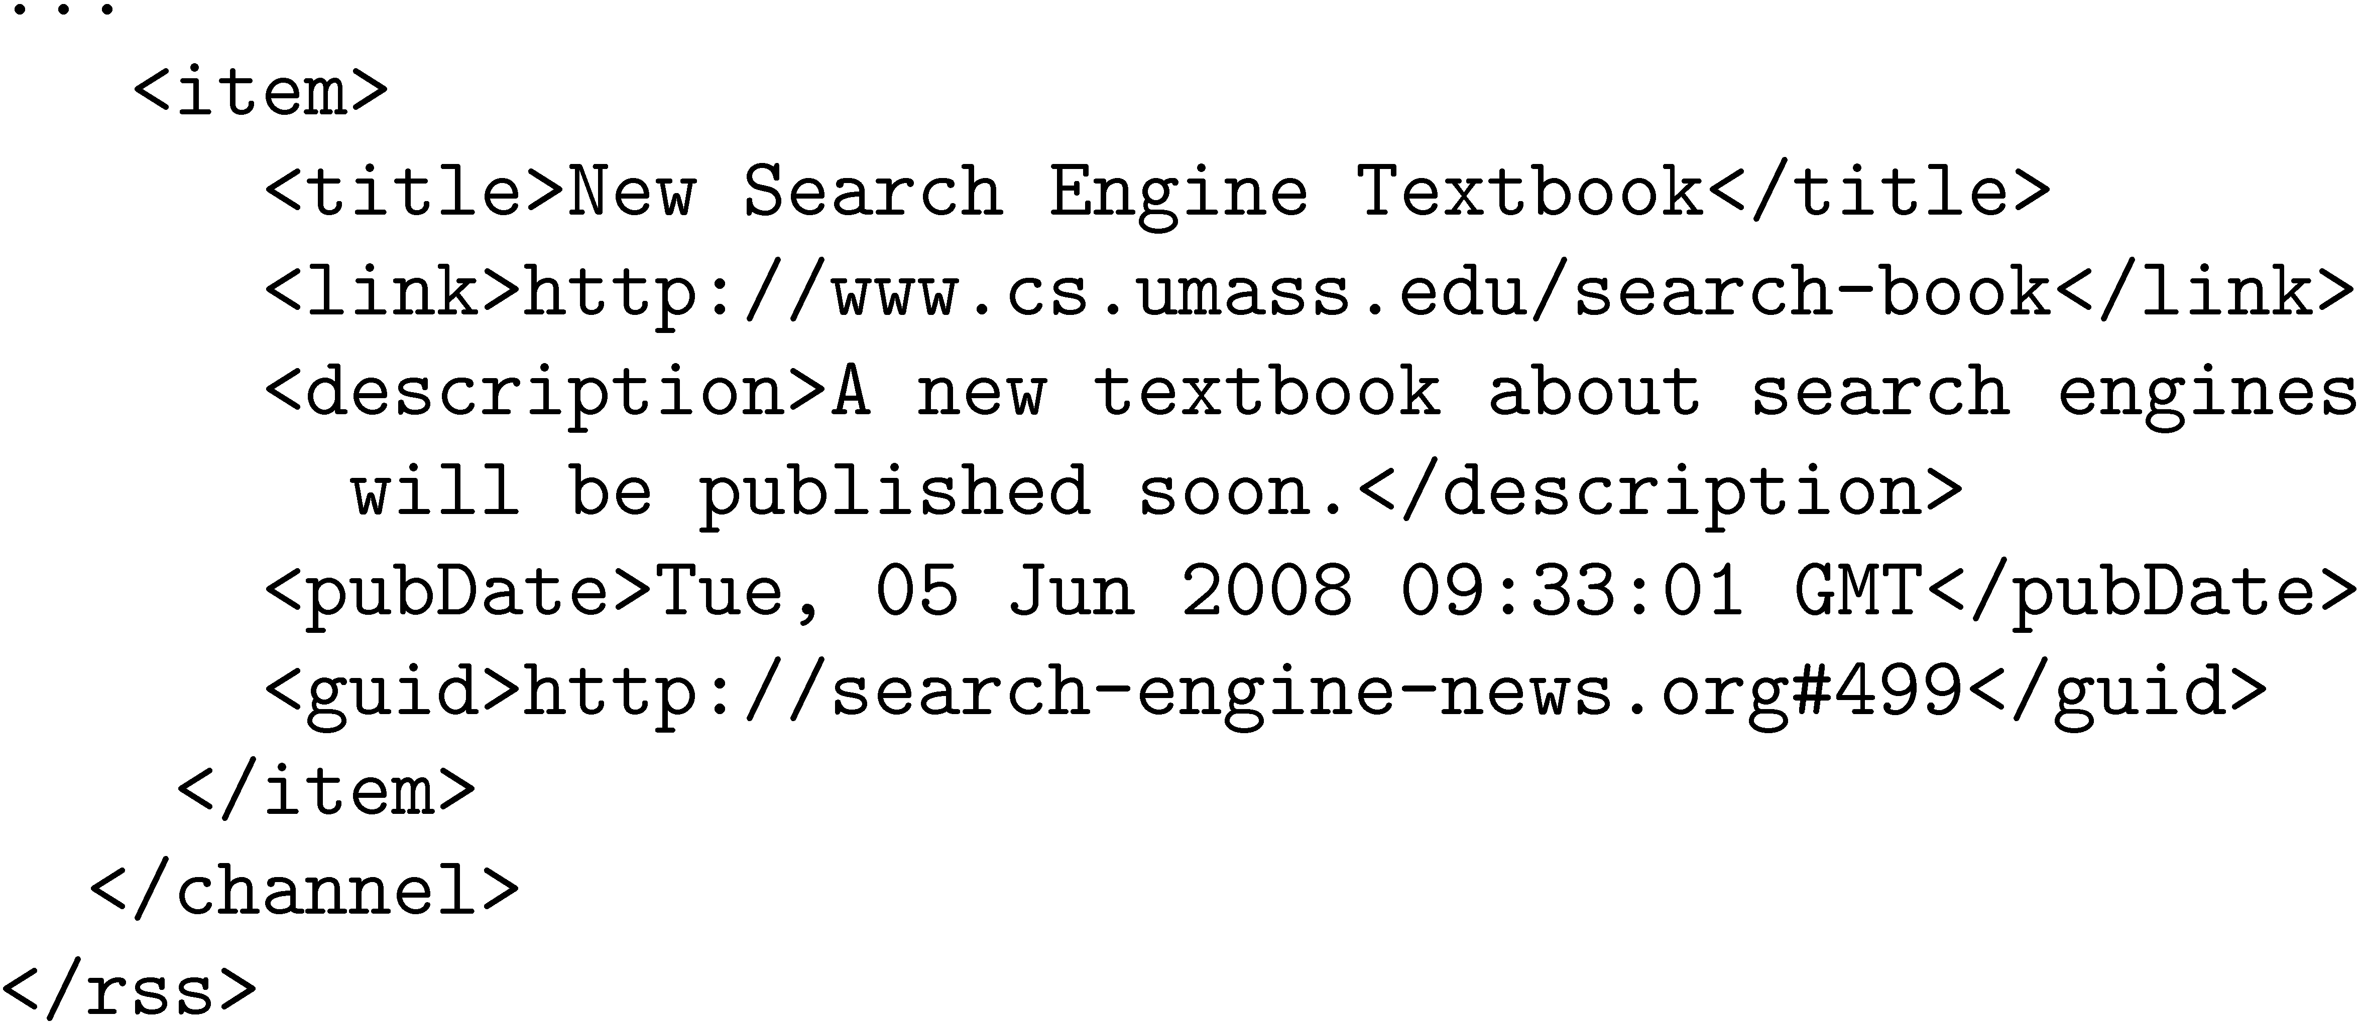
RSS Example

Slide 32
RSS
ttl tag (time to live)
  amount of time (in minutes) contents should be cached
RSS feeds are accessed like web pages
  using HTTP GET requests to web servers that host them
Easy for crawlers to parse
Easy to find new information

Slide 33

Many document, many file formats, many encodings

Slide 34

Encoding and Conversion

Slide 35
Conversion
Text is stored in hundreds of incompatible file formats
  e.g., raw text, RTF, HTML, XML, Microsoft Word, ODF, PDF
Other types of files also important
  e.g., PowerPoint, Excel
Typically use a conversion tool
  converts the document content into a tagged text format such as HTML or XML
  retains some of the important formatting information

Slide 36
Character Encoding
A character encoding is a mapping between bits and glyphs/letters
  i.e., getting from bits in a file to characters on a screen
  Can be a major source of incompatibility
ASCII is basic character encoding scheme for English
  encodes 128 letters, numbers, special characters, and control characters in 7 bits, extended with an extra bit for storage in bytes

Slide 37
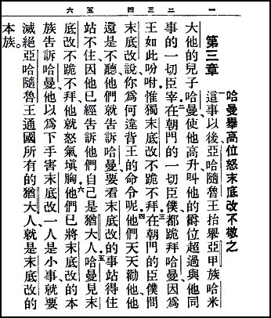
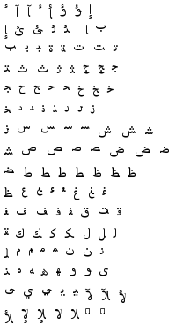
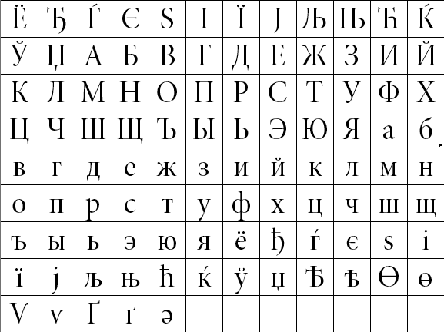
Example Glyphs

Slide 38
Character Encoding
Other languages can have many more glyphs
  e.g., Chinese has more than 40,000 characters, with over 3,000 in common use
Many languages have multiple encoding schemes
  e.g., CJK (Chinese-Japanese-Korean) family of East Asian languages, Hindi, Arabic
  must specify encoding
  can’t have multiple languages in one file
Unicode developed to address encoding problems

Slide 39
Unicode
Single mapping from numbers to glyphs that attempts to include all glyphs in common use in all known languages
Unicode is a mapping between numbers and glyphs
  does not uniquely specify bits to glyph mapping!
  e.g., UTF-8, UTF-16, UTF-32

Slide 40
Unicode
Proliferation of encodings comes from a need for compatibility and to save space
  UTF-8 uses one byte for English (ASCII), as many as 4 bytes for some traditional Chinese characters
  variable length encoding
    more difficult to do string operations
  UTF-32 uses 4 bytes for every character
Many applications use UTF-32 for internal text encoding (fast random lookup) and UTF-8 for disk storage (less space)

Slide 41
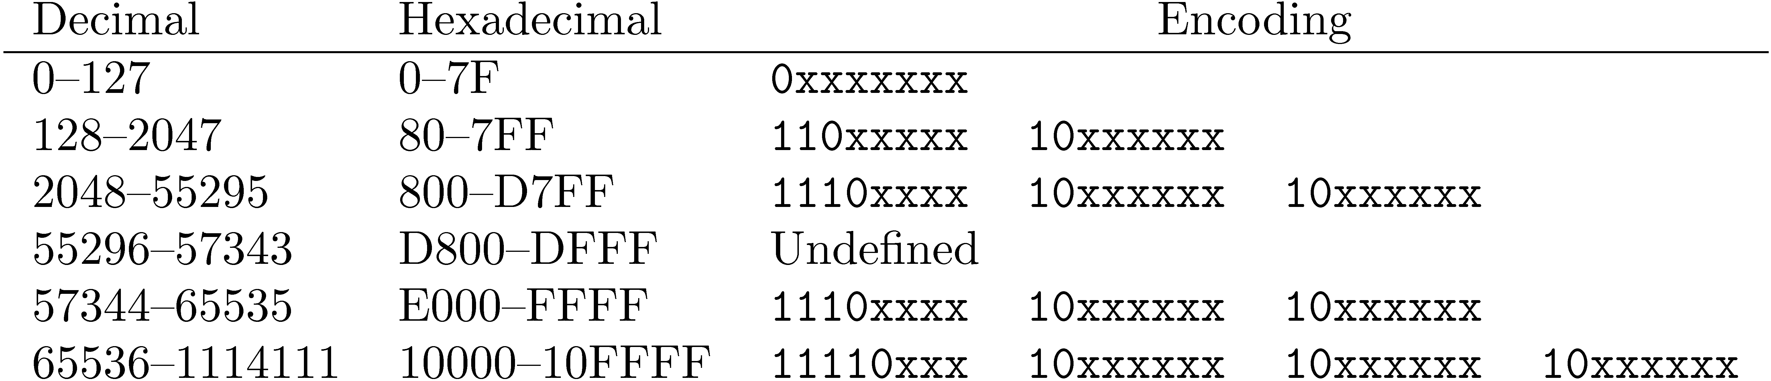
Unicode
  e.g., Greek letter pi (π) is Unicode symbol number 960
  In binary, 00000011 11000000 (3C0 in hexadecimal)
  Final encoding is 11001111 10000000 (CF80 in hexadecimal)

Slide 42

Storage

Slide 43
Storing the Documents
Many reasons to store converted document text
  saves crawling time when page is not updated
  provides efficient access to text for snippet generation, information extraction, etc.
Database systems can provide document storage for some applications
  web search engines use customized document storage systems

Slide 44
Storing the Documents
Requirements for document storage system:
  Random access
    request the content of a document based on its URL
    hash function based on URL is typical
  Compression and large files
    reducing storage requirements and efficient access
  Update
    handling large volumes of new and modified documents
    adding new anchor text

Slide 45
Large Files
Store many documents in large files, rather than each document in a file
  avoids overhead in opening and closing files
  reduces seek time relative to read time
Compound documents formats
  used to store multiple documents in a file
  e.g., TREC Web

Slide 46
TREC Web Format

Slide 47
Compression
Text is highly redundant (or predictable)
Compression techniques exploit this redundancy to make files smaller without losing any of the content
Compression of indexes covered later
Popular algorithms can compress HTML and XML text by 80%
  e.g., DEFLATE (zip, gzip) and LZW (UNIX compress, PDF)
  may compress large files in blocks to make access faster

Slide 48

Case Study

Slide 49
BigTable
Google’s document storage system
  Customized for storing, finding, and updating web pages
  Handles large collection sizes using inexpensive computers

Slide 50
Motivation: semi-structured data
Lots of (semi-)structured data at Google
  URLs:
    Contents, crawl metadata, links, anchors, pagerank, …
  Per-user data:
    User preference settings, recent queries/search results, …
  Geographic locations:
    Physical entities (shops, restaurants, etc.), roads, satellite image data, user annotations, …
Scale is large
  Billions of URLs, many versions/page (~20K/version)
  Hundreds of millions of users, thousands or q/sec
  100TB+ of satellite image data

Slide 51
BigTable
BigTable is a distributed storage system for managing structured data.
Designed to scale to a very large size
  Petabytes of data across thousands of servers
Used for many Google projects
  Web indexing, Personalized Search, Google Earth, Google Analytics, Google Finance, …

Slide 52
BigTable
No query language, no complex queries to optimize
Only row-level transactions
Tablets are stored in a replicated file system that is accessible by all BigTable servers
Any changes to a BigTable tablet are recorded to a transaction log, which is also stored in a shared file system
If any tablet server crashes, another server can immediately read the tablet data and transaction log from the file system and take over

Slide 53
BigTable
Logically organized into rows
A row stores data for a single web page
Combination of a row key, a column key, and a timestamp point to a single cell in the row

Slide 54
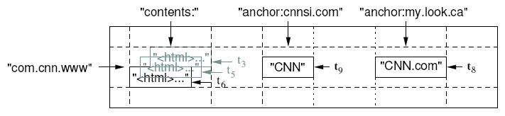
Basic Data Model
A BigTable is a sparse, distributed persistent multi-dimensional sorted map
(row, column, timestamp) -> cell contents
Good match for most Google applications

Slide 55
BigTable
BigTable can have a huge number of columns per row
  all rows have the same column groups
  not all rows have the same columns
  important for reducing disk reads to access document data
Rows are partitioned into tablets based on their row keys
  simplifies determining which server is appropriate

Slide 56
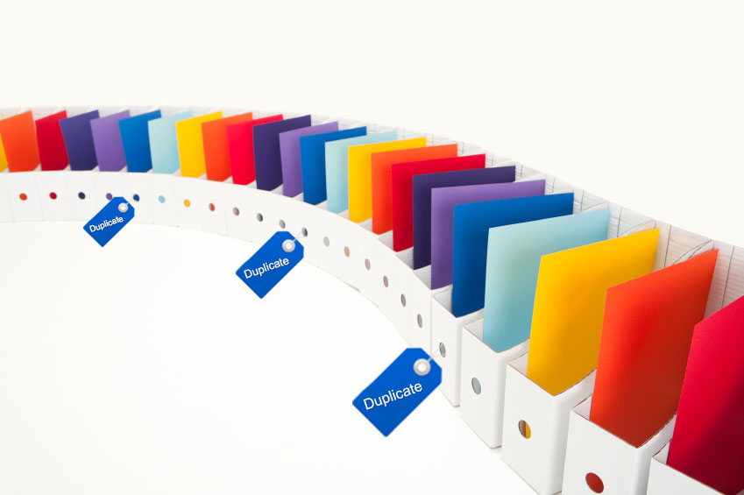
Detecting Duplicates

Slide 57
Detecting Duplicates
Duplicate and near-duplicate documents occur in many situations
  Copies, versions, plagiarism, spam, mirror sites
  30% of the web pages in a large crawl are exact, or
  near duplicates of pages in the other 70%
Duplicates consume significant resources during crawling, indexing, and search
  Little value to most users

Slide 58
Duplicate Detection
Exact duplicate detection is relatively easy
Checksum techniques
  A checksum is a value that is computed based on the content of the document
    e.g., sum of the bytes in the document file
  Possible for files with different text to have same checksum
Functions such as a cyclic redundancy check (CRC), have been developed that consider the positions of the bytes

Slide 59
Near-Duplicate Detection
More challenging task
  Are web pages with same text context but different advertising or format near-duplicates?
A near-duplicate document is defined using a threshold value for some similarity measure between pairs of documents
  e.g., document D1 is a near-duplicate of document D2 if more than 90% of the words in the documents are the same

Slide 60
Near-Duplicate Detection
Search:
  find near-duplicates of a document D
  O(N) comparisons required
Discovery:
  find all pairs of near-duplicate documents in the collection
  O(N²) comparisons
IR techniques are effective for search scenario
For discovery, other techniques used to generate compact representations

Slide 61
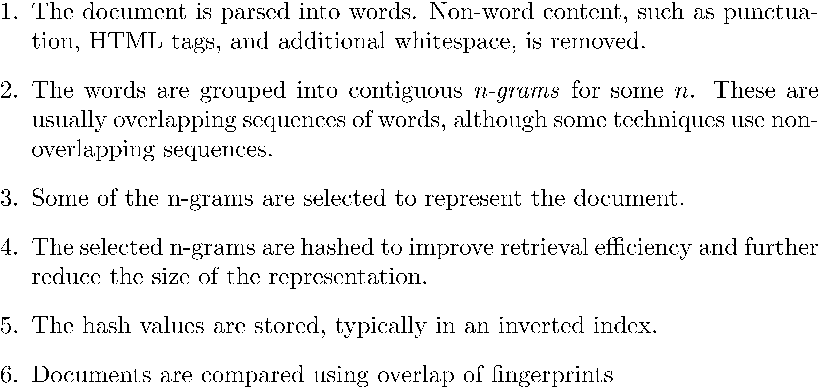
Fingerprints

Slide 62
Fingerprint Example

Slide 63
Simhash
Similarity comparisons using word-based representations more effective at finding near-duplicates
  Problem is efficiency
Simhash combines the advantages of the word-based similarity measures with the efficiency of fingerprints based on hashing
Similarity of two pages as measured by the cosine correlation measure is proportional to the number of bits that are the same in the simhash fingerprints

Slide 64
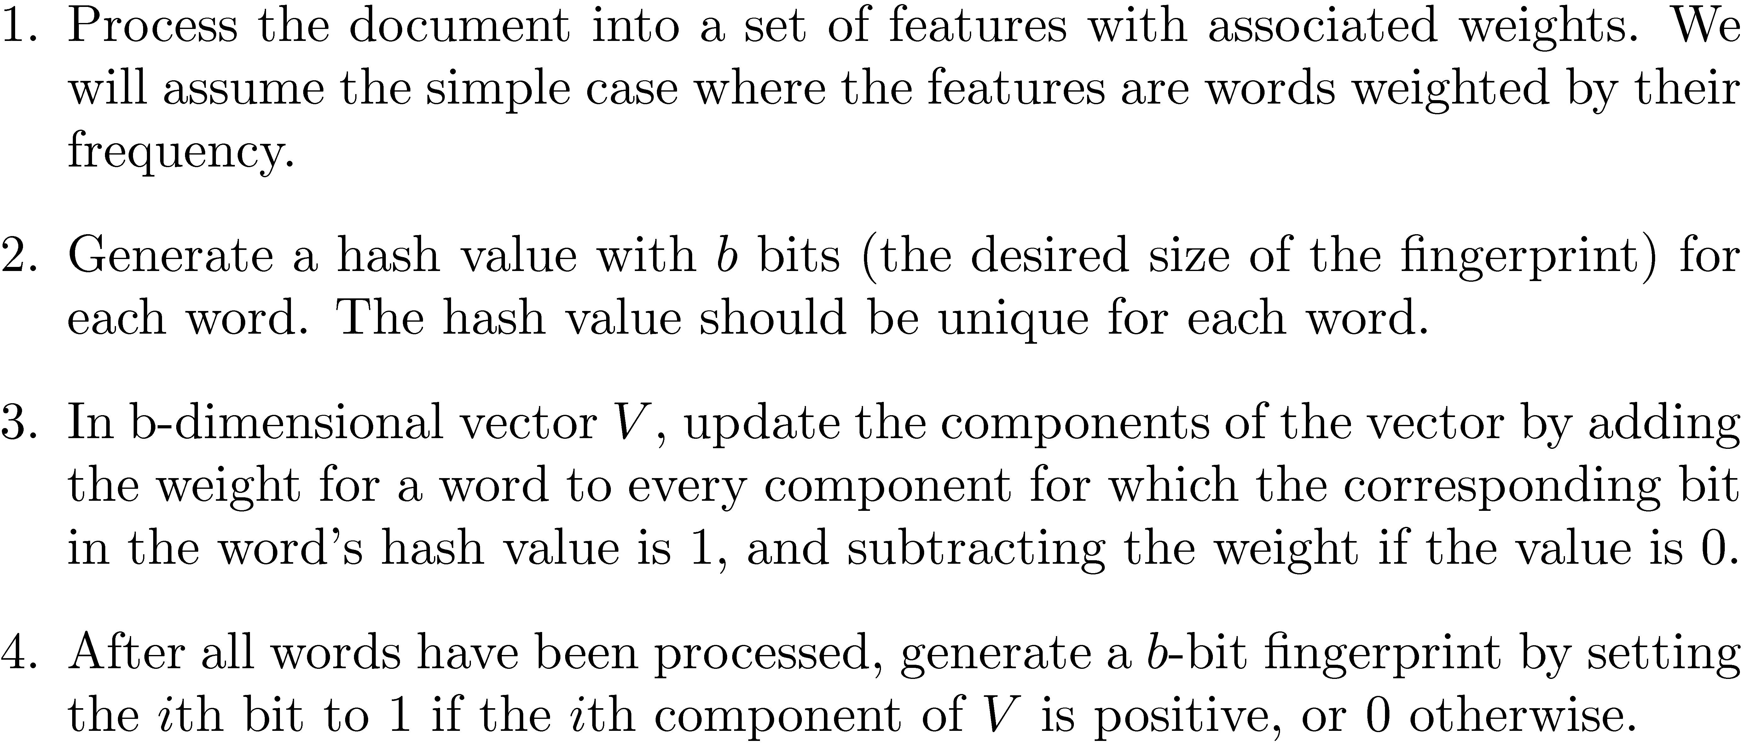
Simhash

Slide 65
Simhash Example

Slide 66
Detecting the Document Content

Slide 67
Removing Noise
Many web pages contain text, links, and pictures that are not directly related to the main content of the page
This additional material is mostly noise that could negatively affect the ranking of the page
Techniques have been developed to detect the content blocks in a web page
  Non-content material is either ignored or reduced in importance in the indexing process

Slide 68
Noise Example

Slide 69
Finding Content Blocks
Cumulative distribution of tags in the example web page
  Main text content of the page corresponds to the “plateau” in the middle of the distribution

Slide 70
Finding Content Blocks
Represent a web page as a sequence of bits, where b_{n} = 1 indicates that the nth token is a tag
Optimization problem where we find values of i and j to maximize both the number of tags below i and above j and the number of non-tag tokens between i and j
i.e., maximize

Slide 71
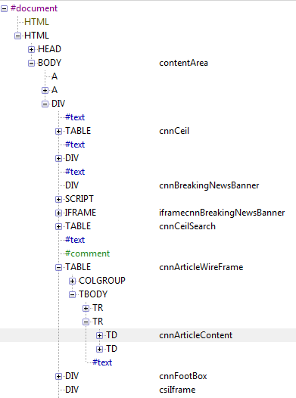
Finding Content Blocks
Other approaches use DOM structure and visual (layout) features

