Slide 1
Random Surfers on the Web Transition Matrix of the Web Dead Ends and Spider Traps Topic-Specific PageRank
PageRank
Information Retrieval in Practice
Slides from Mining Massive Data Sets at
http://web.stanford.edu/class/cs246/handouts.html

Slide 2
What Is Web Spam?
Spamming = any deliberate action solely in order to boost a Web page’s position in search-engine results.
Spam = Web pages that are the result of spamming.
SEO industry might disagree!
SEO = search engine optimization

Slide 3
Web Spam Taxonomy
Boosting techniques.
Techniques for achieving high relevance/importance for a Web page.
Hiding techniques.
Techniques to hide the use of boosting from humans and Web crawlers.

Slide 4
Boosting: Term Manipulation
Term spamming.
Manipulating the text of web pages in order to appear relevant to queries.

Slide 5
Term-Spamming Techniques
Repetition of terms, e.g., “Viagra,” in order to subvert TF.IDF-based rankings.
Dumping = adding large numbers of words to your page.
Example: run the search query you would like your page to match, and add copies of the top 10 pages.
Example: add a dictionary, so you match every search query.
Key hiding technique: words are hidden by giving them the same color as the background.

Slide 6
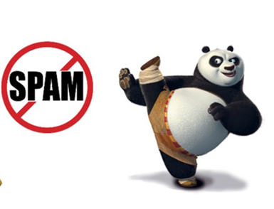

Slide 7
Need a Different Paradigm
Page Importance

Slide 8
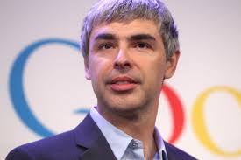
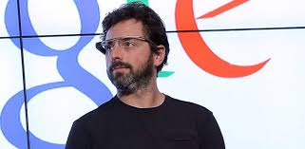
Inventors

Slide 9
Intuition – (1)
Web pages are important if people visit them a lot.
But, can we watch everybody using the Web?
A good surrogate for visiting pages is to assume people follow links randomly.
Leads to random surfer model:
Start at a random page and follow random out-links repeatedly, from whatever page you are at.
PageRank = limiting probability of being at a page.

Slide 10
Intuition – (2)
Solve the recursive equation:
a page is important to the extent that important pages link to it
Equivalent to the random-surfer definition of PageRank.
Technically, importance = the principal eigenvector of the transition matrix of the Web.
A few fixups needed.

Slide 11
Transition Matrix of the Web
Number the pages 1, 2,… .
Page i corresponds to row and column i.
M [i, j] = 1/n if page j links to n pages, including page i ; 0 if j does not link to i.
M [i, j] is the probability we’ll next be at page i if we are now at page j.

Slide 12


Example: Transition Matrix
Suppose page j links to 3 pages, including i but not x.
j
i
$$y= \frac{1}{2 }+\frac{1/2}{2 }$$
$$a= \frac{1/2}{2 }$$
$$m= \frac{1/2}{2 }$$
$$y= \frac{1}{2 }+\frac{1}{2 }$$
$$a= \frac{1}{2 }$$
$$m= \frac{1}{2 }$$
1/3
x
0

Slide 13
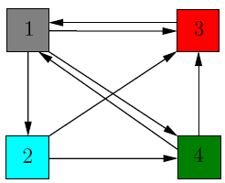
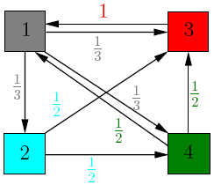
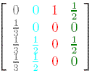
Example
Source: http://www.math.cornell.edu/~mec/Winter2009/RalucaRemus/Lecture3/lecture3.html

Slide 14
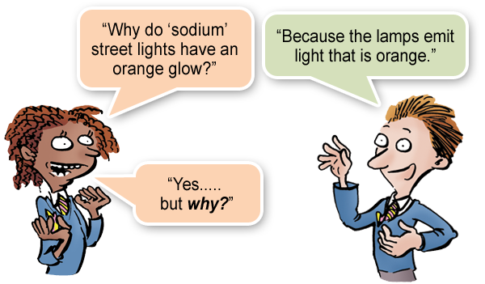
Random Walks on the Web
Suppose v is a vector whose i ^{th} component is the probability that a random walker is at page i at a certain time.
If a walker follows a link from i at random, the probability distribution for walkers is then given by the vector Mv.

Slide 15
Random Walks – (2)
Starting from any vector u, the limit M (M (…M (M u ) …)) is the long-term distribution of walkers.
Intuition: pages are important in proportion to how likely a walker is to be there.
The math: limiting distribution = principal eigenvector of M = PageRank.
Note: because M has each column summing to 1, the principal eigenvalue is 1.
Why? If v is the limit of MM…Mu, then v satisfies the equations v = Mv.

Slide 16
Running Example
y a m
Yahoo
y 1/2 1/2 0
a 1/2 0 1
m 0 1/2 0
Amazon
M’soft

Slide 17
Solving The Equations
Because there are no constant terms, the equations v = Mv do not have a unique solution.
In Web-sized examples, we cannot solve by Gaussian elimination anyway; we need to use relaxation (= iterative solution).
Works if you start with any nonzero u.

Slide 18
Simulating a Random Walk
Start with the vector u = [1, 1,…, 1] representing the idea that each Web page is given one unit of importance.
Note: it is more common to start with each vector element = 1/n, where n is the number of Web pages.
Repeatedly apply the matrix M to u, allowing the importance to flow like a random walk.
About 50 iterations is sufficient to estimate the limiting solution.

Slide 19


Example: Iterating Equations
Equations v = Mv:
y = y /2 + a /2
a = y /2 + m
m = a /2
y a m
Note: “=” is
really “assignment.”
y 1/2 1/2 0
a 1/2 0 1
m 0 1/2 0
$$y= \frac{1}{2 }+\frac{3/2}{2 }$$
$$a= \frac{1}{2 }+\frac{1}{2}$$
$$m= \frac{3/2}{2 }$$
$$y= \frac{1}{2 }+\frac{1}{2 }$$
$$a= \frac{1}{2 }+1$$
$$m= \frac{1}{2 }$$
y
a =
m
1
1
1
1
3/2
1/2
5/4
1
3/4
9/8
11/8
1/2
6/5
6/5
3/5
. . .

Slide 20
The Walkers
Yahoo
Amazon
M’soft

Slide 21
The Walkers
Yahoo
Amazon
M’soft

Slide 22
The Walkers
Yahoo
Amazon
M’soft

Slide 23
The Walkers
Yahoo
Amazon
M’soft

Slide 24
In the Limit …
Yahoo
Amazon
M’soft

Slide 25
Dead Ends Spider Traps Taxation Policies
The Web Is More Complex
Than That
Notes:
We’re now going to forget whether the sets we deal with come from shingled documents or any other source, and concentrate on the sets themselves. We’ll learn the formal definition of “similarity” that is commonly used for sets – this notion is called “Jaccard similarity.” We’ll then learn how to construct signatures from sets using the minhashing technique, and we’ll prove the strong relationship between the similarity of the signatures and the sets they represent.

Slide 26
Real-World Problems
Some pages are dead ends (have no links out).
Such a page causes importance to leak out.
Other groups of pages are spider traps (all out-links are within the group).
Eventually spider traps absorb all importance.

Slide 27
Microsoft Becomes Dead End
y a m
Yahoo
y 1/2 1/2 0
a 1/2 0 0
m 0 1/2 0
Amazon
M’soft

Slide 28
Example: Effect of Dead Ends
Equations v = Mv:
y = y /2 + a /2
a = y /2
m = a /2
$$y= \frac{1}{2 }+\frac{1/2}{2 }$$
$$a= \frac{1/2}{2 }$$
$$m= \frac{1/2}{2 }$$
$$y= \frac{1}{2 }+\frac{1}{2 }$$
$$a= \frac{1}{2 }$$
$$m= \frac{1}{2 }$$
y
a =
m
1
1
1
1
1/2
1/2
3/4
1/2
1/4
5/8
3/8
1/4
0
0
0
. . .

Slide 29
Microsoft Becomes a Dead End
Yahoo
Amazon
M’soft

Slide 30
Microsoft Becomes a Dead End
Yahoo
Amazon
M’soft

Slide 31
Microsoft Becomes a Dead End
Yahoo
Amazon
M’soft

Slide 32
Microsoft Becomes a Dead End
Yahoo
Amazon
M’soft

Slide 33
In the Limit …
Yahoo
Amazon
M’soft

Slide 34
M’soft Becomes Spider Trap
y a m
Yahoo
y 1/2 1/2 0
a 1/2 0 0
m 0 1/2 1
Amazon
M’soft

Slide 35
Example: Effect of Spider Trap
Equations v = Mv:
y = y /2 + a /2
a = y /2
m = a /2 + m
y
a =
m
1
1
1
1
1/2
3/2
3/4
1/2
7/4
5/8
3/8
2
0
0
3
. . .

Slide 36
Microsoft Becomes a Spider Trap
Yahoo
Amazon
M’soft

Slide 37
Microsoft Becomes a Spider Trap
Yahoo
Amazon
M’soft

Slide 38
Microsoft Becomes a Spider Trap
Yahoo
Amazon
M’soft

Slide 39
In the Limit …
Yahoo
Amazon
M’soft

Slide 40
PageRank Solution to Traps, Etc.
“Tax” each page a fixed percentage at each iteration.
Add a fixed constant to all pages.
Optional but useful: add exactly enough to balance the loss (tax + PageRank of dead ends).
Models a random walk with a fixed probability of leaving the system, and a fixed number of new walkers injected into the system at each step.
Divided equally among all pages.

Slide 41
Example: Microsoft is a Spider Trap; 20% Tax
Equations v = 0.8(Mv) + 0.2:
y = 0.8(y/2 + a/2) + 0.2
a = 0.8(y/2) + 0.2
m = 0.8(a/2 + m) + 0.2
y
a =
m
1
1
1
1.00
0.60
1.40
0.84
0.60
1.56
0.776
0.536
1.688
7/11
5/11
21/11
. . .

Slide 42
Teleport Sets
Assume each walker has a small probability of “teleporting” at any tick.
Teleport can go to:
Any page with equal probability.
As in the “taxation” scheme.
A set of “relevant” pages (teleport set).
For topic-specific PageRank.

Slide 43
Picking the Teleport Set
Choose the pages belonging to the topic in Open Directory.
“Learn,” from a training set, the typical words in pages belonging to the topic; use pages heavy in those words as the teleport set.

Slide 44
Application: Link Spam
Spam farmers create networks of millions of pages designed to focus PageRank on a few undeserving pages.
To minimize their influence, use a teleport set consisting of trusted pages only.
Example: home pages of universities.

Slide 45
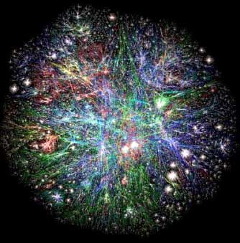
PageRank at Web Scale
Web graph
How do we compute PageRank for graph of such scale?

Slide 46
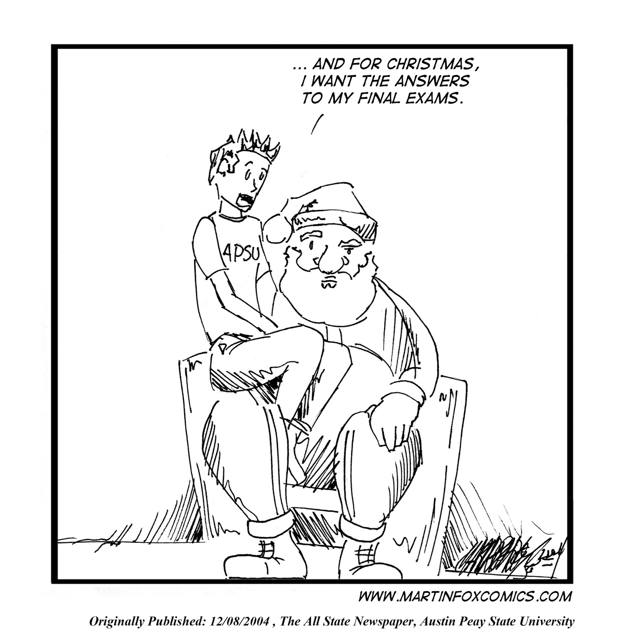
Final Exam Questions

