Slide 1
Brief Introduction to Hadoop
CIS 5517 – Data Intensive and Cloud Computing
Reading: Chapter 3 from Hadoop: The Definitive Guide: Tom White

Slide 2
Key Questions to Answer
Why Hadoop?
What is Hadoop?
How to Hadoop?
Examples of Hadoop

Slide 3
Why is Hadoop ?

Slide 4
How much data is there?
Lots of data have been collected and stored: web, scientific data, ecommerce transactions, digital media, financial institutes, social network…
The amount of data in the world was estimated to be 44 zettabytes at the dawn of 2020.
By 2025, the amount of data generated each day is expected to reach 463 exabytes globally.
Google, Facebook, Microsoft, and Amazon store at least 1,200 petabytes of information.
By 2025, there would be 75 billion Internet-of-Things (IoT) devices in the world.
1T=2⁴⁰
1P=2⁵⁰
1E=2⁶⁰
1Z=2⁷⁰
Source: https://seedscientific.com/how-much-data-is-created-every-day/, accessed 9/26/2024

Slide 5
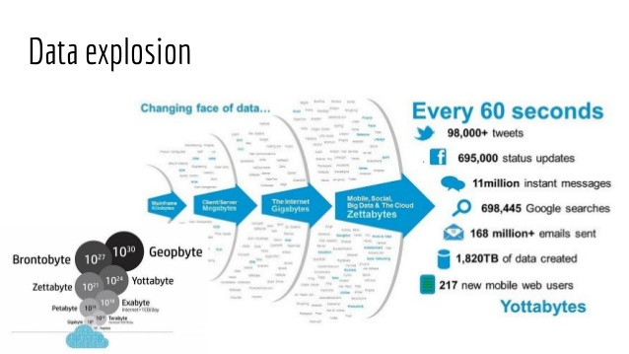
Source: slideshare.net

Slide 6
Big data challenges
Knowledge discovery from large and fast growing datasets is challenging. With rapid advancement and sophistication of experiment instrumentation, data is being generated at a high speed unprecedented in history.
High variety of big data in data types, representation, and semantic interpretation makes general-purpose storage systems or conventional databases unacceptably inefficient and slow. The design for systems support for big data analytics must be semantics- and application-aware.
As the size and complexity of storage systems scale up to accommodate big data, the frequency of hardware, system or software failures grows proportionally.

Slide 7
How big is big?
2008: Google processes 20 PB a day
2009: Facebook has 2.5 PB user data + 15 TB /day
2011: Yahoo! has 180-200 PB of data
2012: Facebook ingests 500 TB/day
2013: YouTube 1000 PB video storage; 4 billion views/day
1 PB=10^3 TB=10^6 GB=10^15 B
1 Exabyte = 1000 PB
Zettabyte, Yottabyte …
Notes:
alphabets

Slide 8
Motivation: Google Example
20+ billion web pages x 20KB = 400+ TB
1 computer reads 30-35 MB/sec from disk
~4 months to read the web
~1,000 hard drives to store the web
Takes even more to do something useful with the data!
Today, a standard architecture for such problems is emerging:
Cluster of commodity Linux nodes
Commodity network (ethernet) to connect them

Slide 9
Who is generating Big Data?

Slide 10
How about 4 years ago?

Slide 11
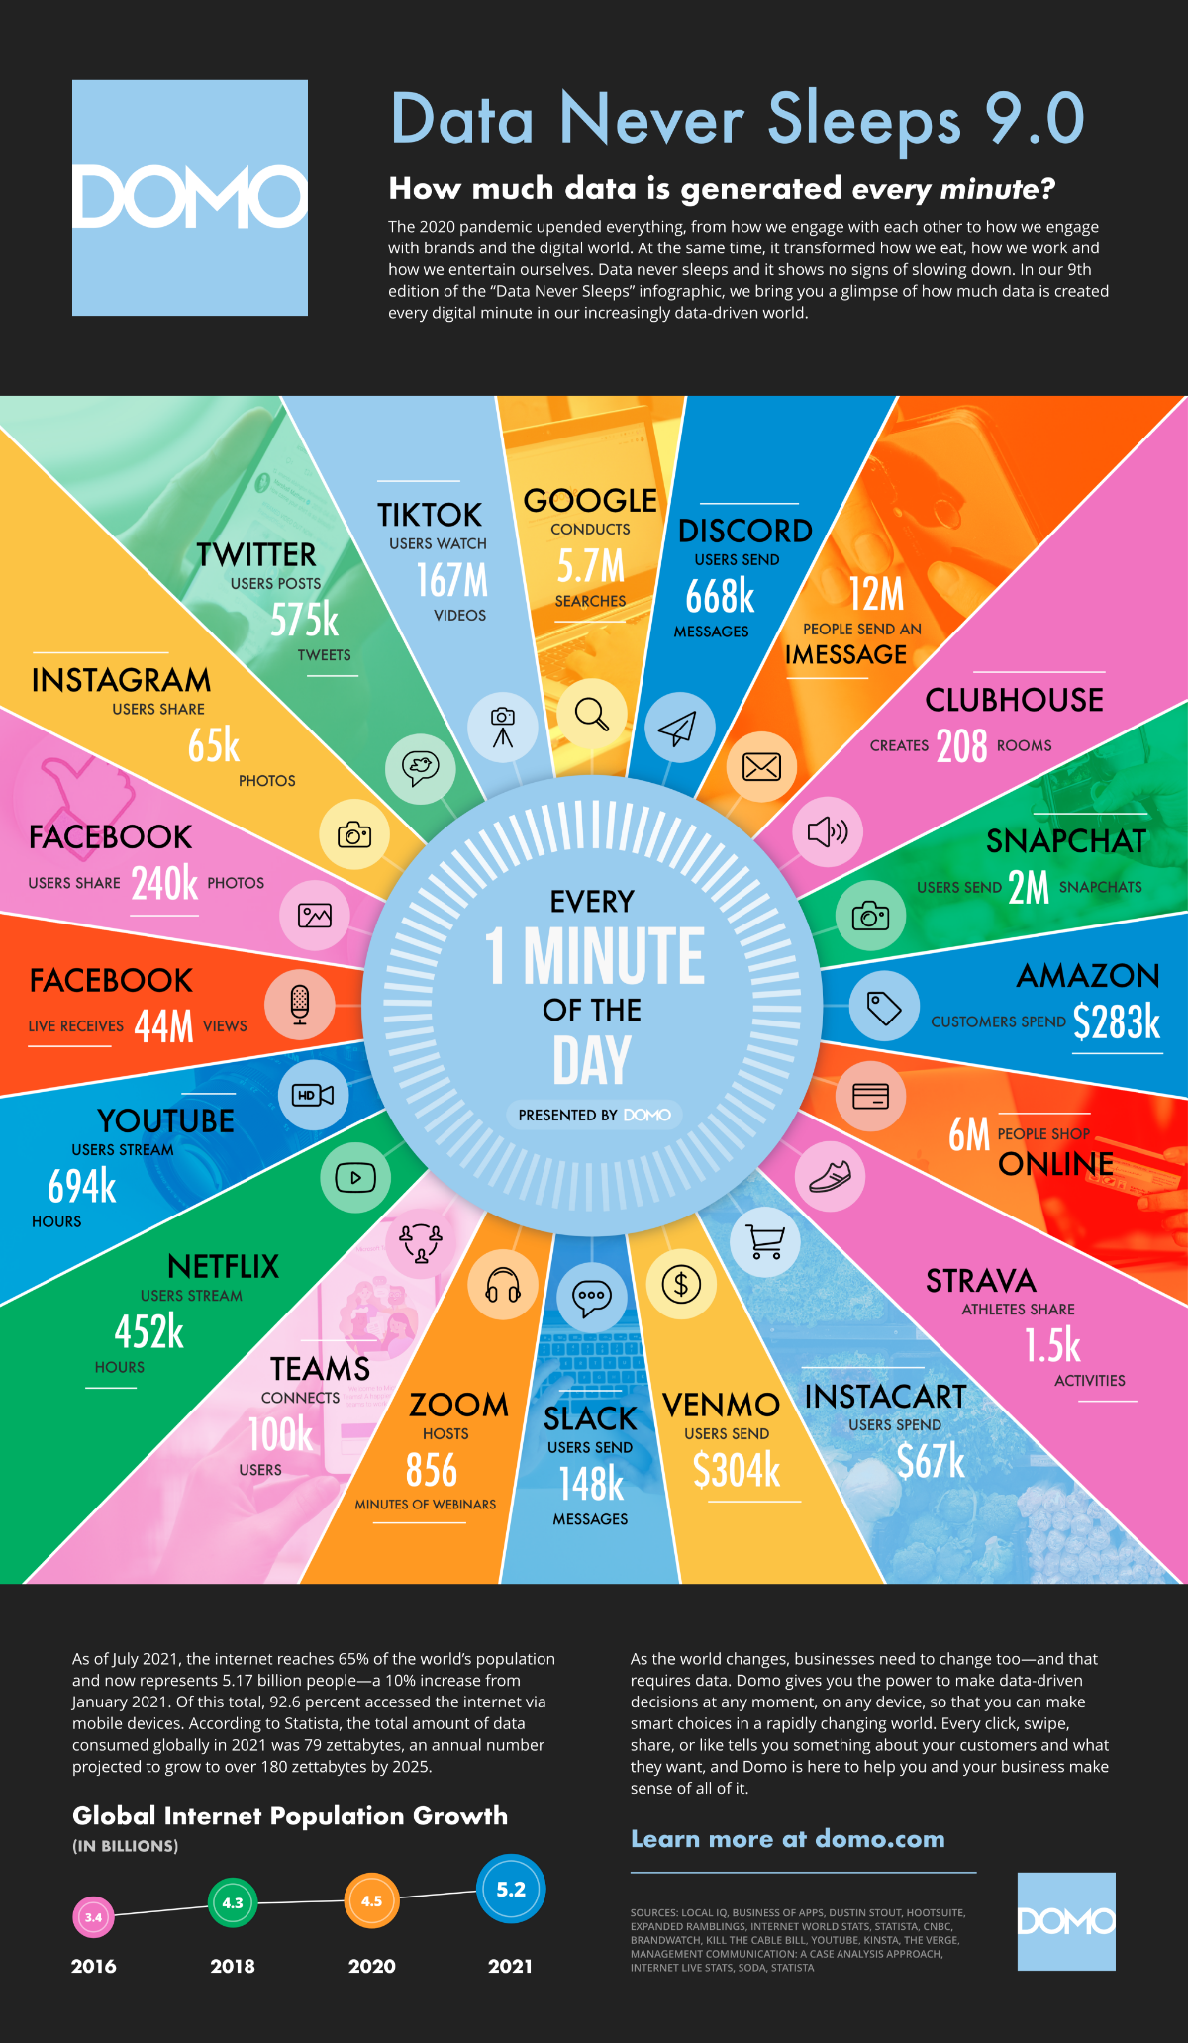
Who is generating Big Data?

Slide 12
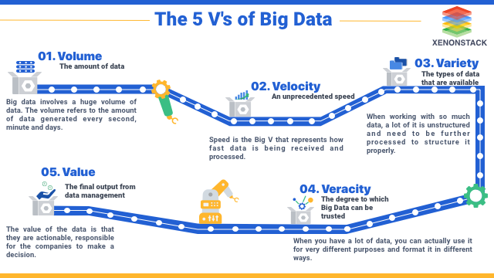
What are Key Features of Big Data?

Slide 13
Large-scale Computing
Large-scale computing for data analytics problems on commodity hardware
Challenges:
How do you distribute computation?
How can we make it easy to write distributed programs?
Machines fail:
One server may stay up 3 years (1,000 days)
If you have 1,000 servers, expect to loose 1/day
People estimated Google had ~1M machines in 2011
1,000 machines fail every day!
Gartner estimated in a July 2016 report that Google at the time had 2.5 million servers

Slide 14
Philosophy to Scale for Big Data?

Slide 15
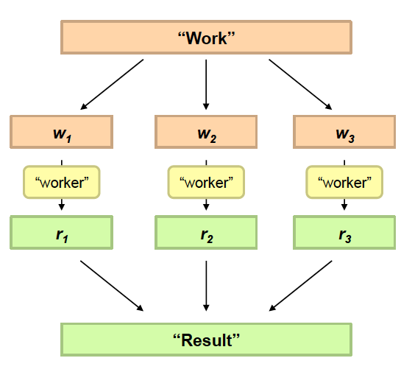
Divide and Conquer
Divide Work
Combine Results

Slide 16
Idea and Solution
Issue: Copying data over a network takes time
Idea:
Bring computation close to the data
Store files multiple times for reliability
Map-reduce addresses these problems
Google’s computational/data manipulation model
Elegant way to work with big data
Storage Infrastructure – File system
Google: GFS. Hadoop: HDFS
Programming model
Map-Reduce

Slide 17
Distributed processing is non-trivial
How to assign tasks to different workers in an efficient way?
What happens if tasks fail?
How do workers exchange results?
How to synchronize distributed tasks allocated to different workers?

Slide 18
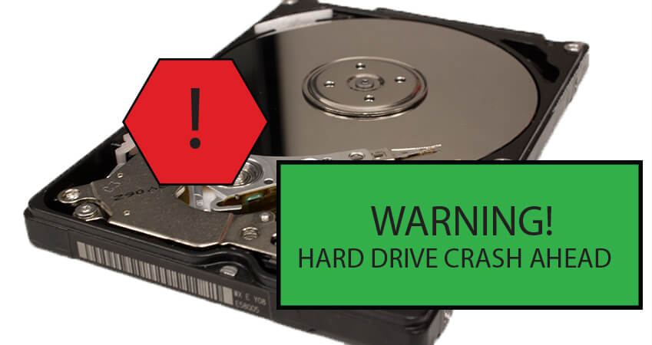
Big data storage is challenging
Data Volumes are massive
Reliability of Storing PBs of data is challenging
All kinds of failures: Disk/Hardware/Network Failures
Probability of failures simply increase with the number of machines …

Slide 19
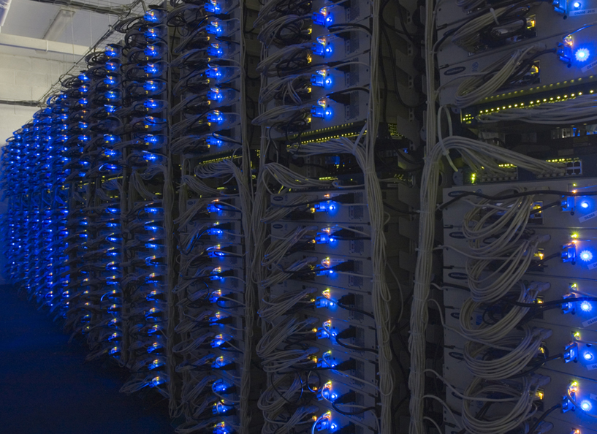
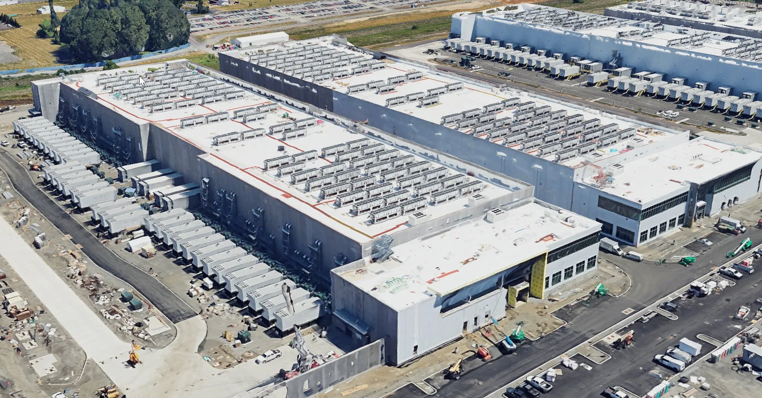

Slide 20
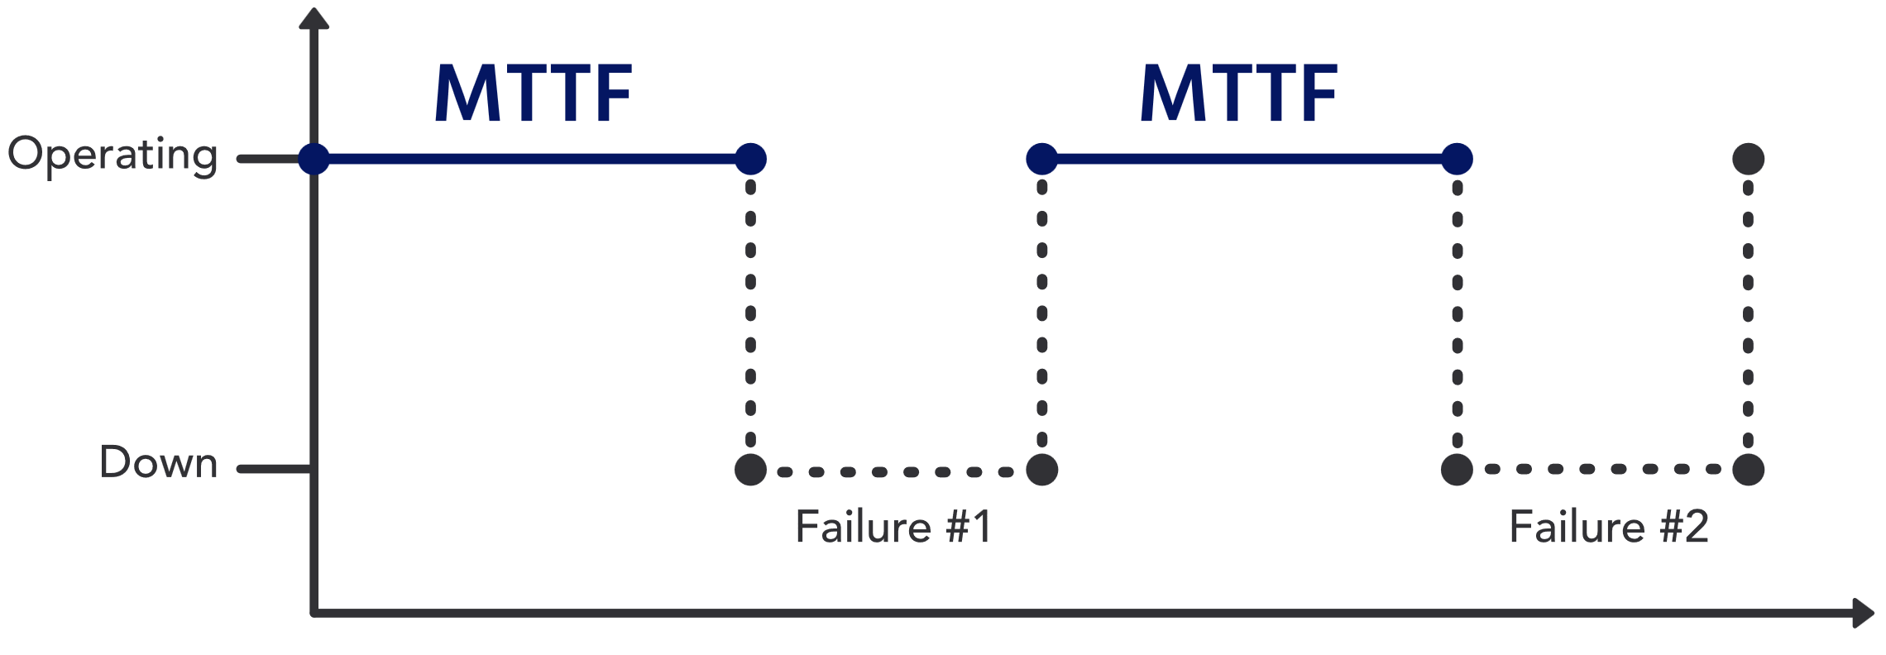
Notes on Reliability
Mean Time to Failure
MTTF is a measure of the average time a non-repairable asset or component is expected to function before it fails.
$MTTF=\frac{Total Operating Time}{Number of Items}$
Example: a data center with 1,000 hard drives. Over a period of 5 years (or approximately 43,800 hours), the data center experiences 50 hard drive failures.
$MTTF=\frac{1000 x 43,800}{50}=\text{876,000 }\text{hours}$
On average a disk will last for 876,000 hours in that data center.

Slide 21
MTTF and Failure Rate
Failure Rate = $\frac{1}{MTTF}$
$MTTF=\frac{1}{43,800}$ failures per hour per HDD
$MTTF=1000\frac{1}{43,800}=\frac{1}{43,8 hours}$
the data center can expect approximately 1 HDD failure every 43.8 hours across its 1,000 drives.

Slide 22
Availability
MTTR = Mean Time to Repair
Availability= $\frac{MTTF}{MTTF+MTTR}$
Suppose it takes 5 hours to replace an HDD
Availability one disk$A_{HDD}=\frac{43,800}{43,800+5}=.9998$ very high
${A_{DC}=A}_{HDD}^{1000}={.9998}^{1000}=0.00004317$ assuming no-redundancy
Data centers typically use redundancy, and hot-swappable drives to ensure uninterrupted service, so overall system availability is much higher than that of individual disks.

Slide 23
Storage Infrastructure
Problem:
If nodes fail, how to store data persistently?
Answer:
Distributed File System:
Provides global file namespace
Google GFS; Hadoop HDFS;
Typical usage pattern
Huge files (100s of GB to TB)
Data is rarely updated in place
Reads and appends are common

Slide 24
Hadoop offers
Redundant, Fault-tolerant data storage
Parallel computation framework
Job coordination

Slide 25
Hadoop offers
Redundant, Fault-tolerant data storage
Parallel computation framework
Job coordination
Q: Where file is located?
No longer need to worry about
Q: How to handle failures & data lost?
Q: How to divide computation?
Programmers
Q: How to program for scaling?

Slide 26
A real world example of New York Times
Goal: Make entire archive of articles available online: 11 million, from 1851
Task: Translate 4 TB TIFF images to PDF files
Solution: Used Amazon Elastic Compute Cloud (EC2) and Simple Storage System (S3)
Time: ?
Costs: ?
Notes:
New York Times Faced Challenge in 2007:
Challenging and Complicated Computing Chore
http://www.greenm3.com/gdcblog/2008/11/5/nytimes-aws-cloud-computing-mistake-cost-240.html

Slide 27
A real world example of New York Times
Goal: Make entire archive of articles available online: 11 million, from 1851
Task: Translate 4 TB TIFF images to PDF files
Solution: Used Amazon Elastic Compute Cloud (EC2) and Simple Storage System (S3)
Time: < 24 hours
Costs: $240
Notes:
New York Times Faced Challenge in 2007:
Challenging and Complicated Computing Chore
http://www.greenm3.com/gdcblog/2008/11/5/nytimes-aws-cloud-computing-mistake-cost-240.html

Slide 28
So we are

Slide 29
A little history on Hadoop
Hadoop is an open-source implementation based on Google File System (GFS) and MapReduce from Google
Hadoop was created by Doug Cutting and Mike Cafarella in 2005
Hadoop was donated to Apache in 2006

Slide 30
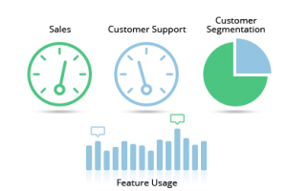
Who are using Hadoop?
Social
User Tracking & Engagement
Homeland Security
eCommerce
Financial Services
Real Time Search
https://wiki.apache.org/hadoop/PoweredBy

Slide 31
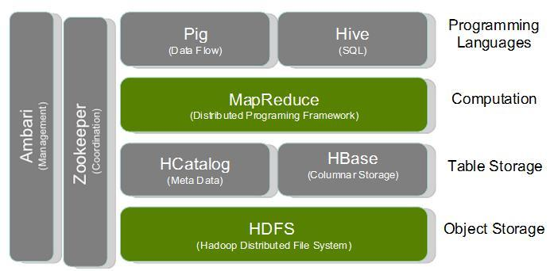
Hadoop Stack

Slide 32
Hadoop Resources
Apache Hadoop Documentation:
http://hadoop.apache.org/docs/current/
Data Intensive Text Processing with Map-Reduce
http://lintool.github.io/MapReduceAlgorithms/
Hadoop Definitive Guide:
http://www.amazon.com/Hadoop-Definitive-Guide-Tom-White/dp/1449311520

Slide 33
HDFS Hadoop Distributed File System

Slide 34
HDFS Outline
Motivation
Architecture and Concepts
Inside
User Interface

Slide 35
Motivation Questions
Problem 1: Data is too big to store on one machine.
HDFS: Store the data on multiple machines!

Slide 36
Motivation Questions
Problem 2: Very high end machines are too expensive
HDFS: Run on commodity hardware!

Slide 37
Motivation Questions
Problem 3: Commodity hardware will fail!
HDFS: Software is intelligent enough to handle hardware failure!
Notes:
1%-10%-100%

Slide 38
Motivation Questions
Problem 4: What happens to the data if the machine stores the data fails?
HDFS: Replicate the data!

Slide 39
Motivation Questions
Problem 5: How can distributed machines organize the data in a coordinated way?
HDFS: Master-Slave Architecture!

Slide 40
HDFS Architecture: Master-Slave
Master
Name Node: Controller
File System Name Space Management
Block Mappings
Data Node: Work Horses
Block Operations
Replication
Secondary Name Node:
Checkpoint node
Name Node (NN)
Secondary Name Node (SNN)
Data Node (DN)
Slaves
Single Rack Cluster

Slide 41
Distributed File System
Chunk servers
File is split into contiguous chunks
Typically each chunk is 16-64MB
Each chunk replicated (usually 2x or 3x)
Try to keep replicas in different racks
Master node
a.k.a. Name Node in Hadoop’s HDFS
Stores metadata about where files are stored
Might be replicated
Client library for file access
Talks to master to find chunk servers
Connects directly to chunk servers to access data

Slide 42
Distributed File System
Reliable distributed file system
Data kept in “chunks” spread across machines
Each chunk replicated on different machines
Seamless recovery from disk or machine failure
C₀
C₁
D₀
C₁
C₂
C₅
C₀
C₅
…
C₅
Chunk server 1
C₂
C₅
Chunk server 2
C₃
D₀
Chunk server 3
D₁
D₀
Chunk server N
C₂
Bring computation directly to the data!
Chunk servers also serve as compute servers
Notes:
42

Slide 43
HDFS Architecture: Master-Slave
Multiple-Rack Cluster
Switch
Switch
Name Node (NN)
Secondary Name Node (SNN)
Data Node (DN)
Data Node (DN)
Data Node (DN)
Rack 1
Rack 2
. . .
Rack N

Slide 44
HDFS Architecture: Master-Slave
Multiple-Rack Cluster
Reliable Storage
Switch
Switch
I know all blocks and replicas!
NN will replicate lost blocks in another node ☺
Name Node (NN)
Secondary Name Node (SNN)
Data Node (DN)
Data Node (DN)
Data Node (DN)
Rack 1
Rack 2
. . .
Rack N

Slide 45
HDFS Architecture: Master-Slave
Multiple-Rack Cluster
Rack Awareness
Switch
Switch
I know the topology of the cluster!
NN will replicate lost blocks across racks ☺
Name Node (NN)
Secondary Name Node (SNN)
Data Node (DN)
Data Node (DN)
Data Node (DN)
Rack 1
Rack 2
. . .
Rack N

Slide 46
HDFS Architecture: Master-Slave
Multiple-Rack Cluster
Switch
Switch
Do not ask me, I am down ☹
Single Point of Failure
Name Node (NN)
Secondary Name Node (SNN)
Data Node (DN)
Data Node (DN)
Data Node (DN)
Rack 1
Rack 2
. . .
Rack N

Slide 47
HDFS Architecture: Master-Slave
Multiple-Rack Cluster
How about network performance?
Switch
Switch
Keep bulky communication within a rack!
Name Node (NN)
Secondary Name Node (SNN)
Data Node (DN)
Data Node (DN)
Data Node (DN)
Rack 1
Rack 2
. . .
Rack N

Slide 48
HDFS Inside: Name Node
Name Node
Snapshot of FS
Edit log: record changes to FS
Filename | Replication factor | Block ID
File 1 | 3 | [1, 2, 3]
File 2 | 2 | [4, 5, 6]
File 3 | 1 | [7,8]
Data Nodes
1, 2, 5, 7,
4, 3
1, 5, 3,
2, 8, 6
1, 4, 3,
2, 6

Slide 49
HDFS Inside: Name Node
Name Node
Periodically
Secondary Name Node
FS image
FS image
Edit log
Edit log
How to detect failures?
House Keeping
Backup NN Meta Data
Reply
(Control Info.
Embedded)
Data Nodes
Notes:
Heart beating every 3 seconds. If NN does not hear from DN in 10 mins, it starts to replicate the blocks

Slide 50
HDFS Inside: Blocks
Q: Why do we need the abstraction “Blocks” in addition to “Files”?
Reasons:
File can be larger than a single disk
Block is of fixed size, easy to manage and manipulate
Easy to replicate and do more fine grained load balancing

Slide 51
HDFS Inside: Blocks
HDFS Block size is by default 64 MB, why it is much larger than regular file system block?
Reasons:
Minimize overhead: disk seek time is almost constant
Example: seek time: 10 ms, file transfer rate: 100MB/s, overhead (seek time/a block transfer time) is 1%, what is the block size?
100 MB (HDFS-> 128 MB)
Notes:
HDFS block is 32K times larger than regular file system

Slide 52
HDFS Inside: Read
1
Name Node
Client
2
3
4
DN1
DN2
DN3
. . .
DNn
Client connects to NN to read data
NN tells client where to find the data blocks
datanodes are sorted according to their proximity to the client.
Client reads blocks directly from data nodes (without going through NN)
In case of node failures, client connects to another node that serves the missing block
Notes:
Analogy: Name Node is like the Index cards in library. When you borrow a book, go to find its index in the central place and then go to book shelves and find those books

Slide 53
HDFS Inside: Read
Q: Why does HDFS choose such a design for read? Why not ask client to read blocks through NN?
Reasons:
Prevent NN from being the bottleneck of the cluster
Allow HDFS to scale to large number of concurrent clients
Spread the data traffic across the cluster

Slide 54
HDFS Inside: Read
Q: Given multiple replicas of the same block, how does NN decide which replica the client should read?
HDFS Solution:
Rack awareness based on network topology

Slide 55
HDFS Inside: Network Topology
The critical resource in HDFS is bandwidth
the rate at which we can transfer data between nodes
distance is defined based on that
Measuring bandwidths between any pair of nodes is too complex and does not scale
Basic Idea:
Processes on the same node
Different nodes on the same rack
Nodes on different racks in the same
data center (cluster)
Nodes in different data centers
Bandwidth becomes less and less
Notes:
scarece

Slide 56
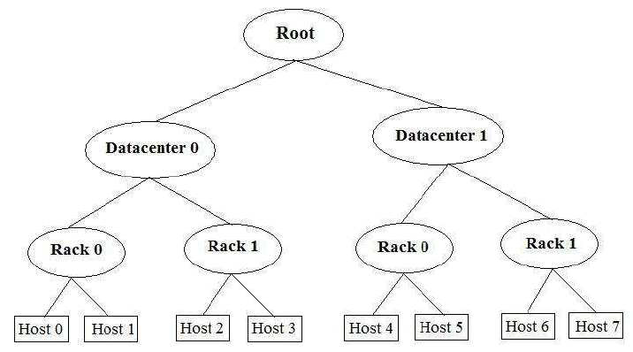
HDFS Topology

Slide 57
HDFS Inside: Network Topology
HDFS takes a simple approach:
See the network as a tree
Distance between two nodes is the sum of their distances to their closest common ancestor
Rack 1
Rack 2
Rack 3
Rack 4
n1
n3
n5
n7
n2
n4
n6
n8
Data center 1
Data center 2
Notes:
Do a short excise

Slide 58
HDFS Inside: Network Topology
What are the distance of the following pairs:
Dist (d1/r1/n1, d1/r1/n1)=
Dist(d1/r1/n1, d1/r1/n2)=
Dist(d1/r1/n1, d1/r2/n3)=
Dist(d1/r1/n1, d2/r3/n6)=
0
2
4
6
Rack 1
Rack 2
Rack 3
Rack 4
n1
n3
n5
n7
n2
n4
n6
n8
Data center 1
Data center 2
Notes:
Do a short excise

Slide 59
HDFS Inside: Write
1
Name Node
Client
2
4
3
DN1
DN2
DN3
. . .
DNn
Client connects to NN to write data
NN tells client write these data nodes
Client writes blocks directly to data nodes with desired replication factor
In case of node failures, NN will figure it out and replicate the missing blocks
Notes:
Q: what happens if a node fails during write?

Slide 60
HDFS Inside: Write
Q: Where should HDFS put the three replicas of a block? What tradeoffs we need to consider?
Tradeoffs:
Reliability
Write Bandwidth
Read Bandwidth
Q: What are some possible strategies?

Slide 61
HDFS Inside: Write
Replication Strategy vs Tradeoffs
 | Reliability | Write Bandwidth | Read Bandwidth
Put all replicas on one node
Put all replicas on different racks

Slide 62
HDFS Inside: Write
Replication Strategy vs Tradeoffs
 | Reliability | Write Bandwidth | Read Bandwidth
Put all replicas on one node
Put all replicas on different racks
HDFS: 1-> same node as client 2-> a node on different rack 3-> a different node on the same rack as 2

Slide 63
HDFS Interface
Web Based Interface
http://ccl.cse.nd.edu/operations/hadoop/
Command Line: Hadoop FS Shell
https://hadoop.apache.org/docs/r2.4.1/hadoop-project-dist/hadoop-common/FileSystemShell.html

Slide 64
Installation
Hadoop supports Linux and Windows
Easy to install and set up on Linux
Windows supported well in Hadoop 2 and after
Can use virtual machine to run locally
Requires several pieces of software
Java 1.6 and above
ssh/sshd
Cygwin (for Windows shell support)

Slide 65
Installation on EC2
Create a cluster
Using prebuilt or custom AMI
Distribute Hadoop to the cluster
Similar to single node setup, but for each node in the cluster
Configure Master node(s) for NameNode, Secondary NameNode and ResourceManager
Configure Slave node(s) for NodeManager and DataNode
A step by step guide is posted in the course canvas.

Slide 66
Distributing Hadoop to EC2 cluster
If using a custom AMI, have Hadoop preloaded
Distribute common configuration files instead
Create configuration locally and use scp to push to each instance
If using a public AMI without Hadoop, distribute entire Hadoop install
Include configuration in scp-based push
Bandwidth expensive and inefficient
http://hadoop.apache.org/docs/r2.7.3/hadoop-project-dist/hadoop-common/ClusterSetup.html

Slide 67
A video on Hadoop
Demystifying Hadoop, ~22 minutes

Slide 68
Try these offline:
Configure Hadoop on AWS
Remember to stop Hadoop and your instances when you are finished
Use EBS or S3 to save your persistent changes
Don’t forget to make local copies of debugging results
Documentation
Hadoop control commands

Slide 69
Useful links
Apache Hadoop: http://hadoop.apache.org/
MapReduce Tutorial
Analyzing bigdata with Amazon EMR
If you have problem with the instruction on setting up single-node cluster use the following link:
http://hadoop.apache.org/docs/r2.7.3/hadoop-project-dist/hadoop-common/SingleCluster.html#Pseudo-Distributed_Operation
If you have problem with configuring a multi-cluster setup, follow:
http://pingax.com/install-apache-hadoop-ubuntu-cluster-setup/
http://hadoop.apache.org/docs/r2.7.3/hadoop-project-dist/hadoop-common/ClusterSetup.html
If you are not confident enough to try setting Hadoop on AWS, then first try on your local machine
User VirtualBox (for Windows or Mac) or KVM (for Linux) with Ubuntu image to create VM and try setting up Hadoop in the VM(s)

Slide 70
References
The original paper on HDFS published in the IEEE MSST conference [2010]
https://storageconference.us/2010/Papers/MSST/Shvachko.pdf
The original paper on Google File System published in SOSP conference [2003]
https://static.googleusercontent.com/media/research.google.com/en//archive/gfs-sosp2003.pdf
A presentation on HDFS:
https://cse.buffalo.edu/~okennedy/courses/cse704fa2012/2.2-HDFS.pptx
Hadoop and HDFS:
https://hadoop.apache.org/docs/current/hadoop-project-dist/hadoop-hdfs/HdfsDesign.html
Introduction to HDFS:
https://www.ibm.com/developerworks/library/wa-introhdfs/index.html
MapReduce: Simplified Data Processing on Large Clusters, OSDI’2014
https://research.google.com/archive/mapreduce-osdi04.pdf

Slide 71
Hadoop Lecture 1 Summary
Big Data and Hadoop background
What and Why about Hadoop
4 V challenge of Big Data
Hadoop Distributed File System (HDFS)
Motivation: guide Hadoop design
Architecture: Single rack vs Multi-rack clusters
Reliable storage, Rack-awareness, Throughput
Inside: Name Node file system, Read, Write
Interface: Web and Command line

