Slide 1

Course website:
  https://cis.temple.edu/~edragut/5517/Spr24/teaching.ht
  Text Book(s)
Workload
Intended Schedule
Projects
  Grading
Reading List

Slide 2
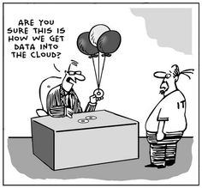

Slide 3
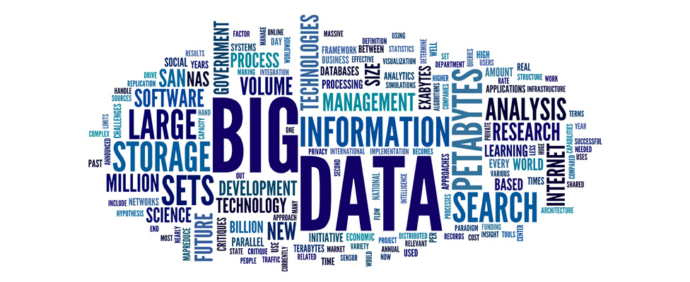
Motivations for the Course:
Data Is Driving Everything
Modern data acquisition is inexpensive!
  Smartphones, embedded systems, inexpensive sensors,
  Medical devices, simulators, …
Data storage is inexpensive!
Parallel (compute cluster) computation is inexpensive
  The Cloud, clusters of computers, GPUs, tensor processors, …
Science only has explanatory and predictive models in a few (mostly physical sciences-related) domains
... So: can we use algorithms + data to understand phenomena? Build or augment models? Build detectors? Make diagnoses?
Notes:
Up next: Buzz Words

Slide 4
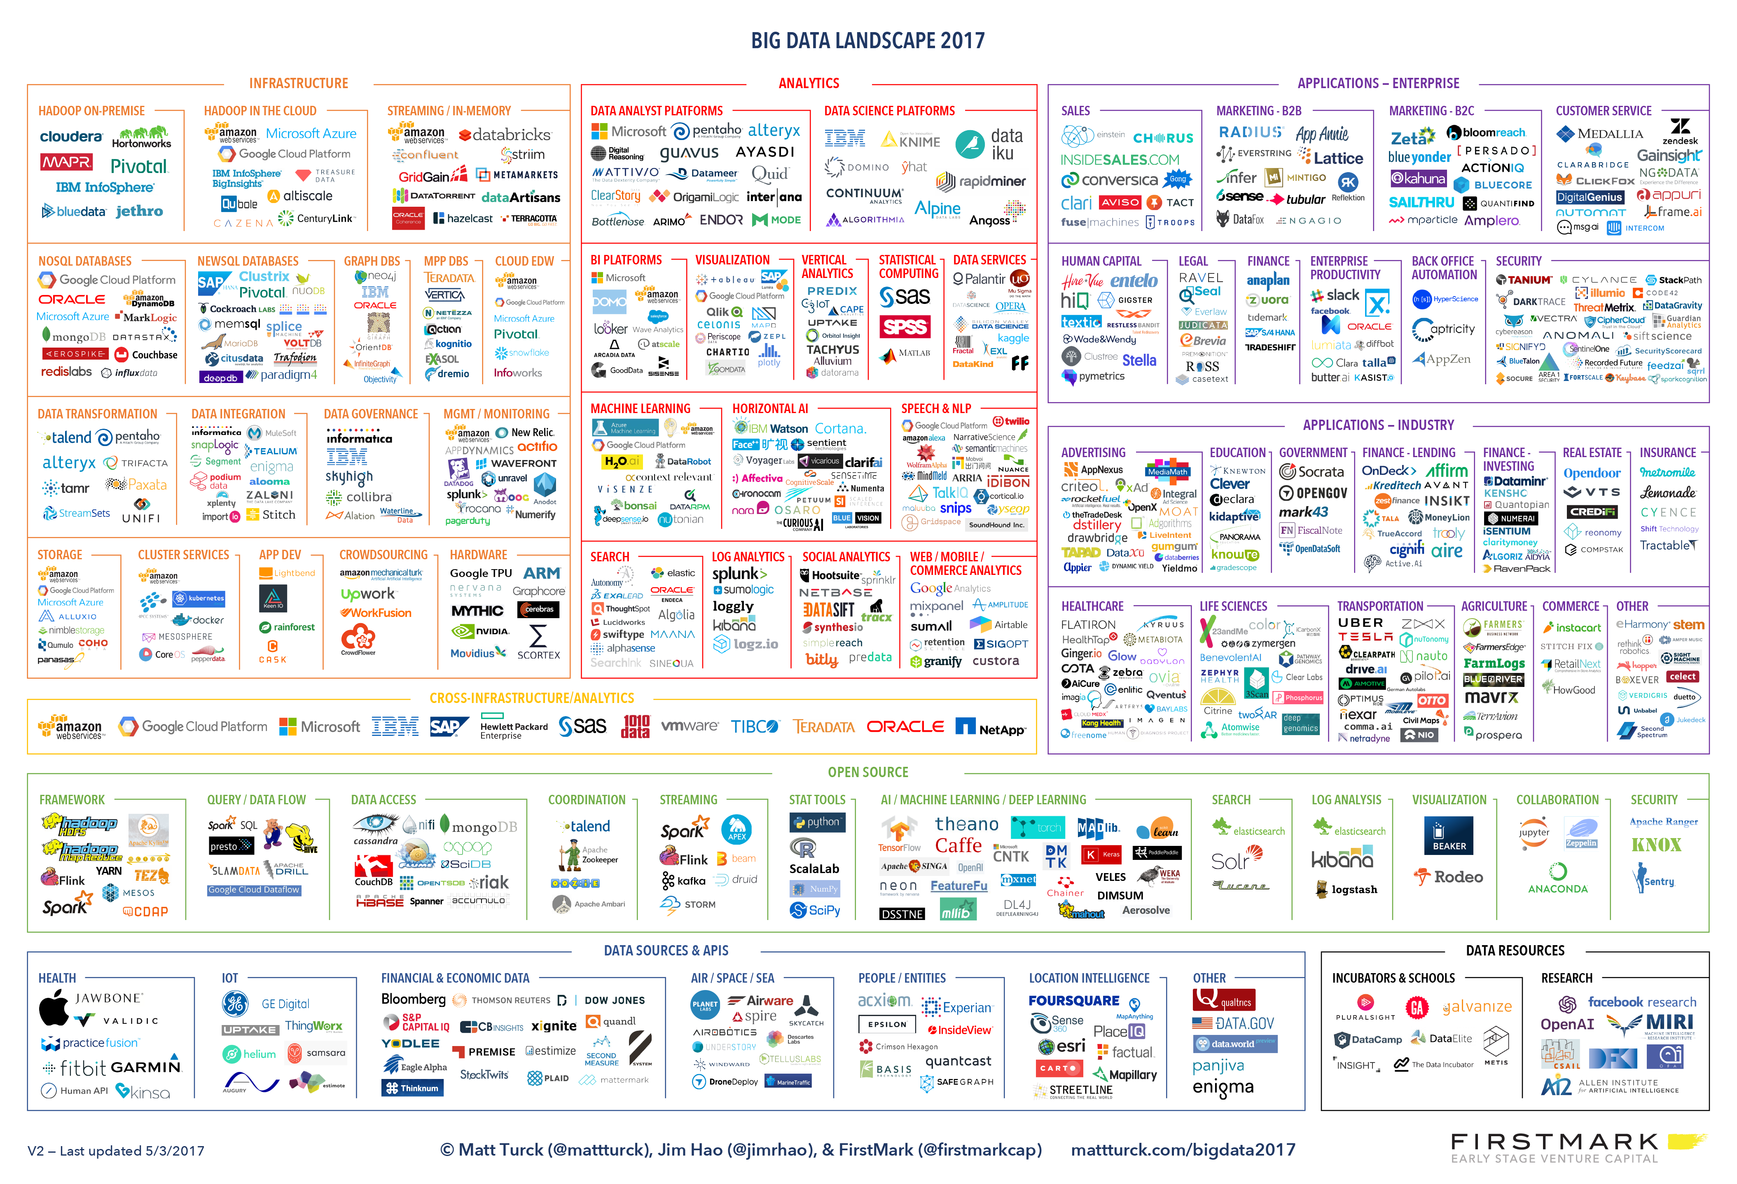

Slide 5
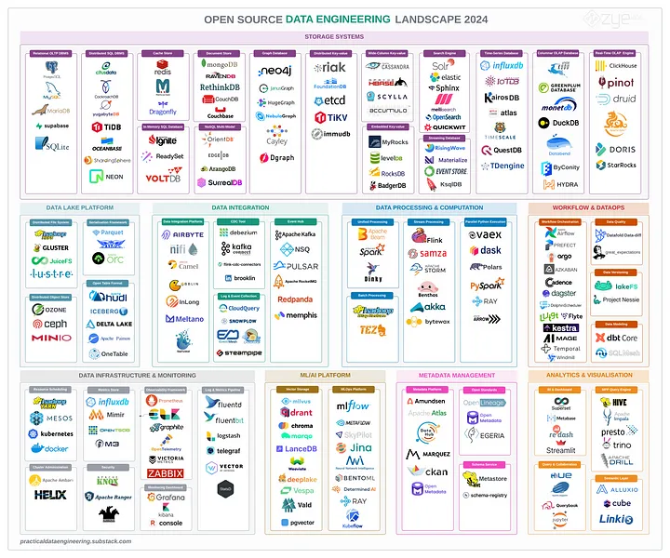
https://alirezasadeghi1.medium.com/open-source-data-engineering-landscape-2024-8a56d23b7fdb

Slide 6
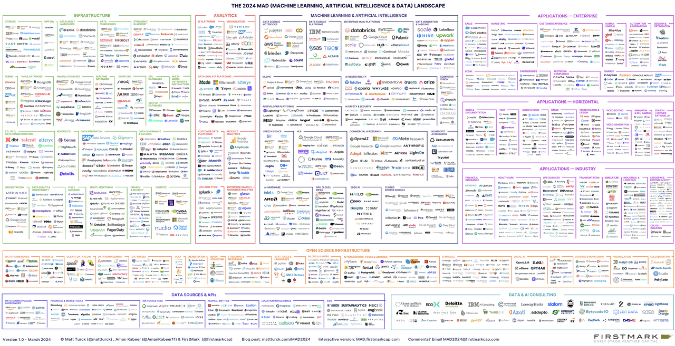
https://www.linkedin.com/pulse/matt-turcks-dataai-landscape-2024-its-logos-manuel-delgado-tenorio-yyqsf/

Slide 7
Can we do it all?

Slide 8
Motivations for the Course:
Data Is Driving Everything
“Big data”
“Data science”
“Data lakes”
“Visual analytics”
“Deep learning”
“Statistical analysis”
“Biomedical informatics”
“Business analytics”
Lots of trends in pursuit of the same goals! Discovery, models, decision-making, …
Notes:
Up next: Outline (C)

Slide 9
Data Needs to Be
Modeled, Cleaned, and Linked!
Notes:
Up Next: Medium Data (Z)+

Slide 10
Most Scenarios: Lots of “Medium Data” that Isn’t Ready for Analytics
Other than in the Web and in monitoring scenarios – we typically don’t have all of the data in one place
  In different systems
  Bringing in public datasets
  Requiring access to Twitter APIs etc.
Also, it’s often not in a form where:
  It’s clean and regular – e.g., we may have missing values, spurious values, etc.
  The features we want to use to make predictions are immediately available to us

Slide 11
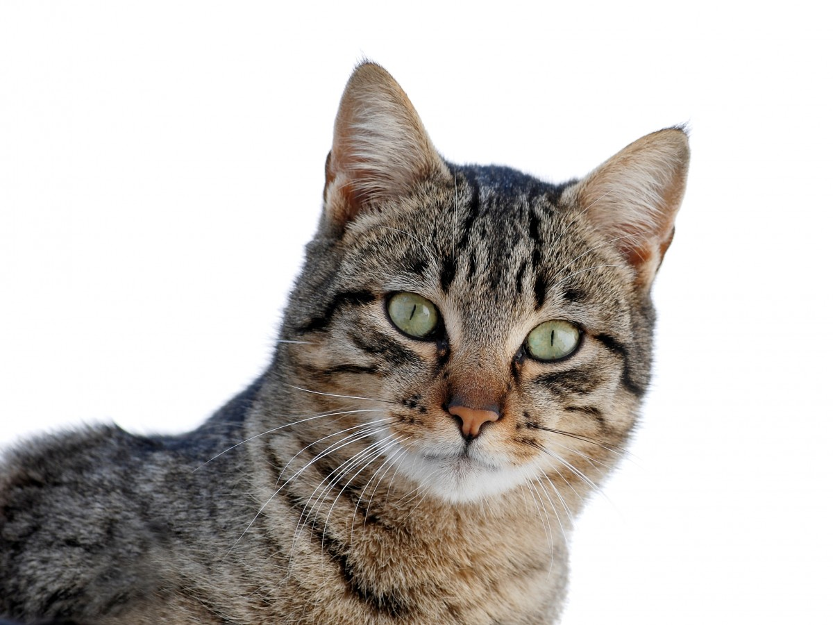
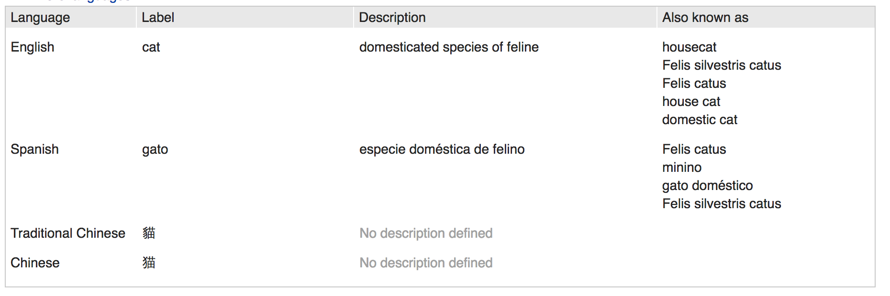
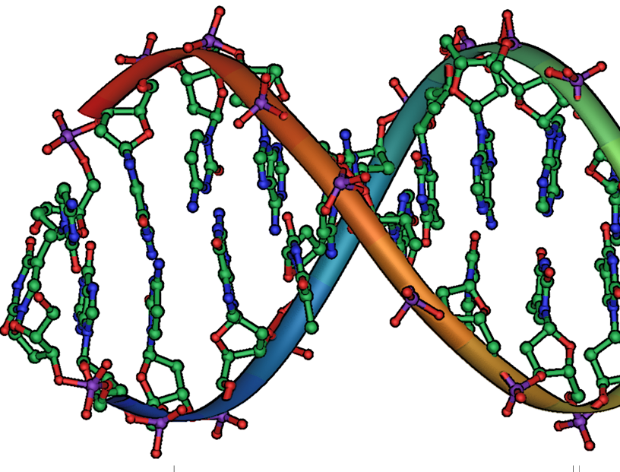
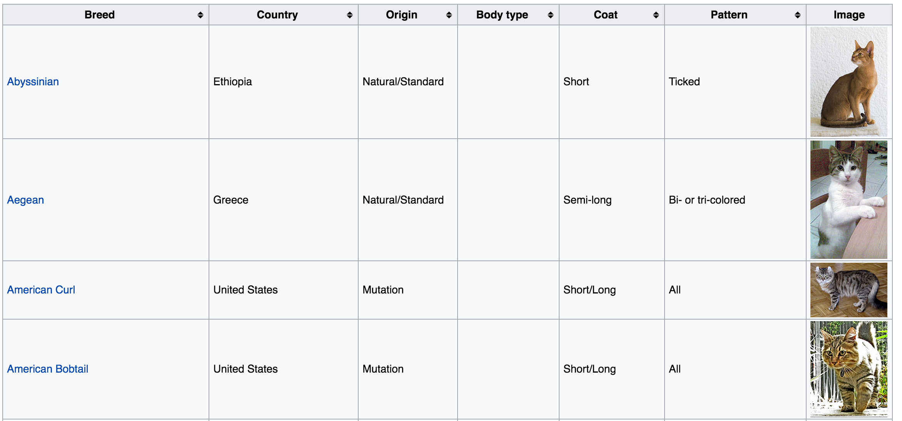
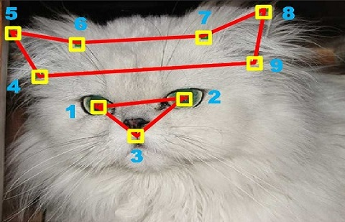
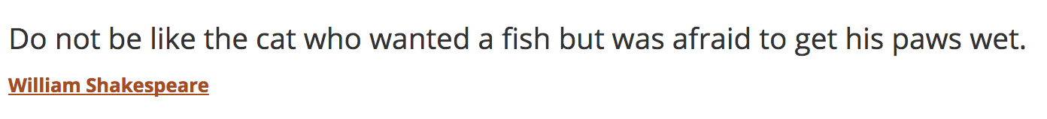
Data vs Structured Data
Images
Data +
feature
extraction,
wrangling
Genes
Goal: raw data → structured data
  Fields, entities, objects, machine learning features
  May be very regular or semi-structured
Ultimately, goal is data → information → knowledge
Text
Notes:
Credits: Wikipedia, https://people.eecs.berkeley.edu/~junyanz/cat/cat_papers.html,
Wikidata

Slide 12
Structural Relationships are Sometimes Important Features

Slide 13
Linked Data: Find Patterns in Connectivity
(Clusters, Paths, …)
Notes:
Facebook graph: https://www.google.com/url?sa=i&rct=j&q=&esrc=s&source=images&cd=&cad=rja&uact=8&ved=0ahUKEwiG-NS3pszYAhUiYt8KHUMFCH4QjRwIBw&url=http%3A%2F%2Fwww.businessinsider.com%2Fexplainer-what-exactly-is-the-social-graph-2012-3&psig=AOvVaw2D5Cm84V0EKbfEKCIh2EYF&ust=1515635983002846
Retweet graph: https://www.researchgate.net/figure/266968024_A-sample-basic-retweet-graph

Slide 14
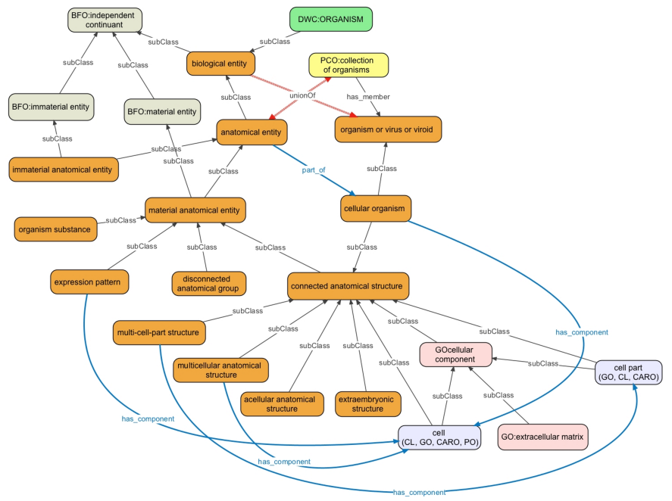
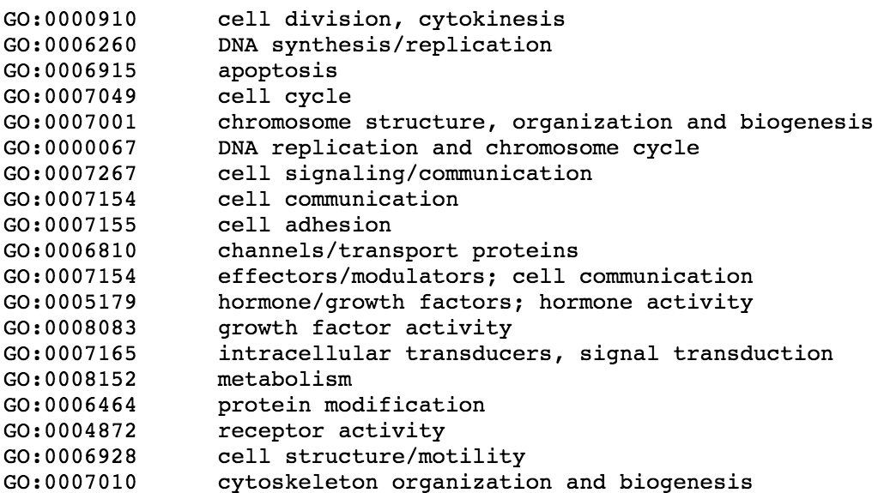
Knowledge Graphs
Classes, subclasses, instances, and properties

Slide 15
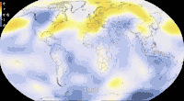
Dynamic Data: Track over Time,
Forecast the Future
Notes:
https://giphy.com/gifs/climate-change-visualization-global-warming-hPovBcQ3c1g9W

Slide 16
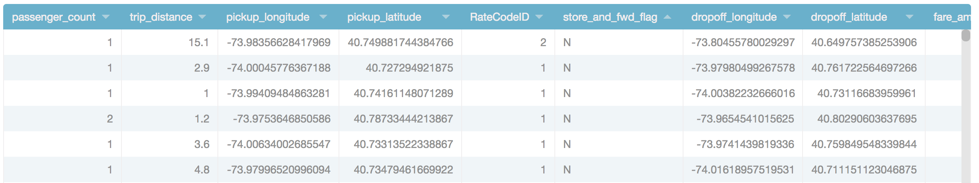
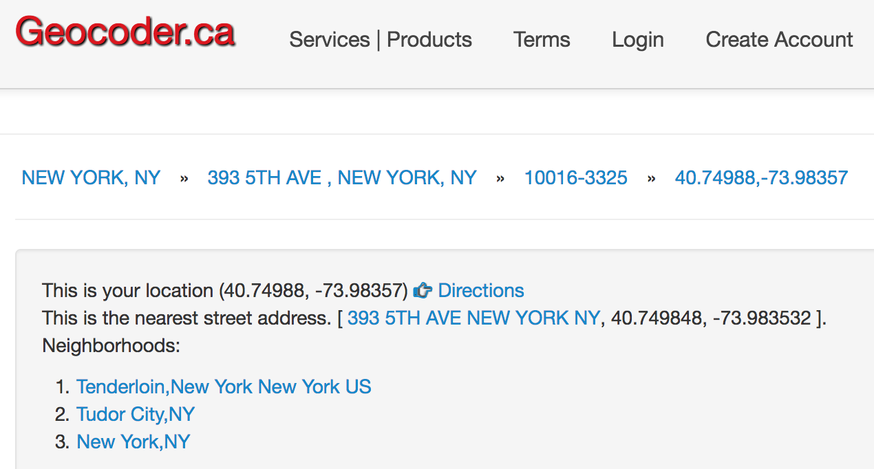
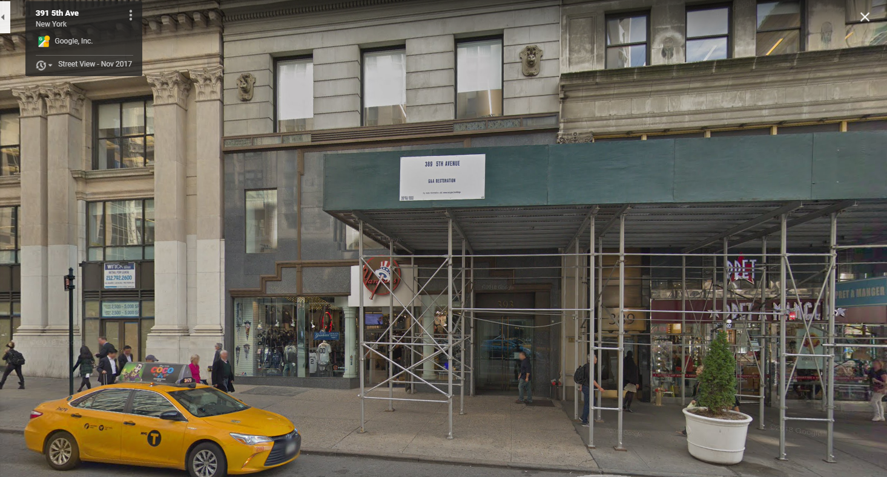
Tabular (Relational) Data and Joins / Lookups (eg to Web Services)
New York Taxi Data
Reverse
Geocode
Data
Street View
Notes:
https://data.cityofnewyork.us/Transportation/2015-Yellow-Taxi-Trip-Data/ba8s-jw6u
Up next: How big? (Z)

Slide 17
What Makes Data “Big” Data?
A GB? A PB? A YB?
A Million records? Billion records? Trillion records?
There is no consensus definition, but from our perspective:
  Too complex for a human to understand directly
  Doesn’t fit into a single uniform memory space (eg variables in Python) –
  means we need to think carefully about I/O and/or communication
  Need more than brute force algorithms to analyze
  May require multiple computers to work together to process
  Possibly high dimensionality, requiring feature selection and dimensionality reduction
Notes:
Up Next: Data Analytics (S)

Slide 18
Data Analytics
Notes:
Up next: CERBA (C)+

Slide 19
The Goal of Data Analytics:
From Data to “Knowledge” or Action
Pattern detection: Raw data → patterns → partial understanding
  “Show me sales by region by product category”
  “Show me clusters of documents by concept”
Given an observation: Hypothesis → experiment over sample → significance
  “Behavioral factor F leads to higher risk of outcome O”
  Do statistical test, measure significance vs. null hypothesis
Collect → Extrapolate → Recognize → Build → Apply
Notes:
We’re gonna recite it. It’s gonna be awesome.
Up next: CERBA in this course

Slide 20
What Does Big Data Analytics Involve?
Acquisition, access – data may exist without being accessible (C)
Wrangling – data may be in the wrong form (CE)
Integration, representation – data relationships may not be captured (ER)
Cleaning, filtering – data may have variable quality (ER)
Hypothesizing, querying, analyzing, modeling – from data to info (ERB)
Understanding, iterating, exploring – helping build knowledge (A)
And: ethical obligations – need to protect data, follow good statistical practices, present results in a non-misleading way (CERBA)
Notes:
Up next: example 1, a recommender system (C)

Slide 21
Example: Netflix Recommendation
(Or Amazon, Or Personalized Search, Or …)
Netflix Movie Recommendation
Santander Product Recommendation
Expedia Hotel Recommendation
Notes:
Explain all of the data that we use for this
Up next: Gene Sequencing (Z)

Slide 22
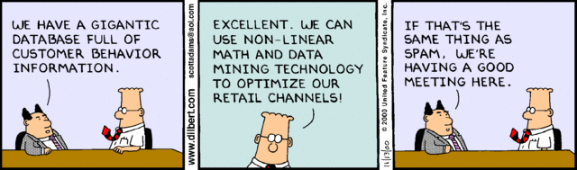

Slide 23
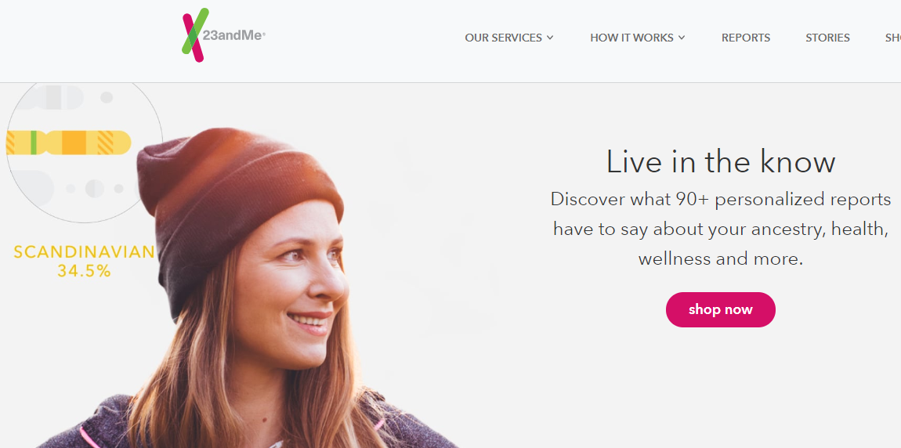
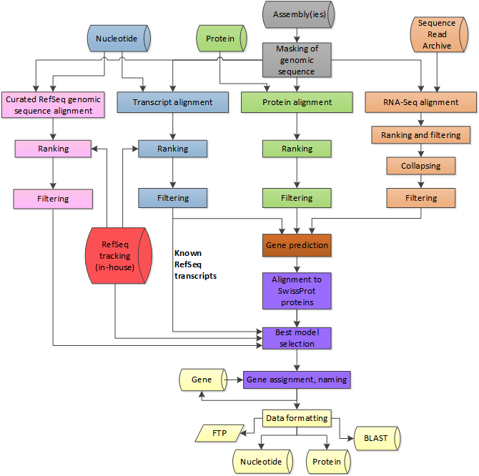
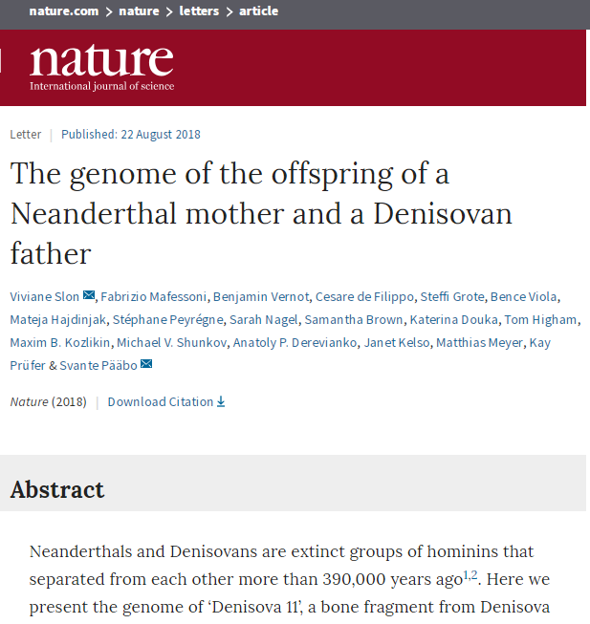
Example: High-Throughput Gene
Sequencing
https://www.ncbi.nlm.nih.gov/genome/annotation_euk/process/
Notes:
Up next: Seizure prediction (Z)

Slide 24
Data Science / Data Analytics:
Beware Over-Hyped Expectations!
Data science myth:
  We’ll learn everything “bottom up” using fancy statistics and machine learning
  Basically we “turn the crank” and out pop insights!
  Data + algorithms → knowledge
Data science reality:
  We’ll typically rely on human expertise to impose models over the data, the features, etc.
  Deep learning can do feature selection – but why throw away what we know!
  Data + human insight + algorithms + iteration → information → knowledge
Notes:
Up next: the application process (C)

Slide 25
Data Science Application Process
What question are you answering?
What is the right scope of the project?
What data will you use?
What techniques are you going to try?
How will you evaluate your results?
What maintenance will be required?
Notes:
Up next: words from Industry (Z)

Slide 26
The Word from Our Students and
Collaborators at Data Science Companies
At least 80-90% of their work involves:
Working with experts to understand the domain, assumptions, questions, etc.
Trying to catalog and make sense of the data sources
Wrangling, extracting, and integrating the data
Cleaning the wrangled data
Before we even get to machine learning!
Notes:
Up next recap motivations (Z)

Slide 27
Recapping Our Motivations for Big Data Analytics (and this Course)
Highly dimensional, hard to understand, and requires understanding computation and I/O costs
Given an integrated dataset (often the hard part!), involves extracting and selecting features and adding semantic structure to data
Many applications, from discovery to clustering to classification to recommendation!
  Sometimes statistical, sometimes algorithmic, and sometimes reliant on extraction
Notes:
Course Logistics (S)

Slide 28
Course Logistics
Notes:
Up next: who is this for (C)+

Slide 29
Who This Class is For
Students from engineering / science, applied math, social science, …
  With basic background in statistics, probabilities, and programming
Students from computer science who want to understand how to analyze data
Notes:
Up next: other courses

Slide 30
What You’ll Learn Here
Data manipulation in Python, its libraries, and the Spark platform
Data representation and wrangling
Data as graphs and matrices
Data ethics and privacy
Data cleaning, hypothesis testing, …
Use of common algorithmic patterns and learning primitives
  Clustering and unsupervised learning
  Training and classification
  Managing time-varying data
  Deep learning
Some data visualization
Notes:
Up next: textbooks

Slide 31
Texts / Reference Books
We will use several books, plus supplemental readings
Each topic will accompanied by a list of reading suggestions.
Notes:
Up next: prereqs and workload (C)

Slide 32
A Disclaimer…
This is a field that is still in its early stages – the course is too…
We will be using some immature technology
We hope it will be a fun course.
Notes:
Up next: Technologies (Z)+

Slide 33
Technologies
We’ll make heavy use of Java and the Python data science ecosystem
  We will attempt to use Docker Containers for simplicity
  Using Jupyter as an integrated environment
  We’ll do some tasks on Amazon, Google, and MS Azure
And Spark for parallel programming
SciPy, Pandas, PySpark, …

