Slide 1
CIS 4517/5517:
Data Intensive and Cloud Computing
Brief Review of Parallel and Distributed Computing
Based on Prof. Xubin He slides

Slide 2
Outline
Brief review of parallel and distributed computing
Cloud computing at a glance

Slide 3
Computing Paradigm Distinctions
Centralized Computing
  All computer resources are centralized in one physical system.
Parallel Computing
  All processors are either tightly coupled with central shared memory or loosely coupled with distributed memory
Distributed Computing
  A distributed system consists of multiple autonomous computers, each with its own private memory, communicating over a network.
Cloud Computing
  An Internet cloud of resources that may be either centralized or decentralized. The cloud applies to parallel or distributed computing or both. Clouds may be built from physical or virtualized resources.

Slide 4
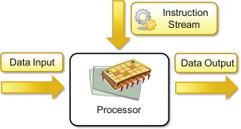
Basic Computing Unit

Slide 5
Flynn’s Taxonomy
Computing is basically executing instructions that operate on data.
Flynn’s taxonomy classifies the system based on the parallelism in instruction stream and parallel in data stream.
  single instruction stream or multiple instruction streams.
  single data stream or multiple data streams.

Slide 6
Flynn’s taxonomy
Single Instruction Single Data (SISD)
Single Instruction Multiple Data (SIMD)
Multiple Instructions Multiple Data (MIMD)
Multiple Instructions Single Data (MISD)

Slide 7
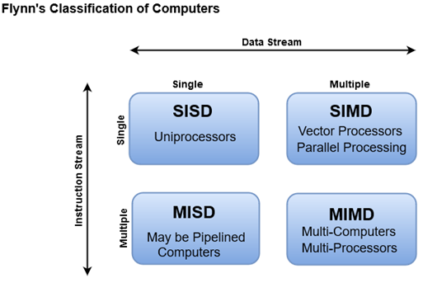
Flynn’s Taxonomy
M.J. Flynn, "Very High-Speed Computers",
Proc. of the IEEE, V 54, 1900-1909, Dec. 1966.
Flynn classified by data and control streams in 1966
SIMD ⇒ Data Level Parallelism
MIMD ⇒ Thread Level Parallelism
https://www.javatpoint.com/flynns-classification-of-computers

Slide 8
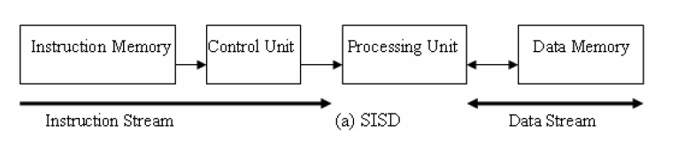
SISD
At one time, one instruction operates on one data
  Traditional sequential architecture, Von Neumann architecture.

Slide 9
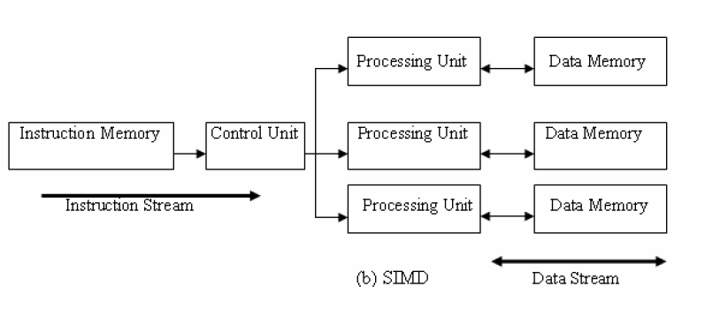
SIMD
Single control unit and multiple processing units. The control unit fetches an instruction and broadcast control to all processing units. The instruction operates on different data.
  Can achieve massive processing power with minimum control logic
  SIMD instructions allow for sequential reasoning.

Slide 10
SIMD
Example: vector multiplication Ci = Ai * Bi
Exploit data-level parallelism
  Matrix-oriented scientific computing and deep learning applications
  Media (image and sound) processing
Vector machines, MMX, SSE (Streaming SIMD Extensions), AVX (Advanced Vector eXtensions), GPU

Slide 11
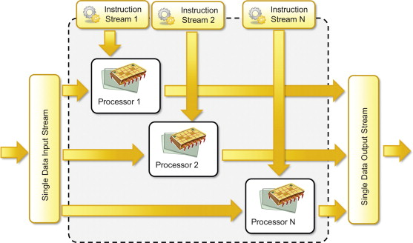
MISD
Not commonly seen, no general purpose MISD computer has been built.
Systolic array is one example of an MISD architecture.
Example y = sin(x) + cos(x) – tan(x)

Slide 12
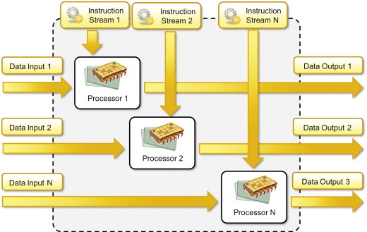

MIMD
Multiple instruction streams operating on multiple data streams
  MIMD can be thought of as many copies of SISD machine.
  Distributed memory multi-computers, shared memory multi-processors, multi-core computers.

Slide 13
Back to Basics
“A parallel computer is a collection of processing elements that cooperate and communicate to solve large problems fast.”
Parallel Architecture = Computer Architecture + Communication Architecture
2 classes of multiprocessors :
Centralized Memory Multiprocessor
  < few dozen processor chips (and < 100 cores)
  Small enough to share single, centralized memory
Physically Distributed-Memory multiprocessor
  Larger number chips and cores.
  Bandwith demands ⇒ Memory distributed among processors

Slide 14
Centralized vs. Distributed Memory
Scale
P
P
P
1
n
P
n
1
$
$
$
$
Mem
Mem
Inter
connection network
Inter
connection network
Mem
Mem
Centralized Memory
Distributed Memory

Slide 15
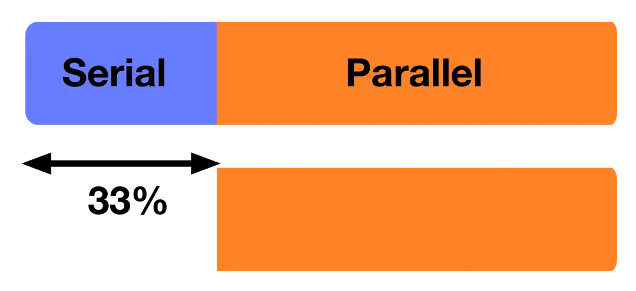
Challenges of Parallel Processing
First challenge is % of program inherently sequential
Suppose we want to achieve 80X speedup from adding 100 processors. What fraction of original program can be sequential?
  10%
  5%
  1%
  <1%

Slide 16
Amdahl's Law
Defines the Speedup that can be gained by using a special feature
Speedup due to enhancement E:
ExTime w/o E Performance w/ E
Speedup(E) = ------------- = -------------------
ExTime w/ E Performance w/o E
F E
Find how Speedup coming from some enhancement E
Suppose that enhancement E accelerates a fraction F of the task by a factor S, and the remainder of the task is unaffected

Slide 17
Amdahl’s Law
Proportion of the program not enhanced (e.g., serial)
ExTime_{new} = ExTime_{old} x (1 - Fraction_{enhanced}) + Fraction_{enhanced}
Speedup_{enhanced}
Number of processors
1
ExTime_{old}
ExTime_{new}
Speedup_{overall} =
=
(1 - Fraction_{enhanced}) + Fraction_{enhanced}
Speedup_{enhanced}
Key Insights from Amdahl’s Law
Limited Speedup – No matter how many processors you add, if part of the program is serial, it limits the maximum speedup.
Diminishing Returns – Increasing the number of processors only helps up to a point; after that, the impact is minimal.
Focus on the Bottleneck – Optimizing the serial portion of a program is crucial for achieving better performance.

Slide 18
Now let’s look at the problem…
Suppose 80X speedup from 100 processors. What fraction of original program can be sequential?
  10%
  5%
  1%
  <1%
Variable

Slide 19
Another example
Suppose that we can improve Floating point instructions to run 2 times faster, and 10% of total instructions are FP. Then, what is the overall speedup with this enhancement?
ExTime_{new} =
Speedup_{overall}
=

Slide 20
Amdahl’s Law
Suppose that we can improve Floating point instructions to run 2 times faster, and 10% of total instructions are FP. Then, what is the overall speedup with this enhancement?
ExTime_{new} = ExTime_{old} x (0.9 + .1/2) = 0.95 x ExTime_{old}
1
Speedup_{overall}
=
=
1.053
0.95

Slide 21
One more example:
A program spends 90% time on computing jobs, and other 10% time on disk accesses. If we use a 100 times faster CPU, how much speedup do we gain?

Slide 22
Amdahl’s Law
A program spends 90% time on computing jobs, and other 10% time on disk accesses. If we use a 100 times faster CPU, how much speedup do we gain?
ExTime_{new} = ExTime_{old} x (0.1 + 0.9/100) = 0.109 x ExTime_{old}
1
Speedup_{overall}
=
=
9.17
0.109

Slide 23

Amdahl’s Law
t
s
ft
s
(1
-
f
)
t
s
Serial section
Parallelizable sections
(a) One processor
(b) Multiple
processors
p
processors
t
(1
-
f
)
t
s
/
p
p
Even with infinite number of processors, maximum speedup limited to 1/f.
Example: With only 5% of computation being serial, maximum speedup is 20, irrespective of number of processors.

Slide 24
Exercise of Amdahl’s Law
Suppose that a calculation has a 4% serial portion, what is the limit of speedup on 16 processors?

Slide 25
The Implication of Amdahl’s Law
20
f
= 0%
Speedup S(p)
16
12
f
= 5%
8
f
= 10%
4
f
= 20%
4
8
12
16
20
Number of processors
,
p

Slide 26
Challenges of Parallel Processing
Second challenge is long latency to remote memory
Suppose 32 CPU MP, 2GHz, 200 ns remote memory, all local accesses hit memory hierarchy and base CPI (cycles per instruction) is 0.5. (Remote access = 200/0.5 = 400 clock cycles.)
What is performance impact if 0.2% instructions involve remote access?
  1.5X
  2.0X
  2.5X

Slide 27
CPI Equation
CPI = Base CPI +
Remote request rate
x Remote request cost
CPI = 0.5 + 0.2% x 400 = 0.5 + 0.8 = 1.3
No communication is 1.3/0.5 or 2.6 faster than 0.2% instructions involving remote access

Slide 28
Parallelism
Find enough parallelism (Amdahl’s Law)
Parallelism overheads include:
  Cost of starting a thread or process
  Cost of communicating shared data
  Cost of synchronizing
  Extra (redundant) computation
Tradeoff: Program needs sufficiently large units of work to run fast in parallel (i.e., large granularity), but not so large that there is not enough parallel work

Slide 29
Load balancing
Load imbalance leads to some idle resources (e.g. processors) in the system
  Insufficient parallelism (during that phase)
  Unequal size tasks
Program needs to balance load
  Sometimes can determine workload, divide up evenly, before starting: static load balancing
  Sometimes workload changes dynamically, need to rebalance dynamically: dynamic load balancing

Slide 30
Languages, frameworks, and system support for parallel/distributed computing
C/S vs P2P:
  Client-server model: sockets, RPC (remote procedure call) & RMI (remote method invocation), web services (XML, SOAP, HTTP)
MPI (message passing interface) vs. SVM (shared virtual memory)
Parallel programming languages/programming model: ADA, Split-C, Linda, High Performance Fortran, Map/Reduce, .NET
Distributed files systems (Sun’s NFS, CMU’s AFS & Coda, Google’s GFS, HDFS)

Slide 31
Cloud computing: what and why?

Slide 32
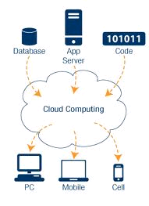
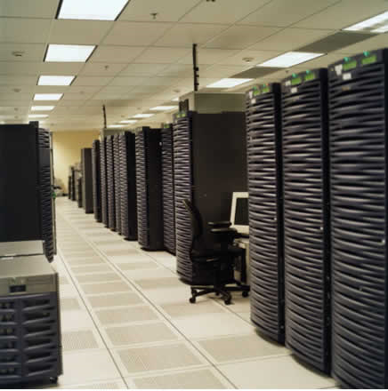
Cloud computing at a glance
Utility computing: our data and applications are hosted somewhere on the Internet (“in the cloud”)
  Most services we access over the Internet are in the cloud (e.g., Google, Amazon, Yahoo)
Benefits:
  Providers: economies of scale by having many users sharing the same infrastructure
  Consumers: reduced cost and overhead
Cloud infrastructure =
Data centers with
100,000’s servers

Slide 33
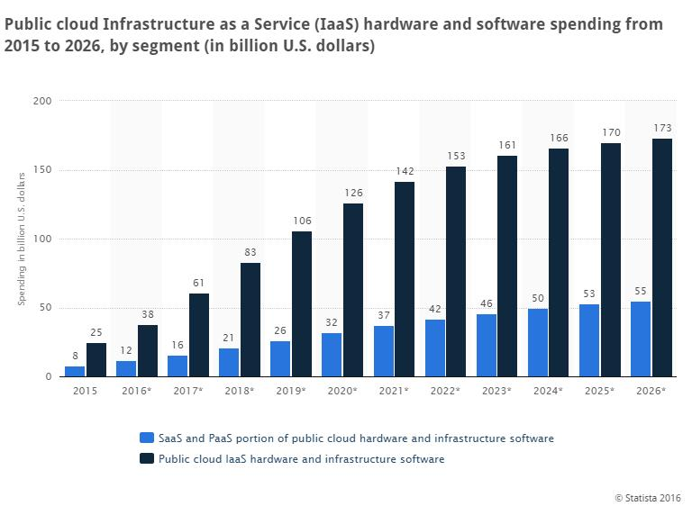
Cloud computing is a big industry

Slide 34
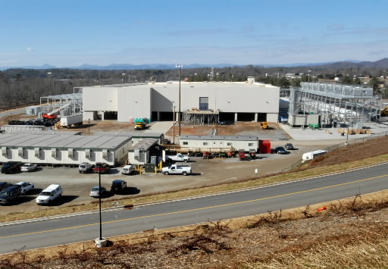
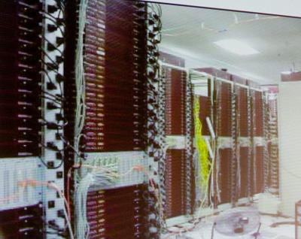
How it all started
Very large data centers with low utilization on average
  How about renting computers when load is low?
Google data center video: https://www.youtube.com/watch?v=XZmGGAbHqa0

Slide 35
What is cloud computing?
Cloud computing means storing and accessing data and programs over the Internet instead of your computer's hard drive. --PC Mag
Cloud computing is the delivery of computing services—servers, storage, databases, networking, software, analytics, and more—over the Internet (“the cloud”). --Microsoft
Cloud computing is the on-demand delivery of compute power, database storage, applications, and other IT resources through a cloud services platform via the internet with pay-as-you-go pricing. –Amazon
A video on Youtube
A history of cloud computing, Computer Weekly

Slide 36
Cloud platforms
  Amazon Web Services (AWS).
  Google AppEngine.
  Microsoft Azure
  Any many others….

Slide 37
Amazon AWS
https://aws.amazon.com/
AWS free tier: three options: always free/12 month free/trials
Create your own AWS account if you don’t have one and play with it.
AWS starter account is free, but some function might be restricted.
Remember to stop your instance (your machine on the cloud) when you don’t use it. Otherwise, your machine will keep running and your free credit will run out quickly!

Slide 38
Next
HW1 is posted in Canvas.
Step-by-step guide on launching AWS and more resources are provided in course canvas under “Resources” section. Please check them offline by yourself.
Next class: Cloud platforms

