Slide 1
Data Intensive and Cloud Computing
Cloud Platforms: Google Cloud and Microsoft Azure
Dr. Xubin He
Computer and Information Sciences
Temple University

Slide 2
Outline
Google Cloud
Microsoft Azure

Slide 3
Cloud models
Service Models (Host-Build-Consume)
  Infrastructure as a Service (IaaS): basic compute and storage resources
    On-demand servers, storage, etc
    Amazon EC2, VMWare vCloud, Google GCE, Windows Azure Virtual Machines
  Platform as a Service (PaaS): platform for cloud applications
    On-demand application-hosting environment
    E.g. Google AppEngine, Salesforce.com, Windows Azure Cloud Platform
  Software as a Service (SaaS): cloud applications
    On-demand applications
    E.g. Office 365, GMail, Microsoft Office Web Companions
Deployment Models
  Private cloud
  Public cloud
  Hybrid public/private cloud

Slide 4
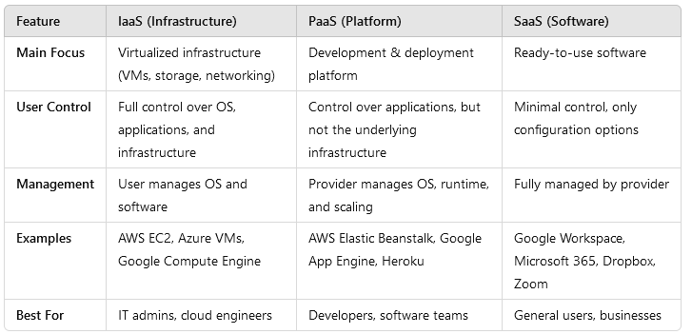
IaaS vs. PaaS vs. SaaS Comparison

Slide 5

PaaS
Developer
1) Provision database, then create tables and add data
2) Deploy application
Data
Application
Web
Server
Load Balancer
DBMS
Operating
System
Operating
System
Operating
System
VM
VM

Slide 6


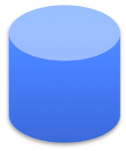


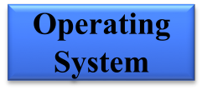

IaaS
Developer
5) Configure load
balancer
1) Choose image, then create VM for DBMS and configure DBMS
2) Choose image, then create and configure VM(s) for application
3) Provision database, then create tables and add data
4) Install application
6) Manage VMs and DBMS (e.g., deploying new OS images in VMs)
Library
VM Images
Data
Application
Web
Server
Load Balancer
DBMS
VM
VM

Slide 7
Google Cloud (https://cloud.google.com)
A wide range of services: compute, app, storage, database, gmail, photos, etc
  Google AppEngine (GAE): PaaS
    https://cloud.google.com/appengine
  Google Compute Engine (GCE): IaaS (equivalent to AWS EC2)
    https://cloud.google.com/compute
  Google Apps: Gmail, photos, sheets, etc: SaaS
Notes:
Equivalent to AWS EC2

Slide 8
What is Google AppEngine?
A platform for developing and hosting web applications on Google's infrastructure
  First released as a beta version in April 2008
It’s a PAAS (Platform As A Service)
Widely advertised with GWT (Google Web ToolKit): http://www.gwtproject.org/
Any user with a Google account can access AppEngine (https://cloud.google.com/appengine/)
  No need to put your credit card info initially
  Can deploy 10 applications for free
    Each can use up to 1GB of code storage and enough CPU, bandwidth to serve around 5 million page views a month

Slide 9
AppEngine programming
Java
  Example application structure: Java Web Service (using servlets) + a GWT client running in the browser
  For server-side, all Java functionality can be used (with some restrictions that would be described later)
  For client side (in GWT), UI is written in Java, but it is compiled into JavaScript (to run in all browsers)
  Also, as extensions, languages dependent on JVM: Groovy, JRuby, Scala, Clojure, Jython and special version of Quercus
    These languages have interpreters that translate their code into Java bytecode
Python, Go, PhP
Use Eclipse plugin
  Create a web project with GWT and deploy it to the App Engine using this plugin

Slide 10
How to use the AppEngine
Create a Google account (if you don’t have one)
Download and install the JDK (1.5 or higher), Eclipse (3.5 or higher)
Set up the Google plugin for Eclipse (https://developers.google.com/appengine/docs/java/tools/eclipse)
Download the App Engine SDK and optionally the GWT SDK (http://www.gwtproject.org/download.html)
Login to https://cloud.google.com/appengine/ with your Google account
You are now ready to develop and deploy your web applications to Google App Engine

Slide 11
Client-service communication
The GWT client is deployed as JavaScript client and the server side code is deployed as java servlets
Client can communicate with the service using:
  HTTP GET/POST requests
  GWT-RPC (Remote Procedure Call)
    More manageable
    Can use asynchronous callback functions in client code
    Can pass any Java serializable object
    RPC done over HTTP
For GWT-RPC, user needs to create 2 client side interfaces and one server side implementation class
  Public interface GreetingService extends RemoteService: synchronous interface
  Public interface GreetingServiceAsync: asynchronous interface
  Public class GreetingServiceImpl extends RemoteServiceServlet implements GreetingService

Slide 12
More details on how to manage Google cloud projects:
https://cloud.google.com/appengine/docs/standard/python/console#instances

Slide 13
GCE Instances and auto scaling
Instances are computing units used by App Engine to automatically scale apps
  GCE: Google compute engines
Each instance has its own queue for incoming requests
  App Engine monitors the number of requests waiting in each instance's queue
  If queue for instance is getting too long, it automatically creates a new instance.

Slide 14
Storage
DataStore
  Works as a schema-less object storage
Google Cloud SQL
  Provides a relational SQL database
  Based on MySQL RDBMS
Google Cloud Storage
  RESTful (https://restfulapi.net/) service for storing and accessing data on Google's infrastructure
BigTable
  NoSQL Big Data database service. It's the same database that powers many core Google services, including Search, Analytics, Maps, and Gmail.

Slide 15
DataStore
Datastore serves as “database” for apps
  Implemented over Google BigTable distributed data structure (which is implemented over the distributed Google File System)
  Independent of apps
Schema-less object datastore, with a query engine and atomic transactions
GQL: query language similar to SQL
Can be accessed from Java
  Java SDK includes implementations of Java Data Objects (JDO) and Java Persistence API (JPA) interfaces and a low-level datastore API
High Replication datastore (Paxos based) provides a more reliable storage with no planned downtime, higher availability of reads and writes
Notes:
S3

Slide 16
Google cloud storage
Multiple layers of redundancy; all data replicated to multiple data centers (US, Europe)
Read-your-writes (RYW) data consistency
  RYW consistency is achieved when the system guarantees that, once a record has been updated, any attempt to read the record will return the updated value
Objects can be terabytes in size, with resumable uploads and downloads, and range read support
Using REST service

Slide 17
REST (https://restfulapi.net/)
REpresentational State Transfer
REST is an architectural style based on web standards and the HTTP protocol. All resources are identified by global IDs (URIs/URLs).
Client/Server
Stateless: Each request from client to server is self contained, i.e., it must contain all of the information necessary to understand the request, and cannot take advantage of any stored context on the server.
Simple operations/methods:
  POST: Add a resource
  PUT: Override/modify an existing resource
  GET: Fetch a resource
  DELETE: Remove a resource

Slide 18
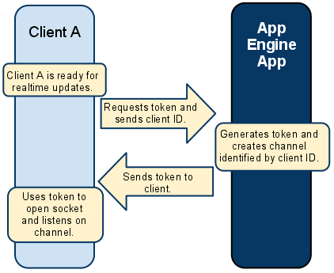
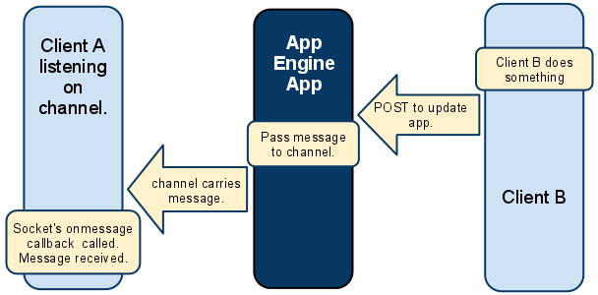
Communication scheme: Channels
The Channel API creates a persistent connection between client and Java service
Service can send messages to multiple JavaScript clients in real time.
This is useful for applications designed to update users about new information immediately
  Examples: collaborative applications, multi-player games, or chat rooms

Slide 19
Communication: TaskQueue
Two types – Push Queue and Pull Queue
Services can create tasks
  Tasks are extra-services (not available from the outside world)
  If an app needs to execute some background work, it may use the Task Queue API to organize that work into tasks
  Tasks inserted into one or more queues
App Engine automatically detects new tasks and executes them when system resources permit
  5 tasks/min can be started (each can run for up to 10 min)
  Tasks are invoked sequentially but can be run in parallel

Slide 20
Cloud tasks
New services (compared to task queues).
Queue management via the API: You can create, delete, pause, and perform other queue management tasks using the API, through the Console, or via the gcloud command.
  List Queues command: list all the queues you have set up in your project.
  List Tasks command: list all the tasks in any of your queues.
Migrate from TaskQueue to Cloud Tasks: https://cloud.google.com/tasks/docs/migrating
Details: https://cloud.google.com/tasks/docs/migrating

Slide 21
MemoryStore
For high performance, web applications often use a distributed in-memory data cache in front of or in place of robust persistent storage
  App Engine uses MemoryStore for this purpose
  One use of MemoryStore is to speed up common datastore queries
It is different from the system cache
  Can cache data in any format like (e.g. , as Database Views)
Documentation:
https://cloud.google.com/appengine/docs/standard/java/using-memorystore
Notes:
Amazon ElastiCache

Slide 22
Open source GAE
An Open Source implementation of Google AppEngine cloud computing interface: https://github.com/AppScale/appscale
  AppScale is an easy-to-manage serverless platform for building and running scalable web and mobile applications on any infrastructure.

Slide 23
Google Cloud (https://cloud.google.com)
A wide range of services: compute, app, storage, database, Gmail, photos, etc
  Google AppEngine (GAE): PaaS
    https://cloud.google.com/appengine
  Google Compute Engine (GCE): IaaS (equivalent to AWS EC2)
    https://cloud.google.com/compute
  Google Apps: Gmail, photos, sheets, etc: SaaS
Notes:
Equivalent to AWS EC2

Slide 24
Outline
Cloud platforms
  Google Cloud
  Microsoft Azure

Slide 25
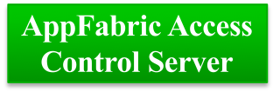

Windows Azure Platform
Windows Azure Applications
Windows
Azure
Middleware
Services
AppFabric Caching
AppFabric Service Bus
Windows
Azure
Data Services
SQL Azure
Windows Azure Storage
Windows Azure CDN
“Red Dog” Front End (RDFE)
Windows
Azure
Compute
Fabric Controller
Windows Azure Networking
Notes:
Fabric Controller: A set of modified virtual Windows Server 2008 images running across Azure that control provisioning and management, kernel of the OS
Role: Microsoft’s name for a specific configuration of Azure virtual machine. The terminology is from Hyper-V.
Service: Azure lets users run Services, which then run virtual machine instances in a few pre-configured types, like Web or Worker Roles. A Service is a batch of instances that are all governed by the Service parameters and policy.
RDFE serves as the front end for all Windows Azure services
Subscription management
Billing
User access
Service management
RDFE is responsible for picking clusters to deploy services and storage accounts
First datacenter region
Then affinity group or cluster load
Normalized VIP and core utilization

Slide 26



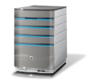


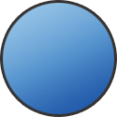
Cross-premise Connectivity
CLOUD
ENTERPRISE
Data Synchronization
SQL Azure Data Sync
Application-layer
Connectivity & Messaging
Service Bus
Secure Machine-to-Machine Network Connectivity
Windows Azure Connect
Secure Site-to-Site
Network Connectivity
Windows Azure Virtual Network
IP-level connectivity
Notes:
Microsoft think about the stack to provide connectivity between on-premise and cloud.
Specifically this deck focuses on the last two layers
Servicebus vs connect – SB requires app code change, Connect/Virtual Networks do not.
Virtual Networks are the net new here. They provide site to site connectivity where Connect provided server to server connectivity.
Virtual Networks are the more flexible and powerful option.

Slide 27
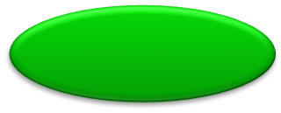
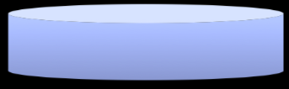

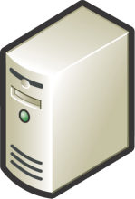
Windows Azure: OS for the data center
Handles resource management, provisioning, and monitoring
Manages application lifecycle
Allows developers to concentrate on application logic
Provides common building blocks for distributed apps
  Reliable queuing, simple structured storage, SQL storage
  Application services like access control, caching, and connectivity
Application
Compute
Storage
Config
Fabric

Slide 28
MS Azure Services
Virtual Machines (VMs)
  Windows, Linux VMs provided by Microsoft or by developer community
  The VMs are provided by a cloud-optimized hypervisor based on Hyper-V
  IaaS
App Services
  Web apps, mobile apps
  Fully managed PaaS
  Can choose to run the apps on shared VMs or your own VMs
  Development in ASP.NET, PHP, Node.js and Python
Cloud Services
  Multi-tier web services
  Can control VMs to a certain extent (e.g., specify roles and number of VMs)

Slide 29
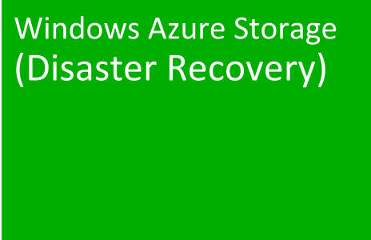
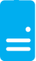
Persistent Disks and Highly Durable
Windows Azure Storage
Virtual Machine
Notes:
The OS and Data Disks are stored in Windows Azure storage. So in addition to the data being persistent you also get the benefits of storage which means your VHD is replicated 3X’s locally and also 3X’s in a separate data center in the same region (geo-replication)

Slide 30
Persistent Disks and Highly Durable
Windows Azure Storage
Virtual
Machine
Virtual Machine
Notes:
This slide simply highlights that if the physical hardware backing your VM goes down a new server will start and pick up the same VHD.

Slide 31
Introducing Microsoft Azure Storage
Cloud Storage - Anywhere and anytime access
  Blobs, Disks, Tables, Queues and Files
Highly Durable, Available and Massively Scalable
  Easily build “Internet scale” applications
  More than 35 tril+ Million requests/sec on average
Pay only for what you use
Exposed via easy and open REST APIs (https://restfulapi.net/)
Rich Client Libraries and Tools

Slide 32
Durable storage
Blobs
Tables
Queues
…
Usage examples
  Large items: blobs (store named files along with meta-data)
  Service state: tables (NoSQL data store)
  Service communication: queues
Three replicas of everything

Slide 33
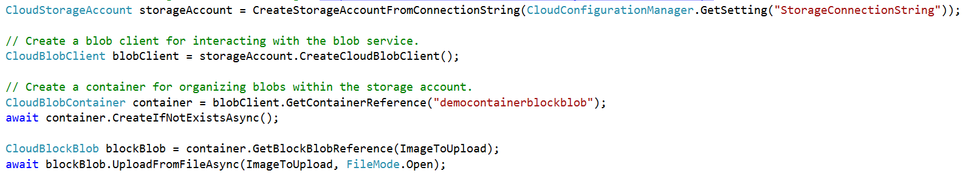
Abstractions – Blobs
Blobs – Massively scalable object store in the cloud
  Simple REST interface (Post, Put, Get, Delete)
  Data sharing – share documents, pictures, video, music, etc.
  Big Data – store raw data/logs and compute/map reduce over data
  Backups – data and device backups

Slide 34
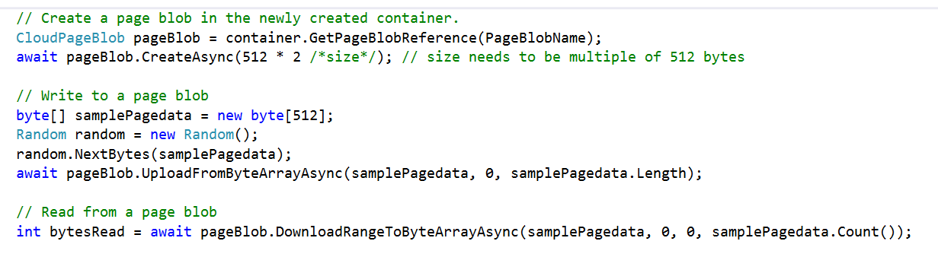
Abstractions – Disks
Persistent disks for VMs in Azure
Disks are VHDs stored in Azure Page Blobs
Page blobs are optimized for random I/O
VM see the VHD/blob as a disk
  Reads translated to GETs, writes to PUTs
  Blob protected by write-lease
  Reads from the blob (and snapshots) still allowed
Windows Azure Storage

Slide 35
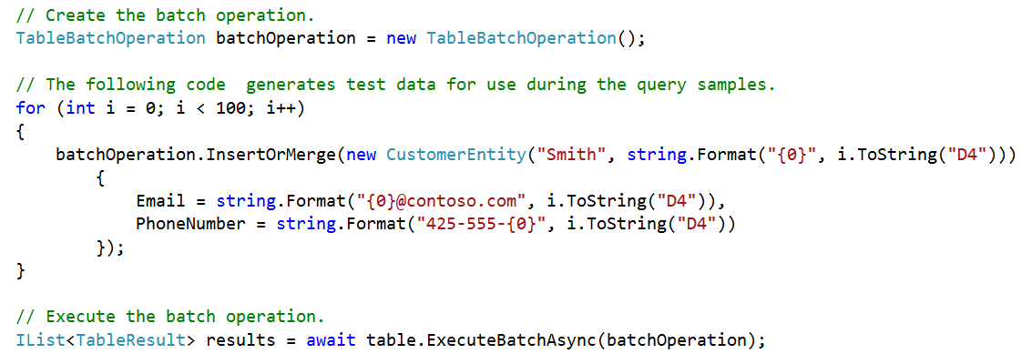
Abstractions – Tables
Tables – Massively scalable NoSQL cloud store
  Key/Attribute(s) store at scale
  Store user, device or any type of metadata for your service
  Auto load balances partitions to meet traffic needs

Slide 36
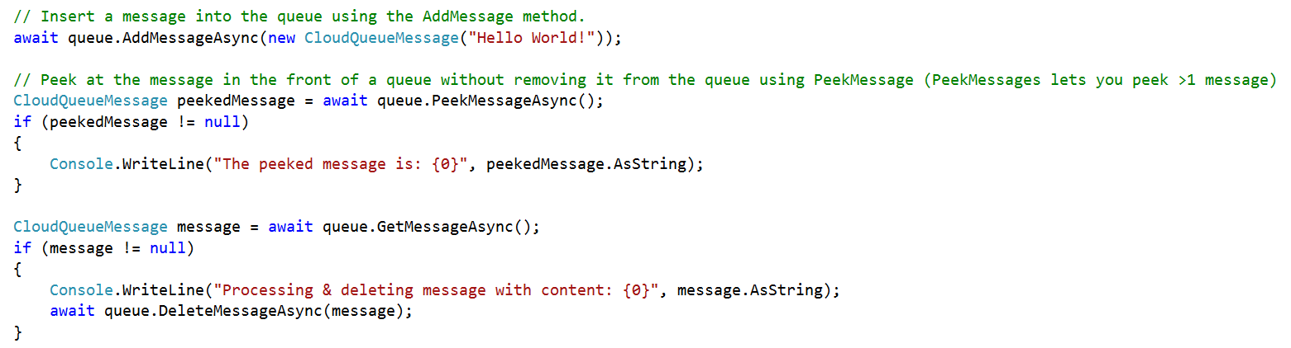
Abstractions – Queues
Queues – Reliable messaging system
  Reliable, low latency, high throughput messaging system
  Decouple components/roles
    Web role to worker role communication
    Allows roles to scale independently

Slide 37
Abstractions – Files
Move on-premises applications to cloud
VMs can use an SMB share using standard file APIs and semantics
SMB 2.1 protocol
VM and storage account within same region
Supports REST and SMB protocol access to same file share
Microsoft Azure
Share data stored in Azure Files among Azure VMs via SMB
Azure Storage
SMB
Blobs
Tables
REST API
Queues
REST API
Files

Slide 38

Summary: Azure Storage Architecture
Import / Export
Client Libraries
(.NET, Java, c++, Android, Node.JS…)
SMB Client
REST
REST
REST
REST
SMB 2.1
Blob/Disk
Endpoint
Table
Endpoint
Queue
Endpoint
File Share
Endpoint
Front End Layer
Partition Layer
Distributed Replication Layer
Stream Layer
  “Windows Azure Storage: A Highly Available Cloud Storage Service with Strong Consistency”, ACM Symposium on Operating System Principals (SOSP), Oct. 2011

Slide 39
Blobs
Account
Container
Blob
IMG1.JPG
pictures
IMG2.JPG
Smith
movies
Sample.mov
13

Slide 40
Tables
A set of entities (rows)
  An entity is a set of properties (columns)
  Billions of entities and TBs of data
  A storage account can create many tables
Account
Table
Entity
Name =…
Email = …
users
Name =…
Email = …
Smith
Photo ID =…
Date =…
photo index
Photo ID =…
Date =…

Slide 41
Queues (1)
Provide reliable message delivery
  Simple, asynchronous work dispatch
  Programming semantics ensure that a message is processed at least once
  Maximum size is 64K
  FIFO in general, but not guaranteed
Pulling an item from the queue doesn’t delete it
  It becomes invisible for a visibility timeout
  Item must be deleted before timeout or else it becomes visible
15

Slide 42
Queues (2)
Account
Queue
Message
128x128, http://…
thumbnail jobs
256x256, http://…
Smith
http://…
photo processing jobs
http://…

Slide 43
Data storage global view
Container
Blobs
http://<account>.blob.core.windows.net/<container>
Account
Table
Entities
http://<account>.table.core.windows.net/<table>
Queue
Messages
http://<account>.queue.core.windows.net/<queue>
17

Slide 44
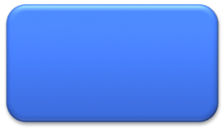
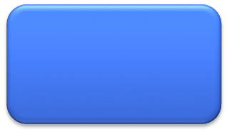
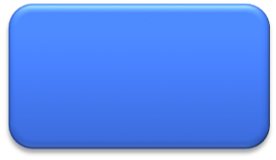
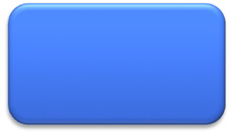
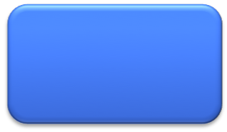
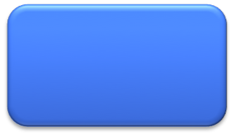
Defining your cloud service
Azure multi-tier application is called cloud service
  Definition information
  Configuration information
  At least one “role” (component)
What are the roles?
  Roles: Code with an entry point that runs in its own virtual machine
Web role
Worker role
Web role
Worker role
Web role
Worker role
LB

Slide 45
More on the role types
Web Role: IIS and ASP.NET in Windows Azure-supplied OS
Worker Role: arbitrary code in Windows Azure-supplied OS
VM Role: uploaded VHD with customer-supplied OS
  Good for: manual install/configuration

Slide 46
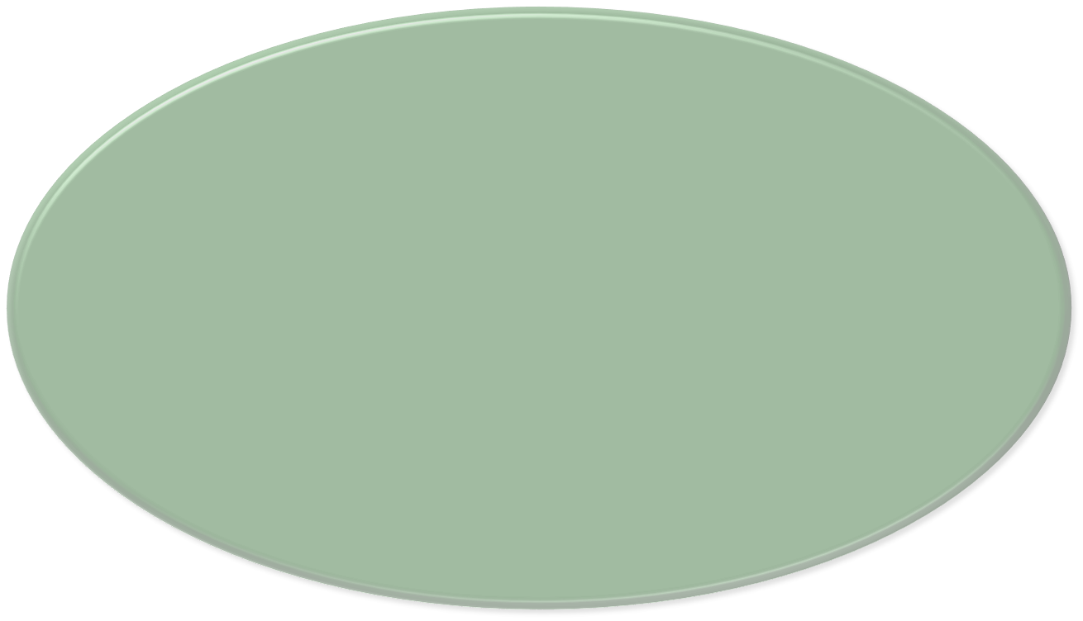
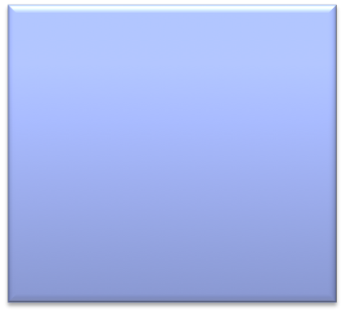


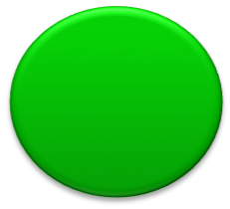
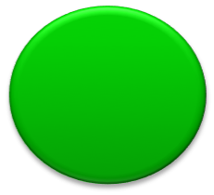

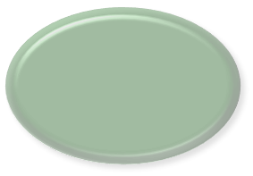

Multi-tier cloud service
Web Role
Worker Role
HTTP
ASP.NET, WCF, etc.
main()
{ … }
Load Balancer
IIS
Agent
Agent
Fabric
Application
Compute
Storage
Fabric
VM
…

Slide 47
Service management
Management tasks are automated by the Fabric Controller
  Kernel of Azure OS
Users tell the Fabric Controller what to do, and it figures out how to do it
Users can instruct Azure for geo-placement
  Choose a location for any of your applications
  Create an “affinity group” to co-locate a set of applications from your cloud project
25

Slide 48
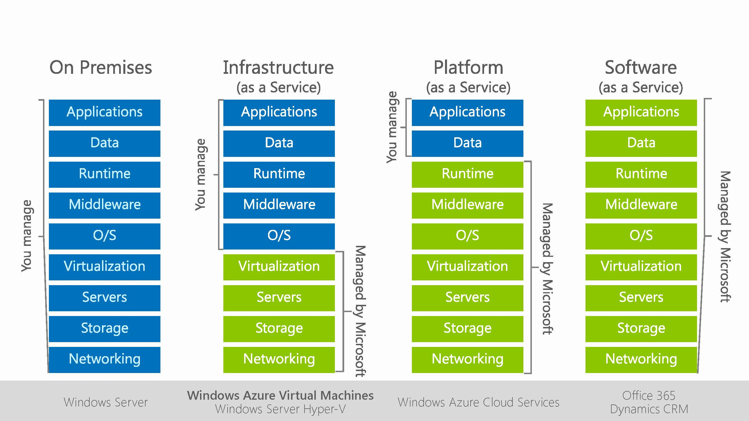
Summary: Microsoft cloud offerings

Slide 49
Public cloud war
Public cloud war: AWS vs Azure vs Google

