Slide 1
MIN-HASHING AND
LOCALITY SENSITIVE HASHING
Slides are mashup of
Rajaraman and Ullman, “Mining Massive Datasets”
Evimaria Terzi at BU
Reading Chapter 3 from “Mining Massive Datasets”

Slide 2
Goals
Many Web-mining problems can be expressed as finding “similar” sets:
  Pages with similar words, e.g., for classification by topic.
  NetFlix users with similar tastes in movies, for recommendation systems.
  Dual: movies with similar sets of fans.
  Images of related things.

Slide 3
Motivating problem
Find duplicate and near-duplicate documents from a web crawl.
If we wanted exact duplicates we could do this by hashing
  We will see how to adapt this technique for near duplicate documents

Slide 4
Distance Measures
  Goal: Find near-neighbors in high-dim. space
  We formally define “near neighbors” as points that are a “small distance” apart
For each application, we first need to define what “distance” means
Today: Jaccard distance/similarity
  The Jaccard similarity of two sets is the size of their intersection divided by the size of their union:
  sim(C₁, C₂) = |C₁∩C₂|/|C₁∪C₂|
  Jaccard distance: d(C₁, C₂) = 1 - |C₁∩C₂|/|C₁∪C₂|
3 in intersection
8 in union
Jaccard similarity= 3/8
Jaccard distance = 5/8

Slide 5
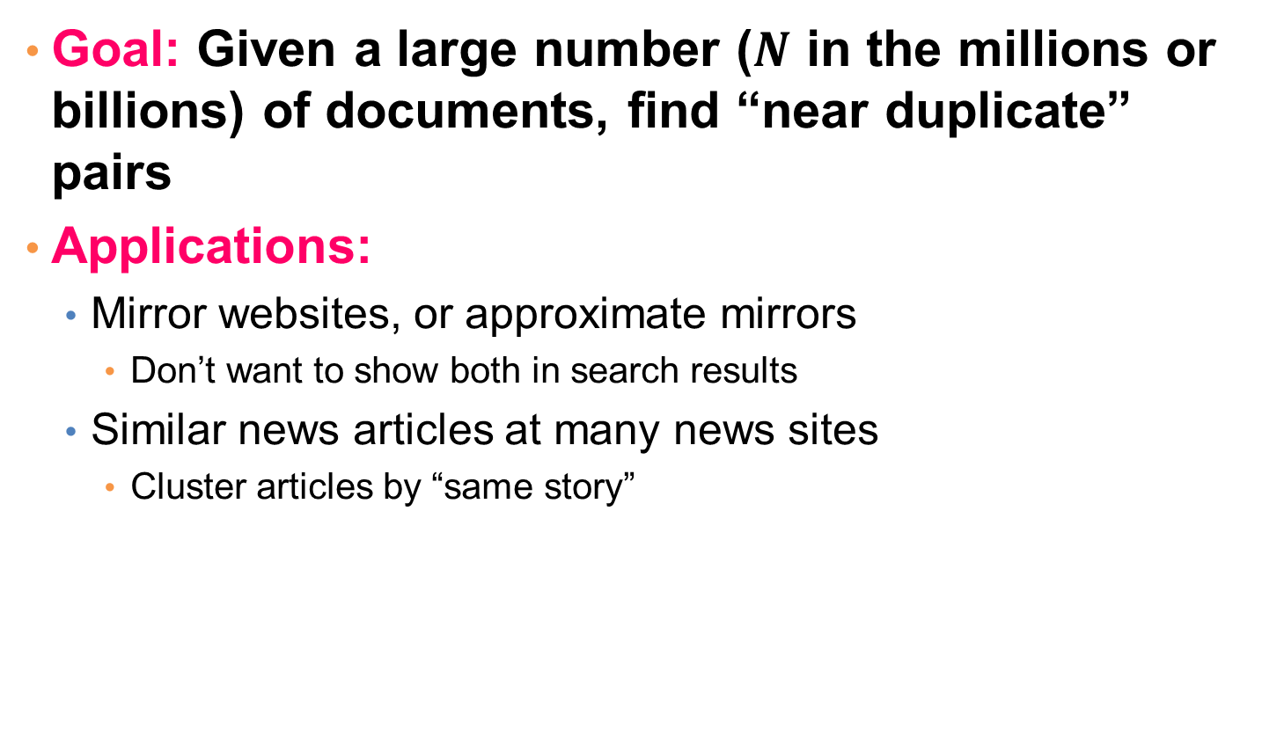
Task: Finding Similar Documents
Goal: Given a large number ($N$ in the millions or billions) of documents, find “near duplicate” pairs
Applications:
  Mirror websites, or approximate mirrors
    Don’t want to show both in search results
  Similar news articles at many news sites
    Cluster articles by “same story”

Slide 6
Main issues
What is the right representation of the document when we check for similarity?
  E.g., representing a document as a set of characters will not do (why?)
When we have billions of documents, keeping the full text in memory is not an option.
  We need to find a shorter representation
How do we do pairwise comparisons of billions of documents?
  If exact match was the issue it would be ok, can we replicate this idea?

Slide 7
3 Essential Steps for Similar Docs
Shingling: Convert documents to sets
Min-Hashing: Convert large sets to short signatures, while preserving similarity
Locality-Sensitive Hashing: Focus on
pairs of signatures likely to be from similar documents
  Candidate pairs!

Slide 8
The Big Picture
Candidate
pairs :
those pairs
of signatures
that we need
to test for
similarity.
Shingling
Minhash-
ing
Locality-
sensitive
Hashing
Docu-
ment
The set
of strings
of length k
that appear
in the doc-
ument
Signatures :
short integer
vectors that
represent the
sets, and
reflect their
similarity

Slide 9
Documents as High-Dim Data
Step 1: Shingling: Convert documents to sets
Simple approaches:
  Document = set of words appearing in document
  Document = set of “important” words
  Don’t work well for this application. Why?
Need to account for ordering of words!
A different way: Shingles!

Slide 10
Define: Shingles
A k-shingle (or k-gram) for a document is a sequence of k tokens that appears in the doc
  Tokens can be characters, words or something else, depending on the application
  Assume tokens = characters for examples
Example: k=2; document D₁ = abcab
Set of 2-shingles: S(D₁) = {ab, bc, ca}
  Option: Shingles as a bag (multiset), count ab twice: S’(D₁) = {ab, bc, ca, ab}

Slide 11
Examples: Word Shingles
Word Shingles (n-grams)
  "The quick brown fox jumps over the lazy dog."
  2-word shingles (bigrams):
  ["The quick", "quick brown", "brown fox", "fox jumps", "jumps over", "over the", "the lazy", "lazy dog"]
  3-word shingles (trigrams):
  ["The quick brown", "quick brown fox", "brown fox jumps", "fox jumps over", "jumps over the", "over the lazy", "the lazy dog"]

Slide 12
Examples: Character Shingles
Character Shingles with Spaces and Punctuation
"NLP is fun!"
3-character shingles:
["NLP", "LP ", "P i", " is", "is ", "s f", " fu", "fun", "un!"]
5-character shingles:
["NLP i", "LP is", "P is ", " is f", "is fu", "s fun", " fun!"]

Slide 13
Compressing Shingles
To compress long shingles, we can hash them to (say) 4 bytes
Represent a document by the set of hash values of its k-shingles
  Idea: Two documents could (rarely) appear to have shingles in common, when in fact only the hash-values were shared
Example: k=2; document D₁= abcab
Set of 2-shingles: S(D₁) = {ab, bc, ca}
Hash the singles: h(D₁) = {1, 5, 7}

Slide 14
Similarity Metric for Shingles
Document D₁ is a set of its k-shingles C₁=S(D₁)
Equivalently, each document is a 0/1 vector in the space of k-shingles
  Each unique shingle is a dimension
  Vectors are very sparse
A natural similarity measure is the
Jaccard similarity:
sim(D₁, D₂) = |C₁∩C₂|/|C₁∪C₂|

Slide 15
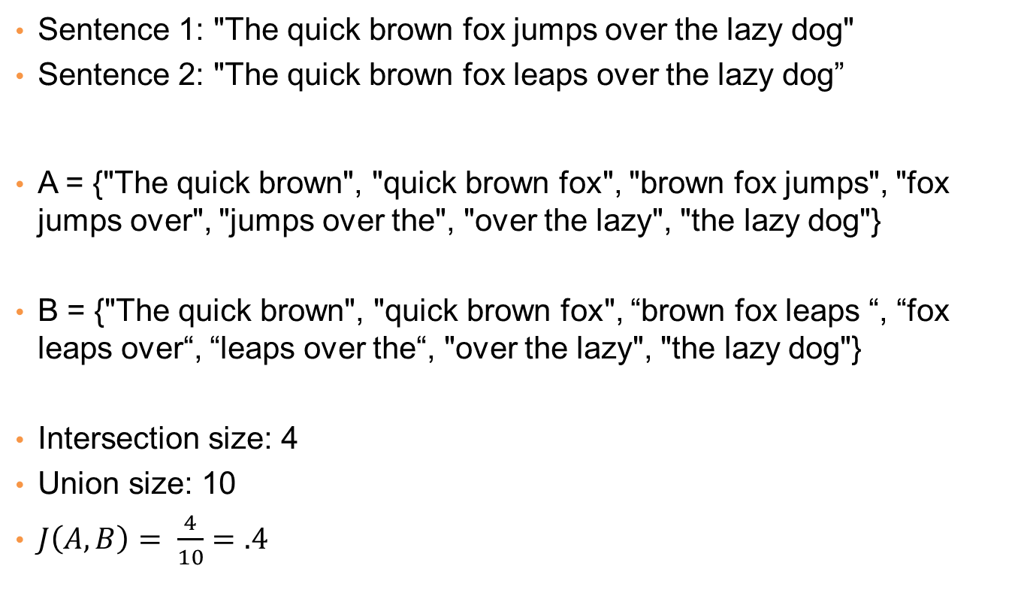
Example
Sentence 1: "The quick brown fox jumps over the lazy dog"
Sentence 2: "The quick brown fox leaps over the lazy dog”
A = {"The quick brown", "quick brown fox", "brown fox jumps", "fox jumps over", "jumps over the", "over the lazy", "the lazy dog"}
B = {"The quick brown", "quick brown fox", “brown fox leaps “, “fox leaps over“, “leaps over the“, "over the lazy", "the lazy dog"}
Intersection size: 4
Union size: 10
$J\left(A,B\right)= \frac{4}{10}=.4$

Slide 16
Working Assumption
Documents that have lots of shingles in common have similar text, even if the text appears in different order
Caveat: You must pick k large enough, or most documents will have most shingles
  k = 5 is OK for short documents
  k = 10 is better for long documents

Slide 17
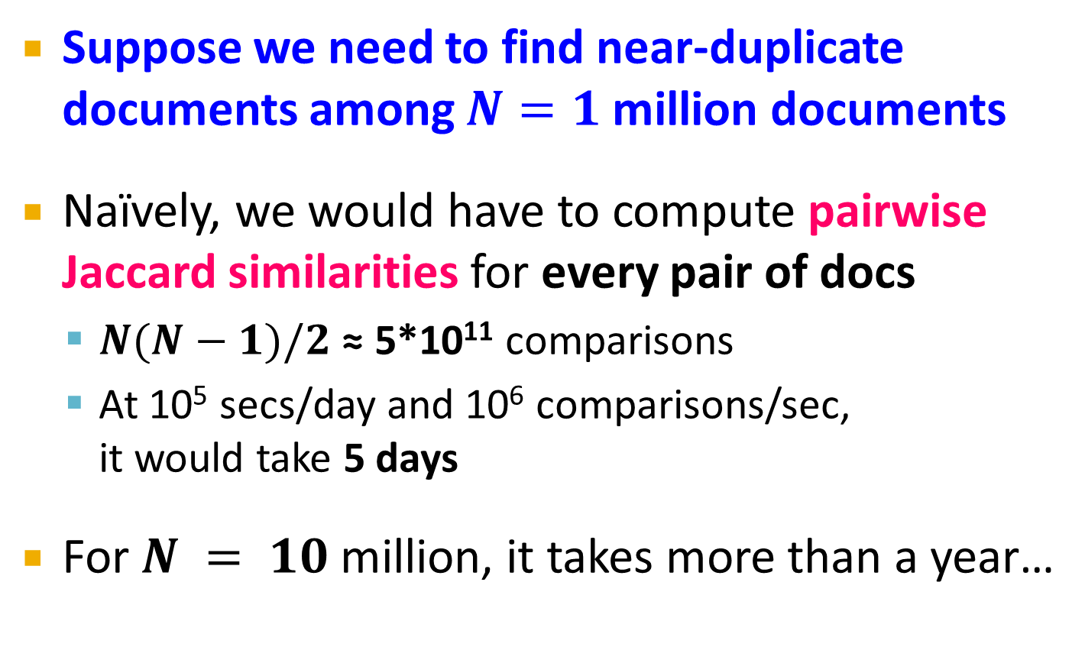
Motivation for Minhash/LSH
Suppose we need to find near-duplicate documents among $N=1$ million documents
Naïvely, we would have to compute pairwise
Jaccard similarities for every pair of docs
  $N(N−1)/2$ ≈ 5*10¹¹ comparisons
  At 10⁵ secs/day and 10⁶ comparisons/sec,
  it would take 5 days
For $N = 10$ million, it takes more than a year…

Slide 18
MinHashing
Shingling
Min-Hash-
ing
Docu-
ment
The set
of strings
of length k
that appear
in the doc-
ument
Signatures:
short integer
vectors that
represent the
sets, and
reflect their
similarity
Step 2: Minhashing: Convert large sets to short signatures, while preserving similarity

Slide 19
Encoding Sets as Bit Vectors
Many similarity problems can be
formalized as finding subsets that
have significant intersection
Encode sets using 0/1 (bit, boolean) vectors
  One dimension per element in the universal set
Interpret set intersection as bitwise AND, and
set union as bitwise OR
Example: C₁ = 10111; C₂ = 10011
  Size of intersection = 3; size of union = 4,
  Jaccard similarity (not distance) = 3/4
  Distance: d(C₁,C₂) = 1 – (Jaccard similarity) = 1/4

Slide 20
From Sets to Boolean Matrices
Rows = elements (shingles)
Columns = sets (documents)
  1 in row e and column s if and only if e is a member of s
  Column similarity is the Jaccard similarity of the corresponding sets (rows with value 1)
  Typical matrix is sparse!
Each document is a column:
  Example: sim(C₁ ,C₂) = ?
    Size of intersection = 3; size of union = 6,
    Jaccard similarity (not distance) = 3/6
    d(C₁,C₂) = 1 – (Jaccard similarity) = 3/6
Documents
1
1
1
0
1
1
0
1
0
1
0
1
0
0
0
1
Shingles
1
0
0
1
1
1
1
0
1
0
1
0

Slide 21
Outline: Finding Similar Columns
So far:
  Documents → Sets of shingles
  Represent sets as boolean vectors in a matrix
Next goal: Find similar columns while computing small signatures
  Similarity of columns == similarity of signatures

Slide 22
Outline: Finding Similar Columns
Next Goal: Find similar columns, Small signatures
Naïve approach:
  1) Signatures of columns: small summaries of columns
  2) Examine pairs of signatures to find similar columns
    Essential: Similarities of signatures and columns are related
  3) Optional: Check that columns with similar signatures are really similar

Slide 23
Hashing Columns (Signatures)
Key idea: “hash” each column C to a small signature h(C), such that:
  (1) h(C) is small enough that the signature fits in RAM
  (2) sim(C₁, C₂) is the same as the “similarity” of signatures h(C₁) and h(C₂)
Goal: Find a hash function h(·) such that:
  If sim(C₁,C₂) is high, then with high prob. h(C₁) = h(C₂)
  If sim(C₁,C₂) is low, then with high prob. h(C₁) ≠ h(C₂)
Hash docs into buckets. Expect that “most” pairs of near duplicate docs hash into the same bucket!

Slide 24
Min-Hashing
Goal: Find a hash function h(·) such that:
  if sim(C₁,C₂) is high, then with high prob. h(C₁) = h(C₂)
  if sim(C₁,C₂) is low, then with high prob. h(C₁) ≠ h(C₂)
Clearly, the hash function depends on
the similarity metric:
  Not all similarity metrics have a suitable
  hash function
There is a suitable hash function for
the Jaccard similarity: It is called Min-Hashing

Slide 25
Min-Hashing
Imagine the rows of the boolean matrix permuted under random permutation π
Define a “hash” function h_{π}(C) = the index of the first (in the permuted order π) row in which column C has value 1:
h_{π} (C) = min_{π} π(C)
Use several (e.g., 100) independent hash functions (that is, permutations) to create a signature of a column

Slide 26
Min-Hashing
Pick a random permutation of the rows (the universe U).
Define “hash” function for set S
  h(S) = the index of the first row (in the permuted order) in which column S has 1.
  OR
  h(S) = the index of the first element of S in the permuted order.
Use k (e.g., k = 100) independent random permutations to create a signature.

Slide 27
Example of minhash signatures
Input matrix
 | S₁ | S₂ | S₃ | S₄
A | 1 | 0 | 1 | 0
B | 1 | 0 | 0 | 1
C | 0 | 1 | 0 | 1
D | 0 | 1 | 0 | 1
E | 0 | 1 | 0 | 1
F | 1 | 0 | 1 | 0
G | 1 | 0 | 1 | 0
 |  | S₁ | S₂ | S₃ | S₄
1 | A | 1 | 0 | 1 | 0
2 | C | 0 | 1 | 0 | 1
3 | G | 1 | 0 | 1 | 0
4 | F | 1 | 0 | 1 | 0
5 | B | 1 | 0 | 0 | 1
6 | E | 0 | 1 | 0 | 1
7 | D | 0 | 1 | 0 | 1
A
C
G
F
B
E
D
1 | 2 | 1 | 2

Slide 28
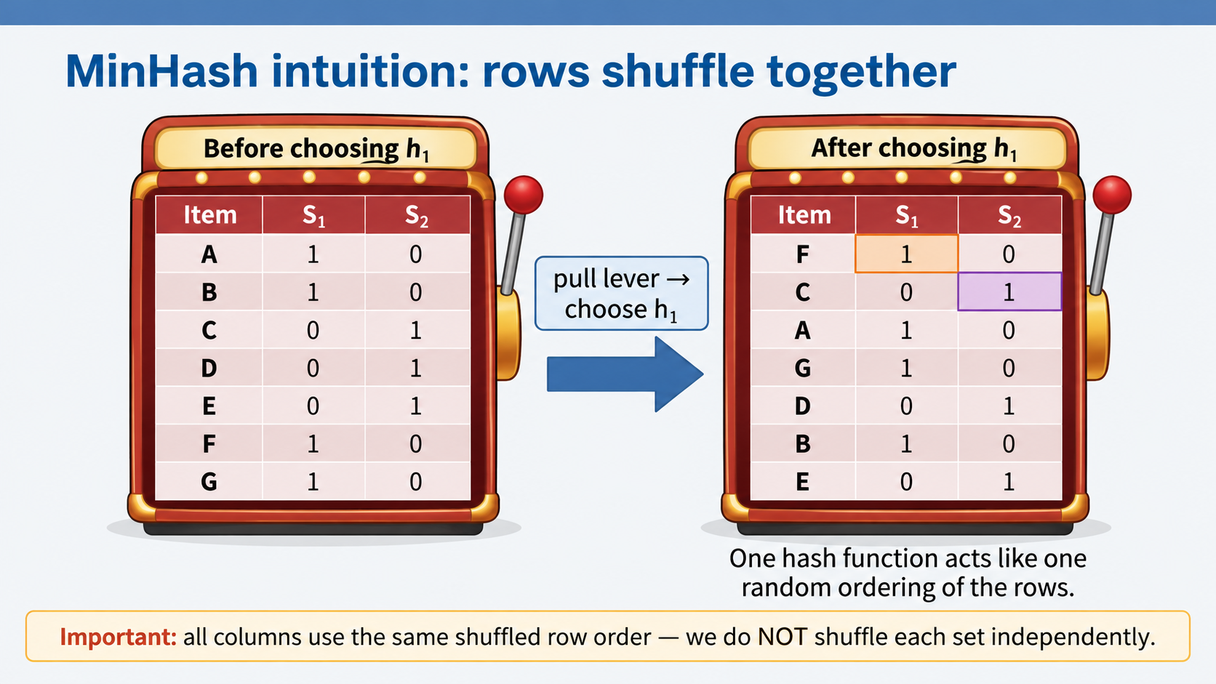

Slide 29
Example of minhash signatures
Input matrix
 | S₁ | S₂ | S₃ | S₄
A | 1 | 0 | 1 | 0
B | 1 | 0 | 0 | 1
C | 0 | 1 | 0 | 1
D | 0 | 1 | 0 | 1
E | 0 | 1 | 0 | 1
F | 1 | 0 | 1 | 0
G | 1 | 0 | 1 | 0
 |  | S₁ | S₂ | S₃ | S₄
1 | D | 0 | 1 | 0 | 1
2 | B | 1 | 0 | 0 | 1
3 | A | 1 | 0 | 1 | 0
4 | C | 0 | 1 | 0 | 1
5 | F | 1 | 0 | 1 | 0
6 | G | 1 | 0 | 1 | 0
7 | E | 0 | 1 | 0 | 1
D
B
A
C
F
G
E
2 | 1 | 3 | 1

Slide 30
Example of minhash signatures
Input matrix
 | S₁ | S₂ | S₃ | S₄
A | 1 | 0 | 1 | 0
B | 1 | 0 | 0 | 1
C | 0 | 1 | 0 | 1
D | 0 | 1 | 0 | 1
E | 0 | 1 | 0 | 1
F | 1 | 0 | 1 | 0
G | 1 | 0 | 1 | 0
 |  | S₁ | S₂ | S₃ | S₄
1 | C | 0 | 1 | 0 | 1
2 | D | 0 | 1 | 0 | 1
3 | G | 1 | 0 | 1 | 0
4 | F | 1 | 0 | 1 | 0
5 | A | 1 | 0 | 1 | 0
6 | B | 1 | 0 | 0 | 1
7 | E | 0 | 1 | 0 | 1
C
D
G
F
A
B
E
3 | 1 | 3 | 1

Slide 31
Example of minhash signatures
Input matrix
 | S₁ | S₂ | S₃ | S₄
A | 1 | 0 | 1 | 0
B | 1 | 0 | 0 | 1
C | 0 | 1 | 0 | 1
D | 0 | 1 | 0 | 1
E | 0 | 1 | 0 | 1
F | 1 | 0 | 1 | 0
G | 1 | 0 | 1 | 0
Signature matrix
 | S₁ | S₂ | S₃ | S₄
h₁ | 1 | 2 | 1 | 2
h₂ | 2 | 1 | 3 | 1
h₃ | 3 | 1 | 3 | 1
≈
Sig(S) = vector of hash values
  e.g., Sig(S₂) = [2,1,1]
Sig(S,i) = value of the i-th hash function for set S
  E.g., Sig(S₂,3) = 1

Slide 32
Hash function Property
Pr(h(S₁) = h(S₂)) = Sim(S₁,S₂)
where the probability is over all choices of permutations.
Why?
  The first row where one of the two sets has value 1 belongs to the union.
    Recall that union contains rows with at least one 1.
  We have equality if both sets have value 1, and this row belongs to the intersection

Slide 33
Example (informal proof)
Universe: U = {A,B,C,D,E,F,G}
X = {A,B,F,G}
Y = {A,E,F,G}
Union =
{A,B,E,F,G}
Intersection =
{A,F,G}
Rows C,D could be anywhere they do not affect the probability
 | X | Y
A | 1 | 1
B | 1 | 0
C | 0 | 0
D | 0 | 0
E | 0 | 1
F | 1 | 1
G | 1 | 1
 | X | Y
D | 0 | 0
C | 0 | 0
D
*
*
C
*
*
*

Slide 34
Example
Universe: U = {A,B,C,D,E,F,G}
X = {A,B,F,G}
Y = {A,E,F,G}
Union =
{A,B,E,F,G}
Intersection =
{A,F,G}
The * rows belong to the union
 | X | Y
A | 1 | 1
B | 1 | 0
C | 0 | 0
D | 0 | 0
E | 0 | 1
F | 1 | 1
G | 1 | 1
 | X | Y
D | 0 | 0
C | 0 | 0
D
*
*
C
*
*
*

Slide 35
Example
Universe: U = {A,B,C,D,E,F,G}
X = {A,B,F,G}
Y = {A,E,F,G}
Union =
{A,B,E,F,G}
Intersection =
{A,F,G}
The question is what is the value of the first * element
 | X | Y
A | 1 | 1
B | 1 | 0
C | 0 | 0
D | 0 | 0
E | 0 | 1
F | 1 | 1
G | 1 | 1
 | X | Y
D | 0 | 0
C | 0 | 0
D
*
*
C
*
*
*

Slide 36
Example
Universe: U = {A,B,C,D,E,F,G}
X = {A,B,F,G}
Y = {A,E,F,G}
Union =
{A,B,E,F,G}
Intersection =
{A,F,G}
If it belongs to the intersection then h(X) = h(Y)
 | X | Y
A | 1 | 1
B | 1 | 0
C | 0 | 0
D | 0 | 0
E | 0 | 1
F | 1 | 1
G | 1 | 1
 | X | Y
D | 0 | 0
C | 0 | 0
D
*
*
C
*
*
*

Slide 37
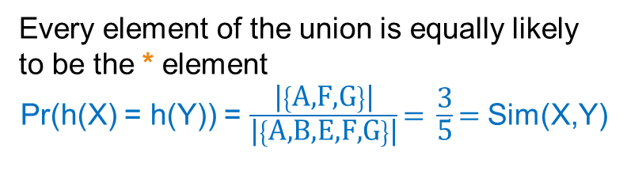
Example
Universe: U = {A,B,C,D,E,F,G}
X = {A,B,F,G}
Y = {A,E,F,G}
Union =
{A,B,E,F,G}
Intersection =
{A,F,G}
Every element of the union is equally likely to be the * element
Pr(h(X) = h(Y)) = $\frac{\text{|}\left\{\text{A,F,G}\right\}\text{|}}{\text{|}\left\{\text{A,B,E,F,G}\right\}\text{|}}\text{= }\frac{\text{3}}{\text{5}}\text{= }$Sim(X,Y)
 | X | Y
A | 1 | 1
B | 1 | 0
C | 0 | 0
D | 0 | 0
E | 0 | 1
F | 1 | 1
G | 1 | 1
 | X | Y
D | 0 | 0
C | 0 | 0
D
*
*
C
*
*
*

Slide 38
Similarity for Signatures
The similarity of signatures is the fraction of the hash functions in which they agree.
With multiple signatures we get a good approximation
 | S₁ | S₂ | S₃ | S₄
A | 1 | 0 | 1 | 0
B | 1 | 0 | 0 | 1
C | 0 | 1 | 0 | 1
D | 0 | 1 | 0 | 1
E | 0 | 1 | 0 | 1
F | 1 | 0 | 1 | 0
G | 1 | 0 | 1 | 0
Signature matrix
 | Actual | Sig
(S₁, S₂) | 0 | 0
(S₁, S₃) | 3/5 | 2/3
(S₁, S₄) | 1/7 | 0
(S₂, S₃) | 0 | 0
(S₂, S₄) | 3/4 | 1
(S₃, S₄) | 0 | 0
S₁ | S₂ | S₃ | S₄
1 | 2 | 1 | 2
2 | 1 | 3 | 1
3 | 1 | 3 | 1
≈
Zero similarity is preserved
High similarity is well approximated

Slide 39
Is it now feasible?
Assume a billion rows
Hard to pick a random permutation of 1…billion
Even representing a random permutation requires 1 billion entries!!!
How about accessing rows in permuted order? ☹

Slide 40
Being more practical
Instead of permuting the rows we will apply a hash function that maps the rows to a new (possibly larger) space
  The value of the hash function is the position of the row in the new order (permutation).
  Each set is represented by the smallest hash value among the elements in the set
The space of the hash functions should be such that if we select one at random each element (row) has equal probability to have the smallest value
  Min-wise independent hash functions

Slide 41
Example: 4 documents
D1: "The quick brown fox jumps over the lazy dog"
D2: "The fast brown fox jumps over the lazy dog"
D3: "A quick brown fox leaps over the sleepy dog"
D4: "The quick fox jumps high over the dog"

Slide 42
Step 1: Generate 3-Word Shingles
We extract overlapping sequences of 3 consecutive words from each document.
Shingles for Each Document:
  D1: "The quick brown fox jumps over the lazy dog"
  → {"The quick brown", "quick brown fox", "brown fox jumps", "fox jumps over", "jumps over the", "over the lazy", "the lazy dog"}
  D2: "The fast brown fox jumps over the lazy dog"
  → {"The fast brown", "fast brown fox", "brown fox jumps", "fox jumps over", "jumps over the", "over the lazy", "the lazy dog"}
  D3: "A quick brown fox leaps over the sleepy dog"
  → {"A quick brown", "quick brown fox", "brown fox leaps", "fox leaps over", "leaps over the", "over the sleepy", "the sleepy dog"}
  D4: "The quick fox jumps high over the dog"
  → {"The quick fox", "quick fox jumps", "fox jumps high", "jumps high over", "high over the", "over the dog"}

Slide 43
Step 2: Shingle-Document Matrix
Index | Shingle (3-gram) | D1 | D2 | D3 | D4
1 | The quick brown | 1 | 0 | 0 | 1
2 | quick brown fox | 1 | 0 | 1 | 1
3 | brown fox jumps | 1 | 1 | 0 | 0
4 | fox jumps over | 1 | 1 | 0 | 0
5 | jumps over the | 1 | 1 | 0 | 0
6 | over the lazy | 1 | 1 | 0 | 0
7 | the lazy dog | 1 | 1 | 0 | 0
8 | The fast brown | 0 | 1 | 0 | 0
9 | A quick brown | 0 | 0 | 1 | 0
10 | brown fox leaps | 0 | 0 | 1 | 0
11 | fox leaps over | 0 | 0 | 1 | 0
12 | leaps over the | 0 | 0 | 1 | 0
13 | over the sleepy | 0 | 0 | 1 | 0
14 | the sleepy dog | 0 | 0 | 1 | 0
15 | The quick fox | 0 | 0 | 0 | 1
16 | quick fox jumps | 0 | 0 | 0 | 1
17 | fox jumps high | 0 | 0 | 0 | 1
18 | jumps high over | 0 | 0 | 0 | 1
19 | high over the | 0 | 0 | 0 | 1
20 | over the dog | 0 | 0 | 0 | 1

Slide 44
Step 3: Permutations
Permutation 1: [2, 5, 4, 8, 7, 11, 3, 13, 10, 20, 16, 19, 1, 9, 15, 14, 17, 12, 6, 18]
Permutation 2: [4, 10, 2, 17, 12, 8, 6, 15, 13, 9, 1, 11, 20, 5, 19, 3, 7, 16, 14, 18]
Permutation 3: [18, 4, 16, 20, 6, 12, 11, 14, 9, 15, 3, 19, 2, 1, 13, 10, 8, 17, 5, 7]

Slide 45
Permutation 1: [2, 5, 4, 8, 7, 11, 3, 13, 10, 20, 16, 19, 1, 9, 15, 14, 17, 12, 6, 18]
New Index | Shingle | D1 | D2 | D3 | D4
1 | quick brown fox | 1 | 0 | 1 | 0
2 | jumps over the | 1 | 1 | 0 | 0
3 | fox jumps over | 1 | 1 | 0 | 0
4 | The fast brown | 0 | 1 | 0 | 0
5 | the lazy dog | 1 | 1 | 0 | 0
6 | fox leaps over | 0 | 0 | 1 | 0
7 | brown fox jumps | 1 | 1 | 0 | 0
8 | over the sleepy | 0 | 0 | 1 | 0
9 | brown fox leaps | 0 | 0 | 1 | 0
10 | over the dog | 0 | 0 | 0 | 1
11 | quick fox jumps | 0 | 0 | 0 | 1
12 | high over the | 0 | 0 | 0 | 1
13 | The quick brown | 1 | 0 | 0 | 0
14 | fast brown fox | 0 | 1 | 0 | 0
15 | The quick fox | 0 | 0 | 0 | 1
16 | the sleepy dog | 0 | 0 | 1 | 0
17 | fox jumps high | 0 | 0 | 0 | 1
18 | leaps over the | 0 | 0 | 1 | 0
19 | over the lazy | 1 | 1 | 0 | 0
20 | jumps high over | 0 | 0 | 0 | 1

Slide 46
Permutation 2: [4, 10, 2, 17, 12, 8, 6, 15, 13, 9, 1, 11, 20, 5, 19, 3, 7, 16, 14, 18]
New Index | Shingle | D1 | D2 | D3 | D4
1 | fox jumps over | 1 | 1 | 0 | 0
2 | brown fox leaps | 0 | 0 | 1 | 0
3 | quick brown fox | 1 | 0 | 1 | 0
4 | fox jumps high | 0 | 0 | 0 | 1
5 | leaps over the | 0 | 0 | 1 | 0
6 | The fast brown | 0 | 1 | 0 | 0
7 | over the lazy | 1 | 1 | 0 | 0
8 | The quick fox | 0 | 0 | 0 | 1
9 | over the sleepy | 0 | 0 | 1 | 0
10 | fast brown fox | 0 | 1 | 0 | 0
11 | The quick brown | 1 | 0 | 0 | 0
12 | fox leaps over | 0 | 0 | 1 | 0
13 | over the dog | 0 | 0 | 0 | 1
14 | jumps over the | 1 | 1 | 0 | 0
15 | high over the | 0 | 0 | 0 | 1
16 | brown fox jumps | 1 | 1 | 0 | 0
17 | the lazy dog | 1 | 1 | 0 | 0
18 | quick fox jumps | 0 | 0 | 0 | 1
19 | the sleepy dog | 0 | 0 | 1 | 0
20 | jumps high over | 0 | 0 | 0 | 1

Slide 47
Permutation 2: [18, 4, 16, 20, 6, 12, 11, 14, 9, 15, 3, 19, 2, 1, 13, 10, 8, 17, 5, 7]
New Index | Shingle | D1 | D2 | D3 | D4
1 | jumps high over | 0 | 0 | 0 | 1
2 | fox jumps over | 1 | 1 | 0 | 0
3 | quick fox jumps | 0 | 0 | 0 | 1
4 | over the dog | 0 | 0 | 0 | 1
5 | over the lazy | 1 | 1 | 0 | 0
6 | leaps over the | 0 | 0 | 1 | 0
7 | fox leaps over | 0 | 0 | 1 | 0
8 | the sleepy dog | 0 | 0 | 1 | 0
9 | fast brown fox | 0 | 1 | 0 | 0
10 | The quick fox | 0 | 0 | 0 | 1
11 | brown fox jumps | 1 | 1 | 0 | 0
12 | high over the | 0 | 0 | 0 | 1
13 | quick brown fox | 1 | 0 | 1 | 0
14 | The quick brown | 1 | 0 | 0 | 0
15 | over the sleepy | 0 | 0 | 1 | 0
16 | brown fox leaps | 0 | 0 | 1 | 0
17 | The fast brown | 0 | 1 | 0 | 0
18 | fox jumps high | 0 | 0 | 0 | 1
19 | jumps over the | 1 | 1 | 0 | 0
20 | the lazy dog | 1 | 1 | 0 | 0

Slide 48
Step 4: MinHash Signature Matrix
Permutation | D1 | D2 | D3 | D4
P1 | 1 | 2 | 1 | 10
P2 | 1 | 1 | 2 | 4
P3 | 1 | 1 | 6 | 1
Step 5: Compute Jaccard Similarity Approximation
Jaccard similarity is estimated by counting how many times two columns match
D1 vs D2: 2/3
D1 vs D3: 1/3
D1 vs D4: 1/3
D2 vs D3: 0/3
D2 vs D4: 1/3
D3 vs D4: 0/3

Slide 49
Algorithm – One set, one hash function
Computing Sig(S,i) for a single column S and single hash function h_{i}
for each row r
compute h_{i} (r )
if column S has 1 in row r then
if h_{i} (r ) is a smaller value than Sig(S,i) then
  Sig(S,i) = h_{i} (r);
In practice only the rows (shingles) that appear in the data
h_{i} (r) = index of row r in permutation
S contains row r
Find the row r with minimum index
Sig(S,i) will become the smallest value of h_{i}(r) among all rows (shingles) for which column S has value 1 (shingle belongs in S); i.e., h_{i} (r) gives the min index for the i-th permutation

Slide 50
How to pick a random hash function h(x)?
Universal hashing:
h_{a,b}(x)=((a·x+b) mod p) mod N
where:
a,b … random integers
p … prime number (p > N)

Slide 51
Algorithm – All sets, k hash functions
Pick k=100 hash functions (h₁,…,h_{k})
for each row r
for each hash function h_{i}
compute h_{i} (r )
for each column S that has 1 in row r
if h_{i} (r ) is a smaller value than Sig(S,i) then
  Sig(S,i) = h_{i} (r);
In practice this means selecting the hash function parameters
Compute h_{i} (r) only once for all sets

Slide 52
Example
Sig1 Sig2
h(0) = 1 1 -
g(0) = 3 3 -
x
0
1
2
3
4
Row S1 S2
A 1 0
B 0 1
C 1 1
D 1 0
E 0 1
h(x)
1
2
3
4
0
g(x)
3
0
2
4
1
h(1) = 2 1 2
g(1) = 0 3 0
h(2) = 3 1 2
g(2) = 2 2 0
h(3) = 4 1 2
g(3) = 4 2 0
h(x) = x+1 mod 5
g(x) = 2x+3 mod 5
h(Row)
0
1
2
3
4
Row S1 S2
E 0 1
A 1 0
B 0 1
C 1 1
D 1 0
g(Row)
0
1
2
3
4
Row S1 S2
B 0 1
E 0 1
C 1 0
A 1 1
D 1 0
h(4) = 0 1 0
g(4) = 1 2 0

Slide 53
Example Walkthrough
Index | Shingle (3-gram) | D1 | D2 | D3 | D4
1 | The quick brown | 1 | 0 | 0 | 1
2 | quick brown fox | 1 | 0 | 1 | 1
3 | brown fox jumps | 1 | 1 | 0 | 0
4 | fox jumps over | 1 | 1 | 0 | 0
5 | jumps over the | 1 | 1 | 0 | 0
We have 3 hash functions:
h₁(x)=(2x+1) mod 7
h₂(x)=(3x+4) mod 7
h₃(x)=(5x+2) mod 7

Slide 54
Step : Initialize the MinHash Signature Matrix with ∞:
Hash Function | D1 | D2 | D3 | D4
h1(x) | ∞ | ∞ | ∞ | ∞
h2(x) | ∞ | ∞ | ∞ | ∞
h3(x) | ∞ | ∞ | ∞ | ∞

Slide 55
Step 2: Compute the hash values for each row (shingle index)
Index | h1(x) | h2(x) | h3(x)
1 | 3 | 0 | 0
2 | 5 | 3 | 4
3 | 0 | 6 | 3
4 | 2 | 2 | 6
5 | 4 | 5 | 2
We have 3 hash functions:
h₁(x)=(2x+1) mod 7
h₂(x)=(3x+4) mod 7
h₃(x)=(5x+2) mod 7

Slide 56
Step 3: Populate the Signature Matrix
Now, we iterate shingle by shingle, updating the minimum hash value for each document.
Processing Row 1 (Shingle s1)
Hash values:
  h1(1) = 3; h2(1) = 0; h3​(1) = 0
Row 1 has 1’s in D1 and D4, so update their signatures:
Hash Function | D1 | D2 | D3 | D4
h1(x) | 3 | ∞ | ∞ | 3
h2(x) | 0 | ∞ | ∞ | 0
h3(x) | 0 | ∞ | ∞ | 0

Slide 57
Step 3: Populate the Signature Matrix
Now, we iterate shingle by shingle, updating the minimum hash value for each document.
Processing Row 2 (Shingle s2)
Hash values:
  h1(2) = 5; h2(2) = 3; h3​(2) = 4
Row 2 has 1’s in D1 and D3, so update if smaller:
Hash Function | D1 | D2 | D3 | D4
h1(x) | 3 | ∞ | 5 | 3
h2(x) | 0 | ∞ | 3 | 0
h3(x) | 0 | ∞ | 4 | 0

Slide 58
Step 3: Populate the Signature Matrix
Now, we iterate shingle by shingle, updating the minimum hash value for each document.
Processing Row 3 (Shingle s3)
Hash values:
  h1(3) = 0; h2(3) = 6; h3​(3) = 3
Row 2 has 1’s in D1 and D2, so update if smaller:
Hash Function | D1 | D2 | D3 | D4
h1(x) | 0 | 0 | 5 | 3
h2(x) | 0 | 6 | 3 | 0
h3(x) | 0 | 3 | 4 | 0

Slide 59
Step 3: Populate the Signature Matrix
Now, we iterate shingle by shingle, updating the minimum hash value for each document.
Processing Row 4 (Shingle s4)
Hash values:
  h1(4) = 2; h2(4) = 2; h3​(4) = 6
Row 2 has 1’s in D1 and D2, so update if smaller:
Hash Function | D1 | D2 | D3 | D4
h1(x) | 0 | 0 | 5 | 3
h2(x) | 0 | 2 | 3 | 0
h3(x) | 0 | 3 | 4 | 0

Slide 60
Step 3: Populate the Signature Matrix
Now, we iterate shingle by shingle, updating the minimum hash value for each document.
Processing Row 5 (Shingle s5)
Hash values:
  h1(5) = 4; h2(5) = 5; h3​(5) = 2
Row 2 has 1’s in D1 and D2, so update if smaller:
Hash Function | D1 | D2 | D3 | D4
h1(x) | 0 | 0 | 5 | 3
h2(x) | 0 | 2 | 3 | 0
h3(x) | 0 | 3 | 4 | 0

Slide 61
Final MinHash Signature Matrix
Hash Function | D1 | D2 | D3 | D4
h1(x) | 0 | 0 | 5 | 3
h2(x) | 0 | 2 | 3 | 0
h3(x) | 0 | 3 | 4 | 0
After processing all shingles, we obtain the final MinHash Signature Matrix, which approximates Jaccard Similarity.
D1 vs D2: 1/3
D1 vs D3: 0/3
D1 vs D4: 2/3
D2 vs D3: 0/3
D2 vs D4: 0/3
D3 vs D4: 0/3

Slide 62
Implementation
Often, data is given by column, not row.
  E.g., columns = documents, rows = shingles.
If so, sort matrix once so it is by row.
And always compute h_{i} (r ) only once for each row.

Slide 63
Candidate
pairs:
those pairs
of signatures
that we need
to test for
similarity
Shingling
Min-Hash-
ing
Locality-
Sensitive
Hashing
Docu-
ment
The set
of strings
of length k
that appear
in the doc-
ument
Signatures:
short integer
vectors that
represent the
sets, and
reflect their
similarity
Step 3: Locality-Sensitive Hashing:
Focus on pairs of signatures likely to be from similar documents

Slide 64
LSH: First Cut
Goal: Find documents with Jaccard similarity at least s (for some similarity threshold, e.g., s=0.8)
LSH – General idea: Use a function f(x,y) that tells whether x and y is a candidate pair: a pair of elements whose similarity must be evaluated
For Min-Hash matrices:
  Hash columns of signature matrix M to many buckets
  Each pair of documents that hashes into the
  same bucket is a candidate pair

Slide 65
Candidates from Min-Hash
Pick a similarity threshold s (0 < s < 1)
Columns x and y of M are a candidate pair if their signatures agree on at least fraction s of their rows:
M (i, x) = M (i, y) for at least frac. s values of i
  We expect documents x and y to have the same (Jaccard) similarity as their signatures

Slide 66
LSH for Min-Hash
Big idea: Hash columns of
signature matrix M several times
Arrange that (only) similar columns are likely to hash to the same bucket, with high probability
Candidate pairs are those that hash to the same bucket

Slide 67
Finding similar pairs
Problem: Find all pairs of documents with similarity at least t = 0.8
While the signatures of all columns may fit in main memory, comparing the signatures of all pairs of columns is quadratic in the number of columns.
Example: 10⁶ columns implies 5*10¹¹ column-comparisons.
At 1 microsecond/comparison: 6 days.

Slide 68
Locality-Sensitive Hashing
What we want: a function f(X,Y) that tells whether or not X and Y is a candidate pair: a pair of elements whose similarity must be evaluated.
A simple idea: X and Y are a candidate pair if they have the same min-hash signature.
  Easy to test by hashing the signatures.
  Similar sets are more likely to have the same signature.
  Likely to produce many false negatives.
    Requiring full match of signature is strict, some similar sets will be lost.
Improvement: Compute multiple signatures; candidate pairs should have at least one common signature.
  Reduce the probability for false negatives.
! Multiple levels of Hashing!

Slide 69
Signature matrix reminder
Prob(Sig(S,i) == Sig(S’,i)) = sim(S,S’)
Sig(S,i)
Sig(S’,i)
hash function i
n hash functions
Sig(S):
signature for set S
signature for set S’
Matrix M

Slide 70
Partition into Bands – (1)
Divide the signature matrix Sig into b bands of r rows.
  Each band is a mini-signature with r hash functions.

Slide 71
Partitioning into bands
n = b*r hash functions
r rows
per band
b bands
b mini-signatures
One
signature
Matrix Sig

Slide 72
Partition into Bands – (2)
Divide the signature matrix Sig into b bands of r rows.
  Each band is a mini-signature with r hash functions.
For each band, hash the mini-signature to a hash table with k buckets.
  Make k as large as possible so that mini-signatures that hash to the same bucket are almost certainly identical.

Slide 73
Hash Table
Columns 2 and 6
are (almost certainly) identical.
Columns 6 and 7 are
surely different.
Matrix M
1
2
3
4
5
6
7
r rows
b bands

Slide 74
Partition into Bands – (3)
Divide the signature matrix Sig into b bands of r rows.
  Each band is a mini-signature with r hash functions.
For each band, hash the mini-signature to a hash table with k buckets.
  Make k as large as possible so that mini-signatures that hash to the same bucket are almost certainly identical.
Candidate column pairs are those that hash to the same bucket for at least 1 band.
Tune b and r to catch most similar pairs, but few non-similar pairs.

Slide 75
Example of LSH
MinHash Signature Matrix for 4 documents, with 6 hash functions
Hash Function | D1 | D2 | D3 | D4
h1(x) | 2 | 3 | 1 | 2
h2(x) | 1 | 1 | 2 | 2
h3(x) | 3 | 2 | 3 | 1
h4(x) | 1 | 3 | 2 | 1
h5(x) | 2 | 2 | 1 | 3
h6(x) | 3 | 1 | 3 | 2

Slide 76
Step 2: Divide into Bands
Let’s say we divide the signature into 3 bands of 2 rows each.
Band | Hash Function | D1 | D2 | D3 | D4
Band 1 | (h1, h2) | (2, 1) | (3, 1) | (1, 2) | (2, 2)
Band 2 | (h3, h4) | (3, 1) | (2, 3) | (3, 2) | (1, 1)
Band 3 | (h5, h6) | (2, 3) | (2, 1) | (1, 3) | (3, 2)

Slide 77
Step 1: Divide into Bands
Let’s say we divide the signature into 3 bands of 2 rows each.
Band | Hash Function | D1 | D2 | D3 | D4
Band 1 | (h1, h2) | (2, 1) | (3, 1) | (1, 2) | (2, 2)
Band 2 | (h3, h4) | (3, 1) | (2, 3) | (3, 2) | (1, 1)
Band 3 | (h5, h6) | (2, 3) | (2, 1) | (1, 3) | (3, 2)

Slide 78
Step 2: Hash each Band
Each band hashed into buckets.
Band | D1 bucket | D2 bucket | D3 bucket | D4 bucket
Band 1 | hash(2, 1) → 5 | hash(3, 1) → 6 | hash(1, 2) → 7 | hash(2, 2) → 8
Band 2 | hash(3, 1) → 9 | hash(2, 3) → 4 | hash(3, 2) → 10 | hash(1, 1) → 9
Band 3 | hash(2, 3) → 4 | hash(2, 1) → 11 | hash(1, 3) → 12 | hash(3, 2) → 10

Slide 79
Step 3: Identify Candidate Pairs
Band 2: D1 and D4 are in the same bucket (9) → Candidate Pair
Band 3: D3 and D4 are in the same bucket (10) → Candidate Pair
Band 3: D1 and D2 are in the same bucket (4) → Candidate Pair
Instead of comparing all pairs, we only compare these candidate pairs!

Slide 80
Intuition: Why does it work?
LSH divides the MinHash signature matrix into b bands with r rows each and hashes each band separately. Two documents are considered a candidate pair if they share at least one band.
Key Idea: Amplifying Similarity Differences
Highly Similar Documents → High Probability of Collision
  If two documents have a high Jaccard Similarity, their MinHash signatures will be similar.
  By dividing the signature into bands and requiring a match in at least one band, we ensure that highly similar documents will likely be detected.
Dissimilar Documents → Low Probability of Collision
  If two documents have low Jaccard Similarity, their MinHash signatures will be different.
  The bands heuristic ensures that unless they are accidentally similar in at least one full band, they are not considered candidates.

Slide 81
Analysis of LSH – What We Want
Probability
= 1 if s > t
Probability
of sharing
a bucket
No chance
if s < t
t
Similarity s of two sets

Slide 82
What One Band of One Row Gives You
Single hash signature
Probability
of sharing
a bucket
Remember:
probability of
equal hash-values
= similarity
t
Prob(Sig(S,i) == Sig(S’,i)) = sim(S,S’)
Similarity s of two sets

Slide 83
What b Bands of r Rows Gives You
At least
one band
identical
No bands
identical
(
s ^{r}
t ~ (1/b)^{1/r}
1 -
1 -
)^{b}
Probability
of sharing
a bucket
Some row
of a band
unequal
All rows
of a band
are equal
t
Similarity s of two sets

Slide 84
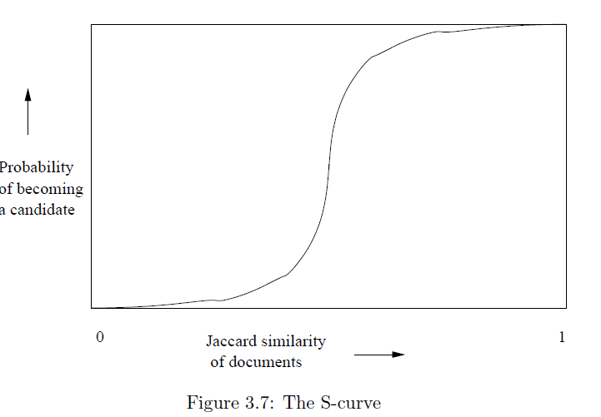
Example: b = 20; r = 5
t = 0.5
s | 1-(1-s^{r})^{b}
.2 | .006
.3 | .047
.4 | .186
.5 | .470
.6 | .802
.7 | .975
.8 | .9996

Slide 85
Suppose S₁, S₂ are 80% Similar
We want all 80%-similar pairs. Choose 20 bands of 5 integers/band.
Probability S₁, S₂ identical in one particular band:
(0.8)⁵ = 0.328.
Probability S₁, S₂ are not similar in any of the 20 bands:
(1-0.328)²⁰ = 0.00035
    i.e., about 1/3000-th of the 80%-similar column pairs are false negatives.
Probability S₁, S₂ are similar in at least one of the 20 bands:
1-0.00035 = 0.999

Slide 86
C₁, C₂ are 30% Similar
Find pairs of ≥ s=0.8 similarity, set b=20, r=5
Assume: sim(C₁, C₂) = 0.3
  Since sim(C₁, C₂) < s we want C₁, C₂ to hash to NO
  common buckets (all bands should be different)
Probability C₁, C₂ identical in one particular band: (0.3)⁵ = 0.00243
Probability C₁, C₂ identical in at least 1 of 20 bands: 1 - (1 - 0.00243)²⁰ = 0.0474
  In other words, approximately 4.74% pairs of docs with similarity 0.3% end up becoming candidate pairs
    They are false positives since we will have to examine them (they are candidate pairs) but then it will turn out their similarity is below threshold s

Slide 87
LSH Summary
Tune to get almost all pairs with similar signatures, but eliminate most pairs that do not have similar signatures.
Check in main memory that candidate pairs really do have similar signatures.
Optional: In another pass through data, check that the remaining candidate pairs really represent similar sets .

Slide 88
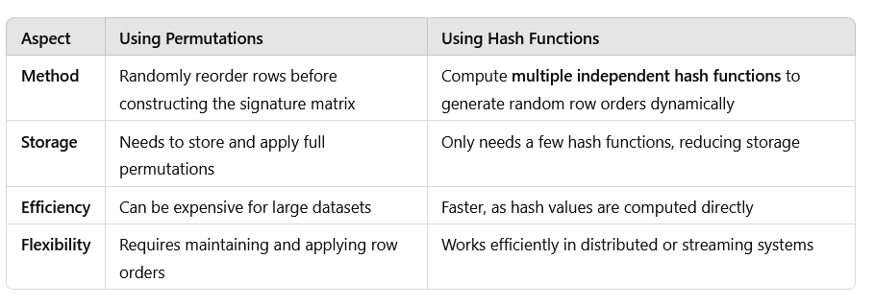
Key Differences Between Using Hash Functions and Explicit Permutations

Slide 89
Locality-sensitive hashing (LSH)
Big Picture: Construct hash functions h: R^{d}→ U such that for any pair of points p, q, for distance function D we have:
  If D(p,q)≤r, then Pr[h(p)=h(q)] ≥ α is high
  If D(p,q)≥cr, then Pr[h(p)=h(q)] ≤ β is small
Then, we can find close pairs by hashing
LSH is a general framework: for a given distance function D we need to find the right h
  h is (r,cr, α, β)-sensitive

Slide 90
Applications
Entity Matching/Record Linkage
Advertising Matching
Image Search
News Article
Fingerprints

