Slide 1
CIS 4517/5517:
Data Intensive and Cloud Computing
Map-Reduce
Credit:
  Most slides are adapted from: http://www.mmds.org
  Mining of Massive Datasets, by Jure Leskovec, Anand Rajaraman, Jeff Ullman
Read Chapter 2 of “Mining of Massive Datasets” at http://www.mmds.org

Slide 2
Why Hadoop and MapReduce?
In the era of big data, how to process data efficiently in a timely and cost-effective manner?
A platform→Hadoop
A programming model→MapReduce
Together, a reliable, scalable, and distributed computing platform for parallel processing of very large datasets.

Slide 3
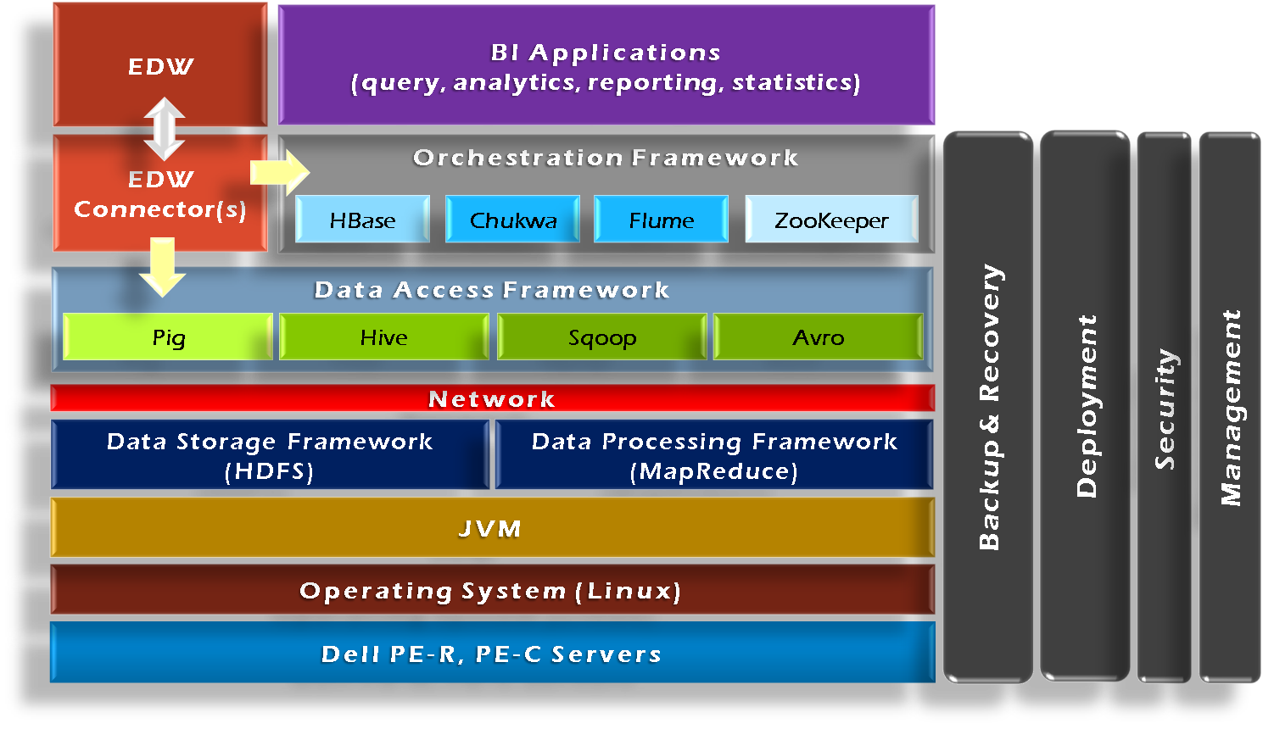

Hadoop Framework Tools
Essential modules: HDFS and MapRedcue

Slide 4
Programming Model: MapReduce
Warm-up task:
We have a huge text document
Count the number of times each
distinct word appears in the file
Sample application:
  Analyze web server logs to find popular URLs

Slide 5
Task: Word Count
Case 1:
  File too large for memory, but all <word, count> pairs fit in memory
Case 2:
Count occurrences of words:
  words(doc.txt) | sort | uniq -c
    where words takes a file and outputs the words in it, one per a line
Case 2 captures the essence of MapReduce
  Great thing is that it is naturally parallelizable

Slide 6
MapReduce: Overview
Sequentially read a lot of data
Map:
  Extract something you care about
Group by key: Sort and Shuffle
Reduce:
  Aggregate, summarize, filter or transform
Write the result
Outline stays the same, Map and Reduce change to fit the problem

Slide 7
MapReduce: The Map Step
Input
key-value pairs
Intermediate
key-value pairs
k
v
map
k
v
k
v
map
k
v
k
v
…
…
k
v
k
v

Slide 8
MapReduce: The Reduce Step
Output
key-value pairs
Intermediate
key-value pairs
Key-value groups
reduce
k
v
k
v
v
v
k
v
Group
by key
reduce
k
v
k
v
v
k
v
k
v
…
…
…
k
v
k
v
k
v

Slide 9
More Specifically
Input: a set of key-value pairs
Programmer specifies two methods:
  Map(k, v) → <k’, v’>*
    Takes a key-value pair and outputs a set of key-value pairs
      E.g., key is the filename, value is a single line in the file
    There is one Map call for every (k,v) pair
  Reduce(k’, <v’>*) → <k’, v’’>*
    All values v’ with same key k’ are reduced together
    and processed in v’ order
    There is one Reduce function call per unique key k’

Slide 10
MapReduce: Word Counting
Provided by the programmer
Provided by the programmer
MAP:
Read input and produces a set of key-value pairs
Group by key:
Collect all pairs with same key
Reduce:
Collect all values belonging to the key and output
The crew of the space shuttle Endeavor recently returned to Earth as ambassadors, harbingers of a new era of space exploration. Scientists at NASA are saying that the recent assembly of the Dextre bot is the first step in a long-term space-based man/mache partnership. '"The work we're doing now -- the robotics we're doing -- is what we're going to need ……………………..
(The, 1)
(crew, 1)
(of, 1)
(the, 1)
(space, 1)
(shuttle, 1)
(Endeavor, 1)
(recently, 1)
….
(crew, 1)
(crew, 1)
(space, 1)
(the, 1)
(the, 1)
(the, 1)
(shuttle, 1)
(recently, 1)
…
(crew, 2)
(space, 1)
(the, 3)
(shuttle, 1)
(recently, 1)
…
Sequentially read the data
Only sequential reads
Big document
(key, value)
(key, value)
(key, value)

Slide 11
Hadoop Word Count Mapper
public class WordCountMapper extends MapReduceBase
implements Mapper {
private final static Text word = new Text();
private final static IntWritable count = new IntWritable(1);
public void map(WritableComparable key, Writable values,
OutputCollector output, Reporter reporter)
throws IOException {
/* Get line from file */
String line = values.toString();
/* Split into tokens */
StringTokenizer itr = new StringTokenizer(line.toLowerCase(),
" \t.!?:()[],'&-;|0123456789");
while(itr.hasMoreTokens()) {
word.set(itr.nextToken());
/* Emit <token,1> as key + value
output.collect(word, count);
}
}
}

Slide 12
Hadoop Word Count Reducer
public class WordCountReducer extends MapReduceBase
implements Reducer {
public void reduce(WritableComparable key, Iterator values,
OutputCollector output, Reporter reporter)
throws IOException {
int cnt = 0;
while(values.hasNext()) {
IntWritable ival = (IntWritable) values.next();
cnt += ival.get();
}
output.collect(key, new IntWritable(cnt));
}
}

Slide 13
Word Count Using MapReduce
map(key, value):
// key: document name; value: text of the document
for each word w in value:
emit(w, 1)
reduce(key, values):
// key: a word; value: an iterator over counts
result = 0
for each count v in values:
result += v
emit(key, result)

Slide 14
Map-Reduce: Environment
Map-Reduce environment takes care of:
Partitioning the input data
Scheduling the program’s execution across a
set of machines
Performing the group by key step
Handling machine failures
Managing required inter-machine communication

Slide 15
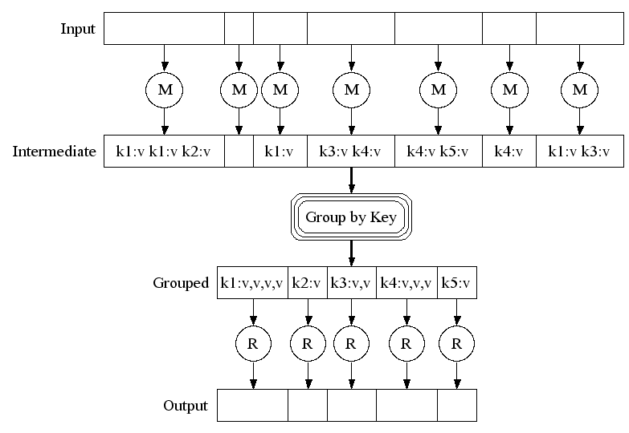
Map-Reduce: A diagram
Big document
MAP:
Read input and produces a set of key-value pairs
Group by key:
Collect all pairs with same key
(Hash merge, Shuffle, Sort, Partition)
Reduce:
Collect all values belonging to the key and output

Slide 16
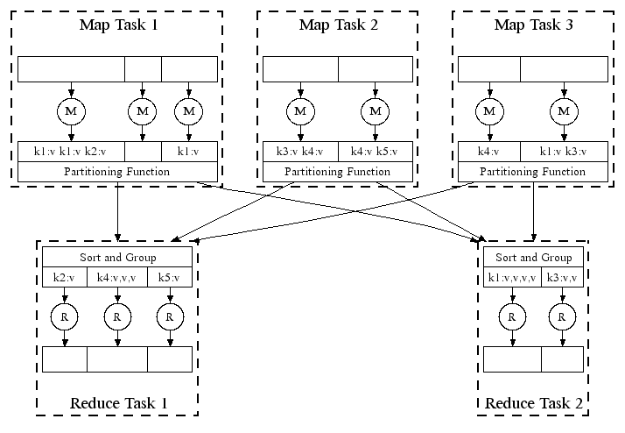
Map-Reduce: In Parallel
All phases are distributed with many tasks doing the work

Slide 17
Map-Reduce
Programmer specifies:
  Map and Reduce and input files
Workflow:
  Read inputs as a set of key-value-pairs
  Map transforms input kv-pairs into a new set of k'v'-pairs
  Sorts & Shuffles the k'v'-pairs to output nodes
  All k’v’-pairs with a given k’ are sent to the same reduce
  Reduce processes all k'v'-pairs grouped by key into new k''v''-pairs
  Write the resulting pairs to files
All phases are distributed with many tasks doing the work
Input 0
Input 1
Input 2
Map 0
Map 1
Map 2
Shuffle
Reduce 0
Reduce 1
Out 0
Out 1

Slide 18
Data Flow
Input and final output are stored on a distributed file system (FS):
  Scheduler tries to schedule map tasks “close” to physical storage location of input data
Intermediate results are stored on local FS
of Map and Reduce workers
Output is often input to another
MapReduce task

Slide 19
Coordination: Master
Master node takes care of coordination:
  Task status: (idle, in-progress, completed)
  Idle tasks get scheduled as workers become available
  When a map task completes, it sends the master the location and sizes of its R intermediate files, one for each reducer
  Master pushes this info to reducers
Master pings workers periodically to detect failures

Slide 20
Distributed Execution Overview
User
Program
fork
fork
fork
Master
assign
map
assign
reduce
Input Data
Worker
write
Output
File 0
local
write
Worker
Split 0
read
Split 1
Worker
Split 2
Output
File 1
Worker
Worker
remote
read,
sort

Slide 21
Dealing with Failures
Map worker failure
  Map tasks completed or in-progress at
  worker are reset to idle
  Reduce workers are notified when task is rescheduled on another worker
Reduce worker failure
  Only in-progress tasks are reset to idle
  Reduce task is restarted
Master failure
  MapReduce task is aborted and client is notified

Slide 22
How many Map and Reduce jobs?
M map tasks, R reduce tasks
Rule of a thumb:
  Make M much larger than the number of nodes in the cluster
  One DFS chunk per map is common
  Improves dynamic load balancing and speeds up recovery from worker failures
Usually R is smaller than M
  Because output is spread across R files

Slide 23
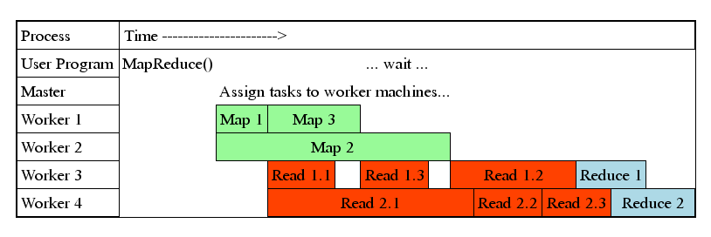
Task Granularity & Pipelining
Fine granularity tasks: map tasks >> machines
  Minimizes time for fault recovery
  Can do pipeline shuffling with map execution
  Better dynamic load balancing

Slide 24
Co-occurrence Matrix
A common task in corpus linguistics and statistical natural language processing
  E.g., Language Models - assign probabilities to sequences of words
The co-occurrence matrix of a corpus is a square n×n matrix where n is the number of unique words in the corpus
A cell m_{ij} contains the number of times word w_{i} co-occurs with word w_{j} within a specific context
  Context: a sentence, paragraph, or a document
Other applications
  Correlation mining, such as customers who buy this tend to also buy that.

Slide 25
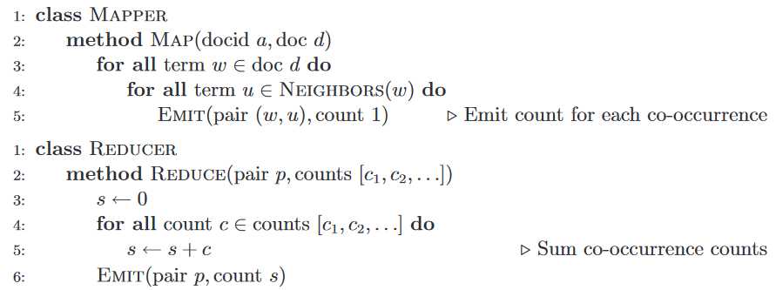
Pseudo-code word co-occurence

Slide 26
Resources
Hadoop Wiki
  Introduction
    http://wiki.apache.org/lucene-hadoop/
  Getting Started
    http://wiki.apache.org/lucene-hadoop/GettingStartedWithHadoop
  Map/Reduce Overview
    http://wiki.apache.org/lucene-hadoop/HadoopMapReduce
    http://wiki.apache.org/lucene-hadoop/HadoopMapRedClasses
  Eclipse Environment
    http://wiki.apache.org/lucene-hadoop/EclipseEnvironment
Javadoc
  http://lucene.apache.org/hadoop/docs/api/

Slide 27
MapReduce
09:30:02 AAPL 100 sh
Computing total trades per minute at scale
09:30:07 MSFT 200 sh
09:30:12 NVDA 300 sh
Problem: millions of trade records arrive across many files/servers.
Goal: group by (stock, minute) and sum shares.
09:30:17 TSLA 150 sh
09:30:22 AMZN 75 sh
09:31:27 AAPL 125 sh
Map creates keys
Shuffle groups keys
Reduce aggregates
09:31:32 MSFT 50 sh
09:31:37 NVDA 250 sh
09:31:42 TSLA 80 sh
09:31:47 AMZN 60 sh

Slide 28
The task: total shares per stock per minute
A high-volume aggregation problem: thousands or millions of events arrive across many files.
09:30:02, AAPL, 100
09:30:05, MSFT, 200
09:30:11, AAPL, 150
09:30:47, NVDA, 300
09:30:55, AAPL, 50
09:31:03, MSFT, 100
Grouping key
Desired output
(stock, minute)
(AAPL, 09:30)
(MSFT, 09:30)
(NVDA, 09:30)
AAPL 09:30 300
MSFT 09:30 200
NVDA 09:30 300
MSFT 09:31 100
The intermediate key defines what will be grouped together later.

Slide 29
Map: turn each trade into a grouping key
Map runs independently on input records. It emits intermediate key–value pairs.
Intermediate output
Mapper 1 input
09:30:02 AAPL 100
09:30:05 MSFT 200
09:30:11 AAPL 150
Map(record):
minute = floor_time(record.time)
emit((record.stock, minute), record.shares)
((AAPL,09:30),100)
((MSFT,09:30),200)
((AAPL,09:30),150)
((NVDA,09:30),300)
((AAPL,09:30),50)
((MSFT,09:31),100)
Mapper 2 input
09:30:47 NVDA 300
09:30:55 AAPL 50
09:31:03 MSFT 100
Map(record):
minute = floor_time(record.time)
emit((record.stock, minute), record.shares)

Slide 30
What Map writes: local intermediate files
Local disk on Mapper 1
Important
Mapper 1
partition file for R0
((AAPL,09:30),250)
((AAPL,09:30),150)
The mapper does not send one huge list to reduce.
It writes reducer-specific intermediate files locally.
The shuffle phase later transfers these files to the reducers that own the keys.
emits:
((AAPL,09:30),150)
((MSFT,09:30),200)
((AAPL,09:30),150)
partition file for R1
((MSFT,09:30),200)
Mapper 2
Local disk on Mapper 2
emits:
((NVDA,09:30),300)
((AAPL,09:30),50)
((MSFT,09:31),100)
partition file for R0
((NVDA,09:30),300)
((AAPL,09:30),50)
Map output can spill to disk
So mapper output does not need to fit in memory.
partition file for R1
((MSFT,09:31),100)
Missing middle step: local partition files exist before network shuffle.

Slide 31
Optional combiner: sum locally before the network
For associative operations such as sum, the mapper can reduce its own duplicate keys first.
Mapper 1 emits
((AAPL,09:30),100)
((MSFT,09:30),200)
((AAPL,09:30),150)
Mapper 1 after combine
((AAPL,09:30),150)
((MSFT,09:30),200)
Local combine
Mapper 2 emits
((NVDA,09:30),300)
((AAPL,09:30),50)
((MSFT,09:31),100)
((MSFT,09:31),75)
Mapper 2 after combine
((NVDA,09:30),300)
((AAPL,09:30),50)
((MSFT,09:31),175)
Local combine
Combiner = local mini-reducer that reduces shuffle traffic.

Slide 32
Partition + Shuffle: bring identical keys together
The runtime decides which reducer owns each key, then moves and groups records.
Mapper 1 partitions
Reducer 0 receives
to R0:
((AAPL,09:30),150)
to R1:
((MSFT,09:30),200)
(AAPL,09:30) → [100,150]
(NVDA,09:30) → [300]
Partitioner
hash(key) mod R
Mapper 2 partitions
Reducer 1 receives
to R0:
((AAPL,09:30),50)
((NVDA,09:30),300)
to R1:
((MSFT,09:31),100)
(MSFT,09:30) → [200]
(MSFT,09:31) → [100]
Partitioner
hash(key) mod R
Shuffle = distributed movement + merge/sort/group, not a single machine.

Slide 33
Reduce: aggregate one completed key group at a time
The group must be complete logically, but it can be streamed from disk/buffers.
Reducer 0 grouped input
(AAPL,09:30) → [250,50,75]
(NVDA,09:30) → [300,125]
Reduce((AAPL,09:30), [250,50,75])
→ ((AAPL,09:30), 375)
Reduce((NVDA,09:30), [300,125])
→ ((NVDA,09:30), 425)
Reducer 1 grouped input
(MSFT,09:30) → [200]
(MSFT,09:31) → [100]
Reduce((MSFT,09:30), [200])
→ ((MSFT,09:30), 200)
Reduce((MSFT,09:31), [100])
→ ((MSFT,09:31), 100)
Reducer waits for all mappers to finish, then processes complete key groups as streams.

Slide 34
The mental model
What each stage contributes in one line.
Map
Partition
Shuffle
Reduce
Creates intermediate keys
Assigns each key to a reducer
Moves + groups identical keys
Computes over each completed group
((AAPL,09:30),100)
hash(key) mod R
(AAPL,09:30) → [250,50,75]
(AAPL,09:30) → 375
Map chooses the grouping key.
Shuffle makes each group complete.
Reduce computes the answer for each group.
Key lesson

Slide 35
Example 1:
Total Sales Per Product using MapReduce
Input Data
Product Sales
Laptop 1200
Phone 800
Tablet 400
Laptop 1500
Phone 600
Tablet 300
Laptop 1700

Slide 36
Step 1: Map Phase
Each Mapper processes a subset of the input and emits key-value pairs:
Mapper Output (Product, Sales)
(Laptop, 1200)
(Phone, 800)
(Tablet, 400)
(Laptop, 1500)
(Phone, 600)
(Tablet, 300)
(Laptop, 1700)

Slide 37
Step 2: Shuffle & Sort Phase
The Shuffle groups all sales by product.
The Sort ensures that all values for the same product are together before reaching the Reducer
Intermediate (Shuffled) Data:
Reducer 1 receives: (Laptop, [1200, 1500, 1700])
Reducer 2 receives: (Phone, [800, 600])
Reducer 3 receives: (Tablet, [400, 300])

Slide 38
Step 3: Reduce Phase
Each Reducer processes the values for a given product and computes the total sales.
Reducer Output (Product, Total Sales)
(Laptop, 4400) → Sum of [1200 + 1500 + 1700]
(Phone, 1400) → Sum of [800 + 600]
(Tablet, 700) → Sum of [400 + 300]

Slide 39
Final Output
Product Total Sales
Laptop 4400
Phone 1400
Tablet 700

