Slide 1
CIS 4517/5517:
Data Intensive and Cloud Computing
MapReduce examples
Credit:
  Most slides are adapted from: http://www.mmds.org
  Mining of Massive Datasets, by Jure Leskovec, Anand Rajaraman, Jeff Ullman
Read Chapter 2 of “Mining of Massive Datasets” at http://www.mmds.org

Slide 2
Problems Suited for
Map-Reduce

Slide 3
Examples
Counting tasks
  Find the total size in bytes of a host
  Compute the frequency of all k-grams on the web
  Compute the frequency of queries
  Compute the frequency of query, url pairs
Other examples:
  Link analysis and graph processing – PageRank
  Machine Learning algorithms
  Linear algebra operations (matrix-vector, matrix-matrix multiplication)

Slide 4
Example: Host size
Suppose we have a large web corpus
Look at the metadata file
  Lines of the form: (URL, size, date, …)
For each host, find the total number of bytes
  That is, the sum of the page sizes for all URLs from that particular host
Other examples:
  Link analysis and graph processing
  Machine Learning algorithms

Slide 5
Example: Language Model
Statistical machine translation:
  Need to count number of times every 5-word sequence occurs in a large corpus of documents
Very easy with MapReduce:
  Map:
    Extract (5-word sequence, count) from document
  Reduce:
    Combine the counts

Slide 6
Example: Join By Map-Reduce
Compute the natural join R(A,B) ⋈ S(B,C)
R and S are each stored in files
Tuples are pairs (a,b) or (b,c)
A | B
a₁ | b₁
a₂ | b₁
a₃ | b₂
a₄ | b₃
B | C
b₂ | c₁
b₂ | c₂
b₃ | c₃
A | C
a₃ | c₁
a₃ | c₂
a₄ | c₃
⋈
=
S
R

Slide 7
Map-Reduce Join
A Map process turns:
  Each input tuple R(a,b) into key-value pair (b,(a,R))
  Each input tuple S(b,c) into (b,(c,S))
Map processes send each key-value pair with key b to Reduce process
  Hadoop does this automatically; just tell it what k is.
Each Reduce process matches all the pairs (b,(a,R)) with all (b,(c,S)) and outputs (a,b,c).

Slide 8
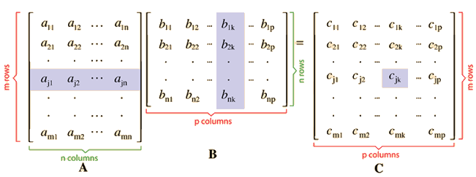
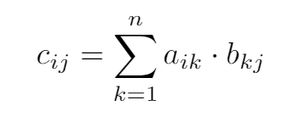
Matrix multiplication

Slide 9


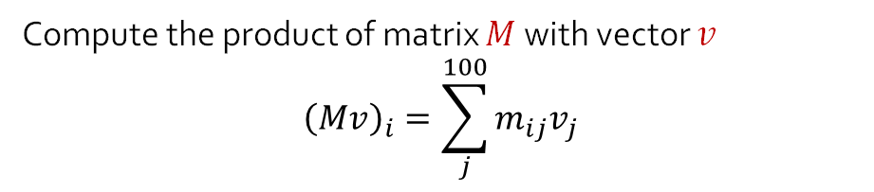
Matrix multiplication
Matrix – Vector Multiplication
and
Matrix – Matrix Multiplication
Compute the product of matrix $M$with vector $v$
$${\left(Mv\right)}_{i}=\sum_{j}^{100}{m_{ij}v_{j}}$$
30,000,000,000,000

Slide 10
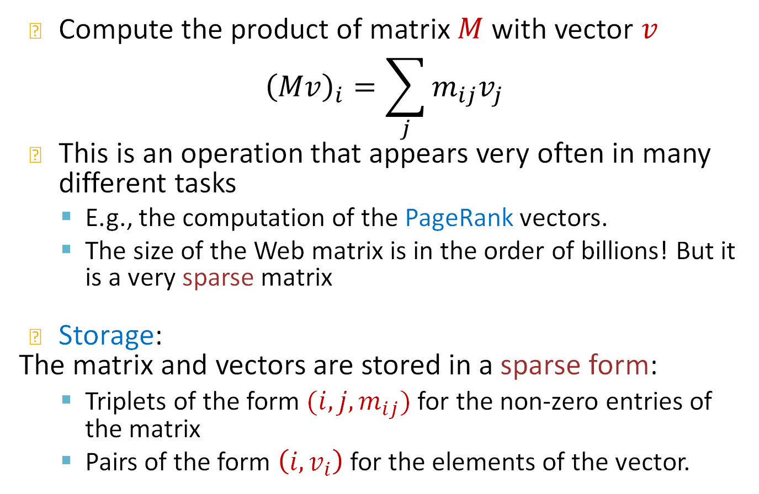
Matrix-Vector multiplication
Compute the product of matrix $M$with vector $v$
$${\left(Mv\right)}_{i}=\sum_{j}{m_{ij}v_{j}}$$
This is an operation that appears very often in many different tasks
  E.g., the computation of the PageRank vectors.
  The size of the Web matrix is in the order of billions! But it is a very sparse matrix
Storage:
The matrix and vectors are stored in a sparse form:
  Triplets of the form $(i,j,m_{ij})$ for the non-zero entries of the matrix
  Pairs of the form $\left(i, v_{i}\right)$ for the elements of the vector.

Slide 11
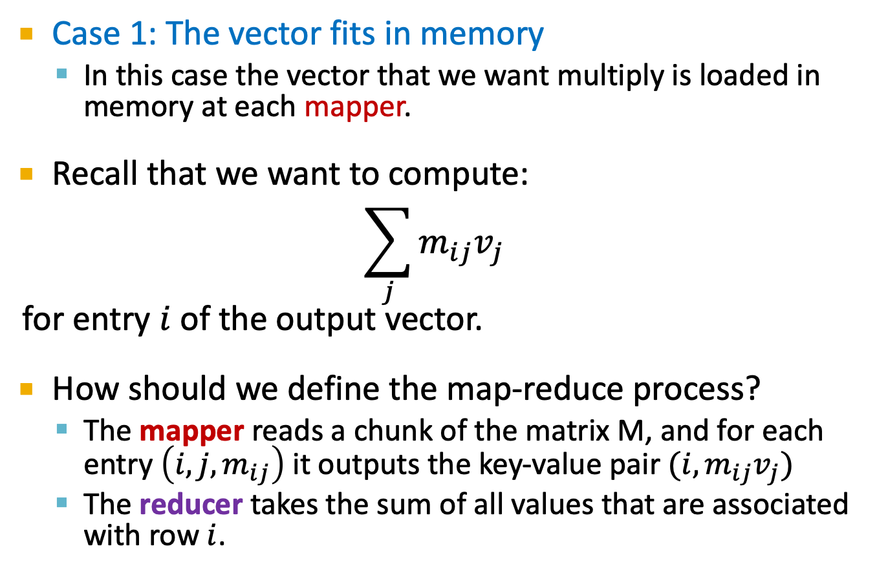
Matrix-vector multiplication
Case 1: The vector fits in memory
  In this case the vector that we want multiply is loaded in memory at each mapper.
Recall that we want to compute:
$$\sum_{j}{m_{ij}v_{j}}$$
for entry $i$ of the output vector.
How should we define the map-reduce process?
  The mapper reads a chunk of the matrix M, and for each entry $\left(i,j,m_{ij}\right)$ it outputs the key-value pair $(i, m_{ij}v_{j})$
  The reducer takes the sum of all values that are associated with row $i$.

Slide 12
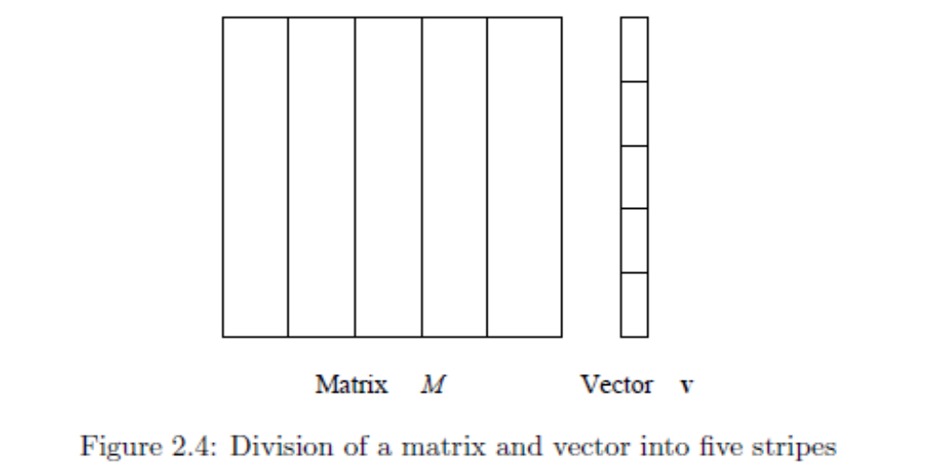
Matrix-vector multiplication
Case 2: The vector does not fit in memory
In this case we split the matrix and the vector into stripes:
We perform the computation for each stripe of the matrix, where the vector can fit into memory
  For PageRank it is better to split the matrix into blocks.

Slide 13
Example: Sparse Matrices with Map/Reduce
A
B
C
10
20
-1
-10
-80
30
40
X
-2
-3
=
-60
-250
50
60
70
-4
-170
-460
  Task: Compute product C = A·B
  Assume most matrix entries are 0
Motivation
  Core problem in scientific computing
  Challenging for parallel execution
  Demonstrate expressiveness of Map/Reduce

Slide 14
Computing Sparse Matrix Product
A
B
1
10
1
1
-1
1
10
20
A
-1
B
1
20
3
2
-2
1
30
40
A
-2
-3
B
2
30
2
2
-3
2
50
60
70
A
-4
B
2
40
3
3
-4
2
A
B
3
50
1
A
3
60
2
A
3
70
3
A
  Represent matrix as list of nonzero entries
    ⟨row, col, value, matrixID⟩
  Strategy
    Phase 1: Compute all products a_{i,k} · b_{k,j}
    Phase 2: Sum products for each entry i,j
    Each phase involves a Map/Reduce

Slide 15
Phase 1 Map of Matrix Multiply
1
10
1
Key = 1
A
10
1
20
3
1
A
1
A
1
-1
1
30
50
B
2
2
3
A
1
A
2
40
3
Key = col
A
Key = 2
3
50
1
2
30
2
2
-2
1
A
A
B
3
60
2
60
2
-3
2
A
3
A
2
B
3
70
3
A
-1
Key = 3
1
B
1
1
20
3
-2
A
Key = row
2
B
1
40
3
-4
2
2
A
3
B
2
-3
2
B
70
-4
3
A
3
3
B
2
  Group values a_{i,k} and b_{k,j} according to key k

Slide 16
Phase 1 “Reduce” of Matrix Multiply
Key = 1
1
-10
1
1
10
1
C
A
X
1
-1
1
-50
B
3
C
1
3
50
1
A
2
-60
1
Key = 2
C
2
30
2
2
-2
1
2
-90
2
A
X
B
C
60
2
-3
2
3
-120
1
3
A
2
B
C
3
-180
2
C
Key = 3
20
1
-80
2
1
A
3
C
-4
2
-160
2
2
40
3
X
3
B
2
C
A
-280
3
C
2
3
70
3
A
  Generate all products a_{i,k} · b_{k,j}

Slide 17
Phase 2 Map of Matrix Multiply
-10
Key = 1,1
1
1
1
-10
1
C
C
3
-50
1
-80
Key = 1,2
C
1
C
2
Key = 2,1
2
-60
1
2
-60
1
C
C
2
-90
2
Key = row,col
Key = 2,2
C
2
-90
2
-120
C
3
C
1
2
-160
2
-180
C
3
C
2
Key = 3,1
3
-120
1
-80
C
1
C
2
3
-50
1
C
2
-160
2
C
Key = 3,2
3
-280
2
3
-280
2
C
C
-180
3
C
2
  Group products a_{i,k} · b_{k,j} with matching values of i and j

Slide 18
Phase 2 Reduce of Matrix Multiply
Key = 1,1
1
-10
1
1
-10
1
C
C
-80
-80
Key = 1,2
1
C
2
1
C
2
Key = 2,1
2
-60
1
2
-60
1
C
C
C
Key = 2,2
-10
-80
2
-90
2
-250
C
2
C
2
-160
-60
-250
2
C
2
-170
-460
Key = 3,1
3
-120
1
3
-170
1
C
C
3
-50
1
C
Key = 3,2
3
-280
2
-460
C
3
C
2
3
-180
2
C
  Sum products to get final entries

Slide 19
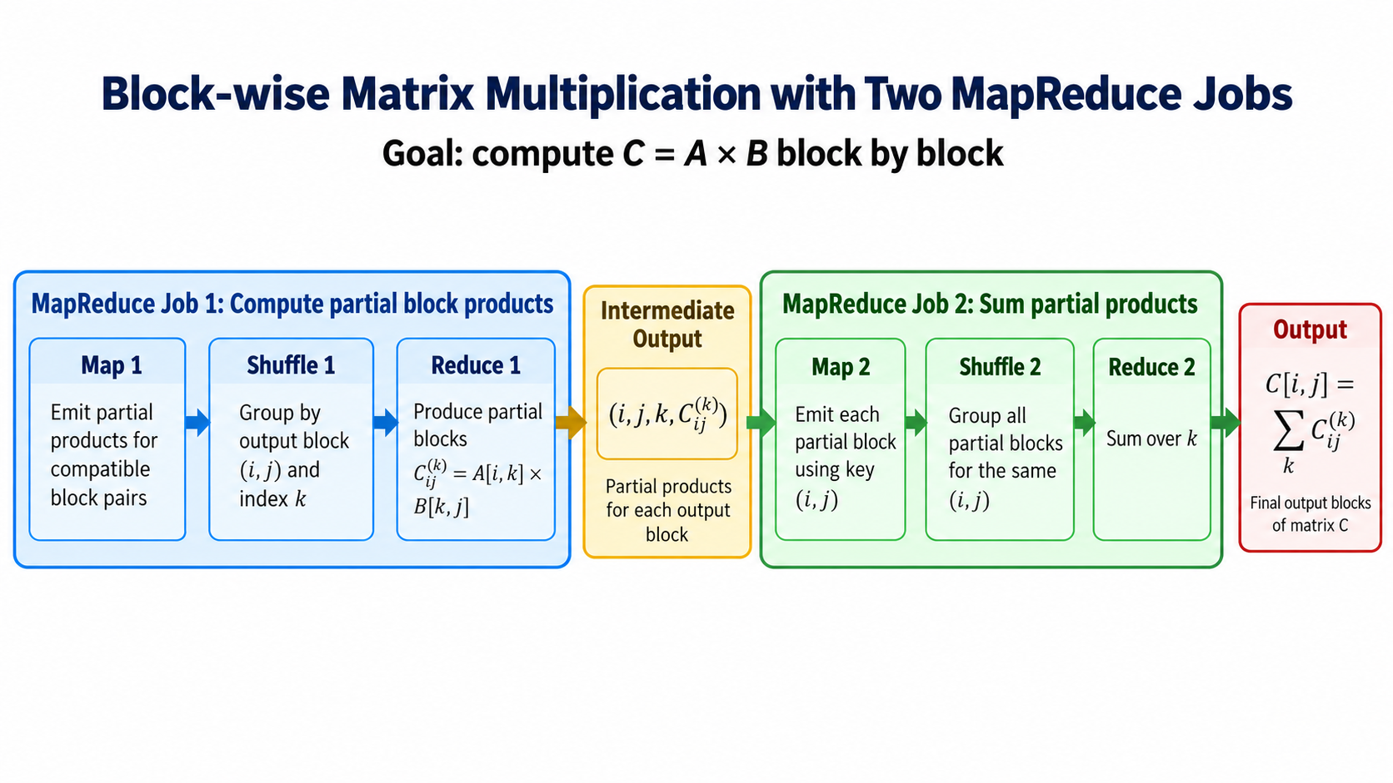

Slide 20
More on Matrix – Matrix Multiplication
http://www.mathcs.emory.edu/~cheung/Courses/554/Syllabus/9-parallel/matrix-mult.html
Machine Learning
  https://www.youtube.com/watch?v=TCA2VuHTHcM
  https://www.coursera.org/lecture/machine-learning/map-reduce-and-data-parallelism-10sqI

Slide 21
More examples of Map/Reduce
Host size
  For each host, find the total number of bytes
Language model
  Count the number of times every n-word sequence occurs in a large pile of documents
Graph reversal
  Construct the graph in which all the links are reversed
and more…
Please check and work by yourself if interested.

Slide 22
Example: Host size
Suppose we have a large web corpus
Look at the metadata file
  Lines of the form: (URL, size, date, …)
For each host, find the total number of bytes
  That is, the sum of the page sizes for all URLs from that particular host

Slide 23
Chaining Multiple MapReduce
Count of URL access frequency
  Input: Log of accessed URLs, e.g., from proxy server
  Output: For each URL, % of total accesses for that URL
  Map – Process web log and outputs <URL, 1>
  Multiple Reducers - Emits <URL, URL_count>
  (So far, like Wordcount. But still need %)
  Chain another MapReduce job after above one
  Map – Processes <URL, URL_count> and outputs <1, (<URL, URL_count> )>
  1 Reducer – Sums up URL_count’s to calculate overall_count.
  Emits multiple <URL, URL_count/overall_count>

Slide 24
Example: Language Model
Statistical machine translation:
  Need to count number of times every 5-word sequence occurs in a large corpus of documents
Very easy with MapReduce:
  Map:
    Extract (5-word sequence, count) from document
  Reduce:
    Combine the counts

Slide 25
Example : Graph reversal
Given a directed graph as an adjacency list:
src1: dest11, dest12, …
src2: dest21, dest22, …
Construct the graph in which all the links are reversed
Can be done in two phases and each phase involves a map/reduce.

Slide 26
Phase 1 Mapper
public class P1Mapper extends MapReduceBase implements Mapper {
public void map(WritableComparable key, Writable values,
OutputCollector output, Reporter reporter) throws IOException {
try {
GraphEdge e = new GraphEdge(values.toString());
IntWritable k;
if (e.tag.equals("A"))
k = new IntWritable(e.toNode);
else
k = new IntWritable(e.fromNode);
output.collect(k, new Text(e.toString()));
} catch (BadGraphException e) {}
}
}

Slide 27
Phase 1 Reducer
public class P1Reducer extends MapReduceBase implements Reducer {
public void reduce(WritableComparable key, Iterator values,
OutputCollector output, Reporter reporter)
throws IOException
{
Text outv = new Text(""); // Don't really need output values
/* First split edges into A and B categories */
LinkedList<GraphEdge> alist = new LinkedList<GraphEdge>();
LinkedList<GraphEdge> blist = new LinkedList<GraphEdge>();
while(values.hasNext()) {
try {
GraphEdge e =
new GraphEdge(values.next().toString());
if (e.tag.equals("A")) {
alist.add(e);
} else {
blist.add(e);
}
} catch (BadGraphException e) {}
}
// Continued

Slide 28
MM Phase 1 Reducer (cont.)
// Continuation
Iterator<GraphEdge> aset = alist.iterator();
// For each incoming edge
while(aset.hasNext()) {
GraphEdge aedge = aset.next();
// For each outgoing edge
Iterator<GraphEdge> bset = blist.iterator();
while (bset.hasNext()) {
GraphEdge bedge = bset.next();
GraphEdge newe = aedge.contractProd(bedge);
// Null would indicate invalid contraction
if (newe != null) {
Text outk = new Text(newe.toString());
output.collect(outk, outv);
}
}
}
}
}

Slide 29
Phase 2 Mapper
public class P2Mapper extends MapReduceBase implements Mapper {
public void map(WritableComparable key, Writable values,
OutputCollector output, Reporter reporter)
throws IOException {
String es = values.toString();
try {
GraphEdge e = new GraphEdge(es);
// Key based on head & tail nodes
String ks = e.fromNode + " " + e.toNode;
output.collect(new Text(ks), new Text(e.toString()));
} catch (BadGraphException e) {}
}
}

Slide 30
Graph Phase 2 Reducer
public class P2Reducer extends MapReduceBase implements Reducer {
public void reduce(WritableComparable key, Iterator values,
OutputCollector output, Reporter reporter)
throws IOException
{
GraphEdge efinal = null;
while (efinal == null && values.hasNext()) {
try {
efinal = new GraphEdge(values.next().toString());
} catch (BadGraphException e) {}
}
if (efinal != null) {
while(values.hasNext()) {
try {
GraphEdge eother =
new GraphEdge(values.next().toString());
efinal.weight += eother.weight;
} catch (BadGraphException e) {}
}
if (efinal.weight != 0)
output.collect(new Text(efinal.toString()),
new Text(""));
}
}
}

Slide 31
Next
PageRank

