Slide 1
Random Surfers on the Web
Transition Matrix of the Web
Dead Ends and Spider Traps
Topic-Specific PageRank
PageRank
Information Retrieval in Practice
Slides from Mining Massive Data Sets at
http://web.stanford.edu/class/cs246/handouts.html

Slide 2
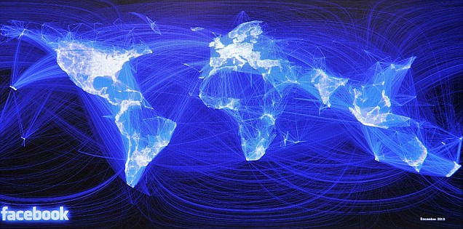
Graph Data: Social Networks
Facebook social graph
4-degrees of separation [Backstrom-Boldi-Rosa-Ugander-Vigna, 2011]

Slide 3
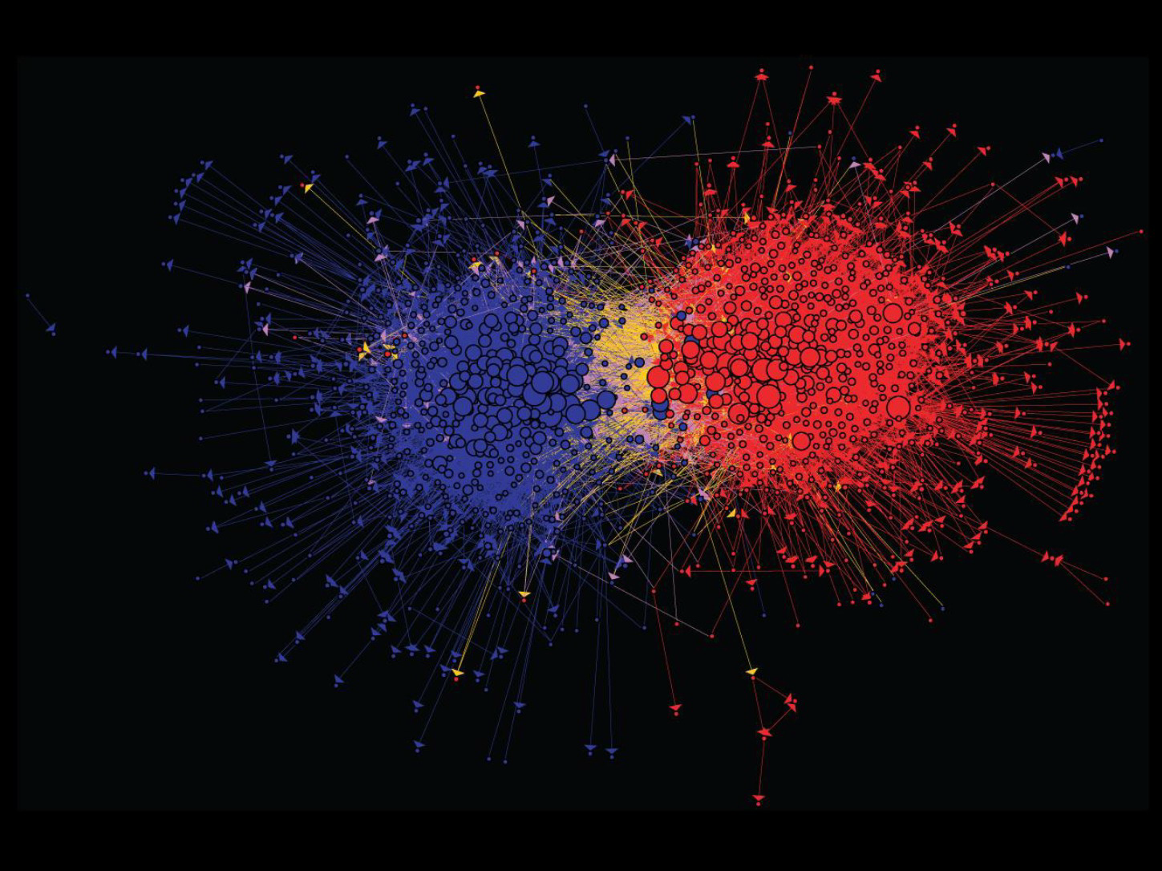
Graph Data: Media Networks
Connections between political blogs
Polarization of the network [Adamic-Glance, 2005]

Slide 4
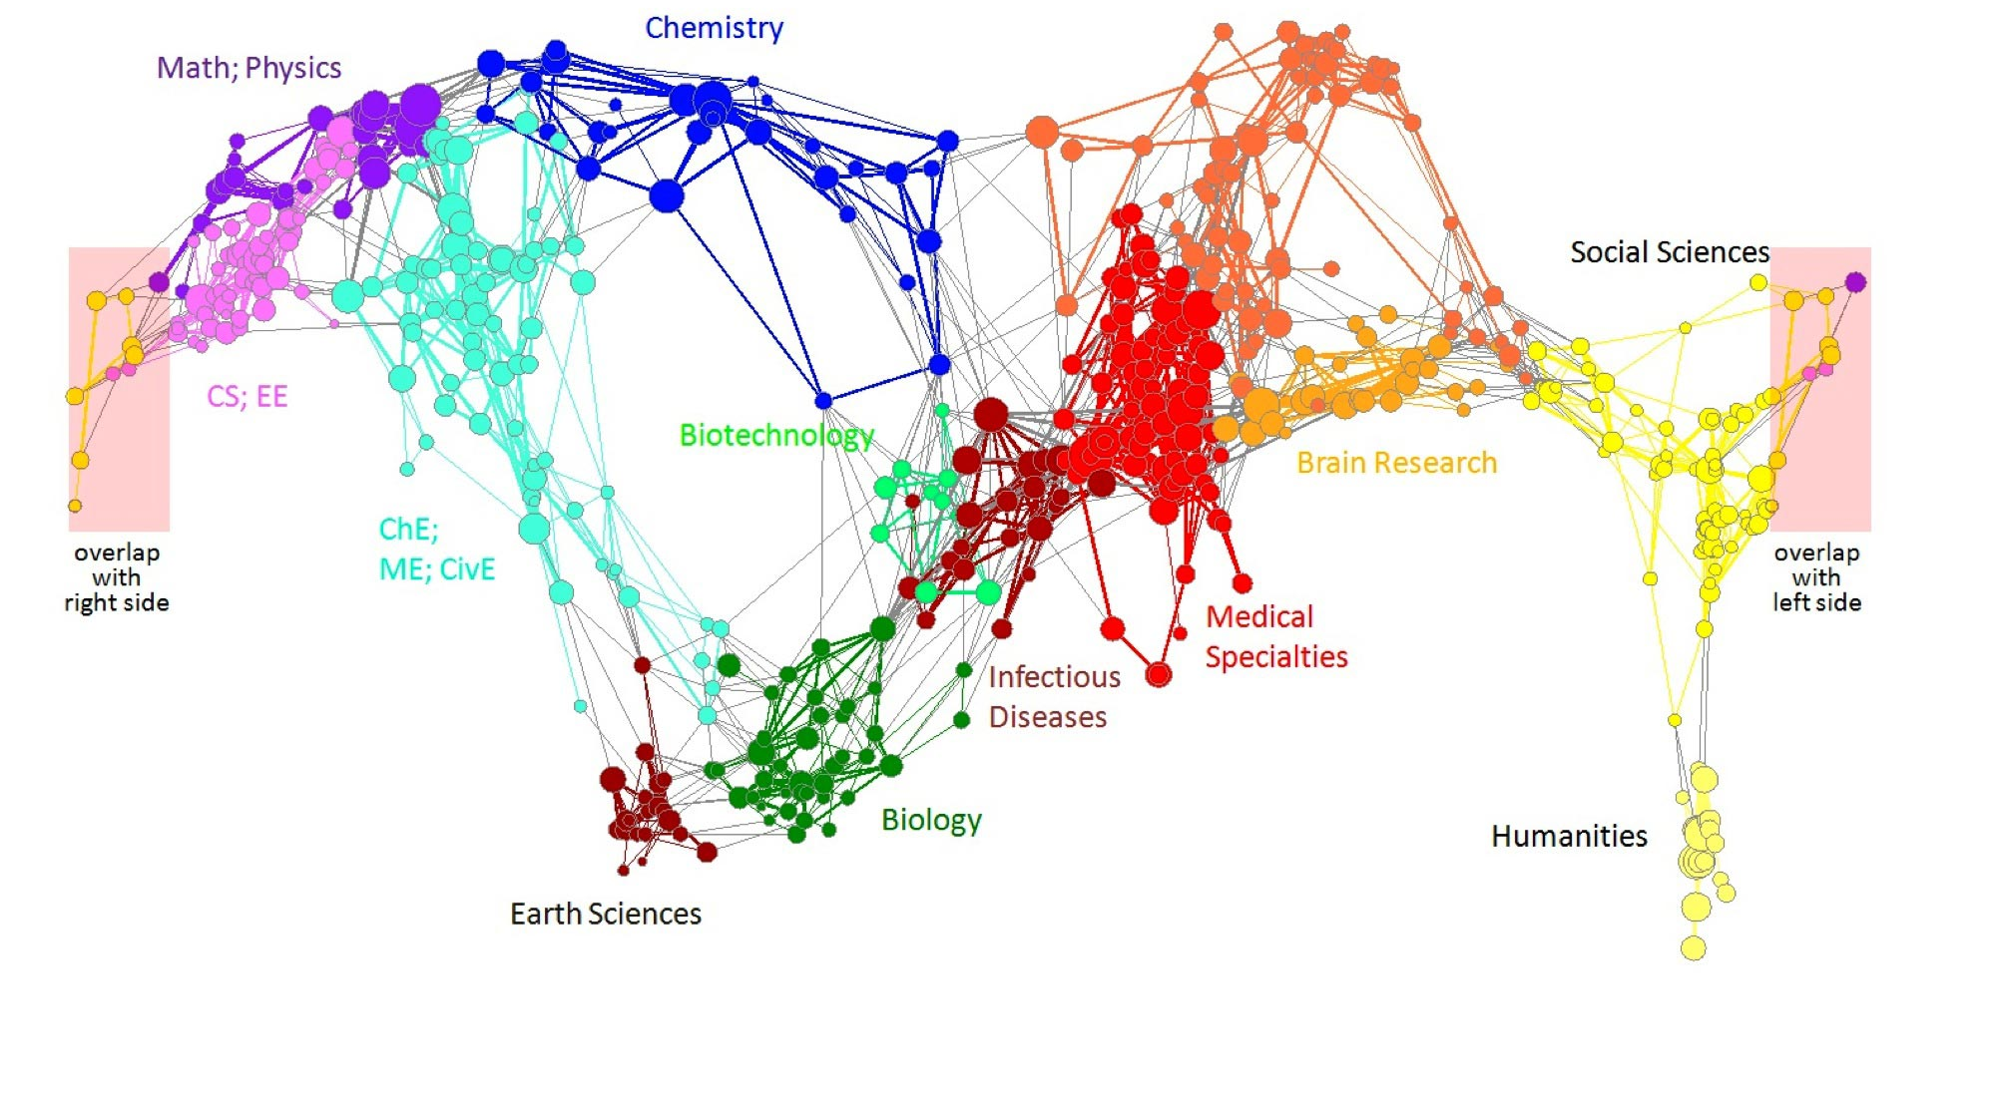
Graph Data: Information Nets
Citation networks and Maps of science
[Börner et al., 2012]

Slide 5
Web as a Graph
Web as a directed graph:
  Nodes: Webpages
  Edges: Hyperlinks
I teach a class on InformationRetrieval.
CS224W: Classes are in the
Tutelman building
Computer Science Department at Temple
Temple University

Slide 6
Web as a Graph
Web as a directed graph:
  Nodes: Webpages
  Edges: Hyperlinks
I teach a class on IR.
CIS5590: Classes are in the
Tutelman building
Computer Science Department at Temple
Temple University

Slide 7

Broad Question
How to organize the Web?
First try: Human curated
Web directories
  Yahoo, DMOZ, LookSmart
Second try: Web Search
  Information Retrieval investigates:
  Find relevant docs in a small
  and trusted set
    Newspaper articles, Patents, etc.
  But: Web is huge, full of untrusted documents, random things, web spam, etc.

Slide 8
Web Search: 2 Challenges
2 challenges of web search:
(1) Web contains many sources of information
Who to “trust”?
  Trick: Trustworthy pages may point to each other!
(2) What is the “best” answer to query “newspaper”?
  No single right answer
  Trick: Pages that actually know about newspapers might all be pointing to many newspapers

Slide 9
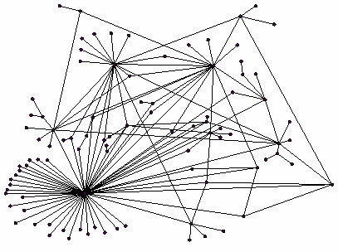
Ranking Nodes on the Graph
All web pages are not equally “important”
  www.joe-schmoe.com vs. www.temple.edu
There is large diversity
in the web-graph
node connectivity.
Let’s rank the pages by
the link structure!

Slide 10
Link Analysis Algorithms
We will cover the following Link Analysis approaches for computing importances
of nodes in a graph:
  Page Rank

Slide 11

Need a Different Paradigm
Page Importance

Slide 12
Links as Votes
Idea: Links as votes
  Page is more important if it has more links
    In-coming links? Out-going links?
Think of in-links as votes:
  www.temple.edu has ? in-links
  www.joe-schmoe.com has 1 in-link
Are all in-links equal?
  Links from important pages count more
  Recursive question!

Slide 13
Simple Recursive Formulation
Each link’s vote is proportional to the importance of its source page
If page j with importance r_{j} has n out-links, each link gets r_{j} / n votes
Page j’s own importance is the sum of the votes on its in-links
i
k
r_{i}/3
r_{k}/4
j
r_{j}/3
r_{j} = r_{i}/3+r_{k}/4
r_{j}/3
r_{j}/3

Slide 14
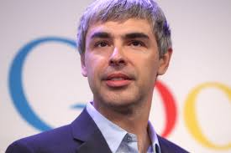

Inventors

Slide 15
Intuition – (1)
Web pages are important if people visit them a lot.
But, can we watch everybody using the Web?
A good surrogate for visiting pages is to assume people follow links randomly.
Leads to random surfer model:
  Start at a random page and follow random out-links repeatedly, from whatever page you are at.
  PageRank = limiting probability of being at a page.

Slide 16
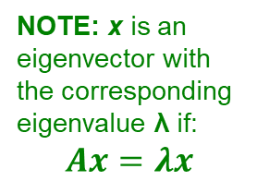
Intuition – (2)
Solve the recursive equation:
a page is important to the extent that important pages link to it
  Equivalent to the random-surfer definition of PageRank.
Technically, importance = the principal eigenvector of the transition matrix of the Web.
  A few fixups needed.
NOTE: x is an eigenvector with the corresponding eigenvalue λ if:
$$Ax=λx$$

Slide 17
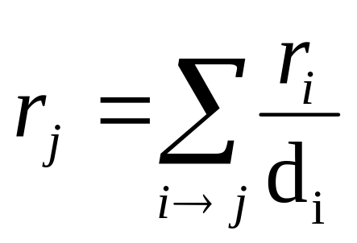

PageRank: The “Flow” Model
A “vote” from an important page is worth more
A page is important if it is pointed to by other important pages
Define a “rank” r_{j} for page j
y/2
y
a/2
y/2
m
a
m
a/2
“Flow” equations:
  r_{y} = r_{y} /2 + r_{a} /2
  r_{a} = r_{y} /2 + r_{m}
  r_{m} = r_{a} /2
$d_{i}$ … out-degree of node $i$

Slide 18
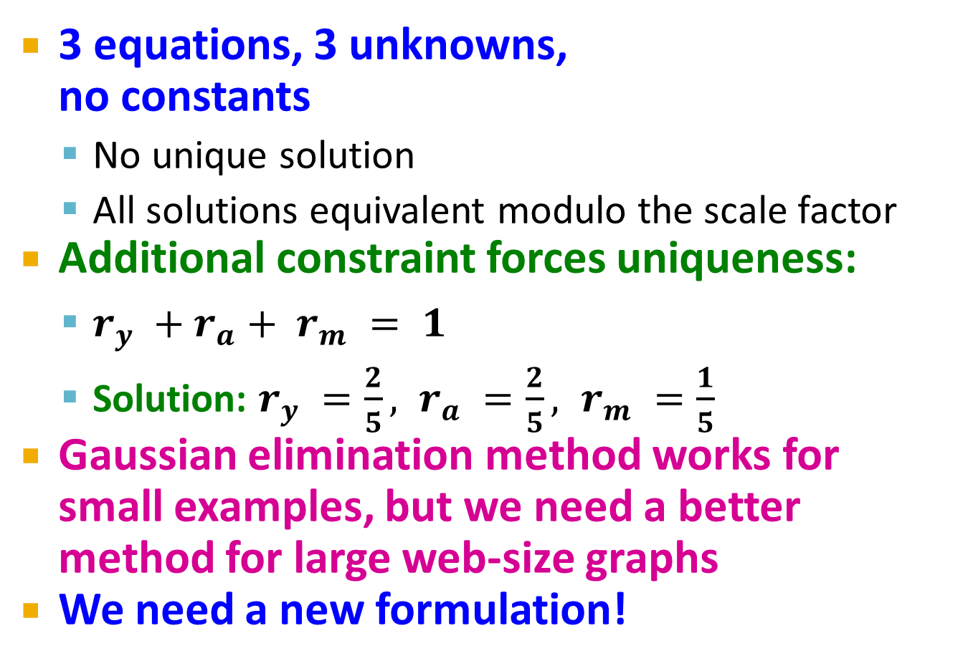
Solving the Flow Equations
Flow equations:
3 equations, 3 unknowns,
no constants
  No unique solution
  All solutions equivalent modulo the scale factor
Additional constraint forces uniqueness:
  $r_{y} +r_{a}+ r_{m} = 1$
  Solution: $r_{y} =\frac{2}{5}, r_{a} =\frac{2}{5}, r_{m} =\frac{1}{5}$
Gaussian elimination method works for
small examples, but we need a better method for large web-size graphs
We need a new formulation!
  r_{y} = r_{y} /2 + r_{a} /2
  r_{a} = r_{y} /2 + r_{m}
  r_{m} = r_{a} /2

Slide 19
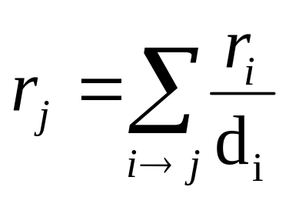
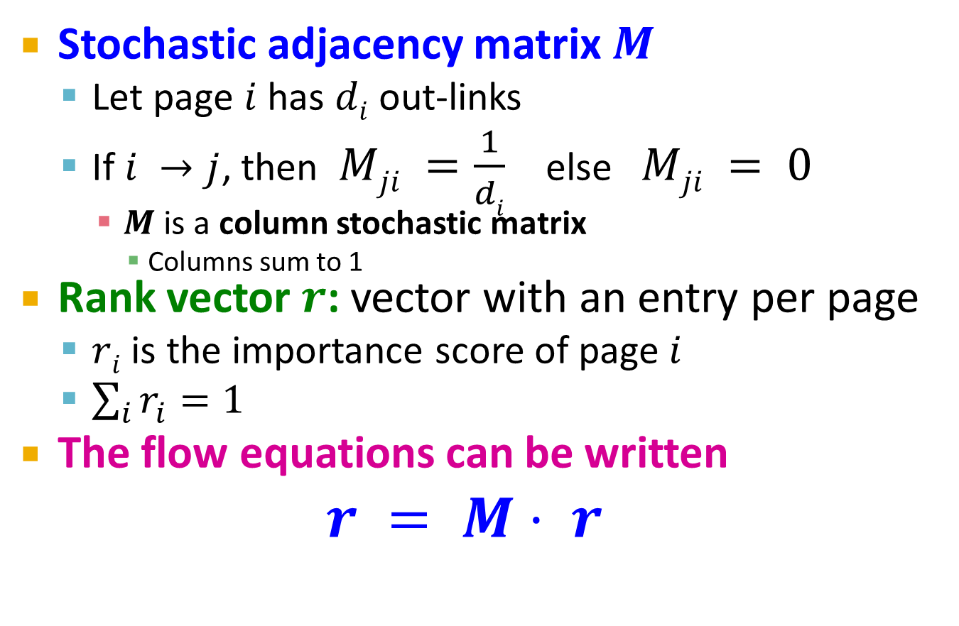
PageRank: Matrix Formulation
Stochastic adjacency matrix $M$
  Let page $i$ has $di$ out-links
  If $i →j$, then $Mji =\frac{1}{di}$ else $Mji = 0$
    $M$ is a column stochastic matrix
      Columns sum to 1
Rank vector $r$: vector with an entry per page
  $ri$ is the importance score of page $i$
  $\sum_{i}{r_{i}^{}=1}$
The flow equations can be written
$r = M⋅ r$

Slide 20
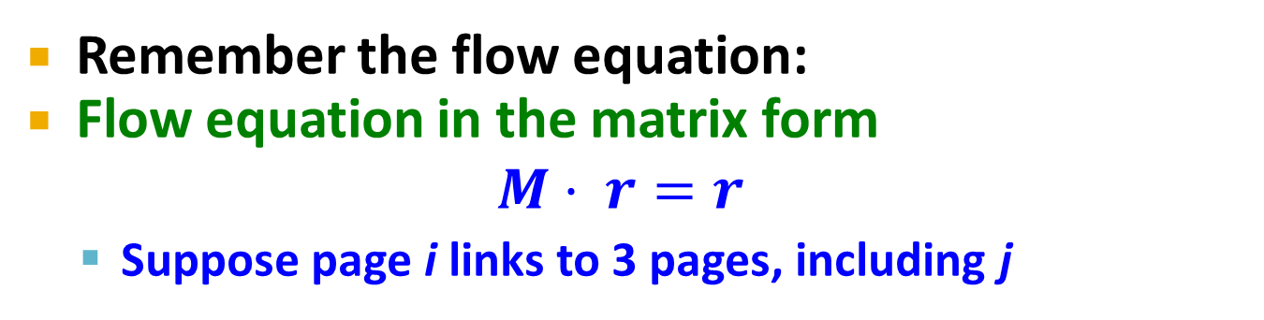
Example
Remember the flow equation:
Flow equation in the matrix form
$$M⋅ r=r$$
  Suppose page i links to 3 pages, including j
i
j
r_{j}
.
=
r_{i}
1/3
M
.
r
=
r

Slide 21
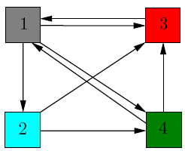
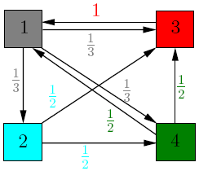
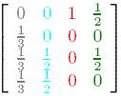
Another Example
Source: http://www.math.cornell.edu/~mec/Winter2009/RalucaRemus/Lecture3/lecture3.html

Slide 22
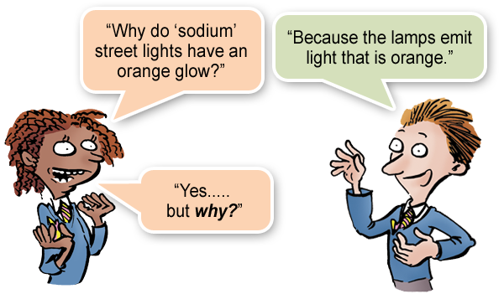
Random Walks on the Web
Suppose v is a vector whose i ^{th} component is the probability that a random walker is at page i at a certain time.
If a walker follows a link from i at random, the probability distribution for walkers is then given by the vector Mv.

Slide 23
Random Walks – (2)
Starting from any vector u, the limit M (M (…M (M u ) …)) is the long-term distribution of walkers.
Intuition: pages are important in proportion to how likely a walker is to be there.
The math: limiting distribution = principal eigenvector of M = PageRank.

Slide 24
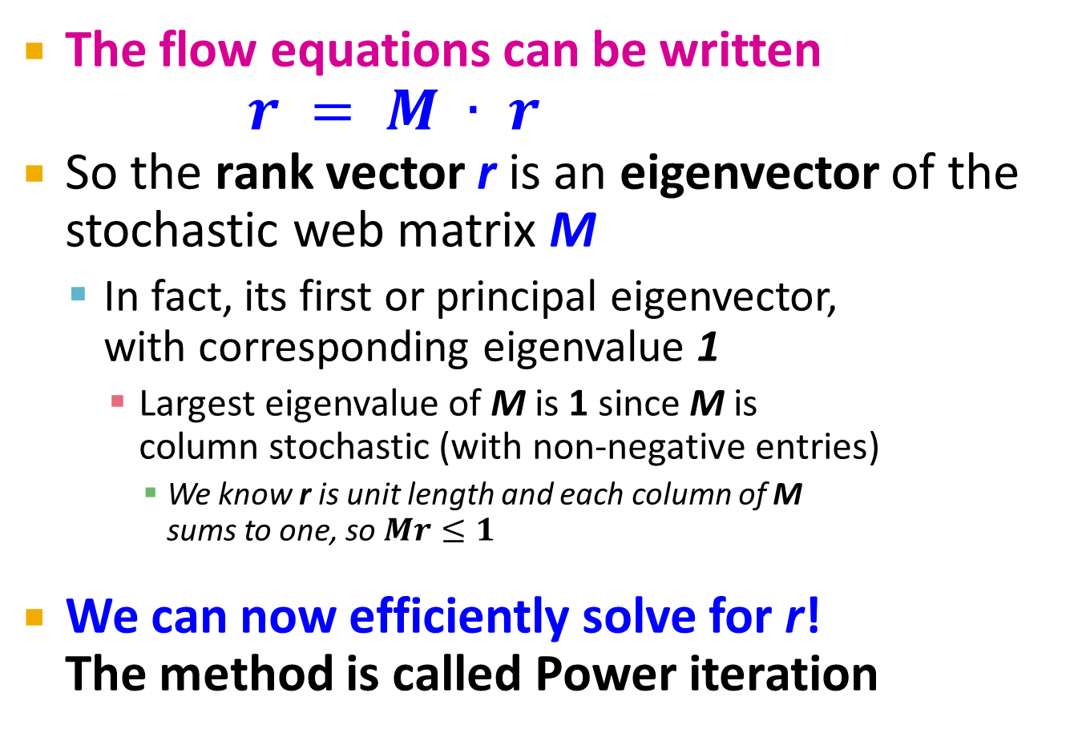
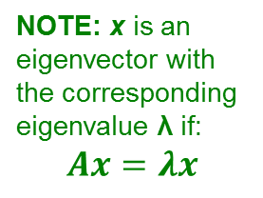
Eigenvector Formulation
The flow equations can be written
$r = M ∙ r$
So the rank vector r is an eigenvector of the stochastic web matrix M
  In fact, its first or principal eigenvector,
  with corresponding eigenvalue 1
    Largest eigenvalue of M is 1 since M is
    column stochastic (with non-negative entries)
      We know r is unit length and each column of M
      sums to one, so $Mr≤1$
We can now efficiently solve for r!
The method is called Power iteration
NOTE: x is an eigenvector with the corresponding eigenvalue λ if:
$$Ax=λx$$

Slide 25
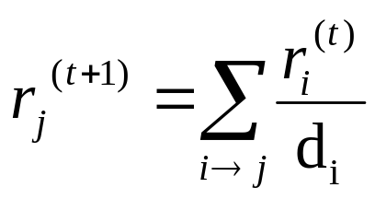
Power Iteration Method
Given a web graph with n nodes, where the nodes are pages and edges are hyperlinks
Power iteration: a simple iterative scheme
  Suppose there are N web pages
  Initialize: r⁽⁰⁾ = [1/N,….,1/N]^{T}
  Iterate: r^{(t+1)} = M ∙ r^{(t)}
  Stop when |r^{(t+1)} – r^{(t)}|₁ < ε
d_{i} …. out-degree of node i
    |x|₁ = ∑_{1≤i≤N}|x_{i}| is the L1 norm
    Can use any other vector norm, e.g., Euclidean
About 50 iterations is sufficient to estimate the limiting solution.

Slide 26
Running Example
Yahoo
 | y | a | m
y | ½ | ½ | 0
a | ½ | 0 | 1
m | 0 | ½ | 0
r = M∙r
Amazon
M’soft
y ½ ½ 0 y
a = ½ 0 1 a
m 0 ½ 0 m
  r_{y} = r_{y} /2 + r_{a} /2
  r_{a} = r_{y} /2 + r_{m}
  r_{m} = r_{a} /2

Slide 27
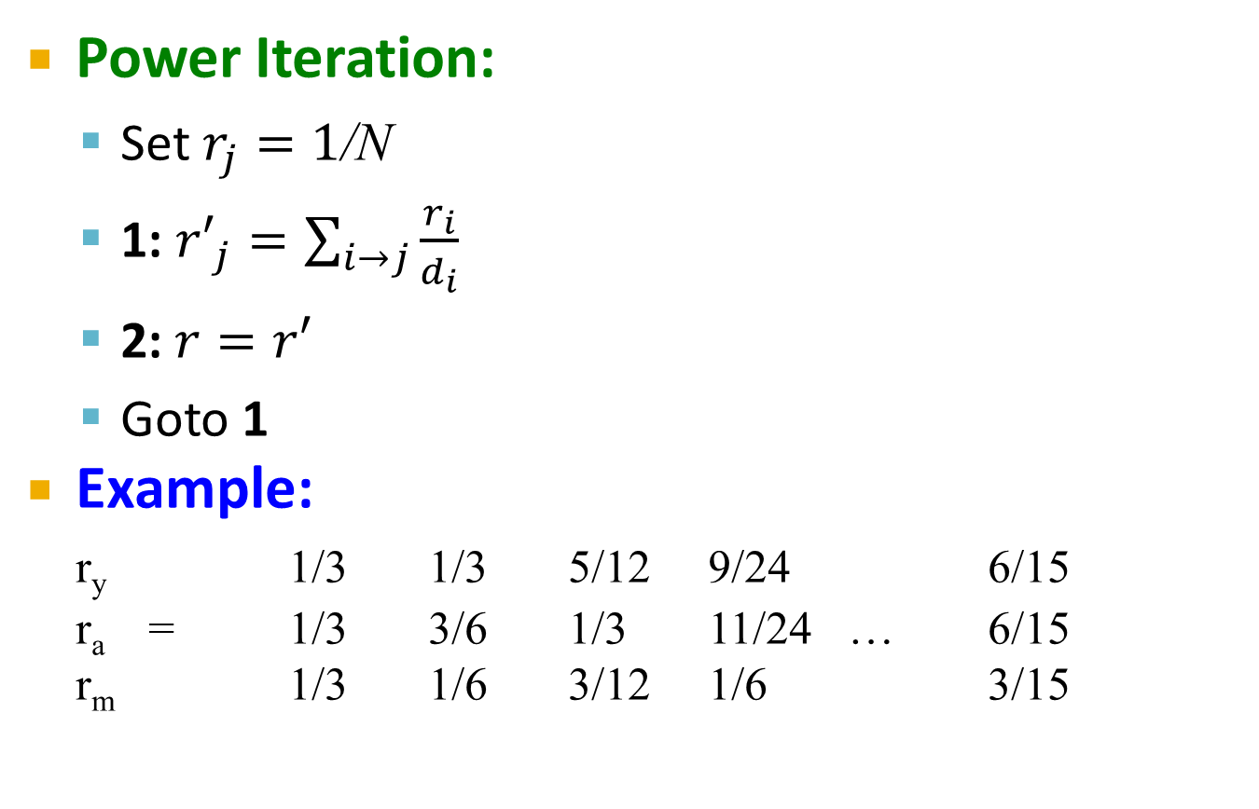
PageRank: How to solve?
Power Iteration:
  Set $r_{j}=1$/N
  1: ${r′}_{j}=\sum_{i→j}{\frac{r_{i}}{d_{i}}}$
  2:$r=r′$
  Goto 1
Example:
r_{y} 1/3 1/3 5/12 9/24 6/15
r_{a} = 1/3 3/6 1/3 11/24 … 6/15
r_{m} 1/3 1/6 3/12 1/6 3/15
y
 | y | a | m
y | ½ | ½ | 0
a | ½ | 0 | 1
m | 0 | ½ | 0
a
m
  r_{y} = r_{y} /2 + r_{a} /2
  r_{a} = r_{y} /2 + r_{m}
  r_{m} = r_{a} /2
Iteration 0, 1, 2, …

Slide 28
PageRank: How to solve?
Power Iteration:
  Set $r_{j}=1$/N
  1: ${r′}_{j}=\sum_{i→j}{\frac{r_{i}}{d_{i}}}$
  2:$r=r′$
  Goto 1
Example:
r_{y} 1/3 1/3 5/12 9/24 6/15
r_{a} = 1/3 3/6 1/3 11/24 … 6/15
r_{m} 1/3 1/6 3/12 1/6 3/15
y
 | y | a | m
y | ½ | ½ | 0
a | ½ | 0 | 1
m | 0 | ½ | 0
a
m
  r_{y} = r_{y} /2 + r_{a} /2
  r_{a} = r_{y} /2 + r_{m}
  r_{m} = r_{a} /2
Iteration 0, 1, 2, …

Slide 29
The Walkers
Yahoo
Amazon
M’soft

Slide 30
The Walkers
Yahoo
Amazon
M’soft

Slide 31
The Walkers
Yahoo
Amazon
M’soft

Slide 32
The Walkers
Yahoo
Amazon
M’soft

Slide 33
In the Limit …
Yahoo
Amazon
M’soft

Slide 34
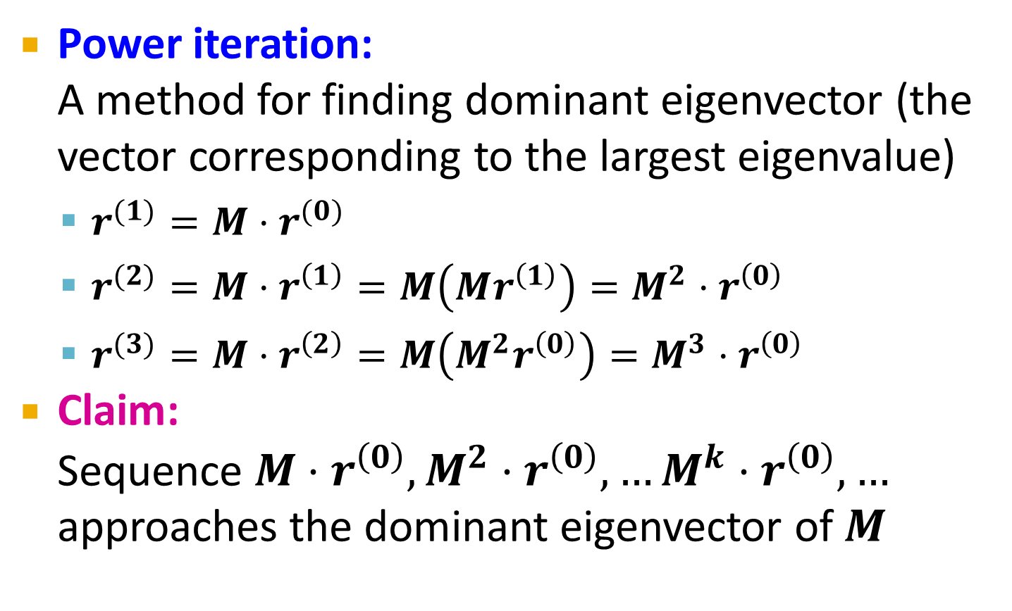
Why Power Iteration works? (1)
Details!
Power iteration:
A method for finding dominant eigenvector (the vector corresponding to the largest eigenvalue)
  $r^{(1)}=M⋅r^{(0)}$
  $r^{(2)}=M⋅r^{\left(1\right)}=M\left(Mr^{\left(1\right)}\right)=M^{2}⋅r^{\left(0\right)}$
  $r^{(3)}=M⋅r^{\left(2\right)}=M\left(M^{2}r^{\left(0\right)}\right)=M^{3}⋅r^{\left(0\right)}$
Claim:
Sequence $M⋅r^{\left(0\right)},M^{2}⋅r^{\left(0\right)},…M^{k}⋅r^{\left(0\right)},…$ approaches the dominant eigenvector of $M$

Slide 35
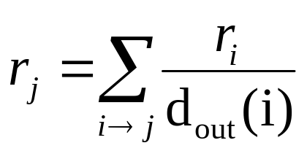
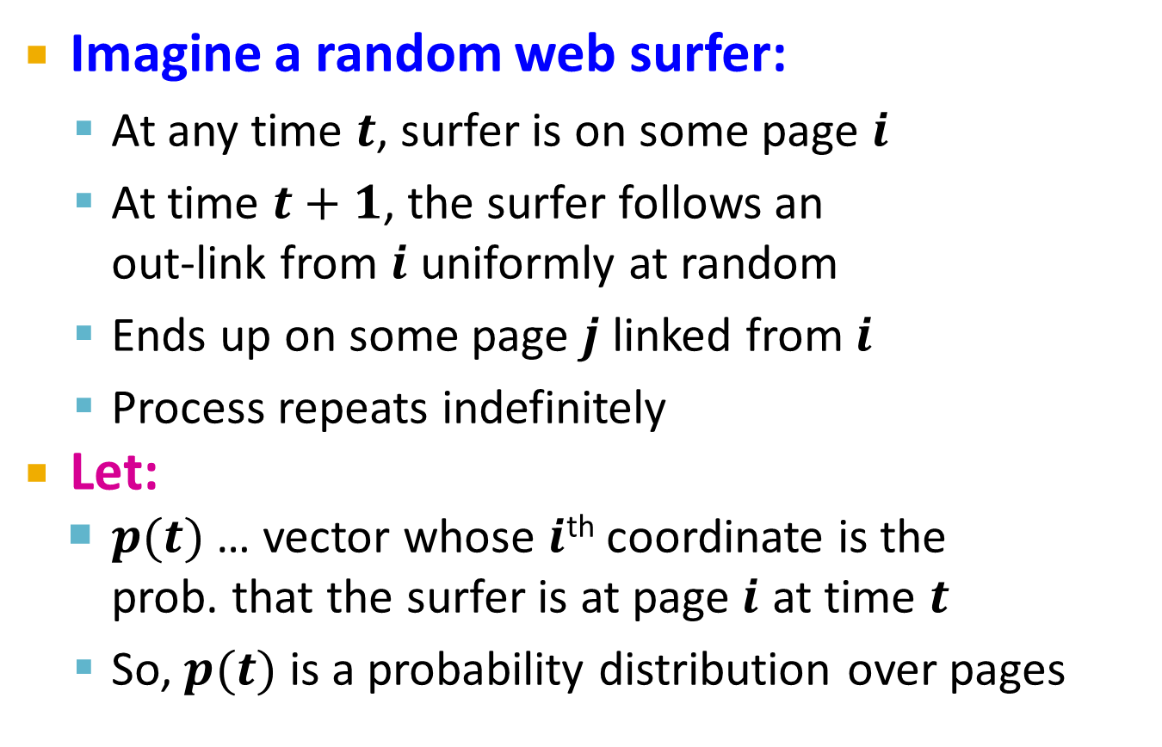
Random Walk Interpretation
Imagine a random web surfer:
  At any time $t$, surfer is on some page $i$
  At time $t+1$, the surfer follows an
  out-link from $i$ uniformly at random
  Ends up on some page $j$ linked from $i$
  Process repeats indefinitely
Let:
  $p(t)$ … vector whose $i$^{th} coordinate is the
  prob. that the surfer is at page $i$ at time $t$
  So, $p(t)$ is a probability distribution over pages
i₁
i₂
i₃
j

Slide 36

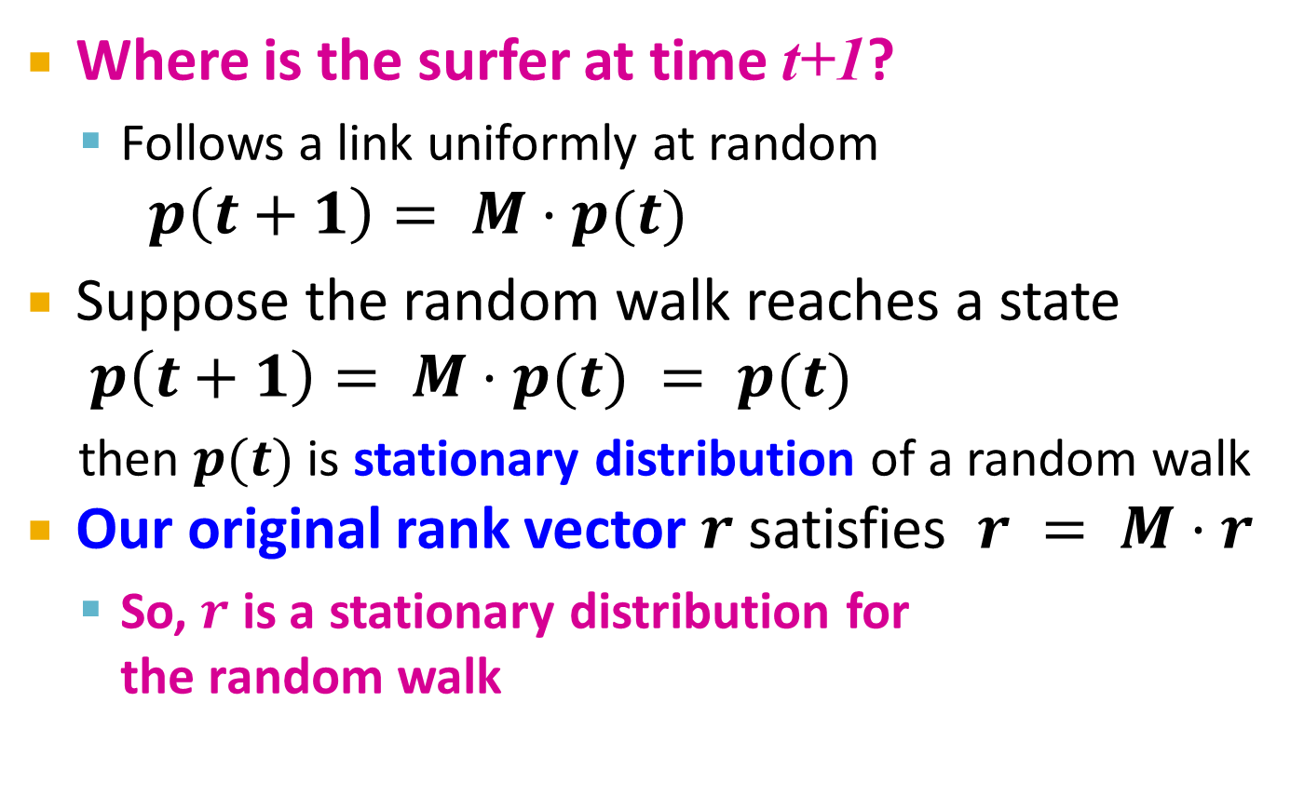
The Stationary Distribution
i₁
i₂
i₃
Where is the surfer at time t+1?
  Follows a link uniformly at random
$p\left(t+1\right)= M⋅p(t)$
Suppose the random walk reaches a state $p\left(t+1\right)= M⋅p(t) = p(t)$
  then $p(t)$ is stationary distribution of a random walk
Our original rank vector $r$ satisfies $r = M⋅r$
  So, $r$ is a stationary distribution for
  the random walk
j

Slide 37
Existence and Uniqueness
A central result from the theory of random walks (a.k.a. Markov processes):
For graphs that satisfy certain conditions,
the stationary distribution is unique and eventually will be reached no matter what the initial probability distribution at time t = 0

Slide 38
Dead Ends
Spider Traps
Taxation Policies
The Web Is More Complex
Than That
Notes:
We’re now going to forget whether the sets we deal with come from shingled documents or any other source, and concentrate on the sets themselves. We’ll learn the formal definition of “similarity” that is commonly used for sets – this notion is called “Jaccard similarity.” We’ll then learn how to construct signatures from sets using the minhashing technique, and we’ll prove the strong relationship between the similarity of the signatures and the sets they represent.

Slide 39

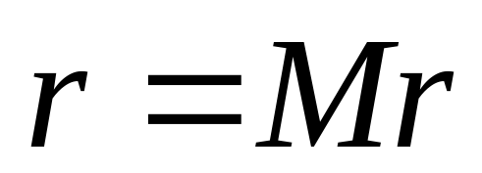
PageRank: Three Questions
Does this converge?
Does it converge to what we want?
Are results reasonable?
or
equivalently

Slide 40
Does this converge?
Example:
r_{a} 1 0 1 0
r_{b} 0 1 0 1
a
b
=
Iteration 0, 1, 2, …

Slide 41
Does it converge to what we want?
Example:
r_{a} 1 0 0 0
r_{b} 0 1 0 0
a
b
=
Iteration 0, 1, 2, …

Slide 42
PageRank: Problems
Dead end
2 problems:
(1) Some pages are
dead ends (have no out-links)
  Random walk has “nowhere” to go to
  Such pages cause importance to “leak out”
(2) Spider traps:
(all out-links are within the group)
  Random walked gets “stuck” in a trap
  And eventually spider traps absorb all importance
Spider trap

Slide 43
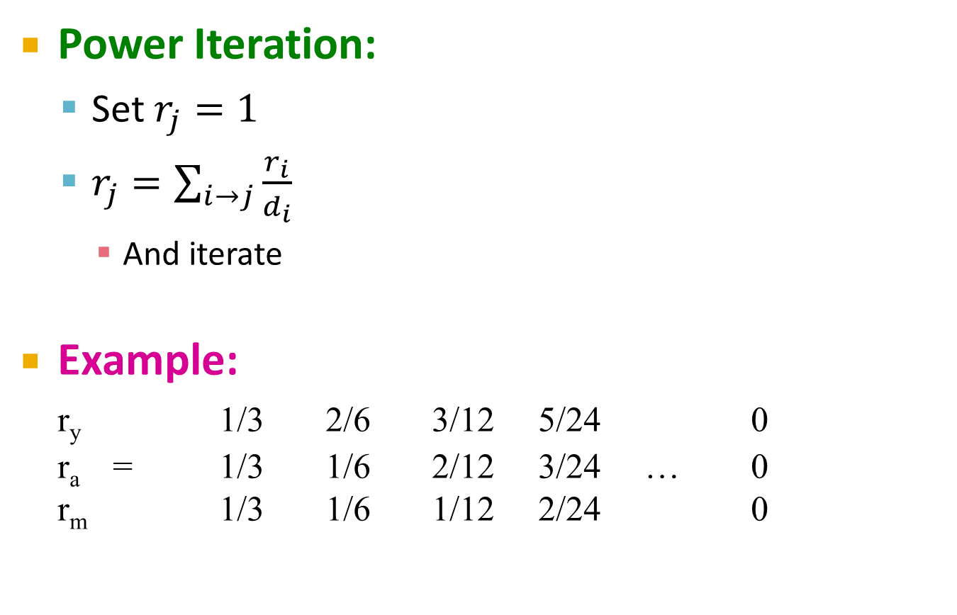
Problem: Dead Ends
Power Iteration:
  Set $r_{j}=1$
  $r_{j}=\sum_{i→j}{\frac{r_{i}}{d_{i}}}$
    And iterate
Example:
r_{y} 1/3 2/6 3/12 5/24 0
r_{a} = 1/3 1/6 2/12 3/24 … 0
r_{m} 1/3 1/6 1/12 2/24 0
y
 | y | a | m
y | ½ | ½ | 0
a | ½ | 0 | 0
m | 0 | ½ | 0
a
m
  r_{y} = r_{y} /2 + r_{a} /2
  r_{a} = r_{y} /2
  r_{m} = r_{a} /2
Iteration 0, 1, 2, …
Here the PageRank “leaks” out since the matrix is not stochastic.

Slide 44
Microsoft Becomes a Dead End
Yahoo
Amazon
M’soft

Slide 45
Microsoft Becomes a Dead End
Yahoo
Amazon
M’soft

Slide 46
Microsoft Becomes a Dead End
Yahoo
Amazon
M’soft

Slide 47
Microsoft Becomes a Dead End
Yahoo
Amazon
M’soft

Slide 48
In the Limit …
Yahoo
Amazon
M’soft

Slide 49
Solution: Always Teleport!
Teleports: Follow random teleport links with probability 1.0 from dead-ends
  Adjust matrix accordingly
y
y
a
m
a
m
 | y | a | m
y | ½ | ½ | 0
a | ½ | 0 | 0
m | 0 | ½ | 0
 | y | a | m
y | ½ | ½ | ⅓
a | ½ | 0 | ⅓
m | 0 | ½ | ⅓

Slide 50

Problem: Spider Traps
Power Iteration:
  Set $r_{j}=1$
  $r_{j}=\sum_{i→j}{\frac{r_{i}}{d_{i}}}$
    And iterate
Example:
r_{y} 1/3 2/6 3/12 5/24 0
r_{a} = 1/3 1/6 2/12 3/24 … 0
r_{m} 1/3 3/6 7/12 16/24 1
y
 | y | a | m
y | ½ | ½ | 0
a | ½ | 0 | 0
m | 0 | ½ | 1
a
m
m is a spider trap
  r_{y} = r_{y} /2 + r_{a} /2
  r_{a} = r_{y} /2
  r_{m} = r_{a} /2 + r_{m}
Iteration 0, 1, 2, …
All the PageRank score gets “trapped” in node m.

Slide 51
Microsoft Becomes a Spider Trap
Yahoo
Amazon
M’soft

Slide 52
Microsoft Becomes a Spider Trap
Yahoo
Amazon
M’soft

Slide 53
Microsoft Becomes a Spider Trap
Yahoo
Amazon
M’soft

Slide 54
In the Limit …
Yahoo
Amazon
M’soft

Slide 55
Solution: Teleports!
The Google solution for spider traps: At each time step, the random surfer has two options
  With prob. β, follow a link at random
  With prob. 1-β, jump to some random page
  Common values for β are in the range 0.8 to 0.9
Surfer will teleport out of spider trap
within a few time steps
y
y
a
m
a
m

Slide 56
Example: Microsoft is a Spider Trap; 20% Tax
Equations v = 0.8(Mv) + 0.2:
  y = 0.8(y/2 + a/2) + 0.2
  a = 0.8(y/2) + 0.2
  m = 0.8(a/2 + m) + 0.2
y
a =
m
1
1
1
1.00
0.60
1.40
0.84
0.60
1.56
0.776
0.536
1.688
7/11
5/11
21/11
. . .

Slide 57
Why Teleports Solve the Problem?
Why are dead-ends and spider traps a problem
and why do teleports solve the problem?
Spider-traps are not a problem, but with traps PageRank scores are not what we want
  Solution: Never get stuck in a spider trap by
  teleporting out of it in a finite number of steps
Dead-ends are a problem
  The matrix is not column stochastic so our initial assumptions are not met
  Solution: Make matrix column stochastic by always teleporting when there is nowhere else to go

Slide 58
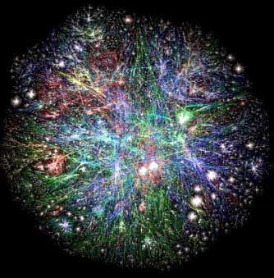
PageRank at Web Scale
Web graph
  How do we compute PageRank for graph of such scale?

Slide 59
