Slide 1

Map-Reduce and the New Software Stack
http://www.mmds.org
Readings: Chapter 2

Slide 2
Programming Model: MapReduce
Warm-up task:
We have a huge text document
Count the number of times each
distinct word appears in the file
Sample application:
  Analyze web server logs to find popular URLs

Slide 3
Task: Word Count
Case 1:
  File too large for memory, but all <word, count> pairs fit in memory
Case 2:
Count occurrences of words:
  words(doc.txt) | sort | uniq -c
    where words takes a file and outputs the words in it, one per a line
Case 2 captures the essence of MapReduce
  Great thing is that it is naturally parallelizable

Slide 4
MapReduce: Overview
Sequentially read a lot of data
Map:
  Extract something you care about
Group by key: Sort and Shuffle
Reduce:
  Aggregate, summarize, filter or transform
Write the result
Outline stays the same, Map and Reduce change to fit the problem

Slide 5
MapReduce: The Map Step
Input
key-value pairs
Intermediate
key-value pairs
k
v
map
k
v
k
v
map
k
v
k
v
…
…
k
v
k
v

Slide 6
MapReduce: The Reduce Step
Output
key-value pairs
Intermediate
key-value pairs
Key-value groups
reduce
k
v
k
v
v
v
k
v
Group
by key
reduce
k
v
k
v
v
k
v
k
v
…
…
…
k
v
k
v
k
v

Slide 7
More Specifically
Input: a set of key-value pairs
Programmer specifies two methods:
  Map(k, v) → <k’, v’>*
    Takes a key-value pair and outputs a set of key-value pairs
      E.g., key is the filename, value is a single line in the file
    There is one Map call for every (k,v) pair
  Reduce(k’, <v’>*) → <k’, v’’>*
    All values v’ with same key k’ are reduced together
    and processed in v’ order
    There is one Reduce function call per unique key k’

Slide 8
MapReduce: Word Counting
Provided by the programmer
Provided by the programmer
MAP:
Read input and produces a set of key-value pairs
Group by key:
Collect all pairs with same key
Reduce:
Collect all values belonging to the key and output
The crew of the space shuttle Endeavor recently returned to Earth as ambassadors, harbingers of a new era of space exploration. Scientists at NASA are saying that the recent assembly of the Dextre bot is the first step in a long-term space-based man/mache partnership. '"The work we're doing now -- the robotics we're doing -- is what we're going to need ……………………..
(The, 1)
(crew, 1)
(of, 1)
(the, 1)
(space, 1)
(shuttle, 1)
(Endeavor, 1)
(recently, 1)
….
(crew, 1)
(crew, 1)
(space, 1)
(the, 1)
(the, 1)
(the, 1)
(shuttle, 1)
(recently, 1)
…
(crew, 2)
(space, 1)
(the, 3)
(shuttle, 1)
(recently, 1)
…
Sequentially read the data
Only sequential reads
Big document
(key, value)
(key, value)
(key, value)

Slide 9
Hadoop Word Count Mapper
public class WordCountMapper extends MapReduceBase
implements Mapper {
private final static Text word = new Text();
private final static IntWritable count = new IntWritable(1);
public void map(WritableComparable key, Writable values,
OutputCollector output, Reporter reporter)
throws IOException {
/* Get line from file */
String line = values.toString();
/* Split into tokens */
StringTokenizer itr = new StringTokenizer(line.toLowerCase(),
" \t.!?:()[],'&-;|0123456789");
while(itr.hasMoreTokens()) {
word.set(itr.nextToken());
/* Emit <token,1> as key + value
output.collect(word, count);
}
}
}

Slide 10
Hadoop Word Count Reducer
public class WordCountReducer extends MapReduceBase
implements Reducer {
public void reduce(WritableComparable key, Iterator values,
OutputCollector output, Reporter reporter)
throws IOException {
int cnt = 0;
while(values.hasNext()) {
IntWritable ival = (IntWritable) values.next();
cnt += ival.get();
}
output.collect(key, new IntWritable(cnt));
}
}

Slide 11
Word Count Using MapReduce
map(key, value):
// key: document name; value: text of the document
for each word w in value:
emit(w, 1)
reduce(key, values):
// key: a word; value: an iterator over counts
result = 0
for each count v in values:
result += v
emit(key, result)

Slide 12
Map-Reduce: Environment
Map-Reduce environment takes care of:
Partitioning the input data
Scheduling the program’s execution across a
set of machines
Performing the group by key step
Handling machine failures
Managing required inter-machine communication

Slide 13
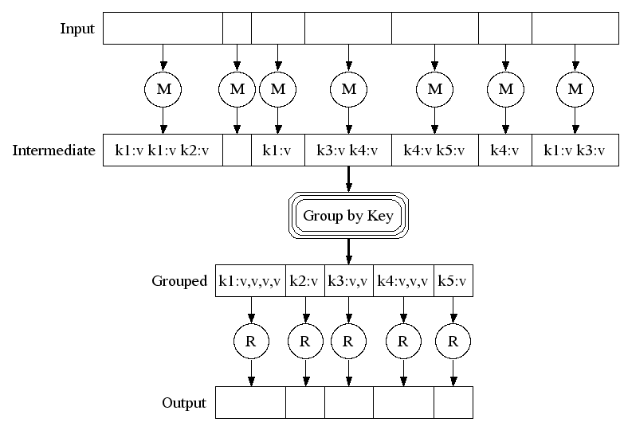
Map-Reduce: A diagram
Big document
MAP:
Read input and produces a set of key-value pairs
Group by key:
Collect all pairs with same key
(Hash merge, Shuffle, Sort, Partition)
Reduce:
Collect all values belonging to the key and output

Slide 14
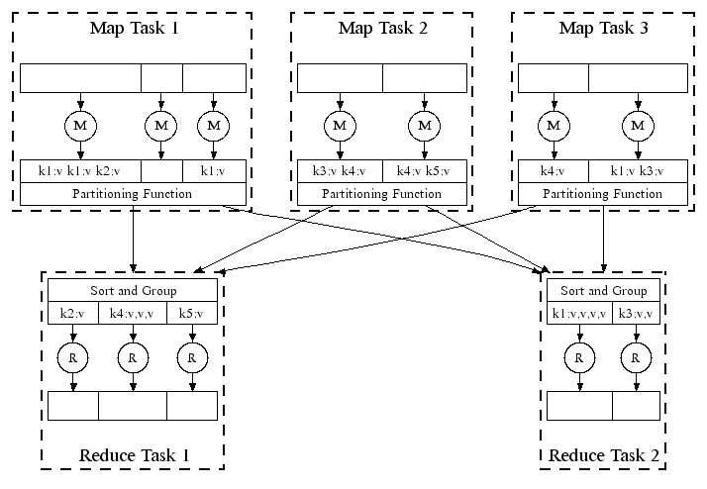
Map-Reduce: In Parallel
All phases are distributed with many tasks doing the work

Slide 15
Map-Reduce
Programmer specifies:
  Map and Reduce and input files
Workflow:
  Read inputs as a set of key-value-pairs
  Map transforms input kv-pairs into a new set of k'v'-pairs
  Sorts & Shuffles the k'v'-pairs to output nodes
  All k’v’-pairs with a given k’ are sent to the same reduce
  Reduce processes all k'v'-pairs grouped by key into new k''v''-pairs
  Write the resulting pairs to files
All phases are distributed with many tasks doing the work
Input 0
Input 1
Input 2
Map 0
Map 1
Map 2
Shuffle
Reduce 0
Reduce 1
Out 0
Out 1

Slide 16
Data Flow
Input and final output are stored on a distributed file system (FS):
  Scheduler tries to schedule map tasks “close” to physical storage location of input data
Intermediate results are stored on local FS
of Map and Reduce workers
Output is often input to another
MapReduce task

Slide 17
Coordination: Master
Master node takes care of coordination:
  Task status: (idle, in-progress, completed)
  Idle tasks get scheduled as workers become available
  When a map task completes, it sends the master the location and sizes of its R intermediate files, one for each reducer
  Master pushes this info to reducers
Master pings workers periodically to detect failures

Slide 18
Overview

Slide 19
Dealing with Failures
Map worker failure
  Map tasks completed or in-progress at
  worker are reset to idle
  Reduce workers are notified when task is rescheduled on another worker
Reduce worker failure
  Only in-progress tasks are reset to idle
  Reduce task is restarted
Master failure
  MapReduce task is aborted and client is notified

Slide 20
How many Map and Reduce jobs?
M map tasks, R reduce tasks
Rule of a thumb:
  Make M much larger than the number of nodes in the cluster
  One DFS chunk per map is common
  Improves dynamic load balancing and speeds up recovery from worker failures
Usually R is smaller than M
  Because output is spread across R files

Slide 21
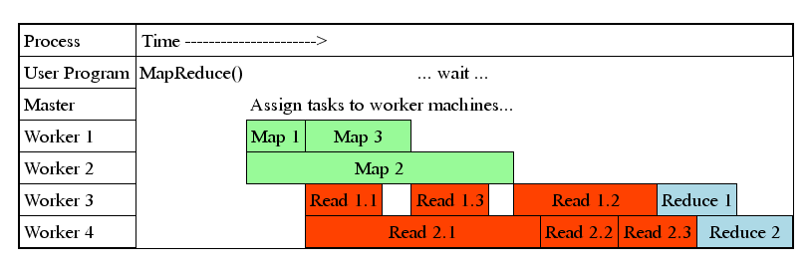
Task Granularity & Pipelining
Fine granularity tasks: map tasks >> machines
  Minimizes time for fault recovery
  Can do pipeline shuffling with map execution
  Better dynamic load balancing

Slide 22
Refinements: Backup Tasks
Problem
  Slow workers significantly lengthen the job completion time:
    Other jobs on the machine
    Bad disks
    Weird things
Solution
  Near end of phase, spawn backup copies of tasks
    Whichever one finishes first “wins”
Effect
  Dramatically shortens job completion time

Slide 23
Refinement: Combiners
Often a Map task will produce many pairs of the form (k,v₁), (k,v₂), … for the same key k
  E.g., popular words in the word count example
Can save network time by
pre-aggregating values in
the mapper:
  combine(k, list(v₁)) → v₂
  Combiner is usually same
  as the reduce function
Works only if reduce
function is commutative and associative

Slide 24
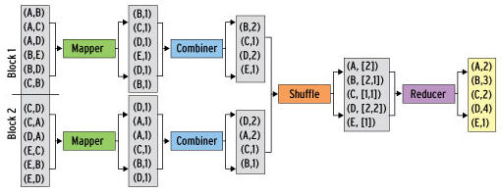
Refinement: Combiners
Back to our word counting example:
  Combiner combines the values of all keys of a single mapper (single machine):
  Much less data needs to be copied and shuffled!

Slide 25
Refinement: Partition Function
Want to control how keys get partitioned
  Inputs to map tasks are created by contiguous splits of input file
  Reduce needs to ensure that records with the same intermediate key end up at the same worker
System uses a default partition function:
  hash(key) mod R
Sometimes useful to override the hash function:
  E.g., hash(hostname(URL)) mod R ensures URLs from a host end up in the same output file

Slide 26
Problems Suited for
Map-Reduce

Slide 27
Examples
Counting tasks
  Find the total size in bytes of a host
  Compute the frequency of all k-grams on the web
  Compute the frequency of queries
  Compute the frequency of query,url pairs
Other examples:
  Link analysis and graph processing – PageRank
  Machine Learning algorithms
  Linear algebra operations (matrix-vector, matrix-matrix multiplication)

Slide 28
Matrix – Vector Multiplication
and
Matrix – Matrix Multiplication

Slide 29
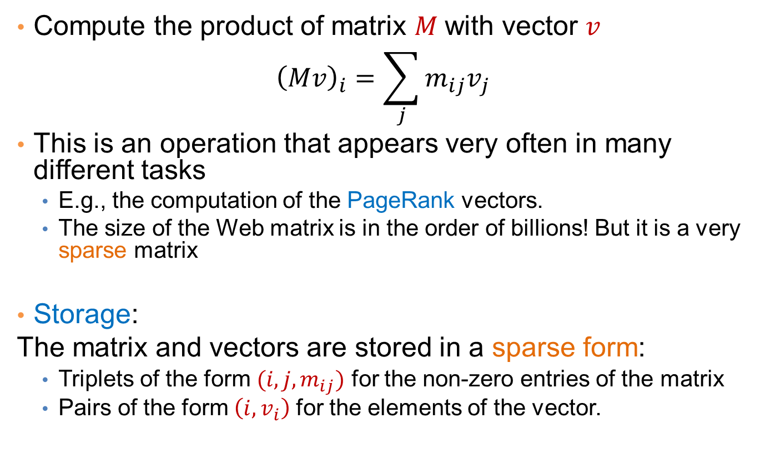
Matrix-Vector multiplication
Compute the product of matrix $M$with vector $v$
$${\left(Mv\right)}_{i}=\sum_{j}{m_{ij}v_{j}}$$
This is an operation that appears very often in many different tasks
  E.g., the computation of the PageRank vectors.
  The size of the Web matrix is in the order of billions! But it is a very sparse matrix
Storage:
The matrix and vectors are stored in a sparse form:
  Triplets of the form $(i,j,m_{ij})$ for the non-zero entries of the matrix
  Pairs of the form $\left(i, v_{i}\right)$ for the elements of the vector.

Slide 30
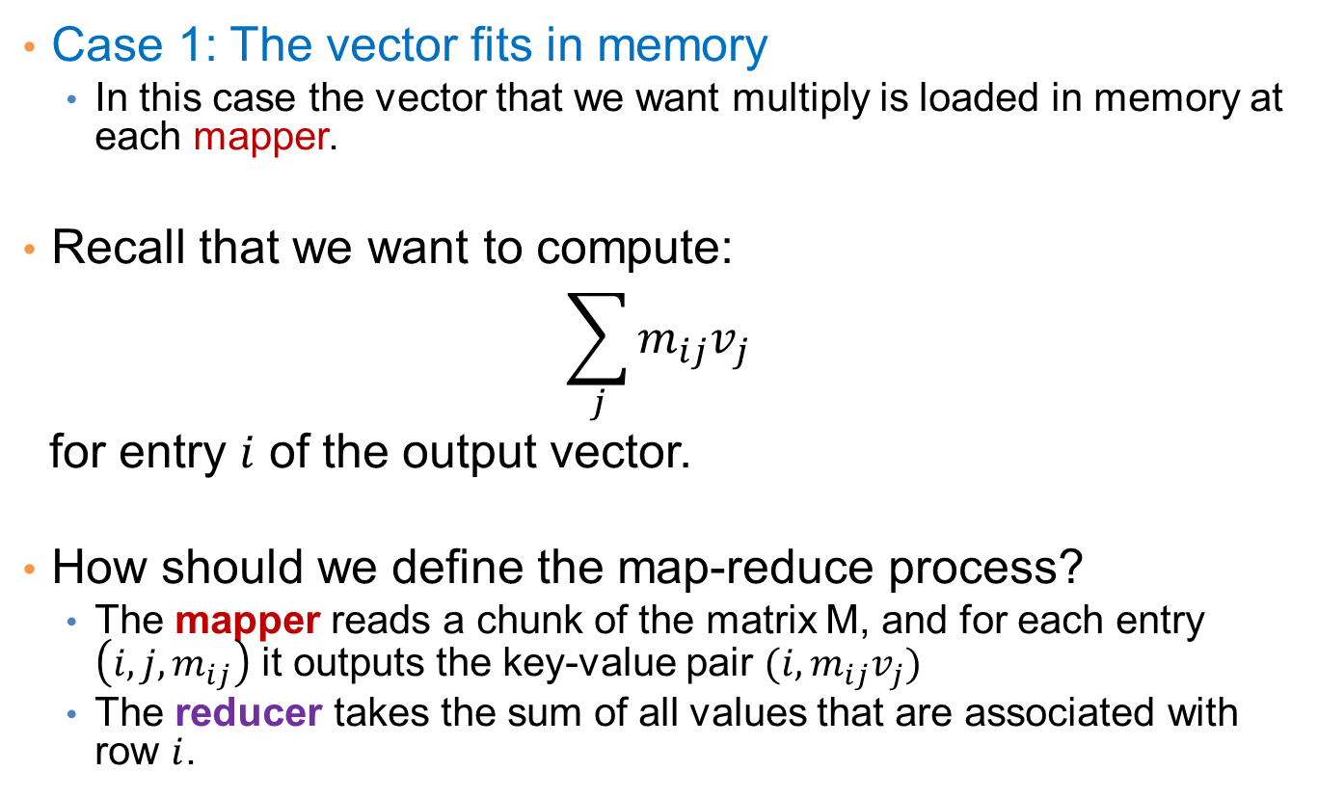
Matrix-vector multiplication
Case 1: The vector fits in memory
  In this case the vector that we want multiply is loaded in memory at each mapper.
Recall that we want to compute:
$$\sum_{j}{m_{ij}v_{j}}$$
for entry $i$ of the output vector.
How should we define the map-reduce process?
  The mapper reads a chunk of the matrix M, and for each entry $\left(i,j,m_{ij}\right)$ it outputs the key-value pair $(i, m_{ij}v_{j})$
  The reducer takes the sum of all values that are associated with row $i$.

Slide 31
Matrix-vector multiplication
Case 2: The vector does not fit in memory
In this case we split the matrix and the vector into stripes:
We perform the computation for each stripe of the matrix, where the vector can fit into memory
  For PageRank it is better to split the matrix into blocks.

Slide 32
Example: Sparse Matrices with Map/Reduce
A
B
C
10
20
-1
-10
-80
30
40
X
-2
-3
=
-60
-250
50
60
70
-4
-170
-460
  Task: Compute product C = A·B
  Assume most matrix entries are 0
Motivation
  Core problem in scientific computing
  Challenging for parallel execution
  Demonstrate expressiveness of Map/Reduce

Slide 33
Computing Sparse Matrix Product
A
B
1
10
1
1
-1
1
10
20
A
-1
B
1
20
3
2
-2
1
30
40
A
-2
-3
B
2
30
2
2
-3
2
50
60
70
A
-4
B
2
40
3
3
-4
2
A
B
3
50
1
A
3
60
2
A
3
70
3
A
  Represent matrix as list of nonzero entries
    ⟨row, col, value, matrixID⟩
  Strategy
    Phase 1: Compute all products a_{i,k} · b_{k,j}
    Phase 2: Sum products for each entry i,j
    Each phase involves a Map/Reduce

Slide 34
Phase 1 Map of Matrix Multiply
1
10
1
Key = 1
A
10
1
20
3
1
A
1
A
1
-1
1
30
50
B
2
2
3
A
1
A
2
40
3
Key = col
A
Key = 2
3
50
1
2
30
2
2
-2
1
A
A
B
3
60
2
60
2
-3
2
A
3
A
2
B
3
70
3
A
-1
Key = 3
1
B
1
1
20
3
-2
A
Key = row
2
B
1
40
3
-4
2
2
A
3
B
2
-3
2
B
70
-4
3
A
3
3
B
2
  Group values a_{i,k} and b_{k,j} according to key k

Slide 35
Phase 1 “Reduce” of Matrix Multiply
Key = 1
1
-10
1
1
10
1
C
A
X
1
-1
1
-50
B
3
A
1
3
50
1
A
2
-60
1
Key = 2
C
2
30
2
2
-2
1
2
-90
2
A
X
B
C
60
2
-3
2
3
-120
1
3
A
2
B
C
3
-180
2
C
Key = 3
20
1
-80
2
1
A
3
C
-4
2
-160
2
2
40
3
X
3
B
2
C
A
-280
3
C
2
3
70
3
A
  Generate all products a_{i,k} · b_{k,j}

Slide 36
Phase 2 Map of Matrix Multiply
-10
Key = 1,1
1
1
1
-10
1
C
C
3
-50
1
-80
Key = 1,2
A
1
C
2
Key = 2,1
2
-60
1
2
-60
1
C
C
2
-90
2
Key = row,col
Key = 2,2
C
2
-90
2
-120
C
3
C
1
2
-160
2
-180
C
3
C
2
Key = 3,1
3
-120
1
-80
C
1
C
2
3
-50
1
A
2
-160
2
C
Key = 3,2
3
-280
2
3
-280
2
C
C
-180
3
C
2
  Group products a_{i,k} · b_{k,j} with matching values of i and j

Slide 37
Phase 2 Reduce of Matrix Multiply
Key = 1,1
1
-10
1
1
-10
1
C
C
-80
-80
Key = 1,2
1
C
2
1
C
2
Key = 2,1
2
-60
1
2
-60
1
C
C
C
Key = 2,2
-10
-80
2
-90
2
-250
C
2
C
2
-160
-60
-250
2
C
2
-170
-460
Key = 3,1
3
-120
1
3
-170
1
C
C
3
-50
1
A
Key = 3,2
3
-280
2
-460
C
3
C
2
3
-180
2
C
  Sum products to get final entries

Slide 38
Matrix Multiply Phase 1 Mapper
public class P1Mapper extends MapReduceBase implements Mapper {
public void map(WritableComparable key, Writable values,
OutputCollector output, Reporter reporter) throws IOException {
try {
GraphEdge e = new GraphEdge(values.toString());
IntWritable k;
if (e.tag.equals("A"))
k = new IntWritable(e.toNode);
else
k = new IntWritable(e.fromNode);
output.collect(k, new Text(e.toString()));
} catch (BadGraphException e) {}
}
}

Slide 39
Matrix Multiply Phase 1 Reducer
public class P1Reducer extends MapReduceBase implements Reducer {
public void reduce(WritableComparable key, Iterator values,
OutputCollector output, Reporter reporter)
throws IOException
{
Text outv = new Text(""); // Don't really need output values
/* First split edges into A and B categories */
LinkedList<GraphEdge> alist = new LinkedList<GraphEdge>();
LinkedList<GraphEdge> blist = new LinkedList<GraphEdge>();
while(values.hasNext()) {
try {
GraphEdge e =
new GraphEdge(values.next().toString());
if (e.tag.equals("A")) {
alist.add(e);
} else {
blist.add(e);
}
} catch (BadGraphException e) {}
}
// Continued

Slide 40
MM Phase 1 Reducer (cont.)
// Continuation
Iterator<GraphEdge> aset = alist.iterator();
// For each incoming edge
while(aset.hasNext()) {
GraphEdge aedge = aset.next();
// For each outgoing edge
Iterator<GraphEdge> bset = blist.iterator();
while (bset.hasNext()) {
GraphEdge bedge = bset.next();
GraphEdge newe = aedge.contractProd(bedge);
// Null would indicate invalid contraction
if (newe != null) {
Text outk = new Text(newe.toString());
output.collect(outk, outv);
}
}
}
}
}

Slide 41
Matrix Multiply Phase 2 Mapper
public class P2Mapper extends MapReduceBase implements Mapper {
public void map(WritableComparable key, Writable values,
OutputCollector output, Reporter reporter)
throws IOException {
String es = values.toString();
try {
GraphEdge e = new GraphEdge(es);
// Key based on head & tail nodes
String ks = e.fromNode + " " + e.toNode;
output.collect(new Text(ks), new Text(e.toString()));
} catch (BadGraphException e) {}
}
}

Slide 42
Matrix Multiply Phase 2 Reducer
public class P2Reducer extends MapReduceBase implements Reducer {
public void reduce(WritableComparable key, Iterator values,
OutputCollector output, Reporter reporter)
throws IOException
{
GraphEdge efinal = null;
while (efinal == null && values.hasNext()) {
try {
efinal = new GraphEdge(values.next().toString());
} catch (BadGraphException e) {}
}
if (efinal != null) {
while(values.hasNext()) {
try {
GraphEdge eother =
new GraphEdge(values.next().toString());
efinal.weight += eother.weight;
} catch (BadGraphException e) {}
}
if (efinal.weight != 0)
output.collect(new Text(efinal.toString()),
new Text(""));
}
}
}

Slide 43
Example: Host size
Suppose we have a large web corpus
Look at the metadata file
  Lines of the form: (URL, size, date, …)
For each host, find the total number of bytes
  That is, the sum of the page sizes for all URLs from that particular host

Slide 44
More on Matrix – Matrix Multiplication
http://www.mathcs.emory.edu/~cheung/Courses/554/Syllabus/9-parallel/matrix-mult.html

Slide 45
Example: Language Model
Statistical machine translation:
  Need to count number of times every 5-word sequence occurs in a large corpus of documents
Very easy with MapReduce:
  Map:
    Extract (5-word sequence, count) from document
  Reduce:
    Combine the counts

Slide 46
Example: Join By Map-Reduce
Compute the natural join R(A,B) ⋈ S(B,C)
R and S are each stored in files
Tuples are pairs (a,b) or (b,c)
A | B
a₁ | b₁
a₂ | b₁
a₃ | b₂
a₄ | b₃
B | C
b₂ | c₁
b₂ | c₂
b₃ | c₃
A | C
a₃ | c₁
a₃ | c₂
a₄ | c₃
⋈
=
S
R

Slide 47
Map-Reduce Join
Use a hash function h from B-values to 1...k
A Map process turns:
  Each input tuple R(a,b) into key-value pair (b,(a,R))
  Each input tuple S(b,c) into (b,(c,S))
Map processes send each key-value pair with key b to Reduce process h(b)
  Hadoop does this automatically; just tell it what k is.
Each Reduce process matches all the pairs (b,(a,R)) with all (b,(c,S)) and outputs (a,b,c).

Slide 48
Pointers and Further Reading

Slide 49
Implementations
Google
  Not available outside Google
Hadoop
  An open-source implementation in Java
  Uses HDFS for stable storage
  Download: http://lucene.apache.org/hadoop/
Aster Data
  Cluster-optimized SQL Database that also implements MapReduce

Slide 50
Cloud Computing
Ability to rent computing by the hour
  Additional services e.g., persistent storage
Amazon’s “Elastic Compute Cloud” (EC2)
Aster Data and Hadoop can both be run on EC2

Slide 51
Reading
Jeffrey Dean and Sanjay Ghemawat: MapReduce: Simplified Data Processing on Large Clusters
  http://labs.google.com/papers/mapreduce.html
Sanjay Ghemawat, Howard Gobioff, and Shun-Tak Leung: The Google File System
  http://labs.google.com/papers/gfs.html

Slide 52
Resources
Hadoop Wiki
  Introduction
    http://wiki.apache.org/lucene-hadoop/
  Getting Started
    http://wiki.apache.org/lucene-hadoop/GettingStartedWithHadoop
  Map/Reduce Overview
    http://wiki.apache.org/lucene-hadoop/HadoopMapReduce
    http://wiki.apache.org/lucene-hadoop/HadoopMapRedClasses
  Eclipse Environment
    http://wiki.apache.org/lucene-hadoop/EclipseEnvironment
Javadoc
  http://lucene.apache.org/hadoop/docs/api/

Slide 53
Resources
Releases from Apache download mirrors
  http://www.apache.org/dyn/closer.cgi/lucene/hadoop/
Nightly builds of source
  http://people.apache.org/dist/lucene/hadoop/nightly/
Source code from subversion
  http://lucene.apache.org/hadoop/version_control.html

