Slide 1
Representing and Manipulating Data
Pandas
Slides based on
Z. Ives’ at University of Pennsylvania
and
Katia Oleinik at Boston University

Slide 2
What Does Big Data Involve?
Acquisition, access – data may exist without being accessible
Wrangling – data may be in the wrong form
Integration, representation – data relationships may not be captured
Cleaning, filtering – data may have variable quality
Hypothesizing, querying, analyzing, modeling – from data to information
Understanding, iterating, exploring – helping build knowledge
And: ethical obligations – need to protect data, follow good statistical practices, present results in a non-misleading way

Slide 3
First: What Does Structure Mean?

Slide 4
Structured Data Building Blocks:
Programming Language Primitives
Scalars: ints, floats, strings
Python3: int64, double-precision, Unicode strings, …
Sets of named, unordered items: Dictionaries or maps
  {key1: val1, key2: val2, key3: val3}
Indexed items: Lists, vectors, arrays (one type), tuples (fixed-length, multi-type)
  [item1, item2, item3, …] (item1, item2, item3, ...)
  Order matters, look up by integer index.
  Different implementations vary in lookup speed, append speed
We’ll use Python in this course – but most languages have similar primitives

Slide 5
Some Examples of Structured Data
JSON Object
Python Dictionary
{ "meta" :
  { "view" :
    { "id" : "rhe8-mgbb",
    "name" : "Medallion Vehicles - Authorized", "attribution" : "Taxi and Limousine Commission (TLC)",
    "averageRating" : 0,
    "category" : "Transportation",
    "createdAt" : 1362166028,
    "description" : ”Medallion vehicles authorized to operate in New York City. ",
    "displayType" : "table",
    "downloadCount" : 47921,
    …
{‘a’: [‘apple’, ‘atom’],
‘b’: [‘bat’, ‘bar’, ‘book]}

Slide 6
Some Examples of Structured Data
Relational Database Table
Vector of Numbers
[3,14,15,92,65,45,…]
(‘Carson Wentz’, 6’ 5’’, 25)
Name | Height | Age
Carson Wentz | 6’ 5’’ | 25
Zack Ertz | 6’ 5’’ | 27
[{‘name’: ‘Carson Wentz’,
‘height’: 6’ 5’’,
‘age’: 25},
{‘name’: ‘Zach Ertz’,
‘height’: 6’ 5’’,
‘age’: 27},
…]
Tuple

Slide 7
Exercise:
How to Represent…?
Calendar appointments with description, time, location
Universities and their schools (colleges)
Sequence of ocean level measurements with location and temperture

Slide 8

Great, So these are Ways of
Constructing Variables…
What about “Big Data”?
In 1969 Edgar F. “Ted” Codd – proposed a novel idea…
Let’s have a “logical representation” of data that isn’t dependent on
  Where things are located (computer, memory region, …)
  Specific in-memory data structures (array vs linked list, tree vs map, …)
  What pointers, indices, etc. are available
  “Implicit” properties like order of access
“Physical data independence”
… Led to the relational database, but much more broadly applicable

Slide 9
Desiderata for
Physical Data Independence
Need an abstraction more general than an in-memory data structure…
Could we have a conceptual data structure that might
  move from memory to disk to network?
  split (“shard”) across a cluster?
  Allow us to do “bulk” computation efficiently?
    e.g., filter, merge, extract, ...

Slide 10
What Might It Look Like?

Slide 11
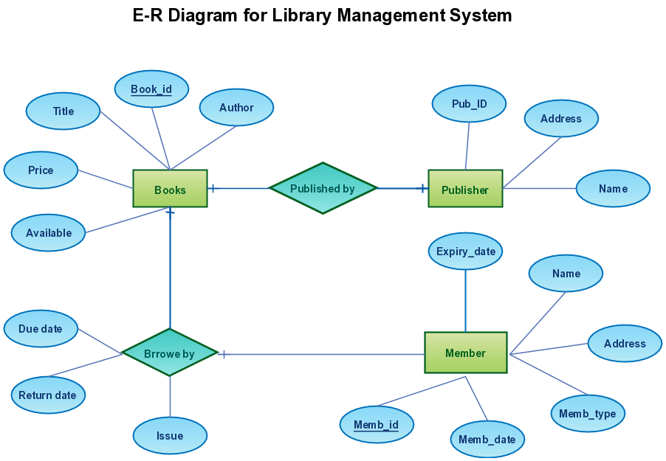
A General Model:
A Graph of Entities & Relationships

Slide 12
How Might We Represent a Node in an Entity/Relationship Graph?
Publisher
Pub_ID | Name | Address
1 | Pearson | UK
2 | Wiley | US
… | …

Slide 13
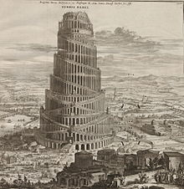
Structured Data
There are lots of different “camps” that talk about data and big data…
  Programming language and compiler developers
  Sofware engineers
  R and Matlab users
  Database developers and users
  MapReduce / Spark
Generally it’s like the Tower of Babel – but maps, vectors, and DataFrames
(of course called different names) are shared abstractions!

Slide 14
DataFrames in Pandas

Slide 15
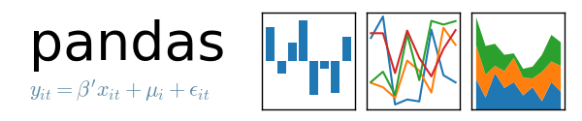
Python Libraries for Data Science
Pandas:
  adds data structures and tools designed to work with table-like data (similar to Series and Data Frames in R)
  provides tools for data manipulation: reshaping, merging, sorting, slicing, aggregation etc.
  allows handling missing data
Link: http://pandas.pydata.org/

Slide 16
Pandas Basics
Series
DataFrame
Creating a Series, DataFrames
Select columns, Select rows with Boolean indexing

Slide 17
Loading Python Libraries - Pandas
In [ ]:
#Import Python Libraries
import pandas as pd

Slide 18
A DataFrame
Is Essentially a Kind of Table
(Special index with a type) | Column with a key and type | Column with a key and type
Index value | value or NaN | value or NaN
Index value | value or NaN | value or NaN
Index value | value or NaN | value or NaN
Think of it as a relation across values, or a
list of maps with the same keys/values.

Slide 19
Creating and Using
Python/Pandas DataFrames

Slide 20
Pandas: Essential Concepts
A Series is a named Python list (dict with list as value).
{ ‘grades’ : [50,90,100,45] }
  http://pandas.pydata.org/pandas-docs/stable/generated/pandas.Series.html
A DataFrame is a dictionary of Series (dict of series):
{ { ‘names’ : [‘bob’,’ken’,’art’,’joe’]}
  { ‘grades’ : [50,90,100,45] }
  }
  http://pandas.pydata.org/pandas-docs/stable/api.html#dataframe

Slide 21
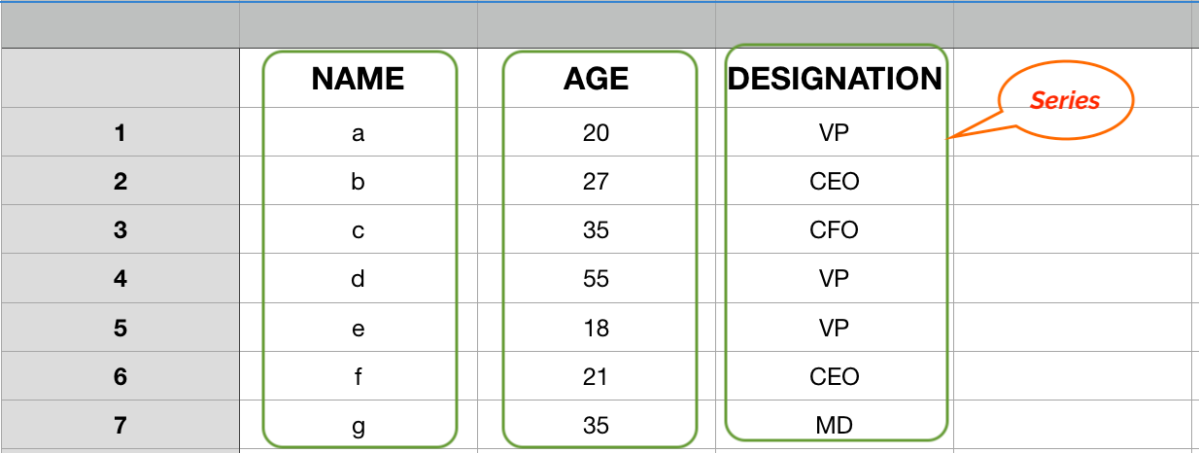
Pandas: Series
A one-dimensional labeled array capable of holding any data type
  Imagine a column in an excel sheet.

Slide 22
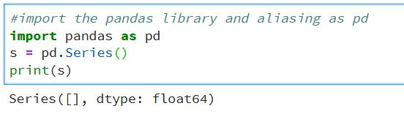
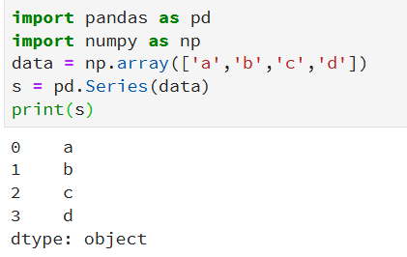
Create Series
Empty
From array

Slide 23
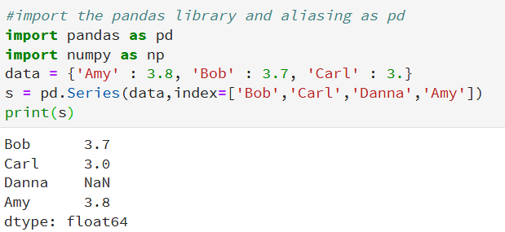
Create Series
From dictionary

Slide 24
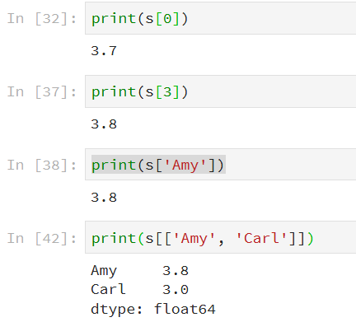
Accessing Series
Accessing Data from Series
by position
by index label
multiple elements

Slide 25
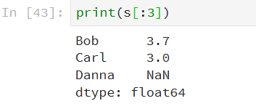
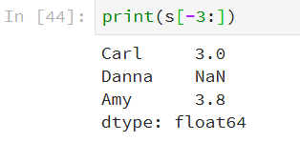
Accessing Series - Advanced
Retrieve the first n elements
Retrieve the last n elements

Slide 26
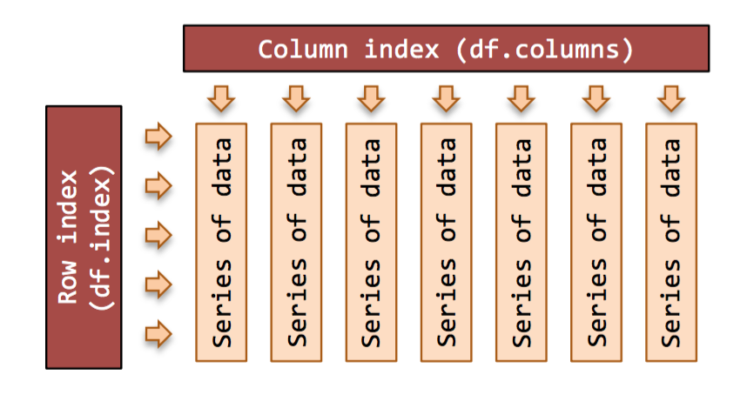
DataFrames

Slide 27
Create DataFrame
A pandas DataFrame can be created using various inputs like −
  Lists
  dict
  Series
  Numpy ndarrays
  Another DataFrame

Slide 28
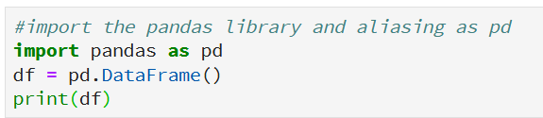

Create an Empty DataFrame

Slide 29
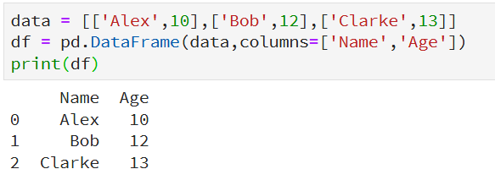
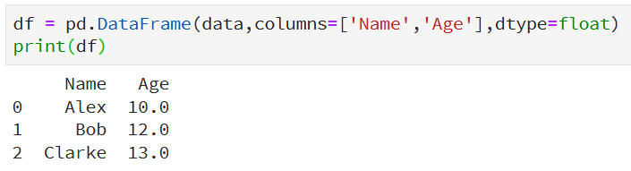
Create DataFrame from Lists

Slide 30
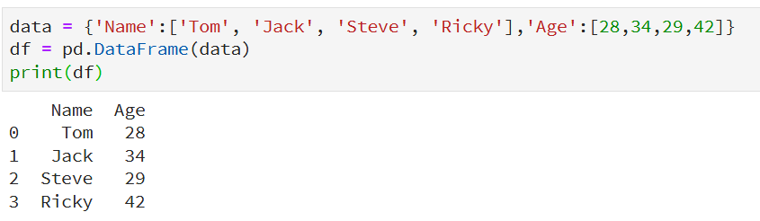
Create a DataFrame from Dict of ndarrays
All the ndarrays must be of same length
Default index

Slide 31
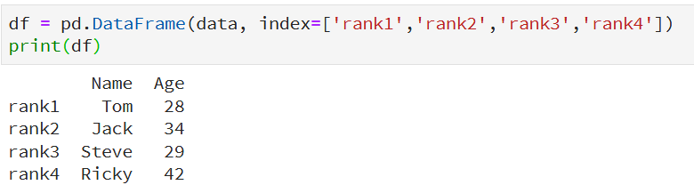
Create a DataFrame from Dict of ndarrays
The length of the index should be equal to the length of the arrays.
Custom index

Slide 32
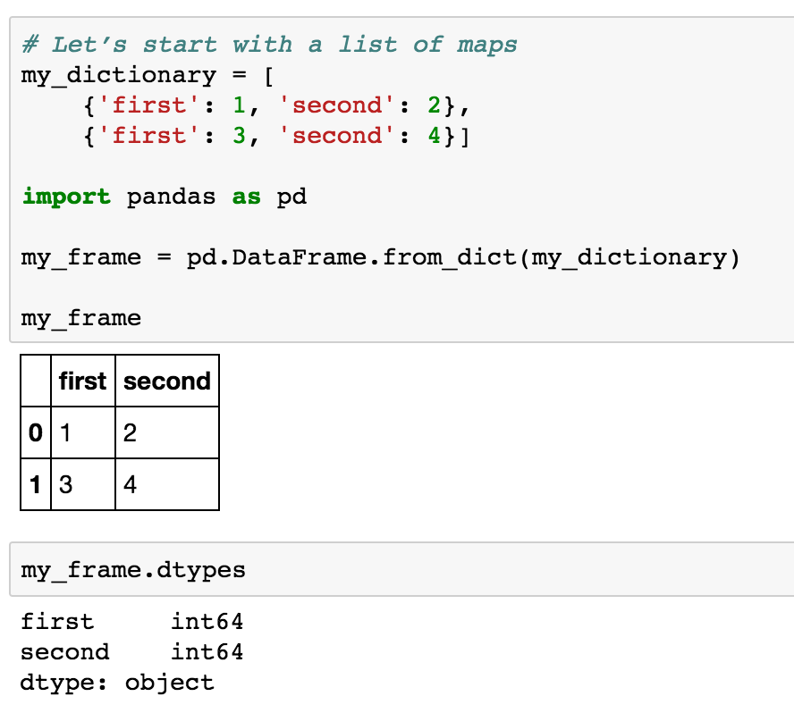
Creating a DataFrame from a List of Maps (“A Table”)
Index

Slide 33
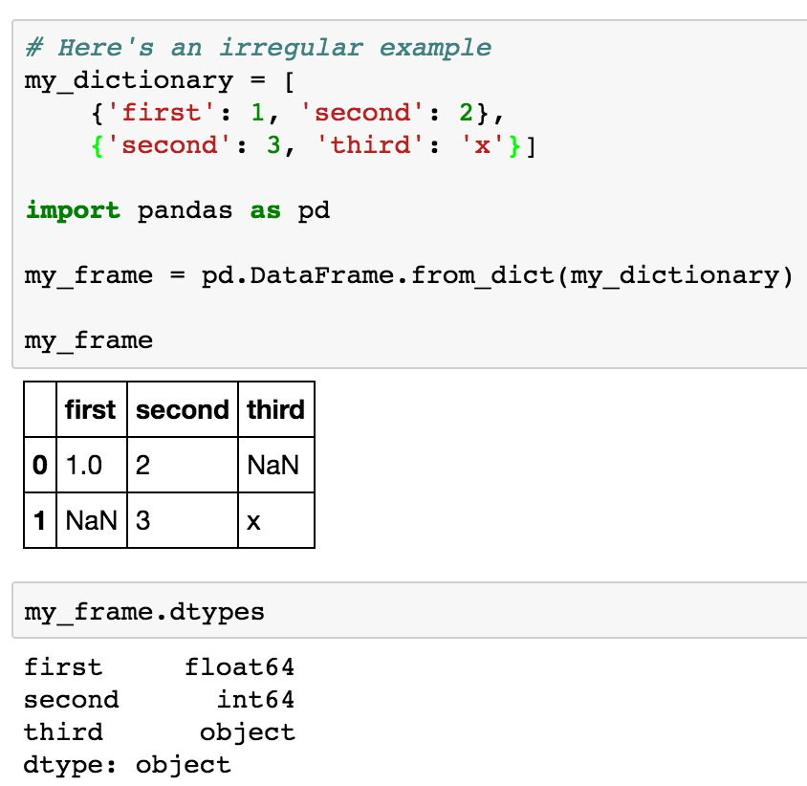
What If the Dictionary
Isn’t Consistent? Padding…
(first, second)
(second, third)

Slide 34
Data Frame data types
Pandas Type | Native Python Type | Description
object | string | The most general dtype. Will be assigned to your column if column has mixed types (numbers and strings).
int64 | int | Numeric characters. 64 refers to the memory allocated to hold this character.
float64 | float | Numeric characters with decimals. If a column contains numbers and NaNs(see below), pandas will default to float64, in case your missing value has a decimal.
datetime64, timedelta[ns] | N/A (but see the datetime module in Python’s standard library) | Values meant to hold time data. Look into these for time series experiments.

Slide 35
Reading data

Slide 36
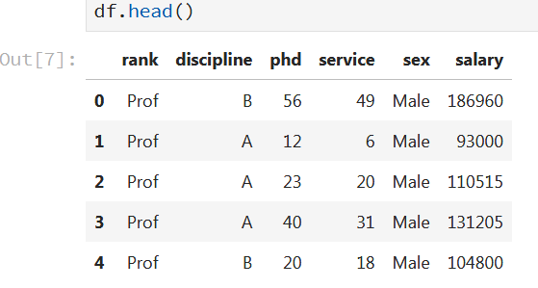
Reading data using pandas
In [ ]:
#Read csv file
df = pd.read_csv("http://rcs.bu.edu/examples/python/data_analysis/Salaries.csv")
Note: The above command has many optional arguments to fine-tune the data import process.

Slide 37
Reading data using pandas
In [ ]:
#Read csv file
df = pd.read_csv("http://rcs.bu.edu/examples/python/data_analysis/Salaries.csv")
Note: The above command has many optional arguments to fine-tune the data import process.
There is a number of pandas commands to read other data formats:
pd.read_excel('myfile.xlsx',sheet_name='Sheet1', index_col=None, na_values=['NA'])
pd.read_stata('myfile.dta')
pd.read_sas('myfile.sas7bdat')
pd.read_hdf('myfile.h5','df')
pd.read_table('myfile.h5', sep=',')

Slide 38
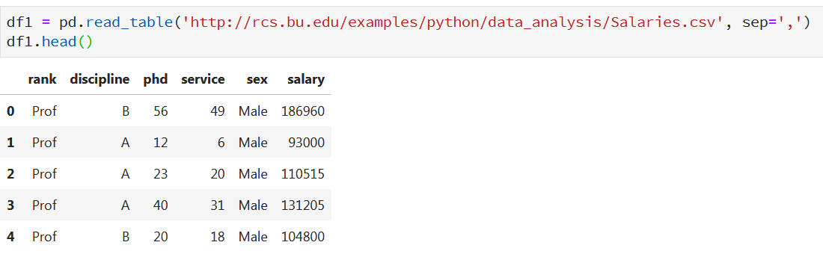
Another Example: read_table()

Slide 39
A Bit More Reading
A file may not always have a header row.
  pandas to assign default column names (but not informative)
  you can specify names yourself

Slide 40
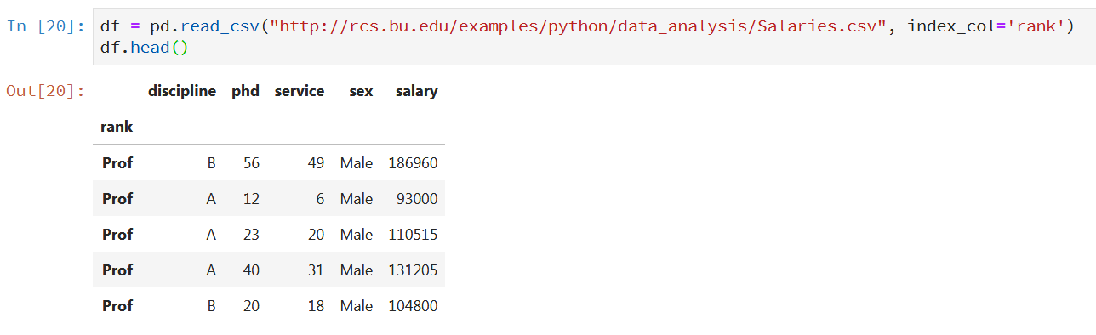
A Bit More Reading
Indices

Slide 41
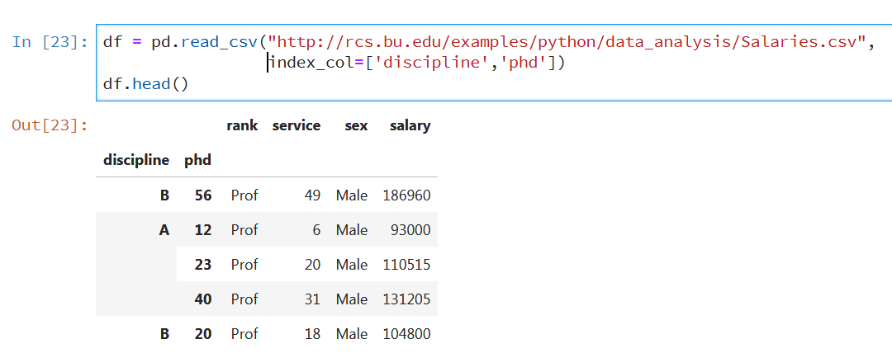
A Bit More Reading
Hierarchical Indices

Slide 42


A Bit More Reading
The file may not have a fixed delimiter, using whitespace or some other pattern to separate fields
  Use a regular expression as a delimiter
  Skip rows

Slide 43
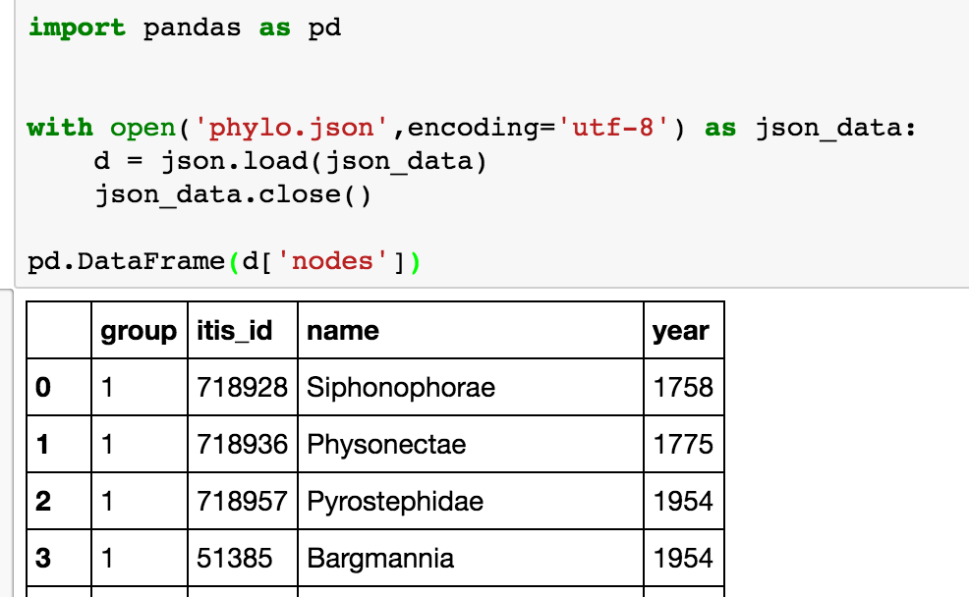
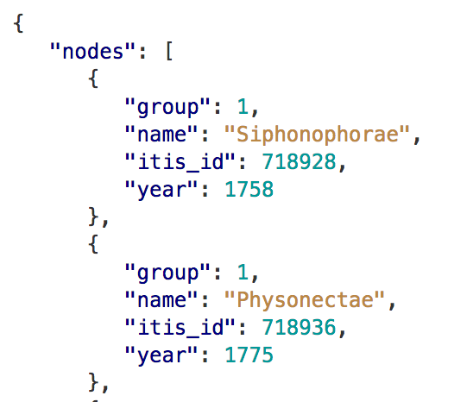
Loading from the
JSON Format
“JavaScript Object Notation” – used very heavily in the Web
Essentially dictionaries and lists – trivial to parse
Note use of file encoding!
json.load – from file
json.loads – from string
https://bitbucket.org/caseywdunn/phylogeny-d3

Slide 44
Reading Large Files
When processing very large files, you may only want to read in a small piece of a file or iterate through smaller chunks of the file.
Scenario 1: Read only a small number of rows from a large file
  specify that with nrows:
Scenario 2: read a file in pieces
  specify a chunksize as a number of rows:

Slide 45
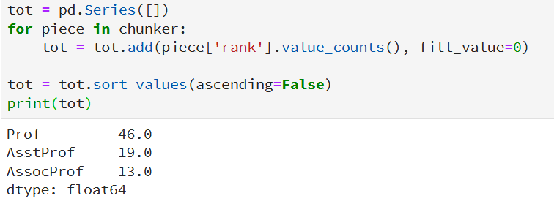
Iterating over Chunks
Iterate over the parts of the file according to the chunksize

Slide 46
Exploring DataFrame

Slide 47
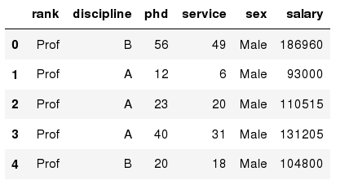
Exploring data frames
In [3]:
#List first 5 records
df.head()
Out[3]:

Slide 48
Data Frame data types
In [4]:
#Check a particular column type
df['salary'].dtype
Out[4]: dtype('int64')
#Check types for all the columns
df.dtypes
In [5]:
Out[4]:
rank
discipline
phd
service
sex
salary
dtype: object
object
object
int64
int64
object
int64

Slide 49
Data Frames attributes
Python objects have attributes and methods.
df.attribute | description
dtypes | list the types of the columns
columns | list the column names
axes | list the row labels and column names
ndim | number of dimensions
size | number of elements
shape | return a tuple representing the dimensionality
values | numpy representation of the data

Slide 50
Hands-on exercises
Find how many records this data frame has;
How many elements are there?
What are the column names?
What types of columns we have in this data frame?

Slide 51
Data Frames methods
Unlike attributes, python methods have parenthesis.
All attributes and methods can be listed with a dir() function: dir(df)
df.method() | description
head( [n] ), tail( [n] ) | first/last n rows
describe() | generate descriptive statistics (for numeric columns only)
max(), min() | return max/min values for all numeric columns
mean(), median() | return mean/median values for all numeric columns
std() | standard deviation
sample([n]) | returns a random sample of the data frame
dropna() | drop all the records with missing values

Slide 52
Hands-on exercises
Give the summary for the numeric columns in the dataset
Calculate standard deviation for all numeric columns;
What are the mean values of the first 50 records in the dataset? Hint: use head() method to subset the first 50 records and then calculate the mean

Slide 53
Selecting a column in a Data Frame
Method 1: Subset the data frame using column name:
df[‘discipline']
Method 2: Use the column name as an attribute:
df.discipline
Note: there is an attribute rank for pandas data frames, so to select a column with a name "rank" we should use method 1.

Slide 54
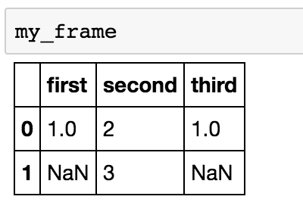
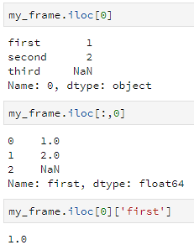
Accessing Elements of a DataFrame by Index: iloc
row
column
cell

Slide 55
“Bulk” Operations over
Structured Data Objects
Key Concept
across all
of Big Data!
Extracting subsets of a DataFrame:
  Selection / filtering – I want rows with certain data values
  Projection – I want certain columns
Changing a DataFrame’s Schema
Composition of DataFrames:
  Concatenation – append a table to another (more rows)
  Joining – merge rows (expand # of columns)

Slide 56
Data Frames: Slicing
There are a number of ways to subset the Data Frame:
  one or more columns
  one or more rows
  a subset of rows and columns
  Rows and columns can be selected by their position or label

Slide 57
Data Frames: Slicing
When selecting one column, it is possible to use single set of brackets, but the resulting object will be a Series (not a DataFrame):
In [ ]:
#Select column salary:
df['salary']
When we need to select more than one column and/or make the output to be a DataFrame, we should use double brackets:
In [ ]:
#Select column salary:
df[['rank','salary']]

Slide 58
Data Frames: Selecting rows
If we need to select a range of rows, we can specify the range using ":"
In [ ]:
#Select rows by their position:
df[10:20]
Notice that the first row has a position 0, and the last value in the range is omitted:
So for 0:10 range the first 10 rows are returned with the positions starting with 0 and ending with 9

Slide 59
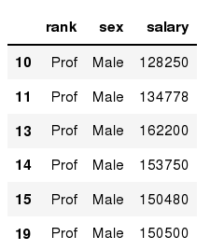
Data Frames: method loc
If we need to select a range of rows, using their labels we can use method loc:
In [ ]:
#Select rows by their labels:
df_sub.loc[10:20,['rank','sex','salary']]
Out[ ]:

Slide 60
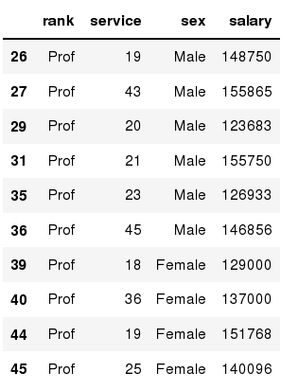
Data Frames: method iloc
If we need to select a range of rows and/or columns, using their positions we can use method iloc:
In [ ]:
#Select rows by their labels:
df_sub.iloc[10:20,[0, 3, 4, 5]]
Out[ ]:

Slide 61
Data Frames: method iloc (summary)
df.iloc[0] # First row of a data frame
df.iloc[i] #(i+1)th row
df.iloc[-1] # Last row
df.iloc[:, 0] # First column
df.iloc[:, -1] # Last column
df.iloc[0:7] #First 7 rows
df.iloc[:, 0:2] #First 2 columns
df.iloc[1:3, 0:2] #Second through third rows and first 2 columns
df.iloc[[0,5], [1,3]] #1st and 6th rows and 2nd and 4th columns

Slide 62
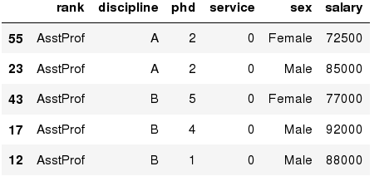
Data Frames: Sorting
We can sort the data by a value in the column. By default the sorting will occur in ascending order and a new data frame is return.
In [ ]:
# Create a new data frame from the original sorted by the column Salary
df_sorted = df.sort_values( by ='service')
df_sorted.head()
Out[ ]:

Slide 63
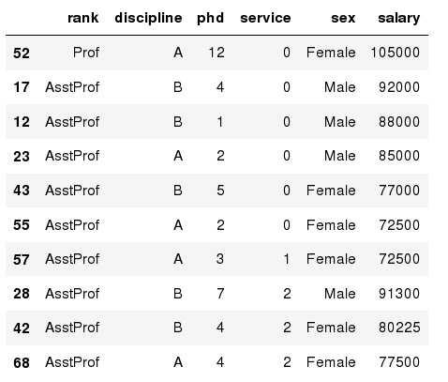
Data Frames: Sorting
We can sort the data using 2 or more columns:
In [ ]:
df_sorted = df.sort_values( by =['service', 'salary'], ascending = [True, False])
df_sorted.head(10)
Out[ ]:

Slide 64
Data Frame: filtering selection
Abstractly:
select(Table T)
Returns: a subset
of T, T’, with fewer
rows but the same
schema
To subset the data we can apply Boolean indexing. This indexing is commonly known as a filter. For example if we want to subset the rows in which the salary value is greater than $120K:
#Calculate mean salary for each professor rank:
df_sub = df[ df['salary'] > 120000 ]
In [ ]:
Any Boolean operator can be used to subset the data:
> greater; >= greater or equal;
< less; <= less or equal;
== equal; != not equal;
#Select only those rows that contain female professors:
df_f = df[ df['sex'] == 'Female' ]
In [ ]:

Slide 65
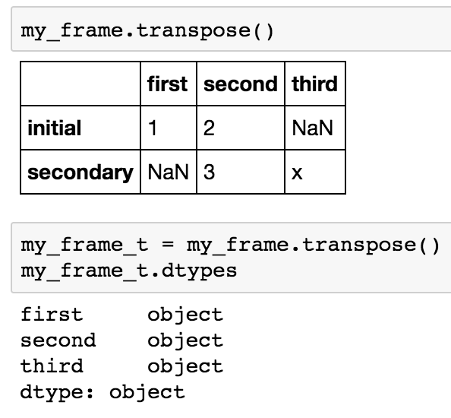
Transposing Rows + Columns

Slide 66
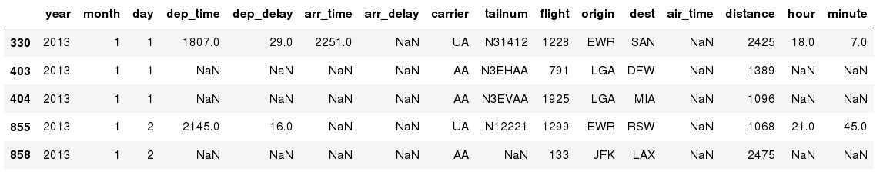
Missing Values
Missing values are marked as NaN
In [ ]:
# Read a dataset with missing values
flights = pd.read_csv("http://rcs.bu.edu/examples/python/data_analysis/flights.csv")
In [ ]:
# Select the rows that have at least one missing value
flights[flights.isnull().any(axis=1)].head()
Out[ ]:

Slide 67
Missing Values
There are a number of methods to deal with missing values in the data frame:
df.method() | description
dropna() | Drop missing observations
dropna(how='all') | Drop observations where all cells is NA
dropna(axis=1, how='all') | Drop column if all the values are missing
dropna(thresh = 5) | Drop rows that contain less than 5 non-missing values
fillna(0) | Replace missing values with zeros
isnull() | returns True if the value is missing
notnull() | Returns True for non-missing values

Slide 68


Getting Rid of Dirty Data
DataFrames use the value NaN to represent a “null” (missing) value
dropna – remove rows
fillna – substitute value
Beware NaN in string column!

Slide 69
Missing Values
When summing the data, missing values will be treated as zero
If all values are missing, the sum will be equal to NaN
cumsum() and cumprod() methods ignore missing values but preserve them in the resulting arrays
Missing values in GroupBy method are excluded (just like in R)
Many descriptive statistics methods have skipna option to control if missing data should be excluded . This value is set to True by default (unlike R)

Slide 70
A Common Concept:
Mapping elements of a collection
Suppose we have…
list: [1, 2, 3, 4, …]
Map each element of the list by applying function f(x) = x * 2

Slide 71
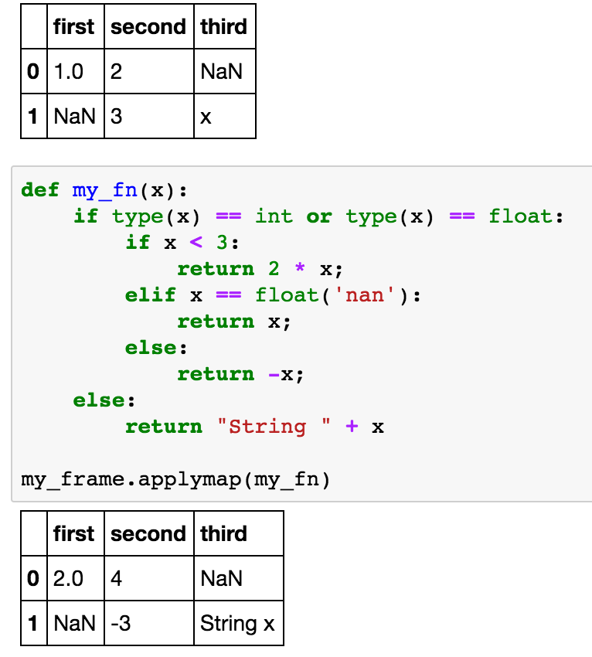
General Value Substitution mapping
To replace a value based on some conditions, use applymap and a function!
Abstractly:
apply(Table T,f)
Returns: a new Table
T’ with all cell content
c replaced by f(c)

Slide 72
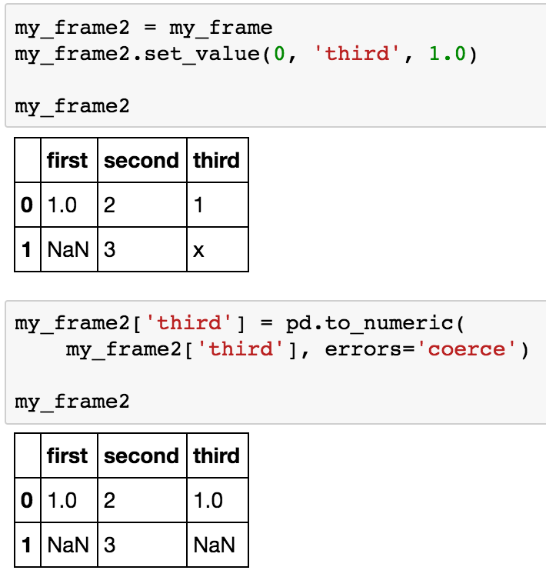
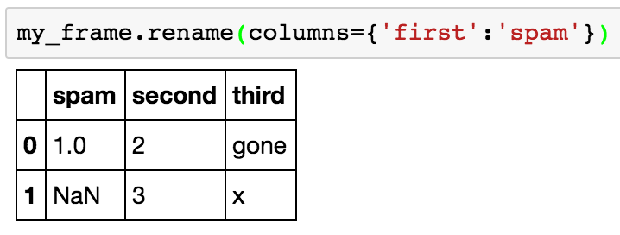
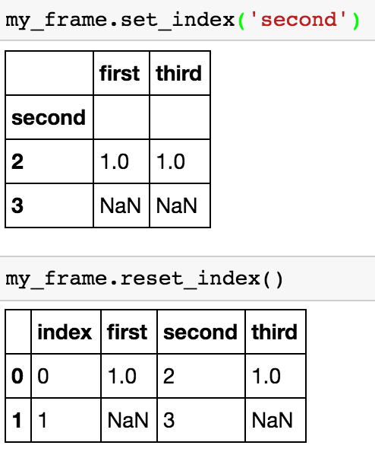
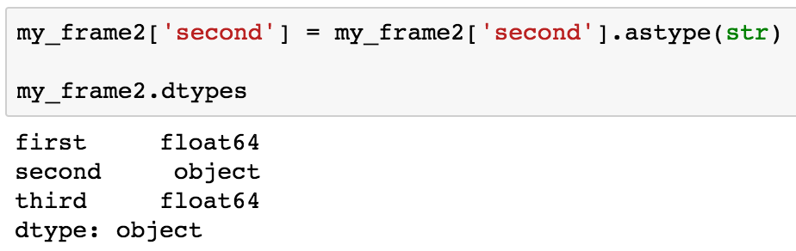
Restructuring the
DataFrame Schema
Change column name
Change index columns
Change column type

Slide 73
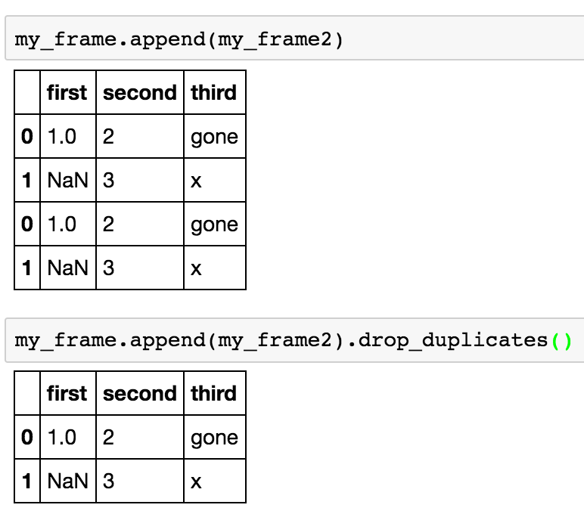
Concatenating DataFrames
Abstractly:
append(Table T1,Table T2)
Returns: if T1, T2 have the
same schema, Table T’ with
all rows in T1 followed by all
rows in T2
May want to eliminate
duplicates

Slide 74
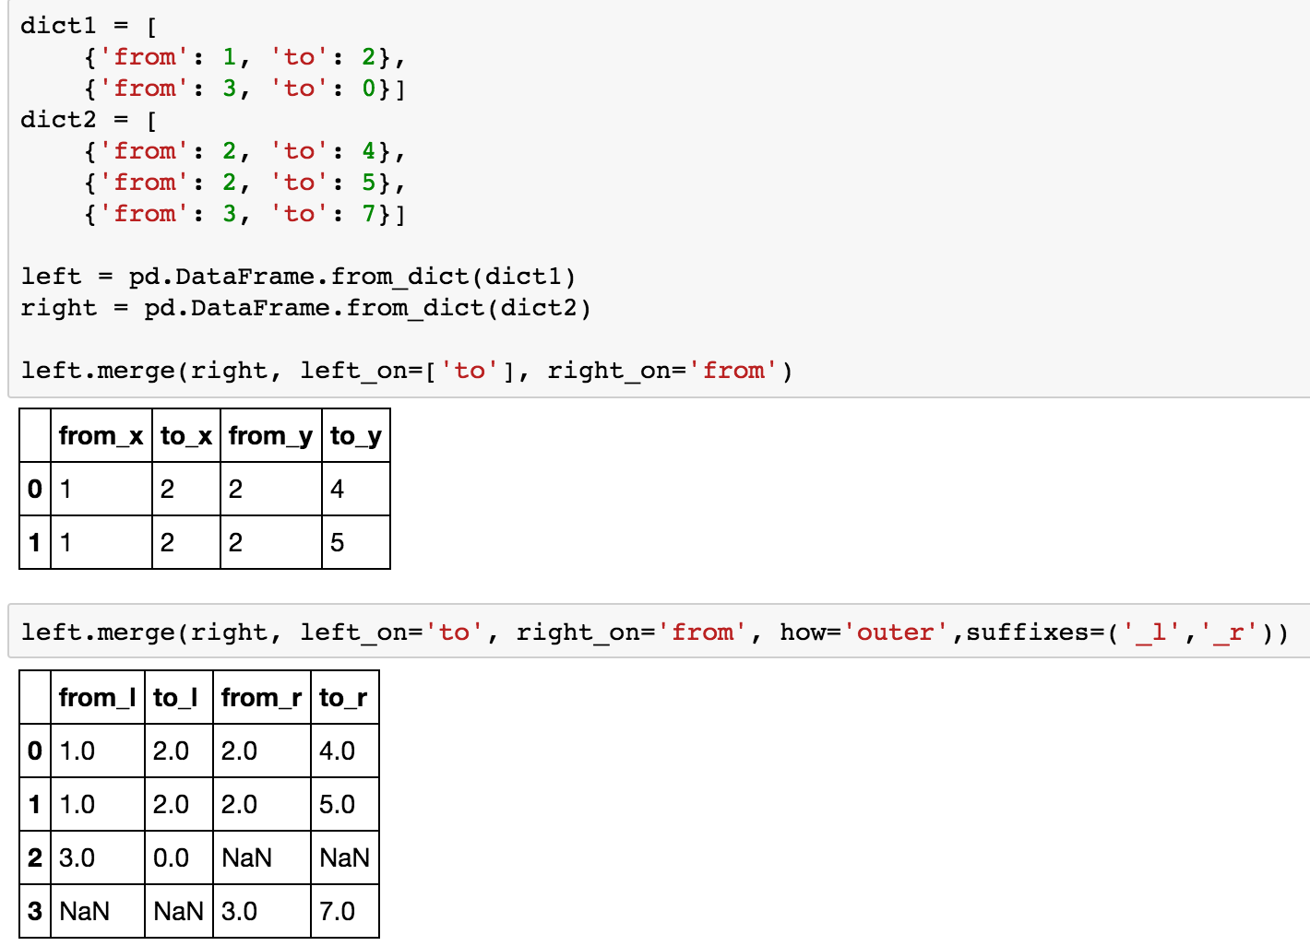
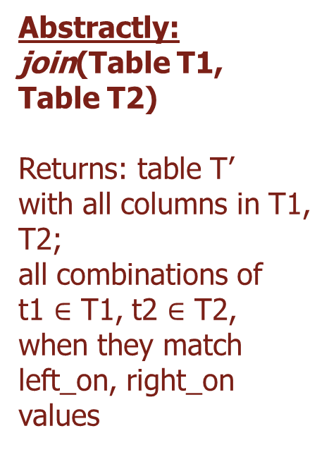
Merging (Joining) DataFrames
Abstractly:
join(Table T1,
Table T2)
Returns: table T’
with all columns in T1,
T2;
all combinations of
t1 $∈$ T1, t2 $∈$ T2,
when they match
left_on, right_on
values
“inner”: matches
“left”: matches + left rows, NaN padded
“right”: matches + right rows
“outer”: matches + all rows padded

Slide 75
Hands-on exercises
Q: How can fillna and dropna be implemented with applymap?

Slide 76

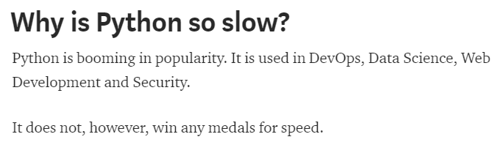
Thinking Beyond Iteration
Iteration in Python is generally VERY slow, leading to articles like…

Slide 77
Thinking Beyond Iteration
Again: Iteration in Python is generally VERY slow
Order doesn’t actually matter – left-to-right, right-to-left, top-to-bottom, etc. – as long as we combine the final output in the right way
So is there a way to do this that does multiple operations at the same time or in any arbitrary order?
Old idea in computer science: “single instruction, multiple data” aka “vector operations” aka “bulk operations” aka “operations over collections”
  “Do the same thing over every element of this DataFrame”
  The basis of parallel computers, GPU computing, supercomputers, vector instructions, databases, MapReduce, TensorFlow, …

Slide 78
GroupBy Mechanisms in Pandas
Step 1: Data contained in a pandas object, whether a Series, DataFrame, is split into groups based on one or more keys that you provide.
  The splitting is performed on a particular axis of an object.
    For example, a DataFrame can be grouped on its rows (axis=0) or its columns (axis=1).
Step 2: Apply a function to each group, producing a new value per group.
Step 3: The results of all those function applications are combined into a result object.

Slide 79
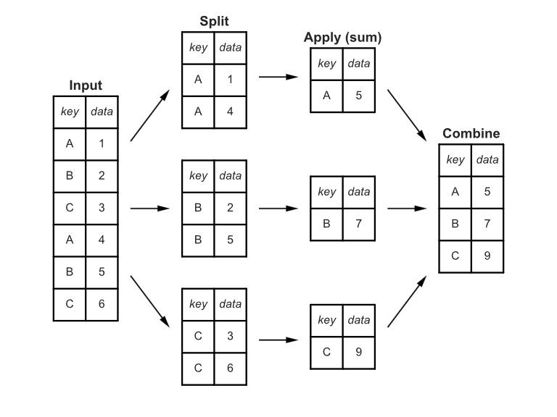
GroupBy Mechanisms

Slide 80
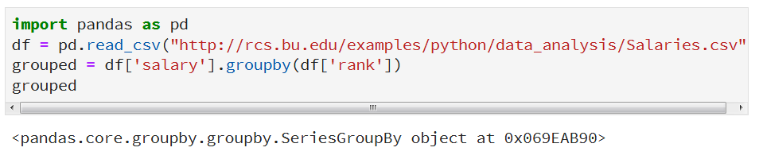
A first examples
The series/column on which you want to compute some aggregation function
The key/column on which you want to group your data.

Slide 81
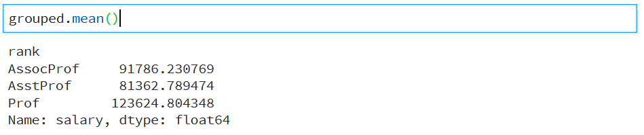
A first examples
Now you can apply a desired aggregate function. More on it soon.

Slide 82
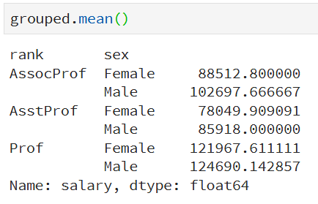
Group on Multiple Columns
Check the function unstack()…

Slide 83
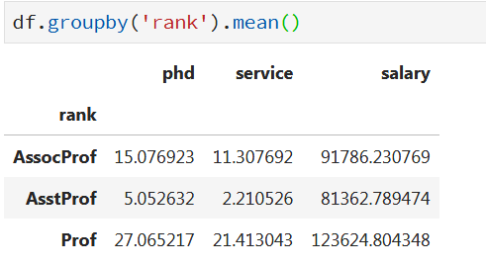
Aggregate on All Columns, But…
Something is missing….
Only numeric columns

Slide 84
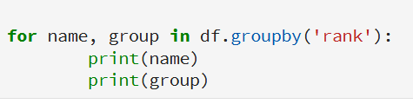

Iterating over Groups
What if you have multiple groupby columns/keys?

Slide 85


Syntactic Sugars
are syntactic sugar for:
Note: If single brackets are used to specify the column (e.g. salary), then the output is Pandas Series object. When double brackets are used the output is a Data Frame

Slide 86
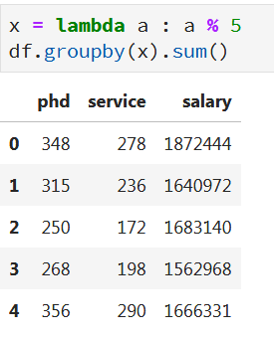
Grouping with Functions
Using Python functions is a more generic way of defining a group mapping.
Any function passed as a group key will be called once per index value, with the return values being used as the group names.
You can use both native functions as well as customs ones (lambdas)

Slide 87
Data Frames groupby method
groupby performance notes:
  no grouping/splitting occurs until it's needed. Creating the groupby object only verifies that you have passed a valid mapping
  - by default the group keys are sorted during the groupby operation. You may want to pass sort=False for potential speedup:
In [ ]:
#Calculate mean salary for each professor rank:
df.groupby(['rank'], sort=False)[['salary']].mean()

Slide 88
Hands-on exercises
Calculate the basic statistics for the salary column;
Find how many values in the salary column (use count method);
Calculate the average salary;

Slide 89
Aggregation Functions in Pandas
Aggregating a Series or all of the columns of a DataFrame is a matter of using aggregate with the desired function or calling a method like mean or std.
Aggregation - computing a summary statistic about each group, i.e.
  compute group sums or means
  compute group sizes/counts
Common aggregation functions:
  min, max
  count, sum, prod
  mean, median, mode, mad
  std, var

Slide 90
Basic Descriptive Statistics
df.method() | description
describe | Basic statistics (count, mean, std, min, quantiles, max)
min, max | Minimum and maximum values
mean, median, mode | Arithmetic average, median and mode
var, std | Variance and standard deviation
sem | Standard error of mean
skew | Sample skewness
kurt | kurtosis

Slide 91

Aggregate on Series

Slide 92

Aggregate with Multiple Functions
You can pass a list of functions or function names; you will get back a DataFrame with column names taken from the functions.

Slide 93

Aggregate: Renaming

Slide 94

Different Functions for Different Columns
Pass a dict to agg that contains a mapping of column names to any of the function specifications listed so far

Slide 95
Graphics to explore the data
Seaborn package is built on matplotlib but provides high level interface for drawing attractive statistical graphics, similar to ggplot2 library in R. It specifically targets statistical data visualization
To show graphs within Python notebook include inline directive:
In [ ]:
%matplotlib inline

Slide 96
Graphics
 | description
distplot | histogram
barplot | estimate of central tendency for a numeric variable
violinplot | similar to boxplot, also shows the probability density of the data
jointplot | Scatterplot
regplot | Regression plot
pairplot | Pairplot
boxplot | boxplot
swarmplot | categorical scatterplot
factorplot | General categorical plot

Slide 97
Basic statistical Analysis
statsmodel and scikit-learn - both have a number of function for statistical analysis
The first one is mostly used for regular analysis using R style formulas, while scikit-learn is more tailored for Machine Learning.
statsmodels:
  linear regressions
  ANOVA tests
  hypothesis testings
  many more ...
scikit-learn:
  kmeans
  support vector machines
  random forests
  many more ...
See examples in the Tutorial Notebook

