Slide 1
Transaction Management Overview
Database Management Systems, 3rd edition
by Raghu Ramakrishnan and Johannes Gehrke
Chapter 16

Slide 2
Components of a DBMS
transaction
Data Definition
query
Query Compiler
Transaction Manager
Schema Manager
Execution Engine
Logging/Recovery
Concurrency Control
Buffer Manager
LOCK TABLE
Storage Manager
BUFFERS
BUFFER POOL
DBMS: a set of cooperating software modules

Slide 3
Transactions
Concurrent execution of user programs is essential for good DBMS performance.
Because disk accesses are frequent, and relatively slow, it is important to keep the cpu humming by working on several user programs concurrently.
A user’s program may carry out many operations on the data retrieved from the database, but the DBMS is only concerned about what data is read/written from/to the database.
A transaction is the DBMS’s abstract view of a user program: a sequence of reads and writes.

Slide 4
Transaction Concept
E.g. transaction to transfer $50 from account A to account B:
1. read(A)
2. A := A – 50
3. write(A)
4. read(B)
5. B := B + 50
6. write(B)
Two main issues to deal with:
Failures of various kinds, such as hardware failures and system crashes
Concurrent execution of multiple transactions

Slide 5
Concurrency Control & Recovery
Very valuable properties of DBMSs
without these, DBMSs would be much less useful
Based on concept of transactions with ACID properties
Remainder of the lectures discuss these issues

Slide 6
Statement of Problem
Concurrent execution of independent transactions
utilization/throughput (“hide” waiting for I/Os.)
response time
fairness
Example:
t0:
t1:
t2:
t3:
t4:
t5:
T1:
tmp1 := read(X)
tmp1 := tmp1 – 20
write tmp1 into X
T2:
tmp2 := read(X)
tmp2 := tmp2 + 10
write tmp2 into X

Slide 7
Concurrency in a DBMS
Users submit transactions, and can think of each transaction as executing by itself.
Concurrency is achieved by the DBMS, which interleaves actions (reads/writes of DB objects) of various transactions.
Each transaction must leave the database in a consistent state if the DB is consistent when the transaction begins.
DBMS will enforce some ICs, depending on the ICs declared in CREATE TABLE statements.
Beyond this, the DBMS does not really understand the semantics of the data. (e.g., it does not understand how the interest on a bank account is computed).
Issues: Effect of interleaving transactions, and crashes.

Slide 8
Statement of problem (cont.)
Arbitrary interleaving can lead to
Temporary inconsistency (ok, unavoidable)
“Permanent” inconsistency (bad!)
Need formal correctness criteria.

Slide 9
Definitions
A program may carry out many operations on the data retrieved from the database
However, the DBMS is only concerned about what data is read/written from/to the database.
database - a fixed set of named data objects (A, B, C, …)
transaction - a sequence of read and write operations (read(A), write(B), …)
DBMS’s abstract view of a user program

Slide 10
Correctness criteria: The ACID properties
A tomicity: All actions in the Xact happen, or none happen.
C onsistency: If each Xact is consistent, and the DB starts consistent, it ends up consistent.
I solation: Execution of one Xact is isolated from that of other Xacts.
D urability: If a Xact commits, its effects persist.

Slide 11
Atomicity of Transactions
A
Two possible outcomes of executing a transaction:
Xact might commit after completing all its actions
or it could abort (or be aborted by the DBMS) after executing some actions.
DBMS guarantees that Xacts are atomic.
From user’s point of view: Xact always either executes all its actions, or executes no actions at all.

Slide 12
Transaction State
Active – the initial state; the transaction stays in this state while it is executing
Partially committed – after the final statement has been executed.
Failed -- after the discovery that normal execution can no longer proceed.
Aborted – after the transaction has been rolled back and the database restored to its state prior to the start of the transaction. Two options after it has been aborted:
restart the transaction
can be done only if no internal logical error
kill the transaction
Committed – after successful completion.

Slide 13
Transaction State (Cont.)

Slide 14
Mechanisms for Ensuring Atomicity
A
One approach: LOGGING
DBMS logs all actions so that it can undo the actions of aborted transactions.
Another approach: SHADOW PAGES
Logging used by modern systems, because of need for audit trail and for efficiency reasons.

Slide 15
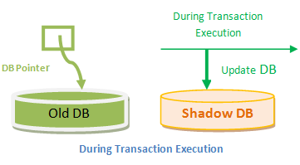
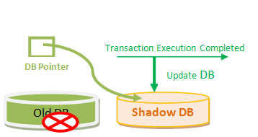
Shadow Paging - Briefly
A database pointer always points to the consistent copy of the database, and copy of the database is used by transactions to update.
All the transactions are executed in the primary memory or the shadow copy of database.
Once all the transactions completely execute, it will be updated to the database.
If there is any failure in the middle of transaction, it will not be reflected in the database. Database will be updated after all the transaction is complete.

Slide 16
Transaction Consistency
C
“Consistency” - data in DBMS is accurate in modeling real world and follows integrity constraints
User must ensure transaction consistent by itself
I.e., if DBMS consistent before Xact, it will be after also
Key point:
consistent database S1
consistent database S2
transaction T

Slide 17
Transaction Consistency (cont.)
C
Recall: Integrity constraints
must be true for DB to be considered consistent
Examples:
1. FOREIGN KEY R.sid REFERENCES S
2. ACCT-BAL >= 0
System checks ICs and if they fail, the transaction rolls back (i.e., is aborted).
Beyond this, DBMS does not understand the semantics of the data.
e.g., it does not understand how interest on a bank account is computed

Slide 18
Isolation of Transactions
I
Users submit transactions, and
Each transaction executes as if it was running by itself.
Concurrency is achieved by DBMS, which interleaves actions (reads/writes of DB objects) of various transactions.
Many techniques have been developed. Fall into two basic categories:
Pessimistic – don’t let problems arise in the first place
Optimistic – assume conflicts are rare, deal with them after they happen.

Slide 19
Example
I
Consider two transactions (Xacts):
T1: BEGIN A=A+100, B=B-100 END
T2: BEGIN A=1.06*A, B=1.06*B END
1st xact transfers $100 from B’s account to A’s
2nd credits both accounts with 6% interest.
Assume at first A and B each have $1000. What are the legal outcomes of running T1 and T2???
$2000 *1.06 = $2120
There is no guarantee that T1 will execute before T2 or vice-versa, if both are submitted together. But, the net effect must be equivalent to these two transactions running serially in some order.

Slide 20
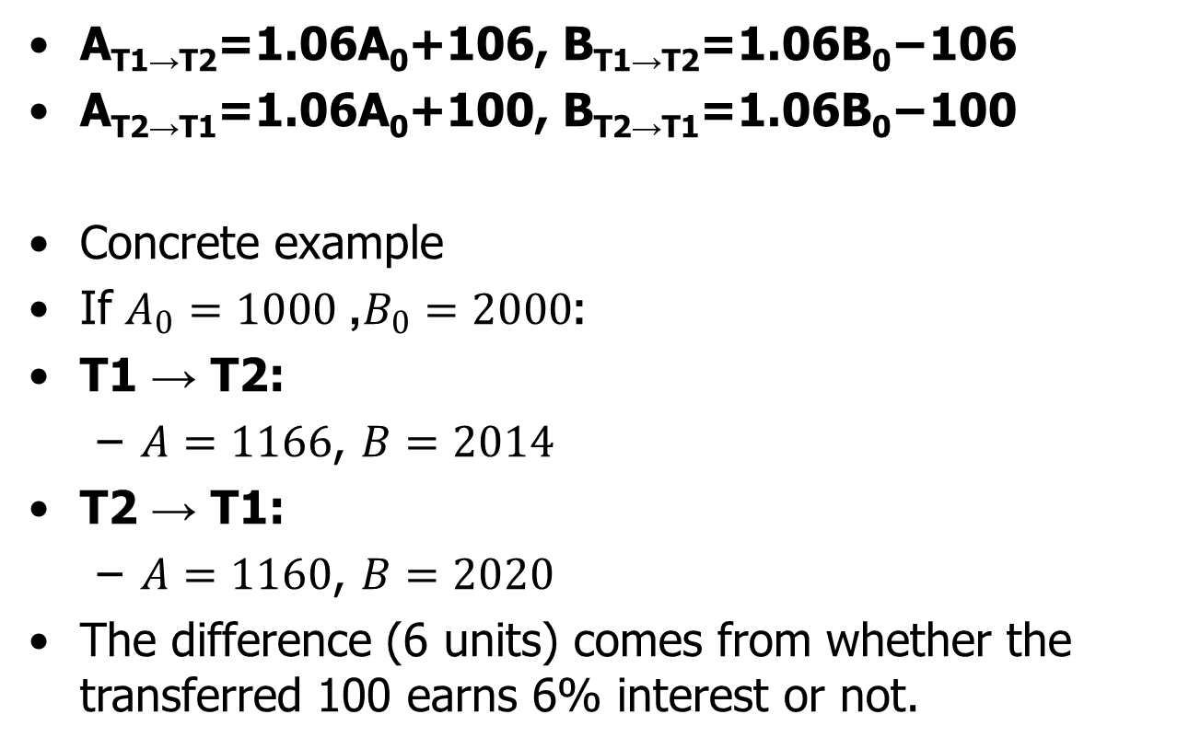
Example Continued
A_{T1→T2}​=1.06A₀​+106, B_{T1→T2}​=1.06B₀​−106
A_{T2→T1}​=1.06A₀​+100, B_{T2→T1}​=1.06B₀​−100
Concrete example
If $A_{0}=1000$, $B_{0}=2000$:
T1 → T2:
$A=1166$, $B=2014$
T2 → T1:
$A=1160$, $B=2020$
The difference (6 units) comes from whether the transferred 100 earns 6% interest or not.

Slide 21
Example (Contd.)
I
Legal outcomes: A=1166,B=954 or A=1160,B=960
Consider a possible interleaved schedule:
T1: A=A+100, B=B-100
T2: A=1.06*A, B=1.06*B
This is OK (same as T1;T2). But what about:
T1: A=A+100, B=B-100
T2: A=1.06*A, B=1.06*B
Result: A=1166, B=960; A+B = 2126, bank loses $6
The DBMS’s view of the second schedule:
T1: R(A), W(A), R(B), W(B)
T2: R(A), W(A), R(B), W(B)

Slide 22
Formal Properties of Schedules
I
Serial schedule: Schedule that does not interleave the actions of different transactions.
Equivalent schedules: For any database state, the effect of executing the first schedule is identical to the effect of executing the second schedule.
Serializable schedule: A schedule that is equivalent to some serial execution of the transactions.
(Note: If each transaction preserves consistency, every serializable schedule preserves consistency. )

Slide 23
Anomalies with Interleaved Execution
I
Reading Uncommitted Data (WR Conflicts, “dirty reads”):
Unrepeatable Reads (RW Conflicts):
T1: R(A), W(A), R(B), W(B), Abort
T2: R(A), W(A), C
T1: R(A), R(A), W(A), C
T2: R(A), W(A), C

Slide 24
Anomalies (Continued)
I
Overwriting Uncommitted Data (WW Conflicts):
T1: W(A), W(B), C
T2: W(A), W(B), C

Slide 25
Schedules
Schedule – a sequences of instructions that specify the chronological order in which instructions of concurrent transactions are executed
A schedule for a set of transactions must consist of all instructions of those transactions
Must preserve the order in which the instructions appear in each individual transaction.
A transaction that successfully completes its execution will have a commit instructions as the last statement
By default transaction assumed to execute commit instruction as its last step
A transaction that fails to successfully complete its execution will have an abort instruction as the last statement

Slide 26
Schedule 1
Let T₁ transfer $50 from A to B, and T₂ transfer 10% of the balance from A to B.
A serial schedule in which T₁ is followed by T₂ :

Slide 27
Schedule 2
A serial schedule where T₂ is followed by T₁

Slide 28
Schedule 3
Let T₁ and T₂ be the transactions defined previously. The following schedule is not a serial schedule, but it is equivalent to Schedule 1.
In Schedules 1, 2 and 3, the sum A + B is preserved.

Slide 29
Schedule 4
The following concurrent schedule does not preserve the value of (A + B ).

Slide 30
Serializability
Basic Assumption – Each transaction preserves database consistency.
Thus, serial execution of a set of transactions preserves database consistency.
A (possibly concurrent) schedule is serializable if it is equivalent to a serial schedule. Different forms of schedule equivalence give rise to the notions of:
1. conflict serializability
2. view serializability

Slide 31
Simplified view of transactions
We ignore operations other than read and write instructions
We assume that transactions may perform arbitrary computations on data in local buffers in between reads and writes.
Our simplified schedules consist of only read and write instructions.

Slide 32
Conflicting Instructions
Instructions l_{i} and l_{j} of transactions T_{i} and T_{j} respectively, conflict if and only if there exists some item Q accessed by both l_{i} and l_{j}, and at least one of these instructions wrote Q.
1. l_{i} = read(Q), l_{j} = read(Q). l_{i} and l_{j} don’t conflict. 2. l_{i} = read(Q), l_{j} = write(Q). They conflict. 3. l_{i} = write(Q), l_{j} = read(Q). They conflict 4. l_{i} = write(Q), l_{j} = write(Q). They conflict
Intuitively, a conflict between l_{i} and l_{j} forces a (logical) temporal order between them.
If l_{i} and l_{j} are consecutive in a schedule and they do not conflict, their results would remain the same even if they had been interchanged in the schedule.

Slide 33
Conflict Serializability
If a schedule S can be transformed into a schedule S’ by a series of swaps of non-conflicting instructions, we say that S and S’ are conflict equivalent.
We say that a schedule S is conflict serializable if it is conflict equivalent to a serial schedule

Slide 34
Conflict Serializability (Cont.)
Schedule 3 can be transformed into Schedule 6, a serial schedule where T₂ follows T₁, by series of swaps of non-conflicting instructions. Therefore Schedule 3 is conflict serializable.
Schedule 3
Schedule 6

Slide 35
Conflict Serializability (Cont.)
Example of a schedule that is not conflict serializable:
We are unable to swap instructions in the above schedule to obtain either the serial schedule < T₃, T₄ >, or the serial schedule < T₄, T₃ >.

Slide 36
View Serializability
Let S and S’ be two schedules with the same set of transactions. S and S’ are view equivalent if the following three conditions are met, for each data item Q,
If in schedule S, transaction T_{i} reads the initial value of Q, then in schedule S’ also transaction T_{i} must read the initial value of Q.
If in schedule S transaction T_{i} executes read(Q), and that value was produced by transaction T_{j} (if any), then in schedule S’ also transaction T_{i} must read the value of Q that was produced by the same write(Q) operation of transaction T_{j} .
The transaction (if any) that performs the final write(Q) operation in schedule S must also perform the final write(Q) operation in schedule S’.
As can be seen, view equivalence is also based purely on reads and writes alone.

Slide 37
View Serializability (Cont.)
A schedule S is view serializable if it is view equivalent to a serial schedule.
Every conflict serializable schedule is also view serializable.
Below is a schedule which is view-serializable but not conflict serializable.
What serial schedule is above equivalent to?
Every view serializable schedule that is not conflict serializable has blind writes.

Slide 38
Other Notions of Serializability
The schedule below produces same outcome as the serial schedule < T₁, T₅ >, yet is not conflict equivalent or view equivalent to it.
Determining such equivalence requires analysis of operations other than read and write.

Slide 39
Testing for Serializability
Consider some schedule of a set of transactions T₁, T₂, ..., T_{n}
Precedence graph — a direct graph where the vertices are the transactions (names).
We draw an arc from T_{i} to T_{j} if the two transaction conflict, and T_{i} accessed the data item on which the conflict arose earlier.
We may label the arc by the item that was accessed.
Example 1

Slide 40
Test for Conflict Serializability
A schedule is conflict serializable if and only if its precedence graph is acyclic.
Cycle-detection algorithms exist which take order n² time, where n is the number of vertices in the graph.
(Better algorithms take order n + e where e is the number of edges.)
If precedence graph is acyclic, the serializability order can be obtained by a topological sorting of the graph.
This is a linear order consistent with the partial order of the graph.
For example, a serializability order for Schedule A would be T₅ → T₁ → T₃ → T₂ → T₄
Are there others?

Slide 41
Test for View Serializability
The precedence graph test for conflict serializability cannot be used directly to test for view serializability.
Extension to test for view serializability has cost exponential in the size of the precedence graph.
The problem of checking if a schedule is view serializable falls in the class of NP-complete problems.
Thus. existence of an efficient algorithm is extremely unlikely.
However practical algorithms that just check some sufficient conditions for view serializability can still be used.

Slide 42
Recoverable Schedules
Need to address the effect of transaction failures on concurrently running transactions.
Recoverable schedule — if a transaction T_{j} reads a data item previously written by a transaction T_{i} , then the commit operation of T_{i} appears before the commit operation of T_{j}.
The following schedule (Schedule 11) is not recoverable
If T₈ should abort, T₉ would have read (and possibly shown to the user) an inconsistent database state. Hence, database must ensure that schedules are recoverable.

Slide 43
Cascading Rollbacks
Cascading rollback – a single transaction failure leads to a series of transaction rollbacks. Consider the following schedule where none of the transactions has yet committed (so the schedule is recoverable)
If T₁₀ fails, T₁₁ and T₁₂ must also be rolled back.
Can lead to the undoing of a significant amount of work

Slide 44
Lock-Based Concurrency Control
I
Here’s a simple way to allow concurrency but avoid the anomalies just described…
Strict Two-phase Locking (Strict 2PL) Protocol:
Each Xact must obtain an S (shared) lock on object before reading, and an X (exclusive) lock on object before writing.
System can obtain these locks automatically
Lock rules:
If an Xact holds an X lock on an object, no other Xact can acquire a lock (S or X) on that object
If an Xact holds an S lock, no other Xact can get an X lock on that object.
Two phases: acquiring locks, and releasing them
No lock is ever acquired after one has been released
All locks held by a transaction are released when the xact completes
Strict 2PL allows only serializable schedules.

Slide 45
Aborting a Transaction (i.e., Rollback)
If an xact Ti aborted, all actions must be undone.
Also, if Tj reads object last written by Ti, Tj must be aborted!
Most systems avoid such cascading aborts by releasing locks only at EOT (i.e., strict locking).
If Ti writes an object, Tj can read this only after Ti finishes.
To undo actions of an aborted transaction, DBMS maintains log which records every write.
Log also used to recover from system crashes:
All active Xacts at time of crash are aborted when system comes back up.

Slide 46
The Log
Log consists of “records” that are written sequentially.
Typically chained together by Xact id
Log is often archived on stable storage.
Need for UNDO and/or REDO depend on Buffer Mgr.
UNDO required if: uncommitted data can overwrite stable version of committed data (STEAL buffer management).
REDO required if: xact can commit before all its updates are on disk (NO FORCE buffer management).
The following actions are recorded in the log:
if Ti writes an object, write a log record with:
If UNDO required need “before image”
IF REDO required need “after image”.
Ti commits/aborts: a log record indicating this action.

Slide 47
Logging (cont.)
Write-Ahead Logging protocol
Log record must go to disk before the changed page!
implemented via a handshake between log manager and the buffer manager.
All log records for a transaction (including its commit record) must be written to disk before the transaction is considered “Committed”.
All logging and CC-related activities are handled transparently by the DBMS.

Slide 48
(Review) Goal: The ACID properties
A tomicity: All actions in the Xact happen, or none happen.
C onsistency: If each Xact is consistent, and the DB starts consistent, it ends up consistent.
I solation: Execution of one Xact is isolated from that of other Xacts.
D urability: If a Xact commits, its effects persist.
What happens if system crashes between commit and flushing modified data to disk ?

Slide 49
Durability - Recovering From a Crash
D
Three phases:
Analysis: Scan the log (forward from the most recent checkpoint) to identify all Xacts that were active at the time of the crash.
Redo: Redo updates as needed to ensure that all logged updates are in fact carried out and written to disk.
Undo: Undo writes of all Xacts that were active at the crash, working backwards in the log.
At the end – all committed updates and only those updates are reflected in the database.
Some care must be taken to handle the case of a crash occurring during the recovery process!

Slide 50
Summary
Concurrency control and recovery are among the most important functions provided by a DBMS.
Concurrency control is automatic
System automatically inserts lock/unlock requests and schedules actions of different Xacts
Property ensured: resulting execution is equivalent to executing the Xacts one after the other in some order.
Write-ahead logging (WAL) and the recovery protocol are used to:
1. undo the actions of aborted transactions, and
2. restore the system to a consistent state after a crash.

