Slide 1
The Many Shades of Data Representation
AdHoc
Relational
Document markup
XML
JSON
NoSQL

Slide 2
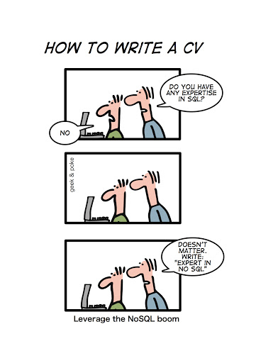
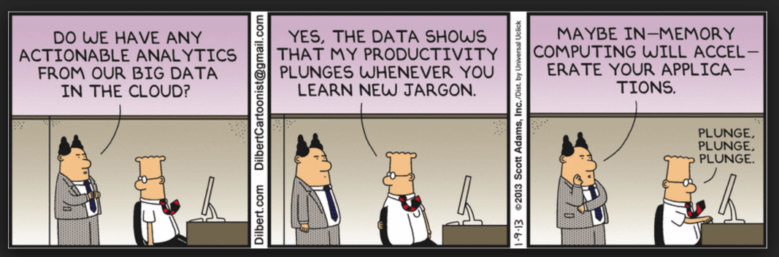
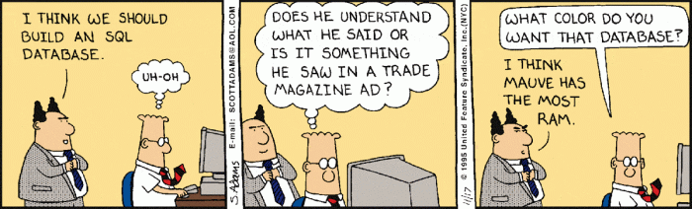

Slide 3
Types of Data
Data can be broadly classified into four types:
  Structured Data:
    Have a predefined model, which organizes data into a form that is relatively easy to store, process, retrieve
    and manage
    E.g., relational data
  Unstructured Data:
    Opposite of structured data
    E.g., Flat binary files containing text, video or audio
    Note: data is not completely devoid of a structure (e.g., an audio file may still have an encoding structure and some metadata associated with it)

Slide 4
Types of Data
Data can be broadly classified into four types:
  Dynamic Data:
    Data that changes relatively frequently
    E.g., transactional entries in a financial database, user generated data online (e.g., tweets), sensor collected data (e.g., weather and machinery)
  Static Data:
    Opposite of dynamic data
    E.g., Medical imaging data from MRI or CT scans

Slide 5
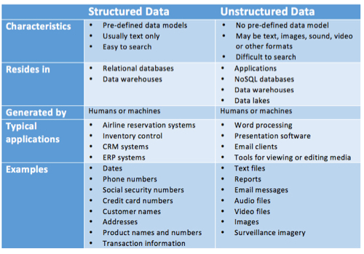
Not all data is structured
Source: https://www.datamation.com/big-data/structured-vs-unstructured-data.html

Slide 6
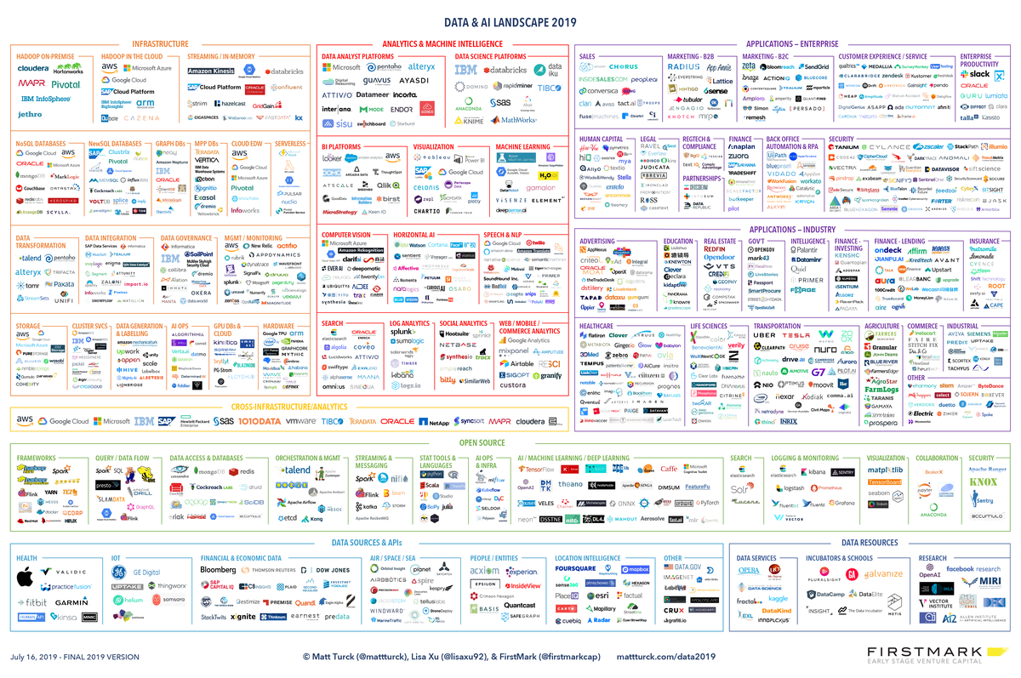

Slide 7
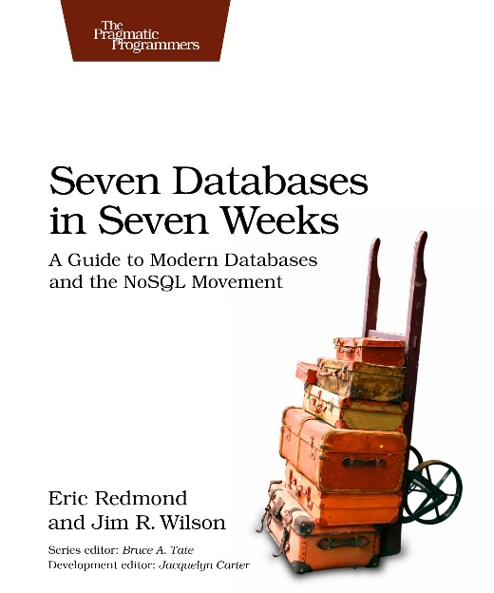
Additional Resources
Tutorial by C. Mohan, An In-Depth Look at Modern Database Systems
https://docs.google.com/file/d/0B7lNUaak0bK1encwYnBVUWZSWjA/edit
Seven Databases in Seven Weeks: A Guide to Modern Databases and the NoSQL Movement

Slide 8
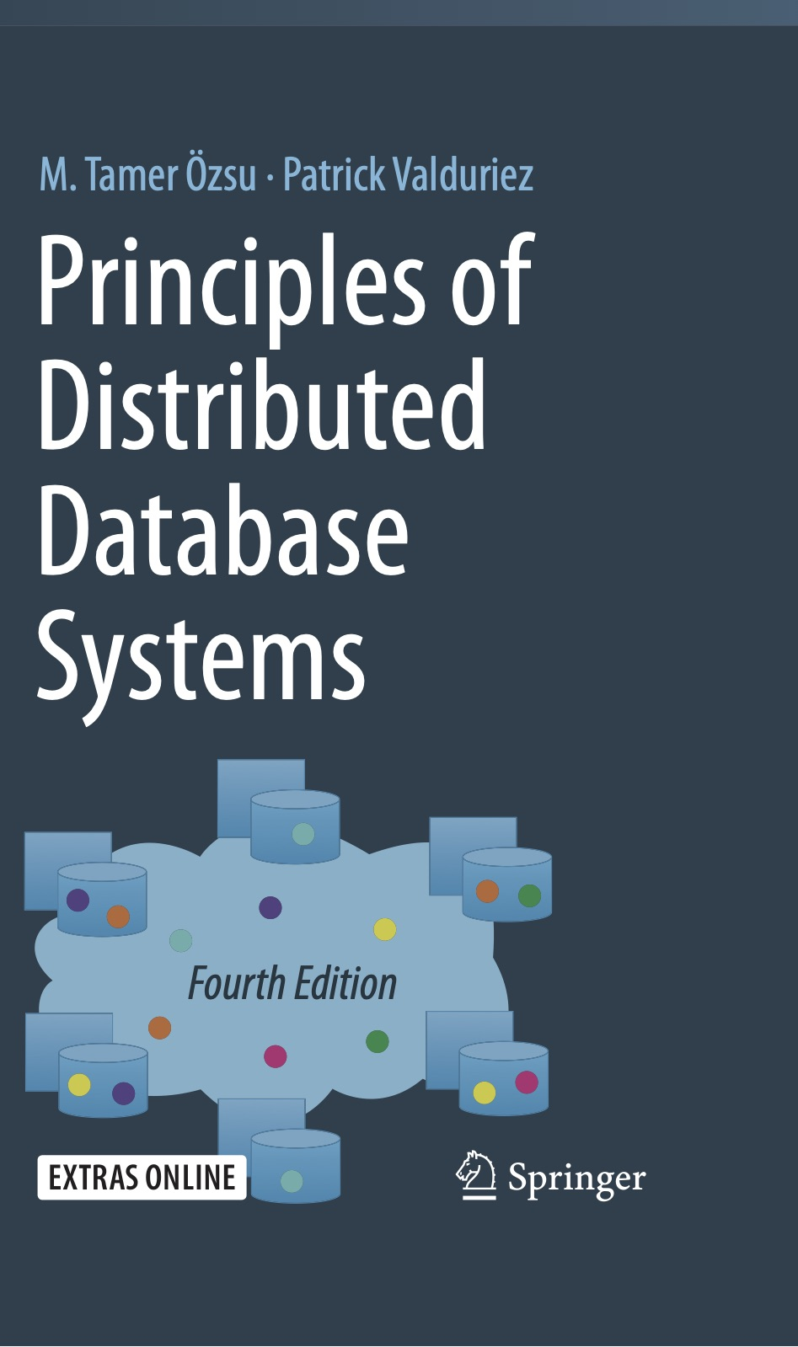
Additional Resources
Principles of Distributed Database Systems, Fourth Edition, by M. Tamer Özsu
Patrick Valduriez
https://cs.uwaterloo.ca/~ddbook/
Chapters 10 and 11.
Give a data management perspective.

Slide 9
Data Models
A collection of tools for describing
  Data
  Data relationships
  Data semantics
  Data constraints
Relational model
Key-Value store
Object-based data models (Object-oriented and Object-relational)
Semistructured data model (XML, JSON)
Graph Databases
  based on the mathematical principle of graph theory.
Notes:
9

Slide 10
Introduction to XML
XML: Extensible Markup Language
Defined by the WWW Consortium (W3C)
Derived from SGML (Standard Generalized Markup Language), but simpler to use than SGML
Documents have tags giving extra information about sections of the document
  E.g., <title> XML </title> <slide> Introduction …</slide>
Extensible, unlike HTML
  Users can add new tags, and separately specify how the tag should be handled for display

Slide 11
XML Introduction (Cont.)
The ability to specify new tags, and to create nested tag structures make XML a great way to exchange data, not just documents.
  Much of the use of XML has been in data exchange applications, not as a replacement for HTML
Tags make data (relatively) self-documenting
  E.g.,
  <university>
  <department>
  <dept_name> Comp. Sci. </dept_name>
  <building> Taylor </building>
  <budget> 100000 </budget>
  </department>
  <course>
  <course_id> CS-101 </course_id>
  <title> Intro. to Computer Science </title>
  <dept_name> Comp. Sci </dept_name>
  <credits> 4 </credits>
  </course>
  </university>

Slide 12
XML: Motivation
Data interchange is critical in today’s networked world
  Examples:
    Banking: funds transfer
    Order processing (especially inter-company orders)
    Scientific data
      Chemistry: ChemML, …
      Genetics: BSML (Bio-Sequence Markup Language), …
  Paper flow of information between organizations is being replaced by electronic flow of information
Each application area has its own set of standards for representing information
XML has become the basis for all new generation data interchange formats

Slide 13
XML Motivation (Cont.)
Earlier generation formats were based on plain text with line headers indicating the meaning of fields
  Similar in concept to email headers
  Does not allow for nested structures, no standard “type” language
  Tied too closely to low level document structure (lines, spaces, etc)
Each XML based standard defines what are valid elements, using
  XML type specification languages to specify the syntax
    DTD (Document Type Descriptors)
    XML Schema
  Plus textual descriptions of the semantics
XML allows new tags to be defined as required
  However, this may be constrained by DTDs
A wide variety of tools is available for parsing, browsing and querying XML documents/data

Slide 14
Comparison with Relational Data
Inefficient: tags, which in effect represent schema information, are repeated
Better than relational tuples as a data-exchange format
  Unlike relational tuples, XML data is self-documenting due to presence of tags
  Non-rigid format: tags can be added
  Allows nested structures
  Wide acceptance, not only in database systems, but also in browsers, tools, and applications

Slide 15
Structure of XML Data
Tag: label for a section of data
Element: section of data beginning with <tagname> and ending with matching </tagname>
Elements must be properly nested
  Proper nesting
    <course> … <title> …. </title> </course>
  Improper nesting
    <course> … <title> …. </course> </title>
  Formally: every start tag must have a unique matching end tag, that is in the context of the same parent element.
Every document must have a single top-level element

Slide 16
Example of Nested Elements
<purchase_order>
<identifier> P-101 </identifier>
<purchaser> …. </purchaser>
<itemlist>
<item>
<identifier> RS1 </identifier>
<description> Atom powered rocket sled </description>
<quantity> 2 </quantity>
<price> 199.95 </price>
</item>
<item>
<identifier> SG2 </identifier>
<description> Superb glue </description>
<quantity> 1 </quantity>
<unit-of-measure> liter </unit-of-measure>
<price> 29.95 </price>
</item>
</itemlist>
</purchase_order>

Slide 17
Motivation for Nesting
Nesting of data is useful in data transfer
  Example: elements representing item nested within an itemlist element
Nesting is not supported, or discouraged, in relational databases
  With multiple orders, customer name and address are stored redundantly
  Normalization replaces nested structures in each order by foreign key into table storing customer name and address information
But nesting is appropriate when transferring data
  External application does not have direct access to data referenced by a foreign key

Slide 18
Structure of XML Data (Cont.)
Mixture of text with sub-elements is legal in XML.
  Example:
  <course>
  This course is being offered for the first time in 2009.
  <course id> BIO-399 </course id>
  <title> Computational Biology </title>
  <dept name> Biology </dept name>
  <credits> 3 </credits>
  </course>
  Useful for document markup, but discouraged for data representation

Slide 19
Attributes
Elements can have attributes
<course course_id= “CS-101”>
<title> Intro. to Computer Science</title>
<dept name> Comp. Sci. </dept name>
<credits> 4 </credits>
</course>
Attributes are specified by name=value pairs inside the starting tag of an element
An element may have several attributes, but each attribute name can only occur once
    <course course_id = “CS-101” credits=“4”>

Slide 20
Attributes vs. Subelements
Distinction between subelement and attribute
  In the context of documents, attributes are part of markup, while subelement contents are part of the basic document contents
  In the context of data representation, the difference is unclear and may be confusing
    Same information can be represented in two ways
      <course course_id= “CS-101”> … </course>
      <course>
      <course_id>CS-101</course_id> …
      </course>
  Suggestion: use attributes for identifiers of elements, and use subelements for contents

Slide 21
More on XML Syntax
Elements without subelements or text content can be abbreviated by ending the start tag with a /> and deleting the end tag
  <course course_id=“CS-101” Title=“Intro. To Computer Science”
  dept_name = “Comp. Sci.” credits=“4” />
To store string data that may contain tags, without the tags being interpreted as subelements, use CDATA as below
  <![CDATA[<course> … </course>]]>
  Here, <course> and </course> are treated as just strings
  CDATA stands for “character data”

Slide 22
XML Document Schema
Database schemas constrain what information can be stored, and the data types of stored values
XML documents are not required to have an associated schema
However, schemas are very important for XML data exchange
  Otherwise, a site cannot automatically interpret data received from another site
Two mechanisms for specifying XML schema
  Document Type Definition (DTD)
    Widely used
  XML Schema
    Newer, increasing use

Slide 23
Document Type Definition (DTD)
The type of an XML document can be specified using a DTD
DTD constraints structure of XML data
  What elements can occur
  What attributes can/must an element have
  What subelements can/must occur inside each element, and how many times.
DTD does not constrain data types
  All values represented as strings in XML
DTD syntax
  <!ELEMENT element (subelements-specification) >
  <!ATTLIST element (attributes) >

Slide 24
Element Specification in DTD
Subelements can be specified as
  names of elements, or
  #PCDATA (parsed character data), i.e., character strings
  EMPTY (no subelements) or ANY (anything can be a subelement)
Example
  <! ELEMENT department (dept_name building, budget)>
  <! ELEMENT dept_name (#PCDATA)>
  <! ELEMENT budget (#PCDATA)>
Subelement specification may have regular expressions
  <!ELEMENT university ( ( department | course | instructor | teaches )+)>
    Notation:
      “|” - alternatives
      “+” - 1 or more occurrences
      “*” - 0 or more occurrences

Slide 25
University DTD
<!DOCTYPE university [
<!ELEMENT university ( (department|course|instructor|teaches)+)>
<!ELEMENT department ( dept name, building, budget)>
<!ELEMENT course ( course id, title, dept name, credits)>
<!ELEMENT instructor (IID, name, dept name, salary)>
<!ELEMENT teaches (IID, course id)>
<!ELEMENT dept name( #PCDATA )>
<!ELEMENT building( #PCDATA )>
<!ELEMENT budget( #PCDATA )>
<!ELEMENT course id ( #PCDATA )>
<!ELEMENT title ( #PCDATA )>
<!ELEMENT credits( #PCDATA )>
<!ELEMENT IID( #PCDATA )>
<!ELEMENT name( #PCDATA )>
<!ELEMENT salary( #PCDATA )>
]>

Slide 26
Attribute Specification in DTD
Attribute specification : for each attribute
  Name
  Type of attribute
    CDATA
    ID (identifier) or IDREF (ID reference) or IDREFS (multiple IDREFs)
      more on this later
  Whether
    mandatory (#REQUIRED)
    has a default value (value),
    or neither (#IMPLIED)
Examples
  <!ATTLIST course course_id CDATA #REQUIRED>, or
  <!ATTLIST course
    course_id ID #REQUIRED
    dept_name IDREF #REQUIRED
    instructors IDREFS #IMPLIED >

Slide 27
IDs and IDREFs
An element can have at most one attribute of type ID
The ID attribute value of each element in an XML document must be distinct
  Thus the ID attribute value is an object identifier
An attribute of type IDREF must contain the ID value of an element in the same document
An attribute of type IDREFS contains a set of (0 or more) ID values. Each ID value must contain the ID value of an element in the same document

Slide 28
University DTD with Attributes
University DTD with ID and IDREF attribute types.
<!DOCTYPE university-3 [
<!ELEMENT university ( (department|course|instructor)+)>
<!ELEMENT department ( building, budget )>
<!ATTLIST department
dept_name ID #REQUIRED >
<!ELEMENT course (title, credits )>
<!ATTLIST course
course_id ID #REQUIRED
dept_name IDREF #REQUIRED
instructors IDREFS #IMPLIED >
<!ELEMENT instructor ( name, salary )>
<!ATTLIST instructor
IID ID #REQUIRED
dept_name IDREF #REQUIRED >
· · · declarations for title, credits, building,
budget, name and salary · · ·
]>

Slide 29
XML data with ID and IDREF attributes
<university-3>
<department dept name=“Comp. Sci.”>
<building> Taylor </building>
<budget> 100000 </budget>
</department>
<department dept name=“Biology”>
<building> Watson </building>
<budget> 90000 </budget>
</department>
<course course id=“CS-101” dept name=“Comp. Sci”
instructors=“10101 83821”>
<title> Intro. to Computer Science </title>
<credits> 4 </credits>
</course>
….
<instructor IID=“10101” dept name=“Comp. Sci.”>
<name> Srinivasan </name>
<salary> 65000 </salary>
</instructor>
….
</university-3>

Slide 30
Limitations of DTDs
No typing of text elements and attributes
  All values are strings, no integers, reals, etc.
Difficult to specify unordered sets of subelements
  Order is usually irrelevant in databases (unlike in the document-layout environment from which XML evolved)
  (A | B)* allows specification of an unordered set, but
    Cannot ensure that each of A and B occurs only once
IDs and IDREFs are untyped
  The instructors attribute of a course may contain a reference to another course, which is meaningless
    instructors attribute should ideally be constrained to refer to instructor elements

Slide 31
XML Schema
XML Schema is a more sophisticated schema language which addresses the drawbacks of DTDs. Supports
  Typing of values
    E.g., integer, string, etc
    Also, constraints on min/max values
  User-defined, complex types
  Many more features, including
    uniqueness and foreign key constraints, inheritance
XML Schema is itself specified in XML syntax, unlike DTDs
  More-standard representation, but verbose
XML Scheme is integrated with namespaces
BUT: XML Schema is significantly more complicated than DTDs.

Slide 32
Querying and Transforming XML Data
Translation of information from one XML schema to another
Querying on XML data
Above two are closely related, and handled by the same tools
Standard XML querying/translation languages
  XPath
    Simple language consisting of path expressions
  XSLT
    Simple language designed for translation from XML to XML and XML to HTML
  XQuery
    An XML query language with a rich set of features

Slide 33
Tree Model of XML Data
Query and transformation languages are based on a tree model of XML data
An XML document is modeled as a tree, with nodes corresponding to elements and attributes
  Element nodes have child nodes, which can be attributes or subelements
  Text in an element is modeled as a text node child of the element
  Children of a node are ordered according to their order in the XML document
  Element and attribute nodes (except for the root node) have a single parent, which is an element node
  The root node has a single child, which is the root element of the document

Slide 34
XQuery
XQuery is a general purpose query language for XML data
Currently being standardized by the World Wide Web Consortium (W3C)
XQuery is derived from the Quilt query language, which itself borrows from SQL, XQL and XML-QL
XQuery uses a
for … let … where … order by …result …
syntax
for ⬄ SQL from
where ⬄ SQL where
order by ⬄ SQL order by
result ⬄ SQL select
let allows temporary variables, and has no equivalent in SQL

Slide 35
FLWOR Syntax in XQuery
For clause uses XPath expressions, and variable in for clause ranges over values in the set returned by XPath
Simple FLWOR expression in XQuery
  find all courses with credits > 3, with each result enclosed in an <course_id> .. </course_id> tag
  for $x in /university-3/course
  let $courseId := $x/@course_id
  where $x/credits > 3
  return <course_id> { $courseId } </course id>
  Items in the return clause are XML text unless enclosed in {}, in which case they are evaluated
Let clause not really needed in this query. Query can be written as:
  for $x in /university-3/course[credits > 3]
  return <course_id> { $x/@course_id } </course_id>
Alternative notation for constructing elements:
return element course_id { element $x/@course_id }

Slide 36
Joins
Joins are specified in a manner very similar to SQL
for $c in /university/course,
$i in /university/instructor,
$t in /university/teaches
where $c/course_id= $t/course id and $t/IID = $i/IID
return <course_instructor> { $c $i } </course_instructor>

Slide 37
Application Program Interface
There are two standard application program interfaces to XML data:
  SAX (Simple API for XML)
    Based on parser model, user provides event handlers for parsing events
      E.g., start of element, end of element
  DOM (Document Object Model)
    XML data is parsed into a tree representation
    Variety of functions provided for traversing the DOM tree
    E.g.: Java DOM API provides Node class with methods
    getParentNode( ), getFirstChild( ), getNextSibling( )
    getAttribute( ), getData( ) (for text node)
    getElementsByTagName( ), …
    Also provides functions for updating DOM tree

Slide 38
Storage of XML in Relational Databases
Alternatives:
  String Representation
  Tree Representation
  Map to relations
All major Relational DBMSes support XML
  MS SQL Server, Oracle, IBM DB2.

Slide 39
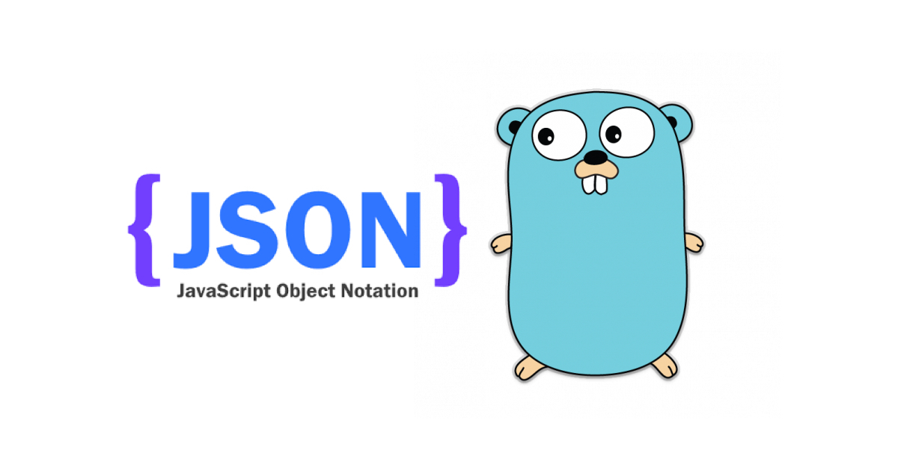

Slide 40
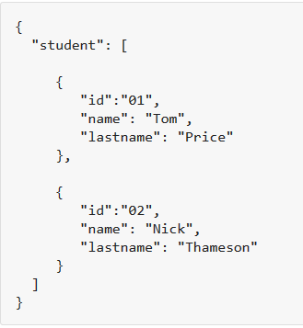
Example
{ "student": [ { "id":"01", "name": "Tom", "lastname": "Price" }, { "id":"02", "name": "Nick", "lastname": "Thameson" } ] }

Slide 41
Data Interchange
The key idea in Ajax.
An alternative to page replacement.
Applications delivered as pages.
How should the data be delivered?

Slide 42
JSON: Goals
Language Independent.
Text-based.
Light-weight.
Easy to parse.

Slide 43
JSON Is Not...
JSON is not a document format.
JSON is not a markup language.
JSON is not a general serialization format.
  No cyclical/recurring structures.
  No invisible structures.
  No functions.

Slide 44
Its Key Ingredients
Strings
Numbers
Booleans
Objects
Arrays
null

Slide 45
Strings
Sequence of 0 or more Unicode characters
No separate character type
  A character is represented as a string with a length of 1
Wrapped in "double quotes"
Backslash escapement

Slide 46
Numbers
Integer
Real
Scientific
No octal or hex
No NaN or Infinity
  Use null instead

Slide 47
Booleans
true
false

Slide 48
null
A value that isn't anything

Slide 49
Object
Objects are unordered containers of key/value pairs
Objects are wrapped in { }
, separates key/value pairs
: separates keys and values
Keys are strings
Values are JSON values
  struct, record, hashtable, object

Slide 50
Object
{"name":"Jack B. Nimble","at large": true,"grade":"A","level":3, "format":{"type":"rect","width":1920, "height":1080,"interlace":false, "framerate":24}}

Slide 51
Object
{
"name": "Jack B. Nimble",
"at large": true,
"grade": "A",
"format": {
"type": "rect",
"width": 1920,
"height": 1080,
"interlace": false,
"framerate": 24
}
}

Slide 52
Array
Arrays are ordered sequences of values
Arrays are wrapped in []
, separates values
JSON does not talk about indexing.
  An implementation can start array indexing at 0 or 1.

Slide 53
Array
["Sunday", "Monday", "Tuesday", "Wednesday", "Thursday", "Friday", "Saturday"]
[
  [0, -1, 0],
  [1, 0, 0],
  [0, 0, 1]
]

Slide 54
Arrays vs Objects
Use objects when the key names are arbitrary strings.
Use arrays when the key names are sequential integers.
Don't get confused by the term Associative Array.

Slide 55
Arguments against JSON
JSON Doesn't Have Namespaces.
JSON Has No Validator.
JSON Is Not Extensible.
JSON Is Not XML.

Slide 56
JSON Is Not XML
objects
arrays
strings
numbers
booleans
null
element
attribute
attribute string
content
<![CDATA[ ]]>
entities
declarations
schema
stylesheets
comments
version
namespace

Slide 57
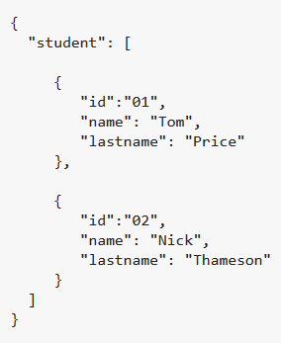
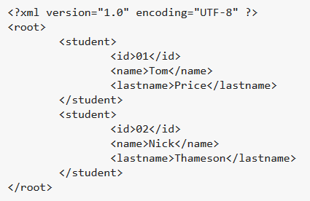
<XML/> vs. {JSON}

Slide 58
Data Interchange
JSON is a simple, common representation of data.
Communication between servers and browser clients.
Communication between peers.
Language independent data interchange.

Slide 59
Working with Data at Scale

Slide 60

Amazon DynamoDB
Key-Value Store
Major service of AWS for data storage
  E.g. product lists, shopping carts, user preferences
Data model (key, structured value)
  Partitioning on the key and secondary indices on attributes
  Simple queries on key and attributes
  Flexible: no schema to be defined (but automatically inferred)
Consistency
  Eventual consistent reads (default)
  Strong consistent reads
  Atomic updates with atomic counters
High availability and fault-tolerance
  Synchronous replication between data centers
Integration with other AWS services
  Identity control and access
  MapReduce
  Redshift data warehouse

Slide 61
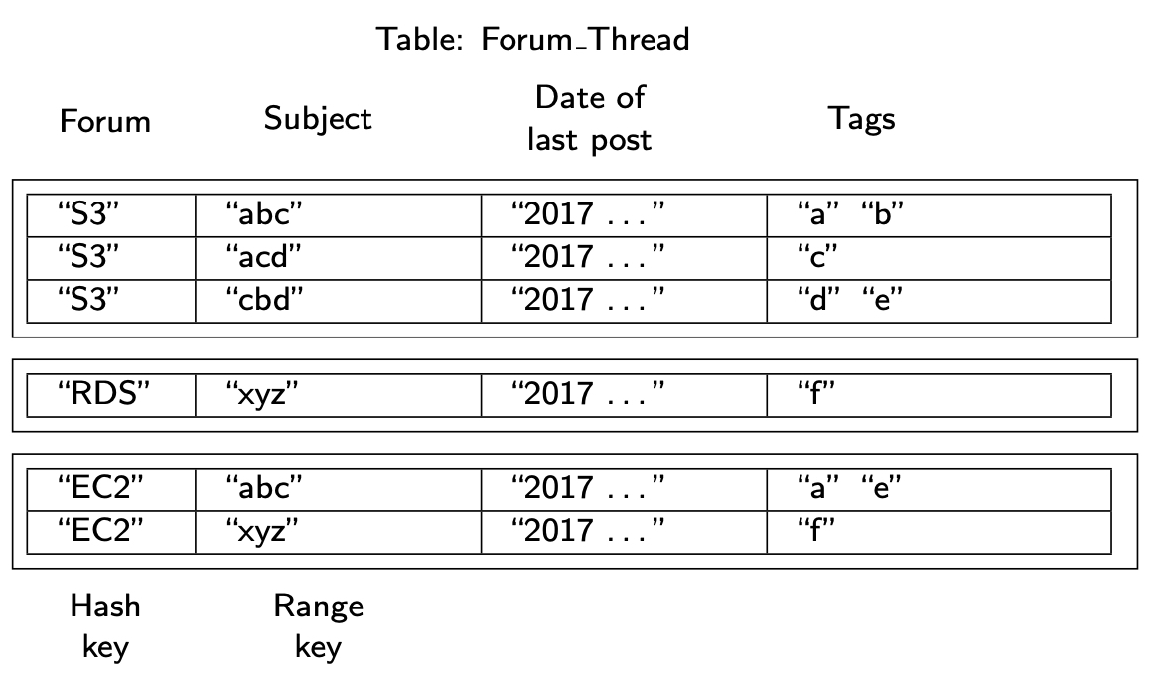
DynamoDB – data model
Table (items)
Item (key, attributes)
  2 types of primary (unique) keys
    Hash (1 attribute)
    Hash & range (2 attributes)
  Attributes of the form "name":"value"
    Type of value: scalar, set, or JSON

Slide 62
Data Model
Primary Key
  Hash Type Primary Key
    one attribute (called hash attribute)
    DynamoDB builds
      an unordered hash index on this primary key attribute.
      Why hashed index?
        Index can be distributed to multiple servers
  Hash and Range Type Primary Key
    two attributes: hash attribute and range attribute.
    DynamoDB builds 2 indexes as follows:
      an unordered hash index on the hash primary key attribute (for equality comparison) and
      a sorted range index on the range primary key attribute (also support inequality comparison, e.g., range queries).
Table Name | Primary Key Type | Hash Attribute Name | Range Attribute Name
Forum ( Name, ... ) | Hash | Attribute Name: Name | -
Thread (ForumName, Subject, ... ) | Hash and Range | Attribute Name: ForumName | Attribute Name: Subject
Reply ( Id, ReplyDateTime, ... ) | Hash and Range | Attribute Name: Id | Attribute Name: ReplyDateTime

Slide 63
Data Model
Primary Key
Table Name | Primary Key Type | Hash Attribute Name | Range Attribute Name
Forum ( Name, ... ) | Hash | Attribute Name: Name | -
Thread (ForumName, Subject, ... ) | Hash and Range | Attribute Name: ForumName | Attribute Name: Subject
Reply ( Id, ReplyDateTime, ... ) | Hash and Range | Attribute Name: Id | Attribute Name: ReplyDateTime

Slide 64
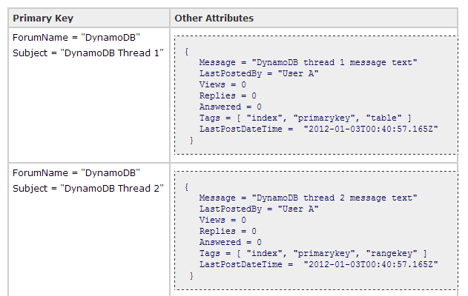
Example

Slide 65
Data Model
Primary Key
  Design consideration
    don’t support cross-table joins.
    Example:
      the Reply table stores both the forum name and subject values in the Id attribute. If you have a thread reply item, you can then parse the Id attribute to find the forum name and subject and use the information to query the Thread or the Forum tables.
Table Name | Primary Key Type | Hash Attribute Name | Range Attribute Name
Forum ( Name, ... ) | Hash | Attribute Name: Name | -
Thread (ForumName, Subject, ... ) | Hash and Range | Attribute Name: ForumName | Attribute Name: Subject
Reply ( Id, ReplyDateTime, ... ) | Hash and Range | Attribute Name: Id | Attribute Name: ReplyDateTime

Slide 66
Query Model
Simple read and write operations to a data item that is uniquely identified by a key.
System Assumptions and Requirements
  Most of Amazon’s services can work with this simple query model and do not need any relational schema.
  targeted applications - store objects that are relatively small (usually less than 1 MB)
  Experience at Amazon has shown that data stores that provide ACID guarantees tend to have poor availability.
  Dynamo targets applications that operate with weaker consistency (the “C” in ACID) if this results in high availability.

Slide 67
Query Model
Java API with methods
  Add, update, delete item
  GetItem: returns an item by primary key in a table
  BatchGetItem: returns the items of same primary key in multiple tables
  Scan: returns all items
  Query
    Range on hash & range key
    Access on indexed attribute
What do these query return?
GetItem (Forum="EC2", Subject="xyz")
Query (Forum="S3", Subject > "ac")

Slide 68
System Design: Efficiency!
Average performance is not enough
A different way of thinking:
Latency requirements which are in general measured at the 99.9th percentile of the distribution
Application can deliver its functionality in bounded time
  Every dependency in the platform needs to deliver its functionality with even tighter bounds.
Example
  service guaranteeing that it will provide a response within 300ms for 99.9% of its requests for a peak client load of 500 requests per second.

Slide 69
System architecture
Ring Partitioning
High Availability for writes
Handling temporary failures
Recovering from permanent failures
Membership and failure detection

Slide 70
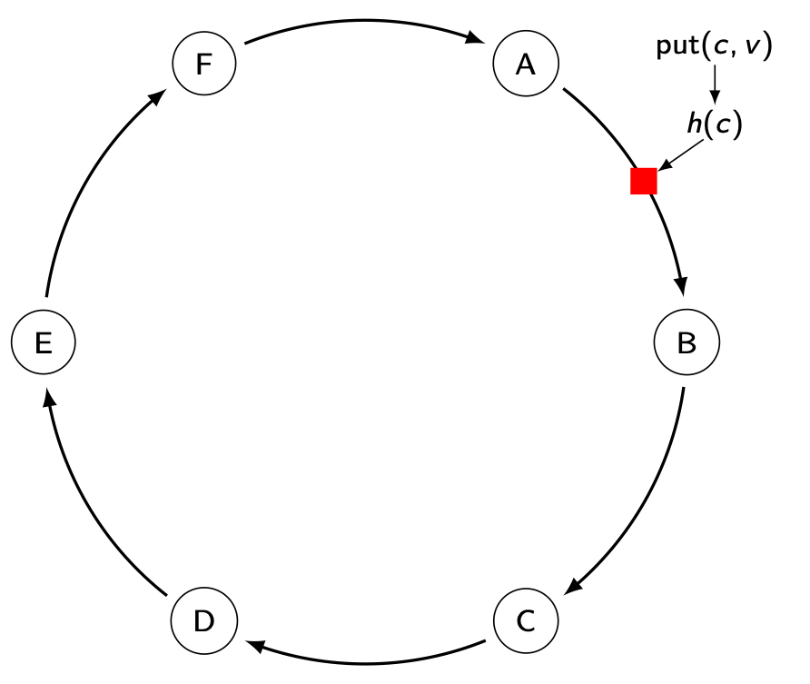
Partition Algorithm
Consistent hashing: The output range of a hash function is treated as a fixed circular space or “ring”.
Replication: An item can be stored in multiple consecutive nodes depending on the degree of replication (N).
In this example, N = 3.
Node B is responsible for the hash value interval (A,B]. Thus, item (c,v) is assigned to node B

Slide 71
Partition Algorithm
“Virtual Nodes”: Each node can be responsible for more than one virtual node.
a
W
X
Example:
  Node X has 3 virtual nodes
  If X becomes unavailable,
    the load handled by node X is evenly dispersed across some of the remaining nodes.
    Key a → node Z
    Key b → node Y
    Key c → node W
Z
X
b
c
Z
X
Y

Slide 72
Partition (Cont’d)
Advantages of using virtual nodes:
If a node becomes unavailable，the load handled by this node is evenly dispersed across the remaining available nodes.
When a node becomes available again, or a new node is added to the system, the newly available node accepts a roughly equivalent amount of load from some of the other available nodes.
The number of virtual nodes that a node is responsible can be decided based on its capacity, accounting for heterogeneity in the physical infrastructure.

Slide 73
Document Stores
Documents are stored in some standard format or encoding (e.g., XML, JSON, PDF or Office Documents)
  These are typically referred to as Binary Large Objects (BLOBs)
Documents can be indexed
  This allows document stores to outperform traditional file systems
E.g., MongoDB and CouchDB (both can be queried using MapReduce)

Slide 74
Document Stores
Main applications
  Document systems
  Content Management Systems
  Catalogs
  Personalization
  Analysis of messages (tweets, etc.) in real time
  Etc.

Slide 75
Data Models for Documents
Documents
  Hierarchical structure, with nesting of elements
  Weak structuring, with "similar" elements
  Base types: text, but also integer, real, date, etc.
Two main data models
  XML (eXtensible Markup Language): W3C standard (1998) for exchanging data on the Web
    Complex and heavy
  JSON (JavaScript Object Notation)

Slide 76

MongoDB
Objective: performance and scalability
  A document is a collection of (key, typed value) with a unique key (generated by MongoDB)
Data model and query language based on JSON
  Binary JSON (BSON): more compact
No schema, no join, no complex transaction
Shared-nothing cluster architecture
Secondary indices
Integration with MapReduce & Spark

Slide 77
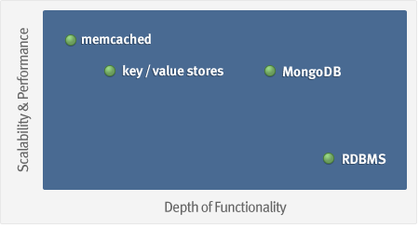
Goal

Slide 78

Document Stores
MongoDB does not need any pre-defined data schema
Every document could have different data!
{name: “will”,
eyes: “blue”,
birthplace: “NY”,
aliases: [“bill”, “la ciacco”],
loc: [32.7, 63.4],
boss: ”ben”}
{name: “jeff”,
eyes: “blue”,
loc: [40.7, 73.4],
boss: “ben”}
{name: “brendan”,
aliases: [“el diablo”]}
{name: “matt”,
pizza: “DiGiorno”,
height: 72,
loc: [44.6, 71.3]}
{name: “ben”,
hat: ”yes”}
Notes:
Applications enforce the data “schema” and integrity, much like MUMPS does in VistA

Slide 79
Data Models for Documents
BSON format (binary JSON)
Developers can easily map to modern object-oriented languages without a complicated Object-Relation Model layer.
lightweight, traversable, efficient

Slide 80
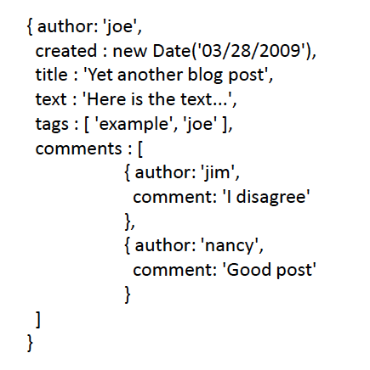
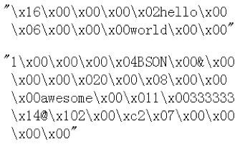
Recall: JSON
Remember it is stored in binary formats (BSON)

Slide 81
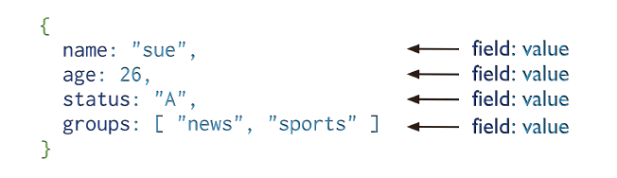
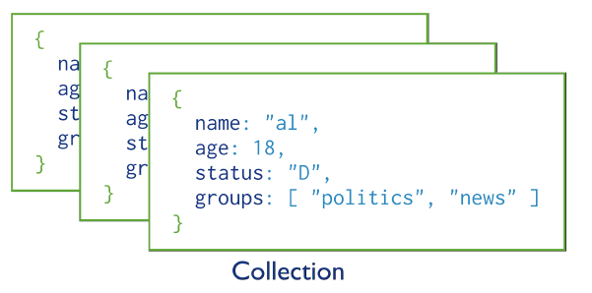
MongoDB Model
One document (e.g., one tuple in RDBMS)
Collection is a group of similar documents
Within a collection, each document must have a unique Id
One Collection (e.g., one Table in RDBMS)
Unlike RDBMS:
No Integrity Constraints in MongoDB

Slide 82
MongoDB Model
One document (e.g., one tuple in RDBMS)
The field names cannot start with the $ character
The field names cannot contain the . character
Max size of single document 16MB
One Collection (e.g., one Table in RDBMS)

Slide 83
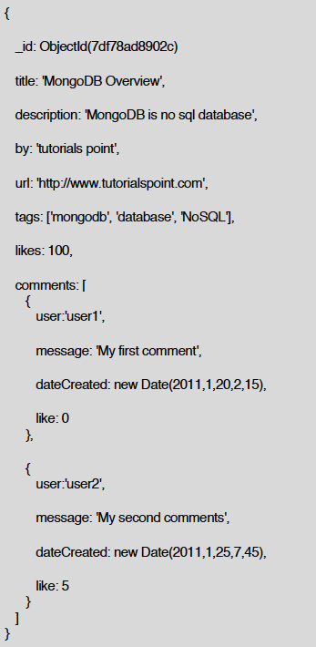
Example Document
_id is a special column in each document
Unique within each collection
_id ⬅➔ Primary Key in RDBMS
_id is 12 Bytes, you can set it yourself
Or:
  1st 4 bytes ➔ timestamp
  Next 3 bytes ➔ machine id
  Next 2 bytes ➔ Process id
  Last 3 bytes ➔ incremental values

Slide 84
MongoDB – query language
Expression of the form
  db.nomBD.function (JSON expression)
Update examples
  db.posts.insert({author:’alex’, title:’No Free Lunch’})
  db.posts.update({author:’alex’, {$set:{age:30}})
  db.posts.update({author:’alex’, {$push:{tags:’music’}})
Select examples
  db.posts.find({author:"alex"})
    All posts from Alex
  db.posts.find({comments.who:"jane"})
    All posts commented by Jane

Slide 85
Query Language: CRUD
Create
  db.collection.insert( <document> )
  db.collection.save( <document> )
  db.collection.update( <query>, <update>, { upsert: true } )
Read
  db.collection.find( <query>, <projection> )
  db.collection.findOne( <query>, <projection> )
Update
  db.collection.update( <query>, <update>, <options> )
Delete
  db.collection.remove( <query>, <justOne> )

Slide 86
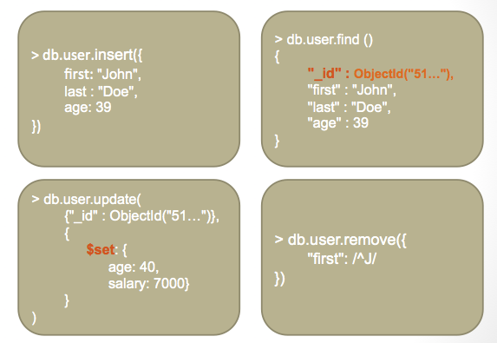
CRUD Examples

Slide 87

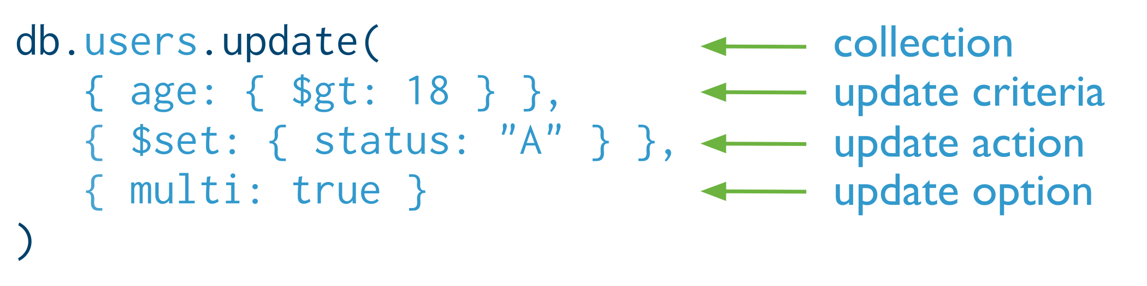
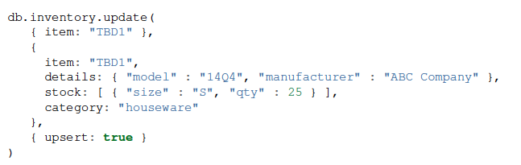


Examples
Update
Either insert the 1st document
Create “Users” collection explicitly
Otherwise, it will update only the 1st matching document
Insert or Replace
Drop an entire collection
Deletion
The upsert option
If the document having item = “TBD1” is in the DB, it will be replaced
Otherwise, it will be inserted.
db.users.remove ( )
Removes all documents from users collection

Slide 88
MongoDB - architecture

Slide 89
Graph Databeses: Neo4J

