Slide 1
Introduction to Apache Spark
Reading:
https://medium.com/@jeeyoungk/how-sharding-works-b4dec46b3f6
https://cacm.acm.org/magazines/2016/11/209116-apache-spark/fulltext
Slides based on
Z. Ives’ at University of Pennsylvania

Slide 2
Abstracting into a Data Flow
Fetch/import data (cards)
CountStack
Worker
Filter+Stack
Worker
blue: 4k
CountStack
Worker
green: 4k
Filter+Stack
Worker
CountStack
Worker
cyan: 3k
Filter+Stack
Worker
CountStack
Worker
gray: 1k
Filter+Stack
Worker
CountStack
Worker
orange: 4k

Slide 3
Dataflow Parallelism
This takes a key and a list of values and produces a result. It’s like the function in groupby.
This is like applymap: it takes a record as an input, and produces a new record (with a key + value)
A standard “template” for parallelism, with two plug-in operations
How does this distribute?
We assign roles to individual machines!
Record’_{A}
Record’_{A}
Reduce_{A}
Record
Map
Record’_{B}
shuffle
Record’_{A}
Record
Map
Record’_{A}
Record’_{A}
Record
Map
Reduce_{B}
Record’_{A}
Record’_{B}
This does a groupby on the key from map

Slide 4
Sharding
Starts with ‘A’-’D’ | Server 1
Starts with ‘E’-’Q’ | Server 2
Starts with ‘R’-’T’ | Server 3
Starts with ‘U’-’Z’ | Server 4
Starts with anything else | Server 5
Sharding is a method of splitting and storing a single logical dataset in multiple databases.
What if we want to uniformly distribute the placement of data but make it predictable?

Slide 5
Vertical vs. Horizontal Partitioning

Slide 6
Hashing “Spreads out” the Values into Predictable Locations
For a “good” hash function:
Given numbers x and y, x ≠ y
h(x) and h(y) are extremely unlikely to be equal
often: changing one bit in input causes ~50% of bits to change in output
A-C | apple avacado
D-F
G-L
M-Q
R-S | rooster runway
T-V | tire tourist turtle
W-Z
other
0-99 | tire
100-199 | apple
200-299 | rooster
300-399 | avacado
400-499
500-599 | tire
600-699
700-799 | runway
800-899
900-999 | tourist
hash function
h(x)
h(’apple’) = 70
h(‘avacado’) = 324
h(‘tire’) = 501
h(‘tourist’) = 980

Slide 7
How Does This Relate to Computing over DataFrames?
Let’s come back to the notion of indexing
In Pandas DataFrames, when we do:
A.merge(B, left_on=‘x’, right_on=‘y’)
How does Pandas make this efficient? Let’s see this with an example using a map / index…

Slide 8
Example: Airports + Routes
Airports
Flights
IATA | City
PHL | Philadelphia
BOS | Boston
JFK | New York JFK
LGA | New York Laguardia
DCA | Washington Reagan
PIT | Pittsburgh
IAD | Washington Dulles
From | To
PHL | BOS
JFK | PIT
PHL | IAD
BOS | DCA
PIT | BOS
PHL | PIT
PIT | PHL
IAD | JFK
DCA | BOS
LGA | PIT
Airports.merge(Flights, left_on=[‘IATA’], right_on=[‘To’])

Slide 9
Airports.merge(Flights, left_on=[‘IATA’], right_on=[‘To’])
Airports
Flights
IATA | City
PHL | Philadelphia
BOS | Boston
JFK | New York JFK
LGA | New York Laguardia
DCA | Washington Reagan
PIT | Pittsburgh
IAD | Washington Dulles
From | To
PHL | BOS
JFK | PIT
PHL | IAD
BOS | DCA
PIT | BOS
PHL | PIT
PIT | PHL
IAD | JFK
DCA | BOS
LGA | PIT
BOS
DCA
IAD
JFK
PIT
PHL

Slide 10
Can I Extend the Same Ideas to Multiple Machines?
Very simple technique – commonly called “sharding”
Take your index key, divide values into “buckets”
Assign one “bucket” per machine
Do work locally over the buckets, exchange (shuffle) data, go on to aggregate

Slide 11
Airports.merge(Flights, left_on=[‘IATA’], right_on=[‘To’])
Airports
Flights
IATA | City
BOS | Boston
DCA | Washington Reagan
IAD | Washington Dulles
JFK | New York JFK
LGA | New York Laguardia
PHL | Philadelphia
PIT | Pittsburgh
From | To
PHL | BOS
JFK | PIT
PHL | IAD
BOS | DCA
PIT | BOS
PHL | PIT
PIT | PHL
IAD | JFK
DCA | BOS
LGA | PIT
IATA | City
PHL | Philadelphia
BOS | Boston
JFK | New York JFK
LGA | New York Laguardia
DCA | Washington Reagan
PIT | Pittsburgh
IAD | Washington Dulles
From | To
DCA | BOS
PHL | BOS
PIT | BOS
BOS | DCA
PHL | IAD
IAD | JFK
PIT | PHL
JFK | PIT
PHL | PIT
LGA | PIT
IATA | S
BOS | 0
DCA | 0
IAD | 1
JFK | 1
LGA | 2
PHL | 2
PIT | 3

Slide 12
A Very Large Database…

Slide 13
From MapReduce to Spark
Early Google work, and the Hadoop engine, focused on a simple framework based on the MapReduce idea
Over time, people wanted a cleaner, more flexible programming – this became Spark, which basically extended MapReduce in a clean way

Slide 14
Computation in Spark: Support for Sharded Data

Slide 15
What is Spark?
Fast and Expressive Cluster Computing Engine Compatible with Apache Hadoop
Up to 10× faster on disk, 100× in memory
2-5× less code
Efficient
Usable
General execution graphs
In-memory storage
Rich APIs in Java, Scala, Python
Interactive shell
Notes:
Generalize the map/reduce framework

Slide 16
Language Support
Python
lines = sc.textFile(...) lines.filter(lambda s: “ERROR” in s).count()
Standalone Programs
Python, Scala, & Java
Interactive Shells
Python & Scala
Performance
Java & Scala are faster due to static typing
…but Python is often fine
Scala
val lines = sc.textFile(...) lines.filter(x => x.contains(“ERROR”)).count()
Java
JavaRDD<String> lines = sc.textFile(...); lines.filter(new Function<String, Boolean>() { Boolean call(String s) { return s.contains(“error”); } }).count();

Slide 17
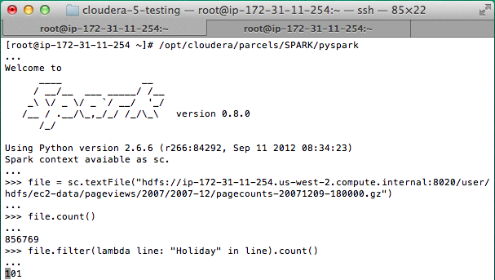
Interactive Shell
The Fastest Way to Learn Spark
Available in Python and Scala
Runs as an application on an existing Spark Cluster…
OR Can run locally
Notes:
The barrier to entry for working with the spark API is minimal

Slide 18
Software Components
Spark runs as a library in your program (1 instance per app)
Runs tasks locally or on cluster
Mesos, YARN or standalone mode
Accesses storage systems via Hadoop InputFormat API
Can use HBase, HDFS, S3, …
Your application
SparkContext
Cluster manager
Local threads
Worker
Worker
Spark executor
Spark executor
HDFS or other storage

Slide 19
Spark’s Building Blocks: Simplest First
“RDD” – resilient distributed dataset
Basically: a map from (sharded) index field → value
Plus it incorporates the MapReduce model – we’ll seldom use it directly
What really happens “under the covers” in Spark
You MUST know this to have a meaningful discussion with many non-Spark big data analytics people

Slide 20
Key Concept: RDD’s
Write programs in terms of operations on distributed datasets
Resilient Distributed Datasets
Collections of objects spread across a cluster, stored in RAM or on Disk
Built through parallel transformations
Automatically rebuilt on failure
Operations
Transformations (e.g. map, filter, groupBy)
Actions (e.g. count, collect, save)
Notes:
RDD ➔ Colloquially referred to as RDDs
(e.g. caching in RAM)
Lazy operations to build RDDs from other RDDs
Return a result or write it to storage

Slide 21
Example: Log Mining
Load error messages from a log into memory, then interactively search for various patterns
Base RDD
Transformed RDD
Cache 1
lines = spark.textFile(“hdfs://...”)
errors = lines.filter(lambda s: s.startswith(“ERROR”))
messages = errors.map(lambda s: s.split(“\t”)[2])
messages.cache()
results
Worker
tasks
Block 1
Driver
Action
messages.filter(lambda s: “mysql” in s).count()
Cache 2
messages.filter(lambda s: “php” in s).count()
Worker
Cache 3
. . .
Full-text search of Wikipedia
60GB on 20 EC2 machine
0.5 sec vs. 20s for on-disk
Worker
Block 2
Block 3
Notes:
Add “variables” to the “functions” in functional programming

Slide 22
What’s an RDD?
‘A’-’D’ | Server 1
‘E’-’Q’ | Server 2
‘R’-’T’ | Server 3
‘U’-’Z’ | Server 4
* | Server 5
Basically, a distributed data collection like a:
set
dictionary
table
It has an index or key, used to “shard” the data
If a machine crashes, computation will recover and reuse (“resilient”)

Slide 23
An Issue with Manipulating RDDs
No program can iterate directly over all elements of the RDD!
So instead we need to define code that can be applied on different machines, to different subsets of the data
… Sound like anything we did in Pandas?

Slide 24
MapReduce Programming Model
Again, recall function map: x → x’
map([x₁, x₂, x₃, …]) = [x₁’, x₂’, x₃’, ...]
We tweak it slightly – function map: x_{i} → [x_{i1}, x_{i2}, …]
map([x₁, x₂, x₃, ...]) = [x₁₁, x₁₂, ...] . [x₂₁, x₂₂, ...] . [x₃₁, x₃₂, ...]
Assume each element x_{ij} is a pair (k, v)
And let’s add a second function reduce: (k_{i}, [v_{i1}, v_{i2}, v_{i3}, ...]) → (k_{i}, v_{i}’)
Multiple copies

Slide 25
MapReduce on RDDs
distrib file → RDD
RDD
RDD
RDD
census taker | city | count
21 | PHL | 3
18 | WAS | 4
99 | NYC | !@#
12 | NYC | 5
21 | PHL | 7
13 | NYC | 4
18 | PHL | 12
 | count
PHL | 3
 | 7
 | 12
 | count
PHL | 3
WAS | 4
NYC | !@#
NYC | 5
PHL | 7
NYC | 4
PHL | 12
 | sum
PHL | 22
DB 1
DB 2
 | sum
WAS | 4
 | count
WAS | 4
DB 3
 | count
NYC | 5
 | 4
 | sum
NYC | 9
map
group
reduce
with sum
(shuffle)

Slide 26
Spark’s Building Blocks, Pt II
“RDD” – resilient distributed dataset
Basically: a map from (sharded) index field → value
Where we’ll focus most of our energy: Spark DataFrame
Builds over the RDD and works a lot like Pandas DataFrames
Every so often we might want to go down to the RDD – but typically we’ll stay at the DataFrame level

Slide 27
What Is a Spark DataFrame?
A distributed table with a subset of its attributes used as the index (it’s built over an RDD)
We can’t iterate over all of its elements!
But we can still use the same kinds of bulk operations we did with Pandas DataFrames
city | count
PHL | 3
PHL | 7
PHL | 12
Machine 1
WAS | 4
Machine 2
NYC | 5
NYC | 4
Machine 3

Slide 28
DataFrames in Spark
DataFrames in Spark try to simultaneously emulate BOTH Pandas DataFrames and SQL relations!
Functions use Java/Scala-style conventions – camelCase – not lowercase_underscore_delimited
To get started, use spark.read.load with a file format…
sdf = spark.read.load(‘myfile.txt’, format=“text”)
Or “json”, “csv”, …
sdf.createOrReplaceTempView(‘sql_name')

Slide 29
Simple Spark DataFrame Commands
printSchema() – similar to info() in Pandas
take(n) – create a collection of n rows from the DataFrame
show() or show(n) – pretty-print the DataFrame (or first n rows) as a table in “ASCII art”

Slide 30
Using DataFrames

Slide 31
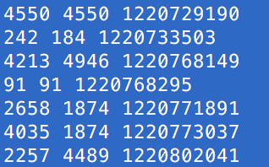
DataFrames in Spark
The sql function on a SparkSession enables applications to run SQL queries programmatically and returns the result as a DataFrame.
my-graph.txt (not csv!)
Print the schema in a tree format

Slide 32
Spark DataFrame Has Different Building Blocks from Pandas
Column – this is an object that specifies part of a DataFrame
Row – this is an object representing a tuple
A DataFrame is a Dataset organized into named columns.
Not Series and tuples…

Slide 33
Spark Has 3 Main Ways of Accessing DataFrame Data
Pandas-style
Bracket notation, operations are functions of the DataFrames
SQL-style
Call spark.sql() with an SQL query!
Programmatic SQL-like
Call dataframe.select() with Python-based arguments list
pyspark.sql.functions library

Slide 34
Updating Values, Renaming Values, Creating Values
http://spark.apache.org/docs/latest/api/python/pyspark.sql.html#module-pyspark.sql.functions
Or graph_space_delimited_sdf[‘value’]

Slide 35
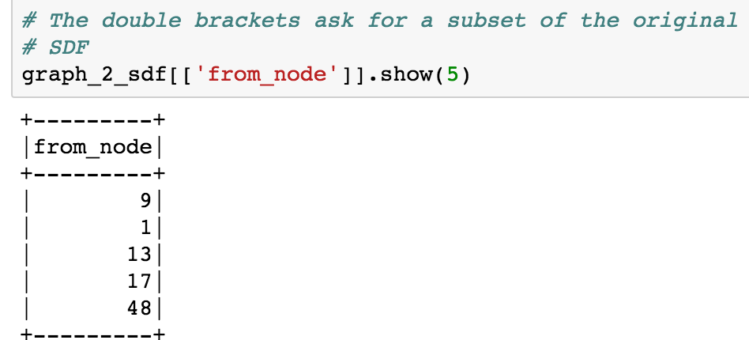
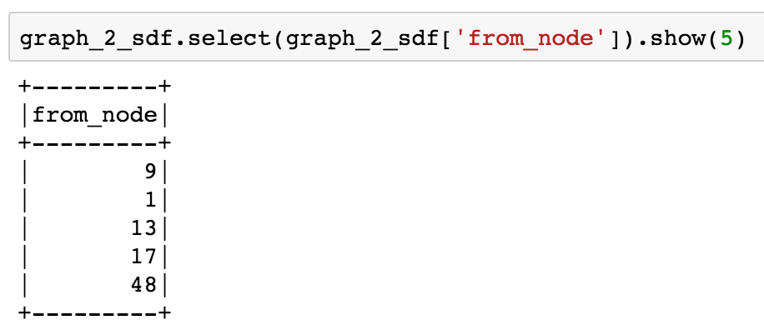
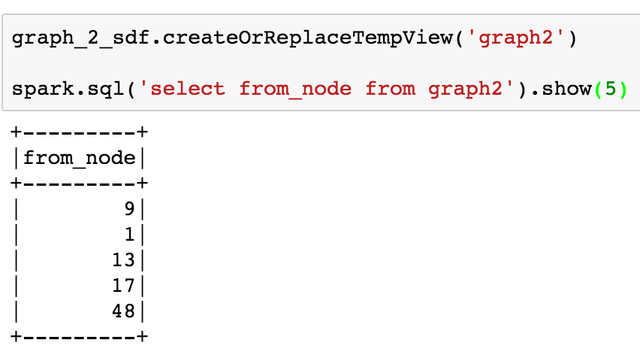
Projecting Data
sdf[sdf[‘my_col’]] or sdf[[‘my_col’]] or sdf[sdf.my_col]
sdf.select(sdf[‘my_col’]) or sdf.select(‘my_col’)
sdf.createOrReplaceTempView(‘sql_name') spark.sql(‘select my_col from sql_name’)

Slide 36
Filtering / Selecting Data
Need the parentheses here –
These are two Columns, actually

Slide 37
Changing Types and Column Names

Slide 38
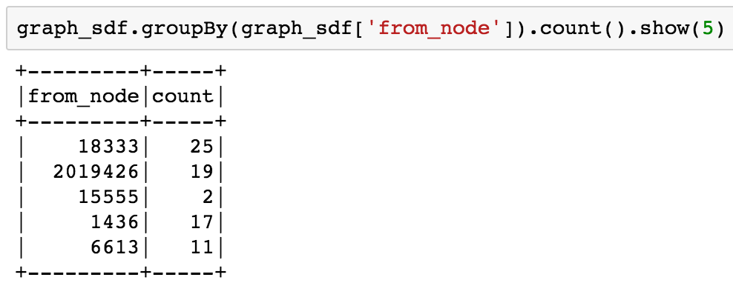
Grouping in Spark
Note there is no separate “index” as in Pandas – instead from_node is just a field

Slide 39
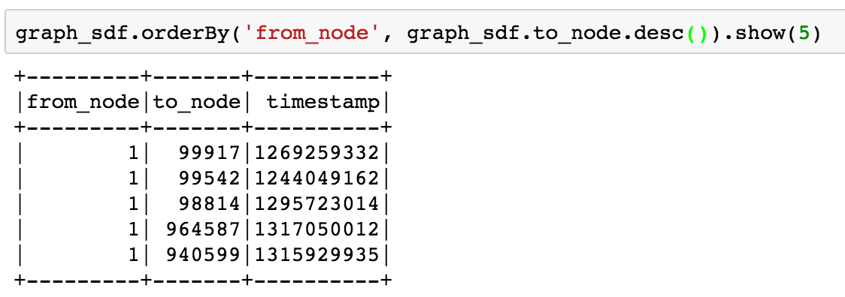
Sorting in Spark

Slide 40
User-Defined Function “Wrappers”: ~ applymap

Slide 41
Partitions and Spark

Slide 42
Joining in Spark
OR

Slide 43
Partitions and Repartitioning
my_sdf.repartition(100, ‘column1’)
Number of partitions
Spark splits data into partitions and executes computations on the partitions in parallel.
Need to understand how data is partitioned
Need to understand when you need to manually adjust the partitioning to keep your Spark computations running efficiently.

Slide 44
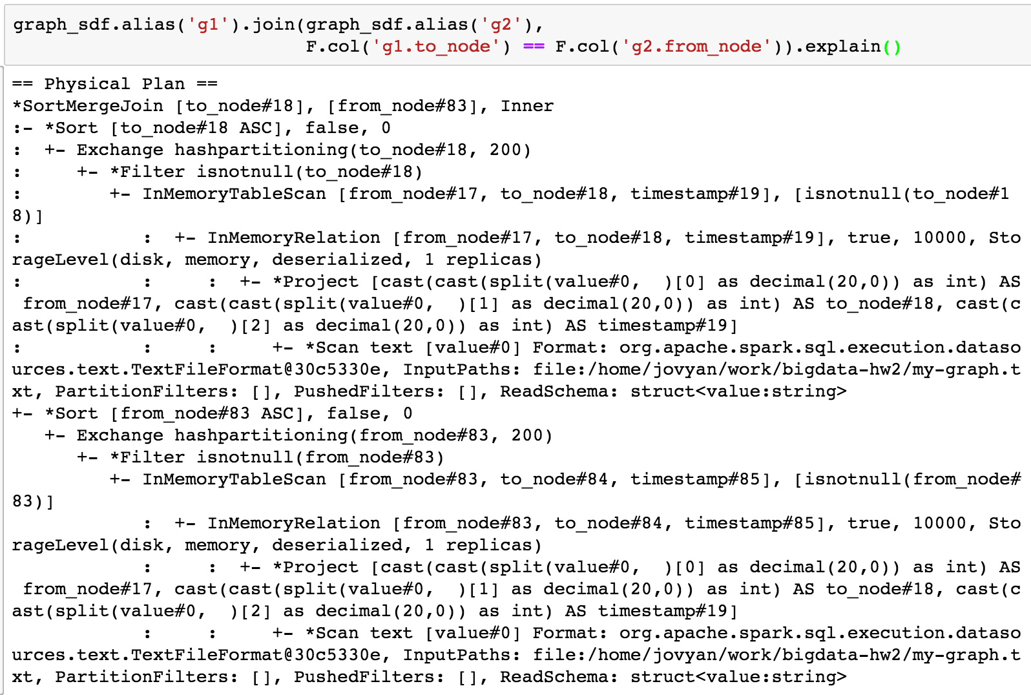
What’s Actually Happening?

Slide 45
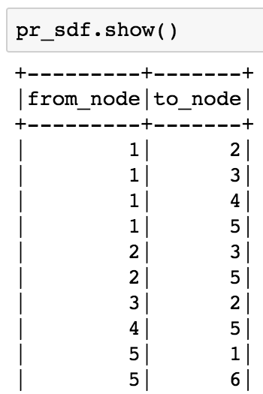
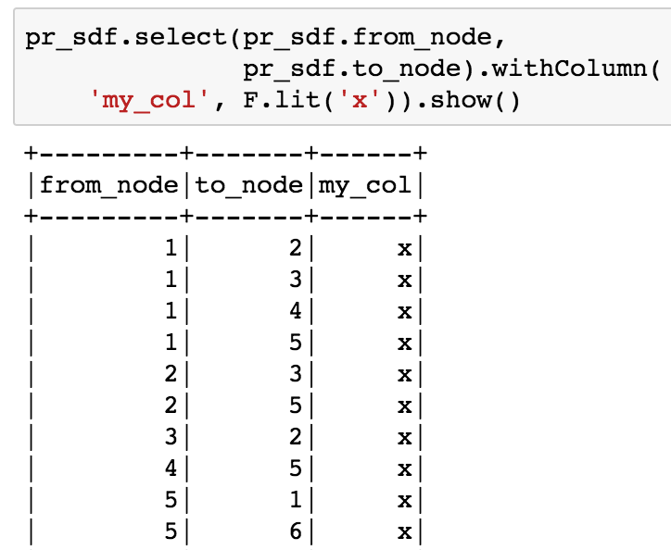
Adding New Columns

Slide 46
Something New: Iteration!

Slide 47
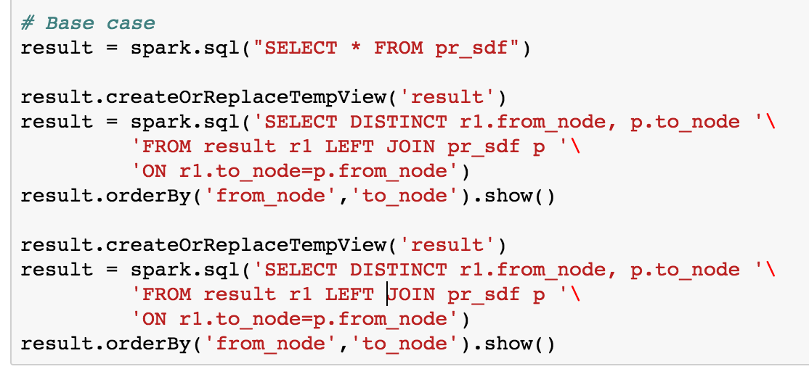
Joins and Paths
We can traverse paths of connections by joining its edges…

Slide 48
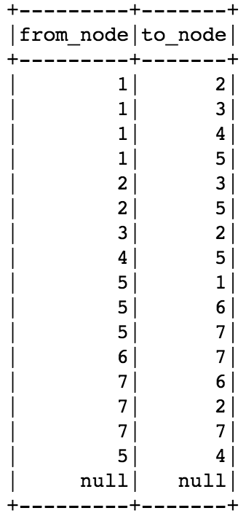
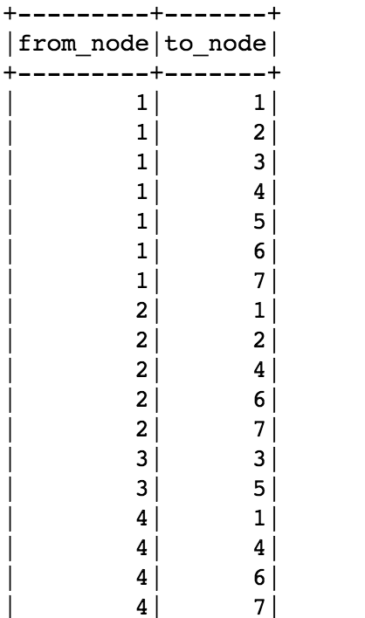
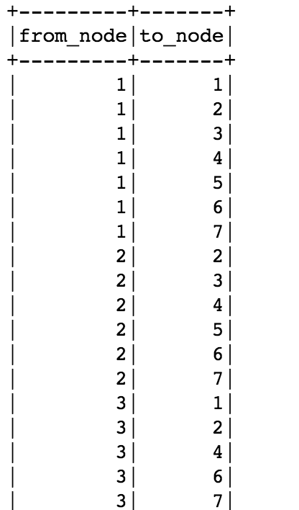
1-hop
2-hop
3-hop

Slide 49
Iterative Join

