Slide 1
Heaps and Priority Queue
Anwar Mamat
Reference: Chapter 2, Algorithms,4rd Edition, Robert Sedgewick, Kevin Wayne

Slide 2
Outline
Priority Queue
Binary Heaps
Implementation and demo
HeapSort

Slide 3
Example 1: Scheduling
EDF (Earliest Deadline First) Scheduling
  Tasks wait in the queue
  A task with a shorter deadline has a higher priority
  Executes a job with the earliest deadline
Q
T₁
T₃
T₂
…
T_{n}
…

Slide 4
Example 1: Cont.
Task T1 is dispatched and removed from the Task waiting queue.
Before T1 is completed, Task Tn+1 arrives. It has the earliest deadline. Tn+1 will be dispatched next.
T₁
Q
T₃
T₂
…
T_{n}
…
Q
T_{n+1}
T₃
T₂
…
T_{n}
…

Slide 5
Priority Queue
EDF scheduler processes Tasks in order. But not necessarily in full sorted order and not necessarily all at once.
An appropriate data type for Task Waiting Queue supports two operations: remove the maximum priority task and insert new tasks. Such a data type is called a priority queue.
Priority queues are characterized by the remove the maximum and insert operations.

Slide 6
Priority Queue Interface
public interface PriorityQueue <T extends Comparable<T> >
{
void insert(T t);
void remove() throws EmptyQueueException;
T top() throws EmptyQueueException;
boolean empty();
}

Slide 7
Example 2: Statistics
Find the largest M items in a stream of N items
(N huge, M large)
  N is huge, cannot sort in memory
  M is large, insert, remove must be fast.
Order of growth of finding the largest M in a stream of N items
Implementation | Time | Space
Sort | N log N | M
Array | N M | M

Slide 8

Elementary Implementations
Unordered Array:
Ordered Array:
Linked List:
Binary Tree
Order-of-growth of running time for priority queue with N items
5 | 1 | 4 | 8 | 2 | 7 | 6 | 3
1 | 2 | 3 | 4 | 5 | 6 | 7 | 8
Implementation | Insert | Remove Max | Max
Unordered Array | 1 | N | N
Ordered Array | N | 1 | 1
Linked List (unsorted) | 1 | N | N
Goal | Log N | Log N | 1

Slide 9
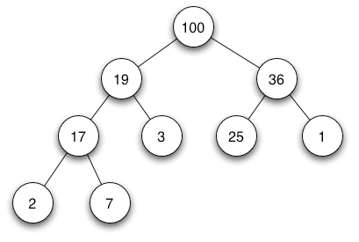
Binary Heap
Complete Binary Tree
Each node is larger than (or equal to) its two children (if any).

Slide 10
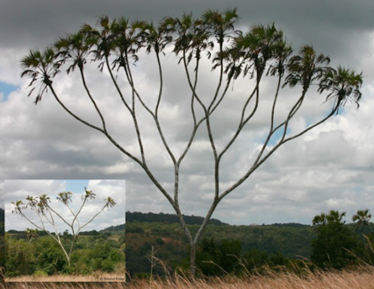
Complete Binary Tree in Nature

Slide 11
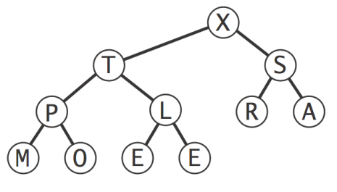
Binary Heap Properties
The largest is found at the root.
Height of complete tree with N nodes is ⌊ lg N⌋
Height only increases when N is a power of 2

Slide 12
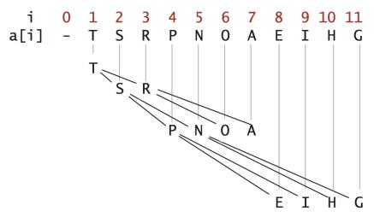
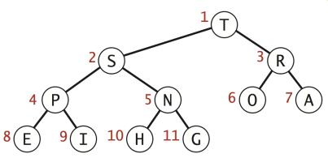
Binary Heap Representations
Array representation of a complete binary tree
  Take nodes in level order
  No explicit links needed

Slide 13
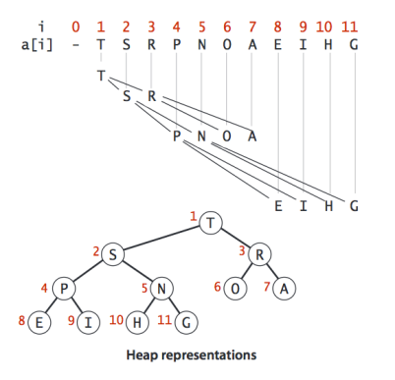
Binary Heap Representations
Largest key is a[1], which is
root of binary tree.
Can use array indices to move
through tree.
Parent of node at k is at k/2.
two children of the node at k
are in positions 2k and 2k + 1.

Slide 14
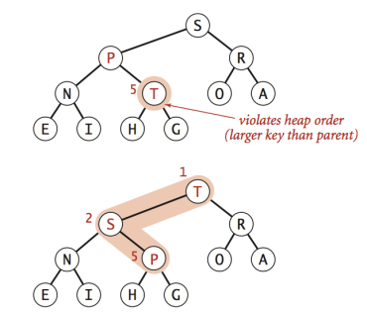
Algorithms on Heaps
Promotion: Child's key becomes larger key than its parent's key.
To eliminate the violation:
Exchange key in child with key in parent.
Repeat until heap order restored.
private void swim(int k) {
while (k > 1 && less(k/2, k)){
swap(k, k/2);
k = k/2;
}
}

Slide 15
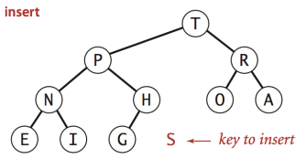
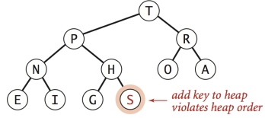
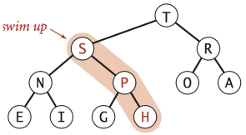
Algorithms on Heaps
Insertion in a heap:
Insert. Add node at end, then swim it up.
Cost. At most lg N compares.
public void insert(T t){
pqArray.add(t);
Size++;
swim(Size);
}

Slide 16
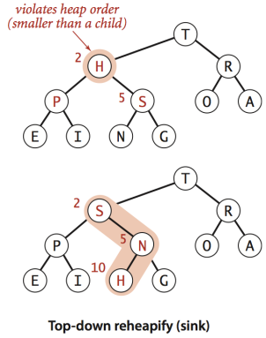
Algorithms on Heaps
Demotion: Parent's key becomes smaller than one (or both) of its children's keys.
To eliminate the violation:
Exchange key in parent with key in larger child.
Repeat until heap order restored.
private void sink(int k){
while(2 * k <= Size){
int j = 2*k;
if(j< Size && less(j,j+1)) j++;
if(!less(k,j)) break;
swap(k,j);
k = j;
}
}

Slide 17
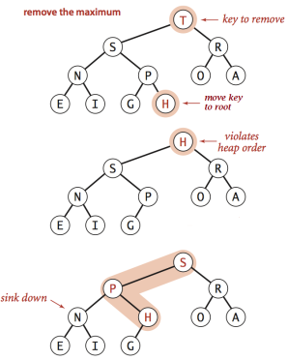
Algorithms on Heaps
Remove the maximum in a heap:
Delete max: Replace root with node at end,
then sink it down.
Cost: At most 2 lg N compares.
public void remove(){
if(Size == 0){
throw new EmptyQueueException("Queue is empty.");
}
pqArray.set(1,pqArray.get(Size));
pqArray.remove(Size);
Size--;
sink(1);
}

Slide 18
Binary Heap Demo
Insertion
35
33
26
15
5
4
24
12
Insert 34
1
23
21
2
34
Violation. swim
--
35
26
33
15
24
5
4
12
1
23
21
2
34

Slide 19
Binary Heap Demo
Insertion
35
33
26
15
5
4
24
12
1
23
21
2
34
Violation. swim
--
35
26
33
15
24
5
4
12
1
23
21
2
34

Slide 20
Binary Heap Demo
Insertion
35
33
26
5
4
15
24
34
12
1
23
21
2
Violation. swim
--
35
26
33
15
24
34
23
21
2
5
4
12
1

Slide 21
Binary Heap Demo
Insertion
35
Done!
33
26
15
34
4
24
12
1
23
21
2
5
Violation. swim
--
35
26
33
15
24
34
4
12
1
23
21
2
5

Slide 22
Binary Heap Demo
Remove max:
35
34
26
15
33
4
24
12
1
23
21
2
5
Delete the last leaf
5
23
21
2
5
Move the last leaf to root
--
35
26
34
15
24
33
4
12
1
5

Slide 23
Binary Heap Demo
Remove
Violation. sink
5
Violation. sink
34
26
15
33
4
24
12
1
23
21
2
--
5
26
34
15
24
33
4
12
1
23
21
2

Slide 24
Binary Heap Demo
Remove
34
Violation. sink
26
5
15
33
4
24
12
1
23
21
2
--
34
26
5
15
24
33
4
12
1
23
21
2

Slide 25
Binary Heap Demo
Remove
34
26
33
15
5
4
24
12
1
23
21
2
Done!
--
34
26
33
15
24
5
4
12
1
23
21
2

Slide 26
Binary Heap Java Code Demo
File name Description
PriorityQueue.java Interface
MaxPQ.java PQ implementation
GraphVizWrite.java Visualize the heap
EmptyQueueException.java Exception
MaxPQTest.java main method
InputHelper.java input utility

Slide 27
Cost summary
Implementation | Insert | Remove Max | Max
Unordered Array | 1 | N | N
Ordered Array | N | 1 | 1
Linked List (unsorted) | 1 | N | N
Binary Heap | Log N | Log N | 1

Slide 28
Immutability of keys
Assumption: client does not change keys while they're on the PQ.
Best practice: use immutable keys.
Immutability: implementing in Java
Immutable data type. Can't change the data type value once created.
Immutable. String, Integer, Double, Color, Vector, Transaction, Point2D.
Mutable. StringBuilder, Stack, Counter, Java array.

Slide 29
Heap Sort
  Sort an array using heap representations
worst case running time O(nlgn)
an in‐place sorting algorithm: only a constant number of array elements are stored outside the input array at any time. thus, require at most O(1) additional memory

Slide 30
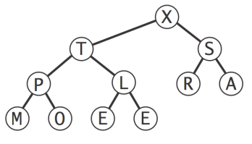
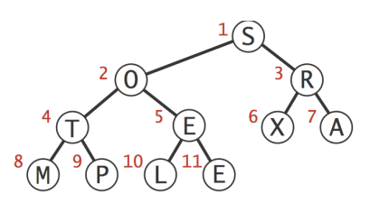
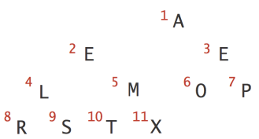
Heap Sort
  Idea:
    Create max-heap with all N keys.
    Repeatedly remove the maximum key.
Build a Max Heap
Original Array
Sorted Array

Slide 31
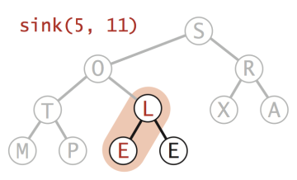
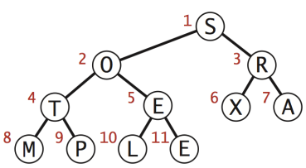
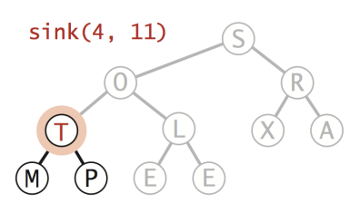
Step 1: Build max-heap
Build heap using bottom-up method
￼for (int k = N/2; k >= 1; k--)
sink(k, N);
Arbitrary Array

Slide 32
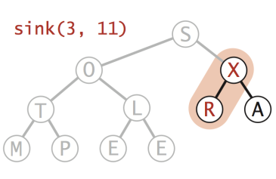
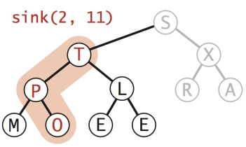
Step 1: Build max-heap
Build heap using bottom-up method
￼for (int k = N/2; k >= 1; k--)
sink(k, N);
Arbitrary Array

Slide 33
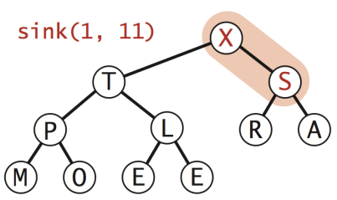
Step 1: Build max-heap
Build heap using bottom-up method
￼for (int k = N/2; k >= 1; k--)
sink(k, N);
Max-heap
Arbitrary Array

Slide 34
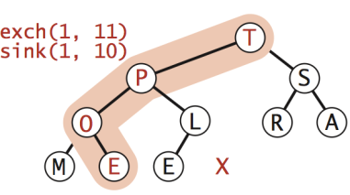
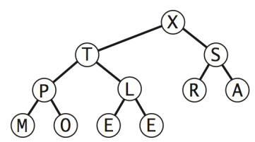
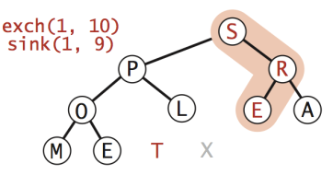
Step 2: Sortdown
Remove the maximum, one at a time
Leave in array, instead of nulling out.
while (N > 1) {
exch(1, N--);
sink(1, N);
}
Heap ordered array

Slide 35
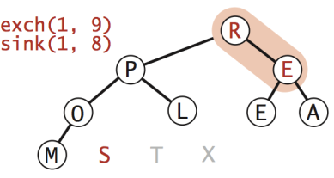
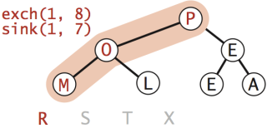
Step 2: Sortdown
Remove the maximum, one at a time
Leave in array, instead of nulling out.
while (N > 1) {
exch(1, N--);
sink(1, N);
}
Heap ordered array

Slide 36
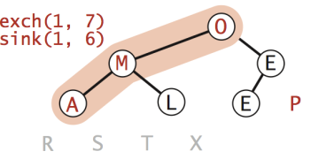
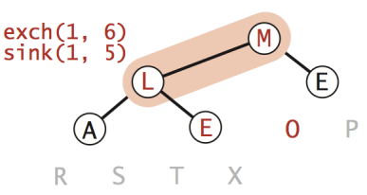
Step 2: Sortdown
Remove the maximum, one at a time
Leave in array, instead of nulling out.
while (N > 1) {
exch(1, N--);
sink(1, N);
}
Heap ordered array

Slide 37
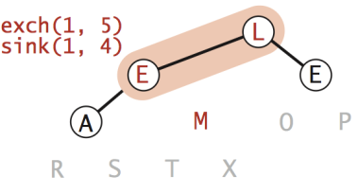
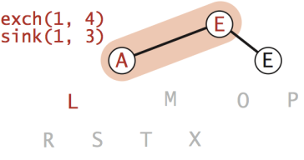
Step 2: Sortdown
Remove the maximum, one at a time
Leave in array, instead of nulling out.
while (N > 1) {
exch(1, N--);
sink(1, N);
}
Heap ordered array

Slide 38
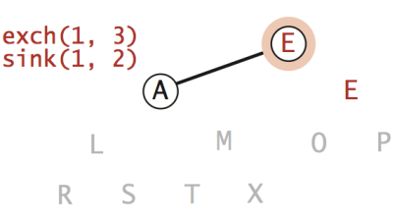
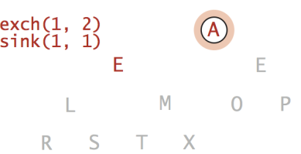
Step 2: Sortdown
Remove the maximum, one at a time
Leave in array, instead of nulling out.
while (N > 1) {
exch(1, N--);
sink(1, N);
}
Heap ordered array

Slide 39
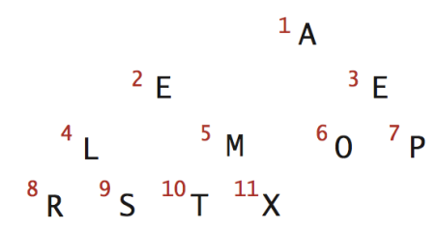
Step 2: Sortdown
Remove the maximum, one at a time
Leave in array, instead of nulling out.
while (N > 1) {
exch(1, N--);
sink(1, N);
}
Sorted Result
-- | A | E | E | L | M | O | P | R | S | T | X
0 | 1 | 2 | 3 | 4 | 5 | 6 | 7 | 8 | 9 | 10 | 11
Heap ordered array

Slide 40
Implementation and Demo

Slide 41
Mathematical Analysis
Heap construction uses fewer than 2 N compares and exchanges.
Heapsort uses at most 2 N lg N compares and exchanges.
Significance:
In-place sorting algorithm with N log N worst-case.
Mergesort: no, linear extra space.
Quicksort: no, quadratic time in worst case.
Heapsort: yes
Heapsort is optimal for both time and space,
Disadvantages:
Makes poor use of cache memory.
Not stable.

Slide 42
Sorting Algorithms Comparison
 | In palce | Stable | Worst | Average | Best
Quick Sort | ✔ |  | n² | 2NlogN | NlogN
Merge Sort |  | ✔ | NlogN | NlogN | NlogN
Heap Sort | ✔ |  | 2NlogN | 2NlogN | NlogN
? | ✔ | ✔ | NlogN | NlogN | NlogN

